Slide 1

Christ-Shaped Lives and Spirit-Inspired Speech
Lesson 8, 3rd Quarter 2023
Ephesians 4:17-32

Slide 2

Memory Text:
Ephesians 4:22-24
²² That ye put off concerning the former conversation the old man, which is corrupt according to the deceitful lusts;
²³ And be renewed in the spirit of your mind;
²⁴ And that ye put on the new man, which after God is created in righteousness and true holiness.

Slide 3

Ephesians So Far:
Paul and the Ephesians
Eph. 1:1-14—Prayer of Gratitude for God’s Grace
Eph. 1:15-23—Gratitude and Joy in Christ
Eph. 2:1-10—Quickened by God’s Grace
Eph. 2:11-22—One Body by the Cross
Eph. 3—A Prisoner of Christ
Eph. 4:1-16—One Accord
Eph.4:17-32—Transformation

Slide 4
Key Ideas: Outlining Ephesians
Opening Greeting (Eph. 1:1, 2)
Part 1: The Doctrinal Section (Eph. 1:3-3:21)
Part 2: The Practical Section (Eph. 4:1-6:20)
Closing Greeting (Ephesians 6:21-24)

Slide 5
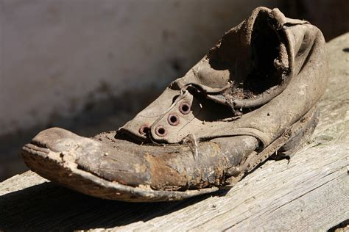
Walking in Vanity:

Slide 6

Walking in Vanity:
Ephesians 4:17-19
¹⁷ This I say therefore, and testify in the Lord, that ye henceforth walk not as other Gentiles walk, in the vanity of their mind,

Slide 7

Walking in Vanity:
Ephesians 4:17-19
SDABC V.6 p.1025
Vanity: Gr. mataiotes. The idea is not of conceit but of frivolous and empty aims. Without Christ, the Gentile wanders on aimlessly, hopelessly, and recklessly. In Romans 1 :21-32 Paul draws a picture of utter depravity when man gives himself up to “vain” ( mataios ) imaginations. This degeneration has taken place in the governing part of the man’s nature, the mind, so that the rational faculties have yielded to misdirected or undirected imaginings. This vanity was not merely worthless, it was degrading.
¹⁷ This I say therefore, and testify in the Lord, that ye henceforth walk not as other Gentiles walk, in the vanity of their mind,

Slide 8
Walking in Vanity:
Ephesians 4:17-19
¹⁷ This I say therefore, and testify in the Lord, that ye henceforth walk not as other Gentiles walk, in the vanity of their mind,

Slide 9

Walking in Vanity:
Ephesians 4:18-19
¹⁸ Having the understanding darkened, being alienated from the life of God through the ignorance that is in them, because of the blindness of their heart:

Slide 10
Walking in Vanity:
Ephesians 4:18-19
Understanding darkened: This is not only the decline of comprehension, but the dimming of the faculties of the mind! The mind separated from God cannot comprehend spiritual truth because of the blockage of sin, but it is also degraded in all of its capacities of reason and perception.
Alienated through ignorance: This phrasing suggests a former condition now removed. Man, who once held communion with his Maker, is now separated from the life of God, that is, from the life that comes from Him. And the source of this alienation is a determined moral ignorance, a deliberate condition.
¹⁸ Having the understanding darkened, being alienated from the life of God through the ignorance that is in them, because of the blindness of their heart:

Slide 11
Walking in Vanity:
Ephesians 4:18-19
¹⁸ Having the understanding darkened, being alienated from the life of God through the ignorance that is in them, because of the blindness of their heart:

Slide 12
Walking in Vanity:
Ephesians 4:18-19
SDABC V.6 p.1025
Blindness: Gr. porosis, “hardening,” the idea being that of spiritual callousness and insensibility. In Rom. 1:21 Paul describes how this hardening came about, the implication there as well as here being that men have brought it on themselves.
¹⁸ Having the understanding darkened, being alienated from the life of God through the ignorance that is in them, because of the blindness of their heart:

Slide 13

Walking in Vanity:
Ephesians 4:19
¹⁹ Who being past feeling have given themselves over unto lasciviousness, to work all uncleanness with greediness.

Slide 14
Walking in Vanity:
Ephesians 4:19
¹⁹ Who being past feeling have given themselves over unto lasciviousness, to work all uncleanness with greediness.
Being past feeling: The natural state of the human mind is complete insensibility to spiritual things. Without the quickening power of God, we’re totally insensate regarding moral issues! And accepting that state results in giving oneself over utterly to self indulgence, commonly in the forms of lust and greed.

Slide 15

A cur for the insensate:

Slide 16
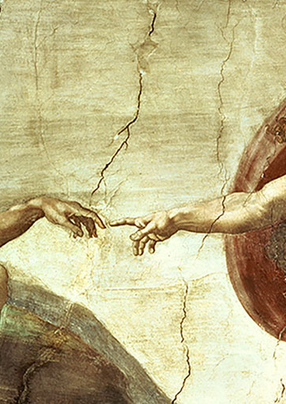
A Cure for the insensate:
Ephesians 4:20-24
²⁰ But ye have not so learned Christ;
²¹ If so be that ye have heard him, and have been taught by him, as the truth is in Jesus:

Slide 17

A Cure for the insensate:
Ephesians 4:22-24
²² That ye put off concerning the former conversation the old man, which is corrupt according to the deceitful lusts;

Slide 18
A Cure for the insensate:
Ephesians 4:22-24
²² That ye put off concerning the former conversation the old man, which is corrupt according to the deceitful lusts;
SDABC V.6 p.1026
Conversation: Gr. anastrophe, “manner of life,” “conduct,” “behavior.” The former manner of life has been described in ch. 4:17-19. The former sinful nature is to be stripped off once and for all, never to be put on again; the new nature is to be put on (see on v. 24). The robe of righteousness is to replace the filthy garments of self-righteousness.

Slide 19
A Cure for the Insensate:
SDA Quarterly: Monday August 14
In ancient times, men wore a knee-length tunic as an undergarment and a cloak or mantle to offer protection from the sun. Similarly, women wore a tunic and a robe. The cultures reflected in the Bible were subsistence ones. Garments were precious and expensive and were kept for a long time. It would have been unusual to own more than one set of clothing.

Slide 20
A Cure for the Insensate:
SDA Quarterly: Monday August 14
The quality and style of those garments signaled identity and status markers about the wearer. To change one’s clothes, exchanging one set of clothes for another, was an unusual and important event (rather than the trifling occurrence it is in many cultures today). Paul imagines the change in life to be as noticeable as exchanging one set of clothing for another would have been in this first-century context.

Slide 21
A Cure for the insensate:
Ephesians 4:22-24
²² That ye put off concerning the former conversation the old man, which is corrupt according to the deceitful lusts;

Slide 22
A Cure for the insensate:
Ephesians 4:22-24
²² That ye put off concerning the former conversation the old man, which is corrupt according to the deceitful lusts;
SDABC V.6 p.1026
The old man: This expression seems to mean more than simply the old acts or habits and to include the very mind and nature that are the source of every act. The old man had died (Rom. 6:6) and should not be revived.

Slide 23
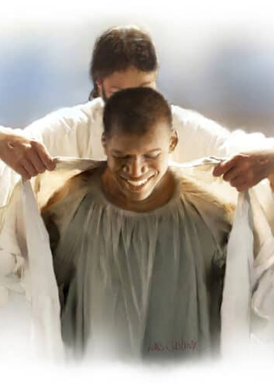
A Cure for the insensate:
Ephesians 4:23-24
²³ And be renewed in the spirit of your mind;
²⁴ And that ye put on the new man, which after God is created in righteousness and true holiness.

Slide 24
A Cure for the insensate:
Ephesians 4:23-24
²³ And be renewed in the spirit of your mind;
²⁴ And that ye put on the new man, which after God is created in righteousness and true holiness.
SDABC V.6 p.1027
In the spirit of your mind: The change is not a superficial change of opinion or a new doctrinal concept; it affects the nature of the mind, its governing principles.

Slide 25
A Cure for the insensate:
Ephesians 4:23-24
²³ And be renewed in the spirit of your mind;
²⁴ And that ye put on the new man, which after God is created in righteousness and true holiness.

Slide 26





A Cure for the insensate:
Ephesians 4:23-24
²³ And be renewed in the spirit of your mind;
²⁴ And that ye put on the new man, which after God is created in righteousness and true holiness.

Slide 27

Transforming Promises:

Slide 28

Transforming Promises:
John 8:34-36
³⁴ Jesus answered them, Verily, verily, I say unto you, Whosoever committeth sin is the servant of sin.
³⁵ And the servant abideth not in the house for ever: but the Son abideth ever.
³⁶ If the Son therefore shall make you free, ye shall be free indeed.

Slide 29

Transforming Promises:
Deuteronomy 30:1-2, 6
30 And it shall come to pass, when all these things are come upon thee, the blessing and the curse, which I have set before thee, and thou shalt call them to mind among all the nations, whither the Lord thy God hath driven thee,
² And shalt return unto the Lord thy God, and shalt obey his voice according to all that I command thee this day, thou and thy children, with all thine heart, and with all thy soul;

Slide 30

Transforming Promises:
Deuteronomy 30:1-2, 6
⁶ And the Lord thy God will circumcise thine heart, and the heart of thy seed, to love the Lord thy God with all thine heart, and with all thy soul, that thou mayest live.

Slide 31

Transforming Promises:
Ezekiel 36:21-29
²¹ But I had pity for mine holy name, which the house of Israel had profaned among the heathen, whither they went.
²² Therefore say unto the house of Israel, thus saith the Lord God; I do not this for your sakes, O house of Israel, but for mine holy name's sake, which ye have profaned among the heathen, whither ye went.

Slide 32

Transforming Promises:
Ezekiel 36:23-29
²³ And I will sanctify my great name, which was profaned among the heathen, which ye have profaned in the midst of them; and the heathen shall know that I am the Lord, saith the Lord God, when I shall be sanctified in you before their eyes.

Slide 33

Transforming Promises:
Ezekiel 36:24-29
²⁴ For I will take you from among the heathen, and gather you out of all countries, and will bring you into your own land.
²⁵ Then will I sprinkle clean water upon you, and ye shall be clean: from all your filthiness, and from all your idols, will I cleanse you.

Slide 34

Transforming Promises:
Ezekiel 36:26-29
²⁶ A new heart also will I give you, and a new spirit will I put within you: and I will take away the stony heart out of your flesh, and I will give you an heart of flesh.
²⁷ And I will put my spirit within you, and cause you to walk in my statutes, and ye shall keep my judgments, and do them.

Slide 35

Transforming Promises:
Ezekiel 36:28-29
²⁸ And ye shall dwell in the land that I gave to your fathers; and ye shall be my people, and I will be your God.
²⁹ I will also save you from all your uncleannesses: and I will call for the corn, and will increase it, and lay no famine upon you.

Slide 36
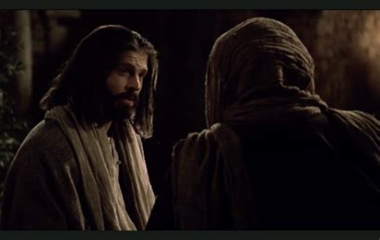
In Jesus’ Words:

Slide 37
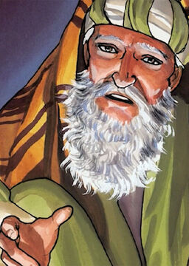
In Jesus’ Words:
John 3:1-21
3 There was a man of the Pharisees, named Nicodemus, a ruler of the Jews:
² The same came to Jesus by night, and said unto him, Rabbi, we know that thou art a teacher come from God: for no man can do these miracles that thou doest, except God be with him.

Slide 38
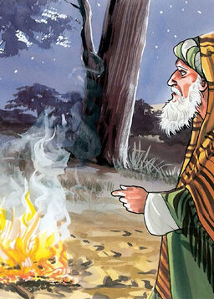
In Jesus’ Words:
John 3:3-21
³ Jesus answered and said unto him, Verily, verily, I say unto thee, Except a man be born again, he cannot see the kingdom of God.
⁴ Nicodemus saith unto him, How can a man be born when he is old? can he enter the second time into his mother's womb, and be born?

Slide 39

In Jesus’ Words:
John 3:5-21
⁵ Jesus answered, Verily, verily, I say unto thee, Except a man be born of water and of the Spirit, he cannot enter into the kingdom of God.
⁶ That which is born of the flesh is flesh; and that which is born of the Spirit is spirit.

Slide 40
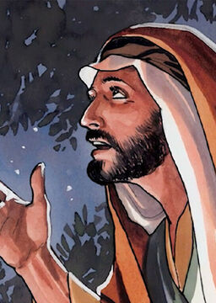
In Jesus’ Words:
John 3:7-21
⁷ Marvel not that I said unto thee, Ye must be born again.
⁸ The wind bloweth where it listeth, and thou hearest the sound thereof, but canst not tell whence it cometh, and whither it goeth: so is every one that is born of the Spirit.

Slide 41
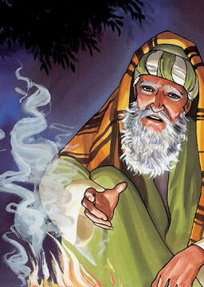
In Jesus’ Words:
John 3:9-21
⁹ Nicodemus answered and said unto him, How can these things be?
¹⁰ Jesus answered and said unto him, Art thou a master of Israel, and knowest not these things?

Slide 42
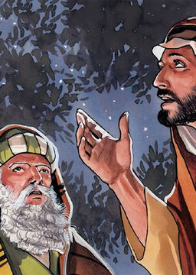
In Jesus’ Words:
John 3:11-21
¹¹ Verily, verily, I say unto thee, We speak that we do know, and testify that we have seen; and ye receive not our witness.
¹² If I have told you earthly things, and ye believe not, how shall ye believe, if I tell you of heavenly things?

Slide 43
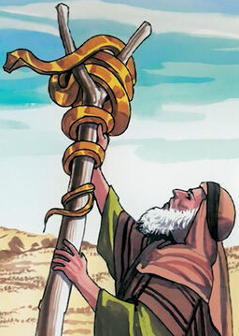
In Jesus’ Words:
John 3:13-21
¹³ And no man hath ascended up to heaven, but he that came down from heaven, even the Son of man which is in heaven.
¹⁴ And as Moses lifted up the serpent in the wilderness, even so must the Son of man be lifted up:

Slide 44
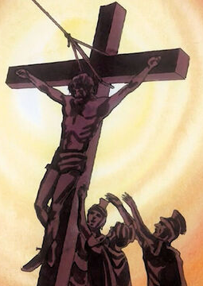
In Jesus’ Words:
John 3:15-21
¹⁵ That whosoever believeth in him should not perish, but have eternal life.
¹⁶ For God so loved the world, that he gave his only begotten Son, that whosoever believeth in him should not perish, but have everlasting life.

Slide 45
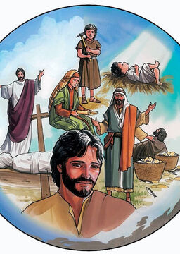
In Jesus’ Words:
John 3:17-21
¹⁷ For God sent not his Son into the world to condemn the world; but that the world through him might be saved.
¹⁸ He that believeth on him is not condemned: but he that believeth not is condemned already, because he hath not believed in the name of the only begotten Son of God.

Slide 46
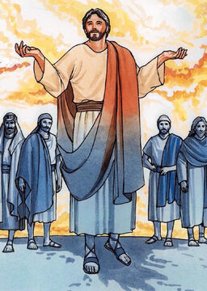
In Jesus’ Words:
John 3:19-21
¹⁹ And this is the condemnation, that light is come into the world, and men loved darkness rather than light, because their deeds were evil.
²⁰ For every one that doeth evil hateth the light, neither cometh to the light, lest his deeds should be reproved.

Slide 47
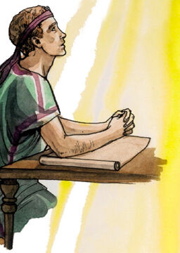
In Jesus’ Words:
John 3:21
²¹ But he that doeth truth cometh to the light, that his deeds may be made manifest, that they are wrought in God.

Slide 48
In Jesus’ Words:
John 3:21
²¹ But he that doeth truth cometh to the light, that his deeds may be made manifest, that they are wrought in God.
So the person that “doeth truth,” or has integrity, is free to come into the light where people can see his actions and know that they are actions of which God can approve.

Slide 49
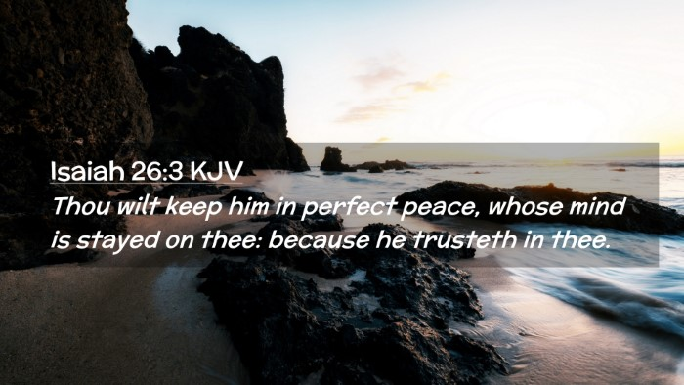
A person who sheds the “old man” and puts on the “new man” can live in the light… in perfect peace!

Slide 50

Honesty, Anger, and Zeal:

Slide 51

Honesty, Anger, and Zeal:
Ephesians 4:24-27
²⁴ And that ye put on the new man, which after God is created in righteousness and true holiness.
²⁵ Wherefore putting away lying, speak every man truth with his neighbour: for we are members one of another.

Slide 52
Honesty, Anger, and Zeal:
Ephesians 4:24-27
SDABC V.6 p.1027
Lying: Deceit brings its own disintegration of soul to the deceiver, often hurting him more than the deceived. How can those who are followers of the One who is the Truth do anything else but hold to the utmost integrity in all things?
²⁴ And that ye put on the new man, which after God is created in righteousness and true holiness.
²⁵ Wherefore putting away lying, speak every man truth with his neighbour: for we are members one of another.

Slide 53

Honesty, Anger, and Zeal:
Ephesians 4:24-27
²⁶ Be ye angry, and sin not: let not the sun go down upon your wrath:
²⁷ Neither give place to the devil.

Slide 54

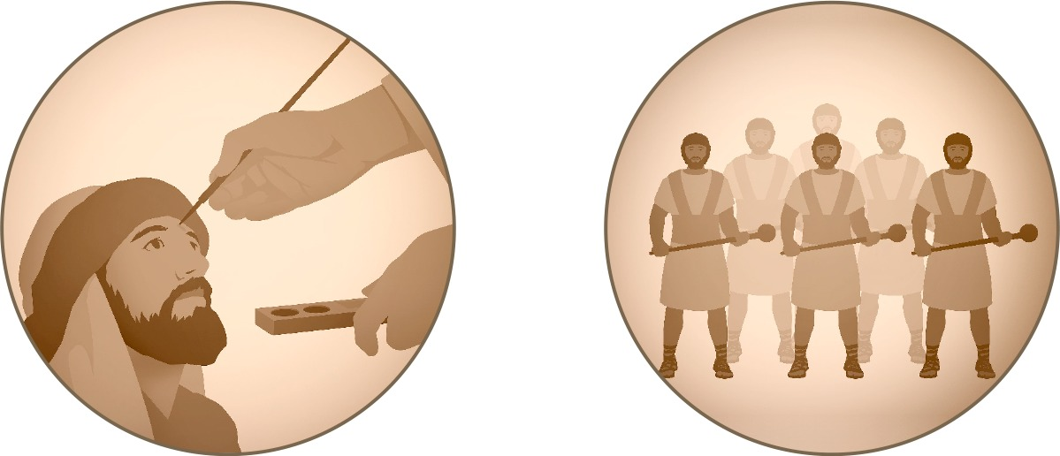
Be Ye Angry: Ezekiel 9:1-6
9 He cried also in mine ears with a loud voice, saying, Cause them that have charge over the city to draw near, even every man with his destroying weapon in his hand.
² And, behold, six men came from the way of the higher gate, which lieth toward the north, and every man a slaughter weapon in his hand; and one man among them was clothed with linen, with a writer's inkhorn by his side: and they went in, and stood beside the brasen altar.

Slide 55
Be Ye Angry: Ezekiel 9:3-6
³ And the glory of the God of Israel was gone up from the cherub, whereupon he was, to the threshold of the house. And he called to the man clothed with linen, which had the writer's inkhorn by his side;
⁴ And the Lord said unto him, Go through the midst of the city, through the midst of Jerusalem, and set a mark upon the foreheads of the men that sigh and that cry for all the abominations that be done in the midst thereof.

Slide 56
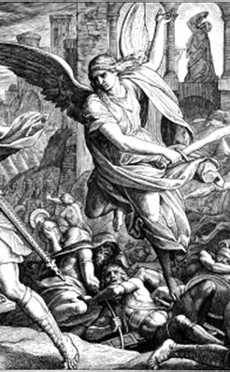
Be Ye Angry: Ezekiel 9:5-6
⁵ And to the others he said in mine hearing, Go ye after him through the city, and smite: let not your eye spare, neither have ye pity:
⁶ Slay utterly old and young, both maids, and little children, and women: but come not near any man upon whom is the mark; and begin at my sanctuary. Then they began at the ancient men which were before the house.

Slide 57
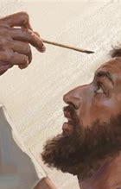
Be Ye Angry: Ezekiel 9:4
⁴ And the Lord said unto him, Go through the midst of the city, through the midst of Jerusalem, and set a mark upon the foreheads of the men that sigh and that cry for all the abominations that be done in the midst thereof.

Slide 58


Slide 59
Honesty, Anger, and Zeal:
Ephesians 4:26-27
²⁶ Be ye angry, and sin not: let not the sun go down upon your wrath:
²⁷ Neither give place to the devil.

Slide 60
Honesty, Anger, and Zeal:
Ephesians 4:26-27
²⁶ Be ye angry, and sin not: let not the sun go down upon your wrath:
²⁷ Neither give place to the devil.
SDABC V.6 p.1027
In the Greek both elements “be ye angry” and “sin not” are commands. Various suggestions have been made in an effort to avoid the implication of a command to be angry, none of them satisfactory. The simplest solution seems to be to regard the anger here spoken of as a righteous indignation. A Christian who is not aroused to the point of indignation by manifest wrongs and injustices may be insensitive to some things that ought to concern him.

Slide 61
Honesty, Anger, and Zeal:
Ephesians 4:26-27
SDABC V.6 p.1027
Righteous indignation has a most important function in stimulating men in the battle against evil. Jesus was not angered by any personal affront, but by hypocritical challenges to God and injustices done to others (see Mark 3:5). Justifiable anger is directed against the wrong act without animosity toward the wrongdoer. To be able to separate the two is a supremely great Christian achievement. A warning (SIN NOT!) is issued lest justifiable anger lead to feelings of personal resentment, vindictiveness, and loss of control. A safeguard also is provided (let not the sun go down) against the abuse of righteous indignation. While there should always remain an indignation against sin, harbored resentments are soul destroying.
²⁶ Be ye angry, and sin not: let not the sun go down upon your wrath:
²⁷ Neither give place to the devil.

Slide 62
Honesty, Anger, and Zeal:
Ephesians 4:26-27
“We do well to be angry at times,
but we have mistaken the times.”

Slide 63
Honesty, Anger, and Zeal:
Ephesians 4:26-27
²⁶ Be ye angry, and sin not: let not the sun go down upon your wrath:
²⁷ Neither give place to the devil.

Slide 64

A Community of New Men:

Slide 65

A Community of New Men:
Ephesians 4:28-32
²⁸ Let him that stole steal no more: but rather let him labour, working with his hands the thing which is good, that he may have to give to him that needeth.

Slide 66
A Community of New Men:
Ephesians 4:28-32
²⁸ Let him that stole steal no more: but rather let him labour, working with his hands the thing which is good, that he may have to give to him that needeth.
SDABC V.6 p.1028
Paul is speaking to those who had, in many instances, come out of paganism. Then too, there are many ways besides the outright taking of the property of others in which we may be guilty of this sin, such as a dishonest or sharp business transaction. Hence Paul’s command may apply to professing Christians. Thieving takes many insidious disguises, but in all cases it is a violation of the basic commandment of love to one’s neighbor.

Slide 67
A Community of New Men:
Ephesians 4:28-32
SDABC V.6 p.1028
There are many who cannot support themselves because of age or other disability. This gives opportunity for a demonstration of the unity that is the theme of the epistle. It is a Christian privilege to give to those in need, those who would perish without such aid. The making of money for its own sake is not a Christian activity; the rewards of honest labor are to be received and dispersed in the spirit of Christian stewardship. The believer works in order that he may be able to help others after having discharged his obligation to society by supporting himself. Thus he lives in marked contrast with the thief.
²⁸ Let him that stole steal no more: but rather let him labour, working with his hands the thing which is good, that he may have to give to him that needeth.

Slide 68

A Community of New Men:
Ephesians 4:29-32
²⁹ Let no corrupt communication proceed out of your mouth, but that which is good to the use of edifying, that it may minister grace unto the hearers.

Slide 69

A Community of New Men:
Ephesians 4:29-32

Slide 70
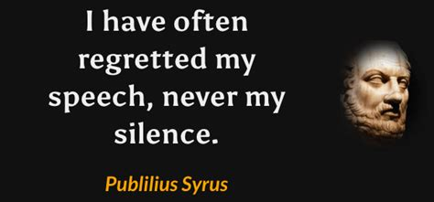
A Community of New Men:
Ephesians 4:29-32

Slide 71

A Community of New Men:
Ephesians 4:30-32
³⁰ And grieve not the holy Spirit of God, whereby ye are sealed unto the day of redemption.

Slide 72
A Community of New Men:
Ephesians 4:30-32
³⁰ And grieve not the holy Spirit of God, whereby ye are sealed unto the day of redemption.
SDABC V.6 p.1028
The personality of the Holy Spirit is here clearly implied; only persons can be grieved. “³¹ Wherefore I say unto you, All manner of sin and blasphemy shall be forgiven unto men: but the blasphemy against the Holy Ghost shall not be forgiven unto men.”

Slide 73

A Community of New Men:
Ephesians 4:31-32
³¹ Let all bitterness, and wrath, and anger, and clamour, and evil speaking, be put away from you, with all malice:

Slide 74
A Community of New Men:
Ephesians 4:31-32
³¹ Let all bitterness, and wrath, and anger, and clamour, and evil speaking, be put away from you, with all malice:
SDABC V.6 p.1028
Bitterness soon becomes a passionate and explosive wrath, wrath merges into a persistent anger, anger leads to unseemly brawling, brawling is always accompanied by abuse or slander, and all of it springs from a satanic malic lodged in the hearts of men. All of them are to be put away; they are all part of the works of the flesh (Gal. 5:19-21).

Slide 75

A Community of New Men:
Ephesians 4:32
³² And be ye kind one to another, tenderhearted, forgiving one another, even as God for Christ's sake hath forgiven you.

Slide 76
A Community of New Men:
Ephesians 4:32
SDABC V.6 p.1028
Kindness and tenderheartedness profit little unless they are given expression in the forgiving spirit. Kindness may be merely a kind of courtesy or politeness if it is not willing to take the step of forgiveness. The forgiving spirit is more than an ideal or even a virtue; it is a certain attitude of heart and soul.
The Lord Himself is the only model we should attempt to follow. Forgiveness for men was purchased at an infinite cost, whereas it costs men nothing, except the sacrifice of some personal pride, to forgive others. Our forgiveness is to be measured against the divine forgiveness, a fact that becomes the more startling the more it is pondered.
³² And be ye kind one to another, tenderhearted, forgiving one another, even as God for Christ's sake hath forgiven you.

Slide 77

Promises REalized:

Slide 78
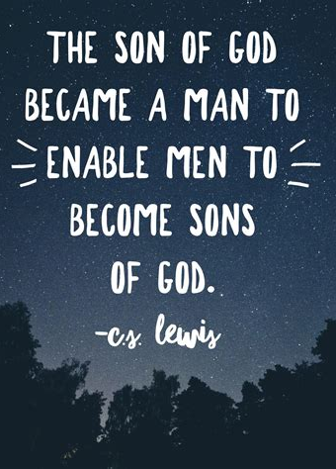
Promises Realized:
1 John 3:1-3
3 Behold, what manner of love the Father hath bestowed upon us, that we should be called the sons of God: therefore the world knoweth us not, because it knew him not.

Slide 79
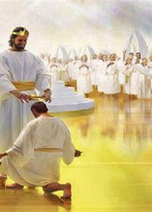
Promises Realized:
1 John 3:2-3
² Beloved, now are we the sons of God, and it doth not yet appear what we shall be: but we know that, when he shall appear, we shall be like him; for we shall see him as he is.

Slide 80
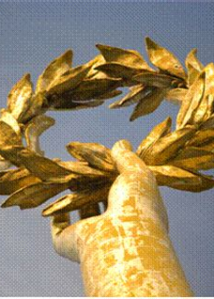
Promises Realized:
1 John 3:3
³ And every man that hath this hope in him purifieth himself, even as he is pure.

Slide 81

Promises Realized:
Philippians 1:3-10
³ I thank my God upon every remembrance of you,
⁴ Always in every prayer of mine for you all making request with joy,
⁵ For your fellowship in the gospel from the first day until now;

Slide 82
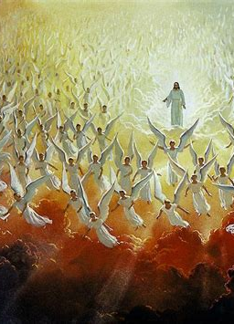
Promises Realized:
Philippians 1:6-10
⁶ Being confident of this very thing, that he which hath begun a good work in you will perform it until the day of Jesus Christ:
⁷ Even as it is meet for me to think this of you all, because I have you in my heart; inasmuch as both in my bonds, and in the defence and confirmation of the gospel, ye all are partakers of my grace.

Slide 83
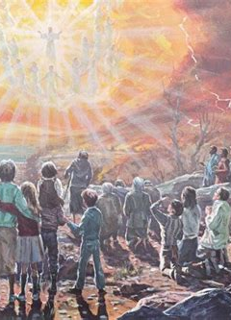
Promises Realized:
Philippians 1:8-10
⁸ For God is my record, how greatly I long after you all in the bowels of Jesus Christ.
⁹ And this I pray, that your love may abound yet more and more in knowledge and in all judgment;
¹⁰ That ye may approve things that are excellent; that ye may be sincere and without offence till the day of Christ.

Slide 84
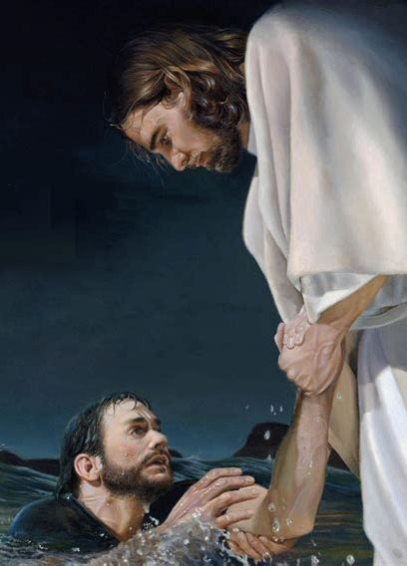
Promises Realized:
Jude 24-25
²⁴ Now unto him that is able to keep you from falling, and to present you faultless before the presence of his glory with exceeding joy,
²⁵ To the only wise God our Saviour, be glory and majesty, dominion and power, both now and ever. Amen.

Slide 85
God promises to transform us, change us into sinless beings.
He keeps His promises!
And He is able to sustain that transformation until He returns for us.

Slide 86
Take a few moments to prepare for Sabbath school next week!
We’ll be looking at the First part of Ephesians 5,
That is, Ephesians 5:1-20

Slide 87
Thank you!
And Happy Sabbath!!

