Slide 1
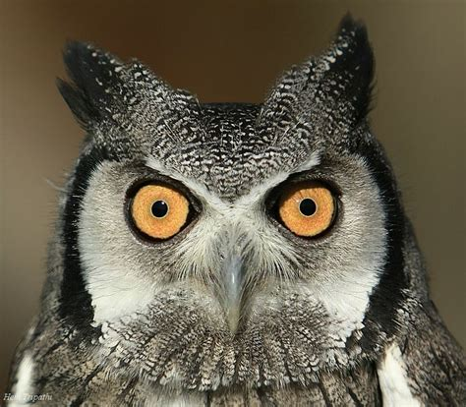

Living Wisely
Lesson 9, 3rd Quarter 2023
Ephesians 5:1-20

Slide 2
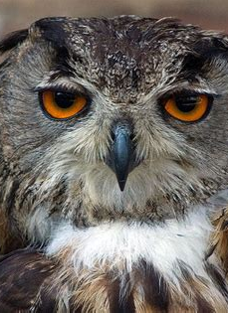
Memory Text:
Ephesians 5:15-17
¹⁵ See then that ye walk circumspectly, not as fools, but as wise,
¹⁶ Redeeming the time, because the days are evil.
¹⁷ Wherefore be ye not unwise, but understanding what the will of the Lord is.

Slide 3

Ephesians So Far:
Paul and the Ephesians
Eph. 1:1-14—Prayer of Gratitude for God’s Grace
Eph. 1:15-23—Gratitude and Joy in Christ
Eph. 2:1-10—Quickened by God’s Grace
Eph. 2:11-22—One Body by the Cross
Eph. 3—A Prisoner of Christ
Eph. 4:1-16—One Accord
Eph. 4:17-32—Transformation
Eph. 5:1-20—Followers of God

Slide 4
Key Ideas: Outlining Ephesians
Opening Greeting (Eph. 1:1, 2)
Part 1: The Doctrinal Section (Eph. 1:3-3:21)
Part 2: The Practical Section (Eph. 4:1-6:20)
Closing Greeting (Ephesians 6:21-24)

Slide 5

Walk in Love:

Slide 6

Walk in Love:
Ephesians 5:1-2
5 Be ye therefore followers of God, as dear children;
² And walk in love, as Christ also hath loved us, and hath given himself for us an offering and a sacrifice to God for a sweetsmelling savour.

Slide 7
Walk in Love:
Ephesians 5:1-2
5 Be ye therefore followers of God, as dear children;
² And walk in love, as Christ also hath loved us, and hath given himself for us an offering and a sacrifice to God for a sweetsmelling savour.
That is, because of the transformation that has occurred in your life, which Paul has discussed in the previous section.

Slide 8

Walk in Love:
Ephesians 5:1-2
5 Be ye therefore followers of God, as dear children;
² And walk in love, as Christ also hath loved us, and hath given himself for us an offering and a sacrifice to God for a sweetsmelling savour.

Slide 9
Followers of God:
The Greek for “followers,” mimetai, means “imitators.” People are wary of being told to be “perfect,” want to explain it away in various ways. Yet Paul tells us to be imitators of God. It’s the same as being perfect, but somehow, to me, it sounds so much more difficult! I checked, and the name “God” here is θεοῦ, transliterated into our characters as “Theou.” It’s the same form of the name of God as we see in the “Spirit of God” (Matt 3:16), after the ascention where Jesus is said to be exalted to the “right hand of God” (Acts 2:33), and even the word that both Satan and the demons (shortly to be residing in pigs) use to describe Jesus as the “Son of God” (Matt 4:3; 8:29). It seems a little Fatherly! Which Paul supports by going on to describe the transformed Christians as “little children.”

Slide 10
Walk in Love:
Ephesians 5:1-2
5 Be ye therefore followers of God, as dear children;
² And walk in love, as Christ also hath loved us, and hath given himself for us an offering and a sacrifice to God for a sweetsmelling savour.

Slide 11
Walk in Love:
Ephesians 5:1-2
5 Be ye therefore followers of God, as dear children;
² And walk in love, as Christ also hath loved us, and hath given himself for us an offering and a sacrifice to God for a sweetsmelling savour.
This verse is a continuation and expansion of ch. 4:32. The apostle has been urging that the example of God be followed, particularly in the spirit of forgiveness. God is the pattern, the ideal to which we strive to attain, in this case with special reference to the spirit of forgiveness. Surely the earnest believer, by God’s own grace, can learn to forgive even as God forgave. -SDABC V.6 p.1031

Slide 12
Walk in Love:
Ephesians 5:1-2
5 Be ye therefore followers of God, as dear children;
² And walk in love, as Christ also hath loved us, and hath given himself for us an offering and a sacrifice to God for a sweetsmelling savour.

Slide 13
Walk in Love:
Ephesians 5:1-2
5 Be ye therefore followers of God, as dear children;
² And walk in love, as Christ also hath loved us, and hath given himself for us an offering and a sacrifice to God for a sweetsmelling savour.

Slide 14
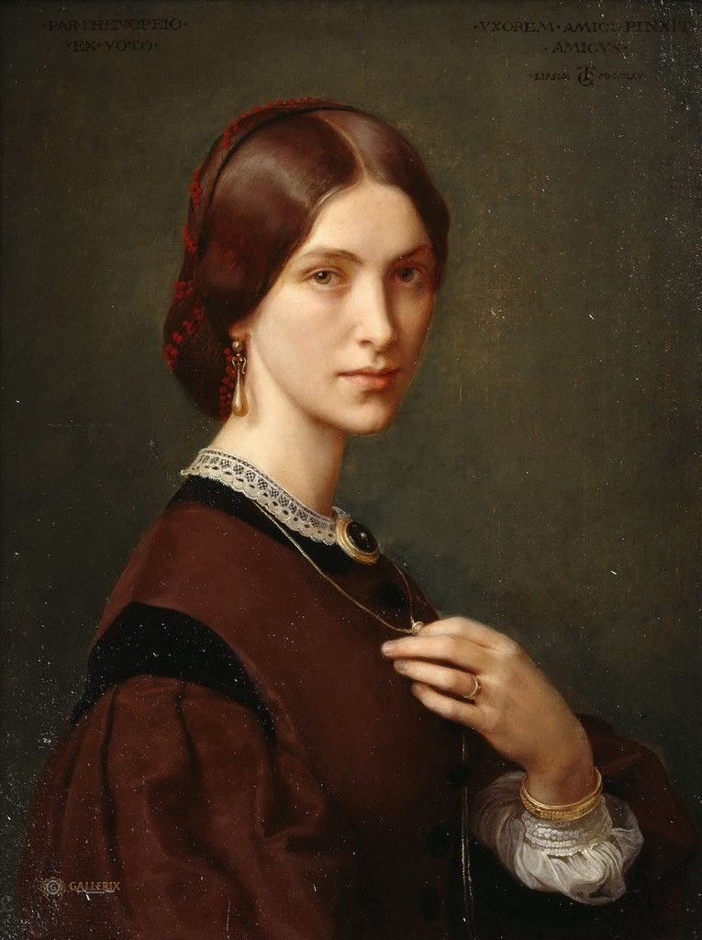
Walk In Love:
2 John 1:1-6
¹ The elder unto the elect lady and her children, whom I love in the truth; and not I only, but also all they that have known the truth;
² For the truth's sake, which dwelleth in us, and shall be with us for ever.

Slide 15

Walk In Love:
2 John 1:3-6
³ Grace be with you, mercy, and peace, from God the Father, and from the Lord Jesus Christ, the Son of the Father, in truth and love.

Slide 16
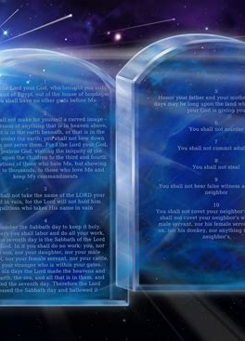
Walk In Love:
2 John 1:4-6
⁴ I rejoiced greatly that I found of thy children walking in truth, as we have received a commandment from the Father.

Slide 17
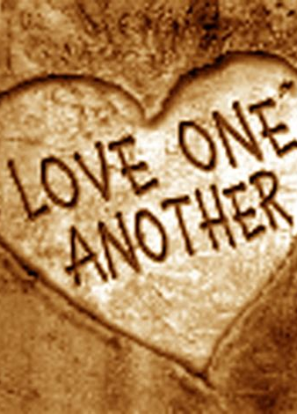
Walk In Love:
2 John 1:5-6
⁵ And now I beseech thee, lady, not as though I wrote a new commandment unto thee, but that which we had from the beginning, that we love one another.

Slide 18
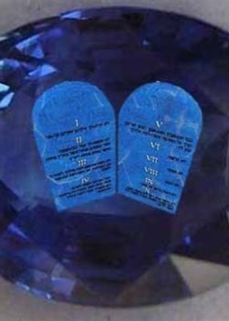
Walk In Love:
2 John 1:6
⁶ And this is love, that we walk after his commandments. This is the commandment, That, as ye have heard from the beginning, ye should walk in it.

Slide 19
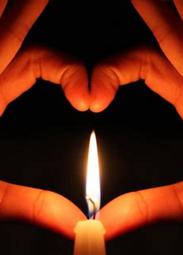
Walk In Love:
1 John 5:1-3
5 Whosoever believeth that Jesus is the Christ is born of God: and every one that loveth him that begat loveth him also that is begotten of him.

Slide 20
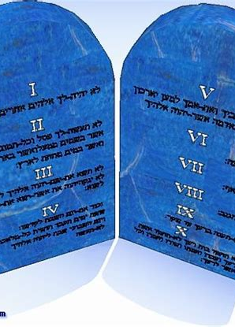
Walk In Love:
1 John 5:1-3
² By this we know that we love the children of God, when we love God, and keep his commandments.
³ For this is the love of God, that we keep his commandments: and his commandments are not grievous.

Slide 21
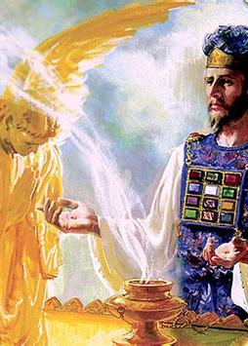
Walk In Love:
1 John 2:1-5
2 My little children, these things write I unto you, that ye sin not. And if any man sin, we have an advocate with the Father, Jesus Christ the righteous:
² And he is the propitiation for our sins: and not for ours only, but also for the sins of the whole world.

Slide 22
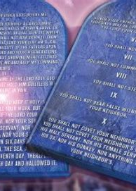
Walk In Love:
1 John 2:3-5
³ And hereby we do know that we know him, if we keep his commandments.
⁴ He that saith, I know him, and keepeth not his commandments, is a liar, and the truth is not in him.

Slide 23
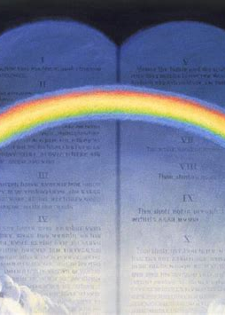
Walk In Love:
1 John 2:3-5
⁵ But whoso keepeth his word, in him verily is the love of God perfected: hereby know we that we are in him.

Slide 24
Walk in Love:
Ephesians 5:1-2
5 Be ye therefore followers of God, as dear children;
² And walk in love, as Christ also hath loved us, and hath given himself for us an offering and a sacrifice to God for a sweetsmelling savour.

Slide 25

(CONTEXT) Bible Flame Mail:

Slide 26
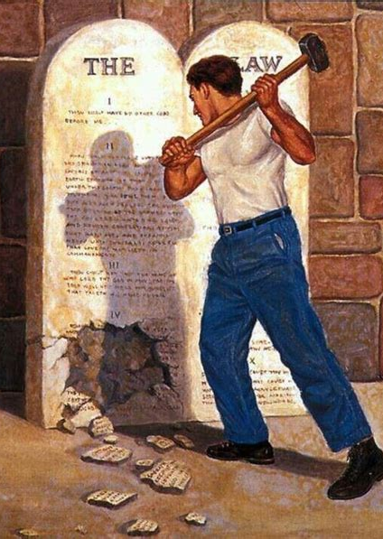

(Context) Bible Flame Mail:
1 Corinthians 5:1-13
5 It is reported commonly that there is fornication among you, and such fornication as is not so much as named among the Gentiles, that one should have his father's wife.
² And ye are puffed up, and have not rather mourned, that he that hath done this deed might be taken away from among you.

Slide 27
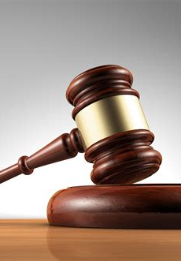
(Context) Bible Flame Mail:
1 Corinthians 5:3-13
³ For I verily, as absent in body, but present in spirit, have judged already, as though I were present, concerning him that hath so done this deed,
⁴ In the name of our Lord Jesus Christ, when ye are gathered together, and my spirit, with the power of our Lord Jesus Christ,

Slide 28
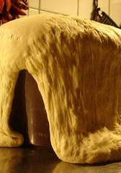
(Context) Bible Flame Mail:
1 Corinthians 5:5-13
⁵ To deliver such an one unto Satan for the destruction of the flesh, that the spirit may be saved in the day of the Lord Jesus.
⁶ Your glorying is not good. Know ye not that a little leaven leaveneth the whole lump?
⁷ Purge out therefore the old leaven, that ye may be a new lump, as ye are unleavened. For even Christ our passover is sacrificed for us:

Slide 29
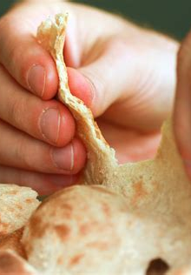
(Context) Bible Flame Mail:
1 Corinthians 5:8-13
⁸ Therefore let us keep the feast, not with old leaven, neither with the leaven of malice and wickedness; but with the unleavened bread of sincerity and truth.
⁹ I wrote unto you in an epistle not to company with fornicators:

Slide 30

(Context) Bible Flame Mail:
1 Corinthians 5:10-13
¹⁰ Yet not altogether with the fornicators of this world, or with the covetous, or extortioners, or with idolaters; for then must ye needs go out of the world.
¹¹ But now I have written unto you not to keep company, if any man that is called a brother be a fornicator, or covetous, or an idolator, or a railer, or a drunkard, or an extortioner; with such an one no not to eat.

Slide 31

(Context) Bible Flame Mail:
1 Corinthians 5:12-13
¹² For what have I to do to judge them also that are without? do not ye judge them that are within?
¹³ But them that are without God judgeth. Therefore put away from among yourselves that wicked person.

Slide 32
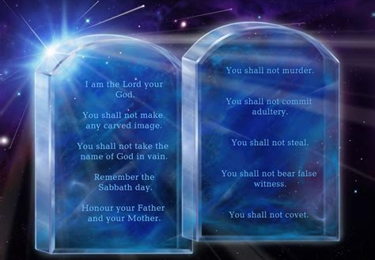
As Becometh Saints:

Slide 33
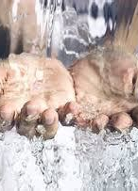
As Becometh Saints:
Ephesians 5:3-6
³ But fornication, and all uncleanness, or covetousness, let it not be once named among you, as becometh saints;
⁴ Neither filthiness, nor foolish talking, nor jesting, which are not convenient: but rather giving of thanks.

Slide 34
As Becometh Saints:
Ephesians 5:3-6
³ But fornication, and all uncleanness, or covetousness, let it not be once named among you, as becometh saints;
⁴ Neither filthiness, nor foolish talking, nor jesting, which are not convenient: but rather giving of thanks.
Covetousness is greed for more, and this is also a mark of all the sensual sins. The covetousness of both lust and avarice is to be considered among the grosser sins and to be abhorred by all who bear the Christian name. How many Christians are prepared to place the sin of avarice in the same evil category as fornication? Greed is a deadly sin that often passes unnoticed in the most respectable circles; indeed, it is frequently hidden in such terms as “competition” and “success.” – SDABC V.6 p.1032

Slide 35
As Becometh Saints:
Ephesians 5:3-6
³ But fornication, and all uncleanness, or covetousness, let it not be once named among you, as becometh saints;
⁴ Neither filthiness, nor foolish talking, nor jesting, which are not convenient: but rather giving of thanks.

Slide 36
As Becometh Saints:
Ephesians 5:3-6
Paul speaks against insipid, stupid talking, without edification or profit. Every idle word is to be brought into judgment (Matt. 12:36), and foolish speech involves more than mere emptiness. Similarly, the word translated “jesting,” eutrapelia, from two roots meaning “well” and “to turn”; hence, “wittiness,” is here used in the low sense of buffoonery, ribaldry, or levity. The apostle is not speaking against the play of innocent humor, but against jesting that is coarse and low. – SDABC V.6 p.1032
³ But fornication, and all uncleanness, or covetousness, let it not be once named among you, as becometh saints;
⁴ Neither filthiness, nor foolish talking, nor jesting, which are not convenient: but rather giving of thanks.

Slide 37
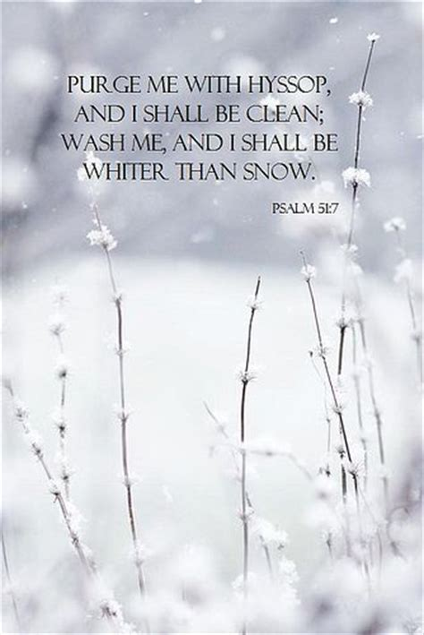
As Becometh Saints:
Ephesians 5:5-6
⁵ For this ye know, that no whoremonger, nor unclean person, nor covetous man, who is an idolater, hath any inheritance in the kingdom of Christ and of God.

Slide 38

Covetous Man:
Colossians 3:5
⁵ Mortify therefore your members which are upon the earth; fornication, uncleanness, inordinate affection, evil concupiscence, and covetousness, which is idolatry:

Slide 39
As Becometh Saints:
Ephesians 5:5-6
⁵ For this ye know, that no whoremonger, nor unclean person, nor covetous man, who is an idolater, hath any inheritance in the kingdom of Christ and of God.

Slide 40
As Becometh Saints:
Ephesians 5:5-6
The covetous person makes a god out of the object of his greed.
– SDABC V.6 p.1032
⁵ For this ye know, that no whoremonger, nor unclean person, nor covetous man, who is an idolater, hath any inheritance in the kingdom of Christ and of God.

Slide 41
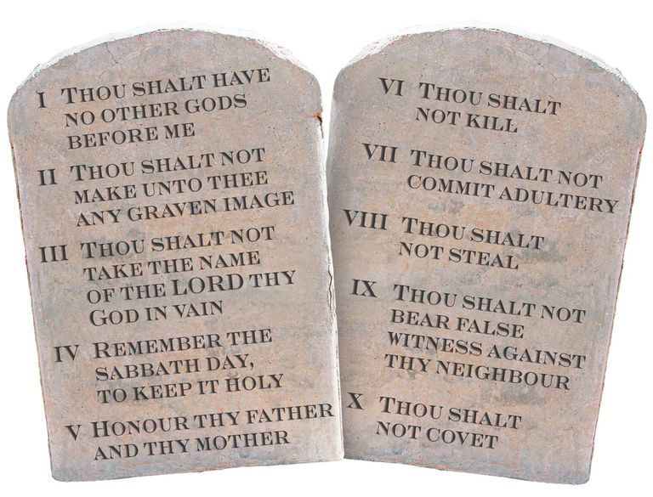


As Becometh Saints:
Ephesians 5:5-6
⁵ For this ye know, that no whoremonger, nor unclean person, nor covetous man, who is an idolater, hath any inheritance in the kingdom of Christ and of God.

Slide 42
As Becometh Saints:
Ephesians 5:5-6
⁵ For this ye know, that no whoremonger, nor unclean person, nor covetous man, who is an idolater, hath any inheritance in the kingdom of Christ and of God.

Slide 43
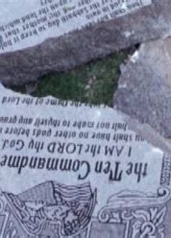
As Becometh Saints:
Ephesians 5:6
⁶ Let no man deceive you with vain words: for because of these things cometh the wrath of God upon the children of disobedience.

Slide 44
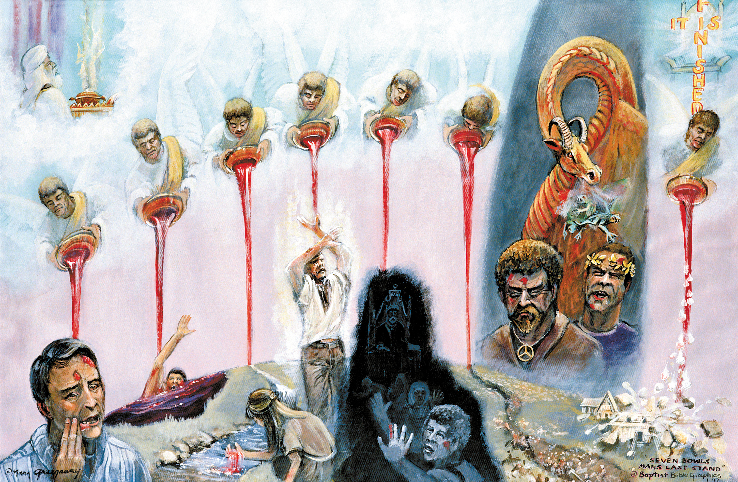
The Wrath of God:

Slide 45
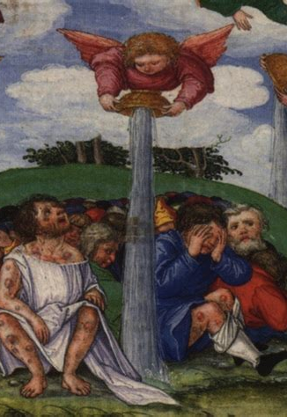
The Wrath of God:
Revelation 16:1-16
16 And I heard a great voice out of the temple saying to the seven angels, Go your ways, and pour out the vials of the wrath of God upon the earth.
² And the first went, and poured out his vial upon the earth; and there fell a noisome and grievous sore upon the men which had the mark of the beast, and upon them which worshipped his image.

Slide 46
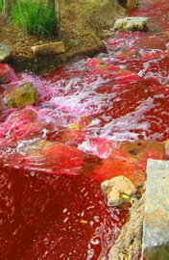
The Wrath of God:
Revelation 16:3-16
³ And the second angel poured out his vial upon the sea; and it became as the blood of a dead man: and every living soul died in the sea.
⁴ And the third angel poured out his vial upon the rivers and fountains of waters; and they became blood.

Slide 47
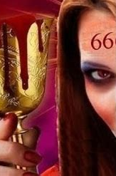
The Wrath of God:
Revelation 16:5-16
⁵ And I heard the angel of the waters say, Thou art righteous, O Lord, which art, and wast, and shalt be, because thou hast judged thus.
⁶ For they have shed the blood of saints and prophets, and thou hast given them blood to drink; for they are worthy.

Slide 48
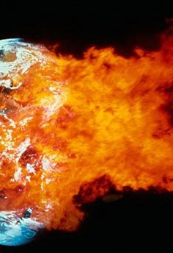
The Wrath of God:
Revelation 16:7-16
⁷ And I heard another out of the altar say, Even so, Lord God Almighty, true and righteous are thy judgments.
⁸ And the fourth angel poured out his vial upon the sun; and power was given unto him to scorch men with fire.

Slide 49
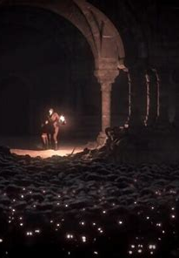
The Wrath of God:
Revelation 16:9-16
⁹ And men were scorched with great heat, and blasphemed the name of God, which hath power over these plagues: and they repented not to give him glory.
¹⁰ And the fifth angel poured out his vial upon the seat of the beast; and his kingdom was full of darkness; and they gnawed their tongues for pain,

Slide 50
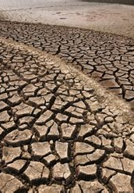
The Wrath of God:
Revelation 16:11-16
¹¹ And blasphemed the God of heaven because of their pains and their sores, and repented not of their deeds.
¹² And the sixth angel poured out his vial upon the great river Euphrates; and the water thereof was dried up, that the way of the kings of the east might be prepared.

Slide 51
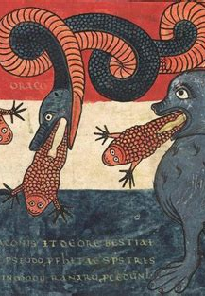
The Wrath of God:
Revelation 16:13-16
¹³ And I saw three unclean spirits like frogs come out of the mouth of the dragon, and out of the mouth of the beast, and out of the mouth of the false prophet.
¹⁴ For they are the spirits of devils, working miracles, which go forth unto the kings of the earth and of the whole world, to gather them to the battle of that great day of God Almighty.

Slide 52
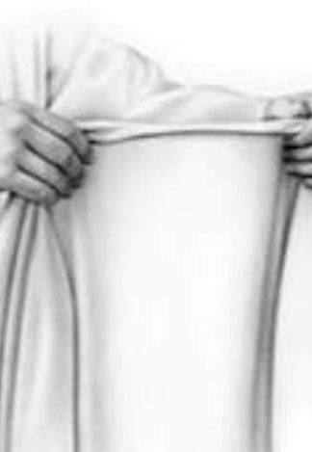
The Wrath of God:
Revelation 16:15-16
¹⁵ Behold, I come as a thief. Blessed is he that watcheth, and keepeth his garments, lest he walk naked, and they see his shame.
¹⁶ And he gathered them together into a place called in the Hebrew tongue Armageddon.

Slide 53
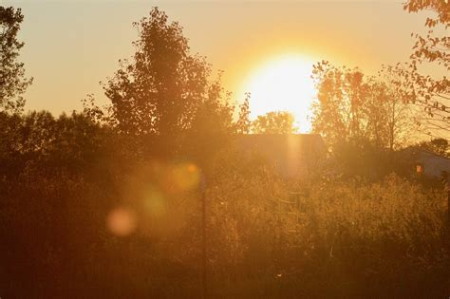
Children of the Light:

Slide 54
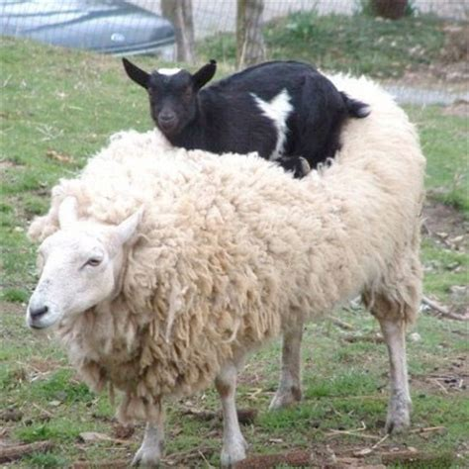
Children of the light:
Ephesians 5:6-14
⁶ Let no man deceive you with vain words: for because of these things cometh the wrath of God upon the children of disobedience.

Slide 55

Children of the light:
Ephesians 5:7-14
⁷ Be not ye therefore partakers with them.
⁸ For ye were sometimes darkness, but now are ye light in the Lord: walk as children of light:

Slide 56
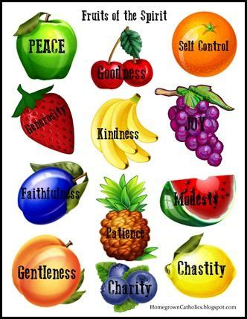
Children of the light:
Ephesians 5:9-14
⁹ (For the fruit of the Spirit is in all goodness and righteousness and truth;)
¹⁰ Proving what is acceptable unto the Lord.

Slide 57
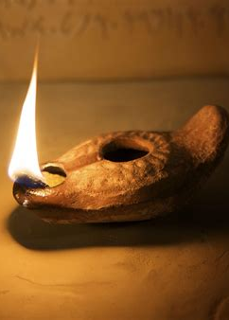
Children of the light:
Ephesians 5:11-14
¹¹ And have no fellowship with the unfruitful works of darkness, but rather reprove them.
¹² For it is a shame even to speak of those things which are done of them in secret.

Slide 58
Children of the light:
Ephesians 5:11-14
¹¹ And have no fellowship with the unfruitful works of darkness, but rather reprove them.
¹² For it is a shame even to speak of those things which are done of them in secret.
By word and life Christians should be a continuous rebuke to the world of evil. It is not sufficient to “have no fellowship” with the works of evil; they must be reproved. The Christian cannot be neutral, a passive observer in the face of wickedness; he must be aggressive in exposure and denunciation of sin. Sympathy with afflicted men must not degenerate into an easygoing indifference or sentimental tolerance, otherwise it will be hard to show that we have “no fellowship” with the works of darkness. – SDABC V.6 p.1033

Slide 59
Children of the light:
Ephesians 5:11-14
¹¹ And have no fellowship with the unfruitful works of darkness, but rather reprove them.
¹² For it is a shame even to speak of those things which are done of them in secret.

Slide 60
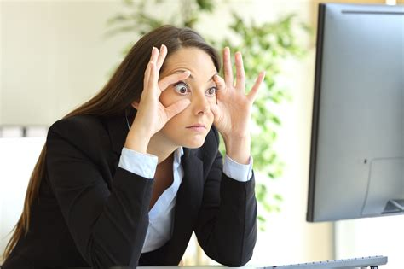
Children of the light:
Ephesians 5:11-14
¹³ But all things that are reproved are made manifest by the light: for whatsoever doth make manifest is light.
¹⁴ Wherefore he saith, Awake thou that sleepest, and arise from the dead, and Christ shall give thee light.

Slide 61
Children of the light:
Ephesians 5:11-14
We sleep in the DARK! The children of the light are wide awake and sensitive to God’s commands. The sleeping Laodicean church needs to AWAKE!
¹³ But all things that are reproved are made manifest by the light: for whatsoever doth make manifest is light.
¹⁴ Wherefore he saith, Awake thou that sleepest, and arise from the dead, and Christ shall give thee light.

Slide 62
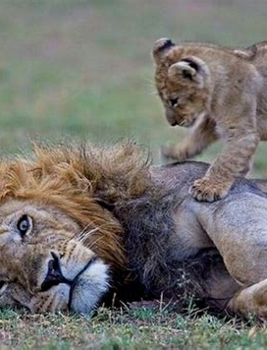
AWAKE!
Romans 13:11-14
¹¹ And that, knowing the time, that now it is high time to awake out of sleep: for now is our salvation nearer than when we believed.
¹² The night is far spent, the day is at hand: let us therefore cast off the works of darkness, and let us put on the armour of light.

Slide 63
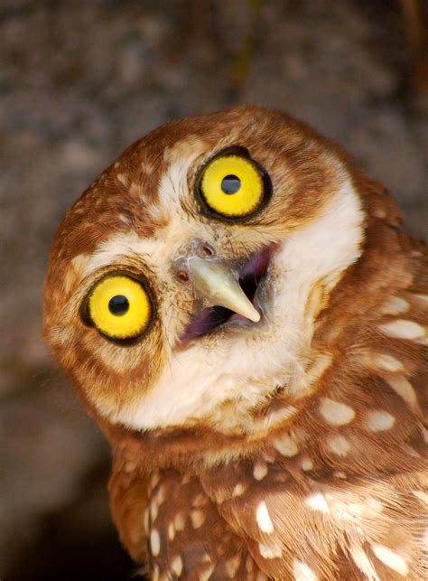
AWAKE!
Romans 13:13-14
¹³ Let us walk honestly, as in the day; not in rioting and drunkenness, not in chambering and wantonness, not in strife and envying.
¹⁴ But put ye on the Lord Jesus Christ, and make not provision for the flesh, to fulfil the lusts thereof.

Slide 64
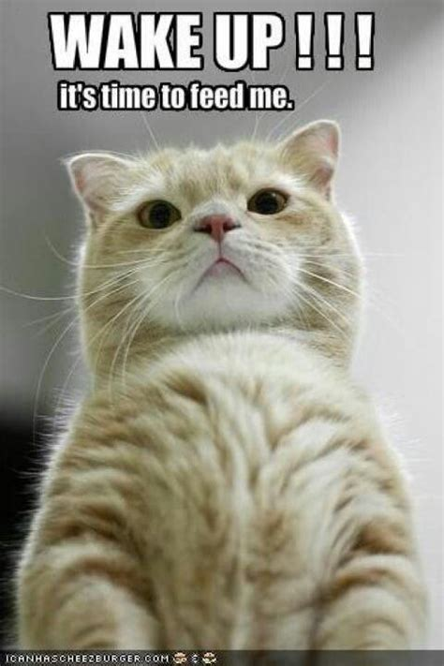
AWAKE!
1 Corinthians 15:34
³⁴ Awake to righteousness, and sin not; for some have not the knowledge of God: I speak this to your shame.

Slide 65
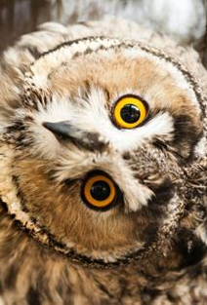
AWAKE!
1 Thessalonians 5:6-8
⁶ Therefore let us not sleep, as do others; but let us watch and be sober.
⁷ For they that sleep sleep in the night; and they that be drunken are drunken in the night.

Slide 66

AWAKE!
1 Thessalonians 5:6-8
⁸ But let us, who are of the day, be sober, putting on the breastplate of faith and love; and for an helmet, the hope of salvation.

Slide 67
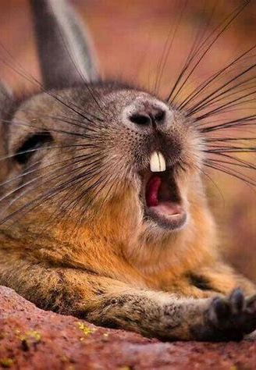
AWAKE!
1 Peter 1:13-16
¹³ Wherefore gird up the loins of your mind, be sober, and hope to the end for the grace that is to be brought unto you at the revelation of Jesus Christ;

Slide 68

AWAKE!
1 Peter 1:14-16
¹⁴ As obedient children, not fashioning yourselves according to the former lusts in your ignorance:

Slide 69
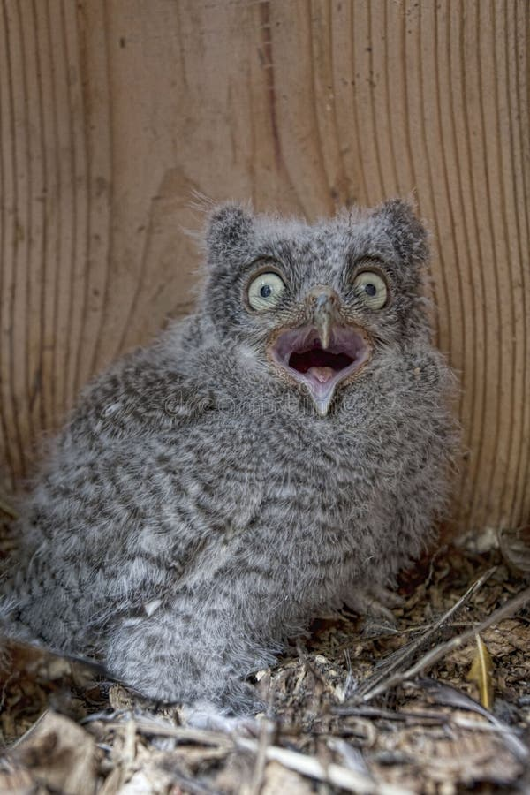
AWAKE!
1 Peter 1:15-16
¹⁵ But as he which hath called you is holy, so be ye holy in all manner of conversation;
¹⁶ Because it is written, Be ye holy; for I am holy.

Slide 70

Redeeming the Time:

Slide 71
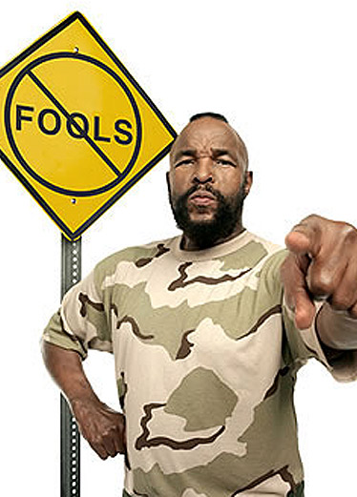
Redeeming the Time:
Ephesians 5:15-20
¹⁵ See then that ye walk circumspectly, not as fools, but as wise,

Slide 72
Redeeming the Time:
Ephesians 5:15-20
¹⁵ See then that ye walk circumspectly, not as fools, but as wise,
The Greek word here rendered “circumspectly” is akribos, “strictly,” “accurately,” “diligently,” “carefully.” Textual evidence is divided between this and the reading, “Take diligent heed how you walk.” The believer is urged to follow a disciplined course. He is to make every effort to resist the temptations that surround him. – SDABC V.6 p.1034

Slide 73
Redeeming the Time:
Ephesians 5:15-20
¹⁵ See then that ye walk circumspectly, not as fools, but as wise,

Slide 74

Redeeming the Time:
Ephesians 5:16-20
¹⁶ Redeeming the time, because the days are evil.

Slide 75
Redeeming the Time:
Ephesians 5:16-20
¹⁶ Redeeming the time, because the days are evil.
Literally, “buying up for yourselves the opportune time,” that is, making the most of the opportunity. To take advantage of every moment of time for great and noble purposes is the obligation and privilege of every Christian. Redeeming the time is more than simply refraining from idleness or frivolous activities. A person is not good merely because he is not bad. Like Jesus, one must be “about” his “Father’s business,” actively seeking opportunity to do good, even to one’s enemies. In the parable of the Unjust Steward, Jesus pointed to the diligence and wisdom of the merchants of the world in conducting their affairs, as an example to the children of light. – SDABC V.6 p.1034

Slide 76

Redeeming the Time:
Ephesians 5:16-20
¹⁶ Redeeming the time, because the days are evil.

Slide 77
Redeeming the Time:
Ephesians 5:16-20
¹⁶ Redeeming the time, because the days are evil.
The necessity for seizing every opportunity that arises is apparent when one considers how life is exposed continuously to evil of all kinds, not only the prevailing moral evil, but ill-health, persecution, and mental suffering, which deprive the Christian of many opportunities to serve. – SDABC V.6 p.1034

Slide 78
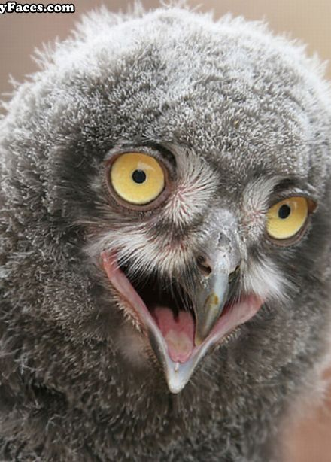
Redeeming the Time:
Ephesians 5:17-20
¹⁷ Wherefore be ye not unwise, but understanding what the will of the Lord is.
¹⁸ And be not drunk with wine, wherein is excess; but be filled with the Spirit;

Slide 79
Redeeming the Time:
Ephesians 5:17-20
The excitement of drunkenness is opposed by the joy and animation of the spirit. The seeking after an earthly stimulant is replaced by the spiritual enthusiasm of the human spirit energized by the Holy Spirit. Although it is true that soberness accompanies the work of the Holy Spirit, nevertheless, the effect of the presence of the Holy Spirit is seen in enthusiastic witnessing for the faith. – SDABC V.6 p.1034
¹⁷ Wherefore be ye not unwise, but understanding what the will of the Lord is.
¹⁸ And be not drunk with wine, wherein is excess; but be filled with the Spirit;

Slide 80

Redeeming the Time:
Ephesians 5:17-20
¹⁷ Wherefore be ye not unwise, but understanding what the will of the Lord is.
¹⁸ And be not drunk with wine, wherein is excess; but be filled with the Spirit;

Slide 81
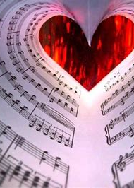
Redeeming the Time:
Ephesians 5:19-20
¹⁹ Speaking to yourselves in psalms and hymns and spiritual songs, singing and making melody in your heart to the Lord;

Slide 82

Redeeming the Time:
Ephesians 5:20
²⁰ Giving thanks always for all things unto God and the Father in the name of our Lord Jesus Christ;

Slide 83
Redeeming the Time:
Ephesians 5:20
²⁰ Giving thanks always for all things unto God and the Father in the name of our Lord Jesus Christ;
“Nothing tends more to promote health of body and of soul than does a spirit of gratitude and praise” (MH 251). The spirit of praise is an antidote to evil and discouragement. When everything else is at its worst, the Christian is at his best and is most cheerful. The spirit of thankfulness prevails in joy or in sorrow, in victory or in defeat, for it is a permanent, sustaining attribute of Christian character . – SDABC V.6 p.1035

Slide 84
Redeeming the Time:
Ephesians 5:20
²⁰ Giving thanks always for all things unto God and the Father in the name of our Lord Jesus Christ;

Slide 85
Take a few moments to prepare for Sabbath school next week!
We’ll be looking at the Second part of Ephesians 5,
That is, Ephesians 5:21-33

Slide 86
Take a few moments to prepare for Sabbath school next week!
AND DADDY WILL BE TEACHING IT!!
We’ll be looking at the Second part of Ephesians 5,
That is, Ephesians 5:21-33

Slide 87
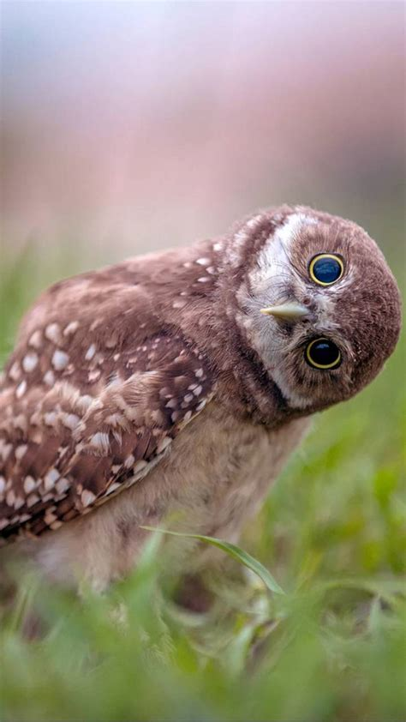
Thank you!
And Happy Sabbath!!

