Slide 1

Practicing Supreme Loyalty to Christ
Lesson 11, 3rd Quarter 2023
Ephesians 6:1-9

Slide 2
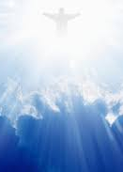
Memory Text:
Ephesians 6:9
⁹ And, ye masters, do the same things unto them, forbearing threatening: knowing that your Master also is in heaven; neither is there respect of persons with him.

Slide 3

Ephesians So Far:
Paul and the Ephesians
Eph. 1:1-14—Prayer of Gratitude for God’s Grace
Eph. 1:15-23—Gratitude and Joy in Christ
Eph. 2:1-10—Quickened by God’s Grace
Eph. 2:11-22—One Body by the Cross
Eph. 3—A Prisoner of Christ
Eph. 4:1-16—One Accord
Eph. 4:17-32—Transformation
Eph. 5:1-20—Followers of God
Eph. 5:21-33—Love as Christ Loved the Church
Eph. 6:1-9—Service

Slide 4
Key Ideas: Outlining Ephesians
Opening Greeting (Eph. 1:1, 2)
Part 1: The Doctrinal Section (Eph. 1:3-3:21)
Part 2: The Practical Section (Eph. 4:1-6:20)
Closing Greeting (Ephesians 6:21-24)

Slide 5
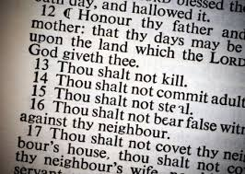
A Child’s Service:

Slide 6
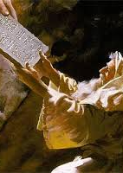
A Child's Service:
Ephesians 6:1-3
6 Children, obey your parents in the Lord: for this is right.
² Honour thy father and mother; which is the first commandment with promise;
³ That it may be well with thee, and thou mayest live long on the earth.

Slide 7
A Child's Service:
Ephesians 6:1-3
Obedience on the part of children is reasonable and just. Of all creatures that are born, a human babe is the most helpless, and for years it is entirely dependent on the kindness and love of parents. There can be no ordered family life without the obedience of the children, for the child is not competent to judge the reason for certain courses of action. But even more important, a child who is disobedient to parents will surely be disobedient to God, for he will know nothing of those disciplines and restraints that are absolutely essential to Christian growth.
6 Children, obey your parents in the Lord: for this is right.
² Honour thy father and mother; which is the first commandment with promise;
³ That it may be well with thee, and thou mayest live long on the earth.

Slide 8
A Child's Service:
Ephesians 6:1-3
6 Children, obey your parents in the Lord: for this is right.
² Honour thy father and mother; which is the first commandment with promise;
³ That it may be well with thee, and thou mayest live long on the earth.
The word “obedience” does not ring pleasantly in some modem ears, but those who resent it as “regimentation” must assume their share of the blame for the alarming rise of juvenile delinquency in recent years.

Slide 9
A Child's Service:
Ephesians 6:1-3
6 Children, obey your parents in the Lord: for this is right.
² Honour thy father and mother; which is the first commandment with promise;
³ That it may be well with thee, and thou mayest live long on the earth.
The phrase “for this is right” qualifies “obey” rather than “parents,” thus establishing that children, within their spiritual capacity, should obey from principle rather than from necessity. To “obey in the Lord” is to give the kind of obedience that springs from being “in Christ”; it may also indicate the limitations that are inherent in any human commands, even those of parents to children.

Slide 10
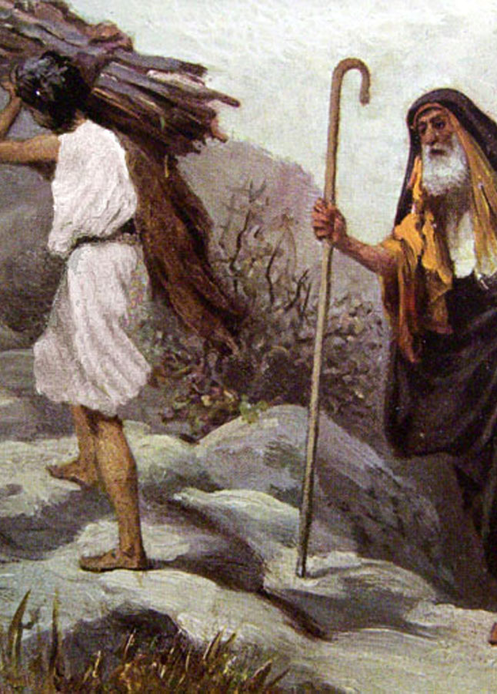
A Child's Service:
Genesis 22:5-12
⁵ And Abraham said unto his young men, Abide ye here with the ass; and I and the lad will go yonder and worship, and come again to you.
⁶ And Abraham took the wood of the burnt offering, and laid it upon Isaac his son; and he took the fire in his hand, and a knife; and they went both of them together.

Slide 11
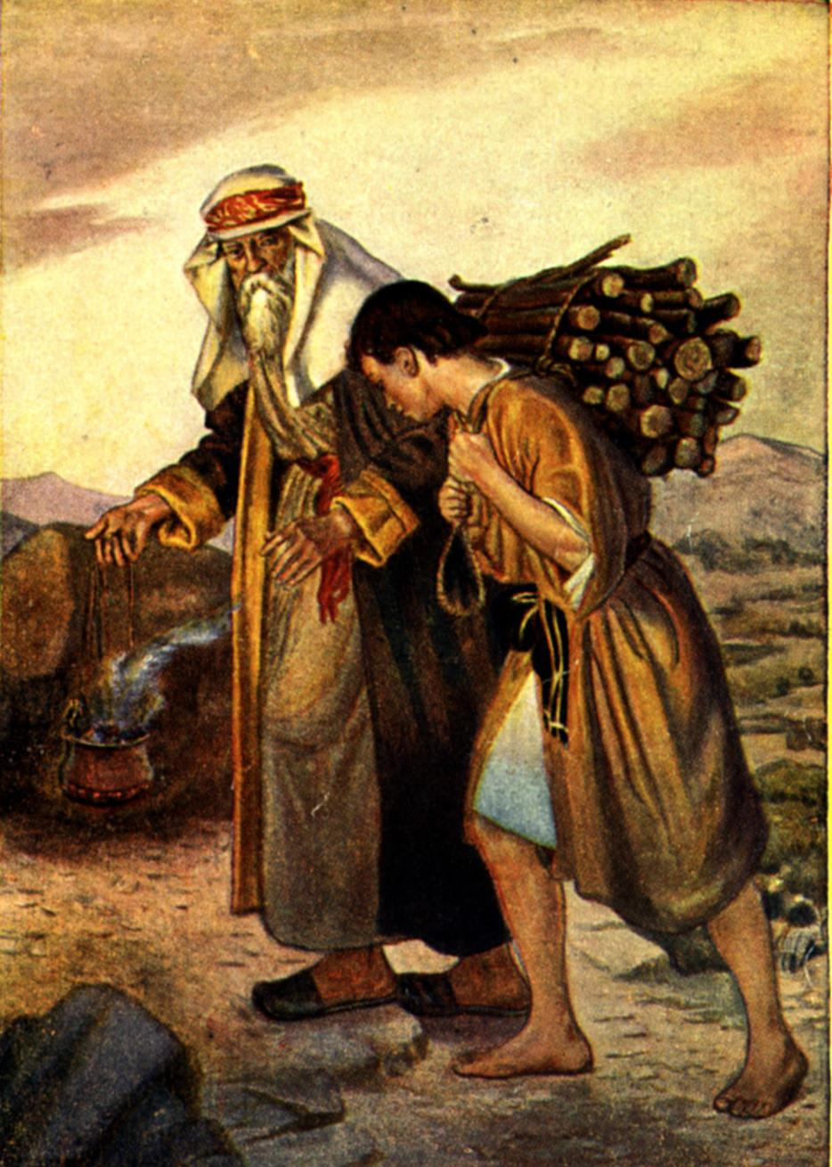
A Child's Service:
Genesis 22:5-12
⁷ And Isaac spake unto Abraham his father, and said, My father: and he said, Here am I, my son. And he said, Behold the fire and the wood: but where is the lamb for a burnt offering?
⁸ And Abraham said, My son, God will provide himself a lamb for a burnt offering: so they went both of them together.

Slide 12
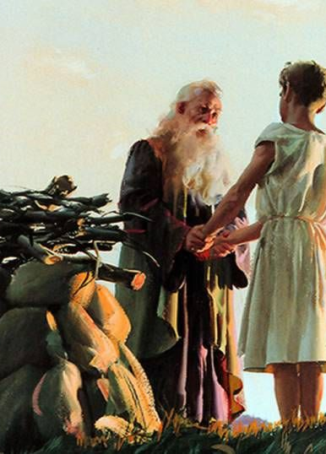
A Child's Service:
Patriarchs and Prophets P.152
“At the appointed place they built the altar and laid the wood upon it. Then, with trembling voice, Abraham unfolded to his son the divine message. It was with terror and amazement that Isaac learned his fate, but he offered no resistance. He could have escaped his doom, had he chosen to do so;”

Slide 13
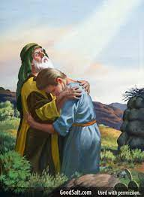
A Child's Service:
Patriarchs and Prophets P.152
“the grief-stricken old man, exhausted with the struggle of those three terrible days, could not have opposed the will of the vigorous youth. But Isaac had been trained from childhood to ready, trusting obedience, and as the purpose of God was opened before him, he yielded a willing submission.”

Slide 14
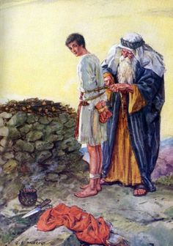
A Child's Service:
Patriarchs and Prophets P.152
“He was a sharer in Abraham's faith, and he felt that he was honored in being called to give his life as an offering to God. He tenderly seeks to lighten the father's grief, and encourages his nerveless hands to bind the cords that confine him to the altar.”

Slide 15
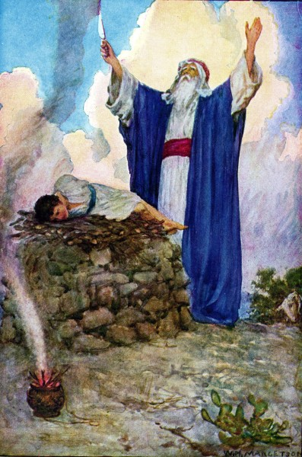
A Child's Service:
Genesis 22:5-12
⁹ And they came to the place which God had told him of; and Abraham built an altar there, and laid the wood in order, and bound Isaac his son, and laid him on the altar upon the wood.
¹⁰ And Abraham stretched forth his hand, and took the knife to slay his son.

Slide 16
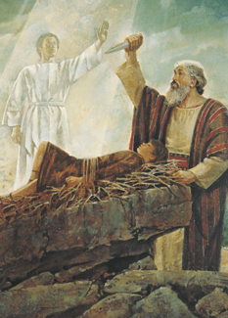
A Child's Service:
Genesis 22:5-12
¹¹ And the angel of the Lord called unto him out of heaven, and said, Abraham, Abraham: and he said, Here am I.
¹² And he said, Lay not thine hand upon the lad, neither do thou any thing unto him: for now I know that thou fearest God, seeing thou hast not withheld thy son, thine only son from me.

Slide 17
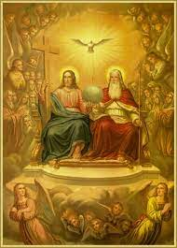
A Child's Service:
John 6:38-39
³⁸ For I came down from heaven, not to do mine own will, but the will of him that sent me.
³⁹ And this is the Father's will which hath sent me, that of all which he hath given me I should lose nothing, but should raise it up again at the last day.

Slide 18
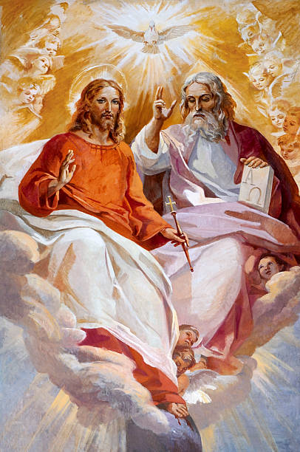
A Child's Service:
John 6:38-39
¹⁷ But Jesus answered them, My Father worketh hitherto, and I work.
¹⁸ Therefore the Jews sought the more to kill him, because he not only had broken the sabbath, but said also that God was his Father, making himself equal with God.

Slide 19
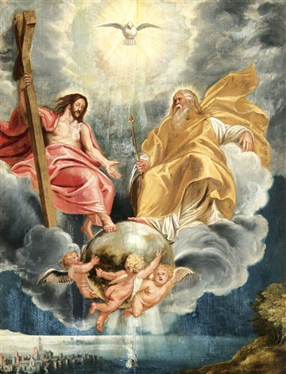
A Child's Service:
John 6:38-39
¹⁹ Then answered Jesus and said unto them, Verily, verily, I say unto you, The Son can do nothing of himself, but what he seeth the Father do: for what things soever he doeth, these also doeth the Son likewise.

Slide 20
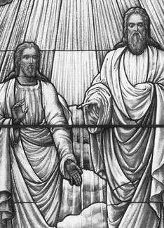
A Child's Service:
John 5:30
³⁰ I can of mine own self do nothing: as I hear, I judge: and my judgment is just; because I seek not mine own will, but the will of the Father which hath sent me.

Slide 21
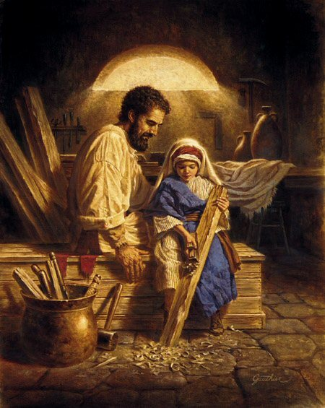
A Child's Service:
Luke 2:49-51
⁴⁹ And he said unto them, How is it that ye sought me? wist ye not that I must be about my Father's business?
⁵⁰ And they understood not the saying which he spake unto them.
⁵¹ And he went down with them, and came to Nazareth, and was subject unto them: but his mother kept all these sayings in her heart.

Slide 22
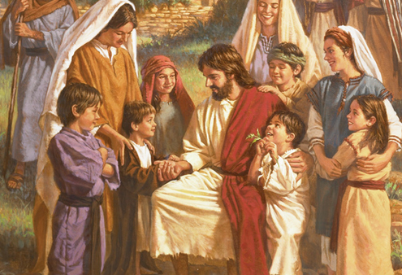
A Parent’s Service:

Slide 23
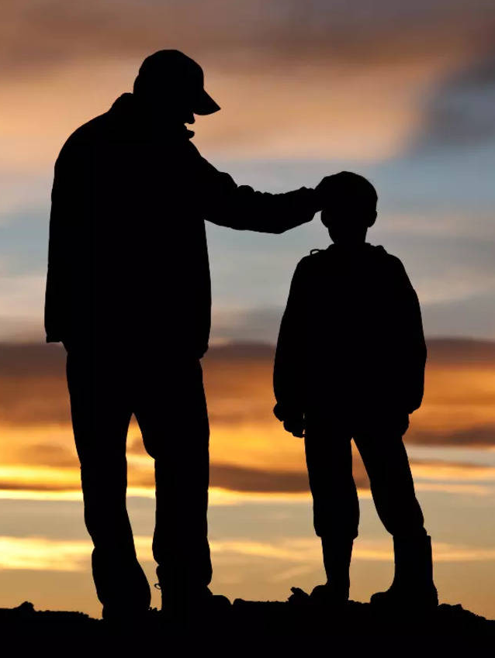
A Parent’s Service:
Ephesians 6:4
⁴ And, ye fathers, provoke not your children to wrath: but bring them up in the nurture and admonition of the Lord.

Slide 24
A Parent’s Service:
Ephesians 6:4
⁴ And, ye fathers, provoke not your children to wrath: but bring them up in the nurture and admonition of the Lord.
This advice is essential if the obedience required of the children is to rest on a moral basis. The parallel passage in Colossians gives the reason for this admonition: “Lest they be discouraged” (Col. 3:21). The present low ebb of parental authority sometimes springs from unjust, irritating, or even brutal demands made by parents on children, particularly the unwanted ones.

Slide 25
A Parent’s Service:
Ephesians 6:4
⁴ And, ye fathers, provoke not your children to wrath: but bring them up in the nurture and admonition of the Lord.
Too often children are considered as “disturbers of the peace” of the home, an annoyance. Another prolific cause of resentment among children is the capricious, inconsistent demands of some parents. Even if outward obedience is gained by violent means, it is at the expense of honor and respect.

Slide 26
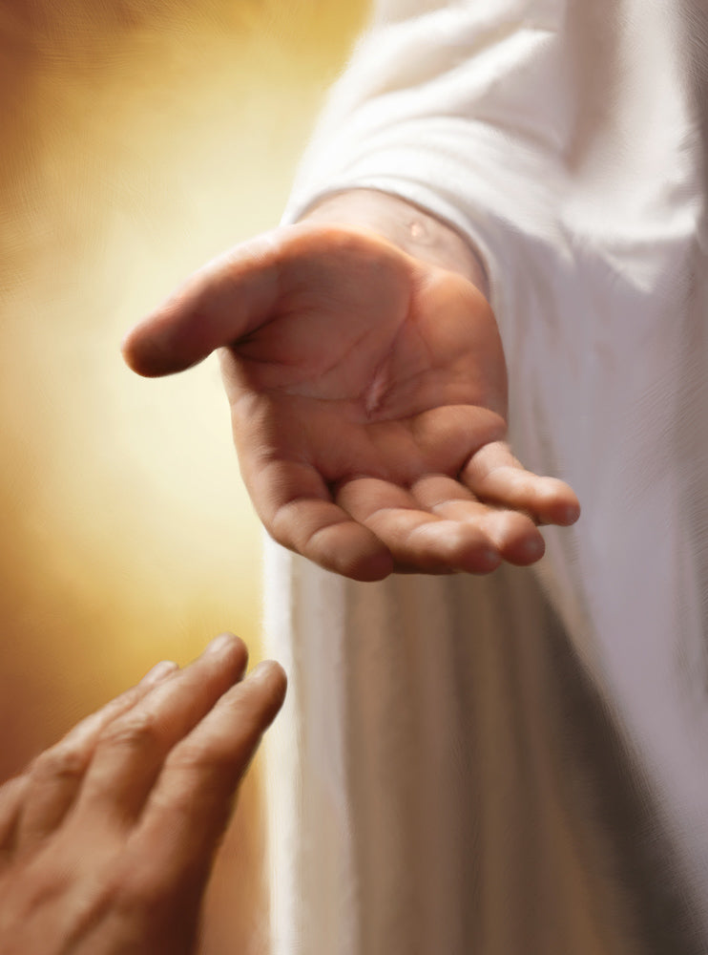
A Parent’s Service:
Child Guidance p. 262
The authority of the parents should be absolute, yet this power is not to be abused. In the control of his children the father should not be governed by caprice, but by the Bible standard. When he permits his own harsh traits of character to bear sway, he becomes a despot.

Slide 27
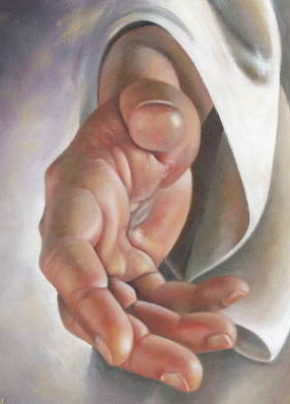
A Parent’s Service:
Child Guidance p. 263
“I am instructed to say to parents, Raise the standard of behavior in your own homes. Teach your children to obey. Rule them by the combined influence of affection and Christlike authority.”

Slide 28
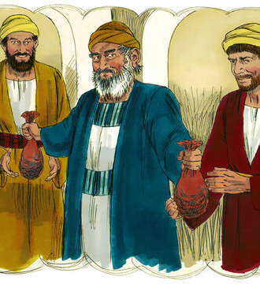
A Parent’s Service:
Luke 15:11-32
¹¹ And he said, A certain man had two sons:
¹² And the younger of them said to his father, Father, give me the portion of goods that falleth to me. And he divided unto them his living.

Slide 29
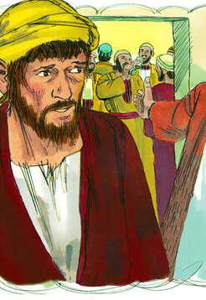
A Parent’s Service:
Luke 15:11-32
¹³ And not many days after the younger son gathered all together, and took his journey into a far country, and there wasted his substance with riotous living.
¹⁴ And when he had spent all, there arose a mighty famine in that land; and he began to be in want.

Slide 30
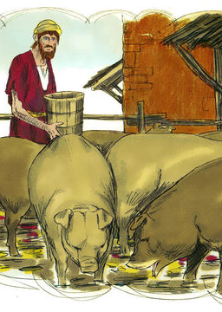
A Parent’s Service:
Luke 15:11-32
¹⁵ And he went and joined himself to a citizen of that country; and he sent him into his fields to feed swine.
¹⁶ And he would fain have filled his belly with the husks that the swine did eat: and no man gave unto him.

Slide 31
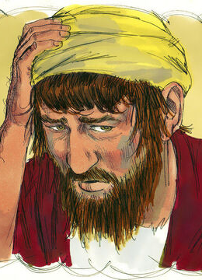
A Parent’s Service:
Luke 15:11-32
¹⁷ And when he came to himself, he said, How many hired servants of my father's have bread enough and to spare, and I perish with hunger!
¹⁸ I will arise and go to my father, and will say unto him, Father, I have sinned against heaven, and before thee,
¹⁹ And am no more worthy to be called thy son: make me as one of thy hired servants.

Slide 32
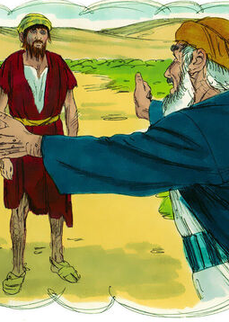
A Parent’s Service:
Luke 15:11-32
²⁰ And he arose, and came to his father. But when he was yet a great way off, his father saw him, and had compassion, and ran, and fell on his neck, and kissed him.
²¹ And the son said unto him, Father, I have sinned against heaven, and in thy sight, and am no more worthy to be called thy son.

Slide 33
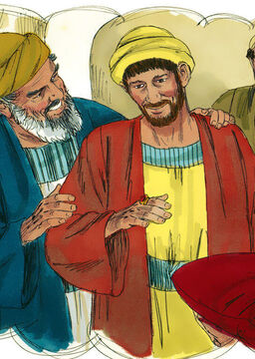
A Parent’s Service:
Luke 15:11-32
²² But the father said to his servants, Bring forth the best robe, and put it on him; and put a ring on his hand, and shoes on his feet:
²³ And bring hither the fatted calf, and kill it; and let us eat, and be merry:
²⁴ For this my son was dead, and is alive again; he was lost, and is found. And they began to be merry.

Slide 34
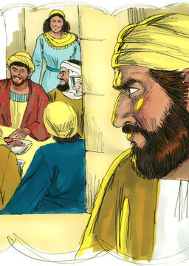
A Parent’s Service:
Luke 15:11-32
²⁵ Now his elder son was in the field: and as he came and drew nigh to the house, he heard musick and dancing.
²⁶ And he called one of the servants, and asked what these things meant.
²⁷ And he said unto him, Thy brother is come; and thy father hath killed the fatted calf, because he hath received him safe and sound.

Slide 35
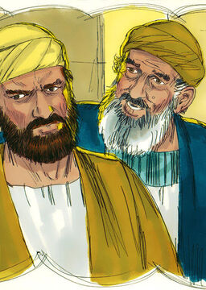
A Parent’s Service:
Luke 15:11-32
²⁸ And he was angry, and would not go in: therefore came his father out, and intreated him.
²⁹ And he answering said to his father, Lo, these many years do I serve thee, neither transgressed I at any time thy commandment: and yet thou never gavest me a kid, that I might make merry with my friends:

Slide 36
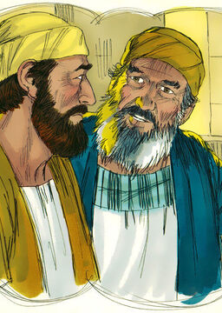
A Parent’s Service:
Luke 15:11-32
³⁰ But as soon as this thy son was come, which hath devoured thy living with harlots, thou hast killed for him the fatted calf.
³¹ And he said unto him, Son, thou art ever with me, and all that I have is thine.
³² It was meet that we should make merry, and be glad: for this thy brother was dead, and is alive again; and was lost, and is found.

Slide 37
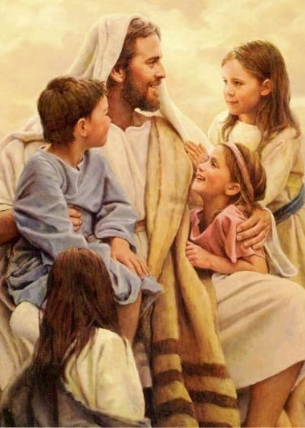
A Parent’s Service:
Mark 10:13-16
¹³ And they brought young children to him, that he should touch them: and his disciples rebuked those that brought them.
¹⁴ But when Jesus saw it, he was much displeased, and said unto them, Suffer the little children to come unto me, and forbid them not: for of such is the kingdom of God.

Slide 38
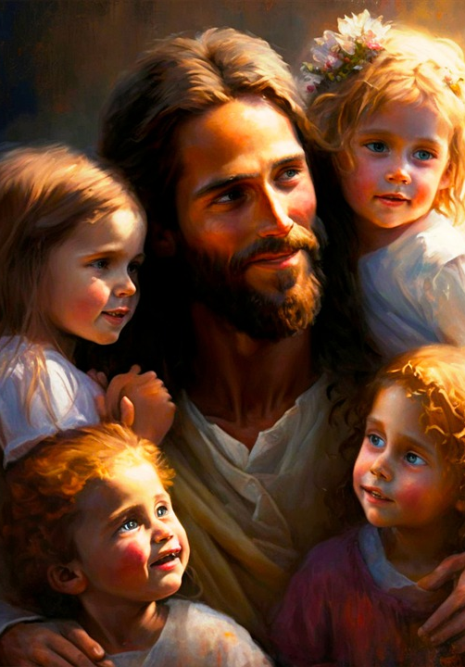
A Parent’s Service:
Mark 10:13-16
¹⁵ Verily I say unto you, Whosoever shall not receive the kingdom of God as a little child, he shall not enter therein.
¹⁶ And he took them up in his arms, put his hands upon them, and blessed them.

Slide 39
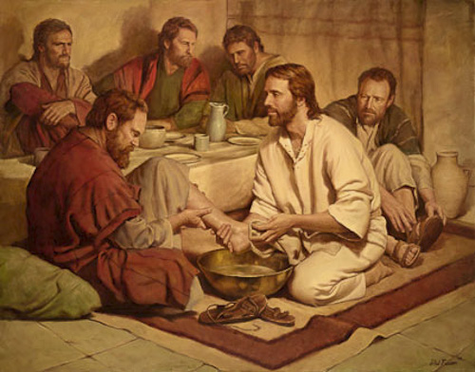
A Slave’s Service:

Slide 40
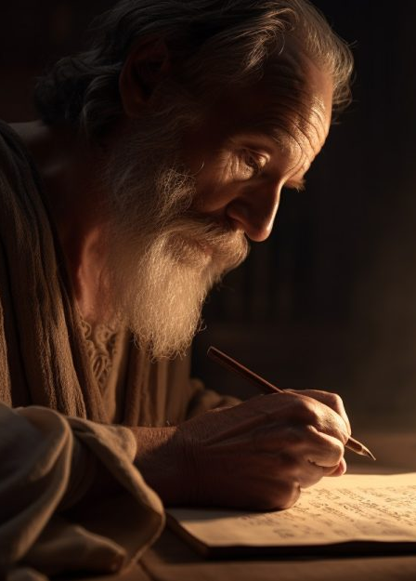
A Slave’s Service:
Ephesians 6:5-8
⁵ Servants, be obedient to them that are your masters according to the flesh, with fear and trembling, in singleness of your heart, as unto Christ;
⁶ Not with eyeservice, as menpleasers; but as the servants of Christ, doing the will of God from the heart;

Slide 41
A Slave’s Service:
Ephesians 6:5-8
⁵ Servants, be obedient to them that are your masters according to the flesh, with fear and trembling, in singleness of your heart, as unto Christ;
⁶ Not with eyeservice, as menpleasers; but as the servants of Christ, doing the will of God from the heart;
Paul uses the Greek word douloi, “slaves,” “bond servants.” Slavery was anciently practiced, not only by pagans, but also by Christians in the early Christian church. Nowhere in the Scriptures is this unnatural practice specifically condemned, but in both the OT and the NT principles are enunciated that would tend in time to eradicate it.

Slide 42
A Slave’s Service:
Ephesians 6:5-8
⁵ Servants, be obedient to them that are your masters according to the flesh, with fear and trembling, in singleness of your heart, as unto Christ;
⁶ Not with eyeservice, as menpleasers; but as the servants of Christ, doing the will of God from the heart;
By following Paul’s instruction on their relations with their masters, the large number of Christian slaves within the empire would have a powerful influence on the upper class, who were the slaveowners. Thus, in their own way, the vast number of slaves would form a mission body whose power would be felt throughout society. Inevitably, with slave and master truly brethren, a social and religious revolution would be under way.

Slide 43
A Slave’s Service:
Ephesians 6:5-8
⁵ Servants, be obedient to them that are your masters according to the flesh, with fear and trembling, in singleness of your heart, as unto Christ;
⁶ Not with eyeservice, as menpleasers; but as the servants of Christ, doing the will of God from the heart;
Servants were to look on the service to their masters as part of their service to Christ.

Slide 44
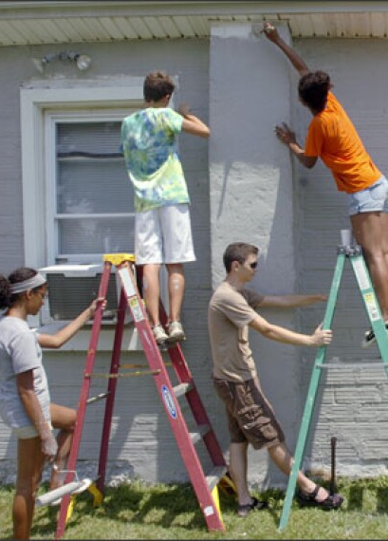
A Slave’s Service:
Ephesians 6:5-8
⁷ With good will doing service, as to the Lord, and not to men:
⁸ Knowing that whatsoever good thing any man doeth, the same shall he receive of the Lord, whether he be bond or free.

Slide 45
A Slave’s Service:
Ephesians 6:5-8
⁷ With good will doing service, as to the Lord, and not to men:
⁸ Knowing that whatsoever good thing any man doeth, the same shall he receive of the Lord, whether he be bond or free.
The servant who takes a sincere interest in the welfare of his master and his business has already escaped the weight of his burden and is approaching the status of a freeman. Indeed, a slave, when he is called into the service of the Lord, “is the Lord’s freeman”. Principles such as these, embedded in the gospel of Christ, eventually destroyed slavery, and, in the meantime, gave relief to Christian slaves throughout the centuries.

Slide 46
A Slave’s Service:
Ephesians 6:5-8
⁷ With good will doing service, as to the Lord, and not to men:
⁸ Knowing that whatsoever good thing any man doeth, the same shall he receive of the Lord, whether he be bond or free.
The conviction that one is led by God is a most powerful incentive to the contented life, as is the knowledge that one’s efforts are accepted by God. The martyr faced the stake in this confidence, and the slave bore patiently his grievous wrongs because of it. However, the martyr’s courage and the slave’s patience do not make right the wrongs of the persecutor and the master. They must answer to God for their wrongs.

Slide 47
A Slave’s Service:
SDABC on Romans 1:1
Paul frequently uses the term “doulos,” to express his relationship as a believer to Christ. The word involves the idea of belonging to a master and rendering bondman service to him. Paul recognized that Christians belong to Christ by purchase, and often applied the term doulos to believers. This is not a title of which we should be ashamed. We should gladly acknowledge that we are Christ’s purchased possession and surrender ourselves to His will. Such absolute service is true freedom, for the more we are bound by the authority of Christ, the more we are free from bondage to men.

Slide 48
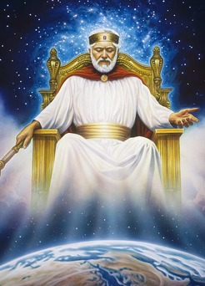
A Slave’s Service:
Ephesians 6:9
⁹ And, ye masters, do the same things unto them, forbearing threatening: knowing that your Master also is in heaven; neither is there respect of persons with him.

Slide 49
A Slave’s Service:
Ephesians 6:9
This is Paul’s version of the golden rule. Masters are to have the same spirit toward servants that he has been counseling the servants to have toward masters; and no master could ever complain that Paul’s advice to servants would encourage rebellion. The apostle has insisted that servants act conscientiously and with fidelity, knowing that the eye of God was upon them; masters should do the same. The interest of their servants would be paramount in their minds, and in treating them rightly they would be serving God also.
⁹ And, ye masters, do the same things unto them, forbearing threatening: knowing that your Master also is in heaven; neither is there respect of persons with him.

Slide 50
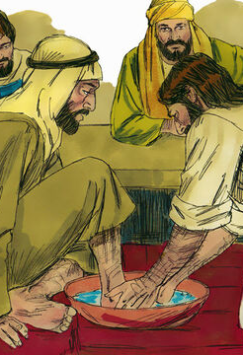
A Slave’s Service:
John 13:3-17
³ Jesus knowing that the Father had given all things into his hands, and that he was come from God, and went to God;
⁴ He riseth from supper, and laid aside his garments; and took a towel, and girded himself.
⁵ After that he poureth water into a bason, and began to wash the disciples' feet, and to wipe them with the towel wherewith he was girded.

Slide 51
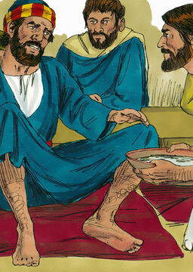
A Slave’s Service:
John 13:3-17
⁶ Then cometh he to Simon Peter: and Peter saith unto him, Lord, dost thou wash my feet?
⁷ Jesus answered and said unto him, What I do thou knowest not now; but thou shalt know hereafter.
⁸ Peter saith unto him, Thou shalt never wash my feet. Jesus answered him, If I wash thee not, thou hast no part with me.

Slide 52
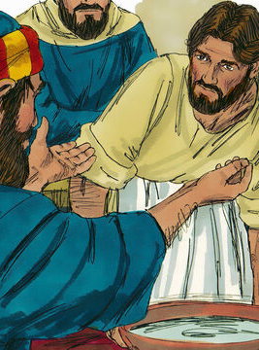
A Slave’s Service:
John 13:3-17
⁹ Simon Peter saith unto him, Lord, not my feet only, but also my hands and my head.
¹⁰ Jesus saith to him, He that is washed needeth not save to wash his feet, but is clean every whit: and ye are clean, but not all.
¹¹ For he knew who should betray him; therefore said he, Ye are not all clean.

Slide 53
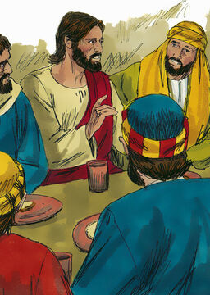
A Slave’s Service:
John 13:3-17
¹² So after he had washed their feet, and had taken his garments, and was set down again, he said unto them, Know ye what I have done to you?
¹³ Ye call me Master and Lord: and ye say well; for so I am.
¹⁴ If I then, your Lord and Master, have washed your feet; ye also ought to wash one another's feet.

Slide 54
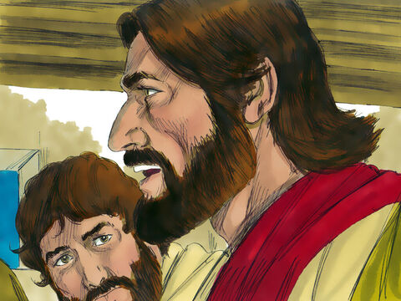
A Slave’s Service:
John 13:3-17
¹⁵ For I have given you an example, that ye should do as I have done to you.
¹⁶ Verily, verily, I say unto you, The servant is not greater than his lord; neither he that is sent greater than he that sent him.
¹⁷ If ye know these things, happy are ye if ye do them.

Slide 55

A Slave’s Service:
1 Peter 2:13-25
¹³ Submit yourselves to every ordinance of man for the Lord's sake: whether it be to the king, as supreme;
¹⁴ Or unto governors, as unto them that are sent by him for the punishment of evildoers, and for the praise of them that do well.

Slide 56
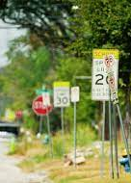
A Slave’s Service:
1 Peter 2:13-25
¹⁵ For so is the will of God, that with well doing ye may put to silence the ignorance of foolish men:
¹⁶ As free, and not using your liberty for a cloke of maliciousness, but as the servants of God.
¹⁷ Honour all men. Love the brotherhood. Fear God. Honour the king.

Slide 57
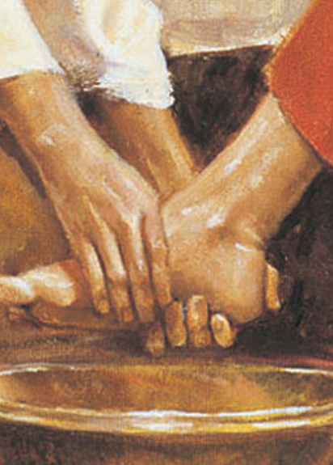
A Slave’s Service:
1 Peter 2:13-25
¹⁸ Servants, be subject to your masters with all fear; not only to the good and gentle, but also to the froward.
¹⁹ For this is thankworthy, if a man for conscience toward God endure grief, suffering wrongfully.

Slide 58
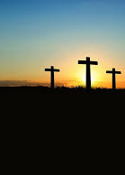
A Slave’s Service:
1 Peter 2:13-25
²⁰ For what glory is it, if, when ye be buffeted for your faults, ye shall take it patiently? but if, when ye do well, and suffer for it, ye take it patiently, this is acceptable with God.
²¹ For even hereunto were ye called: because Christ also suffered for us, leaving us an example, that ye should follow his steps:

Slide 59
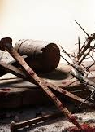
A Slave’s Service:
1 Peter 2:13-25
²² Who did no sin, neither was guile found in his mouth:
²³ Who, when he was reviled, reviled not again; when he suffered, he threatened not; but committed himself to him that judgeth righteously:

Slide 60
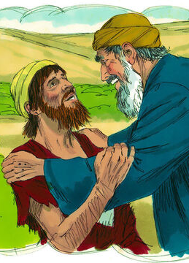
A Slave’s Service:
1 Peter 2:13-25
²⁴ Who his own self bare our sins in his own body on the tree, that we, being dead to sins, should live unto righteousness: by whose stripes ye were healed.
²⁵ For ye were as sheep going astray; but are now returned unto the Shepherd and Bishop of your souls.

Slide 61
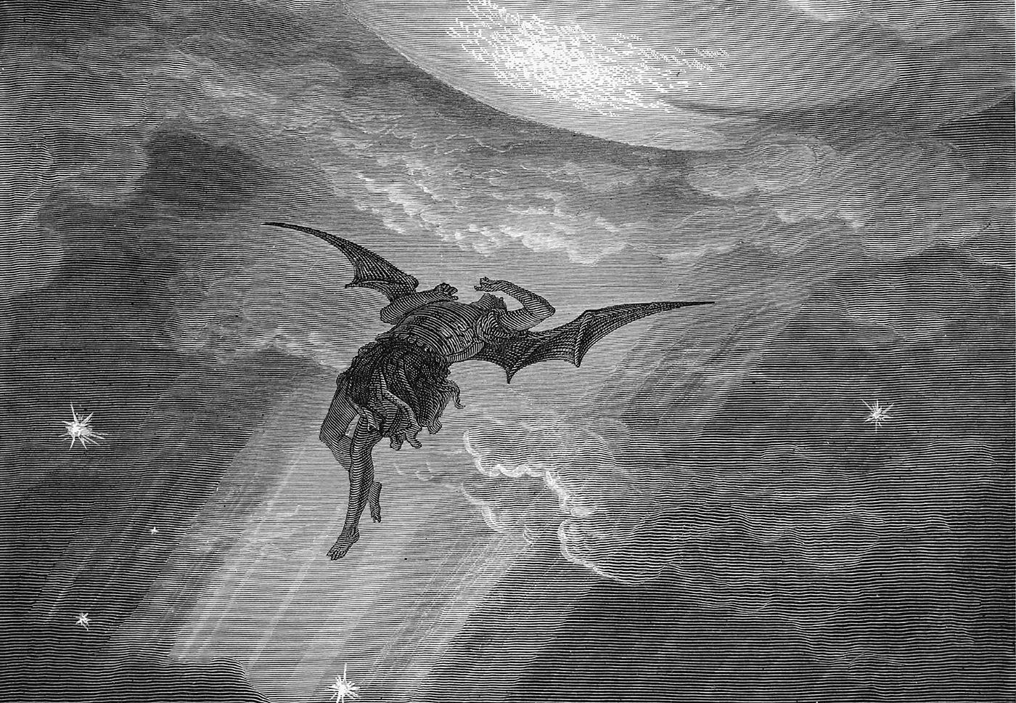
A Counter-Example:

Slide 62
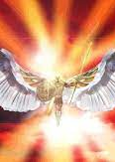
A Counter-Example:
Ezekiel 28:13-15
¹³ Thou hast been in Eden the garden of God; every precious stone was thy covering, the sardius, topaz, and the diamond, the beryl, the onyx, and the jasper, the sapphire, the emerald, and the carbuncle, and gold: the workmanship of thy tabrets and of thy pipes was prepared in thee in the day that thou wast created.

Slide 63
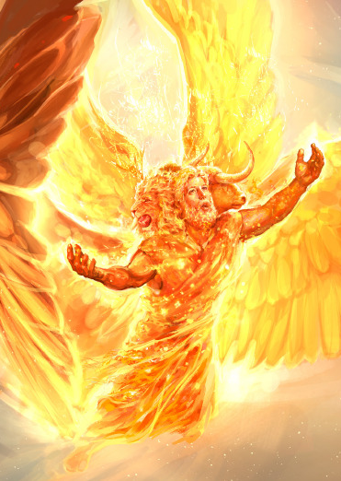
A Counter-Example:
Ezekiel 28:13-15
¹⁴ Thou art the anointed cherub that covereth; and I have set thee so: thou wast upon the holy mountain of God; thou hast walked up and down in the midst of the stones of fire.
¹⁵ Thou wast perfect in thy ways from the day that thou wast created, till iniquity was found in thee.

Slide 64
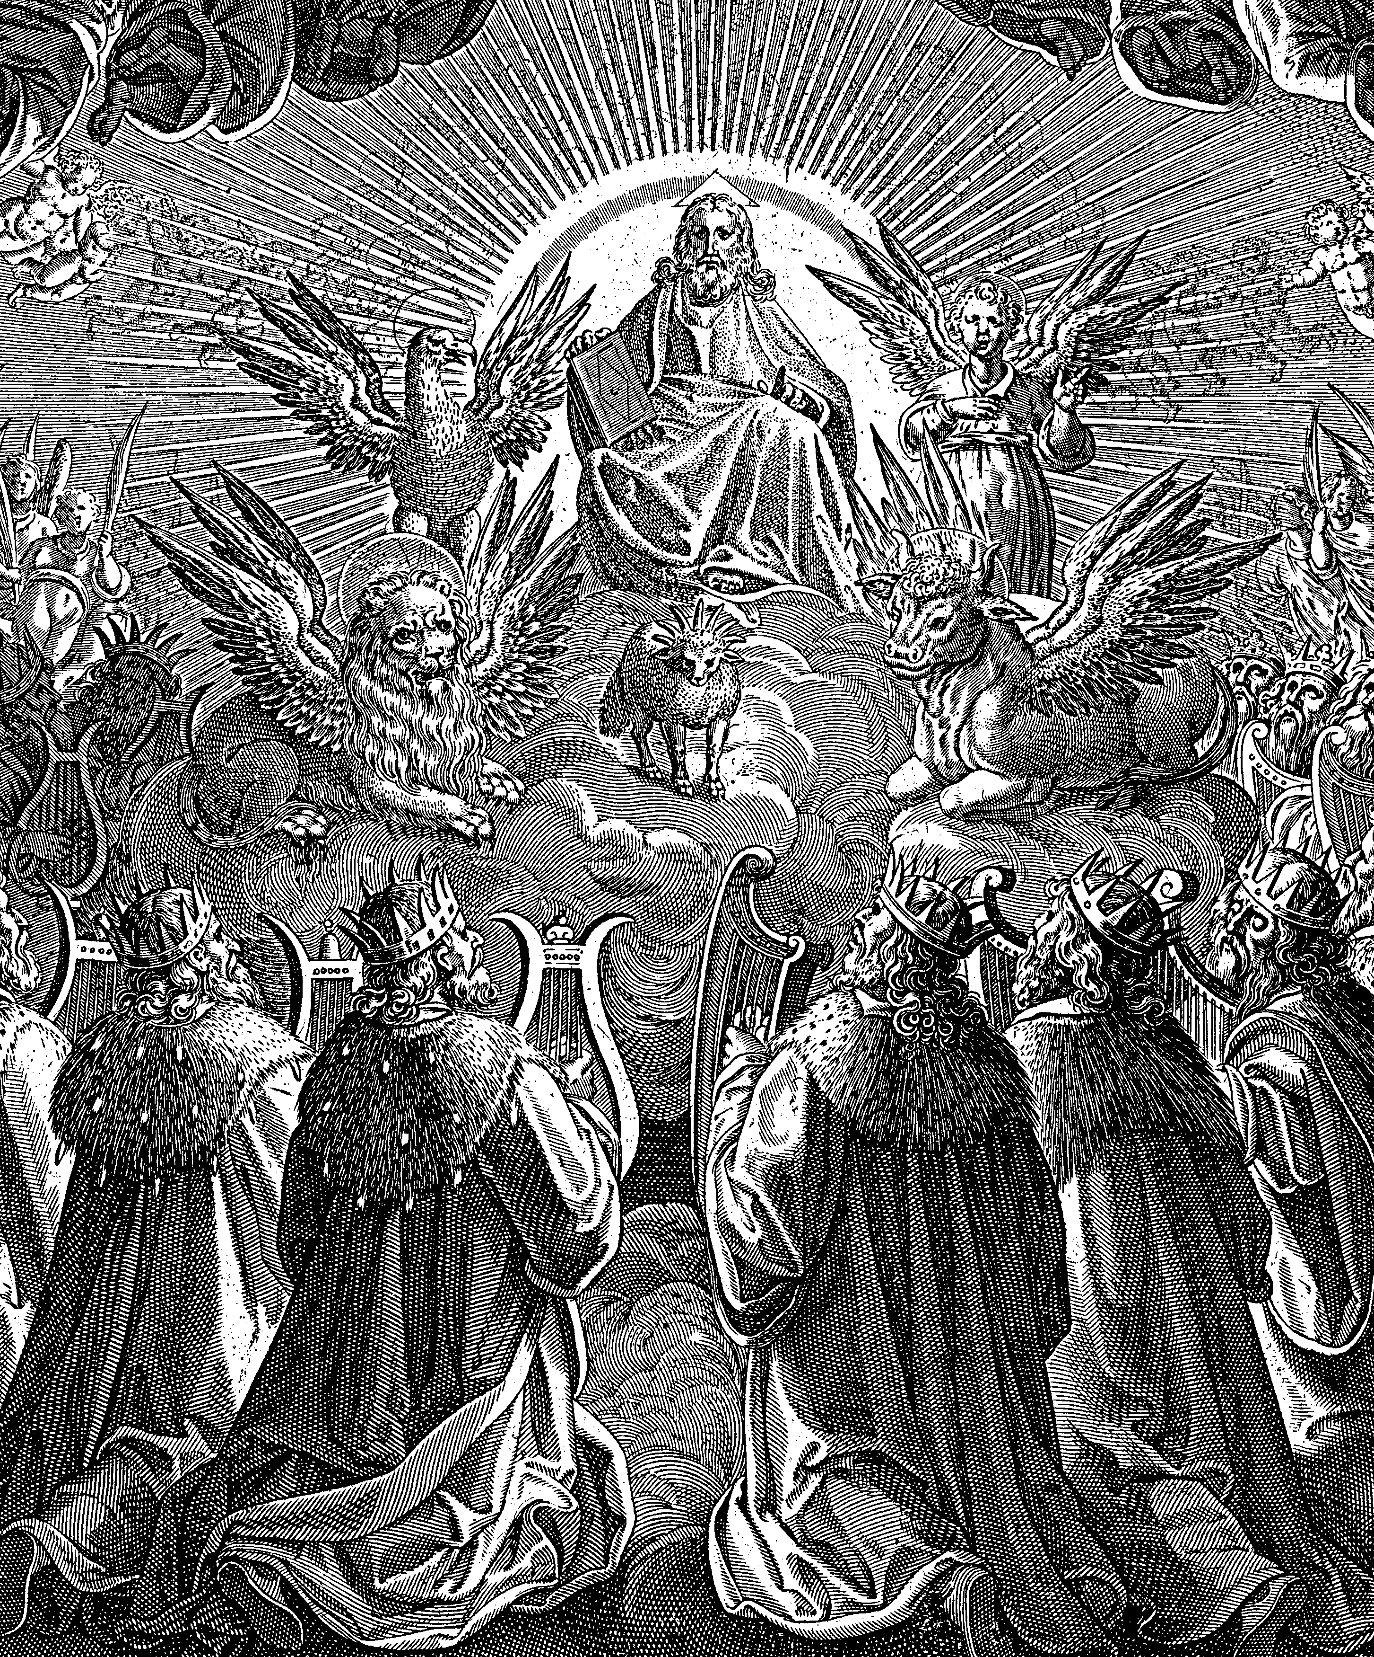
A Counter-Example:
The Great Controversy p. 494
Lucifer might have remained in favor with God, beloved and honored by all the angelic host, exercising his noble powers to bless others and to glorify his Maker. But, says the prophet, “Thine heart was lifted up because of thy beauty, thou hast corrupted thy wisdom by reason of thy brightness.” Verse 17.

Slide 65
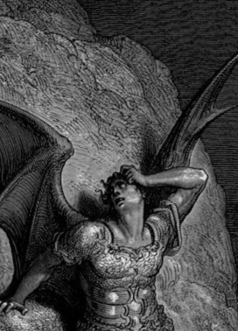
A Counter-Example:
The Great Controversy p. 494
Little by little, Lucifer came to indulge a desire for self-exaltation. “Thou hast set thine heart as the heart of God.” “Thou hast said, ... I will exalt my throne above the stars of God: I will sit also upon the mount of the congregation....I will ascend above the heights of the clouds; I will be like the Most High.” Verse 6; Isaiah 14:13, 14.

Slide 66
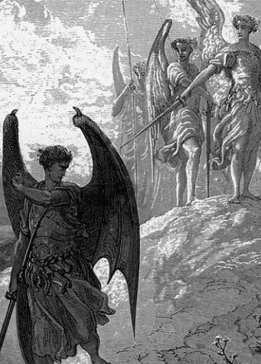
A Counter-Example:
The Great Controversy p. 494
Instead of seeking to make God supreme in the affections and allegiance of His creatures, it was Lucifer's endeavor to win their service and homage to himself. And coveting the honor which the infinite Father had bestowed upon His Son, this prince of angels aspired to power which it was the prerogative of Christ alone to wield.

Slide 67

A Counter-Example:
The Great Controversy p. 495
Pride in his own glory nourished the desire for supremacy. The high honors conferred upon Lucifer were not appreciated as the gift of God and called forth no gratitude to the Creator. He gloried in his brightness and exaltation, and aspired to be equal with God. He was beloved and reverenced by the heavenly host. Angels delighted to execute his commands, and he was clothed with wisdom and glory above them all.

Slide 68
A Counter-Example:
The Great Controversy p. 495
Yet the Son of God was the acknowledged Sovereign of heaven, one in power and authority with the Father. In all the counsels of God, Christ was a participant, while Lucifer was not permitted thus to enter into the divine purposes. “Why,” questioned this mighty angel, “should Christ have the supremacy? Why is He thus honored above Lucifer?”

Slide 69

Our Example:

Slide 70
A Counter-Example:
Satan is obsessed with his own status, specifically with raising his status above Jesus.
Jesus willingly gave up His position in Heaven to come and die for ungrateful humanity.

Slide 71

Our Example:
Isaiah 53:1-12
53 Who hath believed our report? and to whom is the arm of the Lord revealed?
² For he shall grow up before him as a tender plant, and as a root out of a dry ground: he hath no form nor comeliness; and when we shall see him, there is no beauty that we should desire him.

Slide 72

Our Example:
Isaiah 53:1-12
³ He is despised and rejected of men; a man of sorrows, and acquainted with grief: and we hid as it were our faces from him; he was despised, and we esteemed him not.
⁴ Surely he hath borne our griefs, and carried our sorrows: yet we did esteem him stricken, smitten of God, and afflicted.

Slide 73

Our Example:
Isaiah 53:1-12
⁵ But he was wounded for our transgressions, he was bruised for our iniquities: the chastisement of our peace was upon him; and with his stripes we are healed.
⁶ All we like sheep have gone astray; we have turned every one to his own way; and the Lord hath laid on him the iniquity of us all.

Slide 74

Our Example:
Isaiah 53:1-12
⁷ He was oppressed, and he was afflicted, yet he opened not his mouth: he is brought as a lamb to the slaughter, and as a sheep before her shearers is dumb, so he openeth not his mouth.
⁸ He was taken from prison and from judgment: and who shall declare his generation? for he was cut off out of the land of the living: for the transgression of my people was he stricken.

Slide 75

Our Example:
Isaiah 53:1-12
⁹ And he made his grave with the wicked, and with the rich in his death; because he had done no violence, neither was any deceit in his mouth.
¹⁰ Yet it pleased the Lord to bruise him; he hath put him to grief: when thou shalt make his soul an offering for sin, he shall see his seed, he shall prolong his days, and the pleasure of the Lord shall prosper in his hand.

Slide 76

Our Example:
Isaiah 53:1-12
¹¹ He shall see of the travail of his soul, and shall be satisfied: by his knowledge shall my righteous servant justify many; for he shall bear their iniquities.

Slide 77

Our Example:
Isaiah 53:1-12
¹² Therefore will I divide him a portion with the great, and he shall divide the spoil with the strong; because he hath poured out his soul unto death: and he was numbered with the transgressors; and he bare the sin of many, and made intercession for the transgressors.

Slide 78

Serving OUR master:

Slide 79

Serving our Master:
Colossians 3:17-25
¹⁷ And whatsoever ye do in word or deed, do all in the name of the Lord Jesus, giving thanks to God and the Father by him.
¹⁸ Wives, submit yourselves unto your own husbands, as it is fit in the Lord.
¹⁹ Husbands, love your wives, and be not bitter against them.

Slide 80

Serving our Master:
Colossians 3:17-25
²⁰ Children, obey your parents in all things: for this is well pleasing unto the Lord.
²¹ Fathers, provoke not your children to anger, lest they be discouraged.
²² Servants, obey in all things your masters according to the flesh; not with eyeservice, as menpleasers; but in singleness of heart, fearing God;

Slide 81

Serving our Master:
Colossians 3:17-25
²³ And whatsoever ye do, do it heartily, as to the Lord, and not unto men;
²⁴ Knowing that of the Lord ye shall receive the reward of the inheritance: for ye serve the Lord Christ.
²⁵ But he that doeth wrong shall receive for the wrong which he hath done: and there is no respect of persons.

Slide 82

Serving our Master:
Matthew 5:43-48
⁴³ Ye have heard that it hath been said, Thou shalt love thy neighbour, and hate thine enemy.
⁴⁴ But I say unto you, Love your enemies, bless them that curse you, do good to them that hate you, and pray for them which despitefully use you, and persecute you;

Slide 83

Serving our Master:
Matthew 5:43-48
⁴⁵ That ye may be the children of your Father which is in heaven: for he maketh his sun to rise on the evil and on the good, and sendeth rain on the just and on the unjust.
⁴⁶ For if ye love them which love you, what reward have ye? do not even the publicans the same?

Slide 84

Serving our Master:
Matthew 5:43-48
⁴⁷ And if ye salute your brethren only, what do ye more than others? do not even the publicans so?
⁴⁸ Be ye therefore perfect, even as your Father which is in heaven is perfect.

Slide 85

Which Master are we serving?

Slide 86
Take a few moments to prepare for Sabbath school next week!
We’ll be looking at the second part of Ephesians 6,
That is, Ephesians 6:10-20

Slide 87
Thank you!
And Happy Sabbath!!

