Slide 1

The Call to Stand
Lesson 12, 3rd Quarter 2023
Ephesians 6:10-20

Slide 2
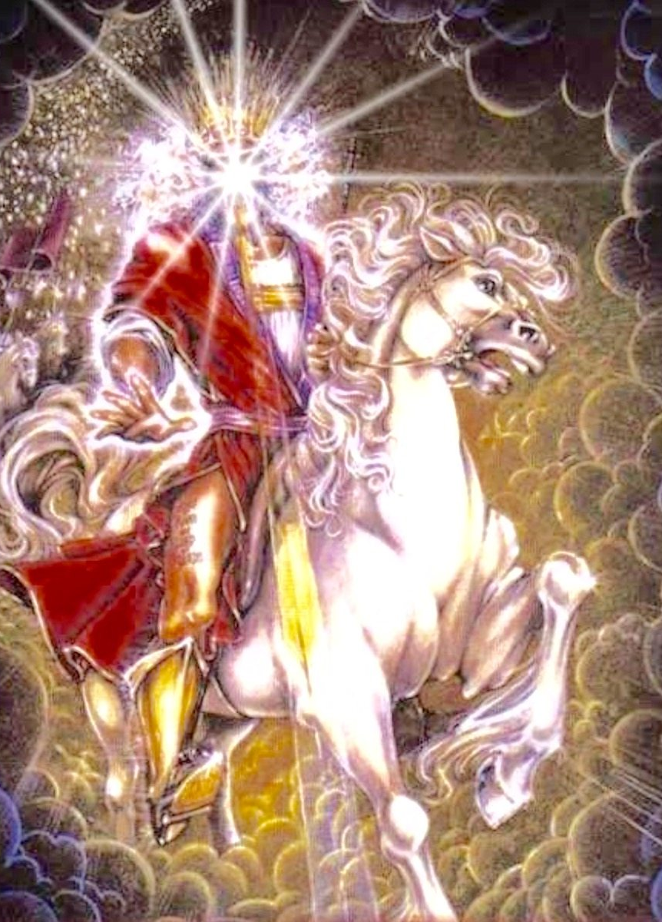
Memory Text:
Ephesians 6:9
¹⁰ Finally, my brethren, be strong in the Lord, and in the power of his might.

Slide 3

Ephesians So Far:
Paul and the Ephesians
Eph. 1:1-14—Prayer of Gratitude for God’s Grace
Eph. 1:15-23—Gratitude and Joy in Christ
Eph. 2:1-10—Quickened by God’s Grace
Eph. 2:11-22—One Body by the Cross
Eph. 3—A Prisoner of Christ
Eph. 4:1-16—One Accord
Eph. 4:17-32—Transformation
Eph. 5:1-20—Followers of God
Eph. 5:21-33—Love as Christ Loved the Church
Eph. 6:1-9—Service
Eph. 6:10-20—A Call to Arms

Slide 4
Key Ideas: Outlining Ephesians
Opening Greeting (Eph. 1:1, 2)
Part 1: The Doctrinal Section (Eph. 1:3-3:21)
Part 2: The Practical Section (Eph. 4:1-6:20)
Closing Greeting (Ephesians 6:21-24)

Slide 5
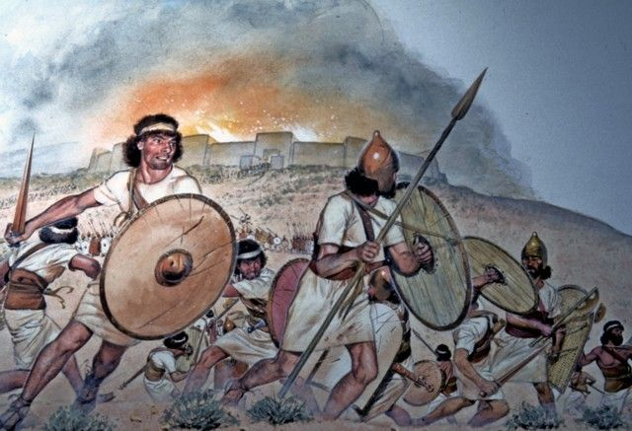
A Battle Cry:

Slide 6
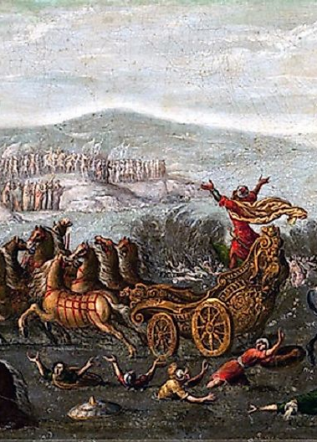
A Battle Cry:
Deuteronomy 20:1-4
The Canaanites had large numbers of chariots (Joshua 11 :4; Judges 4:3). The army of Israel was composed of infantrymen; they never lost their fear of armed chariots (Joshua 17:16; Judges 1:19; 1 Sam. 13:5, 6). Notuntil David’s time did they have chariots of their own (2 Sam. 8:4).

Slide 7
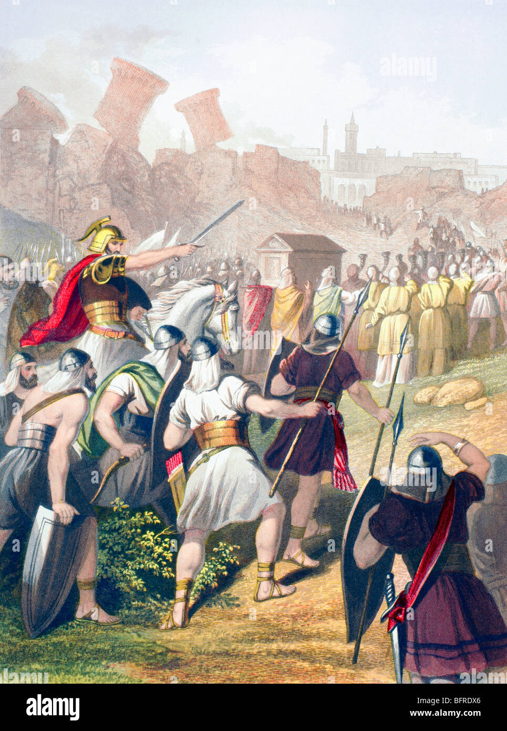
A Battle Cry
Deuteronomy 20:1-4
20 When thou goest out to battle against thine enemies, and seest horses, and chariots, and a people more than thou, be not afraid of them: for the Lord thy God is with thee, which brought thee up out of the land of Egypt.
² And it shall be, when ye are come nigh unto the battle, that the priest shall approach and speak unto the people,

Slide 8
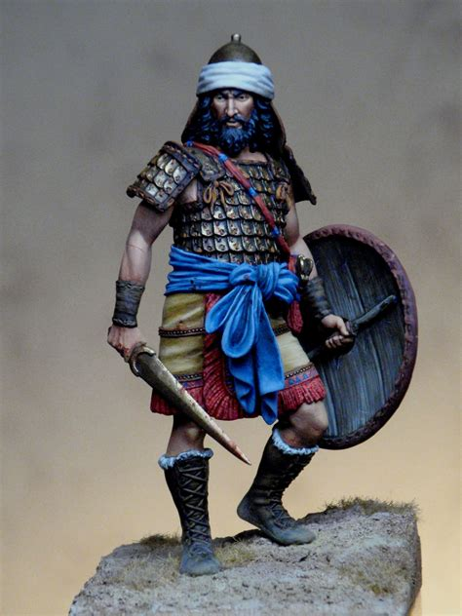
A Battle Cry
Deuteronomy 20:3-4
³ And shall say unto them, Hear, O Israel, ye approach this day unto battle against your enemies: let not your hearts faint, fear not, and do not tremble, neither be ye terrified because of them;
⁴ For the Lord your God is he that goeth with you, to fight for you against your enemies, to save you.

Slide 9
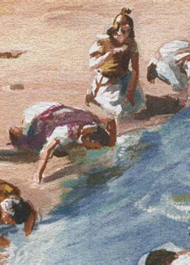
A Battle Cry:
Judges 7:15-18
Gideon’s faith must have been severely tested when the Lord told him that those who were with him were too Many of the men had enlisted because of the stirring appeals of Gideon, but in their hearts they were fearful and unbelieving. Lest they flee when the battle began, or take the glory of victory to themselves, the Lord asked that they be sent back. The two thirds who left constitute a sad commentary on the extent to which idolatry had destroyed Israel’s faith in God.

Slide 10
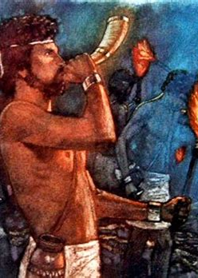
A Battle Cry
Judges 7:15-18
¹⁵ And it was so, when Gideon heard the telling of the dream, and the interpretation thereof, that he worshipped, and returned into the host of Israel, and said, Arise; for the Lord hath delivered into your hand the host of Midian.
¹⁶ And he divided the three hundred men into three companies, and he put a trumpet in every man's hand, with empty pitchers, and lamps within the pitchers.

Slide 11
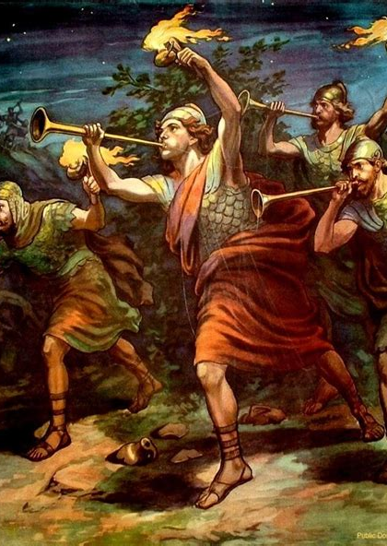
A Battle Cry
Judges 7:17-18
¹⁷ And he said unto them, Look on me, and do likewise: and, behold, when I come to the outside of the camp, it shall be that, as I do, so shall ye do.
¹⁸ When I blow with a trumpet, I and all that are with me, then blow ye the trumpets also on every side of all the camp, and say, The sword of the Lord, and of Gideon.

Slide 12
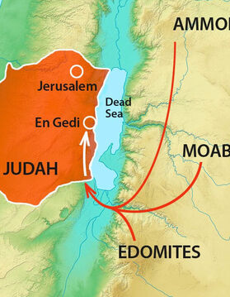
A Battle Cry:
2 Chronicles 20:1-18
It is not wrong to fear when face to face with danger, but it is wrong to succumb to fear. Strong and courageous men are often afraid, but in spite of their fears they go forward to do resolute deeds. Jehoshaphat had for years been building up the strength of his nation by equipping armies and fortifying cities. But at this time of crisis he placed his trust, not in men, but in God.

Slide 13
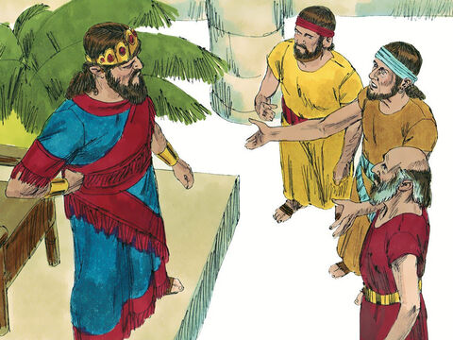
A Battle Cry
2 Chronicles 20:1-18
20 It came to pass after this also, that the children of Moab, and the children of Ammon, and with them other beside the Ammonites, came against Jehoshaphat to battle.
² Then there came some that told Jehoshaphat, saying, There cometh a great multitude against thee from beyond the sea on this side Syria; and, behold, they be in Hazazontamar, which is Engedi.

Slide 14
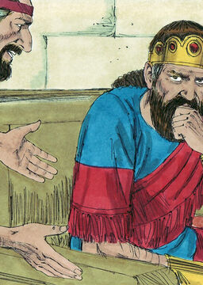
A Battle Cry
2 Chronicles 20:3-18
³ And Jehoshaphat feared, and set himself to seek the Lord, and proclaimed a fast throughout all Judah.
⁴ And Judah gathered themselves together, to ask help of the Lord: even out of all the cities of Judah they came to seek the Lord.

Slide 15
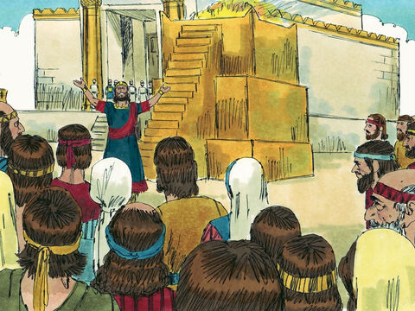
A Battle Cry
2 Chronicles 20:5-18
⁵ And Jehoshaphat stood in the congregation of Judah and Jerusalem, in the house of the Lord, before the new court,
⁶ And said, O Lord God of our fathers, art not thou God in heaven? and rulest not thou over all the kingdoms of the heathen? and in thine hand is there not power and might, so that none is able to withstand thee?

Slide 16
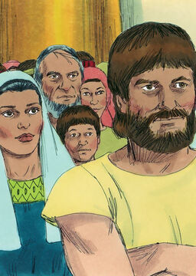
A Battle Cry
2 Chronicles 20:7-18
⁷ Art not thou our God, who didst drive out the inhabitants of this land before thy people Israel, and gavest it to the seed of Abraham thy friend for ever?
⁸ And they dwelt therein, and have built thee a sanctuary therein for thy name, saying,

Slide 17
A Battle Cry
2 Chronicles 20:9-18
⁹ If, when evil cometh upon us, as the sword, judgment, or pestilence, or famine, we stand before this house, and in thy presence, (for thy name is in this house,) and cry unto thee in our affliction, then thou wilt hear and help.
¹⁰ And now, behold, the children of Ammon and Moab and mount Seir, whom thou wouldest not let Israel invade, when they came out of the land of Egypt, but they turned from them, and destroyed them not;

Slide 18
A Battle Cry
2 Chronicles 20:11-18
¹¹ Behold, I say, how they reward us, to come to cast us out of thy possession, which thou hast given us to inherit.
¹² O our God, wilt thou not judge them? for we have no might against this great company that cometh against us; neither know we what to do: but our eyes are upon thee.

Slide 19
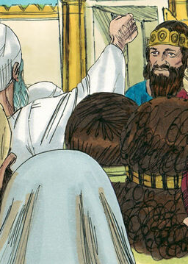
A Battle Cry
2 Chronicles 20:13-18
¹³ And all Judah stood before the Lord, with their little ones, their wives, and their children.
¹⁴ Then upon Jahaziel the son of Zechariah, the son of Benaiah, the son of Jeiel, the son of Mattaniah, a Levite of the sons of Asaph, came the Spirit of the Lord in the midst of the congregation;

Slide 20
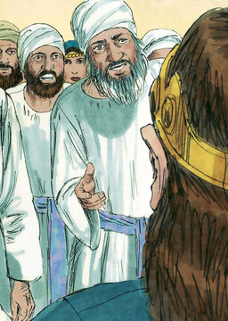
A Battle Cry
2 Chronicles 20:15-18
¹⁵ And he said, Hearken ye, all Judah, and ye inhabitants of Jerusalem, and thou king Jehoshaphat, Thus saith the Lord unto you, Be not afraid nor dismayed by reason of this great multitude; for the battle is not yours, but God's.
¹⁶ To morrow go ye down against them: behold, they come up by the cliff of Ziz; and ye shall find them at the end of the brook, before the wilderness of Jeruel.

Slide 21
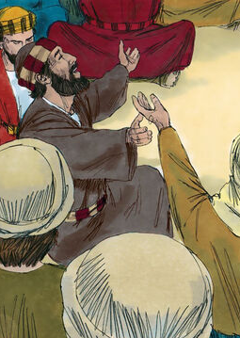
A Battle Cry
2 Chronicles 20:17-18
¹⁷ Ye shall not need to fight in this battle: set yourselves, stand ye still, and see the salvation of the Lord with you, O Judah and Jerusalem: fear not, nor be dismayed; to morrow go out against them: for the Lord will be with you.
¹⁸ And Jehoshaphat bowed his head with his face to the ground: and all Judah and the inhabitants of Jerusalem fell before the Lord, worshipping the Lord.

Slide 22
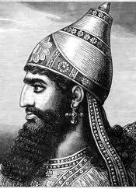
A Battle Cry:
2 Chronicles 32:1-8
Sennacherib largely succeeded in winning the fenced cities of Judah for himself. In his annals he claims to have taken 46 of the fenced, or walled, cities of Judah and to have carried away captive 200,150 people, besides a large amount of booty. This campaign was in the 14th year of Hezekiah’s sole reign. The year was 701 B.C., according to the generally accepted dating of Sennacherib’s record.

Slide 23
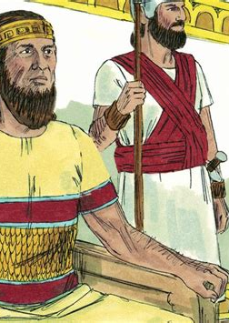
A Battle Cry
2 Chronicles 32:1-8
32 After these things, and the establishment thereof, Sennacherib king of Assyria came, and entered into Judah, and encamped against the fenced cities, and thought to win them for himself.
² And when Hezekiah saw that Sennacherib was come, and that he was purposed to fight against Jerusalem,

Slide 24
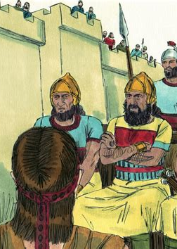
A Battle Cry
2 Chronicles 32:3-8
³ He took counsel with his princes and his mighty men to stop the waters of the fountains which were without the city: and they did help him.
⁴ So there was gathered much people together, who stopped all the fountains, and the brook that ran through the midst of the land, saying, Why should the kings of Assyria come, and find much water?

Slide 25
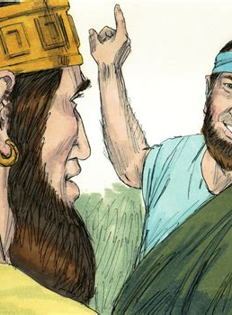
A Battle Cry
2 Chronicles 32:5-8
⁵ Also he strengthened himself, and built up all the wall that was broken, and raised it up to the towers, and another wall without, and repaired Millo in the city of David, and made darts and shields in abundance.
⁶ And he set captains of war over the people, and gathered them together to him in the street of the gate of the city, and spake comfortably to them, saying,

Slide 26
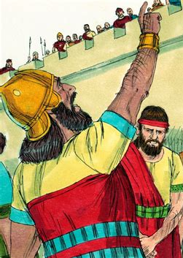
A Battle Cry
2 Chronicles 32:7-8
⁷ Be strong and courageous, be not afraid nor dismayed for the king of Assyria, nor for all the multitude that is with him: for there be more with us than with him:
⁸ With him is an arm of flesh; but with us is the Lord our God to help us, and to fight our battles. And the people rested themselves upon the words of Hezekiah king of Judah.

Slide 27
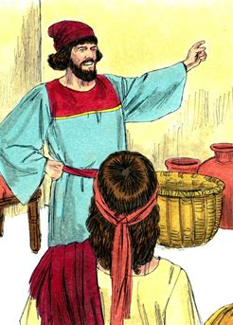
A Battle Cry:
Nehemiah 4:14, 19-20
The ostentatious movement of the enemy forces and the rumors of impending attack that they purposely circulated frightened the Jews living in the border regions of Judea to flee to Jerusalem for safety. They brought the alarming report that their enemies were about to attack from all sides.

Slide 28
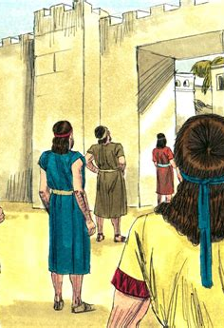
A Battle Cry
Nehemiah 4:14, 19-21
⁹ And I said unto the nobles, and to the rulers, and to the rest of the people, The work is great and large, and we are separated upon the wall, one far from another.
²⁰ In what place therefore ye hear the sound of the trumpet, resort ye thither unto us: our God shall fight for us.
²¹ So we laboured in the work: and half of them held the spears from the rising of the morning till the stars appeared.

Slide 29
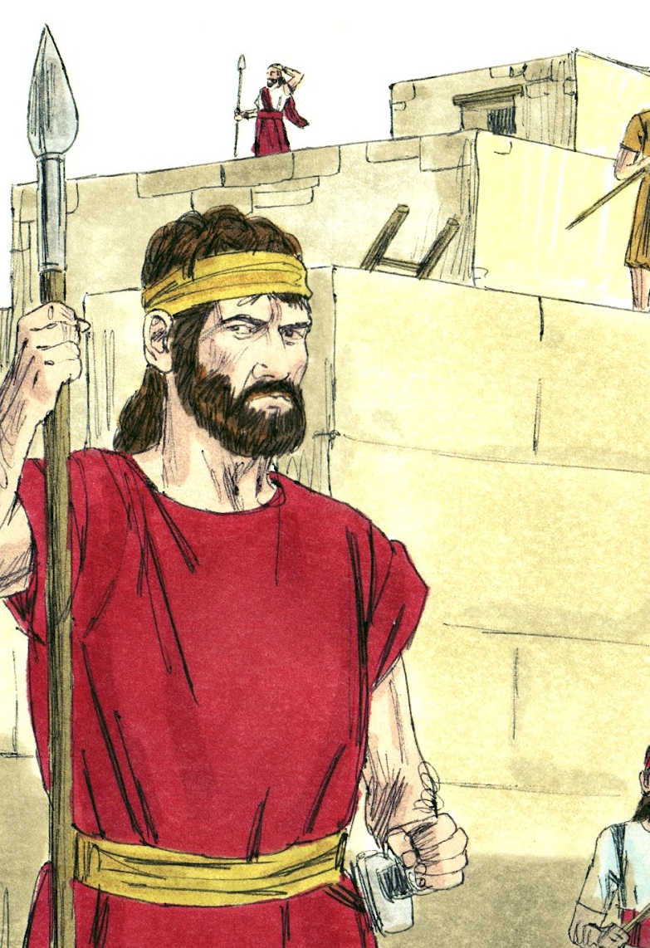
A Battle Cry
Nehemiah 4:14, 19-21
¹⁴ And I looked, and rose up, and said unto the nobles, and to the rulers, and to the rest of the people, Be not ye afraid of them: remember the Lord, which is great and terrible, and fight for your brethren, your sons, and your daughters, your wives, and your houses.

Slide 30
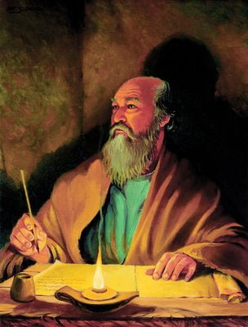
A Battle Cry:
Ephesians 6:10-13
Paul is bringing his epistle to a conclusion. He has stated the theological and spiritual basis for unity of all men, and has given instruction concerning the practical outworking of this unity in church relationships, the family, and society. Now he is about to answer the question that naturally arises as to the possibility of living up to such a profession. How can one attain to these virtues?

Slide 31
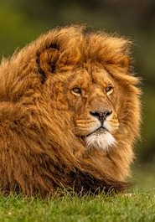
A Battle Cry
Ephesians 6:10-13
¹⁰ Finally, my brethren, be strong in the Lord, and in the power of his might.
¹¹ Put on the whole armour of God, that ye may be able to stand against the wiles of the devil.

Slide 32
A Battle Cry
Ephesians 6:10-13
A half-armed soldier may well pay for his rashness. He goes out with a false sense of security, and the enemy is sure to seek out his unprotected parts. The Christian is vulnerable at many spots, and often that characteristic he thinks is his strongest turns out, under temptation, to be his weakest. As a chain is no stronger than its weakest link, so the Christian is no stronger than his weakest element of character. In view of the variety of foes that must be met and the various weaknesses of the flesh, nothing less than the entire armor will suffice.
¹⁰ Finally, my brethren, be strong in the Lord, and in the power of his might.
¹¹ Put on the whole armour of God, that ye may be able to stand against the wiles of the devil.

Slide 33
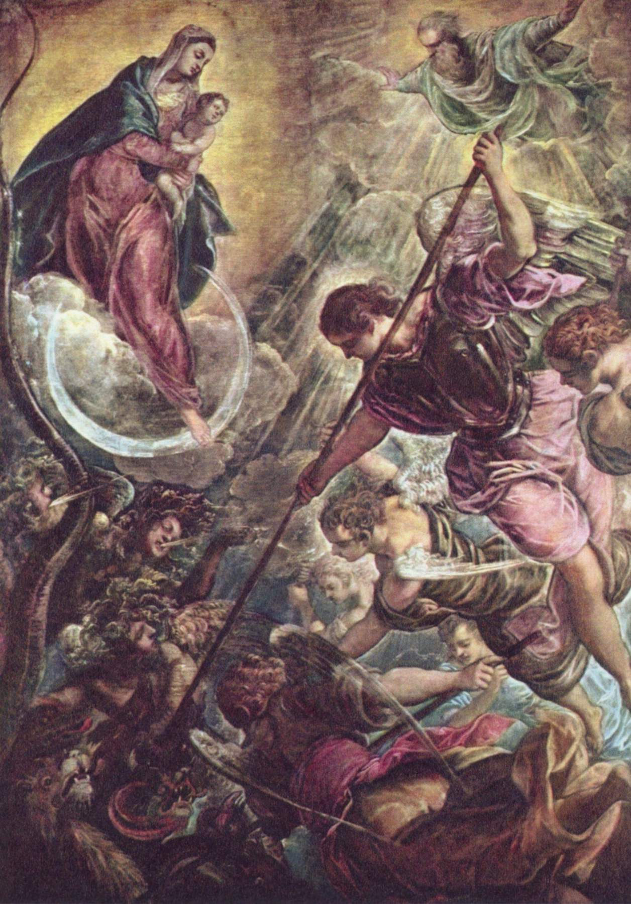
A Battle Cry
Ephesians 6:12-13
¹² For we wrestle not against flesh and blood, but against principalities, against powers, against the rulers of the darkness of this world, against spiritual wickedness in high places.
¹³ Wherefore take unto you the whole armour of God, that ye may be able to withstand in the evil day, and having done all, to stand.

Slide 34
A Battle Cry
Ephesians 6:10-13
“Having done all” probably refers to having done all things by way of preparation for the conflict. Some apply it to the Christian’s having done his best during the struggle. Trust in God never deprives one of the privilege of exerting his own God-given powers to the utmost. Although it is true that the battle will never be won without God’s armor and power, neither will it be won without the cooperation of the human with the divine.
¹² For we wrestle not against flesh and blood, but against principalities, against powers, against the rulers of the darkness of this world, against spiritual wickedness in high places.
¹³ Wherefore take unto you the whole armour of God, that ye may be able to withstand in the evil day, and having done all, to stand.

Slide 35
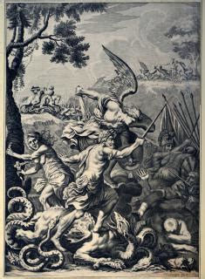
A Battle Cry:
Ephesians 6:10-13
The apostle is about to picture vast armies of evil gathered together to overwhelm the church. The contest is desperately uneven, with all the advantages on the side of the enemy, except as the church makes an alliance, through faith, with the resources of Omnipotence.

Slide 36
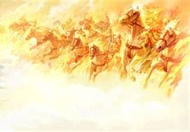
Having Done All:

Slide 37
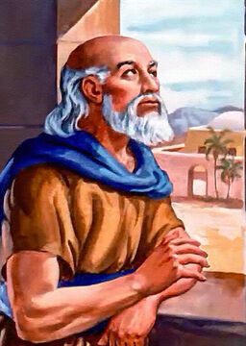
Having Done All:
2 Kings 6:8-18
⁸ Then the king of Syria warred against Israel, and took counsel with his servants, saying, In such and such a place shall be my camp.
⁹ And the man of God sent unto the king of Israel, saying, Beware that thou pass not such a place; for thither the Syrians are come down.

Slide 38
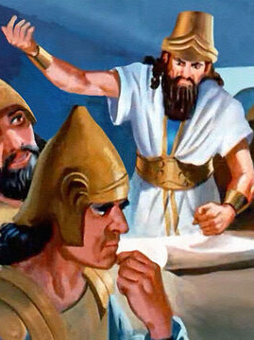
Having Done All:
2 Kings 6:10-18
¹⁰ And the king of Israel sent to the place which the man of God told him and warned him of, and saved himself there, not once nor twice.
¹¹ Therefore the heart of the king of Syria was sore troubled for this thing; and he called his servants, and said unto them, Will ye not shew me which of us is for the king of Israel?

Slide 39
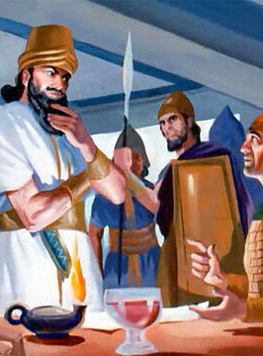
Having Done All:
2 Kings 6:12-18
¹² And one of his servants said, None, my lord, O king: but Elisha, the prophet that is in Israel, telleth the king of Israel the words that thou speakest in thy bedchamber.
¹³ And he said, Go and spy where he is, that I may send and fetch him. And it was told him, saying, Behold, he is in Dothan.

Slide 40
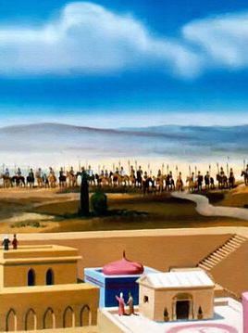
Having Done All:
2 Kings 6:14-18
¹⁴ Therefore sent he thither horses, and chariots, and a great host: and they came by night, and compassed the city about.

Slide 41
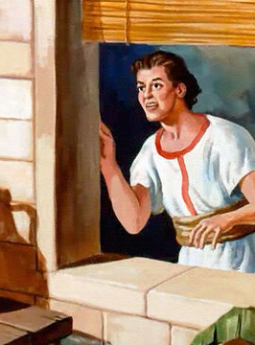
Having Done All:
2 Kings 6:15-18
¹⁵ And when the servant of the man of God was risen early, and gone forth, behold, an host compassed the city both with horses and chariots. And his servant said unto him, Alas, my master! how shall we do?

Slide 42
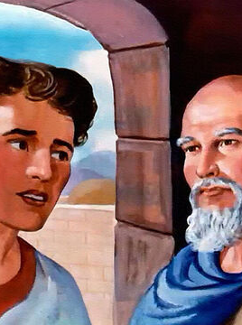
Having Done All:
2 Kings 6:16-18
¹⁶ And he answered, Fear not: for they that be with us are more than they that be with them.

Slide 43
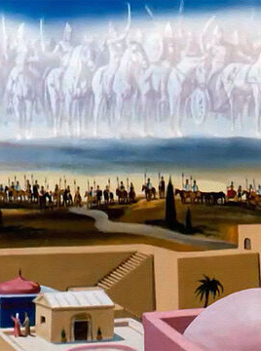
Having Done All:
2 Kings 6:17-18
¹⁷ And Elisha prayed, and said, Lord, I pray thee, open his eyes, that he may see. And the Lord opened the eyes of the young man; and he saw: and, behold, the mountain was full of horses and chariots of fire round about Elisha.

Slide 44
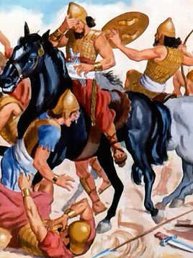
Having Done All:
2 Kings 6:18
¹⁸ And when they came down to him, Elisha prayed unto the Lord, and said, Smite this people, I pray thee, with blindness. And he smote them with blindness according to the word of Elisha.

Slide 45
The greatest realities cannot be seen with eyes of flesh. God and His angels are invisible to man without the help of the Lord. With the eyes of flesh we can see only things of flesh. Spiritual things are spiritually discerned. Our greatest need is that our eyes may be opened and we may see God and the vital importance of the things of His kingdom. Unless God opens our eyes we may go through life as blind men, never understanding the things of Lord, never seeing the vital importance righteousness or appreciating the importance of holiness. When we pray to God our eyes are opened, and we begin to see the importance of the most vital things of earth.

Slide 46
In the sojourn of life the people of God often find themselves in situations that would cause them to be uncertain and afraid, but God makes His presence known and speaks words of courage and hope. As long as God’s people are on earth, difficulties will arise and dangers will need to be met. Satan will do his utmost to cause the righteous to give way to doubt and fear, but through the mist of uncertainty and doubt the voice of the Lord still comes to us clear and assuring: “Let not your heart be troubled, neither let it be afraid” (John 14:27).

Slide 47
When a man of God is surrounded by the enemies of the Lord, he may always have the assurance that the strength that is with him is infinitely greater than the strength of the enemy. The weakest child of God, seemingly alone and forsaken on earth, need never be afraid of all the forces the enemy may send against him. With God on his side he is more than a match for the mightiest hosts of evil.

Slide 48
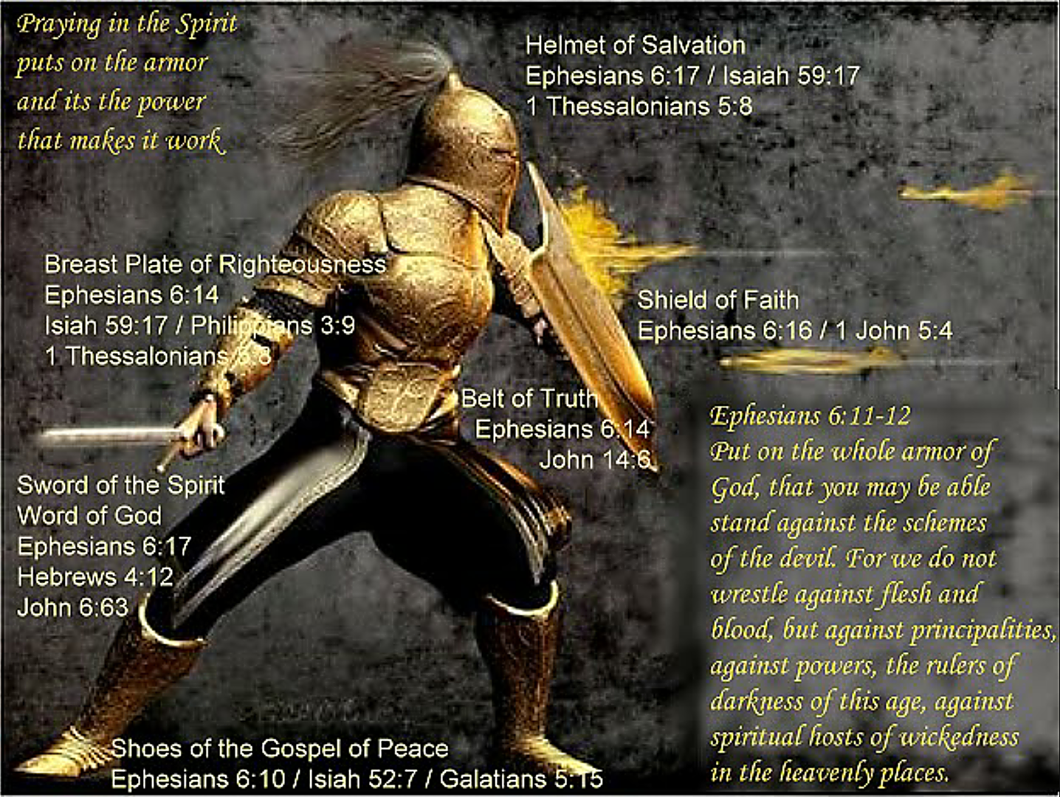
To Stand:

Slide 49
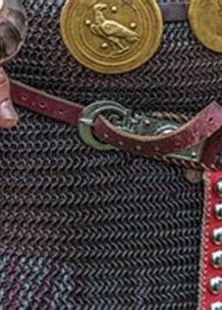
To STAND:
Ephesians 6:14
¹⁴ Stand therefore, having your loins girt about with truth, and having on the breastplate of righteousness;

Slide 50
The truth spoken of here is more than personal honesty; it is the truth of God as it is lodged in the heart, appropriated, and acted upon. It was the Pharisees’ insincerity that brought down Jesus’ denunciation upon them. If truth and integrity, both intellectual and moral, do not prevail in the field of religion, where will they prevail?

Slide 51
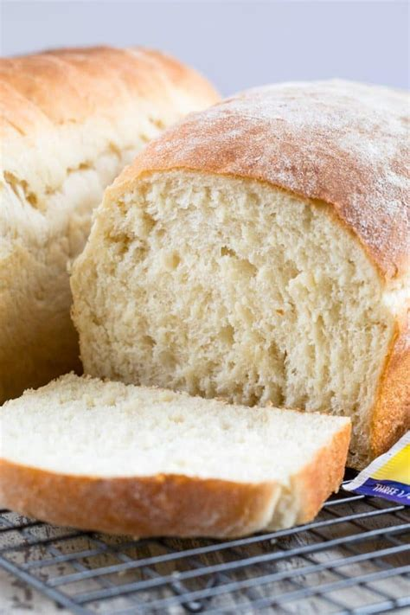
To Stand (With Integrity):
1 Corinthians 5:6-9
⁶ Your glorying is not good. Know ye not that a little leaven leaveneth the whole lump?
⁷ Purge out therefore the old leaven, that ye may be a new lump, as ye are unleavened. For even Christ our passover is sacrificed for us:

Slide 52
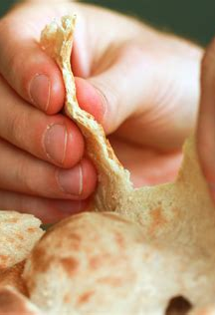
To Stand (With Integrity):
1 Corinthians 5:8-9
⁸ Therefore let us keep the feast, not with old leaven, neither with the leaven of malice and wickedness; but with the unleavened bread of sincerity and truth.
⁹ I wrote unto you in an epistle not to company with fornicators:

Slide 53

To Stand (With Integrity):
Proverbs 11:3
³ The integrity of the upright shall guide them: but the perverseness of transgressors shall destroy them.

Slide 54

To Stand (With Integrity):
1 Peter 3:15-16
¹⁵ But sanctify the Lord God in your hearts: and be ready always to give an answer to every man that asketh you a reason of the hope that is in you with meekness and fear:
¹⁶ Having a good conscience; that, whereas they speak evil of you, as of evildoers, they may be ashamed that falsely accuse your good conversation in Christ.

Slide 55
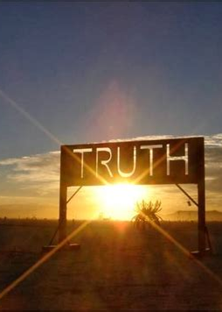
To Stand (With Integrity):
Proverbs 12:22
²² Lying lips are abomination to the Lord: but they that deal truly are his delight.

Slide 56
As the storm approaches, a large class who have professed faith in the third angel's message, but have not been sanctified through obedience to the truth, abandon their position, and join the ranks of the opposition… They become the most bitter enemies of their former brethren.
When Sabbath-keepers are brought before the courts to answer for their faith, these apostates are the most efficient agents of Satan to misrepresent and accuse them, and by false reports and insinuations to stir up the rulers against them
Ellen White GC88 608.1

Slide 57
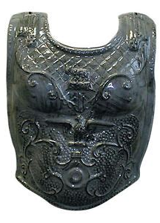
To STAND:
Ephesians 6:14
¹⁴ Stand therefore, having your loins girt about with truth, and having on the breastplate of righteousness;

Slide 58
As the breastplate covers the heart of the soldier, righteousness preserves the life of the believer, and protects the “vital organs” of spiritual life. Some apply this to the righteousness of Christ that covers the child of God; others, to tine Christian’s personal loyalty to principle. Both are essential for successful warfare, and Paul probably had both in mind.

Slide 59
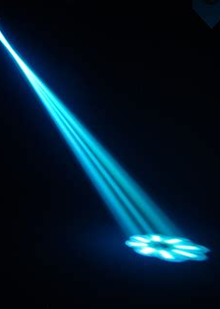
To Stand (IN RIGHTEOUSNESS):
Romans 1:16-17
¹⁶ For I am not ashamed of the gospel of Christ: for it is the power of God unto salvation to every one that believeth; to the Jew first, and also to the Greek.
¹⁷ For therein is the righteousness of God revealed from faith to faith: as it is written, The just shall live by faith.

Slide 60
To Stand (IN RIGHTEOUSNESS):
Romans 1:16-17
¹⁶ For I am not ashamed of the gospel of Christ: for it is the power of God unto salvation to every one that believeth; to the Jew first, and also to the Greek.
¹⁷ For therein is the righteousness of God revealed from faith to faith: as it is written, The just shall live by faith.
Paul is using the term “the righteousness of God” in a general and comprehensive sense. The gospel reveals the righteousness and perfection of God. It reveals the kind of righteousness that comes from God and how it may be received by man.

Slide 61
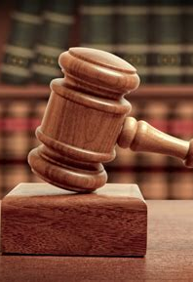
To Stand (IN RIGHTEOUSNESS):
Matthew 5:18-20
¹⁸ For verily I say unto you, Till heaven and earth pass, one jot or one tittle shall in no wise pass from the law, till all be fulfilled.
¹⁹ Whosoever therefore shall break one of these least commandments, and shall teach men so, he shall be called the least in the kingdom of heaven: but whosoever shall do and teach them, the same shall be called great in the kingdom of heaven.

Slide 62
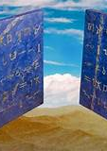
To Stand (IN RIGHTEOUSNESS):
Matthew 5:20
²⁰ For I say unto you, That except your righteousness shall exceed the righteousness of the scribes and Pharisees, ye shall in no case enter into the kingdom of heaven.

Slide 63
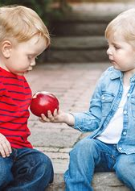
To Stand (IN RIGHTEOUSNESS):
Philippians 3:8-9
⁸ Yea doubtless, and I count all things but loss for the excellency of the knowledge of Christ Jesus my Lord: for whom I have suffered the loss of all things, and do count them but dung, that I may win Christ,
⁹ And be found in him, not having mine own righteousness, which is of the law, but that which is through the faith of Christ, the righteousness which is of God by faith:

Slide 64
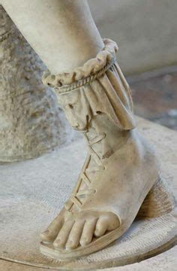
To STAND:
Ephesians 6:15
¹⁵ And your feet shod with the preparation of the gospel of peace;

Slide 65
In Paul’s figure the sandals apparently served to enable the wearer to stand firm rather than to run. In Isa. 52:7 and Rom. 10:15 the “feet” and the proclamation of the “gospel of peace” are closely linked, suggesting action, the bearing of the message of good news. In this verse, however, the idea seems to be that of steadfastness in the Christian warfare. Hence the gospel, in this instance, is not so much the gospel to be proclaimed, but the gospel that has found lodgment in the heart of the Christian. It is a beautiful and encouraging thought that the warrior in the midst of spiritual conflict can stand firm in peace. He has peace with God. Essentially, the gospel is the good news that men need not die, and that is a welcome word to the warrior facing relentless foes. He stands firm on the knowledge of Christ incarnate, crucified, risen, ascended — the heart of the gospel, and the reason for peace.

Slide 66
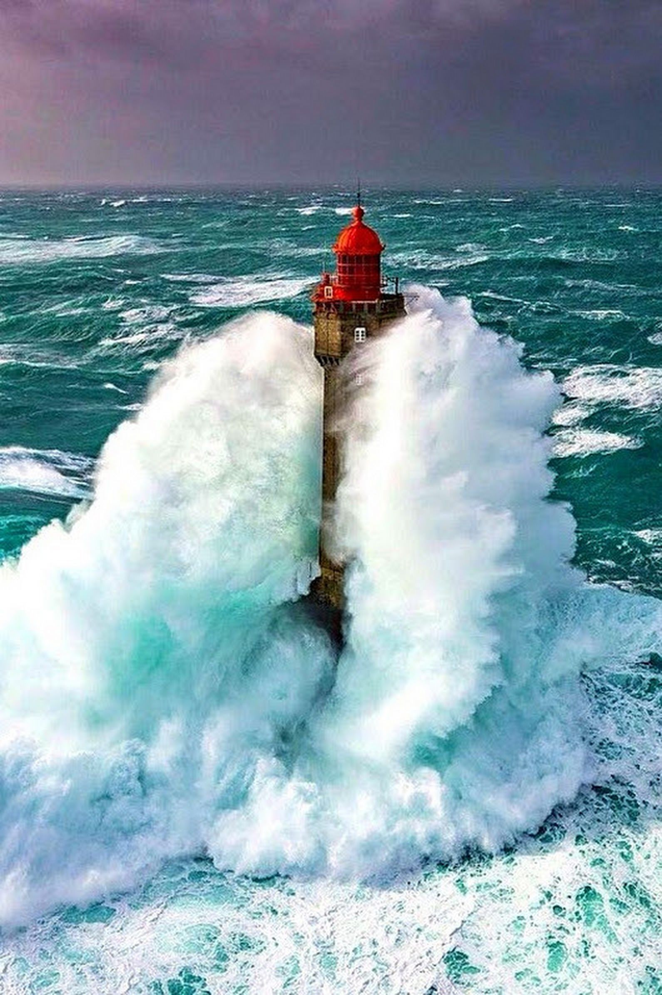
To Stand (Steadfast):
1 Corinthians 4:1-2
4 Let a man so account of us, as of the ministers of Christ, and stewards of the mysteries of God.
² Moreover it is required in stewards, that a man be found faithful.

Slide 67
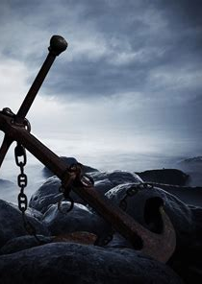
To Stand (Steadfast):
Hebrews 10:22-23
²² Let us draw near with a true heart in full assurance of faith, having our hearts sprinkled from an evil conscience, and our bodies washed with pure water.
²³ Let us hold fast the profession of our faith without wavering; (for he is faithful that promised;)

Slide 68

To Stand (Steadfast):
1 Corinthians 16:13
¹³ Watch ye, stand fast in the faith, quit you like men, be strong.

Slide 69

To Stand (Steadfast):
1 Corinthians 15:58
⁵⁸ Therefore, my beloved brethren, be ye stedfast, unmoveable, always abounding in the work of the Lord, forasmuch as ye know that your labour is not in vain in the Lord.

Slide 70

Hold Fast—A Personal Appeal:

Slide 71

HOLD FAST:
2 Timothy 1:2-14
² To Timothy, my dearly beloved son: Grace, mercy, and peace, from God the Father and Christ Jesus our Lord.
³ I thank God, whom I serve from my forefathers with pure conscience, that without ceasing I have remembrance of thee in my prayers night and day;

Slide 72

HOLD FAST:
2 Timothy 1:4-14
⁴ Greatly desiring to see thee, being mindful of thy tears, that I may be filled with joy;
⁵ When I call to remembrance the unfeigned faith that is in thee, which dwelt first in thy grandmother Lois, and thy mother Eunice; and I am persuaded that in thee also.

Slide 73

HOLD FAST:
2 Timothy 1:6-14
⁶ Wherefore I put thee in remembrance that thou stir up the gift of God, which is in thee by the putting on of my hands.
⁷ For God hath not given us the spirit of fear; but of power, and of love, and of a sound mind.

Slide 74

HOLD FAST:
2 Timothy 1:8-14
⁸ Be not thou therefore ashamed of the testimony of our Lord, nor of me his prisoner: but be thou partaker of the afflictions of the gospel according to the power of God;

Slide 75

HOLD FAST:
2 Timothy 1:9-14
⁹ Who hath saved us, and called us with an holy calling, not according to our works, but according to his own purpose and grace, which was given us in Christ Jesus before the world began,
¹⁰ But is now made manifest by the appearing of our Saviour Jesus Christ, who hath abolished death, and hath brought life and immortality to light through the gospel:

Slide 76

HOLD FAST:
2 Timothy 1:11-14
¹¹ Whereunto I am appointed a preacher, and an apostle, and a teacher of the Gentiles.
¹² For the which cause I also suffer these things: nevertheless I am not ashamed: for I know whom I have believed, and am persuaded that he is able to keep that which I have committed unto him against that day.

Slide 77

HOLD FAST:
2 Timothy 1:13-14
¹³ Hold fast the form of sound words, which thou hast heard of me, in faith and love which is in Christ Jesus.
¹⁴ That good thing which was committed unto thee keep by the Holy Ghost which dwelleth in us.

Slide 78

Stand Therefore:

Slide 79

Stand Therefore:
Ephesians 6:16
¹⁶ Above all, taking the shield of faith, wherewith ye shall be able to quench all the fiery darts of the wicked.

Slide 80
“This is the victory that overcometh the world, even our faith” (1 John 5:4). This faith is active, like the shield that is raised to catch the fiery darts; it is also passive in that it trusts in God for deliverance. Under the impact of temptation of any kind it is faith that restores confidence and enables one to carry on the battle. Moreover, “without faith it is impossible to please him” (Heb. 1 1 :6). Faith stops the arrows of temptation before they become sin in the soul. Temptations and all assaults of the enemy are to be encountered before they reach the vulnerable parts of the spiritual body.

Slide 81

Stand therefore (By Faith):
Hebrews 11:1-9, 29-39
11 Now faith is the substance of things hoped for, the evidence of things not seen.
² For by it the elders obtained a good report.
³ Through faith we understand that the worlds were framed by the word of God, so that things which are seen were not made of things which do appear.

Slide 82

Stand therefore (By Faith):
Hebrews 11:4-9, 29-39
⁴ By faith Abel offered unto God a more excellent sacrifice than Cain, by which he obtained witness that he was righteous, God testifying of his gifts: and by it he being dead yet speaketh.
⁵ By faith Enoch was translated that he should not see death; and was not found, because God had translated him: for before his translation he had this testimony, that he pleased God.

Slide 83

Stand therefore (By Faith):
Hebrews 11:6-9, 29-39
⁶ But without faith it is impossible to please him: for he that cometh to God must believe that he is, and that he is a rewarder of them that diligently seek him.
⁷ By faith Noah, being warned of God of things not seen as yet, moved with fear, prepared an ark to the saving of his house; by the which he condemned the world, and became heir of the righteousness which is by faith.

Slide 84

Stand therefore (By Faith):
Hebrews 11:8-9, 29-39
⁸ By faith Abraham, when he was called to go out into a place which he should after receive for an inheritance, obeyed; and he went out, not knowing whither he went.
⁹ By faith he sojourned in the land of promise, as in a strange country, dwelling in tabernacles with Isaac and Jacob, the heirs with him of the same promise:

Slide 85

Stand therefore (By Faith):
Hebrews 11:29-39
²⁹ By faith they passed through the Red sea as by dry land: which the Egyptians assaying to do were drowned.
³⁰ By faith the walls of Jericho fell down, after they were compassed about seven days.

Slide 86

Stand therefore (By Faith):
Hebrews 11:31-39
³¹ By faith the harlot Rahab perished not with them that believed not, when she had received the spies with peace.
³² And what shall I more say? for the time would fail me to tell of Gedeon, and of Barak, and of Samson, and of Jephthae; of David also, and Samuel, and of the prophets:

Slide 87

Stand therefore (By Faith):
Hebrews 11:33-39
³³ Who through faith subdued kingdoms, wrought righteousness, obtained promises, stopped the mouths of lions.
³⁴ Quenched the violence of fire, escaped the edge of the sword, out of weakness were made strong, waxed valiant in fight, turned to flight the armies of the aliens.

Slide 88

Stand therefore (By Faith):
Hebrews 11:35-39
³⁵ Women received their dead raised to life again: and others were tortured, not accepting deliverance; that they might obtain a better resurrection:
³⁶ And others had trial of cruel mockings and scourgings, yea, moreover of bonds and imprisonment:

Slide 89

Stand therefore (By Faith):
Hebrews 11:37-39
³⁷ They were stoned, they were sawn asunder, were tempted, were slain with the sword: they wandered about in sheepskins and goatskins; being destitute, afflicted, tormented;
³⁸ (Of whom the world was not worthy:) they wandered in deserts, and in mountains, and in dens and caves of the earth.

Slide 90

Stand therefore (By Faith):
Hebrews 11:39
³⁹ And these all, having obtained a good report through faith, received not the promise:
⁴⁰ God having provided some better thing for us, that they without us should not be made perfect.

Slide 91

Stand Therefore:
Ephesians 6:17
¹⁷ And take the helmet of salvation, and the sword of the Spirit, which is the word of God:

Slide 92

Stand therefore (Saved):
Ephesians 1:12-14
¹² That we should be to the praise of his glory, who first trusted in Christ.
¹³ In whom ye also trusted, after that ye heard the word of truth, the gospel of your salvation: in whom also after that ye believed, ye were sealed with that holy Spirit of promise,
¹⁴ Which is the earnest of our inheritance until the redemption of the purchased possession, unto the praise of his glory.

Slide 93

Stand therefore (Saved):
Revelation 7:2-3
² And I saw another angel ascending from the east, having the seal of the living God: and he cried with a loud voice to the four angels, to whom it was given to hurt the earth and the sea,
³ Saying, Hurt not the earth, neither the sea, nor the trees, till we have sealed the servants of our God in their foreheads.

Slide 94

Stand therefore (Saved):
Revelation 9:3-4
³ And there came out of the smoke locusts upon the earth: and unto them was given power, as the scorpions of the earth have power.
⁴ And it was commanded them that they should not hurt the grass of the earth, neither any green thing, neither any tree; but only those men which have not the seal of God in their foreheads.

Slide 95

Stand therefore (Saved):
Revelation 14:1-5
14 And I looked, and, lo, a Lamb stood on the mount Sion, and with him an hundred forty and four thousand, having his Father's name written in their foreheads.
² And I heard a voice from heaven, as the voice of many waters, and as the voice of a great thunder: and I heard the voice of harpers harping with their harps:

Slide 96

Stand therefore (Saved):
Revelation 14:3-5
³ And they sung as it were a new song before the throne, and before the four beasts, and the elders: and no man could learn that song but the hundred and forty and four thousand, which were redeemed from the earth.

Slide 97

Stand therefore (Saved):
Revelation 14:4-5
⁴ These are they which were not defiled with women; for they are virgins. These are they which follow the Lamb whithersoever he goeth. These were redeemed from among men, being the firstfruits unto God and to the Lamb.
⁵ And in their mouth was found no guile: for they are without fault before the throne of God.

Slide 98
The head needs special protection as being a most vital part, the seat of the will and the intelligence. In 1 Thess. 5:8 the helmet is called the hope of salvation. Salvation is past, present, and future .

Slide 99

Stand Therefore:
Ephesians 6:17
¹⁷ And take the helmet of salvation, and the sword of the Spirit, which is the word of God:

Slide 100
The other parts of the armor are defensive only, whereas the sword is both defensive and offensive.
THIS IS THE ONLY WEAPON WE HAVE IN OUR BATTLE. But it’s the only one we need! The Word of God is what Jesus Himself used in His battles with Satan.

Slide 101

Stand therefore (Armed):
John 1:1-5
1 In the beginning was the Word, and the Word was with God, and the Word was God.
² The same was in the beginning with God.
³ All things were made by him; and without him was not any thing made that was made.

Slide 102

Stand therefore (Armed):
John 1:1-5
⁴ In him was life; and the life was the light of men.
⁵ And the light shineth in darkness; and the darkness comprehended it not.

Slide 103

Stand therefore (Armed):
Matthew 4:2-4
² And when he had fasted forty days and forty nights, he was afterward an hungred.
³ And when the tempter came to him, he said, If thou be the Son of God, command that these stones be made bread.
⁴ But he answered and said, It is written, Man shall not live by bread alone, but by every word that proceedeth out of the mouth of God.

Slide 104

Stand Therefore:
Ephesians 6:18
¹⁸ Praying always with all prayer and supplication in the Spirit, and watching thereunto with all perseverance and supplication for all saints;

Slide 105
Prayer is not another weapon; rather, it is the spirit, the manner, in which the whole armor is to be worn and the battle fought. Paul is here urging it as a perpetual state of mind, a continuous attitude of communion with God.
Note that the result of being fully armed and armored here is a state of communion with God. Trusting fully in Him and living within His will is the victory that we seek!

Slide 106
Even though we have the best of intentions, our prayers often reveal our poor judgment, hidden prejudices, and sheer ignorance of what is best for us. There are few who cannot look back and thank God that the Holy Spirit revised their prayers, as it were; noted the intention, and presented them to God in such a form that He could answer them. How often has time revealed to us the utter foolishness of some of our praying, and how grateful we are that we never received some things we asked for!

Slide 107
Perseverance in prayer is not for the purpose, by sheer persistence, of making God change His mind, in some such fashion as a begging child finally extracts what he wants from an unwilling parent. Perseverance in prayer, however, clearly indicates on the part of the suppliant a state of mind that gives God an opportunity to do things He could not safely do for him otherwise.

Slide 108

Stand Therefore:
Ephesians 6:19-2o
¹⁹ And for me, that utterance may be given unto me, that I may open my mouth boldly, to make known the mystery of the gospel,
²⁰ For which I am an ambassador in bonds: that therein I may speak boldly, as I ought to speak.

Slide 109
Our work is an aggressive one, and as faithful soldiers of Jesus, we must bear the blood-stained banner into the very strongholds of the enemy…If we will consent to lay down our arms, to lower the blood-stained banner, to become the captives and servants of Satan, we may be released from the conflict and the suffering. But this peace will be gained only at the loss of Christ and heaven. We cannot accept peace on such conditions.
Let it be war, war, to the end of earth's history, rather than peace through apostasy and sin.
— Ellen G. White, The Review and Herald, May 8, 1888.

Slide 110
Thank you!
And Happy Sabbath!!

