Slide 1

Waging Peace (?)
Lesson 13, 3rd Quarter 2023
Ephesians 6:10-20

Slide 2
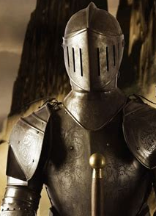
Memory Text:
Ephesians 6:16-17
¹⁶ Above all, taking the shield of faith, wherewith ye shall be able to quench all the fiery darts of the wicked.
¹⁷ And take the helmet of salvation, and the sword of the Spirit, which is the word of God:

Slide 3

Key Ideas: Outlining Ephesians
Opening Greeting (Eph. 1:1, 2)
Part 1: The Doctrinal Section (Eph. 1:3-3:21)
Part 2: The Practical Section (Eph. 4:1-6:20)
Closing Greeting (Ephesians 6:21-24)

Slide 4
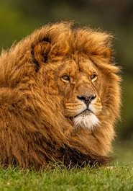
Facing the Battle
Ephesians 6:10-13
¹⁰ Finally, my brethren, be strong in the Lord, and in the power of his might.
¹¹ Put on the whole armour of God, that ye may be able to stand against the wiles of the devil.

Slide 5
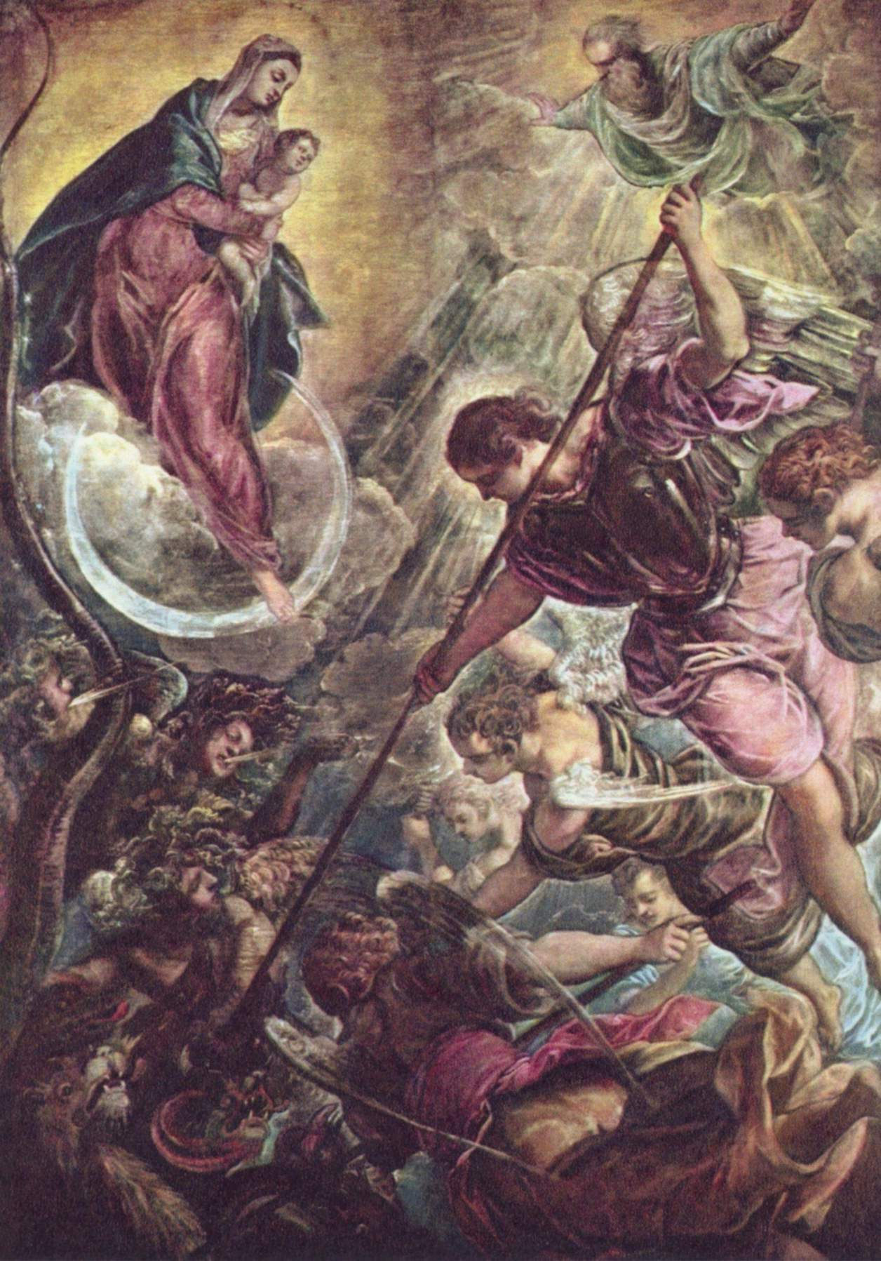
Facing the Battle
Ephesians 6:12-13
¹² For we wrestle not against flesh and blood, but against principalities, against powers, against the rulers of the darkness of this world, against spiritual wickedness in high places.
¹³ Wherefore take unto you the whole armour of God, that ye may be able to withstand in the evil day, and having done all, to stand.

Slide 6
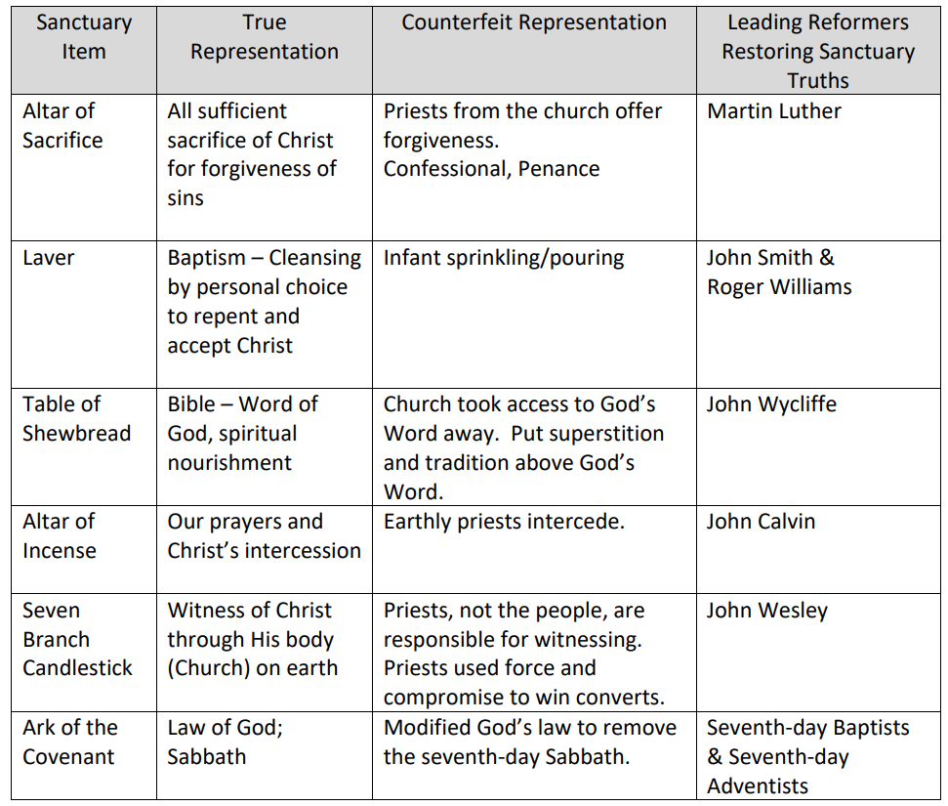

Slide 7
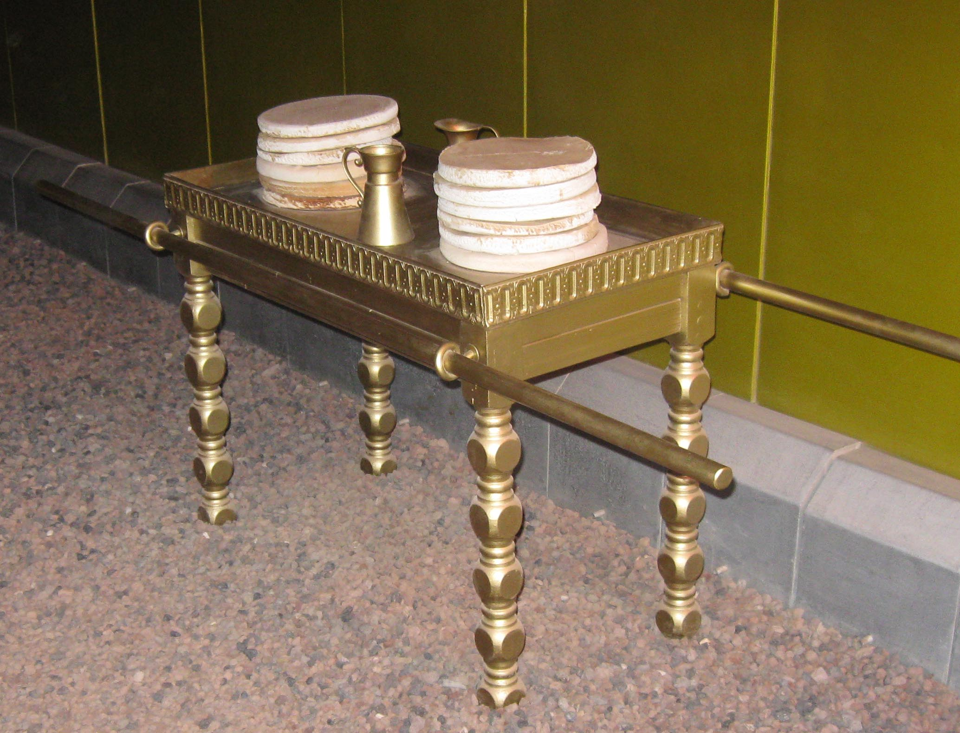
John Wycliffe:

Slide 8
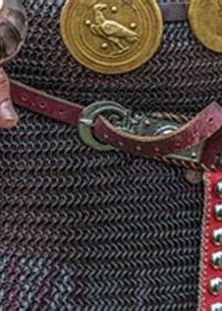
Girt About with Truth:
Ephesians 6:14
¹⁴ Stand therefore, having your loins girt about with truth, and having on the breastplate of righteousness;

Slide 9
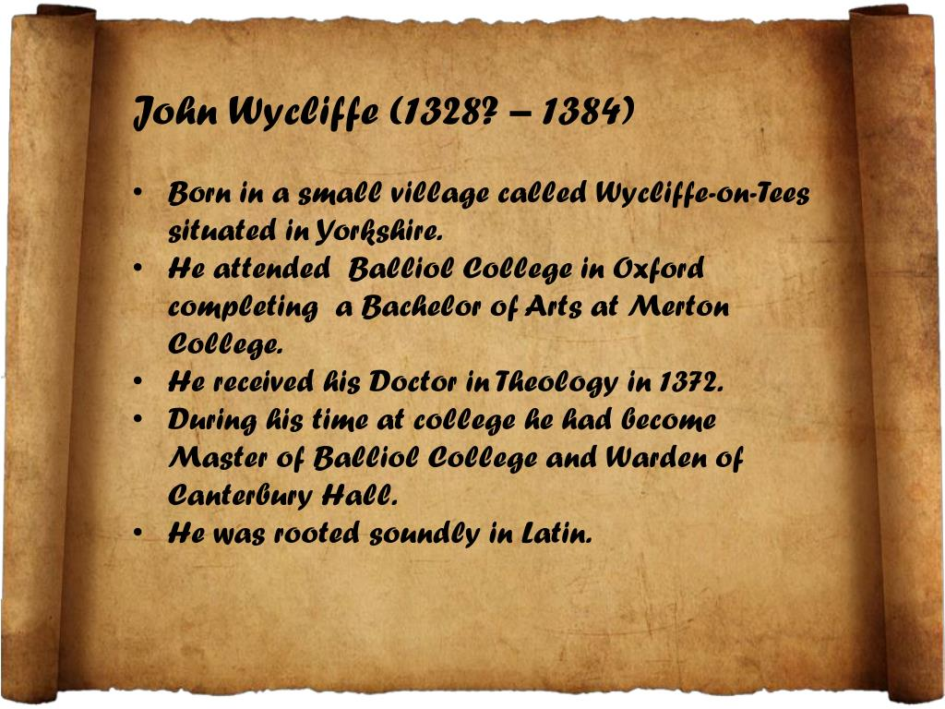

Slide 10
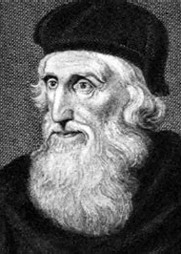
Girt About with Truth:
Wycliffe advocated translation of the Bible into the common vernacular. According to tradition, Wycliffe is said to have completed a translation direct from the Vulgate into Middle English – a version now known as Wycliffe's Bible. While it is probable that he personally translated the Gospels of Matthew, Mark, Luke, and John, it is possible he translated the entire New Testament.

Slide 11
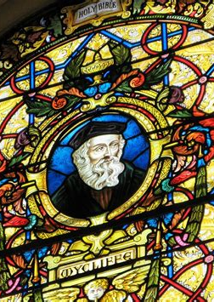
Girt About with Truth GC 87
Wycliffe, like his Master, preached the gospel to the poor. Not content with spreading the light in their humble homes in his own parish of Lutterworth, he determined that it should be carried to every part of England. To accomplish this he organized a body of preachers, simple, devout men, who loved the truth and desired nothing so much as to extend it.

Slide 12
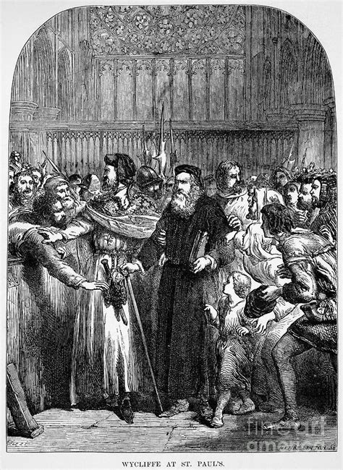
Girt About with Truth GC 87
These men went everywhere, teaching in the market places, in the streets of the great cities, and in the country lanes. They sought out the aged, the sick, and the poor, and opened to them the glad tidings of the grace of God.

Slide 13
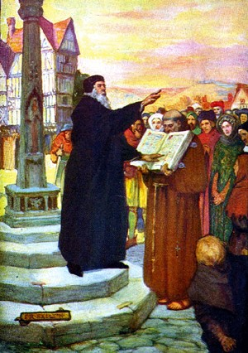
Girt About with Truth GC 87
As a professor of theology at Oxford, Wycliffe preached the word of God in the halls of the university. So faithfully did he present the truth to the students under his instruction, that he received the title of “the gospel doctor.”

Slide 14
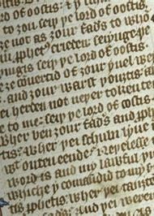
Girt About with Truth GC 87
But the greatest work of his life was to be the translation of the Scriptures into the English language. In a work, On the Truth and Meaning of Scripture, he expressed his intention to translate the Bible, so that every man in England might read, in the language in which he was born, the wonderful works of God.

Slide 15
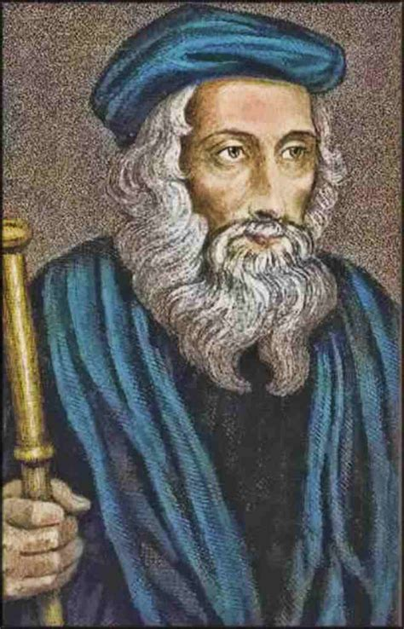
Girt About with Truth GC 87
But suddenly his labors were stopped. Though not yet sixty years of age, unceasing toil, study, and the assaults of his enemies had told upon his strength and made him prematurely old. He was attacked by a dangerous illness. The tidings brought great joy to the friars.

Slide 16
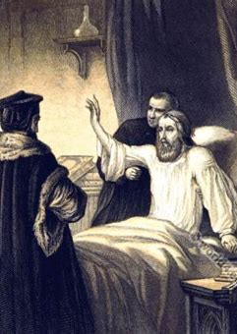
Girt About with Truth GC 87
Now they thought he would bitterly repent the evil he had done the church, and they hurried to his chamber to listen to his confession. Representatives from the four religious orders, with four civil officers, gathered about the supposed dying man.

Slide 17
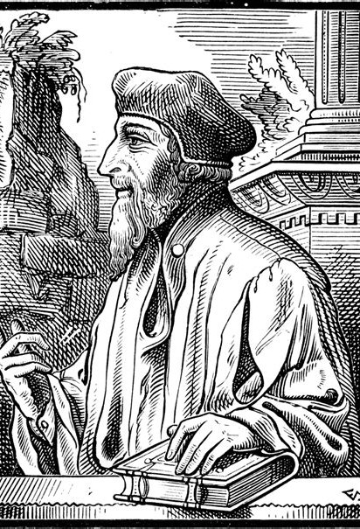
Girt About with Truth GC 87
“You have death on your lips,” they said; “be touched by your faults, and retract in our presence all that you have said to our injury.” The Reformer listened in silence; then he bade his attendant raise him in his bed, and, gazing steadily upon them as they stood waiting for his recantation, he said, in the firm, strong voice which had so often caused them to tremble:

Slide 18
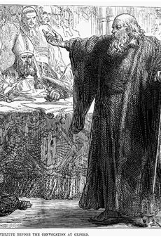
Girt About with Truth GC 87
“I shall not die, but live; and again declare the evil deeds of the friars.”—D'Aubigne, b. 17, ch. 7. Astonished and abashed, the monks hurried from the room.
Wycliffe's words were fulfilled.

Slide 19
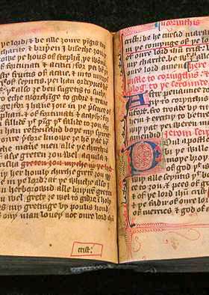
Girt About with Truth GC 88
He lived to place in the hands of his countrymen the most powerful of all weapons against Rome—to give them the Bible, the Heaven-appointed agent to liberate, enlighten, and evangelize the people. There were many and great obstacles to surmount in the accomplishment of this work.

Slide 20

Girt About with Truth GC 88
Wycliffe was weighed down with infirmities; he knew that only a few years for labor remained for him; he saw the opposition which he must meet; but, encouraged by the promises of God's word, he went forward nothing daunted.

Slide 21
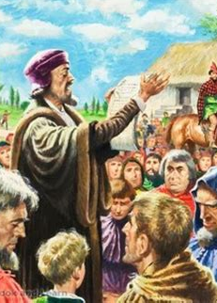
Girt About with Truth GC 88
In the full vigor of his intellectual powers, rich in experience, he had been preserved and prepared by God's special providence for this, the greatest of his labors. While all Christendom was filled with tumult, the Reformer in his rectory at Lutterworth, unheeding the storm that raged without, applied himself to his chosen task.

Slide 22
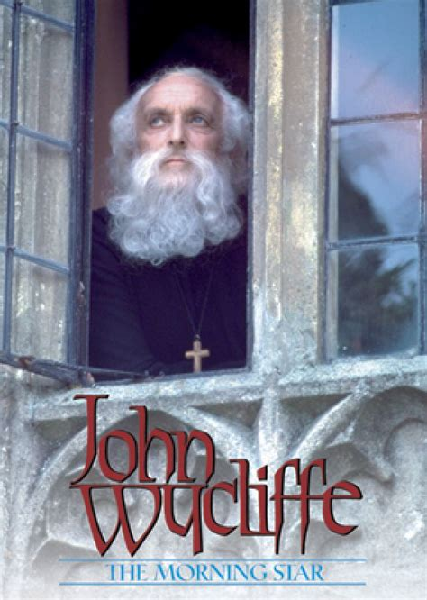
Girt About with Truth GC 88
At last the work was completed—the first English translation of the Bible ever made. The word of God was opened to England. The Reformer feared not now the prison or the stake. He had placed in the hands of the English people a light which should never be extinguished.

Slide 23
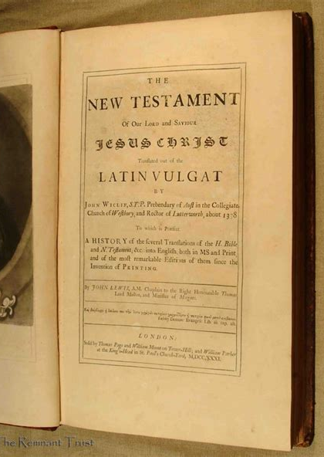
Girt About with Truth GC 88
In giving the Bible to his countrymen, he had done more to break the fetters of ignorance and vice, more to liberate and elevate his country, than was ever achieved by the most brilliant victories on fields of battle.

Slide 24
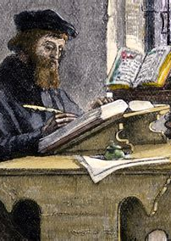
Girt About with Truth GC 89
The appeal to men's reason aroused them from their passive submission to papal dogmas. Wycliffe now taught the distinctive doctrines of Protestantism—salvation through faith in Christ, and the sole infallibility of the Scriptures.

Slide 25
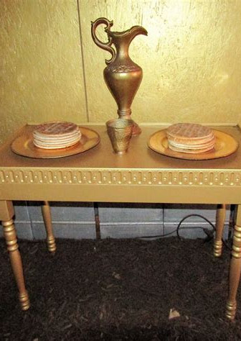
Girt About with Truth GC 89
The preachers whom he had sent out circulated the Bible, together with the Reformer's writings, and with such success that the new faith was accepted by nearly one half of the people of England.

Slide 26
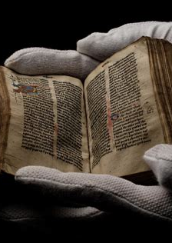
Girt About with Truth GC 89
The appearance of the Scriptures brought dismay to the authorities of the church. They had now to meet an agency more powerful than Wycliffe—an agency against which their weapons would avail little. There was at this time no law in England prohibiting the Bible,

Slide 27
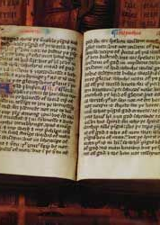
Girt About with Truth GC 89
for it had never before been published in the language of the people. Such laws were afterward enacted and rigorously enforced. Meanwhile, notwithstanding the efforts of the priests, there was for a season opportunity for the circulation of the word of God.

Slide 28
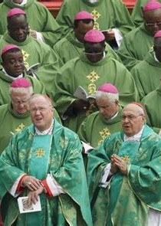
Girt About with Truth GC 89
Again the papal leaders plotted to silence the Reformer's voice. Before three tribunals he was successively summoned for trial, but without avail. First a synod of bishops declared his writings heretical, and, winning the young king, Richard II, to their side, they obtained a royal decree consigning to prison all who should hold the condemned doctrines.

Slide 29
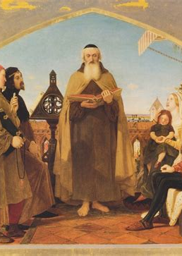
Girt About with Truth GC 89
Wycliffe appealed from the synod to Parliament; he fearlessly arraigned the hierarchy before the national council and demanded a reform of the enormous abuses sanctioned by the church. With convincing power he portrayed the usurpation and corruptions of the papal see. His enemies were brought to confusion.

Slide 30
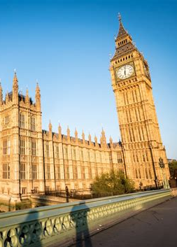
Girt About with Truth GC 89
The friends and supporters of Wycliffe had been forced to yield, and it had been confidently expected that the Reformer himself, in his old age, alone and friendless, would bow to the combined authority of the crown and the miter. But instead of this the papists saw themselves defeated.

Slide 31
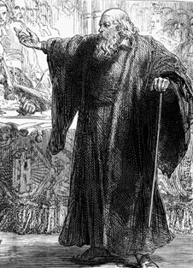
Girt About with Truth GC 89-90
Parliament, roused by the stirring appeals of Wycliffe, repealed the persecuting edict, and the Reformer was again at liberty.
A third time he was brought to trial, and now before the highest ecclesiastical tribunal in the kingdom. Here no favor would be shown to heresy.

Slide 32
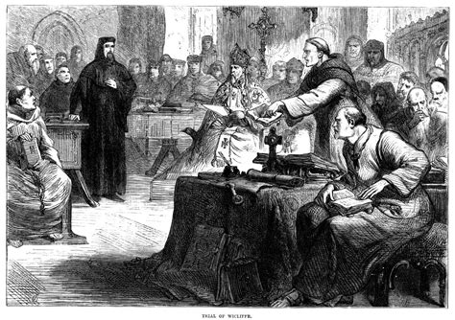
Girt About with Truth GC 90
Here at last Rome would triumph, and the Reformer's work would be stopped. So thought the papists. If they could but accomplish their purpose, Wycliffe would be forced to abjure his doctrines, or would leave the court only for the flames.

Slide 33
Girt About with Truth GC 90
But Wycliffe did not retract; he would not dissemble. He fearlessly maintained his teachings and repelled the accusations of his persecutors. Losing sight of himself, of his position, of the occasion, he summoned his hearers before the divine tribunal, and weighed their sophistries and deceptions in the balances of eternal truth.

Slide 34
Girt About with Truth GC 90
The power of the Holy Spirit was felt in the council room. A spell from God was upon the hearers. They seemed to have no power to leave the place. As arrows from the Lord's quiver, the Reformer's words pierced their hearts. The charge of heresy, which they had brought against him, he with convincing power threw back upon themselves.

Slide 35
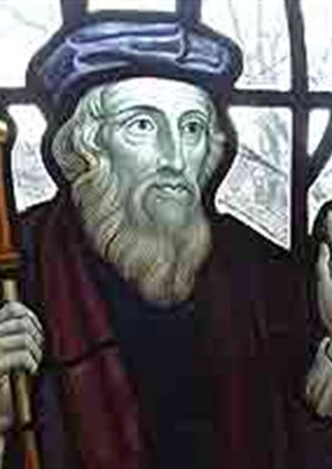
Girt About with Truth GC 90
Why, he demanded, did they dare to spread their errors? For the sake of gain, to make merchandise of the grace of God? “With whom, think you,” he finally said, “are ye contending? with an old man on the brink of the grave? No! with Truth—Truth which is stronger than you, and will overcome you.”—Wylie, b. 2, ch. 13.

Slide 36
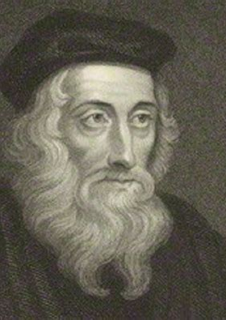
Girt About with Truth GC 90
So saying, he withdrew from the assembly, and not one of his adversaries attempted to prevent him.
Wycliffe's work was almost done; the banner of truth which he had so long borne was soon to fall from his hand; but once more he was to bear witness for the gospel. The truth was to be proclaimed from the very stronghold of the kingdom of error.

Slide 37
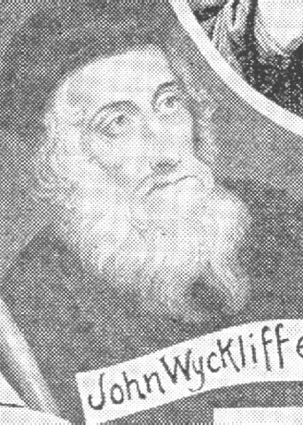
Girt About with Truth GC 90
Wycliffe was summoned for trial before the papal tribunal at Rome, which had so often shed the blood of the saints. He was not blind to the danger that threatened him, yet he would have obeyed the summons had not a shock of palsy made it impossible for him to perform the journey.

Slide 38
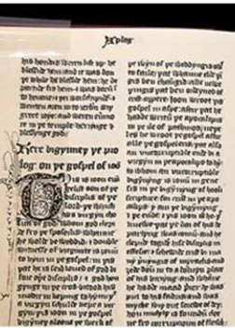
Girt About with Truth GC 90
But though his voice was not to be heard at Rome, he could speak by letter, and this he determined to do. From his rectory the Reformer wrote to the pope a letter, which, while respectful in tone and Christian in spirit, was a keen rebuke to the pomp and pride of the papal see.

Slide 39
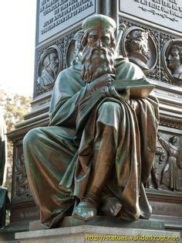

Girt About with Truth GC 91
“Verily I do rejoice,” he said, “to open and declare unto every man the faith which I do hold, and especially unto the bishop of Rome: which, forasmuch as I do suppose to be sound and true, he will most willingly confirm my said faith, or if it be erroneous, amend the same.

Slide 40
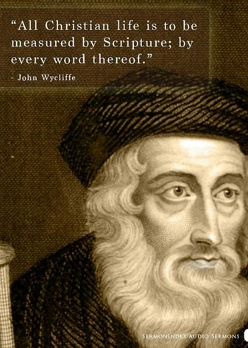
Girt About with Truth GC 91
“First, I suppose that the gospel of Christ is the whole body of God's law.... I do give and hold the bishop of Rome, forasmuch as he is the vicar of Christ here on earth, to be most bound, of all other men, unto that law of the gospel. For the greatness among Christ's disciples did not consist in worldly dignity or honors, but in the near and exact following of Christ in His life and manners....

Slide 41
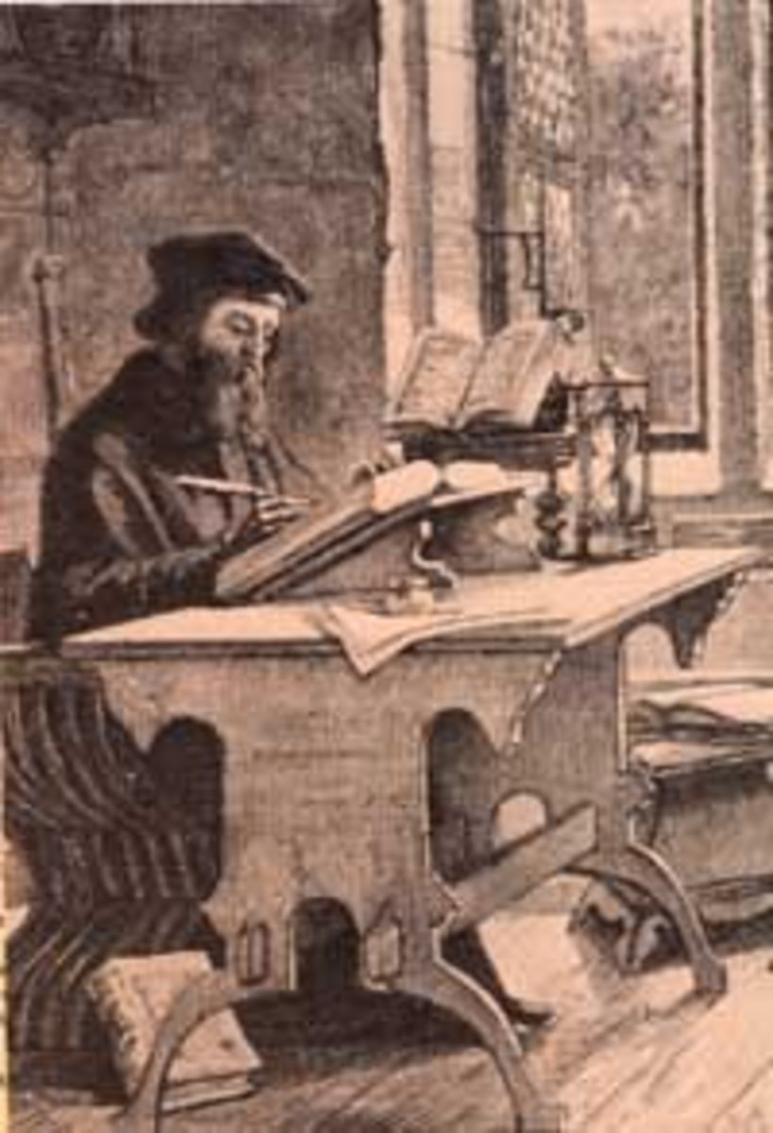
Girt About with Truth GC 91
Christ, for the time of His pilgrimage here, was a most poor man, abjecting and casting off all worldly rule and honor....
“No faithful man ought to follow either the pope himself or any of the holy men, but in such points as he hath followed the Lord Jesus Christ; for Peter and the sons of Zebedee,

Slide 42
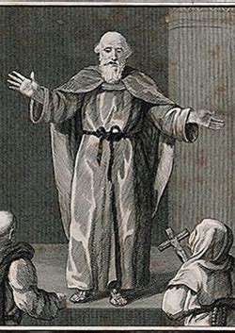
Girt About with Truth GC 91
by desiring worldly honor, contrary to the following of Christ's steps, did offend, and therefore in those errors they are not to be followed....
“The pope ought to leave unto the secular power all temporal dominion and rule, and thereunto effectually to move and exhort his whole clergy; for so did Christ, and especially by His apostles.

Slide 43
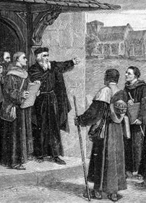
Girt About with Truth GC 91
Wherefore, if I have erred in any of these points, I will most humbly submit myself unto correction, even by death, if necessity so require; and if I could labor according to my will or desire in mine own person, I would surely present myself before the bishop of Rome; but the Lord hath otherwise visited me to the contrary, and hath taught me rather to obey God than men.”

Slide 44
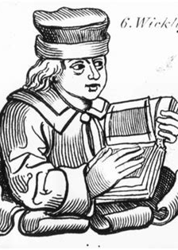
Girt About with Truth GC 91
In closing he said: “Let us pray unto our God, that He will so stir up our Pope Urban VI, as he began, that he with his clergy may follow the Lord Jesus Christ in life and manners; and that they may teach the people effectually, and that they, likewise, may faithfully follow them in the same.”—John Foxe, Acts and Monuments, vol. 3, pp. 49, 50.

Slide 45
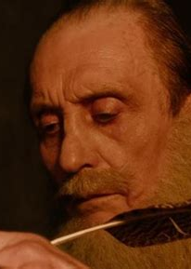
Girt About with Truth GC 92
Wycliffe fully expected that his life would be the price of his fidelity. The king, the pope, and the bishops were united to accomplish his ruin, and it seemed certain that a few months at most would bring him to the stake. But his courage was unshaken. “Why do you talk of seeking the crown of martyrdom afar?” he said.

Slide 46
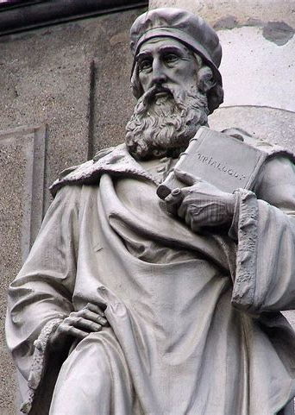
Girt About with Truth GC 92
“Preach the gospel of Christ to haughty prelates, and martyrdom will not fail you. What! I should live and be silent? ... Never! Let the blow fall, I await its coming.”—D'Aubigne, b. 17, ch. 8.

Slide 47
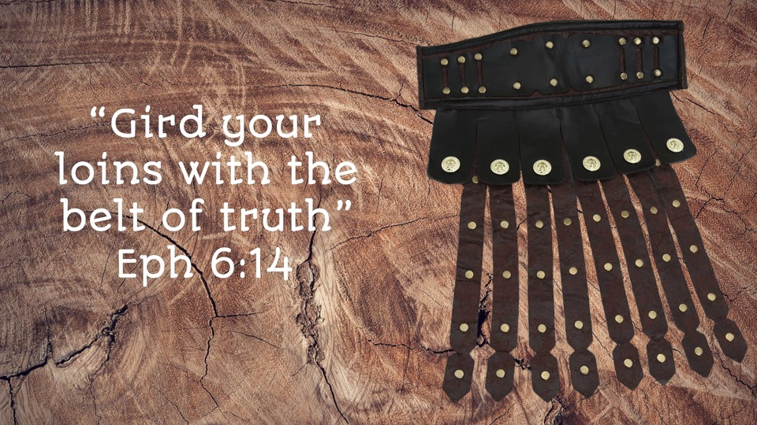

Slide 48
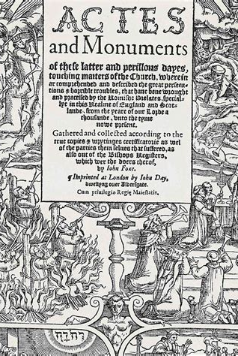
Girt About with Truth
Foxes Book of mARTYRS
...though they digged up his body, burnt his bones, and drowned his ashes, yet the Word of God and the truth of his doctrine, with the fruit and success thereof, they could not burn; which yet to this day...doth remain.

Slide 49
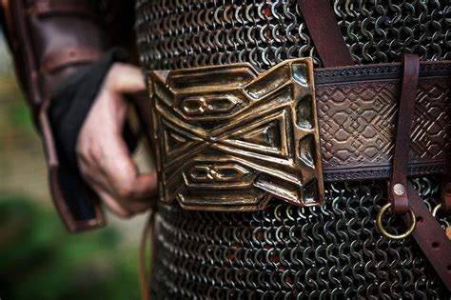

Slide 50
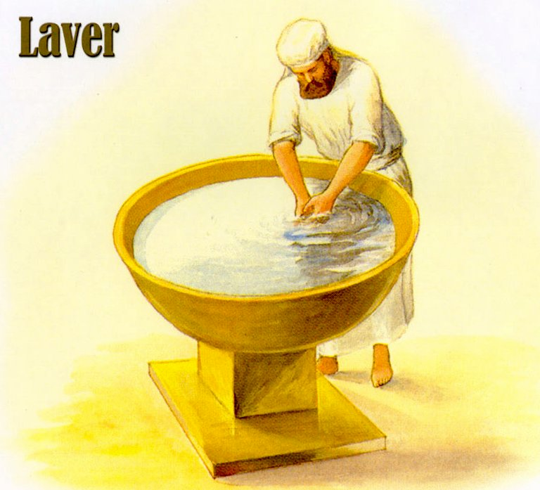
Having the Breastplate of Righteousness:

Slide 51
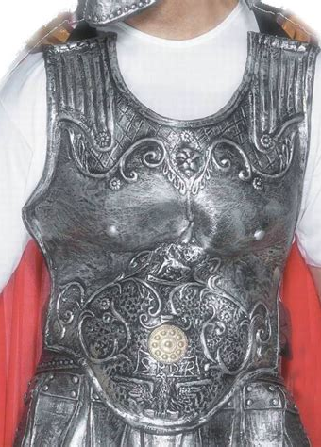
The Breastplate of Righteousness:
Ephesians 6:14
¹⁴ Stand therefore, having your loins girt about with truth, and having on the breastplate of righteousness;

Slide 52
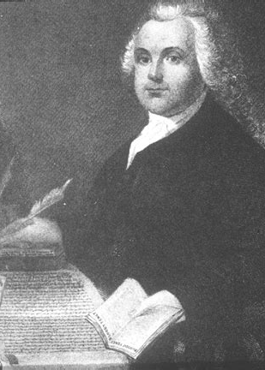
Righteousness: GC 293
Eleven years after the planting of the first colony, Roger Williams came to the New World. Like the early Pilgrims he came to enjoy religious freedom; but, unlike them, he saw—what so few in his time had yet seen—that this freedom was the inalienable right of all, whatever might be their creed. He was an earnest seeker for truth, with Robinson holding it impossible that all the light from God's word had yet been received.

Slide 53
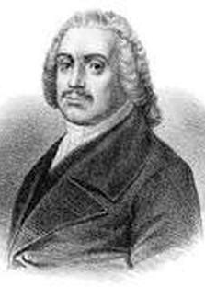
Righteousness: GC 293
Williams “was the first person in modern Christendom to establish civil government on the doctrine of the liberty of conscience, the equality of opinions before the law.”—Bancroft, pt. 1, ch. 15, par. 16. He declared it to be the duty of the magistrate to restrain crime, but never to control the conscience.

Slide 54
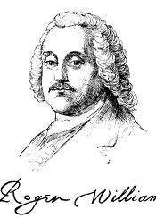
Righteousness: GC 293
“The public or the magistrates may decide,” he said, “what is due from man to man; but when they attempt to prescribe a man's duties to God, they are out of place, and there can be no safety; for it is clear that if the magistrate has the power, he may decree one set of opinions or beliefs today and another tomorrow;

Slide 55
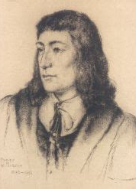
Righteousness: GC 293-4
as has been done in England by different kings and queens, and by different popes and councils in the Roman Church; so that belief would become a heap of confusion.”—Martyn, vol. 5, p. 340.
Attendance at the services of the established church was required under a penalty of fine or imprisonment. “Williams reprobated the law;

Slide 56

Righteousness: GC 294
the worst statute in the English code was that which did but enforce attendance upon the parish church. To compel men to unite with those of a different creed, he regarded as an open violation of their natural rights; to drag to public worship the irreligious and the unwilling, seemed only like requiring hypocrisy.... ‘No one should be bound to worship, or,’ he added, ‘to maintain a worship, against his own consent.’

Slide 57

Righteousness: GC 294
‘What!’ exclaimed his antagonists, amazed at his tenets, ‘is not the laborer worthy of his hire?’ ‘Yes,’ replied he, ‘from them that hire him.’”—Bancroft, pt. 1, ch. 15, par. Roger Williams was respected and beloved as a faithful minister, a man of rare gifts, of unbending integrity and true benevolence; yet his steadfast denial of the right of civil magistrates to authority over the church, and his demand for religious liberty, could not be tolerated.

Slide 58

Righteousness: GC 294
The application of this new doctrine, it was urged, would “subvert the fundamental state and government of the country.”—Ibid., pt. 1, ch. 15, par. 10. He was sentenced to banishment from the colonies, and, finally, to avoid arrest, he was forced to flee, amid the cold and storms of winter, into the unbroken forest.

Slide 59

Righteousness: GC 294
“For fourteen weeks,” he says, “I was sorely tossed in a bitter season, not knowing what bread or bed did mean.” But “the ravens fed me in the wilderness,” and a hollow tree often served him for a shelter.—Martyn, vol. 5, pp. 349, 350. Thus he continued his painful flight through the snow and the trackless forest, until he found refuge with an Indian tribe whose confidence and affection he had won while endeavoring to teach them the truths of the gospel.

Slide 60

Righteousness: GC 294
Making his way at last, after months of change and wandering, to the shores of Narragansett Bay, he there laid the foundation of the first state of modern times that in the fullest sense recognized the right of religious freedom.

Slide 61

Righteousness: GC 294
The fundamental principle of Roger Williams's colony was “that every man should have liberty to worship God according to the light of his own conscience.”—Ibid., vol. 5, p. 354. His little state, Rhode Island, became the asylum of the oppressed, and it increased and prospered until its foundation principles—civil and religious liberty—became the cornerstones of the American Republic.

Slide 62


Slide 63

The Gospel of Peace:

Slide 64

To STAND:
Ephesians 6:15
¹⁵ And your feet shod with the preparation of the gospel of peace;

Slide 65

The Gospel of Peace GC 254
John and Charles Wesley, after being ordained to the ministry, were sent on a mission to America. On board the ship was a company of Moravians. Violent storms were encountered on the passage, and John Wesley, brought face to face with death, felt that he had not the assurance of peace with God.

Slide 66

The Gospel of Peace GC 254-5
The Germans, on the contrary, manifested a calmness and trust to which he was a stranger.
“I had long before,” he says, “observed the great seriousness of their behavior. Of their humility they had given a continual proof, by performing those servile offices for the other passengers which none of

Slide 67

The Gospel of Peace GC 255
the English would undertake; for which they desired and would receive no pay, saying it was good for their proud hearts, and their loving Saviour had done more for them. And every day had given them occasion of showing a meekness which no injury could move. If they were pushed, struck, or thrown down, they rose again and went away;

Slide 68

The Gospel of Peace GC 255
but no complaint was found in their mouth. There was now an opportunity of trying whether they were delivered from the spirit of fear, as well as from that of pride, anger, and revenge. In the midst of the psalm wherewith their service began, the sea broke over, split the mainsail in pieces, covered the ship, and

Slide 69

The Gospel of Peace GC 255
poured in between the decks as if the great deep had already swallowed us up. A terrible screaming began among the English. The Germans calmly sang on. I asked one of them afterwards, ‘Were you not afraid?’ He answered, ‘I thank God, no.’ I asked, ‘But were not your women and children afraid?’

Slide 70

The Gospel of Peace GC 255
He replied mildly, ‘No; our women and children are not afraid to die.’”—Whitehead, Life of the Rev. John Wesley, vol. 2, page 10.
On his return to England, Wesley, under the instruction of a Moravian preacher, arrived at a clearer understanding of Bible faith.

Slide 71

The Gospel of Peace GC 255
He was convinced that he must renounce all dependence upon his own works for salvation and must trust wholly to “the Lamb of God, which taketh away the sin of the world.” At a meeting of the Moravian society in London a statement was read from Luther, describing the change which the Spirit of God works in the heart of the believer.

Slide 72

The Gospel of Peace GC 255
As Wesley listened, faith was kindled in his soul. “I felt my heart strangely warmed,” he says. “I felt I did trust in Christ, Christ alone, for salvation: and an assurance was given me, that He had taken away my sins, even mine, and saved me from the law of sin and death.”—Ibid., page 52.

Slide 73

The Gospel of Peace GC 256
Through long years of wearisome and comfortless striving—years of rigorous self-denial, of reproach and humiliation—Wesley had steadfastly adhered to his one purpose of seeking God. Now he had found Him; and he found that the grace which he had toiled to win by prayers and fasts, by almsdeeds and self-abnegation, was a gift, “without money and without price.”

Slide 74

The Gospel of Peace GC 256
Once established in the faith of Christ, his whole soul burned with the desire to spread everywhere a knowledge of the glorious gospel of God's free grace. “I look upon all the world as my parish,” he said; “in whatever part of it I am, I judge it meet, right, and my bounden duty, to declare unto all that are willing to hear, the glad tidings of salvation.”—Ibid., page 74.

Slide 75

The Gospel of Peace GC 256
He continued his strict and self-denying life, not now as the ground, but the result of faith; not the root, but the fruit of holiness. The grace of God in Christ is the foundation of the Christian's hope, and that grace will be manifested in obedience.

Slide 76

The Gospel of Peace GC 256
Wesley's life was devoted to the preaching of the great truths which he had received—justification through faith in the atoning blood of Christ, and the renewing power of the Holy Spirit upon the heart, bringing forth fruit in a life conformed to the example of Christ.

Slide 77

The Gospel of Peace GC 257
As members of the Church of England they were strongly attached to her forms of worship, but the Lord had presented before them in His word a higher standard. The Holy Spirit urged them to preach Christ and Him crucified. The power of the Highest attended their labors. Thousands were convicted and truly converted.

Slide 78

The Gospel of Peace GC 257-8
It was necessary that these sheep be protected from ravening wolves. Wesley had no thought of forming a new denomination, but he organized them under what was called the Methodist Connection. …
The servants of God trod a rugged path. Men of influence and learning employed their powers against them.

Slide 79

The Gospel of Peace GC 258
After a time many of the clergy manifested determined hostility, and the doors of the churches were closed against a pure faith and those who proclaimed it. The course of the clergy in denouncing them from the pulpit aroused the elements of darkness, ignorance, and iniquity.

Slide 80

The Gospel of Peace GC 258
Again and again did John Wesley escape death by a miracle of God's mercy. When the rage of the mob was excited against him, and there seemed no way of escape, an angel in human form came to his side, the mob fell back, and the servant of Christ passed in safety from the place of danger.

Slide 81

The Gospel of Peace GC 258
Of his deliverance from the enraged mob on one of these occasions, Wesley said: “Many endeavored to throw me down while we were going down hill on a slippery path to the town; as well judging that if I was once on the ground, I should hardly rise any more. But I made no stumble at all, nor the least slip, till I was entirely out of their hands....

Slide 82

The Gospel of Peace GC 258
Although many strove to lay hold on my collar or clothes, to pull me down, they could not fasten at all: only one got fast hold of the flap of my waistcoat, which was soon left in his hand; the other flap, in the pocket of which was a bank note, was torn but half off.... A lusty man just behind, struck at me several times,

Slide 83

The Gospel of Peace GC 258
with a large oaken stick; with which if he had struck me once on the back part of my head, it would have saved him all further trouble. But every time, the blow was turned aside, I know not how; for I could not move to the right hand or left.... Another came rushing through the press, and raising his arm to strike,

Slide 84

The Gospel of Peace GC 258
on a sudden let it drop, and only stroked my head, saying, ‘What soft hair he has!’ ... The very first men whose hearts were turned were the heroes of the town, the captains of the rabble on all occasions, one of them having been a prize fighter at the bear gardens....

Slide 85

The Gospel of Peace GC 259
“By how gentle degrees does God prepare us for His will! Two years ago, a piece of brick grazed my shoulders. It was a year after that the stone struck me between the eyes. Last month I received one blow, and this evening two, one before we came into the town, and one after we were gone out; but both were as nothing:

Slide 86

The Gospel of Peace GC 259
for though one man struck me on the breast with all his might, and the other on the mouth with such force that the blood gushed out immediately, I felt no more pain from either of the blows than if they had touched me with a straw.”—John Wesley, Works, vol. 3, pp. 297, 298.

Slide 87


Slide 88

The Shield of Faith:

Slide 89

Stand Therefore:
Ephesians 6:16
¹⁶ Above all, taking the shield of faith, wherewith ye shall be able to quench all the fiery darts of the wicked.

Slide 90

Faith of Jesus: GC 451
The work of Sabbath reform to be accomplished in the last days is foretold in the prophecy of Isaiah: “Thus saith the Lord, Keep ye judgment, and do justice: for My salvation is near to come, and My righteousness to be revealed. Blessed is the man that doeth this, and the son of man that layeth hold on it; that keepeth the Sabbath from polluting it, and keepeth his hand from doing any evil.”

Slide 91

Faith of Jesus: GC 451
“The sons of the stranger, that join themselves to the Lord, to serve Him, and to love the name of the Lord, to be His servants, everyone that keepeth the Sabbath from polluting it, and taketh hold of My covenant; even them will I bring to My holy mountain, and make them joyful in My house of prayer.” Isaiah 56:1, 2, 6, 7.

Slide 92

Faith of Jesus: GC 451
These words apply in the Christian age, as shown by the context: “The Lord God which gathereth the outcasts of Israel saith, Yet will I gather others to him, beside those that are gathered unto him.” Verse 8. Here is foreshadowed the gathering in of the Gentiles by the gospel.

Slide 93

Faith of Jesus: GC 451
And upon those who then honor the Sabbath, a blessing is pronounced. Thus the obligation of the fourth commandment extends past the crucifixion, resurrection, and ascension of Christ, to the time when His servants should preach to all nations the message of glad tidings.

Slide 94

Faith of Jesus: GC 452
The Lord commands by the same prophet: “Bind up the testimony, seal the law among My disciples.” Isaiah 8:16. The seal of God's law is found in the fourth commandment. This only, of all the ten, brings to view both the name and the title of the Lawgiver. It declares Him to be the Creator of the heavens and the earth, and thus

Slide 95

Faith of Jesus: GC 452
shows His claim to reverence and worship above all others. Aside from this precept, there is nothing in the Decalogue to show by whose authority the law is given. When the Sabbath was changed by the papal power, the seal was taken from the law. The disciples of Jesus are called upon to restore it by exalting the

Slide 96

Faith of Jesus: GC 452
Sabbath of the fourth commandment to its rightful position as the Creator's memorial and the sign of His authority.
The prophet thus points out the ordinance which has been forsaken: “Thou shalt raise up the foundations of many generations; and thou shalt

Slide 97

Faith of Jesus: GC 452
be called, The repairer of the breach, The restorer of paths to dwell in. If thou turn away thy foot from the Sabbath, from doing thy pleasure on My holy day; and call the Sabbath a delight, the holy of the Lord, honorable; and shalt honor Him, not doing thine own ways, nor finding thine own pleasure, nor speaking thine

Slide 98

Faith of Jesus: GC 452
own words: then shalt thou delight thyself in the Lord.” Verses 12-14. This prophecy also applies in our time. The breach was made in the law of God when the Sabbath was changed by the Roman power. But the time has come for that divine institution to be restored. The breach is to be repaired and the foundation of many generations to be raised up.

Slide 99

Faith of Jesus: GC 453
From that day to the present the knowledge of God's law has been preserved in the earth, and the Sabbath of the fourth commandment has been kept. Though the “man of sin” succeeded in trampling underfoot God's holy day, yet even in the period of his supremacy there were,

Slide 100

Faith of Jesus: GC 453
hidden in secret places, faithful souls who paid it honor. Since the Reformation, there have been some in every generation to maintain its observance. Though often in the midst of reproach and persecution, a constant testimony has been borne to the perpetuity of the law of God and the sacred obligation of the creation Sabbath.

Slide 101

Faith of Jesus: GC 453
These truths, as presented in Revelation 14 in connection with “the everlasting gospel,” will distinguish the church of Christ at the time of His appearing. For as the result of the threefold message it is announced: “Here are they that keep the commandments of God, and the faith of Jesus.”

Slide 103

The Helmet of Salvation

Slide 104

The Helmet of Salvation:
Ephesians 6:17
¹⁷ And take the helmet of salvation, and the sword of the Spirit, which is the word of God:

Slide 105

The Helmet of Salvation GC 120
Foremost among those who were called to lead the church from the darkness of popery into the light of a purer faith, stood Martin Luther. Zealous, ardent, and devoted, knowing no fear but the fear of God, and acknowledging no foundation for religious faith but the Holy Scriptures, Luther was the man for his time; through him God accomplished a great work for the reformation of the church and the enlightenment of the world.

Slide 106

The Helmet of Salvation GC 131
Though Luther had been moved by the Spirit of God to begin his work, he was not to carry it forward without severe conflicts. The reproaches of his enemies, their misrepresentation of his purposes, and their unjust and malicious reflections upon his character and motives, came in upon him like an overwhelming flood; and they were not without effect.

Slide 107

The Helmet of Salvation GC 131
He had felt confident that the leaders of the people, both in the church and in the schools, would gladly unite with him in efforts for reform. Words of encouragement from those in high position had inspired him with joy and hope. Already in anticipation he had seen a brighter day dawning for the church.

Slide 108

The Helmet of Salvation GC 131
But encouragement had changed to reproach and condemnation. Many dignitaries, of both church and state, were convicted of the truthfulness of his theses; but they soon saw that the acceptance of these truths would involve great changes. To enlighten and reform the people would be virtually to undermine the authority of

Slide 109

The Helmet of Salvation GC 131
Rome, to stop thousands of streams now flowing into her treasury, and thus greatly to curtail the extravagance and luxury of the papal leaders. Furthermore, to teach the people to think and act as responsible beings, looking to Christ alone for salvation, would overthrow the pontiff's throne and eventually destroy their own authority.

Slide 110

The Helmet of Salvation GC 131-2
For this reason they refused the knowledge tendered them of God and arrayed themselves against Christ and the truth by their opposition to the man whom He had sent to enlighten them.
Luther trembled as he looked upon himself—one man opposed to the mightiest powers of earth.

Slide 111

The Helmet of Salvation GC 132
He sometimes doubted whether he had indeed been led of God to set himself against the authority of the church. “Who was I,” he writes, “to oppose the majesty of the pope, before whom ... the kings of the earth and the whole world trembled? ... No one can know what my heart suffered during these first two years, and into

Slide 112

The Helmet of Salvation GC 132
what despondency, I may say into what despair, I was sunk.”—Ibid., b. 3, ch. 6. But he was not left to become utterly disheartened. When human support failed, he looked to God alone and learned that he could lean in perfect safety upon that all-powerful arm.

Slide 113

The Helmet of Salvation GC 132
To a friend of the Reformation Luther wrote: “We cannot attain to the understanding of Scripture either by study or by the intellect. Your first duty is to begin by prayer. Entreat the Lord to grant you, of His great mercy, the true understanding of His word. There is no other interpreter of the word of God than the Author of this word, as

Slide 114

The Helmet of Salvation GC 132
He Himself has said, ‘They shall be all taught of God.’ Hope for nothing from your own labors, from your own understanding: trust solely in God, and in the influence of His Spirit. Believe this on the word of a man who has had experience.”—Ibid., b. 3, ch. 7. Here is a lesson of vital importance to those who feel that God has called them to present to others the solemn truths for this time.

Slide 115

The Helmet of Salvation GC 132
These truths will stir the enmity of Satan and of men who love the fables that he has devised. In the conflict with the powers of evil there is need of something more than strength of intellect and human wisdom.

Slide 116

The Helmet of Salvation GC 140
Rome became more and more exasperated by the attacks of Luther, and it was declared by some of his fanatical opponents, even by doctors in Catholic universities, that he who should kill the rebellious monk would be without sin. One day a stranger, with a pistol hidden under his cloak, approached the Reformer and inquired why he went thus alone.

Slide 117

The Helmet of Salvation GC 140
“I am in God's hands,” answered Luther. “He is my strength and my shield. What can man do unto me?”—Ibid., b. 6, ch. 2. Upon hearing these words, the stranger turned pale and fled away as from the presence of the angels of heaven.
Rome was bent upon the destruction of Luther; but God was his defense.

Slide 118

The Helmet of Salvation GC 140
His doctrines were heard everywhere—“in cottages and convents, ... in the castles of the nobles, in the universities, and in the palaces of kings;” and noble men were rising on every hand to sustain his efforts.—Ibid., b. 6, ch. 2.

Slide 119

The Helmet of Salvation GC 140
It was about this time that Luther, reading the works of Huss, found that the great truth of justification by faith, which he himself was seeking to uphold and teach, had been held by the Bohemian Reformer. “We have all,” said Luther, “Paul, Augustine, and myself, been Hussites without knowing it!”

Slide 120

The Helmet of Salvation GC 140,1
“God will surely visit it upon the world,” he continued, “that the truth was preached to it a century ago, and burned!”—Wylie, b. 6, ch. 1 …
The whole nation was stirred, and multitudes were roused to rally around the standard of reform. Luther's opponents, burning with a desire for revenge, urged the pope to take decisive measures against him.

Slide 121

The Helmet of Salvation GC 140,1
It was decreed that his doctrines should be immediately condemned. Sixty days were granted the Reformer and his adherents, after which, if they did not recant, they were all to be excommunicated.
That was a terrible crisis for the Reformation.

Slide 122

The Helmet of Salvation GC 141
For centuries Rome's sentence of excommunication had struck terror to powerful monarchs; it had filled mighty empires with woe and desolation. Those upon whom its condemnation fell were universally regarded with dread and horror; they were cut off from intercourse with their fellows and treated as outlaws, to be hunted to extermination.

Slide 123

The Helmet of Salvation GC 141
Luther was not blind to the tempest about to burst upon him; but he stood firm, trusting in Christ to be his support and shield. With a martyr's faith and courage he wrote: “What is about to happen I know not, nor do I care to know.... Let the blow light where it may, I am without fear. Not so much as a leaf falls, without the will of our Father.

Slide 124

The Helmet of Salvation GC 141
How much rather will He care for us! It is a light thing to die for the Word, since the Word which was made flesh hath Himself died. If we die with Him, we shall live with Him; and passing through that which He has passed through before us, we shall be where He is and dwell with Him forever.”—Ibid., 3d London ed., Walther, 1840, b. 6, ch. 9.

Slide 125

The Helmet of Salvation GC 141
When the papal bull reached Luther, he said: “I despise and attack it, as impious, false.... It is Christ Himself who is condemned therein.... I rejoice in having to bear such ills for the best of causes. Already I feel greater liberty in my heart; for at last I know that the pope is antichrist, and that his throne is that of Satan himself.”—D'Aubigne, b. 6, ch. 9.

Slide 126

The Helmet of Salvation GC 142
Yet the mandate of Rome was not without effect. Prison, torture, and sword were weapons potent to enforce obedience. The weak and superstitious trembled before the decree of the pope; and while there was general sympathy for Luther, many felt that life was too dear to be risked in the cause of reform.

Slide 127

The Helmet of Salvation GC 142
Everything seemed to indicate that the Reformer's work was about to close.
But Luther was fearless still. Rome had hurled her anathemas against him, and the world looked on, nothing doubting that he would perish or be forced to yield.

Slide 128

The Helmet of Salvation GC 142
But with terrible power he flung back upon herself the sentence of condemnation and publicly declared his determination to abandon her forever. In the presence of a crowd of students, doctors, and citizens of all ranks Luther burned the pope's bull, with the canon laws, the decretals, and certain writings sustaining the papal power.

Slide 129

The Helmet of Salvation GC 142
“My enemies have been able, by burning my books,” he said, “to injure the cause of truth in the minds of the common people, and destroy their souls; for this reason I consumed their books in return. A serious struggle has just begun. Hitherto I have been only playing with the pope. I began this work in God's name; it will be ended without me, and by His might.”—Ibid., b. 6, ch. 10.

Slide 130


Slide 131

The Sword of the Spirit:

Slide 132

The Sword of the Spirit:
Ephesians 6:17
¹⁷ And take the helmet of salvation, and the sword of the Spirit, which is the word of God:

Slide 133

The Sword of the Spirit:
Ephesians 6:18
¹⁸ Praying always with all prayer and supplication in the Spirit, and watching thereunto with all perseverance and supplication for all saints;

Slide 134

The Sword of the Spirit:
Ephesians 6:19-2o
¹⁹ And for me, that utterance may be given unto me, that I may open my mouth boldly, to make known the mystery of the gospel,
²⁰ For which I am an ambassador in bonds: that therein I may speak boldly, as I ought to speak.

Slide 135

Sword of the Spirit: GC 220
A cousin of Calvin's, who had joined the Reformers, was in Paris. The two kinsmen often met and discussed together the matters that were disturbing Christendom. “There are but two religions in the world,” said Olivetan, the Protestant.

Slide 136

Sword of the Spirit: GC 220
“The one class of religions are those which men have invented, in all of which man saves himself by ceremonies and good works; the other is that one religion which is revealed in the Bible, and which teaches man to look for salvation solely from the free grace of God.”

Slide 137

Sword of the Spirit: GC 220
“I will have none of your new doctrines,” exclaimed Calvin; “think you that I have lived in error all my days?”—Wylie, b. 13, ch. 7.
But thoughts had been awakened in his mind which he could not banish at will. Alone in his chamber he pondered upon his cousin's words.

Slide 138

Sword of the Spirit: GC 220
Conviction of sin fastened upon him; he saw himself, without an intercessor, in the presence of a holy and just Judge. The mediation of saints, good works, the ceremonies of the church, all were powerless to atone for sin. He could see before him nothing but the blackness of eternal despair.

Slide 139

Sword of the Spirit: GC 220
In vain the doctors of the church endeavored to relieve his woe. Confession, penance, were resorted to in vain; they could not reconcile the soul with God.
While still engaged in these fruitless struggles, Calvin, chancing one day to visit one of the public squares, witnessed there the burning of a heretic.

Slide 140

Sword of the Spirit: GC 220
He was filled with wonder at the expression of peace which rested upon the martyr's countenance. Amid the tortures of that dreadful death, and under the more terrible condemnation of the church,

Slide 141

Sword of the Spirit: GC 220
he manifested a faith and courage which the young student painfully contrasted with his own despair and darkness, while living in strictest obedience to the church. Upon the Bible, he knew, the heretics rested their faith. He determined to study it, and discover, if he could, the secret of their joy.

Slide 142

Sword of the Spirit: GC 221
In the Bible he found Christ. “O Father,” he cried, “His sacrifice has appeased Thy wrath; His blood has washed away my impurities; His cross has borne my curse; His death has atoned for me.

Slide 143

Sword of the Spirit: GC 221
We had devised for ourselves many useless follies, but Thou hast placed Thy word before me like a torch, and Thou hast touched my heart, in order that I may hold in abomination all other merits save those of Jesus.”—Martyn, vol. 3, ch. 13.

Slide 144


Slide 145


Slide 146
Thank you!
And Happy Sabbath!!

