Slide 1

Ephesians in the Heart
Lesson 14, 3rd Quarter 2023
Ephesians 6:21-24

Slide 2
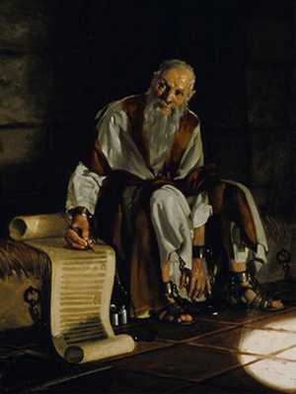
Memory Text:
Ephesians 2:8-10
⁸ For by grace are ye saved through faith; and that not of yourselves: it is the gift of God:
⁹ Not of works, lest any man should boast.
¹⁰ For we are his workmanship, created in Christ Jesus unto good works, which God hath before ordained that we should walk in them.

Slide 3

Ephesians, an Overview:
Eph. 1:1-14—Prayer of Gratitude for God’s Grace
Eph. 1:15-23—Gratitude and Joy in Christ
Eph. 2:1-10—Quickened by God’s Grace
Eph. 2:11-22—One Body by the Cross
Eph. 3—A Prisoner of Christ
Eph. 4:1-16—One Accord
Eph. 4:17-32—Transformation
Eph. 5:1-20—Followers of God
Eph. 5:21-33—Love as Christ Loved the Church
Eph. 6:1-9—Service
12, 13)Eph. 6:10-20—A Call to Arms & Many Examples

Slide 4
Key Ideas: Outlining Ephesians
Opening Greeting (Eph. 1:1, 2)
Part 1: The Doctrinal Section (Eph. 1:3-3:21)
Part 2: The Practical Section (Eph. 4:1-6:20)
Closing Greeting (Ephesians 6:21-24)

Slide 5
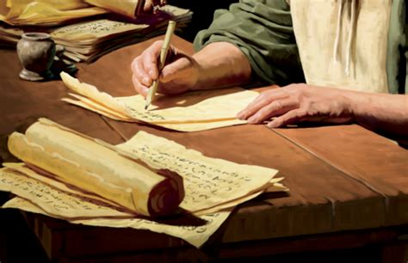
The Closing Greeting:

Slide 6
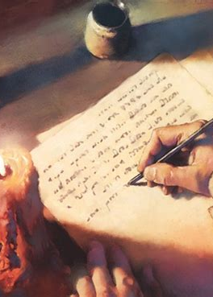
The Closing Greeting:
Ephesians 6:21-24
²¹ But that ye also may know my affairs, and how I do, Tychicus, a beloved brother and faithful minister in the Lord, shall make known to you all things:

Slide 7
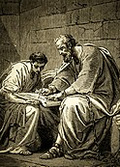
The Closing Greeting:
Ephesians 6:22-24
²² Whom I have sent unto you for the same purpose, that ye might know our affairs, and that he might comfort your hearts.

Slide 8

The Closing Greeting:
Ephesians 6:23-24
²³ Peace be to the brethren, and love with faith, from God the Father and the Lord Jesus Christ.

Slide 9
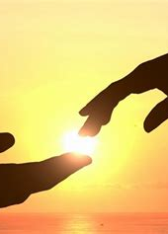
The Closing Greeting:
Ephesians 6:24
²⁴ Grace be with all them that love our Lord Jesus Christ in sincerity. Amen.

Slide 10
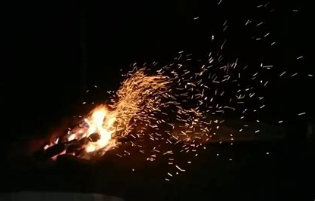
Paul’s Ministry:

Slide 11
A Timeline for Paul’s Ministry:
31 AD:
Crucifixion
Ascension
Pentecost
34 AD:
Stephen stoned;
church persecuted;
gospel carried to Samaria
35 AD:
Paul converted
Paul at Damascus and in Arabia
31 AD
34 AD
37 AD

Slide 12
Galatians 1:15-20
¹⁵ But when it pleased God, who separated me from my mother's womb, and called me by his grace, ¹⁶ To reveal his Son in me, that I might preach him among the heathen; immediately I conferred not with flesh and blood:
38 AD: Paul escapes from Damascus; visits Jerusalem, goes to Tarsus.
40 AD
43 AD
46 AD

Slide 13
Galatians 1:15-20
¹⁷ Neither went I up to Jerusalem to them which were apostles before me; but I went into Arabia, and returned again unto Damascus. ¹⁸ Then after three years I went up to Jerusalem to see Peter, and abode with him fifteen days. ¹⁹ But other of the apostles saw I none, save James the Lord's brother.
38 AD: Paul escapes from Damascus; visits Jerusalem, goes to Tarsus.
40 AD
43 AD
46 AD

Slide 14
Acts 11:25-26 ²⁵ Then departed Barnabas to Tarsus, for to seek Saul:
²⁶ And when he had found him, he brought him unto Antioch. And it came to pass, that a whole year they assembled themselves with the church, and taught much people. And the disciples were called Christians first in Antioch.
44 AD: James brother of John martyred; Peter imprisoned; Agrippa dies. Barnabas brings Paul to Antioch for a year.
38 AD: Paul escapes from Damascus; visits Jerusalem, goes to Tarsus.
40 AD
43 AD
46 AD

Slide 15
Acts 14:19-28 ¹⁹ And there came thither [to Lycaonia, where Paul and Barnabus were teaching] certain Jews from Antioch and Iconium, who persuaded the people, and having stoned Paul, drew him out of the city, supposing he had been dead.
45 AD:
Barnabas and Paul take famine relief to Jerusalem. Paul’s 1st Missionary Journey; on return, Paul remains at Antioch.
44 AD: James brother of John martyred; Peter imprisoned; Agrippa dies. Barnabas brings Paul to Antioch for a year.
38 AD: Paul escapes from Damascus; visits Jerusalem, goes to Tarsus.
40 AD
43 AD
46 AD

Slide 16
Acts 14:19-28 ²⁰ Howbeit, as the disciples stood round about him, he rose up, and came into the city: and the next day he departed with Barnabas to Derbe.
45 AD:
Barnabas and Paul take famine relief to Jerusalem. Paul’s 1st Missionary Journey; on return, Paul remains at Antioch.
44 AD: James brother of John martyred; Peter imprisoned; Agrippa dies. Barnabas brings Paul to Antioch for a year.
38 AD: Paul escapes from Damascus; visits Jerusalem, goes to Tarsus.
40 AD
43 AD
46 AD

Slide 17
Acts 14:19-28 ²¹ And when they had preached the gospel to that city, and had taught many, they returned again to Lystra, and to Iconium, and Antioch,
45 AD:
Barnabas and Paul take famine relief to Jerusalem. Paul’s 1st Missionary Journey; on return, Paul remains at Antioch.
44 AD: James brother of John martyred; Peter imprisoned; Agrippa dies. Barnabas brings Paul to Antioch for a year.
38 AD: Paul escapes from Damascus; visits Jerusalem, goes to Tarsus.
40 AD
43 AD
46 AD

Slide 18
Acts 14:19-28 ²² Confirming the souls of the disciples, and exhorting them to continue in the faith, and that we must through much tribulation enter into the kingdom of God.
45 AD:
Barnabas and Paul take famine relief to Jerusalem. Paul’s 1st Missionary Journey; on return, Paul remains at Antioch.
44 AD: James brother of John martyred; Peter imprisoned; Agrippa dies. Barnabas brings Paul to Antioch for a year.
38 AD: Paul escapes from Damascus; visits Jerusalem, goes to Tarsus.
40 AD
43 AD
46 AD

Slide 19
Acts 14:19-28 ²³ And when they had ordained them elders in every church, and had prayed with fasting, they commended them to the Lord, on whom they believed.
45 AD:
Barnabas and Paul take famine relief to Jerusalem. Paul’s 1st Missionary Journey; on return, Paul remains at Antioch.
44 AD: James brother of John martyred; Peter imprisoned; Agrippa dies. Barnabas brings Paul to Antioch for a year.
38 AD: Paul escapes from Damascus; visits Jerusalem, goes to Tarsus.
40 AD
43 AD
46 AD

Slide 20
Acts 14:19-28 ²⁴ And after they had passed throughout Pisidia, they came to Pamphylia.
²⁵ And when they had preached the word in Perga, they went down into Attalia:
45 AD:
Barnabas and Paul take famine relief to Jerusalem. Paul’s 1st Missionary Journey; on return, Paul remains at Antioch.
44 AD: James brother of John martyred; Peter imprisoned; Agrippa dies. Barnabas brings Paul to Antioch for a year.
38 AD: Paul escapes from Damascus; visits Jerusalem, goes to Tarsus.
40 AD
43 AD
46 AD

Slide 21
Acts 14:19-28 ²⁶ And thence sailed to Antioch, from whence they had been recommended to the grace of God for the work which they fulfilled.
45 AD:
Barnabas and Paul take famine relief to Jerusalem. Paul’s 1st Missionary Journey; on return, Paul remains at Antioch.
44 AD: James brother of John martyred; Peter imprisoned; Agrippa dies. Barnabas brings Paul to Antioch for a year.
38 AD: Paul escapes from Damascus; visits Jerusalem, goes to Tarsus.
40 AD
43 AD
46 AD

Slide 22
Acts 14:19-28 ²⁷ And when they were come, and had gathered the church together, they rehearsed all that God had done with them, and how he had opened the door of faith unto the Gentiles.
²⁸ And there they abode long time with the disciples.
45 AD:
Barnabas and Paul take famine relief to Jerusalem. Paul’s 1st Missionary Journey; on return, Paul remains at Antioch.
44 AD: James brother of John martyred; Peter imprisoned; Agrippa dies. Barnabas brings Paul to Antioch for a year.
38 AD: Paul escapes from Damascus; visits Jerusalem, goes to Tarsus.
40 AD
43 AD
46 AD

Slide 23
Galatians 2:1- 14 Then fourteen years after I went up again to Jerusalem with Barnabas, and took Titus with me also.
² And I went up by revelation, and communicated unto them that gospel which I preach among the Gentiles, but privately to them which were of reputation, lest by any means I should run, or had run, in vain. ³ But neither Titus, who was with me, being a Greek, was compelled to be circumcised:
49 AD: The Jerusalem Council
49 AD
52 AD
55 AD

Slide 24
Galatians 2:1- 14 ⁴ And that because of false brethren unawares brought in, who came in privily to spy out our liberty which we have in Christ Jesus, that they might bring us into bondage:
⁵ To whom we gave place by subjection, no, not for an hour; that the truth of the gospel might continue with you.
⁶ But of these who seemed to be somewhat, (whatsoever they were, it maketh no matter to me: God accepteth no man's person:) for they who seemed to be somewhat in conference added nothing to me:
49 AD: The Jerusalem Council
49 AD
52 AD
55 AD

Slide 25
Galatians 2:1- 14 ⁷ But contrariwise, when they saw that the gospel of the uncircumcision was committed unto me, as the gospel of the circumcision was unto Peter;
⁸ (For he that wrought effectually in Peter to the apostleship of the circumcision, the same was mighty in me toward the Gentiles:)
49 AD: The Jerusalem Council
49 AD
52 AD
55 AD

Slide 26
Galatians 2:1- 14 ⁹ And when James, Cephas, and John, who seemed to be pillars, perceived the grace that was given unto me, they gave to me and Barnabas the right hands of fellowship; that we should go unto the heathen, and they unto the circumcision.
¹⁰ Only they would that we should remember the poor; the same which I also was forward to do.
¹¹ But when Peter was come to Antioch, I withstood him to the face, because he was to be blamed.
49 AD: The Jerusalem Council
49 AD
52 AD
55 AD

Slide 27
Galatians 2:1- 14 ¹² For before that certain came from James, he did eat with the Gentiles: but when they were come, he withdrew and separated himself, fearing them which were of the circumcision.
¹³ And the other Jews dissembled likewise with him; insomuch that Barnabas also was carried away with their dissimulation.
49 AD: The Jerusalem Council
49 AD
52 AD
55 AD

Slide 28
Galatians 2:1- 14 ¹⁴ But when I saw that they walked not uprightly according to the truth of the gospel, I said unto Peter before them all, If thou, being a Jew, livest after the manner of Gentiles, and not as do the Jews, why compellest thou the Gentiles to live as do the Jews?
49 AD: The Jerusalem Council
49 AD
52 AD
55 AD

Slide 29
Acts 18:1-21 After these things Paul departed from Athens, and came to Corinth; ² And found a certain Jew named Aquila, born in Pontus, lately come from Italy, with his wife Priscilla; (because that Claudius had commanded all Jews to depart from Rome:) and came unto them. ³ And because he was of the same craft, he abode with them, and wrought: for by their occupation they were tentmakers.
49 AD: Paul begins 2nd Missionary Journey; preaches in Phrygia, Galatia, and enters Europe.
51 AD:
Paul arrives in Corinth.
49 AD: The Jerusalem Council
49 AD
52 AD
55 AD

Slide 30
Acts 18:1-21 ⁴ And he reasoned in the synagogue every sabbath, and persuaded the Jews and the Greeks. ⁵ And when Silas and Timotheus were come from Macedonia, Paul was pressed in the spirit, and testified to the Jews that Jesus was Christ.
49 AD: Paul begins 2nd Missionary Journey; preaches in Phrygia, Galatia, and enters Europe.
51 AD:
Paul arrives in Corinth.
49 AD: The Jerusalem Council
49 AD
52 AD
55 AD

Slide 31
Acts 18:1-21 ⁶ And when they opposed themselves, and blasphemed, he shook his raiment, and said unto them, Your blood be upon your own heads; I am clean; from henceforth I will go unto the Gentiles.
⁷ And he departed thence, and entered into a certain man's house, named Justus, one that worshipped God, whose house joined hard to the synagogue.
49 AD: Paul begins 2nd Missionary Journey; preaches in Phrygia, Galatia, and enters Europe.
51 AD:
Paul arrives in Corinth.
49 AD: The Jerusalem Council
49 AD
52 AD
55 AD

Slide 32
Acts 18:1-21 ⁸ And Crispus, the chief ruler of the synagogue, believed on the Lord with all his house; and many of the Corinthians hearing believed, and were baptized. ⁹ Then spake the Lord to Paul in the night by a vision, Be not afraid, but speak, and hold not thy peace: ¹⁰ For I am with thee, and no man shall set on thee to hurt thee: for I have much people in this city.
49 AD: Paul begins 2nd Missionary Journey; preaches in Phrygia, Galatia, and enters Europe.
51 AD:
Paul arrives in Corinth.
49 AD: The Jerusalem Council
49 AD
52 AD
55 AD

Slide 33
Acts 18:1-21 ¹¹ And he continued there a year and six months, teaching the word of God among them. ¹² And when Gallio was the deputy of Achaia, the Jews made insurrection with one accord against Paul, and brought him to the judgment seat, ¹³ Saying, This fellow persuadeth men to worship God contrary to the law.
49 AD: Paul begins 2nd Missionary Journey; preaches in Phrygia, Galatia, and enters Europe.
51 AD:
Paul arrives in Corinth.
49 AD: The Jerusalem Council
49 AD
52 AD
55 AD

Slide 34
Acts 18:1-21 ¹⁴ And when Paul was now about to open his mouth, Gallio said unto the Jews, If it were a matter of wrong or wicked lewdness, O ye Jews, reason would that I should bear with you: ¹⁵ But if it be a question of words and names, and of your law, look ye to it; for I will be no judge of such matters. ¹⁶ And he drave them from the judgment seat.
49 AD: Paul begins 2nd Missionary Journey; preaches in Phrygia, Galatia, and enters Europe.
51 AD:
Paul arrives in Corinth.
49 AD: The Jerusalem Council
49 AD
52 AD
55 AD

Slide 35
Acts 18:1-21 ¹⁷ Then all the Greeks took Sosthenes, the chief ruler of the synagogue, and beat him before the judgment seat. And Gallio cared for none of those things. ¹⁸ And Paul after this tarried there yet a good while, and then took his leave of the brethren, and sailed thence into Syria, and with him Priscilla and Aquila; having shorn his head in Cenchrea: for he had a vow.
49 AD: Paul begins 2nd Missionary Journey; preaches in Phrygia, Galatia, and enters Europe.
51 AD:
Paul arrives in Corinth.
49 AD: The Jerusalem Council
49 AD
52 AD
55 AD

Slide 36
Acts 18:1-21 ¹⁹ And he came to Ephesus, and left them there: but he himself entered into the synagogue, and reasoned with the Jews. ²⁰ When they desired him to tarry longer time with them, he consented not; ²¹ But bade them farewell, saying, I must by all means keep this feast that cometh in Jerusalem: but I will return again unto you, if God will. And he sailed from Ephesus.
49 AD: Paul begins 2nd Missionary Journey; preaches in Phrygia, Galatia, and enters Europe.
51 AD:
Paul arrives in Corinth.
49 AD: The Jerusalem Council
49 AD
52 AD
55 AD

Slide 37
Acts 18:22-23 ²² And when he had landed at Caesarea, and gone up, and saluted the church, he went down to Antioch.
²³ And after he had spent some time there, he departed, and went over all the country of Galatia and Phrygia in order, strengthening all the disciples.
52 AD:
End of 2nd Missionary Journey; Paul “some time” at Antioch.
49 AD: Paul begins 2nd Missionary Journey; preaches in Phrygia, Galatia, and enters Europe.
51 AD:
Paul arrives in Corinth.
49 AD: The Jerusalem Council
49 AD
52 AD
55 AD

Slide 38
Acts 20:1-4 And after the uproar [regarding the Ephesian silversmiths] was ceased, Paul called unto him the disciples, and embraced them, and departed for to go into Macedonia. ² And when he had gone over those parts, and had given them much exhortation, he came into Greece,
53-58 AD: Paul’s 3rd Missionary Journey; travels through Asia Minor; 3 yrs at Ephesus, travels Macedonia, 3 mos at Corinth
58 AD
61 AD
64 AD

Slide 39
Acts 20:1-4 ³ And there abode three months. And when the Jews laid wait for him, as he was about to sail into Syria, he purposed to return through Macedonia. ⁴ And there accompanied him into Asia Sopater of Berea; and of the Thessalonians, Aristarchus and Secundus; and Gaius of Derbe, and Timotheus; and of Asia, Tychicus and Trophimus.
53-58 AD: Paul’s 3rd Missionary Journey; travels through Asia Minor; 3 yrs at Ephesus, travels Macedonia, 3 mos at Corinth
58 AD
61 AD
64 AD

Slide 40
Acts 20:22, 37-38 ²² And now, behold, I go bound in the spirit unto Jerusalem, not knowing the things that shall befall me there: ³⁷ And they all wept sore, and fell on Paul's neck, and kissed him, ³⁸ Sorrowing most of all for the words which he spake, that they should see his face no more. And they accompanied him unto the ship.
53-58 AD: Paul’s 3rd Missionary Journey; travels through Asia Minor; 3 yrs at Ephesus, travels Macedonia, 3 mos at Corinth
58 AD
61 AD
64 AD

Slide 41
Acts 21:17-19 ¹⁷ And when we were come to Jerusalem, the brethren received us gladly. ¹⁸ And the day following Paul went in with us unto James; and all the elders were present. ¹⁹ And when he had saluted them, he declared particularly what things God had wrought among the Gentiles by his ministry.
53-58 AD: Paul’s 3rd Missionary Journey; travels through Asia Minor; 3 yrs at Ephesus, travels Macedonia, 3 mos at Corinth
58 AD
61 AD
64 AD

Slide 42
Acts 21:23-24 ²³ Do therefore this that we say to thee: We have four men which have a vow on them; ²⁴ Them take, and purify thyself with them, and be at charges with them, that they may shave their heads: and all may know that those things, whereof they were informed concerning thee, are nothing; but that thou thyself also walkest orderly, and keepest the law.
53-58 AD: Paul’s 3rd Missionary Journey; travels through Asia Minor; 3 yrs at Ephesus, travels Macedonia, 3 mos at Corinth
58 AD
61 AD
64 AD

Slide 43
Acts 21:26-27, 31-33 ²⁶ Then Paul took the men, and the next day purifying himself with them entered into the temple, to signify the accomplishment of the days of purification, until that an offering should be offered for every one of them. ²⁷ And when the seven days were almost ended, the Jews which were of Asia, when they saw him in the temple, stirred up all the people, and laid hands on him,
53-58 AD: Paul’s 3rd Missionary Journey; travels through Asia Minor; 3 yrs at Ephesus, travels Macedonia, 3 mos at Corinth
58 AD
61 AD
64 AD

Slide 44
Acts 21:31-33 ³¹ And as they went about to kill him, tidings came unto the chief captain of the band, that all Jerusalem was in an uproar. ³² Who immediately took soldiers and centurions, and ran down unto them: and when they saw the chief captain and the soldiers, they left beating of Paul. ³³ Then the chief captain came near, and took him, and commanded him to be bound with two chains; and demanded who he was, and what he had done.
53-58 AD: Paul’s 3rd Missionary Journey; travels through Asia Minor; 3 yrs at Ephesus, travels Macedonia, 3 mos at Corinth
58 AD
61 AD
64 AD

Slide 45
Acts 23:23-35 ²³ And he called unto him two centurions, saying, Make ready two hundred soldiers to go to Caesarea, and horsemen threescore and ten, and spearmen two hundred, at the third hour of the night; ²⁴ And provide them beasts, that they may set Paul on, and bring him safe unto Felix the governor.
53-58 AD: Paul’s 3rd Missionary Journey; travels through Asia Minor; 3 yrs at Ephesus, travels Macedonia, 3 mos at Corinth
58 AD
61 AD
64 AD

Slide 46
Acts 23:23-35 ²⁵ And he wrote a letter after this manner:
²⁶ Claudius Lysias unto the most excellent governor Felix sendeth greeting. ²⁷ This man was taken of the Jews, and should have been killed of them: then came I with an army, and rescued him, having understood that he was a Roman.
53-58 AD: Paul’s 3rd Missionary Journey; travels through Asia Minor; 3 yrs at Ephesus, travels Macedonia, 3 mos at Corinth
58 AD
61 AD
64 AD

Slide 47
Acts 23:23-35 ²⁸ And when I would have known the cause wherefore they accused him, I brought him forth into their council: ²⁹ Whom I perceived to be accused of questions of their law, but to have nothing laid to his charge worthy of death or of bonds.³⁰ And when it was told me how that the Jews laid wait for the man, I sent straightway to thee, and gave commandment to his accusers also to say before thee what they had against him. Farewell.
53-58 AD: Paul’s 3rd Missionary Journey; travels through Asia Minor; 3 yrs at Ephesus, travels Macedonia, 3 mos at Corinth
58 AD
61 AD
64 AD

Slide 48
Acts 23:23-35 ³⁴ And when the governor had read the letter, he asked of what province he was. And when he understood that he was of Cilicia; ³⁵ I will hear thee, said he, when thine accusers are also come. And he commanded him to be kept in Herod's judgment hall.
53-58 AD: Paul’s 3rd Missionary Journey; travels through Asia Minor; 3 yrs at Ephesus, travels Macedonia, 3 mos at Corinth
58 AD
61 AD
64 AD

Slide 49
Acts 24:27, 25:8-12 ²⁷ But after two years Porcius Festus came into Felix' room: and Felix, willing to shew the Jews a pleasure, left Paul bound. …
⁸ While he answered for himself, Neither against the law of the Jews, neither against the temple, nor yet against Caesar, have I offended any thing at all.
53-58 AD: Paul’s 3rd Missionary Journey; travels through Asia Minor; 3 yrs at Ephesus, travels Macedonia, 3 mos at Corinth
58-60 AD: Paul imprisoned at Caesarea “two years”
58 AD
61 AD
64 AD

Slide 50
Acts 24:27, 25:8-12 ⁹ But Festus, willing to do the Jews a pleasure, answered Paul, and said, Wilt thou go up to Jerusalem, and there be judged of these things before me? ¹⁰ Then said Paul, I stand at Caesar's judgment seat, where I ought to be judged: to the Jews have I done no wrong, as thou very well knowest.
53-58 AD: Paul’s 3rd Missionary Journey; travels through Asia Minor; 3 yrs at Ephesus, travels Macedonia, 3 mos at Corinth
58-60 AD: Paul imprisoned at Caesarea “two years”
58 AD
61 AD
64 AD

Slide 51
Acts 24:27, 25:8-12 ¹¹ For if I be an offender, or have committed any thing worthy of death, I refuse not to die: but if there be none of these things whereof these accuse me, no man may deliver me unto them. I appeal unto Caesar. ¹² Then Festus, when he had conferred with the council, answered, Hast thou appealed unto Caesar? unto Caesar shalt thou go.
53-58 AD: Paul’s 3rd Missionary Journey; travels through Asia Minor; 3 yrs at Ephesus, travels Macedonia, 3 mos at Corinth
58-60 AD: Paul imprisoned at Caesarea “two years”
58 AD
61 AD
64 AD

Slide 52
Acts 27:1-2 And when it was determined that we should sail into Italy, they delivered Paul and certain other prisoners unto one named Julius, a centurion of Augustus' band. ² And entering into a ship of Adramyttium, we launched, meaning to sail by the coasts of Asia; one Aristarchus, a Macedonian of Thessalonica, being with us.
53-58 AD: Paul’s 3rd Missionary Journey; travels through Asia Minor; 3 yrs at Ephesus, travels Macedonia, 3 mos at Corinth
58-60 AD: Paul imprisoned at Caesarea “two years”
60 -61 AD:
Paul’s journey to Rome
58 AD
61 AD
64 AD

Slide 53
Acts 28:16, 30-31 ¹⁶ And when we came to Rome, the centurion delivered the prisoners to the captain of the guard: but Paul was suffered to dwell by himself with a soldier that kept him.
53-58 AD: Paul’s 3rd Missionary Journey; travels through Asia Minor; 3 yrs at Ephesus, travels Macedonia, 3 mos at Corinth
58-60 AD: Paul imprisoned at Caesarea “two years”
60 -61 AD:
Paul’s journey to Rome
61-63 AD:
Paul a prisoner in Rome “two whole years”
58 AD
61 AD
64 AD

Slide 54
Acts 28:16, 30-31 ³⁰ And Paul dwelt two whole years in his own hired house, and received all that came in unto him,
³¹ Preaching the kingdom of God, and teaching those things which concern the Lord Jesus Christ, with all confidence, no man forbidding him.
53-58 AD: Paul’s 3rd Missionary Journey; travels through Asia Minor; 3 yrs at Ephesus, travels Macedonia, 3 mos at Corinth
58-60 AD: Paul imprisoned at Caesarea “two years”
60 -61 AD:
Paul’s journey to Rome
61-63 AD:
Paul a prisoner in Rome “two whole years”
58 AD
61 AD
64 AD

Slide 55
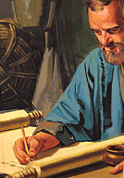
Close of 1st Roman Imprisonment:
Philippians 1:12-14, 2:19, 23-24
¹² But I would ye should understand, brethren, that the things which happened unto me have fallen out rather unto the furtherance of the gospel;
¹³ So that my bonds in Christ are manifest in all the palace, and in all other places;
¹⁴ And many of the brethren in the Lord, waxing confident by my bonds, are much more bold to speak the word without fear.

Slide 56
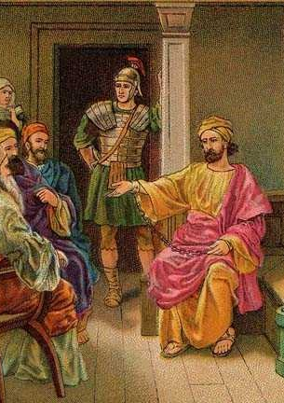
Close of 1st Roman Imprisonment:
Philippians 1:12-14, 2:19, 23-24
⁹ But I trust in the Lord Jesus to send Timotheus shortly unto you, that I also may be of good comfort, when I know your state. ….
²³ Him therefore I hope to send presently, so soon as I shall see how it will go with me.
²⁴ But I trust in the Lord that I also myself shall come shortly.

Slide 57
AA 489 Paul's work among the churches after his acquittal at Rome, could not escape the observation of his enemies. Since the beginning of the persecution under Nero the Christians had everywhere been a proscribed sect. After a time the unbelieving Jews conceived the idea of fastening upon Paul the crime of instigating the burning of Rome. Not one of them thought for a moment that he was guilty; but they knew that such a charge, made with the faintest show of plausibility, would seal his doom. Through their efforts, Paul was again arrested, and hurried away to his final imprisonment.
63-66 AD: Paul travels in Crete, Asia Minor, Macedonia
67 AD
70 AD
73 AD

Slide 58
2 Timothy 4:6-7, 11-13, 16-18
⁶ For I am now ready to be offered, and the time of my departure is at hand.
⁷ I have fought a good fight, I have finished my course, I have kept the faith:
63-66 AD: Paul travels in Crete, Asia Minor, Macedonia
67 AD: Death of Paul and Peter.
67 AD
70 AD
73 AD

Slide 59
2 Timothy 4:6-7, 11-13, 16-18
¹¹ Only Luke is with me. Take Mark, and bring him with thee: for he is profitable to me for the ministry.
¹² And Tychicus have I sent to Ephesus.
¹³ The cloke that I left at Troas with Carpus, when thou comest, bring with thee, and the books, but especially the parchments.
63-66 AD: Paul travels in Crete, Asia Minor, Macedonia
67 AD: Death of Paul and Peter.
67 AD
70 AD
73 AD

Slide 60
2 Timothy 4:6-7, 11-13, 16-18 ¹⁶ At my first answer no man stood with me, but all men forsook me: I pray God that it may not be laid to their charge. ¹⁷ Notwithstanding the Lord stood with me, and strengthened me; that by me the preaching might be fully known, and that all the Gentiles might hear: and I was delivered out of the mouth of the lion. ¹⁸ And the Lord shall deliver me from every evil work, and will preserve me unto his heavenly kingdom: to whom be glory for ever and ever. Amen.
63-66 AD: Paul travels in Crete, Asia Minor, Macedonia
67 AD: Death of Paul and Peter.
67 AD
70 AD
73 AD

Slide 61
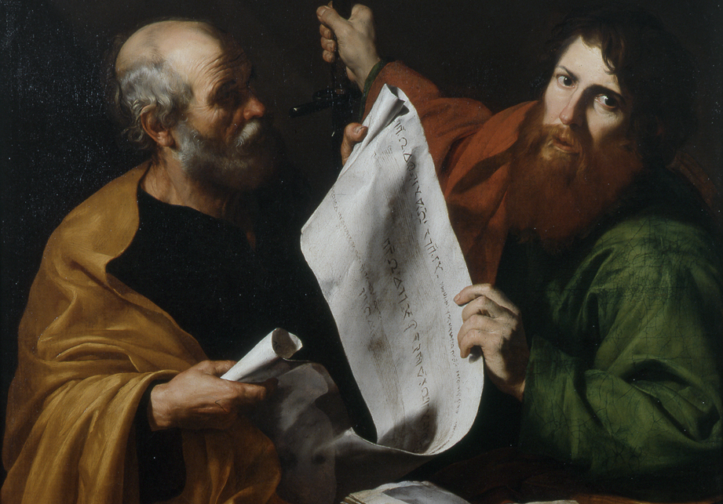
Triumph of Two Apostles:

Slide 62
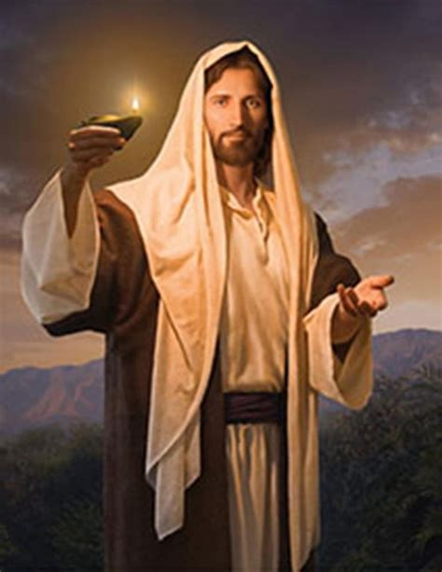
Triumph of Two Apostles:
AA 531
None need fail of attaining, in his sphere, to perfection of Christian character. By the sacrifice of Christ, provision has been made for the believer to receive all things that pertain to life and godliness. God calls upon us to reach the standard of perfection and places before us the example of Christ's character.

Slide 63
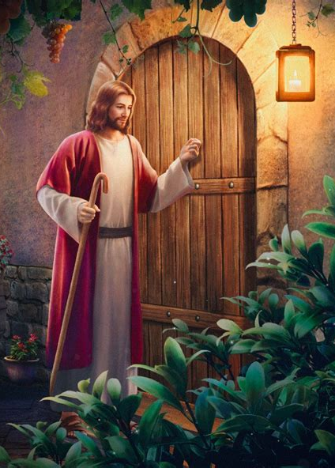
Triumph of Two Apostles:
AA 531
In His humanity, perfected by a life of constant resistance of evil, the Saviour showed that through co-operation with Divinity, human beings may in this life attain to perfection of character. This is God's assurance to us that we, too, may obtain complete victory.

Slide 64
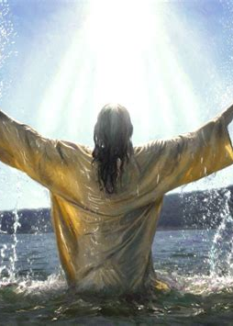
Triumph of Two Apostles:
AA 532
Before the believer is held out the wonderful possibility of being like Christ, obedient to all the principles of the law. But of himself man is utterly unable to reach this condition. The holiness that God's word declares he must have before he can be saved is the result of the working of divine grace …

Slide 65
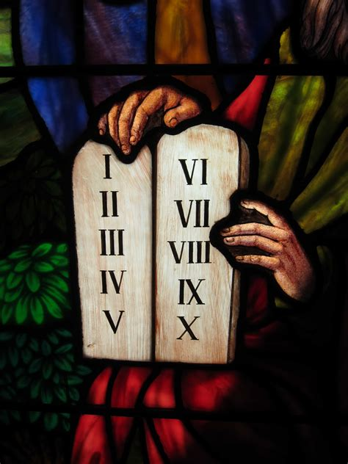
Triumph of Two Apostles:
AA 532
as he bows in submission to the discipline and restraining influences of the Spirit of truth. Man's obedience can be made perfect only by the incense of Christ's righteousness, which fills with divine fragrance every act of obedience. The part of the Christian is to persevere in overcoming every fault.

Slide 66
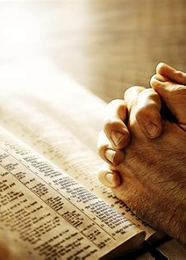
Triumph of Two Apostles:
AA 532
Constantly he is to pray to the Saviour to heal the disorders of his sin-sick soul. He has not the wisdom or the strength to overcome; these belong to the Lord, and He bestows them on those who in humiliation and contrition seek Him for help.

Slide 67

Triumph of Two Apostles:
AA 532
The work of transformation from unholiness to holiness is a continuous one. Day by day God labors for man's sanctification, and man is to co-operate with Him, putting forth persevering efforts in the cultivation of right habits. He is to add grace to grace; and as he thus works on the plan of addition,

Slide 68

Triumph of Two Apostles:
AA 532
God works for him on the plan of multiplication. Our Saviour is always ready to hear and answer the prayer of the contrite heart, and grace and peace are multiplied to His faithful ones. Gladly He grants them the blessings they need in their struggle against the evils that beset them.

Slide 69

Triumph of Two Apostles:
AA 533
The apostle Peter had had a long experience in the things of God. His faith in God's power to save had strengthened with the years, until he had proved beyond question that there is no possibility of failure before the one who, advancing by faith, ascends round by round, ever upward and onward, to the topmost round of the ladder that reaches even to the portals of heaven.

Slide 70
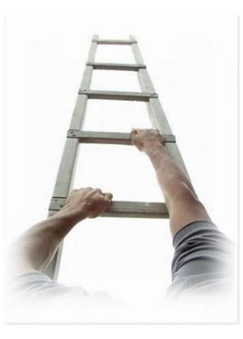
Triumph of Two Apostles:
AA 533
For many years Peter had been urging upon the believers the necessity of a constant growth in grace and in a knowledge of the truth; and now, knowing that soon he would be called to suffer martyrdom for his faith, he once more drew attention to the precious privileges within the reach of every believer.

Slide 71

Triumph of Two Apostles:
AA 533
In the full assurance of his faith the aged disciple exhorted his brethren to steadfastness of purpose in the Christian life. “Give diligence,” he pleaded, “to make your calling and election sure: for if ye do these things, ye shall never fall:

Slide 72
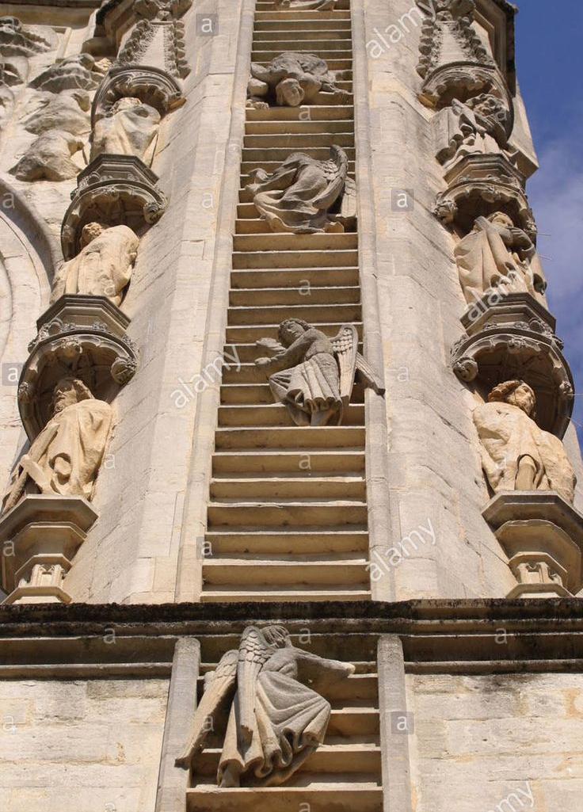
Triumph of Two Apostles:
AA 533
for so an entrance shall be ministered unto you abundantly into the everlasting kingdom of our Lord and Saviour Jesus Christ.” Precious assurance! Glorious is the hope before the believer as he advances by faith toward the heights of Christian perfection!

Slide 73
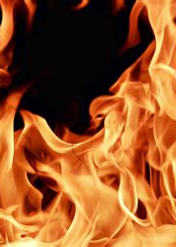
Triumph of Two Apostles:
AA 536
“Seeing then that all these things shall be dissolved, what manner of persons ought ye to be in all holy conversation and godliness, looking for and hasting unto the coming of the day of God, wherein the heavens being on fire shall be dissolved, and the elements shall melt with fervent heat?

Slide 74

Triumph of Two Apostles:
AA 536
Nevertheless we, according to His promise, look for new heavens and a new earth, wherein dwelleth righteousness.
“Wherefore, beloved, seeing that ye look for such things, be diligent that ye may be found of Him in peace, without spot, and blameless.

Slide 75

Triumph of Two Apostles:
AA 536
And account that the long-suffering of our Lord is salvation; even as our beloved brother Paul also according to the wisdom given unto him hath written unto you.... Ye therefore, beloved, seeing ye know these things before, beware lest ye also, being led away with the error of the wicked, fall from your own steadfastness.

Slide 76
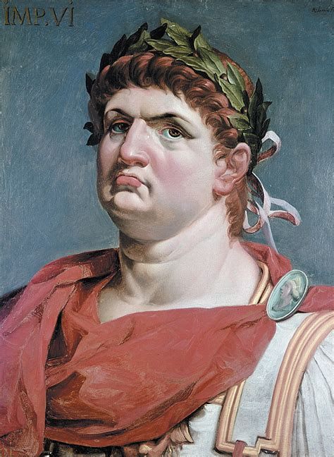
Triumph of Two Apostles:
AA 536-537
But grow in grace, and in the knowledge of our Lord and Saviour Jesus Christ.”
In the providence of God, Peter was permitted to close his ministry in Rome, where his imprisonment was ordered by the emperor Nero about the time of Paul's final arrest.

Slide 77
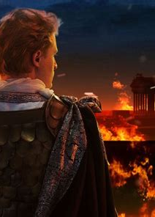
Triumph of Two Apostles:
AA 537
Thus the two veteran apostles, who for many years had been widely separated in their labors, were to bear their last witness for Christ in the world's metropolis, and upon its soil to shed their blood as the seed of a vast harvest of saints and martyrs.

Slide 78
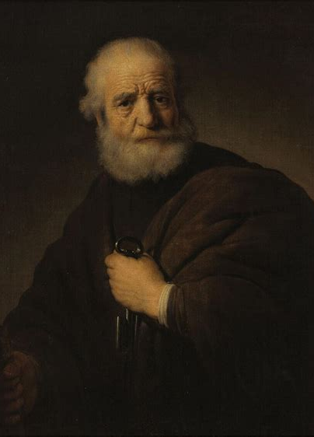
Triumph of Two Apostles:
AA 537
Since his reinstatement after his denial of Christ, Peter had unflinchingly braved danger and had shown a noble courage in preaching a crucified, risen, and ascended Saviour. As he lay in his cell he called to mind the words that Christ had spoken to him:

Slide 79
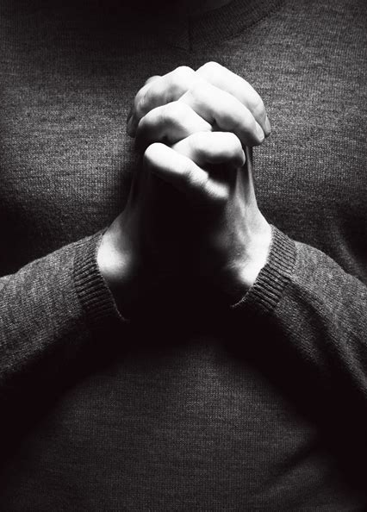
Triumph of Two Apostles:
AA 537
“Verily, verily, I say unto thee, When thou wast young, thou girdedst thyself, and walkedst whither thou wouldest: but when thou shalt be old, thou shalt stretch forth thy hands, and another shall gird thee, and carry thee whither thou wouldest not.” John 21:18.

Slide 80
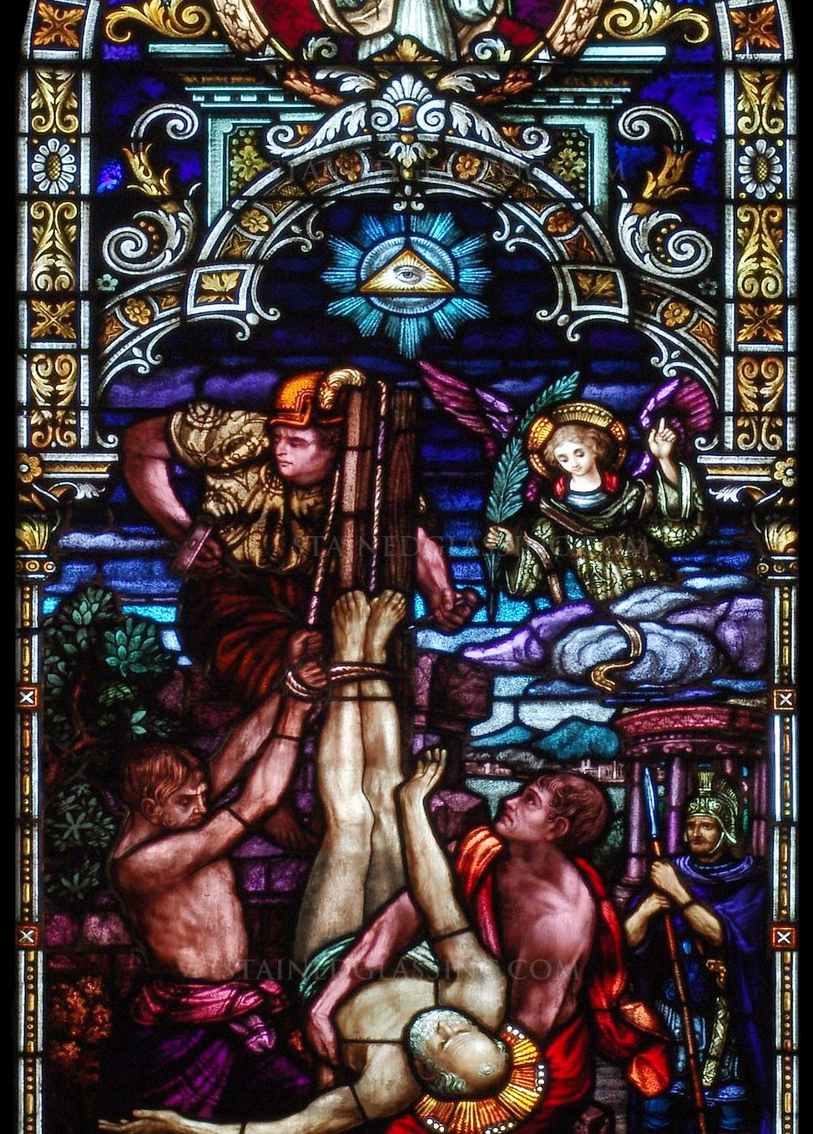
Triumph of Two Apostles:
AA 537
Thus Jesus had made known to the disciple the very manner of his death, and even foretold the stretching of his hands upon the cross.
Peter, as a Jew and a foreigner, was condemned to be scourged and crucified.

Slide 81
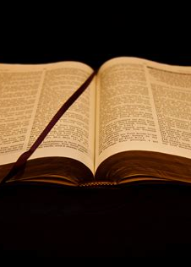
Triumph of Two Apostles:
AA 537
In prospect of this fearful death, the apostle remembered his great sin in denying Jesus in the hour of His trial. Once so unready to acknowledge the cross, he now counted it a joy to yield up his life for the gospel, feeling only that, for him who had denied his Lord, to die in the same manner as his Master died was too great an honor.

Slide 82
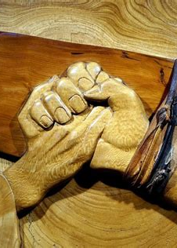
Triumph of Two Apostles:
AA 537
Peter had sincerely repented of that sin and had been forgiven by Christ, as is shown by the high commission given him to feed the sheep and lambs of the flock. But he could never forgive himself. Not even the thought of the agonies of the last terrible scene could lessen the bitterness of his sorrow and repentance.

Slide 83
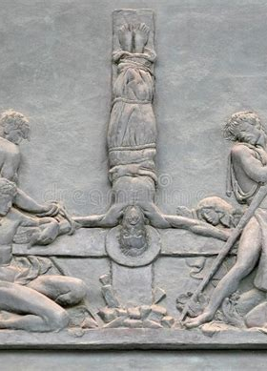
Triumph of Two Apostles:
AA 537
As a last favor he entreated his executioners that he might be nailed to the cross with his head downward. The request was granted, and in this manner died the great apostle Peter.

Slide 84

Triumph of Two Apostles
Ephesians 4:21-24
²¹ If so be that ye have heard him, and have been taught by him, as the truth is in Jesus:
²² That ye put off concerning the former conversation the old man, which is corrupt according to the deceitful lusts;

Slide 85
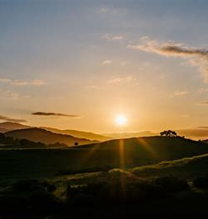
Triumph of Two Apostles
Ephesians 4:21-24
²³ And be renewed in the spirit of your mind;
²⁴ And that ye put on the new man, which after God is created in righteousness and true holiness.

Slide 86
Thank you!
And Happy Sabbath!!

