Slide 1
Genesis 12-14:
The Toledot of Terah
Lesson 6

Slide 2
The Toledot of Terah
God called to Abram and said to him, “Leave your home, your relatives, and your father’s house, and travel to a land that I will show you. And I will make of you a great nation, and bless you. I will make your name great and cause you to be a blessing to others. And I will bless also those that bless you, and curse those that curse you.” So Abram left Ur as God had instructed and headed toward Canaan. With him was his father Terah, his wife Sarai, and his nephew Lot.

Slide 3
The Toledot of Terah
They paused in Haran, where Terah died. Afterward, Abram gathered his family and moved to Canaan. There God appeared to Abram again, and said that He would give the land of Canaan to Abram. Abram settled nearby for a while, then there was a famine in the land. Abram took his family south into Egypt. While he was there, the Pharaoh admired Sarai.

Slide 4
The Toledot of Terah
But Abram lied to the Pharaoh, saying that Sarai was his sister, rather than acknowledging her as his wife. God sent a plague on Pharaoh because he wanted to take Sarai as a wife. When Pharaoh discovered the cause of the plague—that he was about to make a married woman his wife—he sent Sarai back to Abram and asked him to take her and get out of the country. So Abram, Sarai, and Lot traveled back north, toward Canaan.

Slide 5
The Toledot of Terah
Now both Abram and Lot had been materially blessed by God, so that they both had vast herds of animals. There were so many sheep that the land couldn’t support both of their flocks. And there was fighting between Abram’s herdsmen and Lot’s herdsmen for access to the water and the best grazing. So Abram and Lot decided to split up, and Abram gave Lot the choice of the lands that he wanted to inhabit.

Slide 6
The Toledot of Terah
Lot chose the green, well-watered plain of Jordan, and chose to live in the wicked city of Sodom. So Abram left the plain of Jordan to Lot and chose to live in the plain of Mamre, which is in Hebron.
Back in the plain of Jordan, a situation occurred in which four kings (led by Chedorlaomer) made war with five kings, including those of Sodom and Gomorrah.

Slide 7
The Toledot of Terah
The four kings led by Chedorlaomer triumphed over the five kings, and they looted the cities of Sodom and Gomorrah. They also took captives, including Lot and his family. When Abram heard this, her armed his trained servants and pursued the four kings. He attacked them by night and chased them to Hobah. He reclaimed all the loot that had been taken and freed all the captives.

Slide 8
The Toledot of Terah
As Abram was returning from the battle with all the loot and the former captives, he was met by the king of Sodom. “And Melchizedek king of Salem brought forth bread and wine: and he was the priest of the most high God. And he blessed him, and said, Blessed be Abram of the most high God, possessor of heaven and earth: And blessed be the most high God, which hath delivered thine enemies into thy hand. And he gave him tithes of all.” -Genesis 14:18-20

Slide 9
The Toledot of Terah
Then the king of Sodom said to Abram, “You can take all the loot for yourself, please just release my captured people.” But Abram told him that he had promised God that he would not take anything, even a shoelace, as loot for himself. The only thing Abram could not return was that portion of the loot his retainers had used as food and what belonged to his confederates.

Slide 10
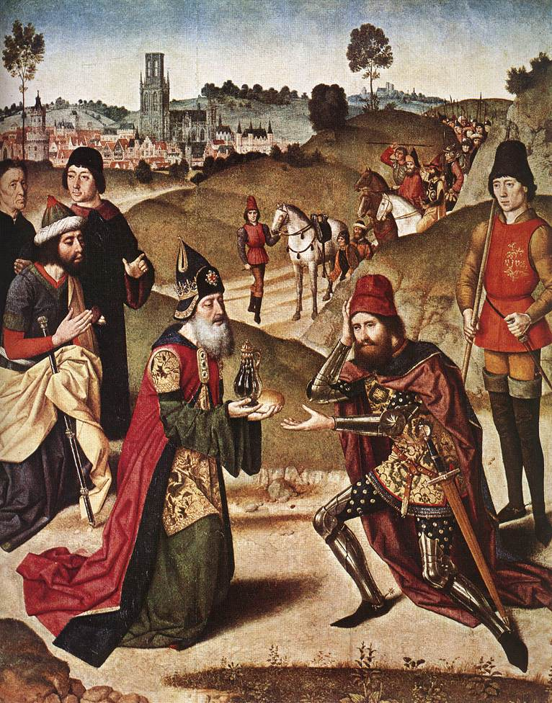
Who is Melchizedek?
Gnostic Ideas
Historical Human
Hellenistic Jewish Interpretations
A Heathen Priest
Shem

Slide 11
Identifying Melchizedek: Whose Priest?
The occurrence of the term “priest” (Kohen) occurs in Genesis 14:18 for the very first time. The word itself implies the existence of a regularly constituted form of sacrificial worship. But the institution of the Levite priesthood was yet hundreds of years in the future.
There have been many suggestions for resolving this situation! One of the easiest is simply the suggestion that Melchizedek was a priest of some other God.

Slide 12
Identifying Melchizedek: Whose Priest?
The name is composed from the two elements: melek(h), "king", and ṣedeq, which means either "righteousness" or the proper name "Zedek” …so that the name literally translates to "king of righteousness" or "my king is Zedek", indicating that he worshipped Zedek, a Canaanite deity worshipped in pre-Israelite Jerusalem.
(Thus making Melchizedek a worshiper of a Canaanite god, Zedek.)
Melchizedek - Wikipedia

Slide 13
Identifying Melchizedek: Whose Priest?
Genesis 14:18 introduces Melchizedek a "Priest of the Most High God" (El Elyon), a term which is re-used in 14:19, 20, 22. Joseph Fitzmyer (1962) connects Genesis 14 with the mention of a god called "Most High," who may appear according to one of three possible translations of a 750 BC inscription found at Al-Safirah in Syria.
(Thus making Melchizedek a priest of some barely known heathen Syrian god whose epithet was “most high”.)
Melchizedek - Wikipedia

Slide 14
Identifying Melchizedek:
God’s Priest
The trouble with identifying Melchizedek as a heathen priest is that Abram appears to accept his blessing. Abram also seems to accept Melchizedek’s commentary that “the most high God” (El Elyon) is responsible for his victory over the kings of the east. Surely, given Abram’s comments to the king of Sodom, Abram would have objected to the attribution of this victory to any one but the Lord God. It seems unlikely also that Abram would give tithe to a heathen priest.

Slide 15
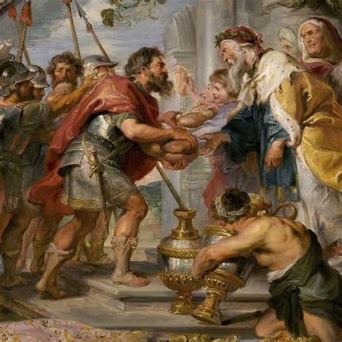
Who is Melchizedek?
Gnostic Ideas
Historical Human
Hellenistic Jewish Interpretations
Shem

Slide 16
Identifying Melchizedek: Shem
Chazalic literature unanimously identify Melchizedek as Shem son of Noah(Targum Yonathan to Genesis chap. 14, Genesis Rabbah 46:7, Babylonian Talmud to Tractate Nedarim 32b). The Talmud Bavli attributes him (Shem and his beth din court of justice) as pioneers in banning prostitution (Avodah Zarah p. 36a).
Melchizedek - Wikipedia

Slide 17
Identifying Melchizedek: Shem
There is, however, disagreement amongst Rishonim as to whether Salem was Melchizedek/Shem's allocated residence by his father Noah or whether he was a foreigner in Salem which was considered the rightful land of his brother Cham. The Ramban is of the opinion that the land was rightfully owned and governed by the offspring of Cham, and explains that Melchizedek/Shem left his home country and came to Salem as a foreigner wishing to serve God as a Kohen. However, Rashi maintains that the land of Canaan was initially allotted to Shem, by Noah his father, and the offspring of Cham conquered the land by forced expansion.
Melchizedek - Wikipedia

Slide 18
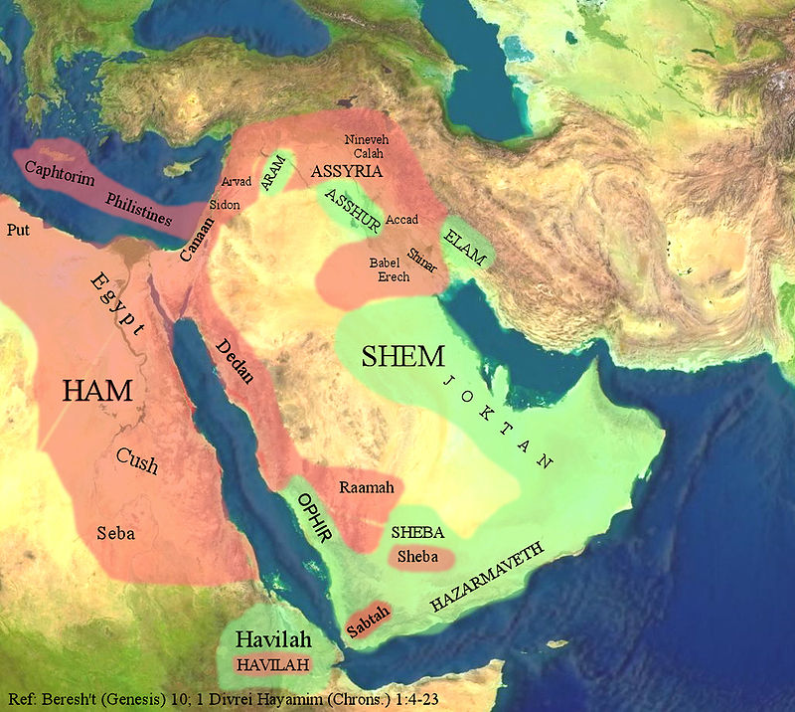
Identifying Melchizedek: Shem

Slide 19
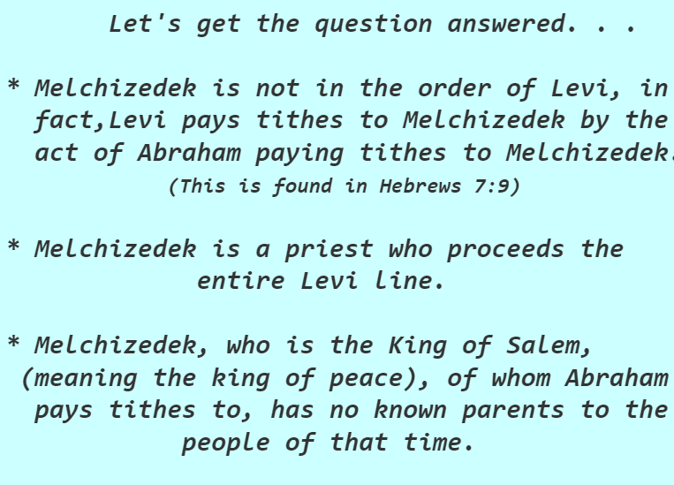
Who is Melchizedek? (bibletruthonline.com)

Slide 20
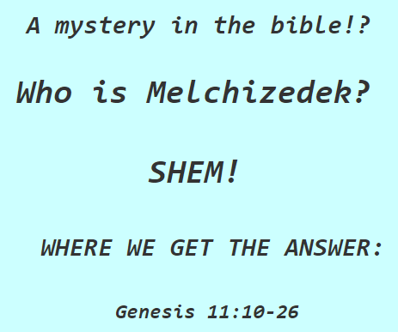
Who is Melchizedek? (bibletruthonline.com)

Slide 21
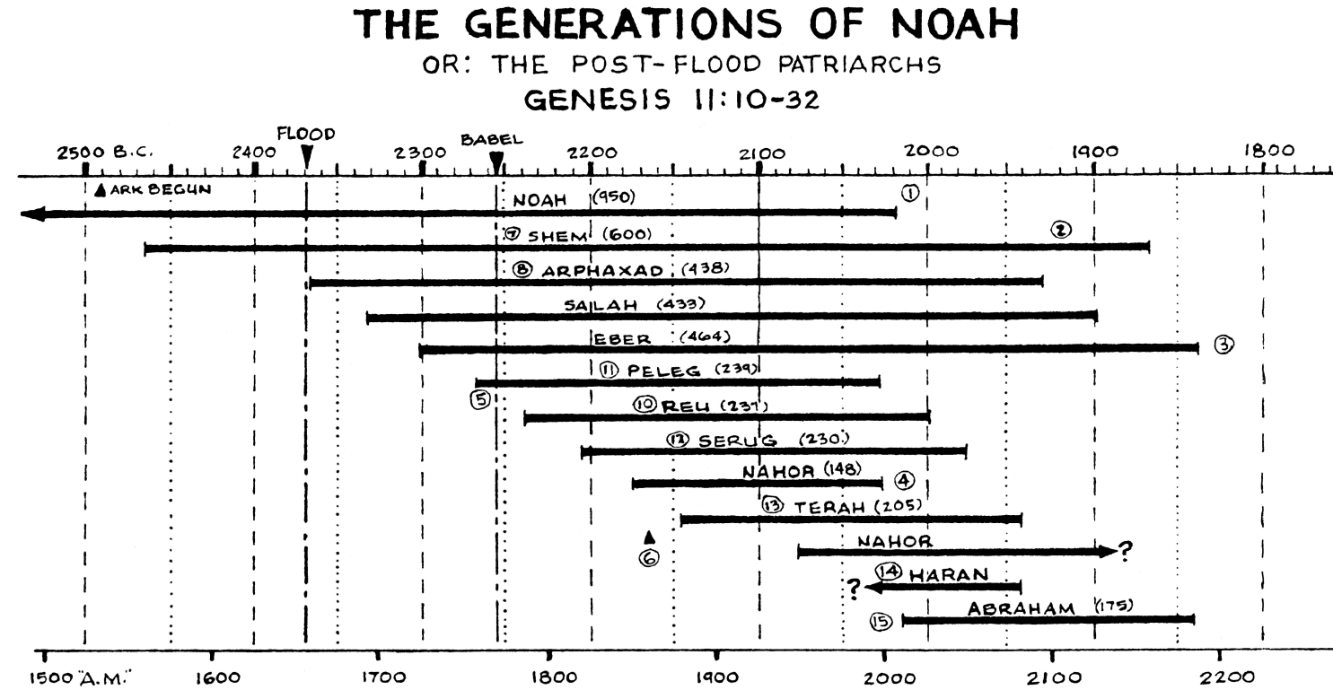
Identifying Melchizedek: Shem

Slide 22
Identifying Melchizedek:
Probably not Shem
It seems that Shem probably was still alive when Abram was freeing Lot. But just because a Bible character was alive during Melchizedek’s time doesn’t make him Melchizedek! That’s fabulously illogical. There’s nothing connecting Shem and Melchizedek besides the coincidence of time.
It does emphasize, though, that there were followers of God existing at the time outside of Abram’s family group!

Slide 23
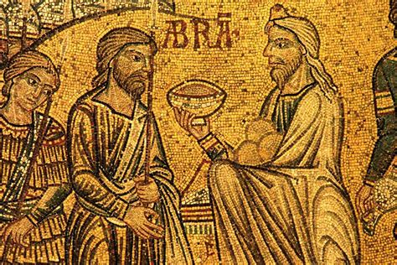
Who is Melchizedek?
Gnostic Ideas
Historical Human
Hellenistic Jewish Interpretations

Slide 24
Identifying Melchizedek:
Jewish Fairytales (in early centuries AD)
The Second Book of Enoch (also called "Slavonic Enoch") is apparently a Jewish sectarian work of the 1st century AD. The last section of the work, the Exaltation of Melchizedek, tells how Melchizedek was born of a virgin, Sofonim (or Sopanima), the wife of Nir, a brother of Noah. The child came out from his mother after she had died and sat on the bed beside her corpse, already physically developed, clothed, speaking and blessing the Lord, and marked with the badge of priesthood. Forty days later, Melchizedek was taken by the archangel Gabriel (Michael in some manuscripts) to the Garden of Eden and was thus preserved from the Deluge without having to be in Noah's Ark.
Melchizedek - Wikipedia

Slide 25
Identifying Melchizedek:
Jewish Fairytales (in early centuries AD)
In the “Story of Melchizedek,” (roughly 3rd century AD) Melchizedek and his brother Melchi are the only sons of the pagan king of Salem, Melchi, son of Salaad and grandson of Queen Salem. Their mother is also named Salem. One day, the king orders Melchizedek to fetch some cattle to sacrifice to idols in the temple of the Twelve Gods. While on his way, Melchizedek observes the sun and contemplates the moon and stars, concluding that the one who created them is the only one worthy of worship. He returns to his father without the cattle and tries to persuade his father to abandon paganism for monotheism. An enraged Melchi decides to sacrifice one of his sons instead. Through his mother's intervention, Melchizedek is spared and his brother is sacrificed (along with hundreds of other boys).
Melchizedek - Wikipedia

Slide 26
Identifying Melchizedek:
Jewish Fairytales (in early centuries AD)
Melchizedek flees Salem for Mount Tabor. As the sacrifice is ongoing, he prays that God would punish all those who take part. The city of Salem and everyone in it, including all of Melchizedek's family, is swallowed up. When he realizes what has happened, Melchizedek returns to Mount Tabor and spends the next seven years completely naked in the forest, living off of berries and dew. Abram goes to Mount Tabor, finds Melchizedek, shaves and clothes him, as God instructed. Three days later, Melchizedek blesses Abram and anoints him Abraham. The two offer sacrifices of bread and wine to God.
Melchizedek - Wikipedia

Slide 27
Identifying Melchizedek:
Jewish Fairytales (in early centuries AD)
These stories are, of course, wildly creative and completely extra-Biblical. You’ll notice they’re also part of the Apocrypha, meaning that they were written down long, long after the encounter between Abram and Melchizedek.
The timing of these writings alone, much less the content, makes these accounts extremely unlikely!
Melchizedek - Wikipedia

Slide 28
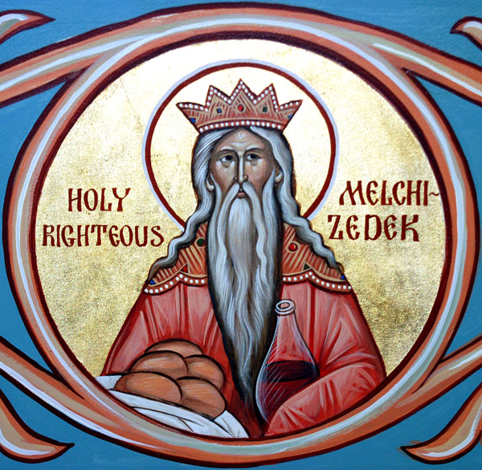
Who is Melchizedek?
Gnostic Ideas
Historical Human

Slide 29
Identifying Melchizedek: Christ Himself
The association or identification of Melchizedek with the Messiah predates Christianity (and thus the discussion in Hebrews), developing in Jewish messianism of the Second Temple period.
A collection of early Gnostic scripts dating on or before the 4th century, discovered in 1945 and known as the Nag Hammadi library, contains a tractate pertaining to Melchizedek. Here it is proposed that Melchizedek is Jesus Christ. Melchizedek, as Jesus Christ, lives, preaches, dies and is resurrected, in a gnostic perspective. The Coming of the Son of God Melchizedek, the first tractate from Codex IX of the Nag Hammadi Library, speaks of his return to bring peace, supported by God, and he is a priest-king who dispenses justice.
Melchizedek - Wikipedia

Slide 30
Identifying Melchizedek: Christ Himself
The text identifies Melchizedek with Jesus Christ; whether this was as a precursor or earlier equivalent, or as exactly the same entity, is disputed by scholars. Melchizedek, as Jesus, lives, preaches, dies, and experiences the resurrection over the Aeons, a Gnostic concept where different emanations of God appear at different stages of history. Melchizedek himself records a revelation given to him by the angel Gabriel, as well as a liturgical rite performed by Melchizedek.
Melchizedek (text) - Wikipedia

Slide 31
Identifying Melchizedek:
Things We Actually Know
There isn’t a lot of data for identifying Melchizedek. He’s mentioned only a few places in the Bible! We know from the Biblical record that
Melchizedek was a “priest of the Most High God,” who was also king of a city-state called Salem (later called Jerusalem) from Genesis 14:18. “And Melchizedek king of Salem brought forth bread and wine: and he was the priest of the most high God.”

Slide 32
Identifying Melchizedek:
Things We Actually Know
Melchizedek was a contemporary of Abram and blessed him, from Genesis 14:19. “And he blessed him, and said, Blessed be Abram of the most high God, possessor of heaven and earth:”
Abram gave tithe to Melchizedek, from Genesis 14:20 and Hebrews 7:4: “And blessed be the most high God, which hath delivered thine enemies into thy hand. And he gave him tithes of all.”

Slide 33
Identifying Melchizedek:
Things We Actually Know
The next mention of Melchizedek in Scripture comes from Psalm 110:
The Lord said unto my Lord, Sit thou at my right hand, until I make thine enemies thy footstool.
² The Lord shall send the rod of thy strength out of Zion: rule thou in the midst of thine enemies.
³ Thy people shall be willing in the day of thy power, in the beauties of holiness from the womb of the morning: thou hast the dew of thy youth.
⁴ The Lord hath sworn, and will not repent, Thou art a priest for ever after the order of Melchizedek.

Slide 34
Identifying Melchizedek:
Things We Actually Know
⁵ The Lord at thy right hand shall strike through kings in the day of his wrath.
⁶ He shall judge among the heathen, he shall fill the places with the dead bodies; he shall wound the heads over many countries.
⁷ He shall drink of the brook in the way: therefore shall he lift up the head.
This psalm of David presents Christ as not only King and Ruler of this world, but also, by God’s solemn oath, as eternal Priest—after the order of Melchizedek.

Slide 35
Identifying Melchizedek:
Things We Actually Know
But Hebrews gives us much greater detail! Check out Hebrews 7:1-2.
7 For this Melchisedec, king of Salem, priest of the most high God, who met Abraham returning from the slaughter of the kings, and blessed him;
² To whom also Abraham gave a tenth part of all; first being by interpretation King of righteousness, and after that also King of Salem, which is, King of peace;

Slide 36
Identifying Melchizedek:
Things We Actually Know
We see from these verses that:
Melchizedek was both king and priest.
His name, Melchizedek, may be translated as
“King of Righteousness” or “my King is Righteousness.”
The word “Salem” means “peace,” so as “king of Salem,” Melchizedek might be properly called “king of peace.”

Slide 37
Identifying Melchizedek:
Things We Actually Know
We continue in Hebrews 7:3
³ Without father, without mother, without descent, having neither beginning of days, nor end of life; but made like unto the Son of God; abideth a priest continually.

Slide 38
Identifying Melchizedek:
Things We Actually Know
This verse has encouraged people to think of Melchizedek as divine. Melchizedek must have been some supernatural being if he were to be literally without parents, without beginning of days, and without end. Such an assertion in its totality can be literally true only of the persons of the Godhead. However, it is not necessary to take this view of the wording. The author may simply mean that there is no record of Melchizedek’s parents, birth, or death.

Slide 39
Identifying Melchizedek:
Things We Actually Know
The Jews were very careful to record and preserve their genealogies, and this was especially true concerning the priests. No one could serve as priest unless he was a direct descendant of Aaron in the tribe of Levi, and this he must be able to prove without any doubt whatever. If there was a break in the line somewhere, he would be counted out and lose the privileges accorded the priests. For this reason, every Jew and particularly the priests carefully preserved their genealogical records.

Slide 40
Identifying Melchizedek:
Things We Actually Know
The priest Melchizedek, other than being briefly mentioned in the account in Genesis, is otherwise unknown. No record of his parentage exists. He stands completely outside the detailed record of the line of Aaron. So possibly the author of Hebrews was simply contrasting this state of being genealogically unknown with the detailed genealogy of the Levitical priesthood.

Slide 41
Identifying Melchizedek:
Things We Actually Know
⁴ Now consider how great this man was, unto whom even the patriarch Abraham gave the tenth of the spoils.
⁵ And verily they that are of the sons of Levi, who receive the office of the priesthood, have a commandment to take tithes of the people according to the law, that is, of their brethren, though they come out of the loins of Abraham:
⁶ But he whose descent is not counted from them received tithes of Abraham, and blessed him that had the promises.
⁷ And without all contradiction the less is blessed of the better.

Slide 42
Identifying Melchizedek:
Things We Actually Know
This passage goes on to describe the superiority of the priesthood of Melchizedek to the priesthood of the Levites. The Levitical priesthood and the ceremonial law were provisional and shadowy, pointing forward to the work that Christ was to perform as our high priest. The ceremonial system expired at the cross. Christ assumed His high priestly office, figuratively after the order of Melchizedek, following the expiration of the law that regulated the Levitical priesthood.

Slide 43
Identifying Melchizedek:
Things We Actually Know
That’s all as far as Bible references to Melchizedek go. There are some others in Hebrews 5 and 6, but they are similar in tone to those that we have already discussed.

Slide 44
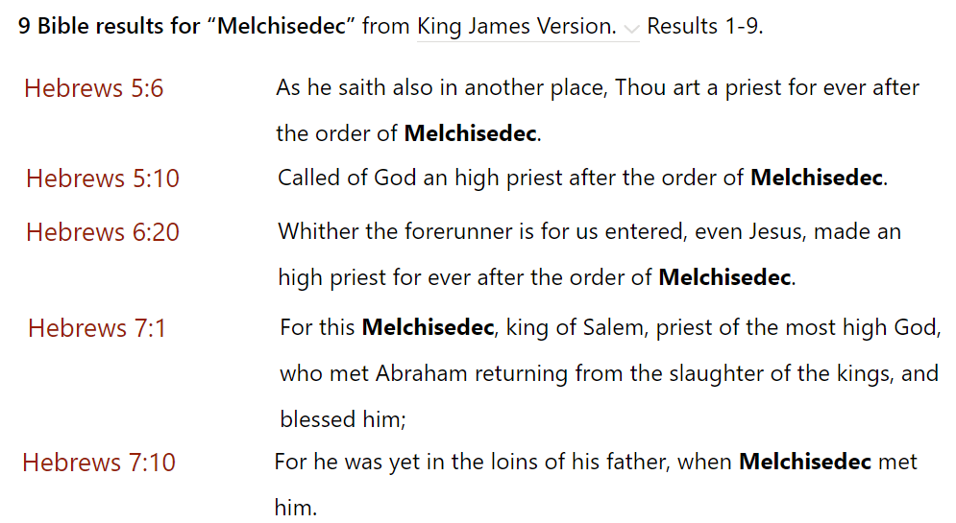
Identifying Melchizedek:
Things We Actually Know

Slide 45
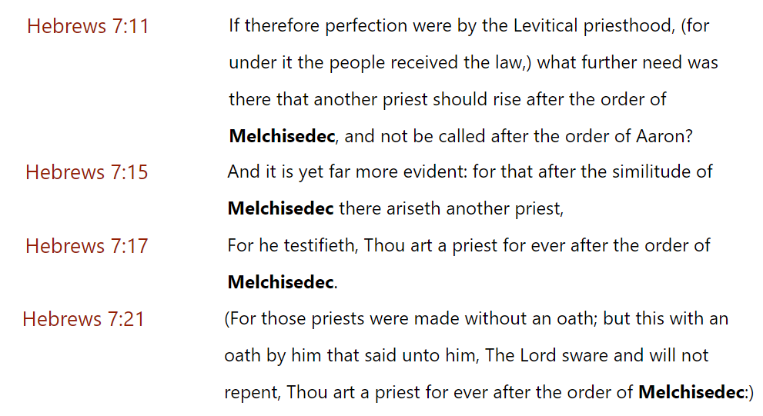
Identifying Melchizedek:
Things We Actually Know

Slide 46
Identifying Melchizedek:
Things We Actually Know
There are only a couple of references to Melchizedek in Ellen White’s writings. In the Desire of Ages, speaking of the triumphal entry of Jesus into Jeruslaem, she makes it clear that Melchizedek is a type of Christ.

Slide 47
Identifying Melchizedek:
Things We Actually Know
E. G. White, Desire of Ages, pg. 578:
“Reports have reached the rulers in Jerusalem that Jesus is approaching the city with a great concourse of people. But they have no welcome for the Son of God. In fear they go out to meet Him, hoping to disperse the throng. As the procession is about to descend the Mount of Olives, it is intercepted by the rulers. They inquire the cause of the tumultuous rejoicing. As they question, “Who is this?” the disciples, filled with the spirit of inspiration, answer this question. In eloquent strains they repeat the prophecies concerning Christ:

Slide 48
Identifying Melchizedek:
Things We Actually Know
E. G. White, Desire of Ages, pg. 578:
Adam will tell you, It is the seed of the woman that shall bruise the serpent's head.
Ask Abraham, he will tell you, It is “Melchizedek King of Salem,” King of Peace. Genesis 14:18.
Jacob will tell you, He is Shiloh of the tribe of Judah.
Isaiah will tell you, “Immanuel,” “Wonderful, Counselor, The mighty God, The everlasting Father, The Prince of Peace.” Isaiah 7:14; 9:6.
Jeremiah will tell you, The Branch of David, “the Lord our Righteousness.” Jeremiah 23:6.

Slide 49
Identifying Melchizedek:
Things We Actually Know
E. G. White, Desire of Ages, pg. 578:
Daniel will tell you, He is the Messiah.
Hosea will tell you, He is “the Lord God of hosts; the Lord is His memorial.” Hosea 12:5.
John the Baptist will tell you, He is “the Lamb of God, which taketh away the sin of the world.” John 1:29.
The great Jehovah has proclaimed from His throne, “This is My beloved Son.” Matthew 3:17.
We, His disciples, declare, This is Jesus, the Messiah, the Prince of life, the Redeemer of the world.
And the prince of the powers of darkness acknowledges Him, saying, “I know Thee who Thou art, the Holy One of God.” Mark 1:24.”

Slide 50
Identifying Melchizedek:
Things We Actually Know
And there is one more reference, in which Ellen White makes Melchizedek’s identity clear. It’s from the Review and Herald, February 18, 1980.

Slide 51
Identifying Melchizedek:
Things We Actually Know
E. G. White, Review and Herald, Feb. 18, 1890, Paragraph 10:
“It was Christ that spoke through Melchisedec, the priest of the most high God. Melchisedec was not Christ, but he was the voice of God in the world, the representative of the Father.”

Slide 52
Thank you!
Happy Sabbath

