Slide 1
Genesis 15-19:
The Covenant
Lesson 7

Slide 2
Genesis 15-19
As you may recall, a lot happens in these chapters! Events include:
God promises Abram an heir of his own blood and descendants to number as the stars.
God promises that Abram will inherit Canaan.
God shows Abram the future: His descendants will be servants in a strange land for 400 years, God will judge the nation that held them and they come out with “great substance” and inherit Canaan. Abram himself will die in peace in “good old age”.

Slide 3
Genesis 15-19
Sarai took Hagar her maid and gave her to her husband to be his wife and have his children.
When Hagar becomes pregnant she begins to look down on Sarai. Sarai resents Hagar and deals “hardly” with her.
Hagar flees to the wilderness where she encounters an angel. The angel assures her that her descendants will be a great multitude. The angel also tells her about Ishmael, her son-to-be, and directs her to return to Abram and Sarai.
Hagar bears Ishmael when Abram is 86.

Slide 4
Genesis 15-19
When Abram is 99, God makes His covenant with Abram and changes his name to Abraham. God also changes Sarai’s name to Sarah and institutes the “sign in the flesh” of His covenant, circumcision.
God promises Abraham a son born of Sarah, Isaac, an heir of the covenant and of the promises.
Abraham and Ishmael, together with all the men of his house, are circumcised in accordance with God’s requirement.

Slide 5
Genesis 15-19
Three “men,” really the Lord and a couple of angels, come by Abraham’s tent. He rushes out to offer them hospitality, including water to wash their feet and food to eat.
Abraham’s heavenly visitor tells him that Sarah would bear a child in nine months’ time. Sarah overhears and laughs, since she had already been through menopause.
God tells Abraham about His plans for Sodom and Gomorrah. Abraham pleads for the people of the cities, and God assures him that He would not destroy the city for the sake of even ten righteous.

Slide 6
Genesis 15-19
Two angels come to Sodom at evening, and Lot invites them to his home. Lot insists, in fact.
The men of Sodom demand that Lot send out the angels so that they can abuse them. Lot refuses in various ways, until the angels pull him back into the house to protect him.
The angels strike the mob with blindness and warn Lot of the coming destruction. Sodom, Gomorrah, and other cities of the plain are destroyed by fire from heaven.
Lot escapes with his two daughters. His wife becomes a pillar of salt as she looks longingly back at the city.

Slide 7
The Sign of the Covenant
Circumcision

Slide 8
Genesis 17:10-14
¹⁰ This is my covenant, which ye shall keep, between me and you and thy seed after thee; Every man child among you shall be circumcised.
¹¹ And ye shall circumcise the flesh of your foreskin; and it shall be a token of the covenant betwixt me and you.
¹² And he that is eight days old shall be circumcised among you, every man child in your generations, he that is born in the house, or bought with money of any stranger, which is not of thy seed..

Slide 9
Genesis 17:13-14
¹³ He that is born in thy house, and he that is bought with thy money, must needs be circumcised: and my covenant shall be in your flesh for an everlasting covenant.
¹⁴ And the uncircumcised man child whose flesh of his foreskin is not circumcised, that soul shall be cut off from his people; he hath broken my covenant.

Slide 10
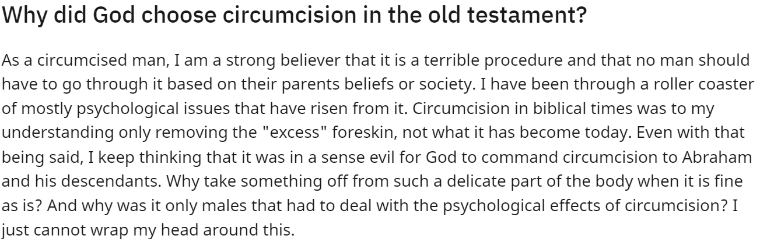
Why Circumcision? (The Crazies)

Slide 11
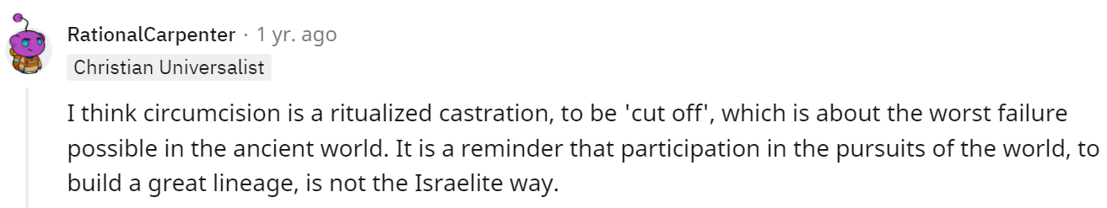
Why Circumcision? (The Crazies)

Slide 12
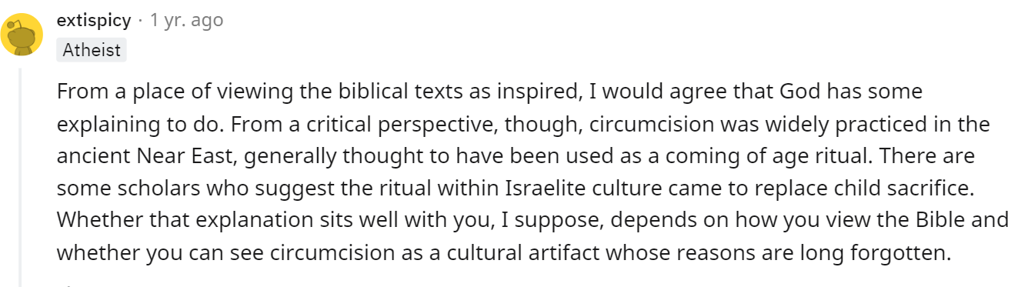
Why Circumcision? (The Crazies)

Slide 13
Why Circumcision?
Surgery seems like a fairly bizarre way to mark the covenant between God and Abraham.
Why would God create foreskins in the first place if He intended them to be removed anyway?
Why should the mark that identifies someone as belonging to God’s people only be put on half the population (the male half)?
Why display the mark of belonging to God’s people in a place that should never be displayed?

Slide 14
Why Circumcision?
The truth is that we can only approach the answers to these questions in a limited way.
God does not always provide a full explanation of His actions to us! Mostly because we wouldn’t be able to understand it anyway.
But there are some interesting things we can learn about this symbol of the covenant between God and man.

Slide 15
Why Circumcision?
Myth #1: A Pagan Inheritance
“Evidence of circumcision from three statues of warriors in North Syria dated around 2800 B.C. provides the earliest evidence of circumcision in the ANE to date. These statues represent the full amputation of the prepuce similar to the operation, which the Hebrews would adopt about a millennium later.”
Meade, John D. “The Meaning of Circumcision in Israel: A Proposal for a Transfer of Rite from Egypt to Israel.” The Southern Baptist Journal of Theology 20, no. 1 (2016): 37.

Slide 16
Why Circumcision?
Myth #1: A Pagan Inheritance
Egypt is not the only African culture that practiced or practices circumcision. It is common among east African peoples and the Bantu, usually as a rite of passage into manhood. Young males of the Xhosa and Zulu ethnic groups traditionally had an elaborate circumcision ritual where their bodies would be painted with whitewash before their circumcision.

Slide 17
Why Circumcision?
Myth #1: A Pagan Inheritance
“In the final analysis, the conclusion that accounted for the most evidence and was able to explain the circumcision of Rā and the circumcision of the royal court of the Pharaoh was that Egyptian circumcision functioned as a specific, voluntary, and initiatory rite to identify and affiliate the subject with the deity and to signify devotion to the same deity.”
The Egyptian god Ra was circumcised. To show their allegiance to their god, the Pharaoh, priests, and the royal court were also circumcised. Circumcision served as an identity marker which permanently associated them with their god, Ra.

Slide 18
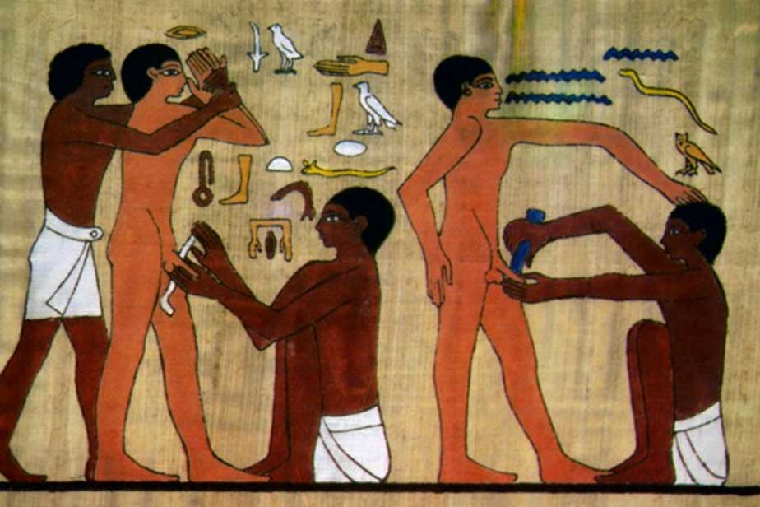
Why Circumcision?
Myth #1: A Pagan Inheritance

Slide 19
Why Circumcision?
Myth #1: A Pagan Inheritance
Egyptian Circumcision
Hebrew circumcision
Took place between the ages of 6 and 14.
Reserved for Egyptian priests and royalty.
Unique surgical technique.
Intended to dedicate the subject to a deity.
Took place at 8 days old.
Intended for every single male within the group.
Unique surgical technique.
Intended to dedicate the subject to God.

Slide 20
Why Circumcision?
Myth #2: Cleanliness and Health
It’s a little strange to call this a myth, because it appears to be basically accurate!
Several current medical studies suggest that circumcision helps prevent urinary-tract infections, penile cancer and HIV and other sexually transmitted diseases.
In 1989, a circumcision task force from the American Academy of Pediatrics justified the practice in part by citing circumcised males' lower incidence of penile cancer.

Slide 21
Why Circumcision?
Myth #2: Cleanliness and Health
And in 2006, the National Institutes of Health released a report saying circumcised adult men may be half as likely to contract the AIDS virus through heterosexual intercourse as their uncircumcised counterparts. Other clinical trials in the 1980s cited a reduced risk as high as 60 percent.
Women also are protected by male circumcision, according to the November 2007 issue of BioEssays. Australian medical professor Brian Morris said that for women, circumcision of the male partner provides more than five times' greater protection from cervical cancer and chlamydia, which can cause pelvic inflammatory disease, infertility and ectopic pregnancy.

Slide 22
Why Circumcision?
Myth #2: Cleanliness and Health
It does seem that circumcision has various health benefits. But we’re talking about a physical sign of the covenant between God and man! Is “it’s healthy” really a meaningful rationale for this?
The thing that makes this reasoning “mythical” is that it opens us up to the argument that God was short-sighted in creating the foreskin in the first place. That is, that it was a bad design, one He had to correct surgically.
“Circumcision is based upon the erroneous principle that boys … are so badly fashioned by Creative Power that they must be reformed by the surgeon,” Elizabeth Blackmore, a 19th-century English doctor.

Slide 23
What we know: Context Clues
Circumcision appears within the context of a promise about the birth of Abraham’s promised heir, Isaac. This is about the identity of a (not yet extant) nation. The Israelites would come about through Abraham’s “seed,” Isaac. By placing the sign of the covenant on the physical organ of reproduction, God may have been emphasizing the transfer of the covenant and His associated promises to future generations of (what would become) Israelites. Certainly that was Abraham’s main concern in this passage! He begins in chapter 15 with the complaint: “And Abram said, Lord God, what wilt thou give me, seeing I go childless, and the steward of my house is this Eliezer of Damascus?”

Slide 24
What we know: Historical Context
Modern standards of behavior don’t necessarily hold when we’re looking at events of the far past. And it seems that circumcision was a more public sign in the past.
In the apocryphal book of 1 Maccabees, we see the statement that in order for the Jews to get along with Gentiles, “they built a gymnasium in Jerusalem, according to Gentile custom, and removed the marks of circumcision, and abandoned the holy covenant. They joined with the Gentiles and sold themselves to do evil,” (1 Maccabees 1:14-15). The word ‘gymnasium’ comes from the ancient Greek term gymnós meaning ‘naked’. This was the way men trained for sport.

Slide 25
What we know: Historical Context
To remove the circumcision bloodlessly, they used a restoration device called the pondus Judaeus (Jewish weight). This “was a special weight made of bronze, copper, or leather, which was fixed to [the] . . . skin and pulled it downward.” When it was applied for a long period of time, the foreskin was lengthened, which covered the exposed glans as desired.
So we know that at some points in history, the fact that a young man was circumcised was on full display to society. And there were, correspondingly, young men who sought to hide their circumcision, or even to undo it, using the device mentioned. Modern versions of this sort of device exist today.

Slide 26
What we know: Symbolism
From very early in history it’s clear that circumcision was a symbol of purity and complete commitment to God.
Deuteronomy 10:16 says, “Circumcise therefore the foreskin of your heart, and be no more stiffnecked.” So it’s a heart change, not a body change, that is truly represented by circumcision.
The act of cutting off a sensitive portion of one’s flesh as a symbol of commitment to God is mentioned also in the New Testament! Take a look at Mark 9:43.

Slide 27
What we know: Symbolism
Mark 9:43 says, “And if thy hand offend thee, cut it off: it is better for thee to enter into life maimed, than having two hands to go into hell, into the fire that never shall be quenched:”
We are supposed to sacrifice self-indulgence and sin in order to be truly committed to our heavenly Father. Cutting off such parts of our lives sometimes seems just as hard as cutting off a bit of flesh! Circumcision, for the Hebrews, may have been symbolic of this willingness to “cut off” any parts of their lives that deviated from God’s law.

Slide 28
Counter to the Covenant
Sodom and Gomorrah

Slide 29
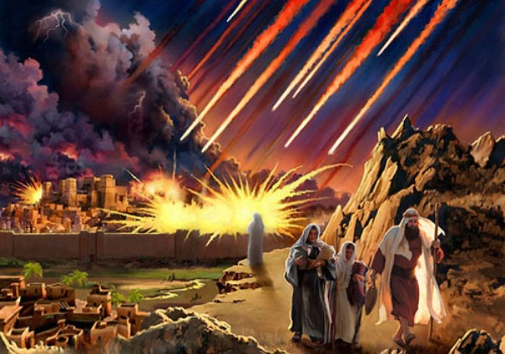

Slide 30
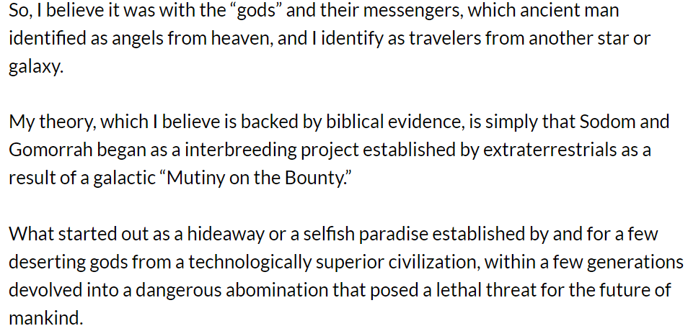
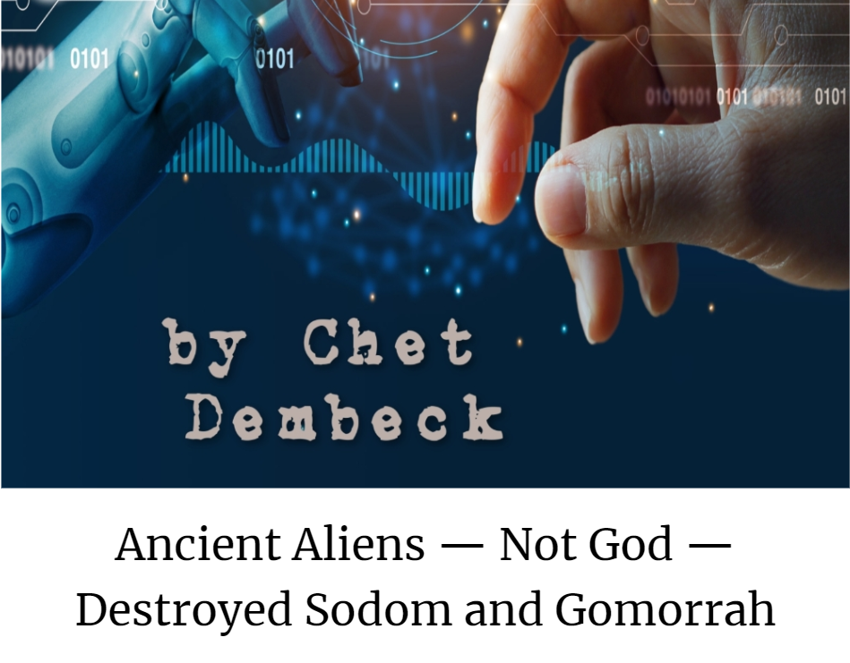
Why did God destroy Sodom and Gomorrah?
(The Crazies)
Ancient Aliens - Not God - Destroyed Sodom and Gomorrah - Unknown Boundaries

Slide 31
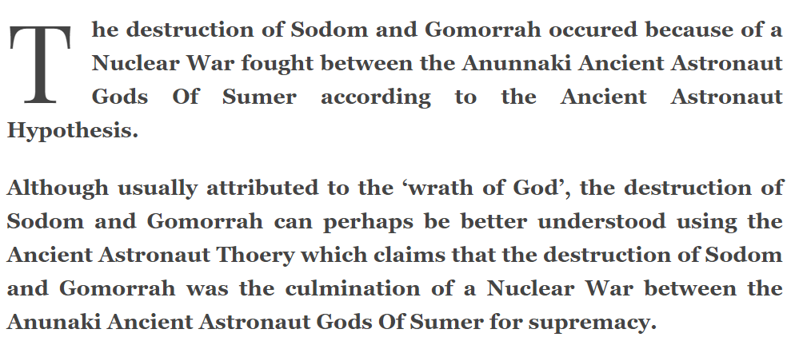
Why did God destroy Sodom and Gomorrah?
(The Crazies)
The Anunnaki Alien Nuclear War (afrikaiswoke.com)

Slide 32
Why did God destroy Sodom and Gomorrah?
(The Crazies)
For Genesis 19, the ideology is homophobia; the existence of the words 'sodomy' and 'sodomite' testify to its sorry career in Christianity. The fate of these cities is held up by religious conservatives to justify the suppression of non-heterosexual people and to fan hatred of same sex eroticism and gender fluidity. The story represents, for Christianity, a tale "of homophobic genocide" signifying the "culture's desire that gay people not be".
Sodom and Gomorrah: What Was the Primary Sin? | Answers in Genesis

Slide 33
Why did God destroy Sodom and Gomorrah?
(The Crazies)
Thus, even if the angels had been consenting, it is wrong to read the Sodomite's demand as anything else but an act of abuse of outsiders. The threatened rape of the angels is an attempt to inscribe outsiders as queer and therefore not real men… But in attempting to inscribe the outsider as queer the Sodomites are also attempting to inscribe the queer as outsider. Thus the tensions of homosexual panic amongst the men of Sodom are relieved in a way that confirms their own heterosexuality. Rather than reading the attempted rape of the angels as an instance of homosexual violence I believe it should be more accurately read as an instance of homophobic violence.
Sodom and Gomorrah: What Was the Primary Sin? | Answers in Genesis

Slide 34
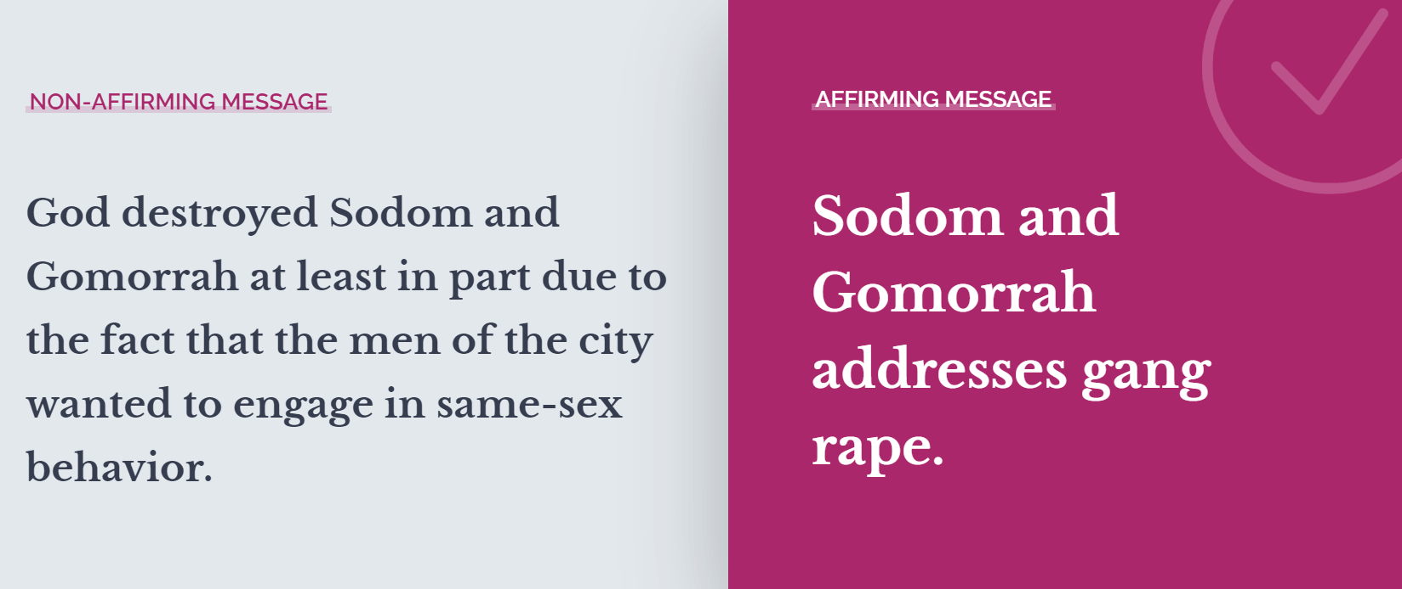
Why did God destroy Sodom and Gomorrah?
(The Mainstream Crazies)
Sodom and Gomorrah addresses gang rape, not a loving relationship. - The Reformation Project

Slide 35
Why did God destroy Sodom and Gomorrah?
This is a surprisingly loaded question!
What was the sin of Sodom and Gomorrah that led to their destruction? In today’s social and political climate, various religious and academic authorities advocate for a more politically correct interpretation of the Biblical story.
There are several possibilities that are widely recognized. For example, Yale historian John Boswell offers four possible reasons for the destruction of Sodom:

Slide 36
Why did God destroy Sodom and Gomorrah?
1. The Sodomites were destroyed for the general wickedness which had prompted the Lord to send angels to the city to investigate in the first place;
2. the city was destroyed because the people of Sodom had tried to rape the angels;
3. The city was destroyed because the men of Sodom had tried to engage in homosexual intercourse with the angels.;
4. The city was destroyed for inhospitable treatment of visitors sent from the Lord.

Slide 37
Why did God destroy Sodom and Gomorrah?
Boswell expands on the fourth explanation. It’s the one he seems to favor as most consistent with “modern scholarship.”
“Lot was violating the custom of Sodom...by entertaining unknown guests within the city walls at night without obtaining the permission of the elders of the city. When the men of Sodom gathered around to demand that the strangers be brought out to them, “that they might know them,” they meant no more than to “know” who they were, and the city was consequently destroyed not for sexual immorality, but for the sin of inhospitality to strangers.”

Slide 38
Why did God destroy Sodom and Gomorrah?
Englishman D. Sherwin Bailey also argues this way in Homosexuality and the Western Christian Tradition (1955). The men of Sodom wanted to interrogate Lot’s guests to see if they were spies. The sin of gang rape is also a possible reason for the destruction. But not homosexuality. In a broader sense, the men of Sodom were inhospitable to Lot’s guests.
Apparently, it did not occur to Boswell that possibilities 2 and 4 are at odds. If “to know” the angels means merely to interrogate them, then there is no attempted rape, only an attempted interrogation. If, on the other hand, the men meant to have sexual relations with the visitors (the traditional view) and are guilty of attempted rape, then the interrogation explanation must be abandoned.

Slide 39
Why did God destroy Sodom and Gomorrah?
Boswell’s second possibility is problematic anyway.
We know that God had already determined that Sodom and Gomorrah would be destroyed BEFORE the angels even entered Sodom. God told Abraham what He would do.
Sodom could not have been destroyed for attempted gang rape of the angels because their judgement had already been pronounced before they attempted any such thing.
Boswell’s third possibility, that Sodom’s sin was attempted homosexual contact with the angels, is problematic too for the same reasons.

Slide 40
Why did God destroy Sodom and Gomorrah?
Boswell’s fourth possibility is a popular one with mainstream politically correct Christians. But it does have some problems. First, the suggestion itself is an odd one. To say that the men of Sodom were inhospitable because of the attempted rape is much like saying a husband who’s just beaten his wife is an insensitive spouse. It may be true, but it’s hardly a meaningful observation given the greater crime.
Second—and more to the textual evidence—it doesn’t fit the collective biblical description of the conduct that earned God’s wrath: a corrupt, lawless, sensuous activity that Lot saw and heard day after day, in which the men went after strange flesh.

Slide 41
What we know: 2 Peter 2:6-8
6 And turning the cities of Sodom and Gomorrha into ashes condemned them with an overthrow, making them an ensample unto those that after should live ungodly;
7 And delivered just Lot, vexed with the filthy conversation of the wicked:
8 (For that righteous man dwelling among them, in seeing and hearing, vexed his righteous soul from day to day with their unlawful deeds;)

Slide 42
What we know: Jude 7-8
7 Even as Sodom and Gomorrha, and the cities about them in like manner, giving themselves over to fornication, and going after strange flesh, are set forth for an example, suffering the vengeance of eternal fire.
8 Likewise also these filthy dreamers defile the flesh, despise dominion, and speak evil of dignities.

Slide 43
What we know: Ezekiel 16:48-50
48 As I live, saith the Lord God, Sodom thy sister hath not done, she nor her daughters, as thou hast done, thou and thy daughters.
49 Behold, this was the iniquity of thy sister Sodom, pride, fulness of bread, and abundance of idleness was in her and in her daughters, neither did she strengthen the hand of the poor and needy.
50 And they were haughty, and committed abomination before me: therefore I took them away as I saw good.

Slide 44
Why did God destroy Sodom and Gomorrah?
The prevailing modern view of the sin of Sodom and Gomorrah is that the attempted rape of Lot’s visitors violated the Mid-East’s high code of hospitality (19:9). This inhospitality, however, is an inference, not a specific point made in the text itself.
Further, the inhospitality charge is dependent upon—and eclipsed by—the greater crime of rape, yet neither could be the sin of Sodom and Gomorrah because God planned to judge the cities long before either had been committed. What possibility is left?

Slide 45
Why did God destroy Sodom and Gomorrah?
Homosexuality fits the biblical details. It was the sin that epitomized the gross wickedness of Sodom and Gomorrah—the “grave,” “ungodly,” “lawless,” “sensual conduct of unprincipled men” that tormented Lot as he “saw and heard” it “day after day,” the “corrupt desire” of those that went after “strange flesh.”
Yet it isn’t solely homosexual behavior that God decries in Sodom. We see that in Ezekiel 16, in addition to “abominations” which certainly include inappropriate sexual behavior, Sodom is charged with idleness, arrogance, and cruelty to the poor. Sodom is in defiance of God’s law, His covenant. This is greatly exemplified by their sexual sins, but is not limited to that behavior.

Slide 46
Why did God destroy Sodom and Gomorrah?
Sodom and Gomorrah have rejected God’s leading and His laws. As a consequence, they have given themselves up to sensual indulgence without restraint. But it is the rejection of God that causes their destruction!
In these chapters we contrast Abraham’s adherence to the covenant with Sodom’s rejection of it. We see Abraham’s hospitality in contrast with Sodom’s. And we see that as always there is a choice between two fates! Choosing adherence to God is always the smarter move!

Slide 47
Thank you!
Happy Sabbath!

