Slide 1
Genesis 20-25:
The Faith of Abraham
Lesson 8

Slide 2
Genesis 22:1-3
22 And it came to pass after these things, that God did tempt Abraham, and said unto him, Abraham: and he said, Behold, here I am.
² And he said, Take now thy son, thine only son Isaac, whom thou lovest, and get thee into the land of Moriah; and offer him there for a burnt offering upon one of the mountains which I will tell thee of.
³ And Abraham rose up early in the morning, and saddled his ass, and took two of his young men with him, and Isaac his son, and clave the wood for the burnt offering, and rose up, and went unto the place of which God had told him.

Slide 3
Genesis 22:4-6
⁴ Then on the third day Abraham lifted up his eyes, and saw the place afar off.
⁵ And Abraham said unto his young men, Abide ye here with the ass; and I and the lad will go yonder and worship, and come again to you.
⁶ And Abraham took the wood of the burnt offering, and laid it upon Isaac his son; and he took the fire in his hand, and a knife; and they went both of them together.

Slide 4
Genesis 22:7-9
⁷ And Isaac spake unto Abraham his father, and said, My father: and he said, Here am I, my son. And he said, Behold the fire and the wood: but where is the lamb for a burnt offering?
⁸ And Abraham said, My son, God will provide himself a lamb for a burnt offering: so they went both of them together.
⁹ And they came to the place which God had told him of; and Abraham built an altar there, and laid the wood in order, and bound Isaac his son, and laid him on the altar upon the wood.

Slide 5
Genesis 22:10-12
¹⁰ And Abraham stretched forth his hand, and took the knife to slay his son.
¹¹ And the angel of the Lord called unto him out of heaven, and said, Abraham, Abraham: and he said, Here am I.
¹² And he said, Lay not thine hand upon the lad, neither do thou any thing unto him: for now I know that thou fearest God, seeing thou hast not withheld thy son, thine only son from me.

Slide 6
Genesis 22:10-12
¹³ And Abraham lifted up his eyes, and looked, and behold behind him a ram caught in a thicket by his horns: and Abraham went and took the ram, and offered him up for a burnt offering in the stead of his son.
¹⁴ And Abraham called the name of that place Jehovahjireh: as it is said to this day, In the mount of the Lord it shall be seen.

Slide 7
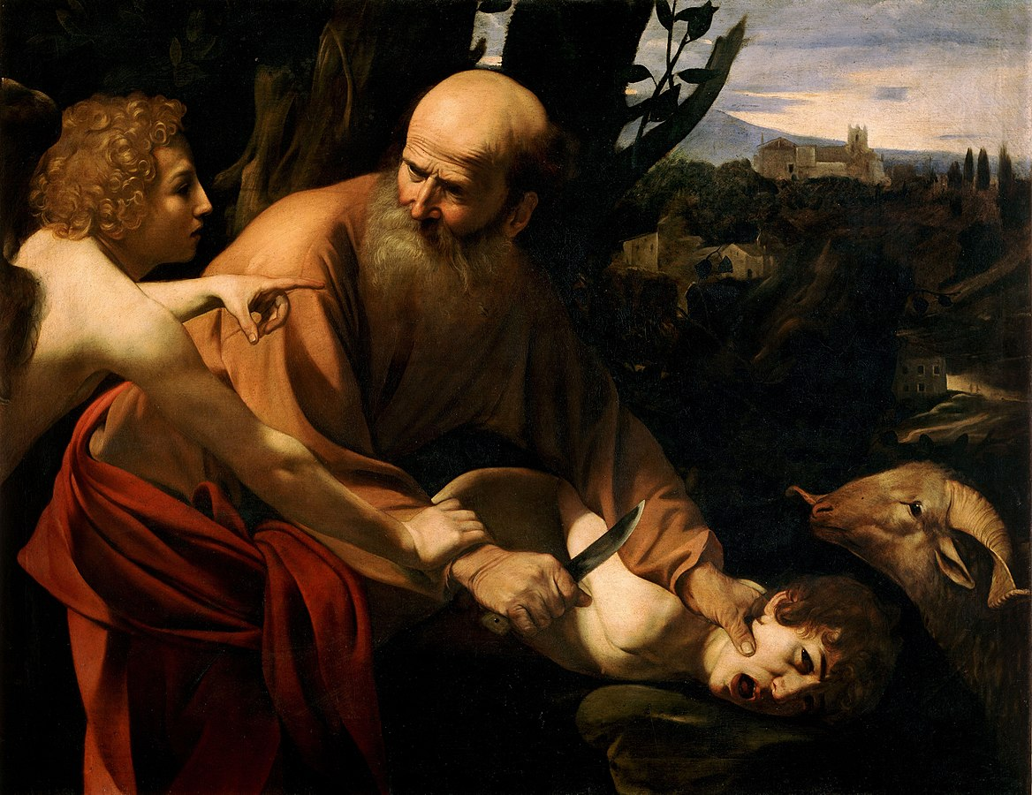

Slide 8
Challenges with this story:
God—the same God who calls child sacrifice an abomination—commands Abraham to sacrifice his “only” son.
Which is curious because Abraham actually has two, namely Ishmael and Isaac.
When Isaac notices the lack of a sacrificial animal, Abraham tells him that God will supply it.
Abraham actually attempts to sacrifice his son, which is credited to him as great faithfulness.

Slide 9
What son did Abraham sacrifice?
Genesis 22:2 “And he said, Take now thy son, thine only son Isaac, whom thou lovest, and get thee into the land of Moriah; and offer him there for a burnt offering upon one of the mountains which I will tell thee of.”
The issue is that there are actually two sons of Abraham, namely, Ishmael and Isaac.

Slide 10
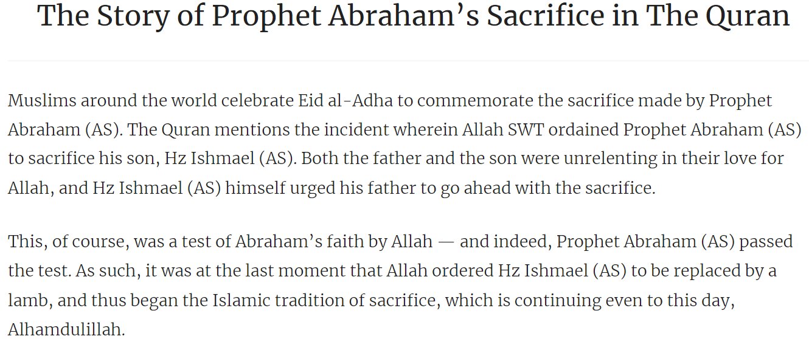
Which Son? (A Muslim Perspective)
The Story of Prophet Abraham's Sacrifice in The Quran - Quranic Quotes

Slide 11
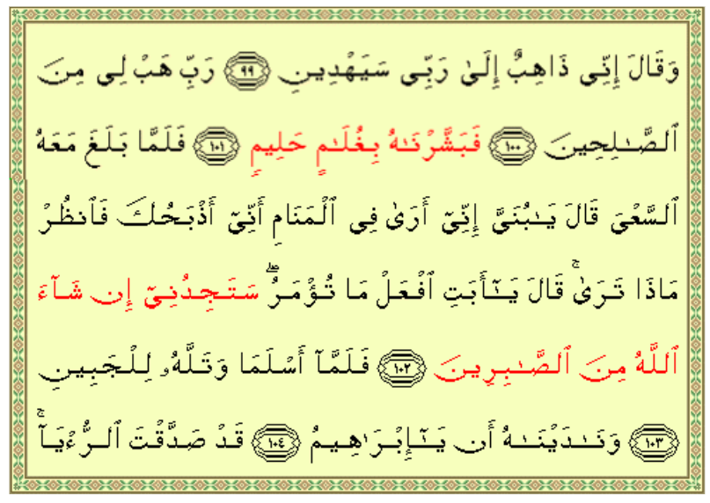
Which Son? (A Muslim Perspective)
The Sacrifice Of Abraham (islamic-awareness.org)

Slide 12
Which Son? (A Muslim Perspective)
99. He said: "I will go to my Lord! He will surely guide me
100. "O my Lord! Grant me a righteous (son)!"
101. So We gave him the good news of a forbearing son.
102. Then, when (the son) reached (the age of) (serious) work with him, he said: "O my son! I have seen in a vision that I offer thee in sacrifice: now see what is thy view!" (The son) said: "O my father! Do as thou art commanded: thou will find me, if Allah so wills, one of the steadfast!"
103. So when they had both submitted (to Allah), and he had laid him prostrate on his forehead (for sacrifice),
104. We called out to him "O Abraham! ...
105. "Thou hast already fulfilled the vision!" - thus indeed do We reward those who do right.
The Sacrifice Of Abraham (islamic-awareness.org)

Slide 13
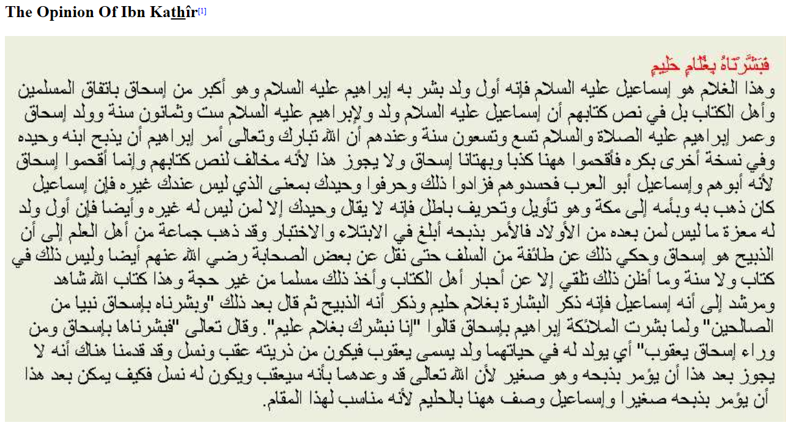
Which Son? (A Muslim Perspective)
This is a section of Muslim commentary on this excerpt from the Qur’an:
“So We gave him the good news of a forbearing son.”
The Sacrifice Of Abraham (islamic-awareness.org)

Slide 14
Which Son? (A Muslim Perspective)
This is a section of Muslim commentary on this excerpt from the Qur’an:
“So We gave him the good news of a forbearing son.”
“And this son is Ishmael^{(P)} for he is the first son whose good news was brought to Abraham^{(P)}. He is older than Isaac according to Muslims and ahl al-kitâb (i.e., the People of the Book) too. It is even said in their Scripture that Ishmael^{(P)} was born when Abraham^{(P)} was 86 years old and Isaac^{(P)} was born when Abraham^{(P)} was 99. In their Scripture as well, God is said to have ordered Abraham^{(P)} to sacrifice his only son and in another version his firstborn. And, at this spot, they inserted falsely the name of Isaac^{(P)} against the text of their very Scripture.”
The Sacrifice Of Abraham (islamic-awareness.org)

Slide 15
Which Son? (A Muslim Perspective)
This is a section of Muslim commentary on this excerpt from the Qur’an:
“So We gave him the good news of a forbearing son.”
“The reason they inserted Isaac^{(P)} is that he is their father whereas Ishmael^{(P)} is the father of the Arabs. They added Isaac^{(P)} out of envy and brushed away "only son" by saying that Ishmael^{(P)} and his mother had already been to Makkah. This is a mere [farfetched] explanation since we never say "only son" except to a person who hasn't got but one son. Moreover, the firstborn has got a special place [in the heart of his father] that is not given to the following children and the order to sacrifice him is therefore a greater test.”
The Sacrifice Of Abraham (islamic-awareness.org)

Slide 16
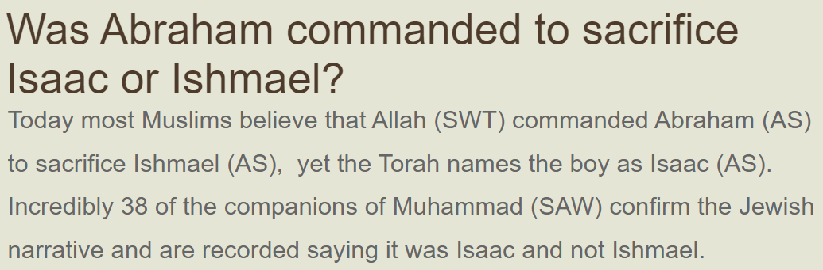
Which Son? (A Muslim Perspective)
Was Abraham commanded to sacrifice Isaac or Ishmael? | Judaism and Islam – comparing the similarities between Judaism and Islam (judaism-islam.com)

Slide 17
Which Son? (A Muslim Perspective)
Was Abraham commanded to sacrifice Isaac or Ishmael? | Judaism and Islam – comparing the similarities between Judaism and Islam (judaism-islam.com)
Since its beginnings Islam’s finest scholars have debated which son Abraham was commanded to sacrifice, yet both Judaism and Christianity host no such discussion. The reason for this is simple, the Torah names Isaac multiple times, while Quran keeps the boy’s identity secret. In the absence of a name Muslim scholars sought answers from those who walked with Muhammad and it is their opinions that we wish to explore.

Slide 18
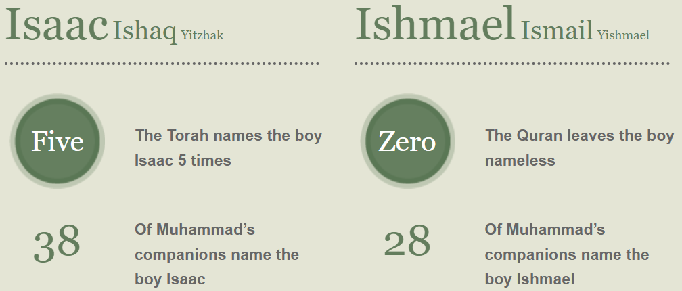
Which Son? (A Muslim Perspective)
Was Abraham commanded to sacrifice Isaac or Ishmael? | Judaism and Islam – comparing the similarities between Judaism and Islam (judaism-islam.com)

Slide 19
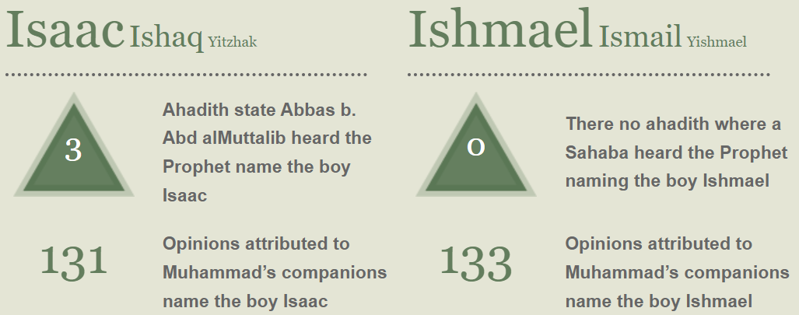
Which Son? (A Muslim Perspective)
Was Abraham commanded to sacrifice Isaac or Ishmael? | Judaism and Islam – comparing the similarities between Judaism and Islam (judaism-islam.com)

Slide 20
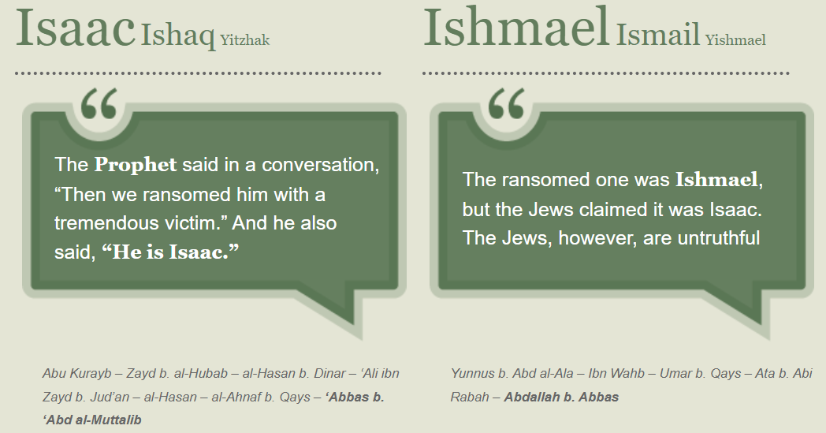
Which Son? (A Muslim Perspective)
Was Abraham commanded to sacrifice Isaac or Ishmael? | Judaism and Islam – comparing the similarities between Judaism and Islam (judaism-islam.com)

Slide 21
The Binding of Isaac
(A Jewish Perspective)
The first-century C.E. Jewish historian Flavius Josephus describes Isaac as a 25-year-old who rushes to the altar, knowing that he is to be the victim. According to this portrayal, in future times of distress, God will remember Isaac’s binding, the Akedah, and heed the prayers of the Jewish people for deliverance from enemies. As the text says, “Because you have done this…I will bestow my blessing upon you and make your descendants as numerous as the stars of heaven and the sands on the seashore” (Genesis 22:16–17). That is why the shofar the ram’s horn is blown at Rosh Hashanah to remind God of the Akedah and his promise; the shofar represents the horn of the ram that was substituted for Isaac.
The Binding or Sacrifice of Isaac - Biblical Archaeology Society

Slide 22
The Binding of Isaac
(A Jewish Perspective)
In later rabbinic collections, Isaac is portrayed as an adult of 37 years, fully aware of what is going to happen to him. He not only accepts the role he is to play, but begs Abraham to bind him lest he struggle in fear, thus invalidating the sacrifice. The Jerusalem Talmud summarizes the tradition that Isaac’s release is the equivalent of all Israel’s release. Abraham received from God, as a reward for his obedience, God’s own future intercession for Isaac’s descendants when they should fall into sin. Remembering the Akedah, God will suppress his wrath and have mercy on his people.
The Binding or Sacrifice of Isaac - Biblical Archaeology Society

Slide 23
The Binding of Isaac
(A Jewish Perspective)
According to the Genesis story, Isaac’s sacrifice was interrupted and the ram substituted. However, several ancient traditions refer to Isaac’s ashes or blood; some accounts even say that Isaac actually died and was revived. Does Genesis itself hint at this? After God tells Abraham that, because of what he has done, his descendants will be like the stars of the heaven and the sands of the sea, “Abraham then returned to his servants, and they departed together for Beer-sheba” (Genesis 22:19). Why no mention of Isaac? What happened to him? Was there another version of the story with a different ending? In any event, in all these traditions, Isaac’s ashes are the symbol of his merit, and the Akedah is the fulfilled expiatory sacrifice.
The Binding or Sacrifice of Isaac - Biblical Archaeology Society

Slide 24
The Sacrifice of Isaac
(A Philosophical Perspective)
*Kierkegaard was a Danish Christian philosopher known as the “father of existentialism.” He was born in 1813 and died in 1855.
First I wish to turn to Kierkegaard's Fear and Trembling, since it has been very influential in Christian thinking about ethics in relation to the Abraham story. I dislike the book intensely and do not wish to get into a long discussion about it. But I will comment briefly. In Kierkegaard's terms, an ethical man is good, but the man of faith is best, and Abraham is the quintessential man of faith.
Should We Admire Abraham's Willingness - Markkula Center for Applied Ethics (scu.edu)

Slide 25
The Sacrifice of Isaac
(A Philosophical Perspective)
Indeed, for Kierkegaard, Abraham's temptation or trial was precisely what he called "the ethical," that standard of human morality that would condemn murder, especially of one's own child. Abraham resists the temptation of the ethical and makes the "leap of faith." Kierkegaard places Abraham above the law…His act can be distinguished from murder only if he can be seen as somehow more than human and therefore beyond human categories. Faith, he says, is "a paradox which is capable of transforming a murder into a holy act, well-pleasing to God."
Should We Admire Abraham's Willingness - Markkula Center for Applied Ethics (scu.edu)

Slide 26
The Sacrifice of Isaac
(A Philosophical Perspective)
I don't think so. Why should such an act be pleasing to God? What kind of God would find that pleasing? Why is faith not demonstrated by the love, care and protection of the child (and other people)? Why should faith first require allegiance to God and only secondarily to fellow humans?
Should We Admire Abraham's Willingness - Markkula Center for Applied Ethics (scu.edu)

Slide 27
The Sacrifice of Isaac
(A Philosophical Perspective)
Today, people who hear voices—even those who claim they hear God speaking to them—are labeled as insane. A chapter in my book describes a trial that happened here in California of a man who sacrificed his child, claiming that God told him to. He was serious and had all the right theological arguments, even though he was relatively uneducated man. He was convicted of murder in the first degree in the first phase of the trial, but in the second phase he was acquitted on the basis of insanity. He did not go free; instead he’s in an institution for the criminally insane rather than in prison.
Should We Admire Abraham's Willingness - Markkula Center for Applied Ethics (scu.edu)

Slide 28
The Sacrifice of Isaac
(A Philosophical Perspective)
But if we deem him insane, why don’t we re-read the Abraham story in that light? Why do we accept that God spoke to him and asked for such a sacrifice?
"If God should really speak to man, man could still never know that it was God speaking. It is quite impossible for man to apprehend the infinite by his senses, distinguish it from sensible beings, and recognize it as such. But in some cases man can be sure the voice he hears is not God’s. For if the voice commands him to do something contrary to moral law, then no matter how majestic the apparition may be, and no matter how it may seem to surpass the whole of nature, he must consider it an illusion.“—Kant (an early humanist)
Should We Admire Abraham's Willingness - Markkula Center for Applied Ethics (scu.edu)

Slide 29
The Sacrifice of Isaac
(A *Nontraditional* Christian Perspective)
I’ve heard lots of explanations over the years about the faithfulness of Abraham in this story. Yes, Abraham is striving to be obedient to God in every detail of his life. But is has always bothered me that people rarely question the idea of God telling Abraham to do something that was against His will: to kill your own child and the heir to God’s unfolding plan. In fact, it was a pagan ritual of the prevailing cultures.
We love to say that God is omniscient–all knowing. If that’s really true, He already knew that Abraham was faithful and did not need to test him.
Was It Really God Who Told Abraham to Sacrifice Isaac? ~ The Bible Speaks to You)

Slide 30
The Sacrifice of Isaac
(A *Nontraditional* Christian Perspective)
Abraham came out of a culture where sacrifice of the first born child was one of highest expressions of devotion in the attempt to please and/or appease certain heathen gods.
Abraham had rejected this polytheistic culture because he heard God’s voice and was coming to know the one, true God.
Why would God tell him to do this? Why would God tell Abraham to revert to a pagan practice to show his faithfulness?
Was It Really God Who Told Abraham to Sacrifice Isaac? ~ The Bible Speaks to You)

Slide 31
The Sacrifice of Isaac
(A *Nontraditional* Christian Perspective)
Now if you take the literal meaning of practically any English translation of the Bible, it will say that God tempted/tested Abraham’s faith by telling him to sacrifice his son. But if you look at everything the Bible says about the nature of God and what He tells people to do, there is an enormous incongruity here.
James 1:13 makes it clear, “for God cannot be tempted with evil, neither tempteth he any man.”
Was It Really God Who Told Abraham to Sacrifice Isaac? ~ The Bible Speaks to You)

Slide 32
The Sacrifice of Isaac
(A *Nontraditional* Christian Perspective)
Elohim is one of the names the Bible uses for God. But it’s an irregular noun. Normally, the suffix im makes masculine Hebrew nouns plural, as in the expression elohim achairim, which means other gods. We know that because achairim is a plural form of the adjective other, which is only used with plural nouns.
When Elohim refers to the one God, it takes singular adjectives and verbs, Dr. Baumgarten said.
Was It Really God Who Told Abraham to Sacrifice Isaac? ~ The Bible Speaks to You)

Slide 33
The Sacrifice of Isaac
(A *Nontraditional* Christian Perspective)
In the original Hebrew “Binding of Isaac” story , Elohim is used with singular nouns and verbs, except in Verse 1. There, the Bible uses ha-elohim. The Hebrew prefix ha- means the. So the word can be interpreted as the gods.
After that, there is no question that Elohim refers to the One God of Abraham, who stops the child sacrifice at the last minute. That is much more appropriate behavior for the just, merciful God of the Old Testament.
The more I have studied and prayed about this passage, the more I have come to the conclusion that it was not actually God telling Abraham to commit this pagan ritual.
Was It Really God Who Told Abraham to Sacrifice Isaac? ~ The Bible Speaks to You)

Slide 34
The Sacrifice of Isaac
(A *Nontraditional* Christian Perspective)
Abraham lived in the city of Ur, which is in the Mesopotamia region.
The Canaanites were his nearby neighbours.
Amongst these people, it was a custom to sacrifice human children to their “gods”.
So human sacrifice was the norm in the area which Abraham lived.
Satan caused these negative influences to infiltrate his mind.
God told Abraham to offer up Isaac to Him, as a burnt offering.
Abraham, being negatively influenced by the cultures and rituals that took place around him, interpreted this instruction from God, very wrongly.
Did God really tell Abraham to Kill his own son? | Bible of God

Slide 35
The Sacrifice of Isaac
(A *Nontraditional* Christian Perspective)
Abraham should have remembered that God is the one who gave the instruction. He should have remembered the nature of God, and understood that God would not request something like that of him or anyone else.
God never told Abraham to walk with wood or a knife; never told him to light a fire for the offering. All of that was Abraham’s own worldly reasoning, based on what Satan infiltrated into his mind.
All God asked of Abraham, was to put his son to serve and commit himself to God, for the rest of his life.
This is what “burnt offering” means in this context.
Did God really tell Abraham to Kill his own son? | Bible of God

Slide 36
Abraham’s Trial of Faith:
The Two Sons
Galatians 4:22-24 (There is only ONE son of promise!)
²² For it is written, that Abraham had two sons, the one by a bondmaid, the other by a freewoman.
²³ But he who was of the bondwoman was born after the flesh; but he of the freewoman was by promise.
²⁴ Which things are an allegory: for these are the two covenants; the one from the mount Sinai, which gendereth to bondage, which is Agar.

Slide 37
Abraham’s Trial of Faith:
The Two Sons
Galatians 4:28-31
²⁸ Now we, brethren, as Isaac was, are the children of promise.
²⁹ But as then he that was born after the flesh persecuted him that was born after the Spirit, even so it is now.
³⁰ Nevertheless what saith the scripture? Cast out the bondwoman and her son: for the son of the bondwoman shall not be heir with the son of the freewoman.
³¹ So then, brethren, we are not children of the bondwoman, but of the free.

Slide 38
Abraham’s Trial of Faith:
The Tempting of Abraham
We know from James 1:13 that God never “tempts” any man to evil. But He does sometimes permit circumstances to arise which prove a person’s faith. That’s because of the great controversy between God and Satan in which we serve as witnesses that God is both merciful and just. This situation is larger than all of our personal circumstances. Consider Job, for example, who served as God’s example of a faithful man before all the leaders of other worlds! Abraham, likewise, is “proved” or “tempted” as the father of the faithful, demonstrating that he would be willing to sacrifice that which matters most to him at God’s direction.

Slide 39
Abraham’s Trial of Faith:
The Tempting of Abraham
We know from James 1:13 that God never “tempts” any man to evil. But He does sometimes permit circumstances to arise which prove a person’s faith. That’s because of the great controversy between God and Satan in which we serve as witnesses that God is both merciful and just. This situation is larger than all of our personal circumstances. Consider Job, for example, who served as God’s example of a faithful man before all the leaders of other worlds! Abraham, likewise, is “proved” or “tempted” as the father of the faithful, demonstrating that he would be willing to sacrifice that which matters most to him at God’s direction.

Slide 40
Abraham’s Trial of Faith:
God’s Unusual Request
God did request that Abraham take Isaac and offer him as a burnt offering, which is a shocking request!
2 Chronicles 28:3
Moreover he burnt incense in the valley of the son of Hinnom, and burnt his children in the fire, after the abominations of the heathen whom the Lord had cast out before the children of Israel.
It’s shocking because child sacrifice was an abomination to God.

Slide 41
Abraham’s Trial of Faith:
God’s Unusual Request
Fortunately, Abraham was already certain that Isaac wouldn’t really die. God had said that Isaac’s descendants would be many, which wouldn’t be possible if he died.
Hebrews 11:17-19
¹⁷ By faith Abraham, when he was tried, offered up Isaac: and he that had received the promises offered up his only begotten son,
¹⁸ Of whom it was said, That in Isaac shall thy seed be called:
¹⁹ Accounting that God was able to raise him up, even from the dead; from whence also he received him in a figure.

Slide 42
Abraham’s Trial of Faith:
God’s Unusual Request
Fortunately, Abraham was already certain that Isaac wouldn’t really die. God had said that Isaac’s descendants would be many, which wouldn’t be possible if he died.
Hebrews 11:17-19
¹⁷ By faith Abraham, when he was tried, offered up Isaac: and he that had received the promises offered up his only begotten son,
¹⁸ Of whom it was said, That in Isaac shall thy seed be called:
¹⁹ Accounting that God was able to raise him up, even from the dead; from whence also he received him in a figure.

Slide 43
Abraham’s Trial of Faith:
Isaac’s Faith
Interestingly, most traditions insist that Isaac complied willingly. He trusted in God, knew the promises, and he must have trusted his father’s faith in God. The Muslim tradition describes Isaac’s willing compliance, and various Jewish traditions do the same. Practically, Abraham was an old man and Isaac was in the prime of life. It’s unlikely that Abraham could have forced his son to comply, even if he had the heart to do so (which seems unlikely). But the Bible records only this conversation:

Slide 44
Abraham’s Trial of Faith:
The Offering
Genesis 22: 7-8
⁷ And Isaac spake unto Abraham his father, and said, My father: and he said, Here am I, my son. And he said, Behold the fire and the wood: but where is the lamb for a burnt offering?
⁸ And Abraham said, My son, God will provide himself a lamb for a burnt offering: so they went both of them together.

Slide 45
Abraham’s Trial of Faith:
The Offering
From the SDA Quarterly on this lesson:
When Isaac asked about the sacrificial animal, Abraham gave an intriguing answer: God will “provide for Himself the lamb for a burnt offering” (Gen. 22:8, NKJV). Yet, the Hebrew verbal form can actually mean “God will provide Himself as the lamb.” The verb “provide” (yir’eh lo) is used in a way that can mean “provide Himself” (or literally, “see Himself”).
What we are being shown here, then, is the essence of the plan of salvation, with the Lord Himself suffering and paying in Himself the penalty for our sins!

Slide 46
Abraham’s Trial of Faith:
The Offering
This brings us to the real crux of the matter. In addition to serving as an opportunity for Abraham to “prove” his faith, this story shows Isaac as a type of Christ, as Christians have long recognized.
Here we see yet another example to the people of the plan of salvation. Jesus has taken the place of sinners as He provided the ram to take the place of Abraham’s son Isaac.

Slide 47
Abraham’s Trial of Faith:
The Offering
“Christians, on the other hand, have from earliest times understood Isaac as a prefiguration of Christ, the beloved son offered as the expiatory sacrifice for the people’s sin. The textual parallels between Jesus and Isaac are striking. Isaac, like Jesus, was miraculously conceived. (Sarah, Isaac’s mother, was 90 years old when she bore Isaac and had been barren all her life; Abraham was a hundred [Genesis 17:17].) Isaac was his father’s beloved son. Isaac carried the wood for his own sacrifice (Genesis 22:6), just as Christ carried his own cross. The journey to Moriah took three days, parallel to the three days Jesus spent in the tomb before his resurrection. And of course Jesus did Isaac one better: Isaac was not sacrificed; Jesus was.”
The Binding or Sacrifice of Isaac - Biblical Archaeology Society

Slide 48
Abraham’s Trial of Faith:
The Offering
Be like Abraham, who did not even consider the deadness of his aged body, nor the barrenness of Sarah’s womb. He hoped against hope that he would be made a father of many nations according to the word of God:
Romans 4:19-21
19 And being not weak in faith, he considered not his own body now dead, when he was about an hundred years old, neither yet the deadness of Sarah’s womb:
20 He staggered not at the promise of God through unbelief; but was strong in faith, giving glory to God;
21 And being fully persuaded that, what he had promised, he was able also to perform.

Slide 49
Abraham’s Trial of Faith:
The Offering
Romans 4:22-25
22 And therefore it was imputed to him for righteousness.
23 Now it was not written for his sake alone, that it was imputed to him;
24 But for us also, to whom it shall be imputed, if we believe on him that raised up Jesus our Lord from the dead;
25 Who was delivered for our offences, and was raised again for our justification.
Abraham trusted that God would fulfill His promises about Isaac and it was “imputed to him” for righteousness. If we trust that God will fulfill His promises about Jesus then it will be imputed to us for righteousness also. Our work is to really believe God, no matter what!

Slide 50
Thank you!
Happy Sabbath!

