Slide 1


Genesis Ch. 25-30
Jacob
Lesson 9

Slide 2
Jacob and Esau
Jacob and Esau were twins, but they had very different natures and fought even in the womb. Esau was a hunter and outdoorsman, while Jacob “was a plain man, dwelling in tents.” Esau was his father’s favorite, while Jacob was Rebekah’s favorite.
God told Rebekah “Two nations are in thy womb, and two manner of people shall be separated from thy bowels; and the one people shall be stronger than the other people; and the elder shall serve the younger.”
Esau sold his birthright to Jacob for a bowl of lentil soup.

Slide 3
Jacob and Esau
Overhearing Isaac’s plan to bless Esau, Rebekah calls Jacob. She prepares food like that Isaac requested of Esau, and uses Esau’s clothes and goatskin to disguise Jacob as Esau. Isaac blesses Jacob, thinking it’s Esau.
Esau swears revenge, planning to kill his brother after his father’s death.
Isaac and Rebekah send Jacob away to his uncle Laban, telling him to find a wife among his mother’s family.
On the way, Jacob has a dream involving a ladder between earth and heaven. God speaks to him and says that Jacob will inherit Abraham’s promises.

Slide 4
Jacob and Esau
Jacob meets Laban’s daughter, Rachel, and falls in love with her.
He offers to work for Laban for seven years in order to marry Rachel, and Laban accepts the offer. Jacob loved Rachel so much that the seven years seem like a few days to him.
But at the wedding feast, Laban sends Leah in to Jacob instead of Rachel.
In the morning, when Jacob recognizes the deception, Laban tells him that he can have Rachel as well, as long as he works for another seven years.

Slide 5





Questions and Objections
1. Why does God choose Jacob over Esau? Esau is the eldest, the “rightful heir” in some sense. Certainly Isaac, his father, intended to favor Esau.

Slide 6
Questions and Objections
2. Jacob is the “deceiver.” Even his name implies this! He certainly lies outright to his father. Why would God reward this?

Slide 7
Questions and Objections
3. Did God actually hate Esau and love Jacob? Why?
  See Malachi 1:2-3
  See Romans 9:10-16

Slide 8

Jacob and Esau: Jewish Crazy
Esau was the older twin. Scripture relates that when leaving their mother’s womb, Jacob grasped Esau’s heel, as if to delay his birth.
The Midrash relates that Jacob was actually created from the first drop of semen, while Esau was created from the second. Similar to two spheres in a tube, in which the one inserted last exits first, Esau exited Rebecca’s womb first, and Jacob exited second. From this perspective, Jacob was essentially the firstborn. This is why he tried to delay his brother’s birth, so that he would be born first just as he was created first.⁵
14 Facts About Esau Everyone Should Know - Jewish History (chabad.org)

Slide 9
Jacob and Esau: Jewish Crazy
While Jacob was an ardent student, Esau was more inclined to spend his days in the fields, hunting animals and birds.⁶ It is told that Nimrod, a master hunter himself, was in possession of a cloak that had been passed down from Adam, which attracted wildlife when worn, facilitating his hunting abilities. Esau strongly desired this cloak, to the extent that he plotted against Nimrod, murdering him and securing the cloak for his personal use.⁷
14 Facts About Esau Everyone Should Know - Jewish History (chabad.org)

Slide 10
Jacob and Esau: Jewish Crazy
The Talmud teaches that on that day, Abraham, the twins’ grandfather, passed away. Jacob was in the kitchen, preparing a lentil soup, the customary mourner’s food, for his father.⁹ The custom was that other people would prepare a meal for the mourners after the burial, and lentil soup was the dish served. Lentils are round, like the circle of life, a message to the mourners that death is natural and inevitable. Additionally, the lentils, which are closed on all sides, are like a mourner whose mouth is closed and cannot speak due to his grief.¹⁰
Jacob and Esau in the Bible - Jewish History (chabad.org)

Slide 11
Jacob and Esau: Jewish Crazy
Esau was faint with hunger because he had been very busy that day. The Talmud learns that the day of Abraham’s death was the same day Esau violated a young bride and committed his first murder, in addition to other sins. When Esau was younger, he was taught and inspired by his grandfather to be righteous and G‑d fearing. On that day though, Esau threw away any last vestiges of morality he retained and succumbed entirely to his evil inclination.¹¹ That is why G‑d made Abraham pass away on that day, before he discovered what his grandson did, because his pain would have been unbearable. Abraham’s allotted years were 180, but G‑d ended his life five years early, at 175, to spare him the agony of watching his grandson go astray.¹²
Jacob and Esau in the Bible - Jewish History (chabad.org)

Slide 12
Jacob and Esau: Jewish Crazy
In the teachings of chassidus it is explained that Esau and Jacob were supposed to personify two types of perfection one can achieve in this world. Jacob was the ascetic Torah scholar, removed from the world and impervious to its goings-on. His focus was on learning Torah, contemplating G‑dliness and connecting to Him. Esau, on the other hand, was supposed to be a down-to-earth man of the world, involved in the physical world and the negativities contained within, yet remain steadfast in his commitment to G‑d. He would utilize his physical surroundings in his G‑dly service, and thereby influence and elevate the world around him.
Jacob and Esau in the Bible - Jewish History (chabad.org)

Slide 13
Jacob and Esau: Jewish Crazy
Esau’s mission was more difficult than Jacob’s, and therefore he was given a more powerful soul, with the capabilities to overcome the challenges and obstacles he would face.¹⁴ He was also older because he had this greater soul, greater potential, and greater capacity to refine the world.
However, he did not succeed. Although in his adolescence he was righteous, the task eventually proved too difficult and he succumbed. Instead of elevating the world, he was sucked into it. He started out on a mission to refine the world, but ended up getting trapped by it, unable to break free.
This is the deeper meaning behind Isaac’s love for his older son. Isaac looked at his son’s soul, viewed him in his spiritual source, and was awed by the potential. He knew that if only Esau would overcome his challenges, he would rise higher than anyone.¹⁵ Therefore, he loved and encouraged him, in an attempt to inspire him to better his ways. That is also why he wanted to give Esau the blessings.
Jacob and Esau in the Bible - Jewish History (chabad.org)

Slide 14
Jacob and Esau: Jewish Crazy
Isaac knew exactly who Esau was and that his intricate halachic questions were just a front. Perhaps, however, the reason he played along was that he hoped that when Esau would see how much pleasure his “piety” gave his father, that would encourage him to mend his ways and truly become righteous.
Because Esau did not complete his mission, it would become necessary for Jacob to step in, buy the birthright, receive the blessings from Isaac, and take it over. Eventually, Jacob would take on both roles, and create a beautiful synthesis between the two: the fusion of abstract Torah learning with the refinement of the mundane world, a union of heaven and earth.
Perhaps that is why Jacob wanted to buy the birthright from Esau. When Jacob saw that Esau committed such terrible sins, he began to realize that the Esau was never going to fulfil his task. The task of refining the world was going to have to be accomplished by him and his descendants. Therefore he bought the birthright from Esau, taking command of destiny.
Jacob and Esau in the Bible - Jewish History (chabad.org)

Slide 15
Jacob and Esau: Other Kinds of Crazy
God hates sin with infinite hatred. For sin opposes the very essence of God, which is all good. But even though scripture says “The LORD is good to all, And His mercies are over all His works” (Ps 145:9), it doesn’t mean that He does not hate the sinner for his sin.
God loves all of mankind (John 3:16), but He hates the sinner for his treachery against infinite good, which is God and His righteousness (Ps 5:5; 11:5). The fallacy that God loves the sinner but hates his sin is unreasonable and found nowhere in scripture. Sin is inanimate. Without the sinner there is no sin. And God hates the source and cause of all sin.
Jacob and Esau: God's choice explained - Removing Veils

Slide 16
Jacob and Esau: Other Kinds of Crazy
Yes, Jacob was a deceiver. But deception is not always sinful. In this case, Jacob was the righteous deceiver. Along with the help of his mother Rebekah, Jacob deceived his father in order to uphold the covenant. (See also the midwives in Exodus 1 and Rahab in Joshua 2.) Having righteously deceived Isaac, Jacob faced a wicked deceiver in his uncle Laban, who deceived Jacob into marrying Leah instead of Rachel (Genesis 29:23-25). Laban sought to deceive Jacob again in regards to the flock, but Jacob would get the better of him through God’s help (Genesis 30:25-43; 31:1-16). Jacob “tricked” Laban “by not telling him that he intended to flee” (Genesis 31:20), but God watched over Jacob (Genesis 31:24).
Jacob—The Righteous Deceiver — Knowing Scripture

Slide 17
Jacob and Esau: Other Kinds of Crazy
And why did God choose Jacob over Esau? We may never know the full reasons, but here are a few thoughts:
God’s decision to bless Jacob is made prior to the children’s birth and prior to their ability to commit a sinful act. In this way, God provides an early demonstration of the principle that his favour is not based on our works.
God foreknew the events that would unfold. Remember that prior to Jacob deceiving his father, it is said of Esau that he “despised his birthright” (Genesis 25:34). He had sold it to his brother for some stew (probably not realising that Jacob was in earnest about taking the birthright).
It is possibly implied that Esau would not have honoured his bargain pertaining to the transfer of the birthright, hence Jacob’s need to take it by deception.
Why did God bless Jacob, the deceiver? – Rob Pomeroy

Slide 18
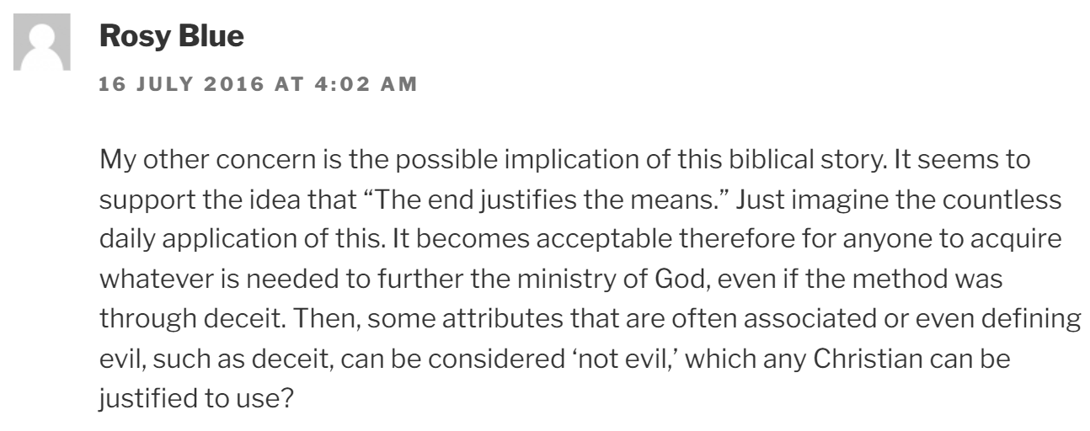
Jacob and Esau: Other Kinds of Crazy
Why did God bless Jacob, the deceiver? – Rob Pomeroy

Slide 19
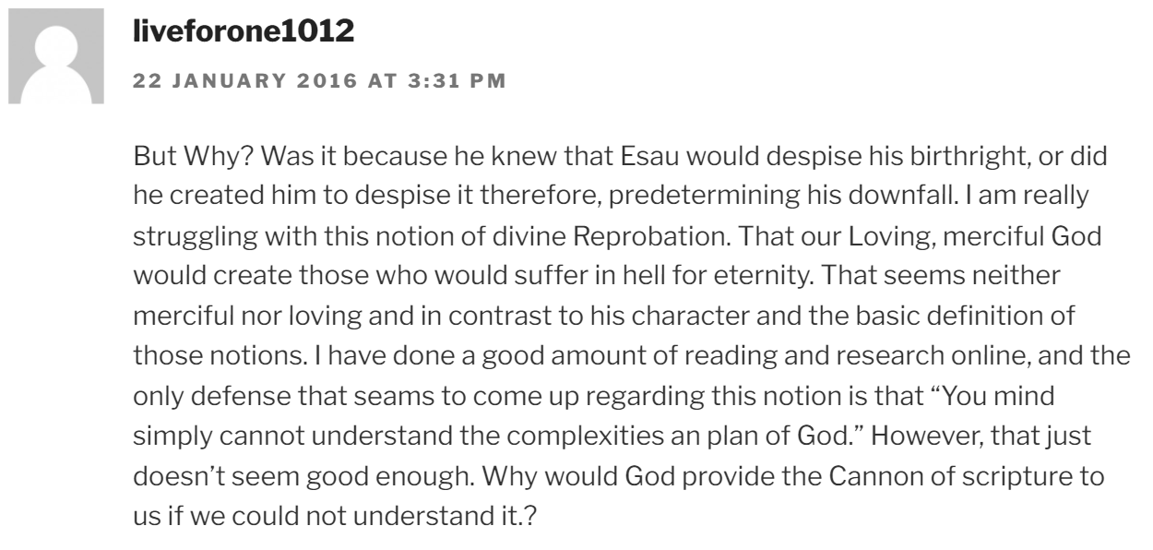
Jacob and Esau: Other Kinds of Crazy
Why did God bless Jacob, the deceiver? – Rob Pomeroy

Slide 20
Questions and Objections
1. Why does God choose Jacob over Esau? Esau is the eldest, the “rightful heir” in some sense. Certainly Isaac, his father, intended to favor Esau.

Slide 21
1. Why does God choose Jacob over Esau?
Genesis 25:22-24
²² And the children struggled together within her; and she said, If it be so, why am I thus? And she went to enquire of the Lord.
²³ And the Lord said unto her, Two nations are in thy womb, and two manner of people shall be separated from thy bowels; and the one people shall be stronger than the other people; and the elder shall serve the younger.
²⁴ And when her days to be delivered were fulfilled, behold, there were twins in her womb.

Slide 22
1. Why does God choose Jacob over Esau?
Notice that this is a prophecy, not a choice! God reveals to Rebekah something of the future.
See Patriarchs and Prophets, pg. 177

Slide 23
Patriarchs and Prophets pg. 177
Jacob and Esau, the twin sons of Isaac, present a striking contrast, both in character and in life. This unlikeness was foretold by the angel of God before their birth. When in answer to Rebekah's troubled prayer he declared that two sons would be given her, he opened to her their future history, that each would become the head of a mighty nation, but that one would be greater than the other, and that the younger would have the pre-eminence.

Slide 24
Patriarchs and Prophets pg. 177
Esau grew up loving self-gratification and centering all his interest in the present. Impatient of restraint, he delighted in the wild freedom of the chase, and early chose the life of a hunter. Yet he was the father's favorite. The quiet, peace-loving shepherd was attracted by the daring and vigor of this elder son, who fearlessly ranged over mountain and desert, returning home with game for his father and with exciting accounts of his adventurous life. Jacob, thoughtful, diligent, and care-taking, ever thinking more of the future than the present, was content to dwell at home, occupied in the care of the flocks and the tillage of the soil. His patient perseverance, thrift, and foresight were valued by the mother. His affections were deep and strong, and his gentle, unremitting attentions added far more to her happiness than did the boisterous and occasional kindnesses of Esau. To Rebekah, Jacob was the dearer son.

Slide 25
1. Why does God choose Jacob over Esau?
God permitted the blessings promised to Abraham to be passed to Jacob rather than Esau. But this isn’t an example of favoritism!
Jacob is a man who is willing to listen to God, while Esau is not. We’re told in verse 34 that Esau “despised his birthright.”
See Hebrews 12: 14-17

Slide 26
1. Why does God choose Jacob over Esau?
Hebrews 12: 14-17
¹⁴ Follow peace with all men, and holiness, without which no man shall see the Lord:
¹⁵ Looking diligently lest any man fail of the grace of God; lest any root of bitterness springing up trouble you, and thereby many be defiled;
¹⁶ Lest there be any fornicator, or profane person, as Esau, who for one morsel of meat sold his birthright.
¹⁷ For ye know how that afterward, when he would have inherited the blessing, he was rejected: for he found no place of repentance, though he sought it carefully with tears.

Slide 27
1. Why does God choose Jacob over Esau?
God permitted the blessings promised to Abraham to be passed to Jacob rather than Esau. But this isn’t an example of favoritism!
Jacob is a man who is willing to listen to God, while Esau is not. We’re told in verse 34 that Esau “despised his birthright.”
See Hebrews 12: 14-17. Esau is described as a “profane” and irreligious person, insensible to spiritual things. He cared for nothing but the gratification of sensual desire. God couldn’t work His will to create a holy nation through Esau.

Slide 28
Patriarchs and Prophets pg. 181
Esau had lightly valued the blessing while it seemed within his reach, but he desired to possess it now that it was gone from him forever. All the strength of his impulsive, passionate nature was aroused, and his grief and rage were terrible. He cried with an exceeding bitter cry, “Bless me, even me also, O my father!” “Hast thou not reserved a blessing for me?” But the promise given was not to be recalled. The birthright which he had so carelessly bartered he could not now regain. “For one morsel of meat,” for a momentary gratification of appetite that had never been restrained, Esau sold his inheritance; but when he saw his folly, it was too late to recover the blessing. “He found no place of repentance, though he sought it carefully with tears.” Hebrews 12:16, 17. Esau was not shut out from the privilege of seeking God's favor by repentance, but he could find no means of recovering the birthright. His grief did not spring from conviction of sin; he did not desire to be reconciled to God. He sorrowed because of the results of his sin, but not for the sin itself.

Slide 29
Questions and Objections
2. Jacob is the “deceiver.” Even his name implies this! He certainly lies outright to his father. Why would God reward this?

Slide 30
2. Why would God reward the deceiver?
God allowed Jacob to inherit the promises of Abraham, and to receive the blessing of his father. But this does not imply divine approval of the act of deception! God is not dependent on artifice to accomplish His will. God did not ordain the act of deception, He overruled it. The blessing came to Jacob, not because of deception, but in spite of it.
Parents and sons were ALL in the wrong, and each in his own way suffered as a result. The perpetrators of deception were forthwith and forever separated.

Slide 31
2. Why would God reward the deceiver?
Rebekah was obliged to send her beloved son forth from his father’s house to a foreign land, never to see him again.
Jacob suffered for his sin against his father and brother by 20 years of exile. Furthermore, he went forth from home utterly destitute. He was without help or recourse in his uncle’s home. And his uncle was not completely honest either.
While in Laban’s home, Jacob himself was repeatedly deceived and disappointed. The deception of Laban in the matter of Leah and Rachel in particular would cause Jacob suffering for the rest of his life. He would become keenly aware of the cost of deception due to this incident and others.

Slide 32
2. Why would God reward the deceiver?
Isaac, by the success of Jacob’s stratagem, was chastened for persisting in his preference for Esau in spite of the revealed will of Jehovah. He was to be separated from the son he had passed by, and to have ever before him the ungodly example of the son he had cherished so blindly.
For his contempt of God and religious things, Esau forfeited forever the privileges of family leadership due the first-born. And through all the complications of human plans and passions the purpose of God was accomplished. Though not as neatly as it might have been had the family cooperated with Him!

Slide 33
Patriarchs and Prophets pg. 183
Threatened with death by the wrath of Esau, Jacob went out from his father's home a fugitive; but he carried with him the father's blessing; Isaac had renewed to him the covenant promise, and had bidden him, as its inheritor, to seek a wife of his mother's family in Mesopotamia. Yet it was with a deeply troubled heart that Jacob set out on his lonely journey. With only his staff in his hand he must travel hundreds of miles through a country inhabited by wild, roving tribes. In his remorse and timidity he sought to avoid men, lest he should be traced by his angry brother. He feared that he had lost forever the blessing that God had purposed to give him; and Satan was at hand to press temptations upon him.

Slide 34
Patriarchs and Prophets pg. 183
The evening of the second day found him far away from his father's tents. He felt that he was an outcast, and he knew that all this trouble had been brought upon him by his own wrong course. The darkness of despair pressed upon his soul, and he hardly dared to pray. But he was so utterly lonely that he felt the need of protection from God as he had never felt it before. With weeping and deep humiliation he confessed his sin, and entreated for some evidence that he was not utterly forsaken. Still his burdened heart found no relief. He had lost all confidence in himself, and he feared that the God of his fathers had cast him off.
But God did not forsake Jacob. His mercy was still extended to His erring, distrustful servant. The Lord compassionately revealed just what Jacob needed—a Saviour. He had sinned, but his heart was filled with gratitude as he saw revealed a way by which he could be restored to the favor of God.

Slide 35
Patriarchs and Prophets pg. 183
In the vision the plan of redemption was presented to Jacob, not fully, but in such parts as were essential to him at that time. The mystic ladder revealed to him in his dream was the same to which Christ referred in His conversation with Nathanael. Said He, “Ye shall see heaven open, and the angels of God ascending and descending upon the Son of man.” John 1:51. Up to the time of man's rebellion against the government of God, there had been free communion between God and man. But the sin of Adam and Eve separated earth from heaven, so that man could not have communion with his Maker. Yet the world was not left in solitary hopelessness. The ladder represents Jesus, the appointed medium of communication. Had He not with His own merits bridged the gulf that sin had made, the ministering angels could have held no communion with fallen man. Christ connects man in his weakness and helplessness with the source of infinite power.

Slide 36
Questions and Objections
3. Did God actually hate Esau and love Jacob? Why?
  See Malachi 1:2-3
  See Romans 9:10-16

Slide 37
3. Did God hate Esau?
Malachi 1:2-3
² I have loved you, saith the Lord. Yet ye say, Wherein hast thou loved us? Was not Esau Jacob's brother? saith the Lord: yet I loved Jacob,
³ And I hated Esau, and laid his mountains and his heritage waste for the dragons of the wilderness.

Slide 38
3. Did God hate Esau?
To understand these verses we need context!
God commissioned the prophet Malachi to bear a stern message of warning, reminding the Jews of their past experiences as a nation and calling upon them to return to God and to the requirements of the covenant relationship.
God’s patient endeavor to elicit recognition of past mistakes, coupled with their progressively vehement denial of having made any, constitutes the theme of the book.

Slide 39
3. Did God hate Esau?
Endeavoring to awaken His people to a realization of their ingratitude, the Lord asks certain pointed questions (“Wherein hast thou loved us?”) These questions, which are characteristic of the book of Malachi, expose the self-justifying attitude of the people of Malachi’s day. These questions may not have been actually voiced by the people, but they truly reflect the inner thinking of the nation.

Slide 40
3. Did God hate Esau?
Using this reference to Jacob and Esau, brothers who were twins, sharing the same heredity and environment, the Lord endeavors to make plain to the Jews that divine favor did not come to Israel because of birth, but because of character. Jacob was the one, who, although he made painful mistakes, finally devoted his life to God’s service.

Slide 41
3. Did God hate Esau?
Malachi 1:4-5
⁴ Whereas Edom saith, We are impoverished, but we will return and build the desolate places; thus saith the Lord of hosts, They shall build, but I will throw down; and they shall call them, The border of wickedness, and, The people against whom the Lord hath indignation for ever.
⁵ And your eyes shall see, and ye shall say, The Lord will be magnified from the border of Israel.

Slide 42
3. Did God hate Esau?
From the context it seems that Edom, the nation of Esau’s descendants, is primarily referred to here rather than the man Esau himself. The use of the word “hate” is typical Oriental hyperbole and should not be taken in its strongest sense. The Lord here makes plain His preference for Jacob and his descendants over Esau and his descendants. This preference arose, of course, out of the relationship of the two brothers to God. Because Jacob was spiritually-minded and loved the things of God, his sins were forgiven and he enjoyed God’s favor and fellowship. Esau, on the other hand, was a worldly-minded person with no desire or love for divine things, and so he put himself out of divine favor.

Slide 43
3. Did God hate Esau?
Romans 9:10-13
¹⁰ And not only this; but when Rebecca also had conceived by one, even by our father Isaac;
¹¹ (For the children being not yet born, neither having done any good or evil, that the purpose of God according to election might stand, not of works, but of him that calleth;)
¹² It was said unto her, The elder shall serve the younger.
¹³ As it is written, Jacob have I loved, but Esau have I hated.
¹⁴ What shall we say then? Is there unrighteousness with God? God forbid.
¹⁵ For he saith to Moses, I will have mercy on whom I will have mercy, and I will have compassion on whom I will have compassion.
¹⁶ So then it is not of him that willeth, nor of him that runneth, but of God that sheweth mercy.

Slide 44
3. Did God hate Esau?
Here again we see the word “hate.” This strong expression does not imply positive hatred, as the term is used today, but that God had preferred Jacob above Esau as the progenitor of the chosen race. It seems to have been common in Biblical times to use the word in this sense. Thus Jacob’s preference for Rachel is compared to his “hatred” for Leah (Gen. 29:30-31). Similarly, Jesus speaks about “hating” one’s father and mother (Luke 14:26) by choosing service to God above service to one’s parents, and “hating” one’s own life (John 12:25) in the same sense. (Consider also Matthew 6:24).

Slide 45
3. Did God hate Esau?
By referring to the history of the patriarchs Paul shows God’s choice of Spiritual Israel in view of the failure of the Jews to fulfill the divine purpose, is fully consistent with His past dealings. God is not being untrue to any. In calling upon the Christian church to accomplish His purposes for the world, God is following the same principle He originally employed when He selected the Israelites and rejected the Edomites and the Ishmaelites. God is simply choosing to direct those who will follow Him!
Paul’s argument here in Romans demonstrates that God did not hate Esau any more than He hated the Israelites in later times. He simply chose another group to carry out His will.

Slide 46

Thank You!
Happy Sabbath!

