Slide 1
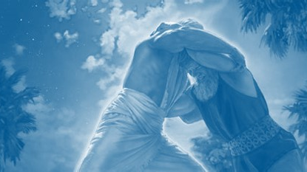
Genesis 32-35
Wrestling with God
Lesson 10
Notes:
To use this title animation slide with a new image simply 1) move the top semi-transparent shape to the side, 2) delete placeholder image,
3) click on the picture icon to add a new picture, 4) Move semi-transparent shape back to original position, 5) Update text on slide.

Slide 2
²⁴ And Jacob was left alone; and there wrestled a man with him until the breaking of the day.
²⁵ And when he saw that he prevailed not against him, he touched the hollow of his thigh; and the hollow of Jacob's thigh was out of joint, as he wrestled with him.
²⁶ And he said, Let me go, for the day breaketh. And he said, I will not let thee go, except thou bless me.
—Genesis 32:24-26

Slide 3
²⁷ And he said unto him, What is thy name? And he said, Jacob.
²⁸ And he said, Thy name shall be called no more Jacob, but Israel: for as a prince hast thou power with God and with men, and hast prevailed.
²⁹ And Jacob asked him, and said, Tell me, I pray thee, thy name. And he said, Wherefore is it that thou dost ask after my name? And he blessed him there.
—Genesis 32:27-29

Slide 4
³⁰ And Jacob called the name of the place Peniel: for I have seen God face to face, and my life is preserved.
³¹ And as he passed over Penuel the sun rose upon him, and he halted upon his thigh.
³² Therefore the children of Israel eat not of the sinew which shrank, which is upon the hollow of the thigh, unto this day: because he touched the hollow of Jacob's thigh in the sinew that shrank.
—Genesis 32:30-32

Slide 5
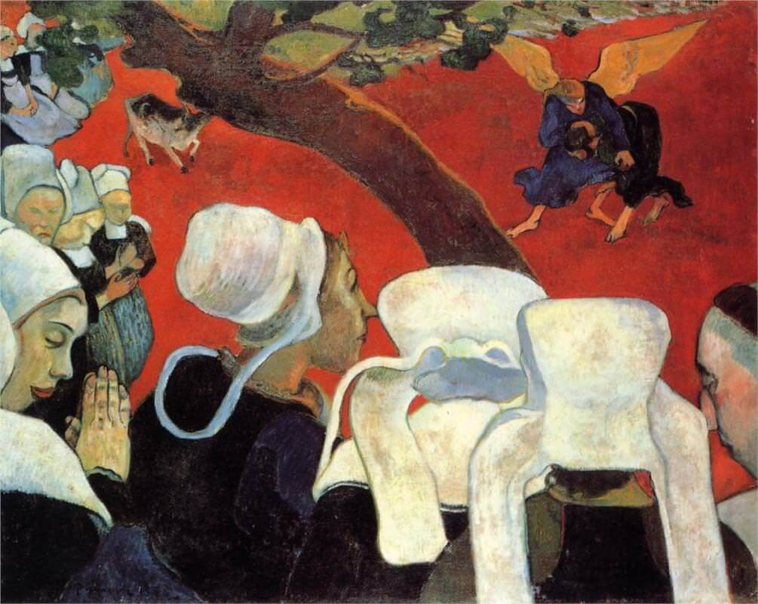
GAUGUIN

Slide 6
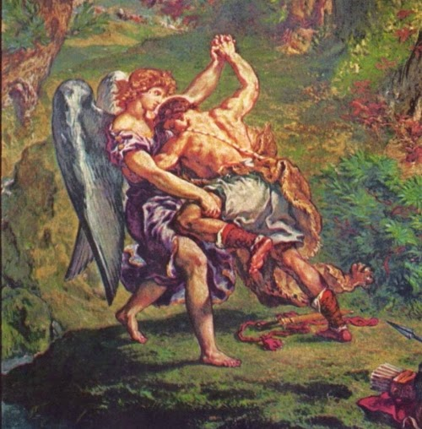
DELACROIX

Slide 7
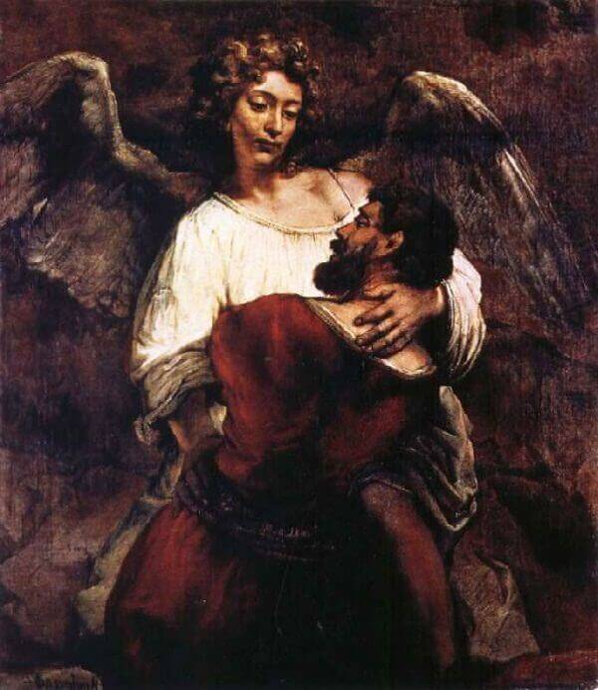
REMBRANDT

Slide 8
Questions
This is a surprising story in many ways! And naturally it gives rise to a number of questions.
Did Jacob really wrestle with God?
  Is this some kind of spiritual allegory or metaphor? Because a literal wrestling match seems bizarre. How could a man wrestle with God?
How can an Almighty God not prevail against a man?
  God is all-powerful. Men aren’t. ???
How can a conflict with God be a good thing?
  Fighting with God seems like a poor life decision in a number of respects. How can it be a positive?

Slide 9
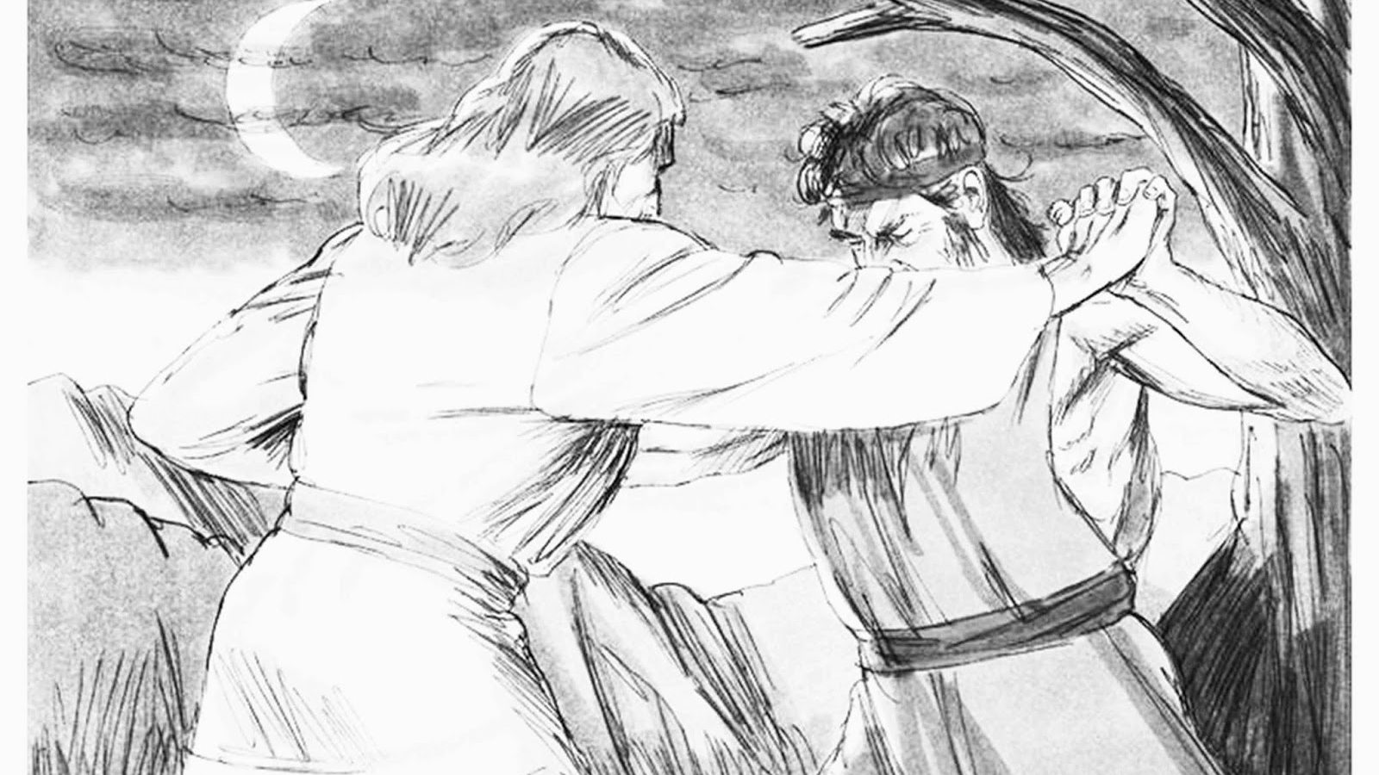
The Crazies
Questions give rise to … interpretations
(OFTEN BAD ONES!)
Notes:
To use this title animation slide with a new image simply 1) move the top semi-transparent shape to the side, 2) delete placeholder image,
3) click on the picture icon to add a new picture, 4) Move semi-transparent shape back to original position, 5) Update text on slide.

Slide 10
Talmudic Teachings
The Crazies
!
“A man wrestled with him: our sages explained that this was the ministering angel of Esau.” A commonplace of Talmudic and midrashic literature is that every nation has its own angelic “minister” who represents its interests before G‑d. It is Esau’s angel, then, who attempts to frustrate Jacob’s mission.
Thus begins the clash of the titans.
“A man wrestled with him until dawn broke.” The contest lasts for hours on end. They grapple with each other, casting up dust all the way up to the divine throne. The angel realizes that he cannot overpower Jacob, so he “touches [Jacob’s] thigh” and dislocates it.
Jacob Wrestles With the Angel - Jewish History (chabad.org))

Slide 11
Talmudic Teachings
The Crazies
!
As dawn breaks, Esau’s angel must join his colleagues to sing to their Creator. The angel tries to disentangle himself from Jacob but cannot do so. He is forced to beg Jacob to let him go, to which Jacob agrees, but only on one condition: The angel must bless him and admit that the blessings Jacob received from Isaac indeed are rightfully his and not Esau’s.
The angel agrees, blesses Jacob, and even bestows upon him a new name, Israel. Among its meanings is that Jacob has received the blessings in a noble manner, rather than by fraud.
In commemoration of this episode, the Jewish people are forbidden to eat the gid ha-nasheh of an animal, which corresponds anatomically to Jacob’s injured nerve.
Jacob Wrestles With the Angel - Jewish History (chabad.org))

Slide 12
Kabbalistic Teachings
The Crazies
?
The “man” with whom Jacob battled was actually the angel of his brother Esau. The Zohar describes Jacob’s battle with the angel as an symbolic of man’s struggle with his darker side. The entire night the battle remained even, as Jacob held strong.
As morning was approaching, the angel knew that he had to act fast, for soon the night—the time when he has power—would be gone, and he would be powerless. He therefore struck Jacob’s thigh, the Zohar explains, which is the place from which all sexual desire extends. And there, he was able to wound him.
Why don’t we eat the sciatic nerve? - Kosher (chabad.org)

Slide 13
Kabbalistic Teachings
The Crazies
?
The Zohar teaches us that in every struggle we are powerful, and can overcome our evil urges if we so desire. There is only one place where the lust is so strong that even great men are powerless—the gid hanasheh. Its very name means “to forget,”² because once it has been aroused, all rational thinking and religious scruples are left far behind.
The only way to win that war is to stay far away in the first place, for once the first flirt his been thrown out, there is no knowing where things can lead. For this reason, the gid is not eaten at all but utterly avoided.
Why don’t we eat the sciatic nerve? - Kosher (chabad.org)

Slide 14
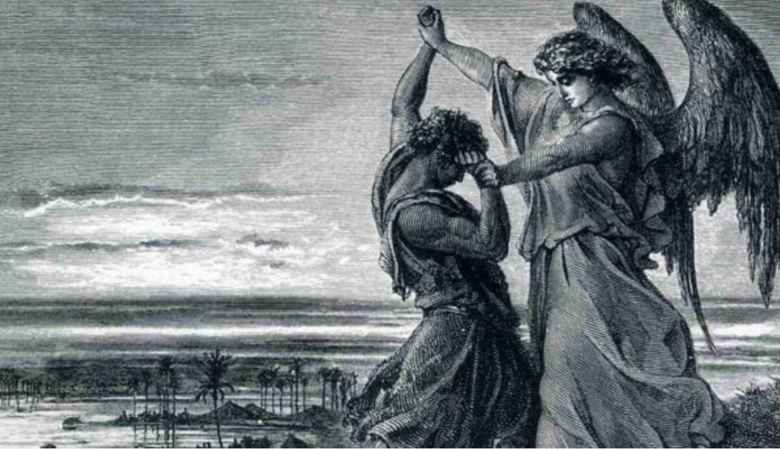

Slide 15
Islamic Teachings
The Crazies
!
This story is not mentioned in the Quran, but is discussed in Muslim commentaries. The commentaries employ the story in explaining other events in the Hebrew Bible that are discussed in the Quran that have parallels, like Moses being attacked by an angel, and to explain Jewish eating customs. Like some Jewish commentators, Islamic commentators described the event as punishment for Jacob failing to give tithes to God but making an offering like a tithe to Esau.
Who Was the Angel Who Wrestled With Jacob? (learnreligions.com)

Slide 16
Catholic Teachings
The Crazies
!
When the man is unable to gain complete mastery over Jacob (whose name means "cheater"), it is said he cheats by putting his thigh out of joint, a wound that leaves Jacob limping when the battle is finished as a reminder of the reality and intensity of the struggle. Jacob was not crazy; the fight and the wound were real.
Such foul play may make one sympathize with Jacob, but as the Genesis account later reveals, it was the Angel of God with whom Jacob actually wrestled, an Angel that could have simply spoken a word and struck Jacob dead rather than expend the effort and time in a seemingly useless struggle.
Scripture Reflection: I Wrestled With God and Won - Living Faith - Home & Family - News - Catholic Online

Slide 17
Catholic Teachings
The Crazies
!
It does not say so in the text, but I believe Jacob discovered something about his adversary through the course of this intense midnight struggle, for he demands a blessing before the "man" leaves, and with more than a little respect conveyed in the telling, he receives it as "one who wrestled with God and won" (Gen. 32:28).
This fascinates me. How on earth is it possible to wrestle with God? How does one win a struggle with the God of the universe? Why would He stoop to undertake such a silly striving that is no match for His matchless power? Interestingly, Jacob never asks why he was confronted and opposed, he simply asked to know the man's name. Then the Angel says something mysterious: "Why is it that you ask my name?" and the name remains undisclosed.
Scripture Reflection: I Wrestled With God and Won - Living Faith - Home & Family - News - Catholic Online

Slide 18
Other Teachings
The Crazies
!
Some people identify Archangel Phanuel as the man who wrestles with Jacob because of the connection between Phanuel's name and the name "Peniel." This is the name Jacob gave to the place where he struggled with the man.
In his book "Of Scribes And Sages: Early Jewish Interpretation And Transmission Of Scripture, Volume 2," Craig A. Evans writes: "In Gen. 32:31, Jacob names the place of his wrestling with God as 'Peniel' — the Face of God. Scholars believe that the angelic name 'Phanuel' and the place 'Peniel' are etymologically connected."
Who Was the Angel Who Wrestled With Jacob? (learnreligions.com)

Slide 19
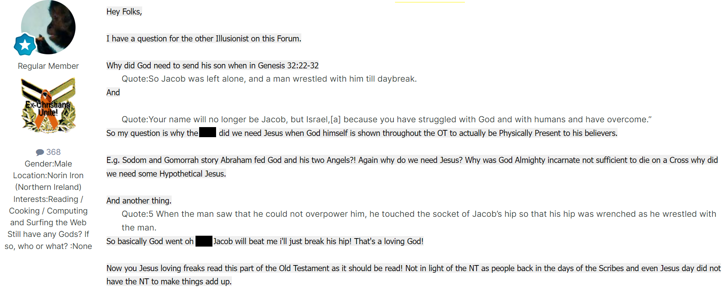
The (Unpleasant)
Crazies
!
Jacob Wrestles With God - Rants and Replies - Ex-Christian.Net

Slide 20
Teachings of, well, Incoherence
The Crazies
?
God as a man? Notice this man did not just touch Jacob's hip, he touched the 'inside' of his body. Most Christians I've seen only think Jacob was touched on the hip. And one Christian I ran into here when asked if God was a man that he should lie presented these verses so as to imply, yes.
Now I know Abraham ate with 'the LORD' too, so. A shame God did not tell Jacob his name at that time. Name meaning 'revelation'. As God revealed himself as El Shaddai to Abraham, and YHWH to Moses. And Yeshua to the apostles.
God revealaed as a man???? I thought man can not look into the face of God, and that he is Spirit not a man. Does God reveal himself as a man? I believe scripture says yes. That God is not a man in that he was created, but a Spirit who 'can' reveal himself in the form of a man......
Jacob wrestled with (the) God (man) | Christian Forums

Slide 21
Protestant Ideas
The Crazies
?
The second possible etiology revolves around the dietary custom of the “tendon” attached to the hip. The problem with this particular notion is that there are no tendons attached to the hip socket—ligaments, yes; tendons, no. However, to clear up the matter, according to the rabbis this passage is actually prohibiting the consumption of the sciatic nerve which is contained in the muscles of the thigh and must be removed for the meat to be kosher.
What is Significant About Jacob's Wrestling Match? (hcna.us)

Slide 22
Protestant Ideas
The Crazies
?
In any event, the story of Jacob wrestling with God seems to be a parenthetical story. The renaming of Jacob occurs again in Genesis 35.9-15 under different circumstances and takes place in a different location, and the prohibition against the hip socket tendon is found nowhere else.
What is Significant About Jacob's Wrestling Match? (hcna.us)

Slide 23
Ligaments, Tendons, and Nerves

Slide 24
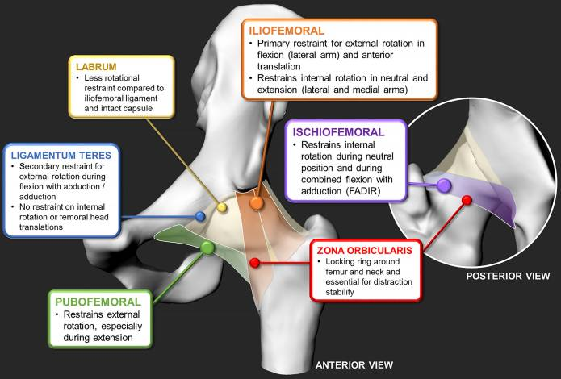
Ligaments
Functional Anatomy of the Hip-Bones and Ligaments - Physiopedia (physio-pedia.com)

Slide 25
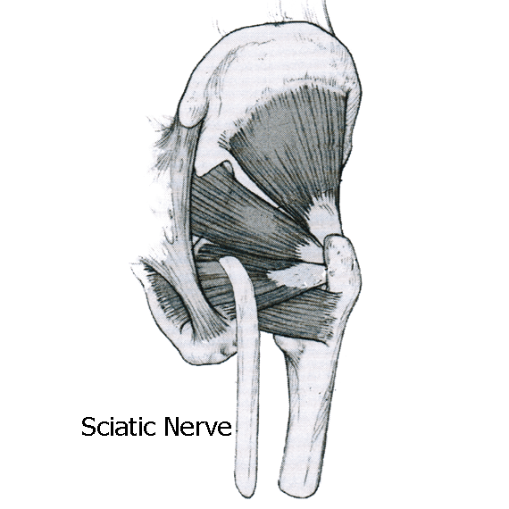
Nerves
Hip Anatomy, Pictures, Function, Problems & Treatment (healthpages.org)

Slide 26
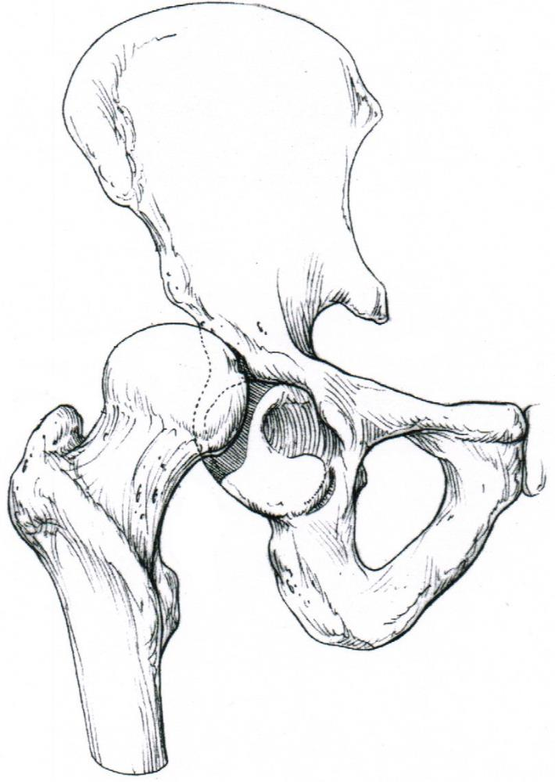
Posterior Hip Dislocation
Hip Anatomy, Pictures, Function, Problems & Treatment (healthpages.org)

Slide 27
Posterior Hip Dislocation
Hip Anatomy, Pictures, Function, Problems & Treatment (healthpages.org)

Slide 28
Connections
The sciatic nerve is the most commonly recognized nerve in the hip and thigh. The sciatic nerve is large—as big around as your thumb—and travels beneath the gluteus maximus down the back of the thigh where it branches to supply the muscles of the leg and foot. Hip dislocations can cause injury to the sciatic nerve.
Hip Anatomy, Pictures, Function, Problems & Treatment (healthpages.org)

Slide 29
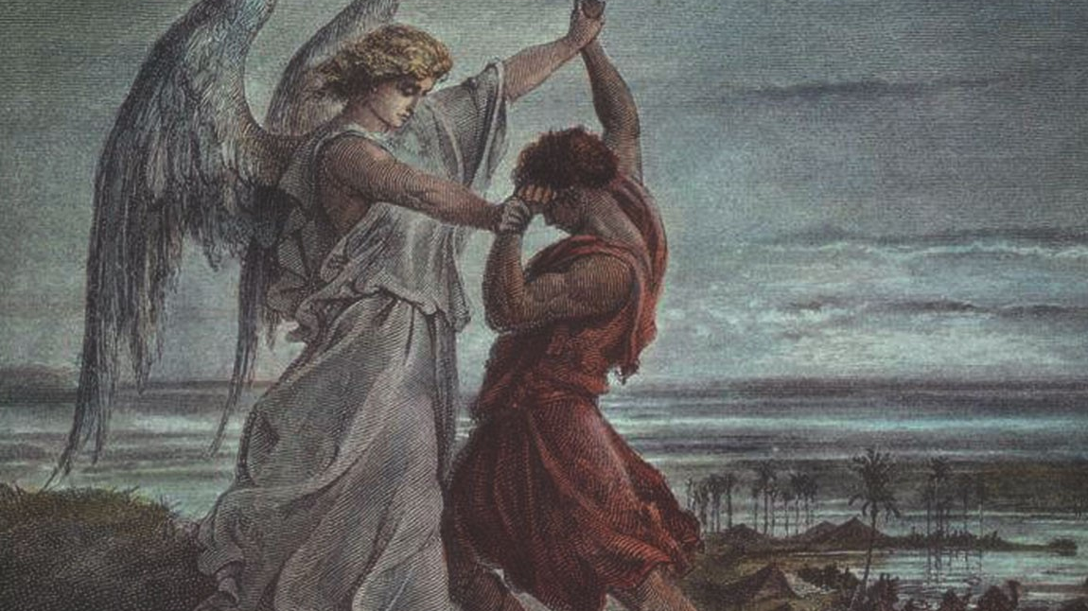
The Real Story:
Wrestling with God
A STUDY
Notes:
To use this title animation slide with a new image simply 1) move the top semi-transparent shape to the side, 2) delete placeholder image,
3) click on the picture icon to add a new picture, 4) Move semi-transparent shape back to original position, 5) Update text on slide.

Slide 30
¹⁷ And he commanded the foremost, saying, When Esau my brother meeteth thee, and asketh thee, saying, Whose art thou? and whither goest thou? and whose are these before thee?
¹⁸ Then thou shalt say, They be thy servant Jacob's; it is a present sent unto my lord Esau: and, behold, also he is behind us.
Genesis
32:17-18

Slide 31
¹⁹ And so commanded he the second, and the third, and all that followed the droves, saying, On this manner shall ye speak unto Esau, when ye find him.
²⁰ And say ye moreover, Behold, thy servant Jacob is behind us. For he said, I will appease him with the present that goeth before me, and afterward I will see his face; peradventure he will accept of me.
Genesis
32:19-20

Slide 32
²² And he rose up that night, and took his two wives, and his two womenservants, and his eleven sons, and passed over the ford Jabbok.
²³ And he took them, and sent them over the brook, and sent over that he had.
²⁴ And Jacob was left alone; and there wrestled a man with him until the breaking of the day.
Genesis
32:22-24

Slide 33
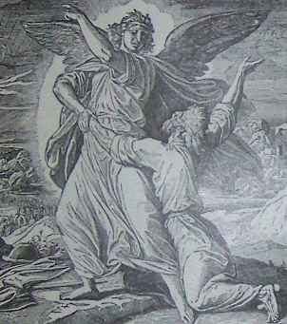
Genesis 32:17-23
Jacob was (understandably) terrified to meet the brother that he had wronged so many years before. Esau had, after all, sworn to kill him!
HAVE YOU EVER BROUGHT SOMETHING TOTALLY ON YOURSELF?
    And really, desperately, wished to avoid the consequences?

Slide 34
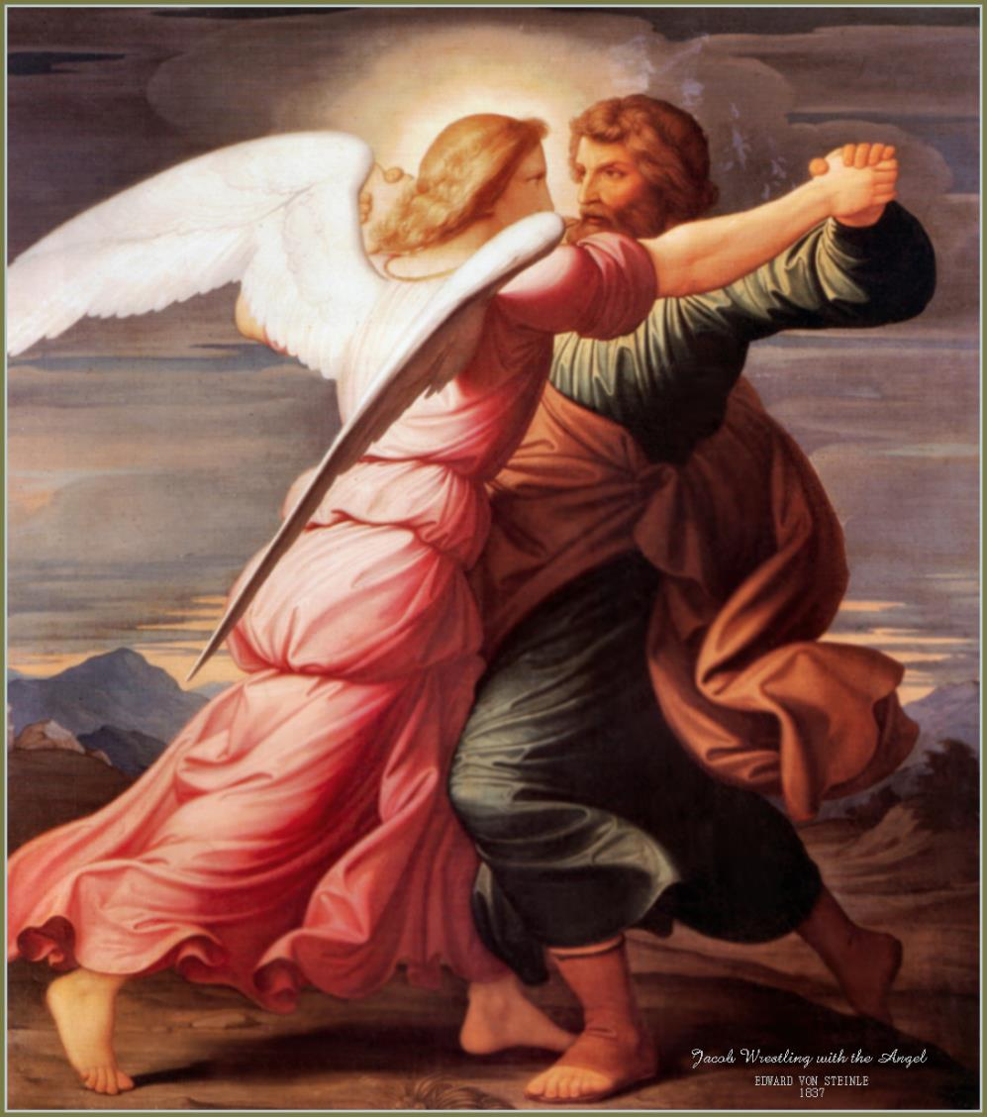
What about really, desperately repenting your unfortunate choices? Wishing you’d taken the higher road?
That is Jacob’s context in this passage. He’s about to meet his brother, and he is struggling with the way they parted. He’s also struggling to move past being regretful for CONSEQUENCES, into repentance for SIN!

Slide 35
Setting the Scene
!
Jacob had remained alone on the northern bank of the river in order that he might be alone to seek God in prayer. In the present situation his usual cleverness was of no avail. God alone could be of help to mitigate Esau’s anger and to save Jacob and his family.
As he is struggling within himself, praying for God’s guidance and protection, the struggle suddenly becomes literal. Someone appears and wrestles with him!

Slide 36
Who is wrestling with Jacob?
1
2
3
4
5
Genesis 32:24
It seems “a man” wrestled with Jacob
Genesis 32:28
The Being says that Jacob has struggled with God.
Genesis 32:30
According to Jacob, he saw the “face of God”
Hosea 12:3
references Jacobs “power with God,” as in Genesis 32:28.
Hosea 12:4
calls the Being who wrestled with Jacob an angel.
Reference : The basics you can find anywhere 5 Steps To Successful Storytelling Published on April 5, 2014 Featured in: Marketing & Advertising

Slide 37
Patriarchs and Prophets pg. 195
Though Jacob had left Padan-aram in obedience to the divine direction, it was not without many misgivings that he retraced the road which he had trodden as a fugitive twenty years before. His sin in the deception of his father was ever before him. He knew that his long exile was the direct result of that sin, and he pondered over these things day and night, the reproaches of an accusing conscience making his journey very sad. As the hills of his native land appeared before him in the distance, the heart of the patriarch was deeply moved. All the past rose vividly before him. With the memory of his sin came also the thought of God's favor toward him, and the promises of divine help and guidance.

Slide 38
Patriarchs and Prophets pg. 195
As he drew nearer his journey's end, the thought of Esau brought many a troubled foreboding. After the flight of Jacob, Esau had regarded himself as the sole heir of their father's possessions. The news of Jacob's return would excite the fear that he was coming to claim the inheritance. Esau was now able to do his brother great injury, if so disposed, and he might be moved to violence against him, not only by the desire for revenge, but in order to secure undisturbed possession of the wealth which he had so long looked upon as his own.

Slide 39
Patriarchs and Prophets pg. 195
Again the Lord granted Jacob a token of the divine care. As he traveled southward from Mount Gilead, two hosts of heavenly angels seemed to encompass him behind and before, advancing with his company, as if for their protection. Jacob remembered the vision at Bethel so long before, and his burdened heart grew lighter at this evidence that the divine messengers who had brought him hope and courage at his flight from Canaan were to be the guardians of his return. And he said, “This is God's host: and he called the name of that place Mahanaim”—“two hosts, or, camps.”

Slide 40
Patriarchs and Prophets pg. 195
Yet Jacob felt that he had something to do to secure his own safety. He therefore dispatched messengers with a conciliatory greeting to his brother. He instructed them as to the exact words in which they were to address Esau. It had been foretold before the birth of the two brothers that the elder should serve the younger, and, lest the memory of this should be a cause of bitterness, Jacob told the servants they were sent to “my lord Esau;” when brought before him, they were to refer to their master as “thy servant Jacob;” and to remove the fear that he was returning, a destitute wanderer, to claim the paternal inheritance, Jacob was careful to state in his message, “I have oxen, and asses, flocks, and menservants, and womenservants: and I have sent to tell my lord, that I may find grace in thy sight.”

Slide 41
Patriarchs and Prophets pg. 195
But the servants returned with the tidings that Esau was approaching with four hundred men, and no response was sent to the friendly message. It appeared certain that he was coming to seek revenge. Terror pervaded the camp. “Jacob was greatly afraid and distressed.” He could not go back, and he feared to advance. His company, unarmed and defenseless, were wholly unprepared for a hostile encounter. He accordingly divided them into two bands, so that if one should be attacked, the other might have an opportunity to escape. He sent from his vast flocks generous presents to Esau, with a friendly message.

Slide 42
Patriarchs and Prophets pg. 196
He did all in his power to atone for the wrong to his brother and to avert the threatened danger, and then in humiliation and repentance he pleaded for divine protection: Thou “saidst unto me, Return unto thy country, and to thy kindred, and I will deal well with thee: I am not worthy of the least of all the mercies, and of all the truth, which Thou hast showed unto Thy servant; for with my staff I passed over this Jordan; and now I am become two bands. Deliver me, I pray Thee, from the hand of my brother, from the hand of Esau: for I fear him, lest he will come and smite me, and the mother with the children.”

Slide 43
Patriarchs and Prophets pg. 196
They had now reached the river Jabbok, and as night came on, Jacob sent his family across the ford of the river, while he alone remained behind. He had decided to spend the night in prayer, and he desired to be alone with God. God could soften the heart of Esau. In Him was the patriarch's only hope. It was in a lonely, mountainous region, the haunt of wild beasts and the lurking place of robbers and murderers. Solitary and unprotected, Jacob bowed in deep distress upon the earth. It was midnight. All that made life dear to him were at a distance, exposed to danger and death.

Slide 44
Patriarchs and Prophets pg. 196
Bitterest of all was the thought that it was his own sin which had brought this peril upon the innocent. With earnest cries and tears he made his prayer before God. Suddenly a strong hand was laid upon him. He thought that an enemy was seeking his life, and he endeavored to wrest himself from the grasp of his assailant. In the darkness the two struggled for the mastery. Not a word was spoken, but Jacob put forth all his strength, and did not relax his efforts for a moment. While he was thus battling for his life, the sense of his guilt pressed upon his soul; his sins rose up before him, to shut him out from God. But in his terrible extremity he remembered God's promises, and his whole heart went out in entreaty for His mercy.

Slide 45
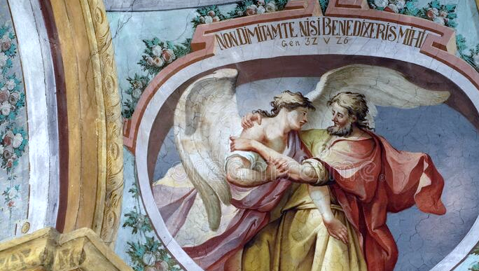
Jacob has changed!
Jacob had approached the solution of life’s problems by questionable methods of his own devising. He was now a changed man. Whereas in the past he had relied upon his own wisdom and strength, he had now learned to trust wholly in God.
Notes:
Tip:
When using complex image as full-bleed background add a transparency (70%-90%) fill layer to give contrast to text.

Slide 46
Patriarchs and Prophets pg. 196
The struggle continued until near the break of day, when the stranger placed his finger upon Jacob's thigh, and he was crippled instantly. The patriarch now discerned the character of his antagonist. He knew that he had been in conflict with a heavenly messenger, and this was why his almost superhuman effort had not gained the victory. It was Christ, “the Angel of the covenant,” who had revealed Himself to Jacob. The patriarch was now disabled and suffering the keenest pain, but he would not loosen his hold.

Slide 47
Patriarchs and Prophets pg. 196
All penitent and broken, he clung to the Angel; “he wept, and made supplication” (Hosea 12:4), pleading for a blessing. He must have the assurance that his sin was pardoned. Physical pain was not sufficient to divert his mind from this object. His determination grew stronger, his faith more earnest and persevering, until the very last. The Angel tried to release Himself; He urged, “Let Me go, for the day breaketh;” but Jacob answered, “I will not let Thee go, except Thou bless me.” Had this been a boastful, presumptuous confidence, Jacob would have been instantly destroyed; but his was the assurance of one who confesses his own unworthiness, yet trusts the faithfulness of a covenant-keeping God

Slide 48
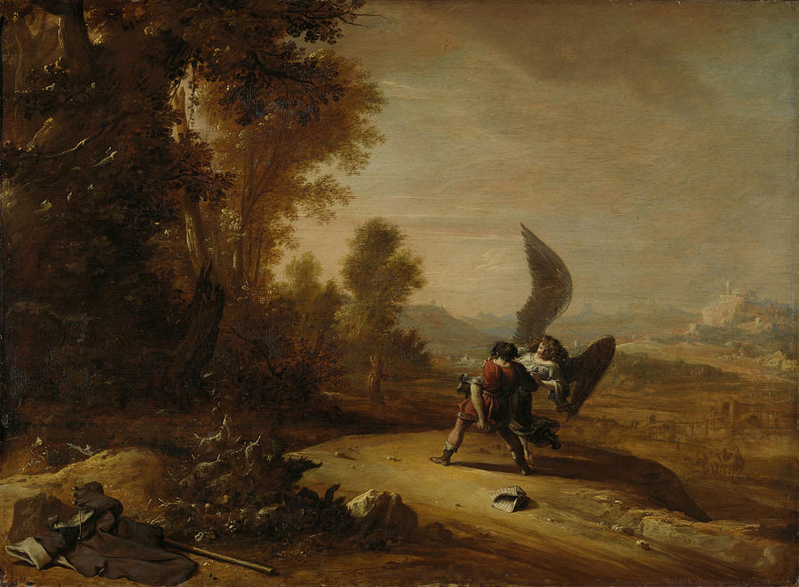
Prevailing through Surrender
        Jacob “had power over the Angel, and prevailed.” Hosea 12:4. Through humiliation, repentance, and self-surrender, this sinful, erring mortal prevailed with the Majesty of heaven. He had fastened his trembling grasp upon the promises of God, and the heart of Infinite Love could not turn away the sinner's plea.
Notes:
Combine an image and multiple key statements with a strong grid.

Slide 49
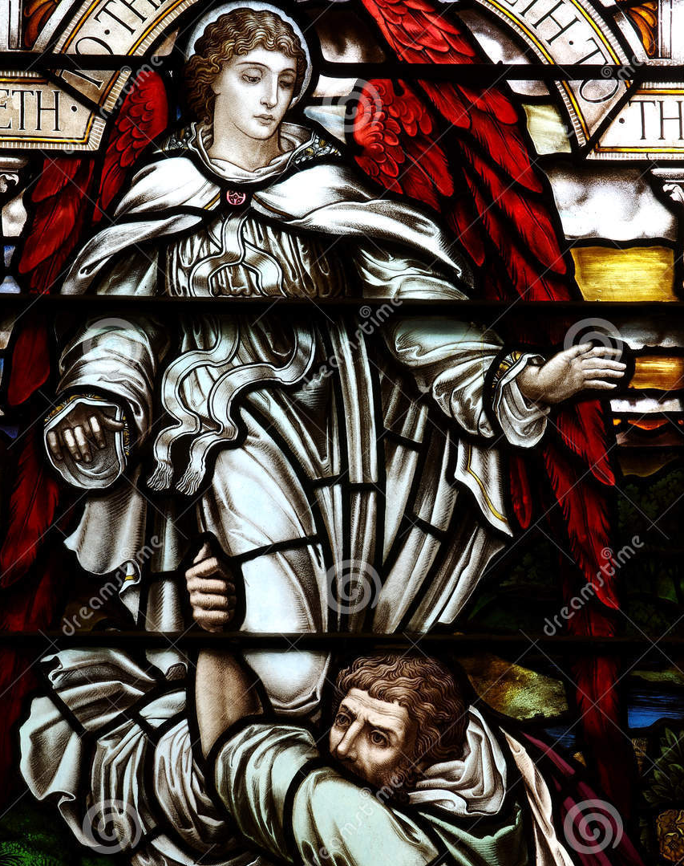
Thy name shall be called…
The error that had led to Jacob's sin in obtaining the birthright by fraud was now clearly set before him. He had not trusted God's promises, but had sought by his own efforts to bring about that which God would have accomplished in His own time and way. As an evidence that he had been forgiven, his name was changed from one that was a reminder of his sin, to one that commemorated his victory. “Thy name,” said the Angel, “shall be called no more Jacob [the supplanter], but Israel: for as a prince hast thou power with God and with men, and hast prevailed.”

Slide 50
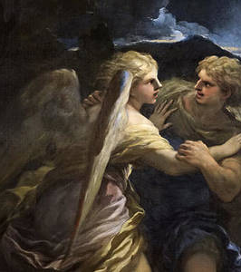
Blessing and Forgiveness…
    Jacob had received the blessing for which his soul had longed. His sin as a supplanter and deceiver had been pardoned. The crisis in his life was past. Doubt, perplexity, and remorse had embittered his existence, but now all was changed; and sweet was the peace of reconciliation with God. Jacob no longer feared to meet his brother. God, who had forgiven his sin, could move the heart of Esau also to accept his humiliation and repentance.

Slide 51
And he said, I will not let thee go, except thou bless me.
—Genesis 32:26

Slide 52
HAPPY
SABBATH!
THANK YOU

