Slide 1
Genesis 6-9:
The Flood
Lesson 4

Slide 2
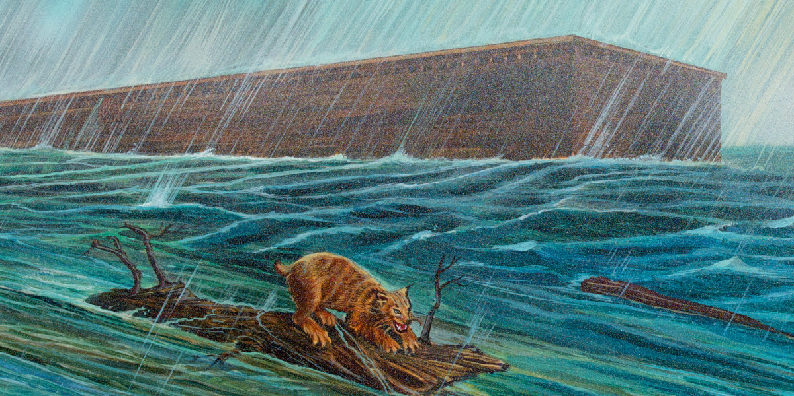
Genesis 6-9: A Story of the Flood

Slide 3
Genesis 6-9: A Story of the Flood
OUTSIDE the ark, the people went about their life the same as before. They still did not believe that the Flood would come. They must have laughed more than ever. But they soon stopped laughing.
All of a sudden water began to fall. It poured down from the sky as when you pour water from a bucket. Noah had been right! But it was too late now for anybody else to get into the ark. The door had been closed tight by Jehovah.

Slide 4
Genesis 6-9: A Story of the Flood
Soon all the low ground was covered. The water became like big rivers. It pushed over trees and rolled around big stones, and made a lot of noise. The people were afraid. They climbed up to higher ground. Oh, how they wished they had listened to Noah and gotten into the ark when the door was still open for them! But now it was too late.
The water kept getting higher and higher. For 40 days and 40 nights the water poured out of the sky. It rose up the sides of the mountains, and soon even the tallest mountains were covered. So just as God had said, all the people and animals outside the ark died. But everyone inside was safe.

Slide 5
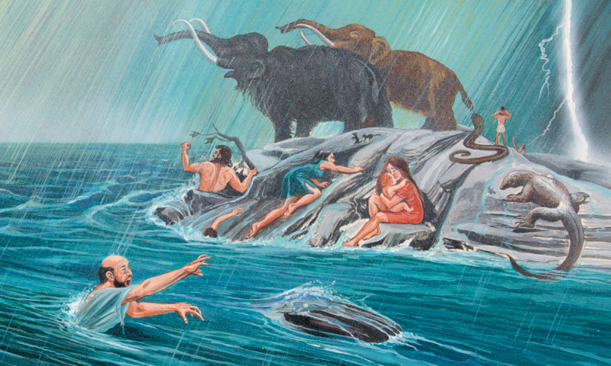
Genesis 6-9: A Story of the Flood

Slide 6
Genesis 6-9: A Story of the Flood
Noah and his sons had done a good job building the ark. The water lifted it up, and it floated right on top of the water. Then one day, after the rain stopped falling, the sun began to shine. What a sight it was! There was just one big ocean everywhere. And the only thing that could be seen was the ark floating on top.

Slide 7
Genesis 6-9: A Story of the Flood
The giants were gone now. No more would they be around to hurt people. All of them had died, along with their mothers and the rest of the bad people. But what happened to their fathers?

Slide 8
Genesis 6-9: A Story of the Flood
The fathers of the giants were not really human people like us. They were angels that had come down to live as men on earth. So when the Flood came, they did not die with the rest of the people. They stopped using the human bodies they had made, and went back to heaven as angels. But they were no longer allowed to be part of the family of God’s angels. So they became the angels of Satan. In the Bible they are called demons.

Slide 9
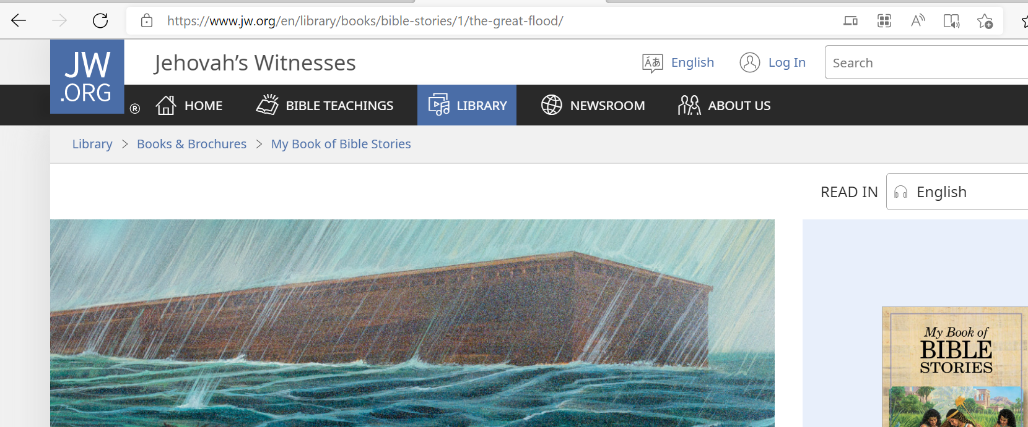
Genesis 6-9: The Flood
All of the preceding text and pictures were copied from a portion of the Jehovah Witness site called jw.org, in a section called “My Book of Bible Stories.”

Slide 10
Genesis 6:1-4: The Giants
6 And it came to pass, when men began to multiply on the face of the earth, and daughters were born unto them,
² That the sons of God saw the daughters of men that they were fair; and they took them wives of all which they chose.
³ And the Lord said, My spirit shall not always strive with man, for that he also is flesh: yet his days shall be an hundred and twenty years.
⁴ There were giants in the earth in those days; and also after that, when the sons of God came in unto the daughters of men, and they bare children to them, the same became mighty men which were of old, men of renown.

Slide 11
Genesis 6:1-4: Ed Jarrett
(from www.biblestudytools.com)
In these first 4 verses there are three specific groups mentioned: the sons of God; the daughters of humans; and the Nephilim. Who are these three groups? One common response is to identify the sons of God as the descendants of Seth, and those who call on the name of the Lord (Gen. 4:26). The daughters of humans would then be the descendants of Cain, and the Nephilim would simply be their offspring.

Slide 12
Genesis 6:1-4: Ed Jarrett
(from www.biblestudytools.com)
“In these first 4 verses there are three specific groups mentioned: the sons of God; the daughters of humans; and the Nephilim. Who are these three groups? One common response is to identify the sons of God as the descendants of Seth, and those who call on the name of the Lord (Gen. 4:26). The daughters of humans would then be the descendants of Cain, and the Nephilim would simply be their offspring.”

Slide 13
Genesis 6:1-4: Ed Jarrett
(from www.biblestudytools.com)
“But, I [Ed Jarrett of the Sylvan Way Baptist Church] believe a more likely explanation identifies the sons of God as being the same group mentioned in Job 1:6 and Job 2:1. In Job, the NIV translates sons of God as angels. But it is the same expression as used in Genesis 6:1, 4. That would mean this passage then describes a sexual union between angels and humans. And their offspring were the Nephilim.”

Slide 14

Genesis 6:1-4: Ed Jarrett
(from www.biblestudytools.com)
“But, I [Ed Jarrett of the Sylvan Way Baptist Church] believe a more likely explanation identifies the sons of God as being the same group mentioned in Job 1:6 and Job 2:1. In Job, the NIV translates sons of God as angels. But it is the same expression as used in Genesis 6:1, 4. That would mean this passage then describes a sexual union between angels and humans. And their offspring were the Nephilim.”

Slide 15
Genesis 6:1-4: Ed Jarrett
(from www.biblestudytools.com)
“The sixth and seventh chapters of the non-canonical book of 1st Enoch describes just this scenario. A group of angels, called watchers, determined to have children by human women. These children were described as giants who preyed on humans, and the watchers taught humans things that they were not supposed to know.”

Slide 16
Genesis 6:4: The Sons of God
Just for the sake of clarity, I’d like to insert here that poor old Ed is quite correct about the Hebrew words used here in Genesis 6:4 and those in Job 1:6. That is to say, both phrases are translated “the sons of God” in the KJV, and the phrase does seem to refer to angels or perhaps the leaders of other worlds in Job 1:6.

Slide 17
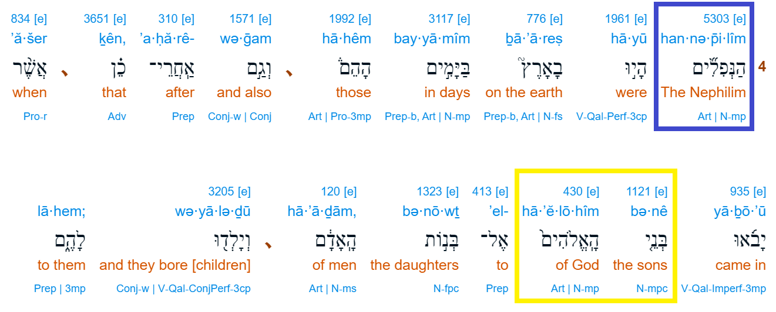
Genesis 6:4: The Sons of God
⁴ There were giants in the earth in those days; and also after that, when the sons of God came in unto the daughters of men, and they bare children to them, the same became mighty men which were of old, men of renown.

Slide 18
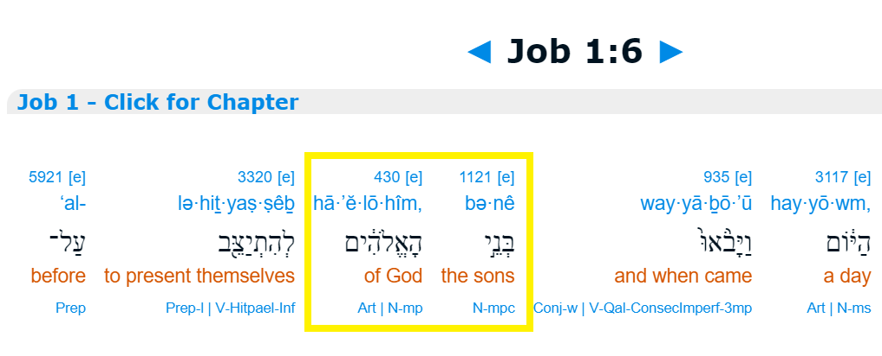
Genesis 6:4: The Sons of God
⁶ Now there was a day when the sons of God came to present themselves before the Lord, and Satan came also among them.

Slide 19
Genesis 6:2: The Sons of God
Ed’s research is good, but his conclusions are still questionable! Let’s go back just two verses, to Genesis 6:2.
Here we see that not only did the “sons of God” have children with the “daughters of men,” they also married them! So the “sons of God” that we read about in Genesis 6:4 are actually married. And there’s the problem!
² That the sons of God saw the daughters of men that they were fair; and they took them wives of all which they chose.

Slide 20
Genesis 6:2: The Sons of God
We know very little about the angels. God did not see fit to give us a high degree of certainty about their appearance, habits, or behavior. He didn’t give us many details at all. But the Bible does say something about angels that we can know for certain. It’s found in Matthew 22:30.
Angels don’t marry. Apparently ever. There’s no evidence that angels have reproductive abilities, though that too is a detail we don’t need!
For in the resurrection they neither marry, nor are given in marriage, but are as the angels of God in heaven.

Slide 21
Genesis 6:3: The Sons of God
The train of thought continues in Genesis 6:3.
There are several interesting things about this verse. We definitely see a withdrawal of the Holy Spirit from the earth. Why? The phrase “for that he also is flesh” might be rendered “in their going astray man is flesh.” That is, by following the lusts of the flesh men have made themselves unresponsive to the Holy Spirit’s prodding.
³ And the Lord said, My spirit shall not always strive with man, for that he also is flesh: yet his days shall be an hundred and twenty years.

Slide 22
Genesis 6:3: The Sons of God
³ And the Lord said, My spirit shall not always strive with man, for that he also is flesh: yet his days shall be an hundred and twenty years.
We further note that the judgement to which this verse alludes cannot be the limiting of human age to 120 yrs. Noah’s son Shem lived to be 600. Noah’s grandson lived to be 438, and so on. Eber, Noah’s great-great-grandson, lived to be 464. The 120 years are a time period before the judgement—the flood—would fall. The people had 120 years to stop their behavior and obey.

Slide 23
Genesis 6:3: The Sons of God
³ And the Lord said, My spirit shall not always strive with man, for that he also is flesh: yet his days shall be an hundred and twenty years.
Failing that, judgment would fall. Specifically, the flood would occur. And please note that this judgment was to fall on humanity. The judgment to be enacted would fall on man because man spent all his time sinfully indulging in the lusts of the flesh. Note that it was not to fall on any lusty angelic group!

Slide 24
Genesis 6:1-4: The Sons of God
The “sons of God” both here in Genesis 6:4 and in Job 1:6 share an outstanding characteristic—they honor God among others who do not. As such we mere humans are honored with the moniker the “sons of God” so long as we behave in a way appropriate for such a title! God later spoke of Israel as His “firstborn son” (Ex. 4:22), and Moses called the people of Israel “children of the Lord your God” in Deut. 14:1. And we see the same honor bestowed in Romans 8:14.
¹⁴ For as many as are led by the Spirit of God, they are the sons of God.

Slide 25
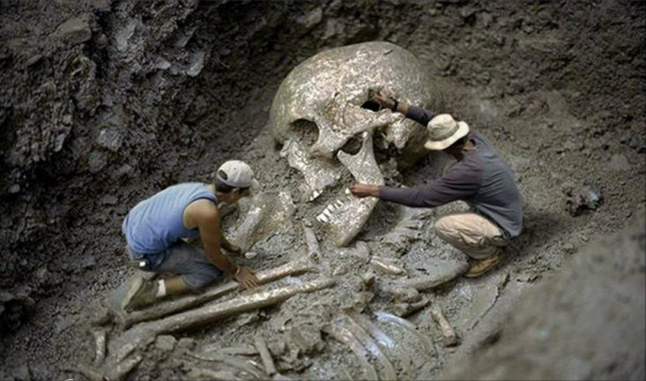
Genesis 6:1-4: Who are the Giants?
Hello Photoshop!

Slide 26
Genesis 6:1-4: Who are the Giants?
So the giants—or “nephilim”—were not the products of fallen angel/human marriages, but descendants of the followers of God (Sethites) who married heathen (Cainite) women.
It seems the word “nephilim” may come from the root “naphal,” meaning violence. Thus the “nephilim” might be rendered “violent ones,” or “fearsome ones.” The later meaning of “giants” makes sense in this context! The prevalence of vicious, amoral people also makes sense given Genesis 6:5, describing the wickedness of the people’s hearts.

Slide 27
Patriarchs and Prophets, pg. 90
The human race yet retained much of its early vigor. But a few generations had passed since Adam had access to the tree which was to prolong life; and man's existence was still measured by centuries. Had that long-lived people, with their rare powers to plan and execute, devoted themselves to the service of God, they would have made their Creator's name a praise in the earth, and would have answered the purpose for which He gave them life. But they failed to do this. There were many giants, men of great stature and strength, renowned for wisdom, skillful in devising the most cunning and wonderful works; but their guilt in giving loose rein to iniquity was in proportion to their skill and mental ability.

Slide 28
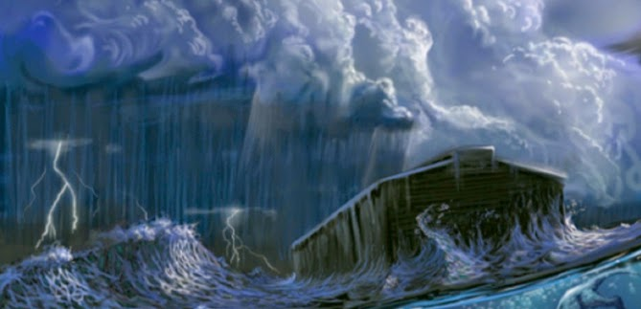
Genesis 6:8

Slide 29
Genesis 6:8
It’s important to remember, amidst the fearful images of the vicious and cunning giants, rampant immorality involving the lusts of the flesh, and the threat of looming judgment, that NOAH FOUND GRACE!

Slide 30
Genesis 6:8: Noah Found Grace
But Noah found grace in the eyes of the Lord.

Slide 31
Genesis 6:8: Noah Found Grace
And the truth is that among terrorists and disasters and the threat of looming judgment, that same grace is available to us today!
Let us therefore come boldly unto the throne of grace, that we may obtain mercy, and find grace to help in time of need.
-Hebrews 4:16

Slide 32
Other Ideas:
(“Genesis flood narrative” – Wikipedia)
In Jewish folklore, the kind of water that was pouring to the earth for forty days is not common rainfall; rather, God bade each drop pass through Gehenna before it fell to earth, which 'hot rain' scalded the skin of the sinners. The punishment that overtook them was befitting their crime. As their sensual desires had made them hot, and inflamed them to immoral excesses, so they were chastised by means of heated water.
Ginzberg, Louis (1909). The Legends of the Jews Vol I : The Inmates of the Ark (Translated by Henrietta Szold) Philadelphia: Jewish Publication Society.

Slide 33
Other Ideas: Hot Water
Curiously, the Bible mentions nothing special about the water! In Genesis 7:11-12:
It’s another argument from silence!
¹¹ In the six hundredth year of Noah's life, in the second month, the seventeenth day of the month, the same day were all the fountains of the great deep broken up, and the windows of heaven were opened.
¹² And the rain was upon the earth forty days and forty nights.

Slide 34
Other Ideas:
(“Genesis flood narrative” – Wikipedia)
In the 3rd century Gnostic codex now referred to as the Hypostasis of the Archons, it is the corrupt rulers (Archons) who decide to flood the world in order to dispose of most of mankind. However, Noah is spared and told to build an ark. But when his wife Norea wants to board the ark, Noah attempts to not let her, thus she uses her divine power to blow on the ark, causing it to be consumed by fire. Noah later builds the ark a second time. When the Archons try to seize Norea, she calls out to God for help, then the angel Eleleth appears and scares away the Archons, revealing to Norea that she is a divine child of the great spirit. A different view is found in the Secret Book of John; instead of an ark, Noah hides in a bright cloud.
Marvin Meyer; Willis Barnstone(2009). "The Reality of the Rulers (The Hypostasis of the Archons) and The Secret Book of John". The Gnostic Bible. Shambhala. ISBN 9781590306314. Retrieved 7 February 2022

Slide 35
Other Ideas: Gnostics
It seems that people have always liked their fairytales!
The Gnostics, among a range of other things, did not believe in the divinity of Christ. So we can know that they were on the wrong track! 1 John 4:2-3
² Hereby know ye the Spirit of God: Every spirit that confesseth that Jesus Christ is come in the flesh is of God:
³ And every spirit that confesseth not that Jesus Christ is come in the flesh is not of God: and this is that spirit of antichrist, whereof ye have heard that it should come; and even now already is it in the world.

Slide 36
Other Ideas:
(“Genesis flood narrative” – Wikipedia)
While some scholars have tried to offer possible explanations for the origins of the flood myth including a legendary retelling of a possible Black Sea deluge, the general mythological exaggeration and implausibility of the story are widely recognized by relevant academic fields. The acknowledgement of this follows closely the development of understanding of the natural history and especially the geology and paleontology of the planet…

Slide 37
Other Ideas:
(“Genesis flood narrative” – Wikipedia)
The development of scientific geology had a profound impact on attitudes towards the biblical flood narrative. By bringing into question the biblical chronology, which placed the Creation and the flood in a history which stretched back no more than a few thousand years, the concept of deep geological time undermined the idea of the historicity of the Ark itself…

Slide 38
Other Ideas:
(“Genesis flood narrative” – Wikipedia)
So-called "flood geology" was championed in the latter half of the twentieth and on into the twenty-first century by Christian fundamentalists who believe in Young Earth creationism. Historian Ronald Numbers argues that this ideological connection by Christians wanting to challenge aspects of the scientific consensus they believe contradict their religion was first established by the publication of the 1961 book, The Genesis Flood…

Slide 39
Other Ideas:
(“Genesis flood narrative” – Wikipedia)
The scientific community maintains that flood geology is a pseudoscience because it contradicts a variety of facts in geology, stratigraphy, geophysics, physics, paleontology, biology, anthropology, and archeology…
This is simply not the case. We “fundamentalists” and “young earth creationists” wish to dispute certain commonly offered interpretations of the facts, never the facts themselves!

Slide 40
Other Ideas:
(“Genesis flood narrative” – Wikipedia)
For example, in contrast to the catastrophism inherent in flood geology, the science of geology relies on Charles Lyell's established principle of uniformitarianism. In relation to geological forces, uniformitarianism explains the formation of the Earth's features by means of mostly slow-acting forces seen in operation today.
Not, you’ll notice, an established fact or reality, but a guiding principle of INTERPRETATION!

Slide 41
Other Ideas:
(“Genesis flood narrative” – Wikipedia)
In contrast, there is a lack of evidence for the catastrophic mechanisms proposed by flood geologists, and scientists do not take their claims seriously.
The supposed “lack of evidence” is simple enough to understand by looking at the final phrase. Whether the evidence is present or not, so-called “scientists” don’t take it seriously.

Slide 42
Other Ideas: Science Falsely So Called
The facts are there, and we have seen some of them previously! But once someone has made the erroneous assumption of “deep time” then they are no longer scientists looking for facts, but people looking to prove an assumption. As in 1 Timothy 20-21:
²⁰ O Timothy, keep that which is committed to thy trust, avoiding profane and vain babblings, and oppositions of science falsely so called:
²¹ Which some professing have erred concerning the faith. Grace be with thee. Amen.

Slide 43
Thank you!

