Slide 1
Commitment, Exhortation, and Discouragement
Hebrews 12

Slide 2
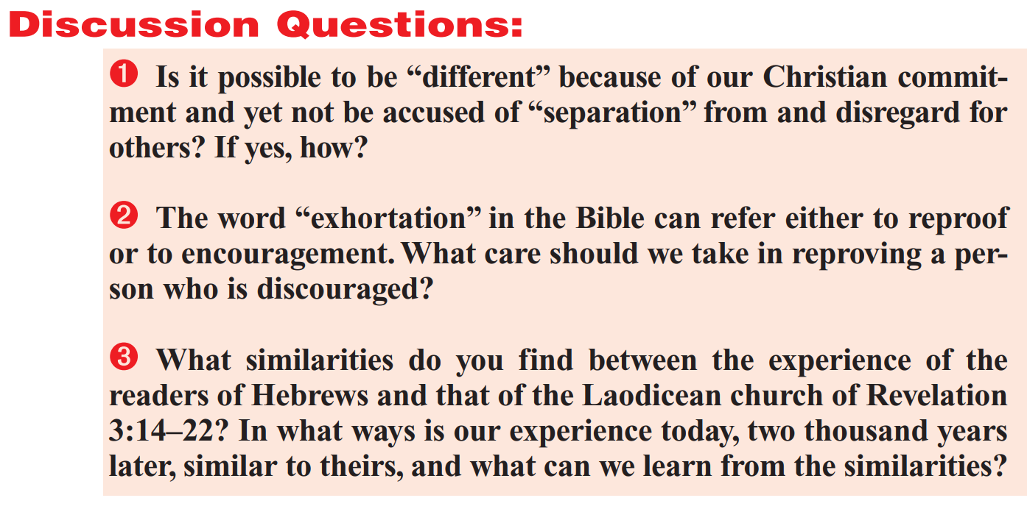

Slide 3
Hebrews 10:32-34
³² But call to remembrance the former days, in which, after ye were illuminated, ye endured a great fight of afflictions;
³³ Partly, whilst ye were made a gazingstock both by reproaches and afflictions; and partly, whilst ye became companions of them that were so used.
³⁴ For ye had compassion of me in my bonds, and took joyfully the spoiling of your goods, knowing in yourselves that ye have in heaven a better and an enduring substance.

Slide 4
Acts 16:19-21
¹⁹ And when her masters saw that the hope of their gains was gone, they caught Paul and Silas, and drew them into the marketplace unto the rulers,
²⁰ And brought them to the magistrates, saying, These men, being Jews, do exceedingly trouble our city,
²¹ And teach customs, which are not lawful for us to receive, neither to observe, being Romans.

Slide 5
Acts 16:22-24
²² And the multitude rose up together against them: and the magistrates rent off their clothes, and commanded to beat them.
²³ And when they had laid many stripes upon them, they cast them into prison, charging the jailor to keep them safely:
²⁴ Who, having received such a charge, thrust them into the inner prison, and made their feet fast in the stocks.

Slide 6
1 Corinthians 4:11-14
¹¹ Even unto this present hour we both hunger, and thirst, and are naked, and are buffeted, and have no certain dwellingplace;
¹² And labour, working with our own hands: being reviled, we bless; being persecuted, we suffer it:
¹³ Being defamed, we intreat: we are made as the filth of the world, and are the offscouring of all things unto this day.
¹⁴ I write not these things to shame you, but as my beloved sons I warn you.

Slide 7
Acts 23:12-13
¹² And when it was day, certain of the Jews banded together, and bound themselves under a curse, saying that they would neither eat nor drink till they had killed Paul.
¹³ And they were more than forty which had made this conspiracy.

Slide 8
Acts 12:1-5
Now about that time Herod the king stretched forth his hands to vex certain of the church.
² And he killed James the brother of John with the sword.
³ And because he saw it pleased the Jews, he proceeded further to take Peter also. (Then were the days of unleavened bread.)
⁴ And when he had apprehended him, he put him in prison, and delivered him to four quaternions of soldiers to keep him; intending after Easter to bring him forth to the people.
⁵ Peter therefore was kept in prison: but prayer was made without ceasing of the church unto God for him.

Slide 9
Persecution
Jesus pronounced God's salvation upon those who are persecuted for righteousness sake (Matthew 5:10-12 ). In an evil world, disciples are to expect persecution (Matthew 10:16-23; Mark 4:17; Mark 13:9; John 15:20; John 16:2 ), just as was the case with the prophets in the Old Testament (Matthew 5:12; Matthew 23:31; Luke 11:47-51; Acts 7:52; Hebrews 11:32-38 ). Paul (1 Corinthians 4:11-13; 2 Corinthians 4:8-12; 2 Corinthians 6:4-10; 2 Corinthians 11:24-27; Galatians 5:11; 1 Thessalonians 2:2; 1 Thessalonians 3:4; Acts 17:5-10; Acts 18:12-17; Acts 21:30-36; Acts 23:12-35 ), as well as Stephen (Acts 6:8-7:60 ), James (Acts 12:2 ), and Peter (Acts 12:3-5 ), together with many anonymous martyrs experienced the truth of the statement: “If they have persecuted me, they will also persecute you” (John 15:20; see Acts 4:3; Acts 5:17-42; Acts 8:1; Acts 12:1; Revelation 2:26 ,Revelation 2:26,2:9-10 ,Revelation 2:9-10,2:13 ,Revelation 2:13,2:19; Revelation 3:8-10; Revelation 6:9; Revelation 16:6; Revelation 17:6; Revelation 18:24; Revelation 20:4 ).

Slide 10
Persecution
Many epistles and books (like 1st Peter and Hebrews) contain encouragement for Christians in a situation of persecution (1 Peter 3:13-18; 1 Peter 4:12-19; 1 Peter 5:6-14; Hebrews 10:32-39; Hebrews 12:3). Something like a “theology of persecution” emerged, which emphasized patience, endurance, and steadfastness (Romans 12:12; 1 Thessalonians 2:14-16; James 5:7-11 ); prayer (Matthew 5:44; Romans 12:14; 1 Corinthians 4:12 ); thanksgiving (2 Thessalonians 1:4 ); testing (Mark 4:17 ) and the strengthening of faith (1 Thessalonians 3:2-3); experiencing the grace of God (Romans 8:35; 2 Corinthians 4:9 , 2 Corinthians 12:10 ), and being blessed through suffering (Matthew 5:10-12; 1 Peter 3:14; 1 Peter 4:12-14). For Paul, persecuting Christians could be a living and visible testimony to the crucified and risen Christ (2 Corinthians 4:7-12 ).
In summary, there is so much in the Bible about persecution that we really ought to be expecting it!

Slide 11
Matthew 10:16-19
¹⁶ Behold, I send you forth as sheep in the midst of wolves: be ye therefore wise as serpents, and harmless as doves.
¹⁷ But beware of men: for they will deliver you up to the councils, and they will scourge you in their synagogues;
¹⁸ And ye shall be brought before governors and kings for my sake, for a testimony against them and the Gentiles.
¹⁹ But when they deliver you up, take no thought how or what ye shall speak: for it shall be given you in that same hour what ye shall speak.

Slide 12
Matthew 10:20-24
²⁰ For it is not ye that speak, but the Spirit of your Father which speaketh in you.
²¹ And the brother shall deliver up the brother to death, and the father the child: and the children shall rise up against their parents, and cause them to be put to death.
²² And ye shall be hated of all men for my name's sake: but he that endureth to the end shall be saved.
²³ But when they persecute you in this city, flee ye into another: for verily I say unto you, Ye shall not have gone over the cities of Israel, till the Son of man be come.
²⁴ The disciple is not above his master, nor the servant above his lord.

Slide 13
From the Quarterly:
To “bear the reproach of Christ” simply meant to identify oneself with Christ and endure the shame and abuse that this association implied. Public animosity against Christians was the result of their distinctive religious commitments. People can get offended by religious practices that they don’t understand or by people whose lifestyle and morals could make others feel guilty or shamed.

Slide 14
Tacitus, The Annals, Book 15, Ch. 44
“Consequently, to get rid of the report, Nero fastened the guilt and inflicted the most exquisite tortures on a class hated for their abominations, called Christians by the populace. Christus, from whom the name had its origin, suffered the extreme penalty during the reign of Tiberius at the hands of one of our procurators, Pontius Pilatus, and a most mischievous superstition, thus checked for the moment, again broke out not only in Judæa, the first source of the evil, but even in Rome, where all things hideous and shameful from every part of the world find their centre and become popular. Accordingly, an arrest was first made of all who pleaded guilty; then, upon their information, an immense multitude was convicted, not so much of the crime of firing the city, as of hatred against mankind. Mockery of every sort was added to their deaths. Covered with the skins of beasts, they were torn by dogs and perished, or were nailed to crosses, or were doomed to the flames and burnt, to serve as a nightly illumination, when daylight had expired.”

Slide 15
From the Quarterly:
David A. deSilva explains clearly why the early Christians suffered persecution: “Christians adopted a lifestyle that … would have been considered antisocial and even subversive. Loyalty to the gods, expressed in pious attendance at sacrifices and the like, was viewed as a symbol for loyalty to the state, authorities, friends, and family. Worship of the deities was something of a symbol for one’s dedication to the relationships that kept society stable and prosperous. By abstaining from the former, Christians (like the Jews) were regarded with suspicion as potential violators of the laws and [as] subversive elements within the empire.” — Perseverance in Gratitude (Grand Rapids, MI: Eerdmans Publishing Company, 2000), p. 12.)

Slide 17
NO

Slide 18
Parsing the Question:
Exhortation (ĕg″zôr-tā′shən)
noun
The act or an instance of exhorting.
A speech or discourse that encourages, incites, or earnestly advises.
The act or practice of exhorting; incitement by means of argument, appeal, or admonition; the argument or appeal made.

Slide 19
Hebrews 12:3-5
³ For consider him that endured such contradiction of sinners against himself, lest ye be wearied and faint in your minds.
⁴ Ye have not yet resisted unto blood, striving against sin.
⁵ And ye have forgotten the exhortation which speaketh unto you as unto children, My son, despise not thou the chastening of the Lord, nor faint when thou art rebuked of him:

Slide 20
Hebrews 12:6-9
⁶ For whom the Lord loveth he chasteneth, and scourgeth every son whom he receiveth.
⁷ If ye endure chastening, God dealeth with you as with sons; for what son is he whom the father chasteneth not?
⁸ But if ye be without chastisement, whereof all are partakers, then are ye bastards, and not sons.
⁹ Furthermore we have had fathers of our flesh which corrected us, and we gave them reverence: shall we not much rather be in subjection unto the Father of spirits, and live?

Slide 21
Hebrews 12:10-13
¹⁰ For they verily for a few days chastened us after their own pleasure; but he for our profit, that we might be partakers of his holiness.
¹¹ Now no chastening for the present seemeth to be joyous, but grievous: nevertheless afterward it yieldeth the peaceable fruit of righteousness unto them which are exercised thereby.
¹² Wherefore lift up the hands which hang down, and the feeble knees;
¹³ And make straight paths for your feet, lest that which is lame be turned out of the way; but let it rather be healed.

Slide 22
Hebrews 12:14-17
¹⁴ Follow peace with all men, and holiness, without which no man shall see the Lord:
¹⁵ Looking diligently lest any man fail of the grace of God; lest any root of bitterness springing up trouble you, and thereby many be defiled;
¹⁶ Lest there be any fornicator, or profane person, as Esau, who for one morsel of meat sold his birthright.
¹⁷ For ye know how that afterward, when he would have inherited the blessing, he was rejected: for he found no place of repentance, though he sought it carefully with tears.

Slide 23
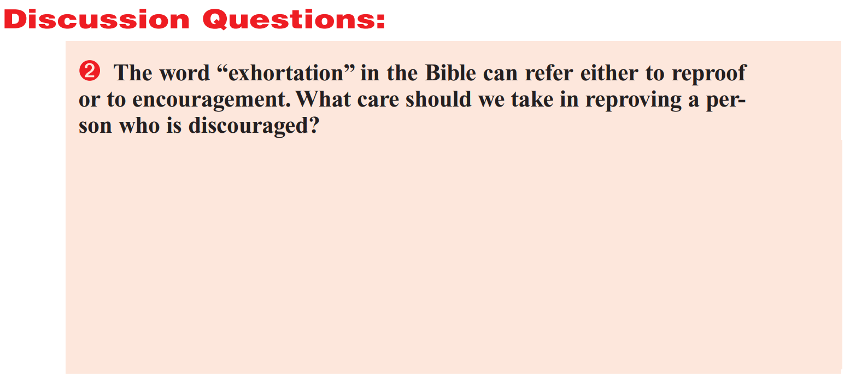
We don’t need to “reprove” a person who is discouraged. We need to “EXHORT” (that is, urge, incite) them to consider the blessings that God has provided. (For consider him that endured such contradiction of sinners against himself, lest ye be wearied and faint in your minds. Ye have not yet resisted unto blood, striving against sin.) We should also recall that the discouraging circumstances which face us are often simply God’s way of teaching us discipline, as a loving parent might punish a child. (And ye have forgotten the exhortation which speaketh unto you as unto children, My son, despise not thou the chastening of the Lord, nor faint when thou art rebuked of him.)

Slide 24
NO

Slide 25
NO
No reproof needed… But some sharp exhortation may be useful!

Slide 26
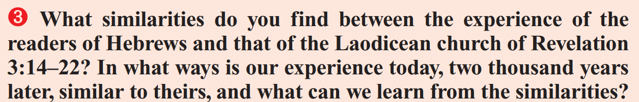
Discussion Question 3

Slide 27
Tacitus, The Annals, Book 15, Ch. 44
Possibly you’ll recall some of this account:
“Consequently, to get rid of the report, Nero fastened the guilt and inflicted the most exquisite tortures on a class hated for their abominations, called Christians by the populace… an immense multitude was convicted, not so much of the crime of firing the city, as of hatred against mankind. Mockery of every sort was added to their deaths. Covered with the skins of beasts, they were torn by dogs and perished, or were nailed to crosses, or were doomed to the flames and burnt, to serve as a nightly illumination, when daylight had expired.
Nero offered his gardens for the spectacle, and was exhibiting a show in the circus, while he mingled with the people in the dress of a charioteer or stood aloft on a car. Hence, even for criminals who deserved extreme and exemplary punishment, there arose a feeling of compassion; for it was not, as it seemed, for the public good, but to glut one man's cruelty, that they were being destroyed.”

Slide 28
Revelation 3:14-16
¹⁴ And unto the angel of the church of the Laodiceans write; These things saith the Amen, the faithful and true witness, the beginning of the creation of God;
¹⁵ I know thy works, that thou art neither cold nor hot: I would thou wert cold or hot.
¹⁶ So then because thou art lukewarm, and neither cold nor hot, I will spue thee out of my mouth.

Slide 29
Revelation 3:17-19
¹⁷ Because thou sayest, I am rich, and increased with goods, and have need of nothing; and knowest not that thou art wretched, and miserable, and poor, and blind, and naked:
¹⁸ I counsel thee to buy of me gold tried in the fire, that thou mayest be rich; and white raiment, that thou mayest be clothed, and that the shame of thy nakedness do not appear; and anoint thine eyes with eyesalve, that thou mayest see.
¹⁹ As many as I love, I rebuke and chasten: be zealous therefore, and repent.

Slide 30
Revelation 3:17-19
¹⁷ Because thou sayest, I am rich, and increased with goods, and have need of nothing; and knowest not that thou art wretched, and miserable, and poor, and blind, and naked:
¹⁸ I counsel thee to buy of me gold tried in the fire, that thou mayest be rich; and white raiment, that thou mayest be clothed, and that the shame of thy nakedness do not appear; and anoint thine eyes with eyesalve, that thou mayest see.
¹⁹ As many as I love, I rebuke and chasten: be zealous therefore, and repent.

Slide 31
Hebrews 12:6-7
⁶ For whom the Lord loveth he chasteneth, and scourgeth every son whom he receiveth.
⁷ If ye endure chastening, God dealeth with you as with sons; for what son is he whom the father chasteneth not?

Slide 32
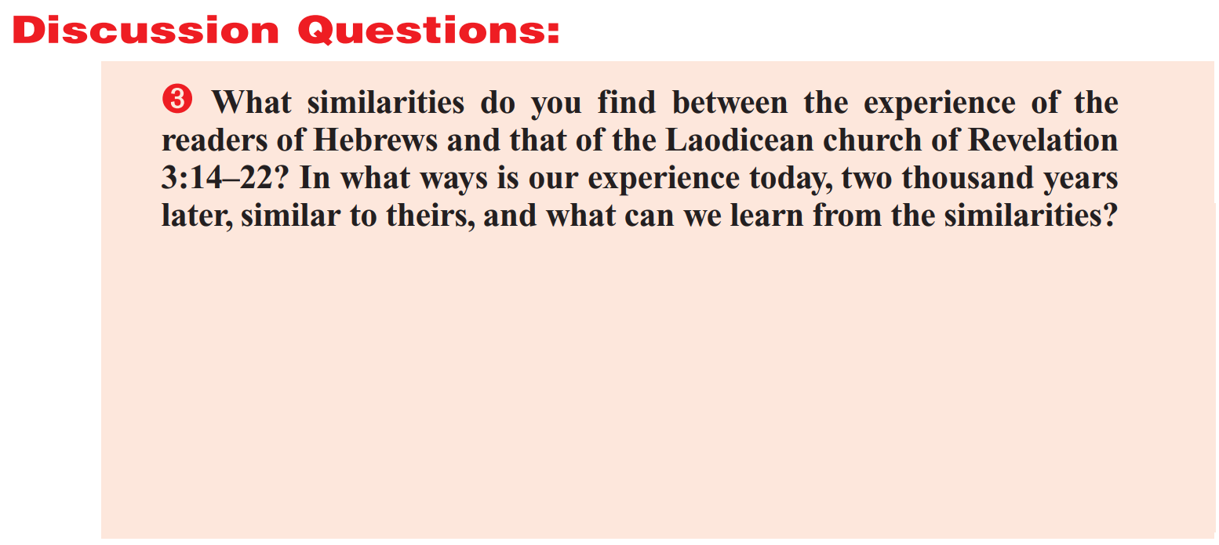
I don’t see a lot of similarities between these two things! Aside from chastening, trials, discouragement, repentance, and other things common to all humans in all times, the experiences seem to be very different. But there can be no doubt that both the original readers of Hebrews and the Laodicean church are called to accept God’s discipline and repent of their wrong-doing.

Slide 34
NO
No reproof needed… But some sharp exhortation may be useful!
Accept God’s chastening and REPENT!

