Slide 1
Champions and Priests
Lesson 2

Slide 2
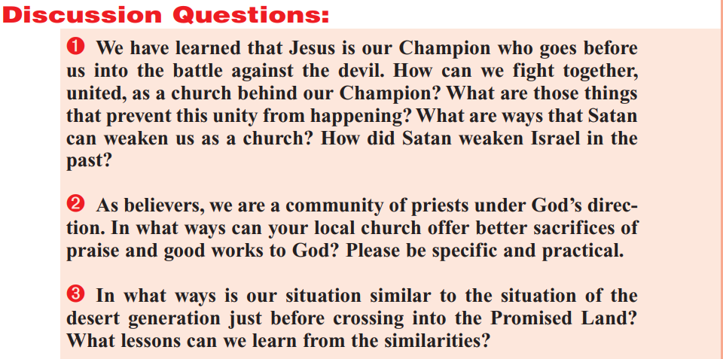
The Questions

Slide 3
Parsing the first question:
We have learned that Jesus is our Champion who goes before us into the battle against the devil.
  How can we fight together, united, as a church behind our Champion?
  What are those things that prevent this unity from happening?
  What are ways that Satan can weaken us as a church?
  How did Satan weaken Israel in the past?

Slide 4
Parsing the first question:
Champion (noun):
a winner of first prize or first place in competition, i.e., “a tennis champion”
a militant advocate or defender, i.e., “a champion of civil rights”
a warrior or fighter representing someone else, i.e., “a champion of his king”
one that does battle for another's rights or honor, as in, “God will raise me up a champion” — Sir Walter Scott

Slide 5
Hebrews 2:14-16
¹⁴ Forasmuch then as the children are partakers of flesh and blood, he also himself likewise took part of the same; that through death he might destroy him that had the power of death, that is, the devil;
¹⁵ And deliver them who through fear of death were all their lifetime subject to bondage.
¹⁶ For verily he took not on him the nature of angels; but he took on him the seed of Abraham.

Slide 6
Isaiah 42:13
¹³ The Lord shall go forth as a mighty man, he shall stir up jealousy like a man of war: he shall cry, yea, roar; he shall prevail against his enemies.

Slide 7
Isaiah 49:24-26
²⁴ Shall the prey be taken from the mighty, or the lawful captive delivered?
²⁵ But thus saith the Lord, Even the captives of the mighty shall be taken away, and the prey of the terrible shall be delivered: for I will contend with him that contendeth with thee, and I will save thy children.
²⁶ And I will feed them that oppress thee with their own flesh; and they shall be drunken with their own blood, as with sweet wine: and all flesh shall know that I the Lord am thy Saviour and thy Redeemer, the mighty One of Jacob.

Slide 8
Parsing the first question:
We have learned that Jesus is our Champion who goes before us into the battle against the devil.
  How can we fight together, united, as a church behind our Champion?
  What are those things that prevent this unity from happening?
  What are ways that Satan can weaken us as a church?
  How did Satan weaken Israel in the past?

Slide 9
How can we FIGHT?
Ephesians 6:10-12
¹⁰ Finally, my brethren, be strong in the Lord, and in the power of his might.
¹¹ Put on the whole armour of God, that ye may be able to stand against the wiles of the devil.
¹² For we wrestle not against flesh and blood, but against principalities, against powers, against the rulers of the darkness of this world, against spiritual wickedness in high places.

Slide 10
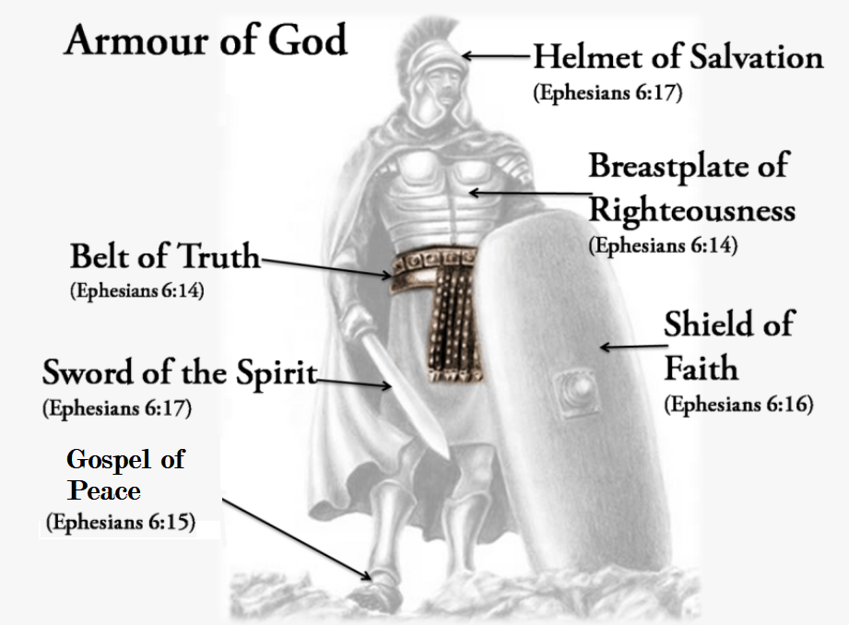
Ephesians 6

Slide 11
How can we FIGHT?
Ephesians 6:13
¹³ Wherefore take unto you the whole armour of God, that ye may be able to withstand in the evil day, and having done all, to stand.

Slide 12
Parsing the first question:
We have learned that Jesus is our Champion who goes before us into the battle against the devil.
  How can we fight together, united, as a church behind our Champion? Put on the whole armor of God!
  What are those things that prevent this unity from happening?
  What are ways that Satan can weaken us as a church?
  How did Satan weaken Israel in the past?

Slide 13
What prevents unity?
Ephesians 4:1-7
I therefore, the prisoner of the Lord, beseech you that ye walk worthy of the vocation wherewith ye are called,
² With all lowliness and meekness, with longsuffering, forbearing one another in love;
³ Endeavouring to keep the unity of the Spirit in the bond of peace.
⁴ There is one body, and one Spirit, even as ye are called in one hope of your calling;
⁵ One Lord, one faith, one baptism,
⁶ One God and Father of all, who is above all, and through all, and in you all.
⁷ But unto every one of us is given grace according to the measure of the gift of Christ.

Slide 14
What prevents unity?
Ephesians 4:8-12
⁸ Wherefore he saith, When he ascended up on high, he led captivity captive, and gave gifts unto men.
⁹ (Now that he ascended, what is it but that he also descended first into the lower parts of the earth?
¹⁰ He that descended is the same also that ascended up far above all heavens, that he might fill all things.)
¹¹ And he gave some, apostles; and some, prophets; and some, evangelists; and some, pastors and teachers;
¹² For the perfecting of the saints, for the work of the ministry, for the edifying of the body of Christ:

Slide 15
What prevents unity?
Ephesians 4:13-16
¹³ Till we all come in the unity of the faith, and of the knowledge of the Son of God, unto a perfect man, unto the measure of the stature of the fulness of Christ:
¹⁴ That we henceforth be no more children, tossed to and fro, and carried about with every wind of doctrine, by the sleight of men, and cunning craftiness, whereby they lie in wait to deceive;
¹⁵ But speaking the truth in love, may grow up into him in all things, which is the head, even Christ:
¹⁶ From whom the whole body fitly joined together and compacted by that which every joint supplieth, according to the effectual working in the measure of every part, maketh increase of the body unto the edifying of itself in love.

Slide 16
Parsing the first question:
We have learned that Jesus is our Champion who goes before us into the battle against the devil.
  How can we fight together, united, as a church behind our Champion? Put on the whole armor of God!
  What are those things that prevent this unity from happening? Not yet “grown into” our Head!
  What are ways that Satan can weaken us as a church?
  How did Satan weaken Israel in the past?

Slide 17
How does Satan weaken the church?
The Great Controversy, pgs. 519-520
Again, Satan sees the Lord's servants burdened because of the spiritual darkness that enshrouds the people. He hears their earnest prayers for divine grace and power to break the spell of indifference, carelessness, and indolence. Then with renewed zeal he plies his arts. He tempts men to the indulgence of appetite or to some other form of self-gratification, and thus benumbs their sensibilities so that they fail to hear the very things which they most need to learn.

Slide 18
How does Satan weaken the church?
The Great Controversy, pgs. 519-520
Satan well knows that all whom he can lead to neglect prayer and the searching of the Scriptures, will be overcome by his attacks. Therefore he invents every possible device to engross the mind. There has ever been a class professing godliness, who, instead of following on to know the truth, make it their religion to seek some fault of character or error of faith in those with whom they do not agree. Such are Satan's right-hand helpers. Accusers of the brethren are not few, and they are always active when God is at work and His servants are rendering Him true homage.
…

Slide 19
How does Satan weaken the church?
The Great Controversy, pgs. 519-520
The great deceiver has many agents ready to present any and every kind of error to ensnare souls—heresies prepared to suit the varied tastes and capacities of those whom he would ruin. It is his plan to bring into the church insincere, unregenerate elements that will encourage doubt and unbelief, and hinder all who desire to see the work of God advance and to advance with it. Many who have no real faith in God or in His word assent to some principles of truth and pass as Christians, and thus they are enabled to introduce their errors as Scriptural doctrines.

Slide 20
How does Satan weaken the church?
The Great Controversy, pg. 528
Satan can present a counterfeit so closely resembling the truth that it deceives those who are willing to be deceived, who desire to shun the self-denial and sacrifice demanded by the truth; but it is impossible for him to hold under his power one soul who honestly desires, at whatever cost, to know the truth. Christ is the truth and the "Light, which lighteth every man that cometh into the world." John 1:9. The Spirit of truth has been sent to guide men into all truth. And upon the authority of the Son of God it is declared: "Seek, and ye shall find." "If any man will do His will, he shall know of the doctrine." Matthew 7:7; John 7:17.

Slide 21
How does Satan weaken the church?
The Great Controversy, pgs. 529-530
[Note: Mrs. White is discussing the events surrounding Balaam’s “curse” against Israel as an example of Satan’s limited albeit powerful ability to attack God’s people.]
The people of Israel were at this time loyal to God; and so long as they continued in obedience to His law, no power in earth or hell could prevail against them. But the curse which Balaam had not been permitted to pronounce against God's people, he finally succeeded in bringing upon them by seducing them into sin. When they transgressed God's commandments, then they separated themselves from Him, and they were left to feel the power of the destroyer.

Slide 22
How does Satan weaken the church?
The Great Controversy, pg. 530
Satan is well aware that the weakest soul who abides in Christ is more than a match for the hosts of darkness, and that, should he reveal himself openly, he would be met and resisted. Therefore he seeks to draw away the soldiers of the cross from their strong fortification, while he lies in ambush with his forces, ready to destroy all who venture upon his ground. Only in humble reliance upon God, and obedience to all His commandments, can we be secure.
No man is safe for a day or an hour without prayer. Especially should we entreat the Lord for wisdom to understand His word. Here are revealed the wiles of the tempter and the means by which he may be successfully resisted. Satan is an expert in quoting Scripture, placing his own interpretation upon passages, by which he hopes to cause us to stumble. We should study the Bible with humility of heart, never losing sight of our dependence upon God. While we must constantly guard against the devices of Satan, we should pray in faith continually: "Lead us not into temptation."

Slide 23
Parsing the first question:
We have learned that Jesus is our Champion who goes before us into the battle against the devil.
  How can we fight together, united, as a church behind our Champion? Put on the whole armor of God!
  What are those things that prevent this unity from happening? Not yet “grown into” our Head!
  What are ways that Satan can weaken us as a church? Temptations to self-indulgence, lack of prayer, lack of study. Introduction of falsehood and “accusers.” Satan can only weaken us if we step away from God, so that is what he tries.
  How did Satan weaken Israel in the past? Exactly the same way.

Slide 24
The Questions

Slide 25
Parsing the second question:
2. As believers, we are a community of priests under God’s direction. In what ways can your local church offer better sacrifices of praise and good works to God? Please be specific and practical.

Slide 26
A “community of priests”
Exodus 19:5-7
⁵ Now therefore, if ye will obey my voice indeed, and keep my covenant, then ye shall be a peculiar treasure unto me above all people: for all the earth is mine:
⁶ And ye shall be unto me a kingdom of priests, and an holy nation. These are the words which thou shalt speak unto the children of Israel.
⁷ And Moses came and called for the elders of the people, and laid before their faces all these words which the Lord commanded him.

Slide 27
A “community of priests”
Revelation 1:5-6
⁵ And from Jesus Christ, who is the faithful witness, and the first begotten of the dead, and the prince of the kings of the earth. Unto him that loved us, and washed us from our sins in his own blood,
⁶ And hath made us kings and priests unto God and his Father; to him be glory and dominion for ever and ever. Amen.

Slide 28
A “community of priests”
1 Peter 2:9
⁹ But ye are a chosen generation, a royal priesthood, an holy nation, a peculiar people; that ye should shew forth the praises of him who hath called you out of darkness into his marvellous light;

Slide 29
A “community of priests”
1 Peter 2:5
⁵ Ye also, as lively stones, are built up a spiritual house, an holy priesthood, to offer up spiritual sacrifices, acceptable to God by Jesus Christ.

Slide 30
Spiritual sacrifices
Hebrews 8:1-5
Now of the things which we have spoken this is the sum: We have such an high priest, who is set on the right hand of the throne of the Majesty in the heavens;
² A minister of the sanctuary, and of the true tabernacle, which the Lord pitched, and not man.
³ For every high priest is ordained to offer gifts and sacrifices: wherefore it is of necessity that this man have somewhat also to offer.
⁴ For if he were on earth, he should not be a priest, seeing that there are priests that offer gifts according to the law:
⁵ Who serve unto the example and shadow of heavenly things, as Moses was admonished of God when he was about to make the tabernacle: for, See, saith he, that thou make all things according to the pattern shewed to thee in the mount.

Slide 31
Spiritual sacrifices
Psalm 51:16-17
¹⁶ For thou desirest not sacrifice; else would I give it: thou delightest not in burnt offering.
¹⁷ The sacrifices of God are a broken spirit: a broken and a contrite heart, O God, thou wilt not despise.

Slide 32
Spiritual sacrifices
Romans 12:1-2
I beseech you therefore, brethren, by the mercies of God, that ye present your bodies a living sacrifice, holy, acceptable unto God, which is your reasonable service.
² And be not conformed to this world: but be ye transformed by the renewing of your mind, that ye may prove what is that good, and acceptable, and perfect, will of God.

Slide 33
Spiritual sacrifices
Hebrews 13:15-16
¹⁵ By him therefore let us offer the sacrifice of praise to God continually, that is, the fruit of our lips giving thanks to his name.
¹⁶ But to do good and to communicate forget not: for with such sacrifices God is well pleased.

Slide 34
Parsing the second question:
2. As believers, we are a community of priests under God’s direction. In what ways can your local church offer better sacrifices of praise and good works to God? Please be specific and practical.
…be ye transformed by the renewing of your mind, that ye may prove what is that good, and acceptable, and perfect, will of God.

Slide 35
The Questions

