Slide 1
The Father and the Son
Christian Praxis

Slide 2
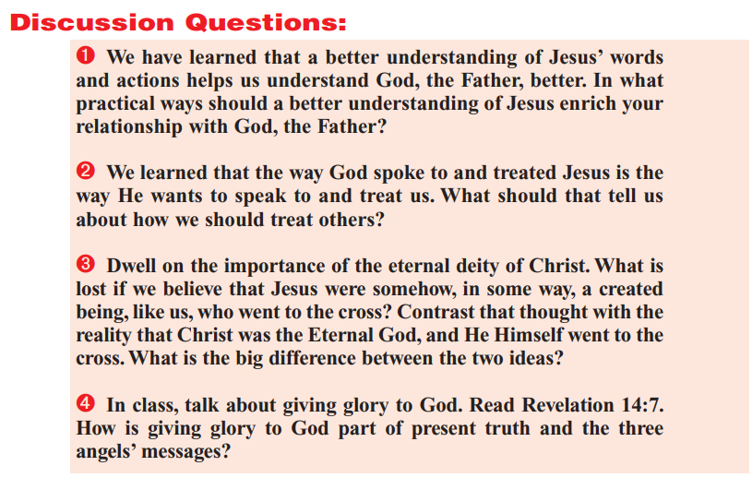

Slide 3
Question 1: John 14:6-9
⁶ Jesus saith unto him, I am the way, the truth, and the life: no man cometh unto the Father, but by me.
⁷ If ye had known me, ye should have known my Father also: and from henceforth ye know him, and have seen him.
⁸ Philip saith unto him, Lord, show us the Father, and it sufficeth us.
⁹ Jesus saith unto him, Have I been so long time with you, and yet hast thou not known me, Philip? he that hath seen me hath seen the Father; and how sayest thou then, Show us the Father?

Slide 4
Question 1: John 14:10-13
¹⁰ Believest thou not that I am in the Father, and the Father in me? the words that I speak unto you I speak not of myself: but the Father that dwelleth in me, he doeth the works.
¹¹ Believe me that I am in the Father, and the Father in me: or else believe me for the very works' sake.
¹² Verily, verily, I say unto you, He that believeth on me, the works that I do shall he do also; and greater works than these shall he do; because I go unto my Father.
¹³ And whatsoever ye shall ask in my name, that will I do, that the Father may be glorified in the Son.

Slide 5
Question 1: Hebrews 1:1-4
God, who at sundry times and in divers manners spake in time past unto the fathers by the prophets,
² Hath in these last days spoken unto us by his Son, whom he hath appointed heir of all things, by whom also he made the worlds;
³ Who being the brightness of his glory, and the express image of his person, and upholding all things by the word of his power, when he had by himself purged our sins, sat down on the right hand of the Majesty on high:
⁴ Being made so much better than the angels, as he hath by inheritance obtained a more excellent name than they.

Slide 6
Question 1
We have learned that a better understanding of Jesus’ words and actions helps us understand God, the Father, better. In what practical ways should a better understanding of Jesus enrich your relationship with God, the Father?
My answer: A better understanding of Jesus “enriches” your relationship with God the Father in all possible ways. The only way to have a relationship with God the Father is to have a relationship with Jesus (no man cometh unto the Father, but by me). God has previously spoken to us by prophets, but He has made His messages clear to us by sending His representative and son, Jesus. And Jesus is the very image of God (being the brightness of his glory, and the express image of his person, ).

Slide 7
Question 2
We learned that the way God spoke to and treated Jesus is the way He wants to speak to and treat us. What should that tell us about how we should treat others?

Slide 8
Question 2: Last paragraph on “Monday”
Meanwhile, Jesus came to be our Representative and our Savior. He would take our place in the fight and defeat the serpent. Similarly, in Hebrews, Jesus is the “pioneer” or “captain” and “forerunner” of believers (Heb. 2:10, Heb. 6:20). He fights for us and represents us. This also means that what God did for Jesus, our Representative, the Father also wants to do for us. He who exalted Jesus at His right hand also wants us to sit with Jesus on His throne (Rev. 3:21). God’s message to us in Jesus includes not only what Jesus said but also what the Father did through Him and to Him, all for our temporal and eternal benefit.

Slide 9
Question 2: Hebrews 2:9-12
⁹ But we see Jesus, who was made a little lower than the angels for the suffering of death, crowned with glory and honour; that he by the grace of God should taste death for every man.
¹⁰ For it became him, for whom are all things, and by whom are all things, in bringing many sons unto glory, to make the captain of their salvation perfect through sufferings.
¹¹ For both he that sanctifieth and they who are sanctified are all of one: for which cause he is not ashamed to call them brethren,
¹² Saying, I will declare thy name unto my brethren, in the midst of the church will I sing praise unto thee.

Slide 10
Question 2: Hebrews 6:17-20
¹⁷ Wherein God, willing more abundantly to shew unto the heirs of promise the immutability of his counsel, confirmed it by an oath:
¹⁸ That by two immutable things, in which it was impossible for God to lie, we might have a strong consolation, who have fled for refuge to lay hold upon the hope set before us:
¹⁹ Which hope we have as an anchor of the soul, both sure and stedfast, and which entereth into that within the veil;
²⁰ Whither the forerunner is for us entered, even Jesus, made an high priest for ever after the order of Melchisedec.

Slide 11
Question 2: Last paragraph on “Monday”
Meanwhile, Jesus came to be our Representative and our Savior. He would take our place in the fight and defeat the serpent. Similarly, in Hebrews, Jesus is the “pioneer” or “captain” and “forerunner” of believers (Heb. 2:10, Heb. 6:20). He fights for us and represents us. This also means that what God did for Jesus, our Representative, the Father also wants to do for us. He who exalted Jesus at His right hand also wants us to sit with Jesus on His throne (Rev. 3:21). God’s message to us in Jesus includes not only what Jesus said but also what the Father did through Him and to Him, all for our temporal and eternal benefit.

Slide 12
Question 2: Revelation 3:20-22
²⁰ Behold, I stand at the door, and knock: if any man hear my voice, and open the door, I will come in to him, and will sup with him, and he with me.
²¹ To him that overcometh will I grant to sit with me in my throne, even as I also overcame, and am set down with my Father in his throne.
²² He that hath an ear, let him hear what the Spirit saith unto the churches.

Slide 13
Question 2
We learned that the way God spoke to and treated Jesus is the way He wants to speak to and treat us. What should that tell us about how we should treat others?
My answer: We’ve noted that Jesus certainly was our “captain” or “forerunner” and also that by His grace, those that “overcome” receive a reward like Jesus Himself. I’m not altogether certain that “that the way God spoke to and treated Jesus is the way He wants to speak to and treat us,” but it would sure be something if we were enough like Jesus that such a thing would be possible. I have absolutely no clue what this tells us about how we should treat others. Are they suggesting that we are to treat others as God treats Jesus? Are we aligned with God in this scenario? Because that strikes me as problematic and potentially disrespectful. Are we meant to be one with “others” as God is with Jesus? Again, problematic—not to mention unlikely. Jesus is our model! We are supposed to treat others as Jesus treated others. Probably we should stick with that.

Slide 14
Question 3
Dwell on the importance of the eternal deity of Christ. What is lost if we believe that Jesus were somehow, in some way, a created being, like us, but who went to the cross? Contrast that thought with the reality that Christ was eternal God, and He Himself went to the cross. What is the big difference between the two ideas?

Slide 15
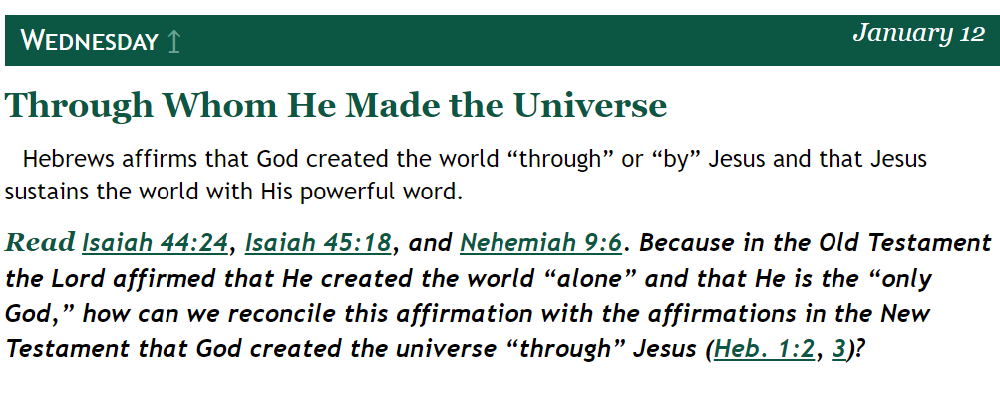
Question 3: The eternal deity of Christ

Slide 16
Question 3: The eternal deity of Christ
Hebrews 1:1-2
God, who at sundry times and in divers manners spake in time past unto the fathers by the prophets,
² Hath in these last days spoken unto us by his Son, whom he hath appointed heir of all things, by whom also he made the worlds;

Slide 17
Question 3: The eternal deity of Christ
Hebrews 1:8-10
⁸ But unto the Son he saith, Thy throne, O God, is for ever and ever: a sceptre of righteousness is the sceptre of thy kingdom.
⁹ Thou hast loved righteousness, and hated iniquity; therefore God, even thy God, hath anointed thee with the oil of gladness above thy fellows.
¹⁰ And, Thou, Lord, in the beginning hast laid the foundation of the earth; and the heavens are the works of thine hands:

Slide 18
Question 3: The eternal deity of Christ
Isaiah 44:24
²⁴ Thus saith the Lord, thy redeemer, and he that formed thee from the womb, I am the Lord that maketh all things; that stretcheth forth the heavens alone; that spreadeth abroad the earth by myself;

Slide 19
Question 3: The eternal deity of Christ
Isaiah 45:18
¹⁸ For thus saith the Lord that created the heavens; God himself that formed the earth and made it; he hath established it, he created it not in vain, he formed it to be inhabited: I am the Lord; and there is none else.

Slide 20
Question 3: The eternal deity of Christ
Isaiah 45:15-18
¹⁵ Verily thou art a God that hidest thyself, O God of Israel, the Saviour.
¹⁶ They shall be ashamed, and also confounded, all of them: they shall go to confusion together that are makers of idols.
¹⁷ But Israel shall be saved in the Lord with an everlasting salvation: ye shall not be ashamed nor confounded world without end.
¹⁸ For thus saith the Lord that created the heavens; God himself that formed the earth and made it; he hath established it, he created it not in vain, he formed it to be inhabited: I am the Lord; and there is none else.

Slide 21
Question 3: The eternal deity of Christ
Nehemiah 9:6-8
⁶ Thou, even thou, art Lord alone; thou hast made heaven, the heaven of heavens, with all their host, the earth, and all things that are therein, the seas, and all that is therein, and thou preservest them all; and the host of heaven worshippeth thee.
⁷ Thou art the Lord the God, who didst choose Abram, and broughtest him forth out of Ur of the Chaldees, and gavest him the name of Abraham;
⁸ And foundest his heart faithful before thee, and madest a covenant with him to give the land of the Canaanites, the Hittites, the Amorites, and the Perizzites, and the Jebusites, and the Girgashites, to give it, I say, to his seed, and hast performed thy words; for thou art righteous:

Slide 22
Question 3: The eternal deity of Christ
Nehemiah 9:9-12
⁹ And didst see the affliction of our fathers in Egypt, and heardest their cry by the Red sea;
¹⁰ And shewedst signs and wonders upon Pharaoh, and on all his servants, and on all the people of his land: for thou knewest that they dealt proudly against them. So didst thou get thee a name, as it is this day.
¹¹ And thou didst divide the sea before them, so that they went through the midst of the sea on the dry land; and their persecutors thou threwest into the deeps, as a stone into the mighty waters.
¹² Moreover thou leddest them in the day by a cloudy pillar; and in the night by a pillar of fire, to give them light in the way wherein they should go.

Slide 23
Question 3: The eternal deity of Christ
Nehemiah 9:13-16
¹³ Thou camest down also upon mount Sinai, and spakest with them from heaven, and gavest them right judgments, and true laws, good statutes and commandments:
¹⁴ And madest known unto them thy holy sabbath, and commandedst them precepts, statutes, and laws, by the hand of Moses thy servant:
¹⁵ And gavest them bread from heaven for their hunger, and broughtest forth water for them out of the rock for their thirst, and promisedst them that they should go in to possess the land which thou hadst sworn to give them.
¹⁶ But they and our fathers dealt proudly, and hardened their necks, and hearkened not to thy commandments,

Slide 24
Question 3: The eternal deity of Christ
Nehemiah 9:17-20
¹⁷ And refused to obey, neither were mindful of thy wonders that thou didst among them; but hardened their necks, and in their rebellion appointed a captain to return to their bondage: but thou art a God ready to pardon, gracious and merciful, slow to anger, and of great kindness, and forsookest them not.
¹⁸ Yea, when they had made them a molten calf, and said, This is thy God that brought thee up out of Egypt, and had wrought great provocations;
¹⁹ Yet thou in thy manifold mercies forsookest them not in the wilderness: the pillar of the cloud departed not from them by day, to lead them in the way; neither the pillar of fire by night, to shew them light, and the way wherein they should go.
²⁰ Thou gavest also thy good spirit to instruct them, and withheldest not thy manna from their mouth, and gavest them water for their thirst.

Slide 25
Question 3: The eternal deity of Christ

Slide 26
Question 3
Dwell on the importance of the eternal deity of Christ. What is lost if we believe that Jesus were somehow, in some way, a created being, like us, but who went to the cross? Contrast that thought with the reality that Christ was eternal God, and He Himself went to the cross. What is the big difference between the two ideas?
My answer: Salvation is lost. Like other created beings, humans have the capacity to die as a reward for their own sins, but not to carry anyone else’s. Our Maker sacrificed Himself for us. That’s a big difference.

Slide 27
Question 4
In class, talk about giving glory to God. Read Revelation 14:7. How is giving glory to God part of present truth and the three angels’ messages?

Slide 28
Question 4: Revelation 14:6-7
⁶ And I saw another angel fly in the midst of heaven, having the everlasting gospel to preach unto them that dwell on the earth, and to every nation, and kindred, and tongue, and people,
⁷ Saying with a loud voice, Fear God, and give glory to him; for the hour of his judgment is come: and worship him that made heaven, and earth, and the sea, and the fountains of waters.

Slide 29
Question 4
In class, talk about giving glory to God. Read Revelation 14:7. How is giving glory to God part of present truth and the three angels’ messages?
My answer: “Glory” here in Revelation is the Greek word doxa, signifying “honor,” “praise,” or “homage.” In the first angel’s message, giving glory to God (that is, humbling oneself and honoring God) is a necessary part of recognizing Him as our Creator. Recognizing God as our Creator is a foundational aspect of both present truth and the three angels’ messages.

Slide 30
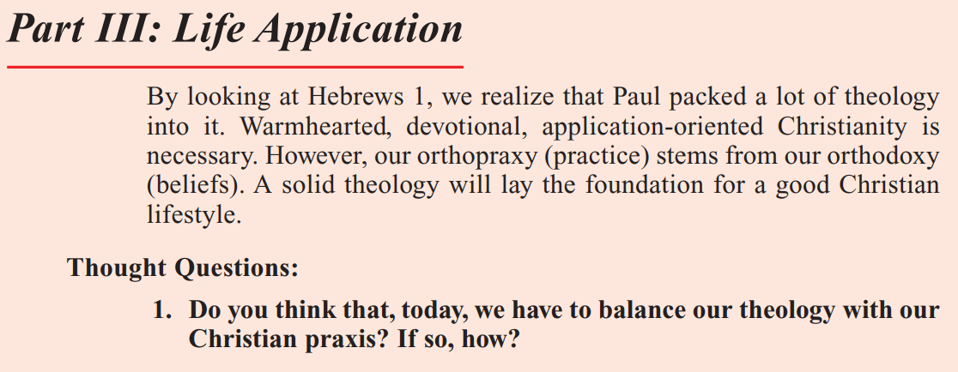
From the Teacher’s Quarterly

Slide 31
Parsing the Question
Definition of praxis (noun)
1: ACTION, PRACTICE: such as
  a: exercise or practice of an art, science, or skill
  b: customary practice or conduct
2: practical application of a theory

Slide 32


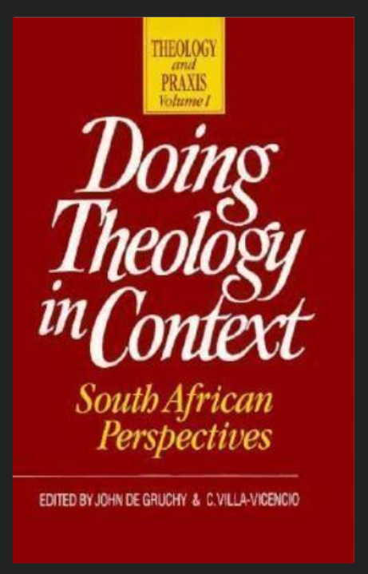
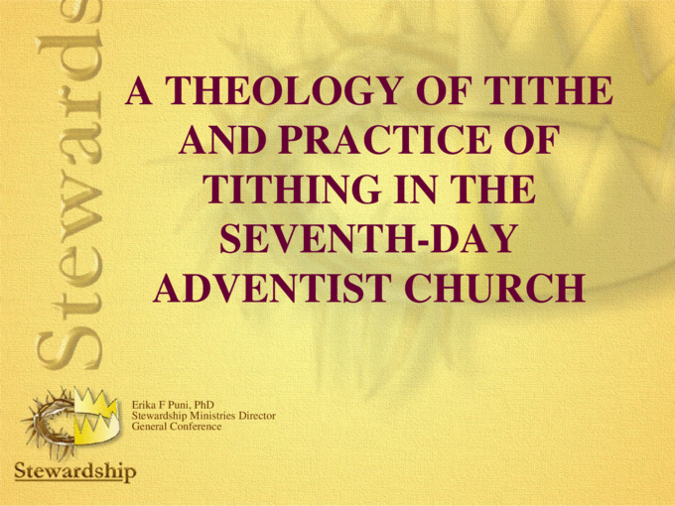

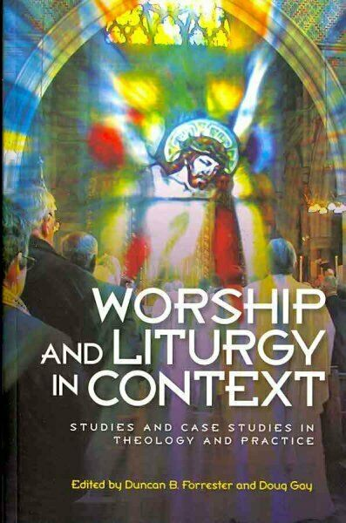
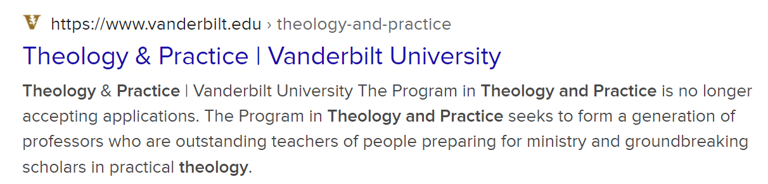
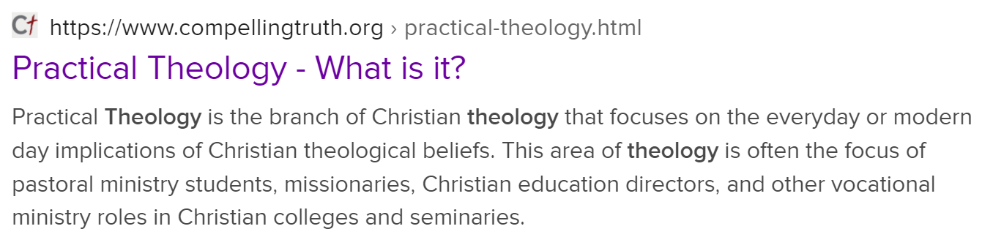
Parsing the Question: Present Context

Slide 33

4. Do you think that, today, we have to balance our theology with our Christian praxis? If so, how?
The word “balance” suggests an even arrangement of opposing forces, as in balancing a scale or maintaining a “Work/Life Balance.” Can we “balance” our theology with Christian conduct? Why do you think the word “balance” is used here?

