Slide 1
Human nature
Lesson 4, Jan. 22, 2022

Slide 2
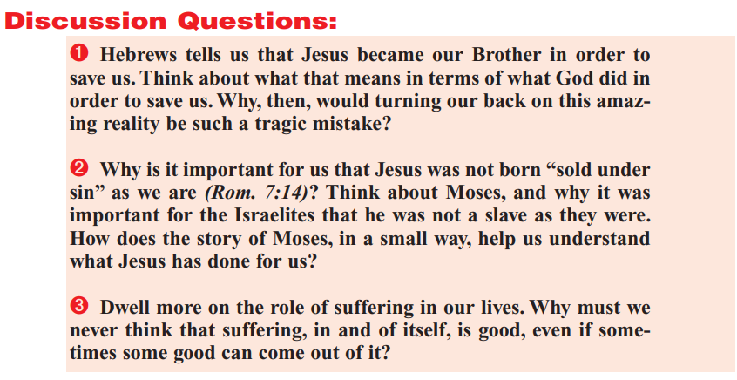

Slide 4
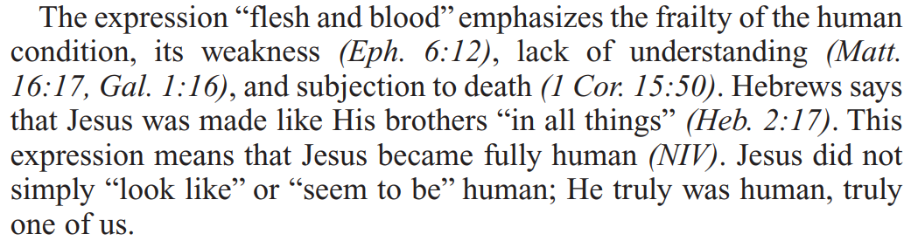
From the Quarterly: The prelude

Slide 5
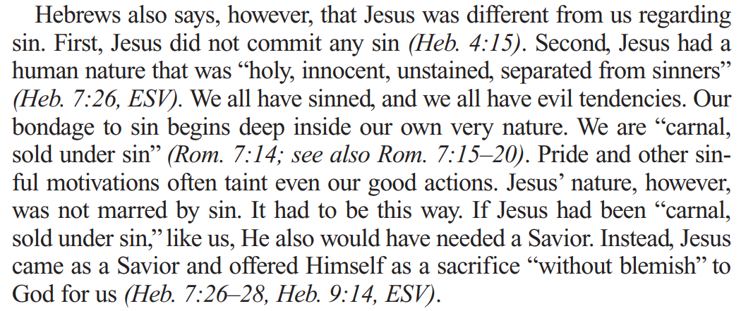
From the Quarterly: The Debatable

Slide 6
From the Quarterly: Two “human” natures
Our human nature
Jesus’ human nature
Frail, flesh and blood
Sinners
Evil tendencies
Carnal
Sold under sin
Frail, flesh and blood
Holy
Innocent
Unstained
Separated from sinners

Slide 7
From the Quarterly: The Debatable

Slide 8
The rationale: Hebrews 7:26
²⁶ For such an high priest became us, who is holy, harmless, undefiled, separate from sinners, and made higher than the heavens;

Slide 9
From the Quarterly: The Debatable

Slide 10
The Rationale: Hebrews 7:26-28
²⁶ For such an high priest became us, who is holy, harmless, undefiled, separate from sinners, and made higher than the heavens;
²⁷ Who needeth not daily, as those high priests, to offer up sacrifice, first for his own sins, and then for the people's: for this he did once, when he offered up himself.
²⁸ For the law maketh men high priests which have infirmity; but the word of the oath, which was since the law, maketh the Son, who is consecrated for evermore.

Slide 11
The Rationale: Hebrews 9:14
¹⁴ How much more shall the blood of Christ, who through the eternal Spirit offered himself without spot to God, purge your conscience from dead works to serve the living God?

Slide 12

Where did this idea come from?

Slide 13
Where did this idea come from?
“Beginning with the valid biblical position of man's inherent carnal nature, which predisposes him to sin, the idea gradually evolved that Adam's guilt was also imputed to his descendants. Augustine was responsible more than any other for propagating this view of transmitted guilt. Through Luther and the reformers it found its way into many of the Protestant churches.”
--Joe Crews’ sermon “Christ’s Human Nature”

Slide 14
Where did this idea come from?
“Adam's weakened, sinful nature was passed on to his children through the laws of heredity, making it impossible for them not to sin as long as they remained in an unconverted state. Since their sin was the result of Adam's sin, it was easy for them to slip into the error of believing that they shared his guilt.”
--Joe Crews’ sermon “Christ’s Human Nature”

Slide 15
Where did this idea come from?
“But there is a very important difference between the inclination to sin and the guilt of sin, and it is that small degree of difference that has triggered a series of other doctrinal errors. Said the prophet, "The son shall not bear the iniquity of the father, neither shall the father bear the iniquity of the son" (Ezekiel 18:20).”
--Joe Crews’ sermon “Christ’s Human Nature”

Slide 16
Consequences of “original sin”?
“The original sin doctrine also gave rise to the dogma of the immaculate conception of Mary. If every baby was born with guilt on its soul, then something would have to be done to preserve Jesus from that guilt—else He could not be a perfect sacrifice for sin. The Catholic solution assigned Mary a miraculous conception also, which preserved her from the effect of original sin. Thus Jesus would be born of a human mother without partaking of the supposed guilt of Adam.”
--Joe Crews’ sermon “Christ’s Human Nature”

Slide 17
Consequences of “original sin”?
“As an extended consequence of their view of Jesus as altogether different from man, the Catholic Church also introduced the illegitimate system of human priesthood. If the Son of God did not dwell in man's fallen nature, then the ladder had not been let down from heaven to earth. The gulf still had not been bridged between a holy God and fallen humanity. Therefore, some further means should be provided to complete the connection.”
--Joe Crews’ sermon “Christ’s Human Nature”

Slide 18
From the Quarterly: Two “human” natures
Our human nature
Jesus’ human nature
Frail, flesh and blood
Sinners
Evil tendencies
Carnal
Sold under sin
Frail, flesh and blood
Holy
Innocent
Unstained
Separated from sinners

Slide 19
Real evidence: Hebrews 2:9-12
⁹ But we see Jesus, who was made a little lower than the angels for the suffering of death, crowned with glory and honour; that he by the grace of God should taste death for every man.
¹⁰ For it became him, for whom are all things, and by whom are all things, in bringing many sons unto glory, to make the captain of their salvation perfect through sufferings.
¹¹ For both he that sanctifieth and they who are sanctified are all of one: for which cause he is not ashamed to call them brethren,
¹² Saying, I will declare thy name unto my brethren, in the midst of the church will I sing praise unto thee.

Slide 20
Real evidence: Hebrews 2:13-16
¹³ And again, I will put my trust in him. And again, Behold I and the children which God hath given me.
¹⁴ Forasmuch then as the children are partakers of flesh and blood, he also himself likewise took part of the same; that through death he might destroy him that had the power of death, that is, the devil;
¹⁵ And deliver them who through fear of death were all their lifetime subject to bondage.
¹⁶ For verily he took not on him the nature of angels; but he took on him the seed of Abraham.

Slide 21
Real evidence: Hebrews 2:17-18
¹⁷ Wherefore in all things it behoved him to be made like unto his brethren, that he might be a merciful and faithful high priest in things pertaining to God, to make reconciliation for the sins of the people.
¹⁸ For in that he himself hath suffered being tempted, he is able to succour them that are tempted.

Slide 22
observations
“Had He not won the victory over Satan in the same nature we have, what encouragement could we draw from His victory? I did not need to be shown that it was possible for Adam not to yield to sin. I already knew that. What I need to know is that I can overcome sin, my nature being what it is… These obvious truths point up one of the great problems in holding to the pre-fall human nature of Christ. If His victory over Satan, in the flesh, was for the purpose of enabling me to fulfill the requirements of the law, how could His victory help me at all if it was obtained in some other flesh than mine? Here is where this false doctrine strikes at the beautiful principle of righteousness by faith.” --Joe Crews’ sermon “Christ’s Human Nature”

Slide 23
Real evidence: Romans 8:3-4
³ For what the law could not do, in that it was weak through the flesh, God sending his own Son in the likeness of sinful flesh, and for sin, condemned sin in the flesh:
⁴ That the righteousness of the law might be fulfilled in us, who walk not after the flesh, but after the Spirit.

Slide 24
Real evidence: Galatians 2:19-21
¹⁹ For I through the law am dead to the law, that I might live unto God.
²⁰ I am crucified with Christ: nevertheless I live; yet not I, but Christ liveth in me: and the life which I now live in the flesh I live by the faith of the Son of God, who loved me, and gave himself for me.
²¹ I do not frustrate the grace of God: for if righteousness come by the law, then Christ is dead in vain.

Slide 25
Real evidence: Romans 6:3-8
³ Know ye not, that so many of us as were baptized into Jesus Christ were baptized into his death?
⁴ Therefore we are buried with him by baptism into death: that like as Christ was raised up from the dead by the glory of the Father, even so we also should walk in newness of life.
⁵ For if we have been planted together in the likeness of his death, we shall be also in the likeness of his resurrection:
⁶ Knowing this, that our old man is crucified with him, that the body of sin might be destroyed, that henceforth we should not serve sin.
⁷ For he that is dead is freed from sin.
⁸ Now if we be dead with Christ, we believe that we shall also live with him:

Slide 26
The fallout
“Thus, we can see how the beautiful, basic truth of sanctification is downgraded and removed from the experience of righteousness by faith. Already we have seen how the "original sin" error has generated two other perversions; namely, that Jesus had the unfallen nature of Adam, and that sanctification cannot be imparted to man by Jesus.”
--Joe Crews’ sermon “Christ’s Human Nature”

Slide 27
The fallout
“In fact, most proponents of original sin do not even believe it is possible to overcome all sin in this life. They deny the repeated assertions of Scripture that fallen man can actually partake of the divine nature of Christ. Somehow they cannot perceive and accept the heavenly mystery, so often affirmed in the Bible, that Jesus took man's fallen nature upon Him and, yet, was never guilty of sin. To them the inherited guilt of Adam is so pervasive in human nature that it can only be overcome when translation takes place at the coming of Christ.”
--Joe Crews’ sermon “Christ’s Human Nature”

Slide 28
The fallout
“In summary, we can see how the ancient error of Adam's imputed guilt has led to a chain of related deceptions. The most significant truths of salvation have been cleverly counterfeited. The humanity of Jesus has been denied, the imparted righteousness of Christ has been challenged, and the possibility of victory over sin has been ridiculed. It is only as we recognize the basic falsehood that we can avoid the perversions that follow. May God give us the wisdom to stand firmly upon the word alone and to reject every doctrine that is not rooted in Him.”
--Joe Crews’ sermon “Christ’s Human Nature”

Slide 29
Conclusion: 1 Corinthians 15:57-58
⁵⁷ But thanks be to God, which giveth us the victory through our Lord Jesus Christ.
⁵⁸ Therefore, my beloved brethren, be ye stedfast, unmoveable, always abounding in the work of the Lord, forasmuch as ye know that your labour is not in vain in the Lord.

