Slide 1
Dead works & defects
Lesson 8

Slide 2
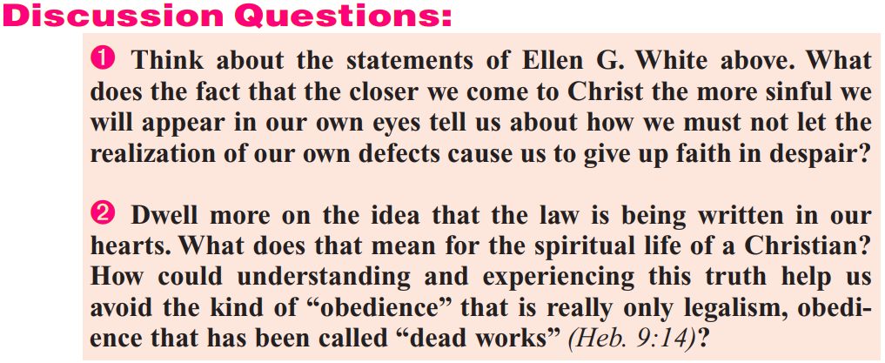

Slide 3
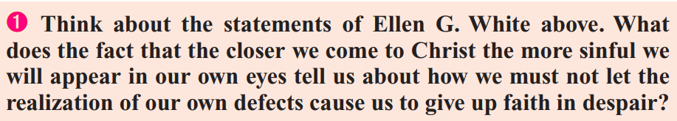
“If our hearts are renewed in the likeness of God, if the divine love is implanted in the soul, will not the law of God be carried out in the life? When the principle of love is implanted in the heart, when man is renewed after the image of Him that created him, the new-covenant promise is fulfilled, ‘I will put My laws into their hearts, and in their minds will I write them.’ Hebrews 10:16. And if the law is written in the heart, will it not shape the life? Obedience — the service and allegiance of love — is the true sign of discipleship. Thus the Scripture says, ‘This is the love of God, that we keep His commandments.’ ‘He that saith, I know Him, and keepeth not His commandments, is a liar, and the truth is not in him.’ 1 John 5:3; 2:4. Instead of releasing man from obedience, it is faith, and faith only, that makes us partakers of the grace of Christ, which enables us to render obedience. …

Slide 4
The closer you come to Jesus, the more faulty you will appear in your own eyes; for your vision will be clearer, and your imperfections will be seen in broad and distinct contrast to His perfect nature. This is evidence that Satan’s delusions have lost their power; that the vivifying influence of the Spirit of God is arousing you.
No deep-seated love for Jesus can dwell in the heart that does not realize its own sinfulness. The soul that is transformed by the grace of Christ will admire His divine character; but if we do not see our own moral deformity, it is unmistakable evidence that we have not had a view of the beauty and excellence of Christ.” — Ellen G. White, Steps to Christ, pp. 60, 64, 65.

Slide 5
It’s a terrible question:
In the first place, as we come closer to Christ we attain not only a clearer view of His perfection and our sinfulness, but additional faith, peace, and a sense of the Holy Spirit’s presence. Not to mention that we should actually have LESS active sin in our lives and ever MORE assurance of God’s forgiveness as we grow closer to Him.
Secondly, giving up faith in despair can never be an acceptable option. Certainly it’s even less of one as we grow closer to Christ.
Finally, I question the purpose of this question. As we recognize our imperfections we’re supposed to deal with them by evicting them from our lives… not focus on feeling better about being imperfect.

Slide 6
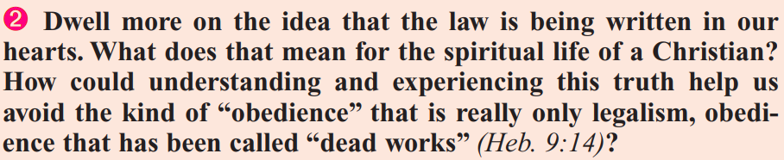
Please turn to
Hebrews 9:7-9

Slide 7
⁷ For if that first covenant had been faultless, then should no place have been sought for the second.
⁸ For finding fault with them, he saith, Behold, the days come, saith the Lord, when I will make a new covenant with the house of Israel and with the house of Judah:
⁹ Not according to the covenant that I made with their fathers in the day when I took them by the hand to lead them out of the land of Egypt; because they continued not in my covenant, and I regarded them not, saith the Lord.

Slide 8
There was a problem with the first covenant, but it had nothing to do with the content of the agreement. The fault couldn’t lie with God either. The problem had to do with the people who misapplied the law and failed to keep the agreement!
Ever since Sinai, God had sought to lead the people to a higher spiritual experience. But they refused. They clung to a belief that salvation could be achieved by strict adherence to law, especially to the ceremonial law.

Slide 9
The spiritual experience under the new covenant was available in Old Testament times, and would have come if the people had complied with the conditions, but the Jews, as a nation, refused it.
Even after Jesus came to make the gospel clear to the Jews, they found it difficult to give up the old system of forms and ceremonies. Quite a bit of the book of Hebrews was designed to help them make the transition from Jew to Christian.

Slide 10
Please turn to
Hebrews 9:10-12

Slide 11
10 For this is the covenant that I will make with the house of Israel after those days, saith the Lord; I will put my laws into their mind, and write them in their hearts: and I will be to them a God, and they shall be to me a people:
11 And they shall not teach every man his neighbour, and every man his brother, saying, Know the Lord: for all shall know me, from the least to the greatest.
12 For I will be merciful to their unrighteousness, and their sins and their iniquities will I remember no more.

Slide 12
At Mt. Sinai the Lord wrote His laws on tables of stone and in a book. These were sealed away in a box in the temple. He intended that these laws should also be written on the hearts of the people. But the Israelites wanted to keep the law in a box, as something external to themselves. They considered that keeping God’s law was just a matter of outward compliance. This was never what God intended. He offered His people the experience of a new heart, but they were content with only an external religion.

Slide 13
Please turn to
Deuteronomy 6:4-6

Slide 14
4 Hear, O Israel: The Lord our God is one Lord:
5 And thou shalt love the Lord thy God with all thine heart, and with all thy soul, and with all thy might.
6 And these words, which I command thee this day, shall be in thine heart:

Slide 15
Please turn to
Matthew 22:37-40

Slide 16
37 Jesus said unto him, Thou shalt love the Lord thy God with all thy heart, and with all thy soul, and with all thy mind.
38 This is the first and great commandment.
39 And the second is like unto it, Thou shalt love thy neighbour as thyself.
40 On these two commandments hang all the law and the prophets.

Slide 17
Under the new covenant men’s hearts and minds are changed. Men do things which are right, not by their own strength, but because Christ dwells in the heart. The emphasis has changed from outward forms to a fundamental alteration in character. Christians are born of the Sprit and bear the fruits of the Sprit.
The change can be effected only by divine power. Only God can “put” His law in the hearts of His followers, though, of course, not without man’s consent and cooperation.

Slide 18
With the new system, there would be no need of continual admonition and counsel, or men would have a personal religious experience. Christians could have direct access to God through their new High Priest, Jesus, rather than through the Levitical priesthood.
Under the new covenant Christians also have, as Hebrews 9:11 suggests, a somewhat different approach to spiritual instruction. Previously the Levitical priesthood undertook to instruct the people in spiritual matters. But with the expiration of the Levitical priesthood a new methodology would be required.

Slide 19
Under the new covenant system, Christians are…
“Led by the Spirit of God” (Romans 8:14) and
“taught of God” (1 Thessalonians 4:9).
We’re even told in 1 John 2:20-21 that:
²⁰ But ye have an unction from the Holy One, and ye know all things.
²¹ I have not written unto you because ye know not the truth, but because ye know it, and that no lie is of the truth.
(“Unction” in this case is like an anointing or consecration.)

Slide 20
From early times, Christians have also had the entire cannon of Scripture (that is, the whole Bible, both Old and New Testaments) to teach them about God!
Fortunately, these facts do not entirely rule out the need for spiritual instructors! As gifts, God has given to the church both “pastors” and “teachers” to help guide the people to what they need to know. (Ephesians 4:11)
God’s people, whether Christian or Jew, have always had a close personal knowledge of Him.

Slide 21
Please turn to
Hebrews 9:13-14

Slide 22
¹³ For if the blood of bulls and of goats, and the ashes of an heifer sprinkling the unclean, sanctifieth to the purifying of the flesh:
¹⁴ How much more shall the blood of Christ, who through the eternal Spirit offered himself without spot to God, purge your conscience from dead works to serve the living God?
What are “dead works?”
The question above implies that legalistic acts of obedience to the law are “dead works.”

Slide 23
Please turn to
Hebrews 6:1-2

Slide 24
Therefore leaving the principles of the doctrine of Christ, let us go on unto perfection; not laying again the foundation of repentance from dead works, and of faith toward God,
² Of the doctrine of baptisms, and of laying on of hands, and of resurrection of the dead, and of eternal judgment.

Slide 25
Clearly the author of these verses is ready to move past the basics of Christianity! He implies that this list of foundational principles is already well established, and that it is time to move on.
One of these basic principles is that we are to repent from “dead works.” The trouble with legalism, of course, is that it requires us to keep the law in our own strength, which is not possible. We need God’s help to truly keep the law as He intends us to keep it. But is the concept of repenting from doing things in our own strength truly one of the foundational concepts to which the author of Hebrew is referring?

Slide 26
Please turn to
Ephesians 2:1

Slide 27
Ephesians 2:1
“And you hath he quickened, who were dead in trespasses and sins;”
What are “trespasses and sins” if not dead works? They are certainly the works of the spiritually dead!
Repentance from “trespasses and sins” is certainly a fundamental principle of Christianity!

Slide 28
The “dead works” of Hebrews 9:14 are thus probably not works involving legalistic obedience to the law, but works that involve the breaking of the law… or as we’ve seen in Ephesians 2:1, trespasses and sins!
So the question above may be parsed as follows:
How does “understanding and experiencing” the truth of God’s law being written on our hearts help us avoid sin?

Slide 29
Under the new covenant, we have less emphasis on the outward appearance of obedience and more emphasis on a personal experience with Christ. Something is wrong because it violates our conscience, whether anyone else sees what we’re doing or not. Public shame and positive peer pressure still have their rolls to play, of course, and hypocrisy is far from dead! But right is right and wrong is wrong regardless of the outward appearance. Our consciences should help keep us on the right track despite the number of witnesses or the actions of others around us!

