Slide 1
Sacrifice
Lesson 9

Slide 2
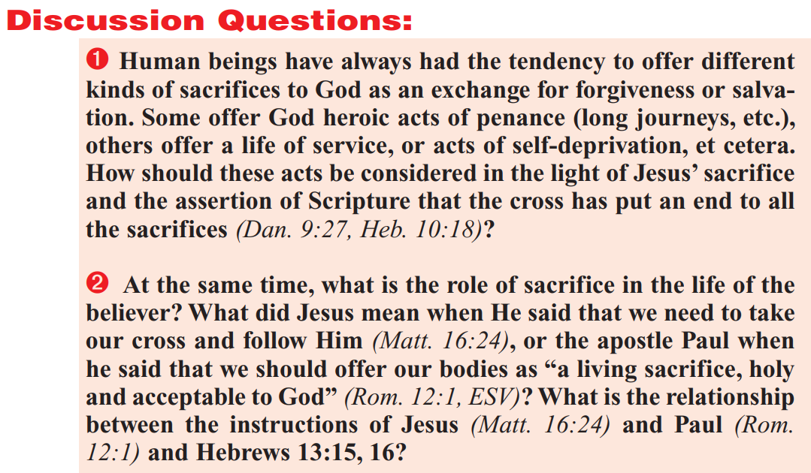

Slide 3
Daniel 9:27
²⁷ And he shall confirm the covenant with many for one week: and in the midst of the week he shall cause the sacrifice and the oblation to cease, and for the overspreading of abominations he shall make it desolate, even until the consummation, and that determined shall be poured upon the desolate.

Slide 4
Hebrews 10:16-18
¹⁶ This is the covenant that I will make with them after those days, saith the Lord, I will put my laws into their hearts, and in their minds will I write them;
¹⁷ And their sins and iniquities will I remember no more.
¹⁸ Now where remission of these is, there is no more offering for sin.

Slide 6
Matthew 16:24-25
²⁴ Then said Jesus unto his disciples, If any man will come after me, let him deny himself, and take up his cross, and follow me.
²⁵ For whosoever will save his life shall lose it: and whosoever will lose his life for my sake shall find it.

Slide 7
Romans 12:1-2
12 I beseech you therefore, brethren, by the mercies of God, that ye present your bodies a living sacrifice, holy, acceptable unto God, which is your reasonable service.
² And be not conformed to this world: but be ye transformed by the renewing of your mind, that ye may prove what is that good, and acceptable, and perfect, will of God.

Slide 8
Hebrews 13:15-16
¹⁵ By him therefore let us offer the sacrifice of praise to God continually, that is, the fruit of our lips giving thanks to his name.
¹⁶ But to do good and to communicate forget not: for with such sacrifices God is well pleased.

Slide 9
A Catholic Perspective:
Top10 Verses on Penance
Luke 13:3 (KJV)
Luke 13:3 (Catholic)
³ I tell you, Nay: but, except ye repent, ye shall all likewise perish.
No, I say to you: but unless you shall do penance, you shall all likewise perish.
This is a solemn promise of Christ to all of us. Unless we do penance, we will “perish.”
For Lent - Top 10 Bible Verses on Penance - Taylor Marshall

Slide 10
A Catholic Perspective:
Top10 Verses on Penance
For Lent - Top 10 Bible Verses on Penance - Taylor Marshall
Ezekiel 18:21 (KJV)
Ezekiel 18:21 (Catholic)
²¹ But if the wicked will turn from all his sins that he hath committed, and keep all my statutes, and do that which is lawful and right, he shall surely live, he shall not die.
But if the wicked do penance for all his sins which he hath committed, and keep all my commandments, and do judgment, and justice, living he shall live, and shall not die.
This is the great promise for Lent. If we humble ourselves and live sacrificially, we will have life. God is merciful and loving and He desires our transformation into the image of Christ His Son.

Slide 11
A Catholic Perspective:
Top10 Verses on Penance
Matthew 11:20(KJV)
Matthew 11:20(Catholic)
²⁰ Then began he to upbraid the cities wherein most of his mighty works were done, because they repented not:
Then began he to upbraid the cities wherein were done the most of his miracles, for that they had not done penance.
This is a sobering verse. Christ doesn’t work miracles where the people don’t repent. Divine power is restricted by human pride.
For Lent - Top 10 Bible Verses on Penance - Taylor Marshall

Slide 12
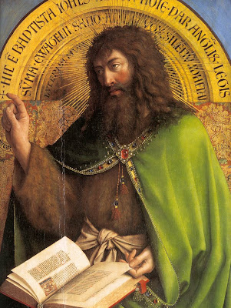
A Catholic Perspective on “Penance”
The preceding verses come from a website titled “Top 10 Bible Verses on Penance.” It is headed with this discussion:
“In Greek, we often find in Scripture the Greek term “metanoia” which is a deep “transformation of mind” of conformity to God. In Latin, we find “agite paenitentiam” or “do penance.” Protestant commentators beginning with Martin Luther criticized this translation because they felt that it emphasized outward acts and not an inward transformation. The Church responded by arguing that “agite paenitentiam” or “do penance” is a perfectly sound interpretation because inward repentance always leads to an outward expression. Moreover, in secular texts “agere paenitentiam” often refers to simple inward remorse. Nevertheless, just as faith without works is dead, so also repentance without penance is dead.”
For Lent - Top 10 Bible Verses on Penance - Taylor Marshall

Slide 13
How would you respond?
Do you agree with Taylor Marshall’s perspective on penance?
Why or why not?
How would you answer someone who made these points?

Slide 15
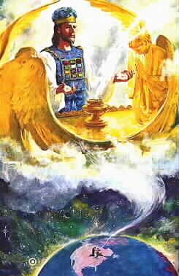
The Sanctuary Doctrine:
The sanctuary doctrine focuses upon Jesus in the sanctuary, including (1) His atoning work on the cross, which functions as the sacrificial altar of the heavenly sanctuary (see Heb. 13:10); (2) His heavenly ministration of intercession for us (Heb. 7:25); and (3) His work of vindicating His people during the pre-Advent judgment (Dan. 7:22). If we really want to focus upon Jesus, then we need to concentrate on where Jesus is now, applying the benefits of His atoning work on Calvary for us personally in the heavenly sanctuary (Heb. 7-10). The sanctuary message is a window into the heart of the Triune God, and involves the united work of Father, Son, and Holy Spirit.

Slide 16
Please turn to Hebrews 9:1-5
A Description of the Earthly Sanctuary
9 Then verily the first covenant had also ordinances of divine service, and a worldly sanctuary.
² For there was a tabernacle made; the first, wherein was the candlestick, and the table, and the shewbread; which is called the sanctuary.
³ And after the second veil, the tabernacle which is called the Holiest of all;
⁴ Which had the golden censer, and the ark of the covenant overlaid round about with gold, wherein was the golden pot that had manna, and Aaron's rod that budded, and the tables of the covenant;
⁵ And over it the cherubims of glory shadowing the mercyseat; of which we cannot now speak particularly.

Slide 17
Please turn to Hebrews 9:6-10
A Description of the Earthly Sanctuary
⁶ Now when these things were thus ordained, the priests went always into the first tabernacle, accomplishing the service of God.
⁷ But into the second went the high priest alone once every year, not without blood, which he offered for himself, and for the errors of the people:
⁸ The Holy Ghost this signifying, that the way into the holiest of all was not yet made manifest, while as the first tabernacle was yet standing:
⁹ Which was a figure for the time then present, in which were offered both gifts and sacrifices, that could not make him that did the service perfect, as pertaining to the conscience;
¹⁰ Which stood only in meats and drinks, and divers washings, and carnal ordinances, imposed on them until the time of reformation.

Slide 18
Please turn to Hebrews 9:11-14
A Description of the Earthly Sanctuary
¹¹ But Christ being come an high priest of good things to come, by a greater and more perfect tabernacle, not made with hands, that is to say, not of this building;
¹² Neither by the blood of goats and calves, but by his own blood he entered in once into the holy place, having obtained eternal redemption for us.
¹³ For if the blood of bulls and of goats, and the ashes of an heifer sprinkling the unclean, sanctifieth to the purifying of the flesh:
¹⁴ How much more shall the blood of Christ, who through the eternal Spirit offered himself without spot to God, purge your conscience from dead works to serve the living God?

Slide 19
Regarding Sacrifices and Penance
Penance or sacrifice is done in order that repentance might be accomplished. As our Catholic friend said, “Just as faith without works is dead, so also repentance without penance is dead.” Sacrifice is done so that the conscience might be cleared!
But take special note of Hebrews 9:14—
“How much more shall the blood of Christ, who through the eternal Spirit offered himself without spot to God, purge your conscience from dead works to serve the living God?”
The blood of Christ is the necessary sacrifice which purges (clears) your conscience, or purifies you, from dead works (sin) and enables you to serve the living God.
Notice that the object of purification is service. People are redeemed for service. The cleansing is NOT an end unto itself (as “penance” often seems to be). Instead, it prepares men to render acceptable service to God.

Slide 20
Please turn to Hebrews 9:19-22
Sacrifice and the Remission of Sins
¹⁹ For when Moses had spoken every precept to all the people according to the law, he took the blood of calves and of goats, with water, and scarlet wool, and hyssop, and sprinkled both the book, and all the people,
²⁰ Saying, This is the blood of the testament which God hath enjoined unto you.
²¹ Moreover he sprinkled with blood both the tabernacle, and all the vessels of the ministry.
²² And almost all things are by the law purged with blood; and without shedding of blood is no remission.

Slide 21
Remission of Sins
Notice Hebrews 9:22—
“And almost all things are by the law purged with blood; and without shedding of blood is no remission.”
Only through blood can we be justified under the law. There can be no remission of sins without the shedding of blood.
But what kind of blood is sufficient for such a purpose? Perhaps the blood of animals originally used for sacrifice?

Slide 22
Please turn to Hebrews 10:1-4
A Greater Sacrifice
10 For the law having a shadow of good things to come, and not the very image of the things, can never with those sacrifices which they offered year by year continually make the comers thereunto perfect.
² For then would they not have ceased to be offered? because that the worshippers once purged should have had no more conscience of sins.
³ But in those sacrifices there is a remembrance again made of sins every year.
⁴ For it is not possible that the blood of bulls and of goats should take away sins.

Slide 23
Please turn to Hebrews 9:23-26
A Greater Sacrifice
²³ It was therefore necessary that the patterns of things in the heavens should be purified with these; but the heavenly things themselves with better sacrifices than these.
²⁴ For Christ is not entered into the holy places made with hands, which are the figures of the true; but into heaven itself, now to appear in the presence of God for us:
²⁵ Nor yet that he should offer himself often, as the high priest entereth into the holy place every year with blood of others;
²⁶ For then must he often have suffered since the foundation of the world: but now once in the end of the world hath he appeared to put away sin by the sacrifice of himself.

Slide 24
Sin is Put Away
Consider Hebrews 9:26—
“For then must he often have suffered since the foundation of the world: but now once in the end of the world hath he appeared to put away sin by the sacrifice of himself.”
Sin is “put away” by Jesus Christ’s sacrifice of Himself. And once it has been purged it’s gone forever! The blood of animals merely pointed forward to the greater sacrifice. Animal sacrifice was never adequate to wipe away sins. Sin cannot be similarly “put away” by any service, offering, penance, or self-punishment of a human being. The penance of our Catholic friends, like the ancient sacrifices, involves “a remembrance again made of sins” on a regular basis. Only Christ’s blood is adequate to eliminate sin altogether.

Slide 26
Please turn to Psalm 40:5-8
The Sacrifice God Desires
⁵ Many, O Lord my God, are thy wonderful works which thou hast done, and thy thoughts which are to us-ward: they cannot be reckoned up in order unto thee: if I would declare and speak of them, they are more than can be numbered.
⁶ Sacrifice and offering thou didst not desire; mine ears hast thou opened: burnt offering and sin offering hast thou not required.
⁷ Then said I, Lo, I come: in the volume of the book it is written of me,
⁸ I delight to do thy will, O my God: yea, thy law is within my heart.

Slide 27
Please turn to 1 Samuel 15:22
The Sacrifice God Desires
²² And Samuel said, Hath the Lord as great delight in burnt offerings and sacrifices, as in obeying the voice of the Lord? Behold, to obey is better than sacrifice, and to hearken than the fat of rams.

Slide 28
Please turn to Hosea 6:4-7
The Sacrifice God Desires
⁴ O Ephraim, what shall I do unto thee? O Judah, what shall I do unto thee? for your goodness is as a morning cloud, and as the early dew it goeth away.
⁵ Therefore have I hewed them by the prophets; I have slain them by the words of my mouth: and thy judgments are as the light that goeth forth.
⁶ For I desired mercy, and not sacrifice; and the knowledge of God more than burnt offerings.
⁷ But they like men have transgressed the covenant: there have they dealt treacherously against me.

Slide 29
Please turn to Matthew 12:7
The Sacrifice God Desires
⁷ But if ye had known what this meaneth, I will have mercy, and not sacrifice, ye would not have condemned the guiltless.

Slide 30
Please turn to Psalm 51:14-17
The Sacrifice God Desires
¹⁴ Deliver me from bloodguiltiness, O God, thou God of my salvation: and my tongue shall sing aloud of thy righteousness.
¹⁵ O Lord, open thou my lips; and my mouth shall shew forth thy praise.
¹⁶ For thou desirest not sacrifice; else would I give it: thou delightest not in burnt offering.
¹⁷ The sacrifices of God are a broken spirit: a broken and a contrite heart, O God, thou wilt not despise.

Slide 31
Please turn to 1 John 1:9
The Sacrifice God Desires
If we confess our sins, he is faithful and just to forgive us our sins, and to cleanse us from all unrighteousness.

