Slide 1

As the Hart
Lesson 10

Slide 2
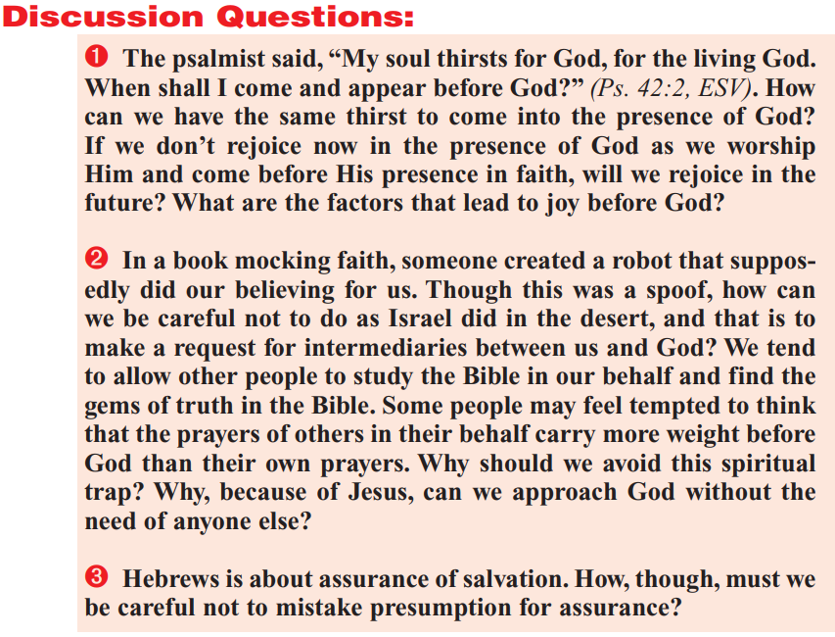

Slide 3
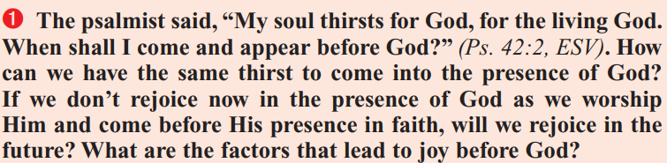
Psalm 42:1-3
As the hart panteth after the water brooks, so panteth my soul after thee, O God.
² My soul thirsteth for God, for the living God: when shall I come and appear before God?
³ My tears have been my meat day and night, while they continually say unto me, Where is thy God?

Slide 4
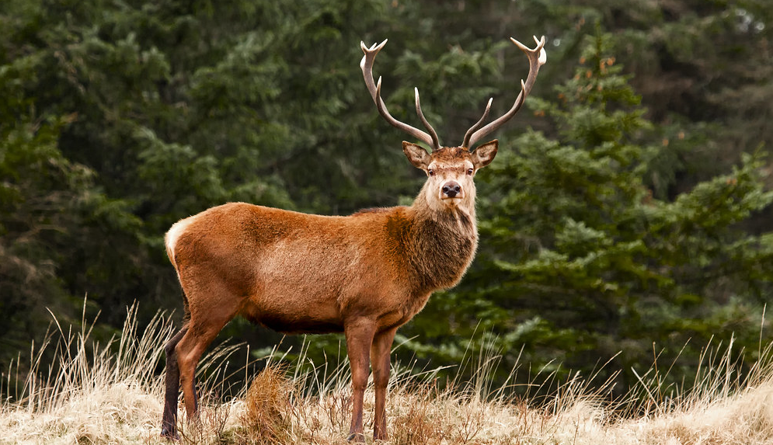
The Hart

Slide 5
Psalm 42:8-11
⁸ Yet the Lord will command his lovingkindness in the day time, and in the night his song shall be with me, and my prayer unto the God of my life.
⁹ I will say unto God my rock, Why hast thou forgotten me? why go I mourning because of the oppression of the enemy?
¹⁰ As with a sword in my bones, mine enemies reproach me; while they say daily unto me, Where is thy God?
¹¹ Why art thou cast down, O my soul? and why art thou disquieted within me? hope thou in God: for I shall yet praise him, who is the health of my countenance, and my God.

Slide 6
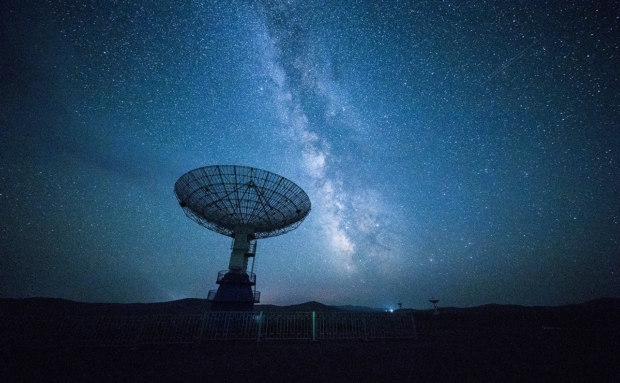
Thirst Makers
WAR IN THE UKRAINE
Letter from the UNT President
ADRA RESPONSE

Slide 7


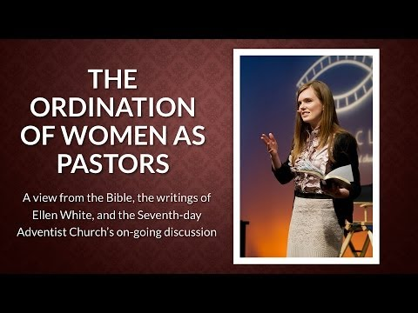
“The Seventh-day Adventist Church, in consultation with the Health Ministries and Public Affairs and Religious Liberty departments of the General Conference of Seventh-day Adventists, is convinced that the vaccination programs that are generally being carried out are important for the safety and health of our members and the larger community,” the October 25 statement reads. “Therefore, claims of religious liberty are not used appropriately in objecting to government mandates or employer programs designed to protect the health and safety of their communities.”

Slide 8
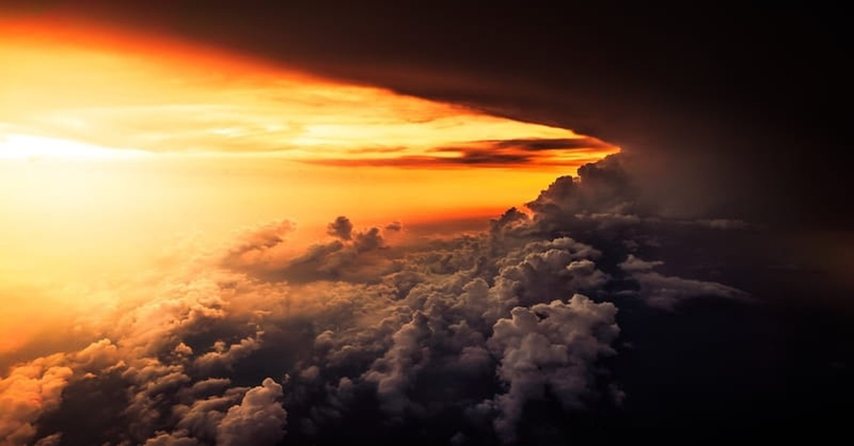
How can we have the same thirst to come into the presence of God?
Romans 8:18 “For I reckon that the sufferings of this present time are not worthy to be compared with the glory which shall be revealed in us.”
Romans 15:13 “Now the God of hope fill you with all joy and peace in believing, that ye may abound in hope, through the power of the Holy Ghost.”
Many things about our life here on this earth are deteriorating quickly these days, with little hope of improvement to come. Positions and institutions we have trusted no longer seem very secure, and the future seems bleak. Fortunately, our hope has never been based in things of this earth!

Slide 9
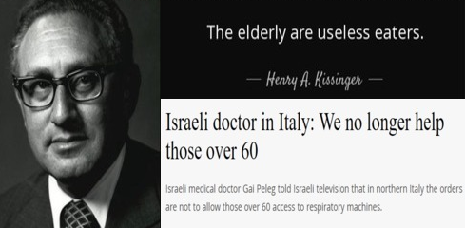
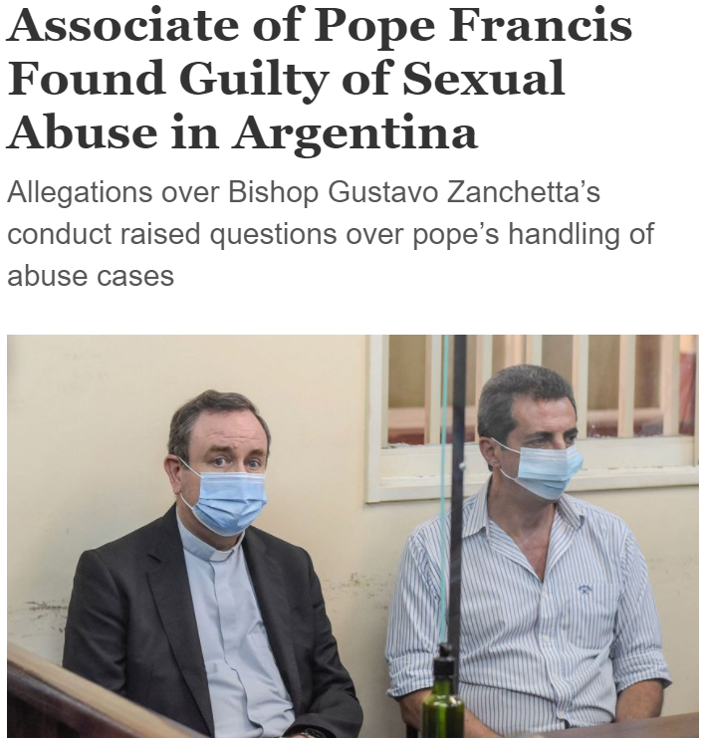
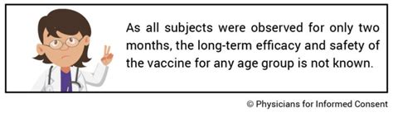
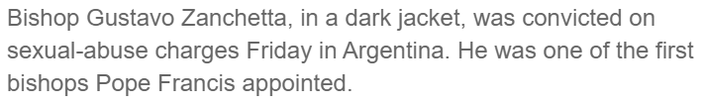

Slide 10
How can we have the same thirst to come into the presence of God?
James 1:17 “Every good gift and every perfect gift is from above, and cometh down from the Father of lights, with whom is no variableness, neither shadow of turning.”
Hebrews 13:8 “ Jesus Christ the same yesterday, and to day, and for ever.”
Our leaders here on earth are dangerously inconsistent—or possibly just perilously confused. We cannot trust in earthly guidance. But God’s guidance is certain! And He never changes.

Slide 11
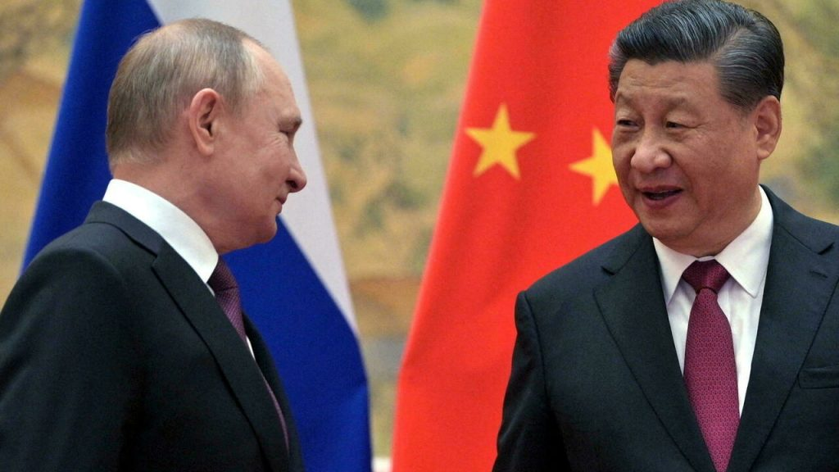

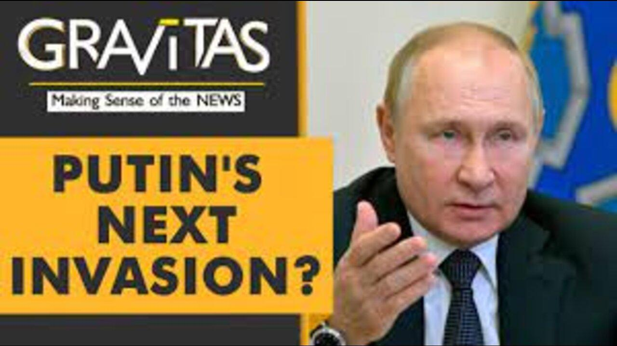
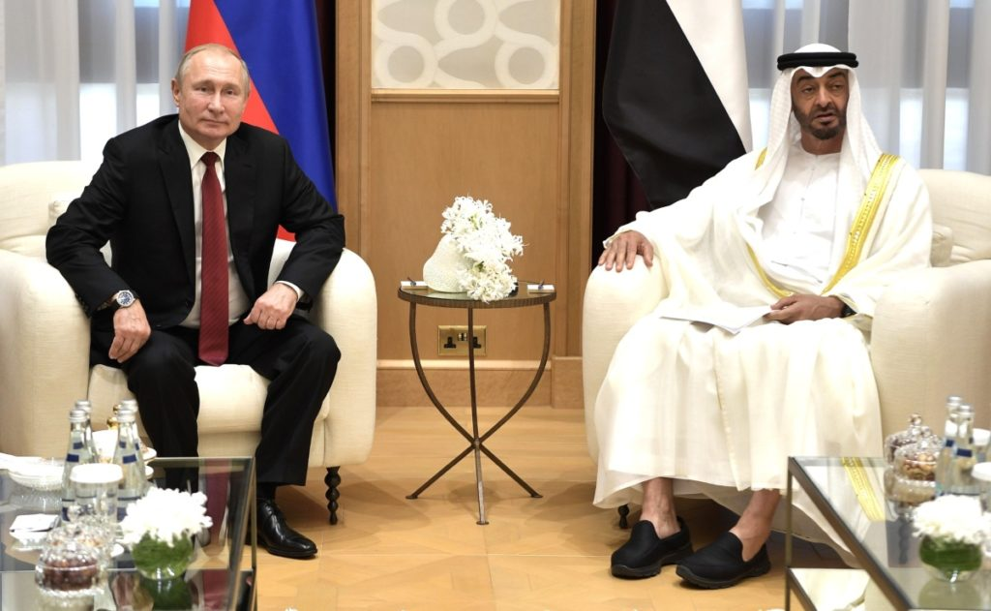

Slide 12
How can we have the same thirst to come into the presence of God?
Lamentations 3:21-23 “This I recall to my mind, therefore have I hope. It is of the Lord's mercies that we are not consumed, because his compassions fail not. They are new every morning: great is thy faithfulness.”
Jeremiah 17:7-8 “Blessed is the man that trusteth in the Lord, and whose hope the Lord is. For he shall be as a tree planted by the waters, and that spreadeth out her roots by the river, and shall not see when heat cometh, but her leaf shall be green; and shall not be careful in the year of drought, neither shall cease from yielding fruit.”
Trust is a very precious commodity! But sadly, not all of our leaders are worthy of the trust that is given to them. Awful as that is, it isn’t going to matter! Because it is in GOD that we trust, and He is certainly more than worthy.

Slide 13
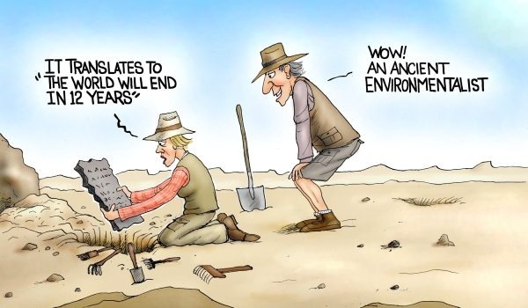

Slide 14
How can we have the same thirst to come into the presence of God?
Jeremiah 29:11-13 “For I know the thoughts that I think toward you, saith the Lord, thoughts of peace, and not of evil, to give you an expected end. Then shall ye call upon me, and ye shall go and pray unto me, and I will hearken unto you. And ye shall seek me, and find me, when ye shall search for me with all your heart.”
There are many things in the world around us that have the capacity to distract us from our proper focus on the Lord. But if we keep our eyes fixed on Him then our future is perfectly secure.

Slide 15
How can we have the same thirst to come into the presence of God?
“Hast thou not known? hast thou not heard, that the everlasting God, the Lord, the Creator of the ends of the earth, fainteth not, neither is weary? there is no searching of His understanding. He giveth power to the faint; and to them that have no might He increaseth strength. Even the youths shall faint and be weary, and the young men shall utterly fall: But they that wait upon the Lord shall renew their strength; they shall mount up with wings as eagles; they shall run, and not be weary; and they shall walk, and not faint.”
Isaiah 40:28-31

Slide 16

What are the factors that lead to joy before God?
Galatians 5:22-23
²² But the fruit of the Spirit is love, joy, peace, longsuffering, gentleness, goodness, faith, ²³ Meekness, temperance: against such there is no law.
Romans 14:17-18
¹⁷ For the kingdom of God is not meat and drink; but righteousness, and peace, and joy in the Holy Ghost. ¹⁸ For he that in these things serveth Christ is acceptable to God, and approved of men.
1 Chronicles 16:27-29
²⁷ Glory and honour are in his presence; strength and gladness are in his place. ²⁸ Give unto the Lord, ye kindreds of the people, give unto the Lord glory and strength. ²⁹ Give unto the Lord the glory due unto his name: bring an offering, and come before him: worship the Lord in the beauty of holiness.

Slide 17
What are the factors that lead to joy before God?
John 16:20-22
²⁰ Verily, verily, I say unto you, That ye shall weep and lament, but the world shall rejoice: and ye shall be sorrowful, but your sorrow shall be turned into joy. ²¹ A woman when she is in travail hath sorrow, because her hour is come: but as soon as she is delivered of the child, she remembereth no more the anguish, for joy that a man is born into the world. ²² And ye now therefore have sorrow: but I will see you again, and your heart shall rejoice, and your joy no man taketh from you.
1 Thessalonians 5:16-18
¹⁶ Rejoice evermore. ¹⁷ Pray without ceasing. ¹⁸ In every thing give thanks: for this is the will of God in Christ Jesus concerning you.
Psalm 30:5
⁵ For his anger endureth but a moment; in his favour is life: weeping may endure for a night, but joy cometh in the morning.

Slide 18
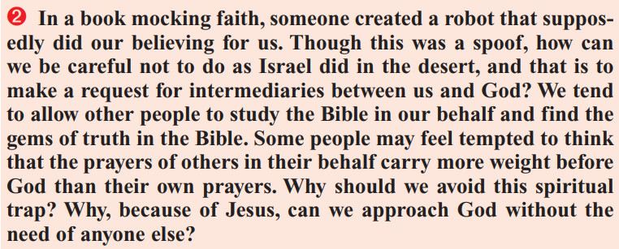
James 4:1-4
4 From whence come wars and fightings among you? come they not hence, even of your lusts that war in your members?
² Ye lust, and have not: ye kill, and desire to have, and cannot obtain: ye fight and war, yet ye have not, because ye ask not.
³ Ye ask, and receive not, because ye ask amiss, that ye may consume it upon your lusts.
⁴ Ye adulterers and adulteresses, know ye not that the friendship of the world is enmity with God? whosoever therefore will be a friend of the world is the enemy of God.

Slide 19
James 4:5-8
⁵ Do ye think that the scripture saith in vain, The spirit that dwelleth in us lusteth to envy?
⁶ But he giveth more grace. Wherefore he saith, God resisteth the proud, but giveth grace unto the humble.
⁷ Submit yourselves therefore to God. Resist the devil, and he will flee from you.
⁸ Draw nigh to God, and he will draw nigh to you. Cleanse your hands, ye sinners; and purify your hearts, ye double minded.

Slide 20

Where are your feet?
Deuteronomy 11:24
Every place whereon the soles of your feet shall tread shall be yours: from the wilderness and Lebanon, from the river, the river Euphrates, even unto the uttermost sea shall your coast be.
Joshua 1:3
³ Every place that the sole of your foot shall tread upon, that have I given unto you, as I said unto Moses.
Joshua 14:9
⁹ And Moses sware on that day, saying, Surely the land whereon thy feet have trodden shall be thine inheritance, and thy children's for ever, because thou hast wholly followed the Lord my God.

Slide 21
Seeking Treasure?
Matthew 13:44-46, 52
⁴⁴ Again, the kingdom of heaven is like unto treasure hid in a field; the which when a man hath found, he hideth, and for joy thereof goeth and selleth all that he hath, and buyeth that field.
⁴⁵ Again, the kingdom of heaven is like unto a merchant man, seeking goodly pearls:
⁴⁶ Who, when he had found one pearl of great price, went and sold all that he had, and bought it.
…
⁵² Then said he unto them, Therefore every scribe which is instructed unto the kingdom of heaven is like unto a man that is an householder, which bringeth forth out of his treasure things new and old.

Slide 22
James 5:14-16
¹⁴ Is any sick among you? let him call for the elders of the church; and let them pray over him, anointing him with oil in the name of the Lord:
¹⁵ And the prayer of faith shall save the sick, and the Lord shall raise him up; and if he have committed sins, they shall be forgiven him.
¹⁶ Confess your faults one to another, and pray one for another, that ye may be healed. The effectual fervent prayer of a righteous man availeth much.

Slide 23
Proverbs 28:9
⁹ He that turneth away his ear from hearing the law, even his prayer shall be abomination.

Slide 24
Isaiah 1:15-17
¹⁵ And when ye spread forth your hands, I will hide mine eyes from you: yea, when ye make many prayers, I will not hear: your hands are full of blood.
¹⁶ Wash you, make you clean; put away the evil of your doings from before mine eyes; cease to do evil;

Slide 25
Approaching God
Philippians 2:12-16
¹² Wherefore, my beloved, as ye have always obeyed, not as in my presence only, but now much more in my absence, work out your own salvation with fear and trembling.
¹³ For it is God which worketh in you both to will and to do of his good pleasure.
¹⁴ Do all things without murmurings and disputings:
¹⁵ That ye may be blameless and harmless, the sons of God, without rebuke, in the midst of a crooked and perverse nation, among whom ye shine as lights in the world;
¹⁶ Holding forth the word of life; that I may rejoice in the day of Christ, that I have not run in vain, neither laboured in vain.

Slide 26
Approaching God
Isaiah 26:3
³ Thou wilt keep him in perfect peace, whose mind is stayed on thee: because he trusteth in thee.
Isaiah 32:17-18
¹⁷ And the work of righteousness shall be peace; and the effect of righteousness quietness and assurance for ever.
¹⁸ And my people shall dwell in a peaceable habitation, and in sure dwellings, and in quiet resting places;

Slide 27
Approaching God
Philippians 4:4-7
⁴ Rejoice in the Lord always: and again I say, Rejoice.
⁵ Let your moderation be known unto all men. The Lord is at hand.
⁶ Be careful for nothing; but in every thing by prayer and supplication with thanksgiving let your requests be made known unto God.
⁷ And the peace of God, which passeth all understanding, shall keep your hearts and minds through Christ Jesus.
1 Peter 5:6-7
⁶ Humble yourselves therefore under the mighty hand of God, that he may exalt you in due time:
⁷ Casting all your care upon him; for he careth for you.

Slide 28

Dear UNT Community,
Last night a registered student organization, Young Conservatives of Texas, hosted a guest speaker at Curry Hall. Because conversations surrounding the student organization’s event, which focused on criminalizing healthcare for transgender children, have been contentious, UNT Police created a plan to ensure their ability to maintain a safe environment for our entire campus community, the student organizers, their guest, and event protestors, requesting advance assistance from both Denton Police and the Texas Department of Public Safety (DPS).
Based on the event space capacity and for safety purposes, the room was limited to 80 attendees. A few hundred protestors gathered outside the building, holding signs and chanting. The police agencies tasked with maintaining public safety were inside and outside the building. DPS officers were staged at a nearby location as an extra safety precaution.
The police believe a small group of protestors not affiliated with the university contributed to escalating the overall protest from peaceful to an aggressive encounter. These actions culminated with a group of protestors swarming police, who were working to safely escort both the guest speaker and student organizers off campus. DPS was called in to assist with maintaining safety.

Slide 29
A group of protestors surrounded the police vehicles containing both the student organizers and their guest and attempted to block their exit from the scene by banging on the vehicles and impeding their movement. The officers engaged emergency lights and sounded warning sirens repeatedly while inching forward as other officers assisted in clearing a path for the vehicles to exit safely. We have heard accounts of a protester who was reportedly injured during that time. However, we do not have confirmed details of that report. While overall the event was not without incident, it did end without any reported serious injuries. UNT Police and the other supporting agencies were able to get the student organizers and their guest to safety, while also dispersing the protestors without further incident.
We have always touted the importance of freedom of expression and been proud of our students’ ability to speak up for themselves and participate in nonviolent protest. UNT Police have continuously worked to create and maintain an environment safe for all students to express themselves, regardless of topic. As always, campus safety is our top priority, and we will continue working to provide a safe environment for our students. We have always been a passionate community that stands up for our ideals, but last night’s behavior by some individuals is not reflective of the UNT I know and love.
Respectfully, Neal Smatresk (UNT President)
BACK

Slide 30
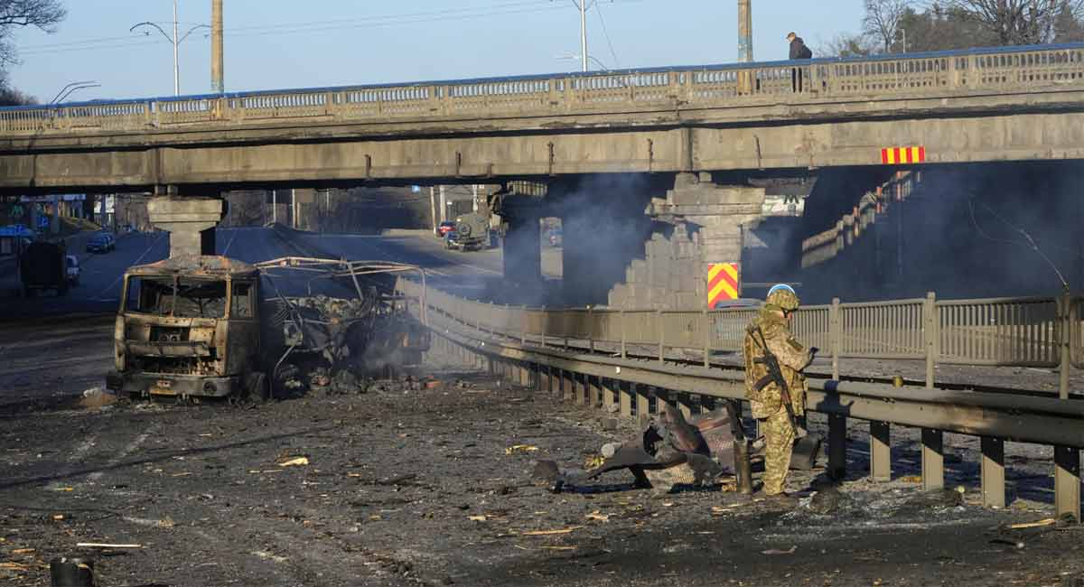
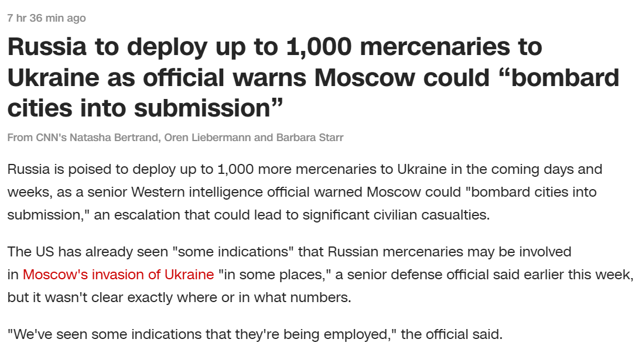
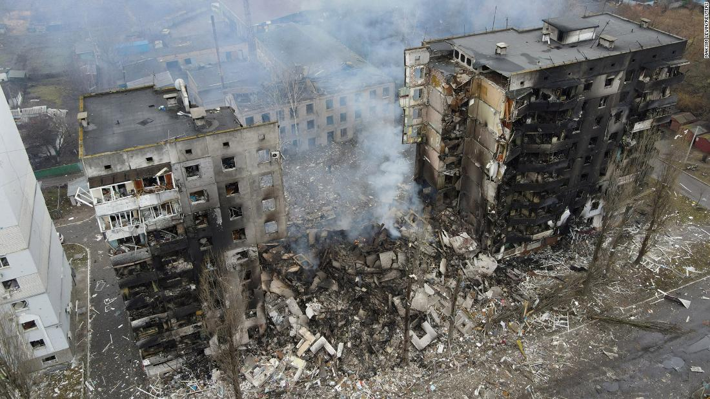
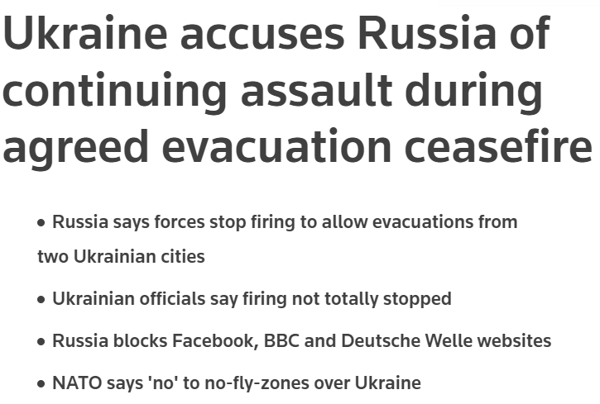
BACK

