Slide 1
By Faith
Lesson 11

Slide 2
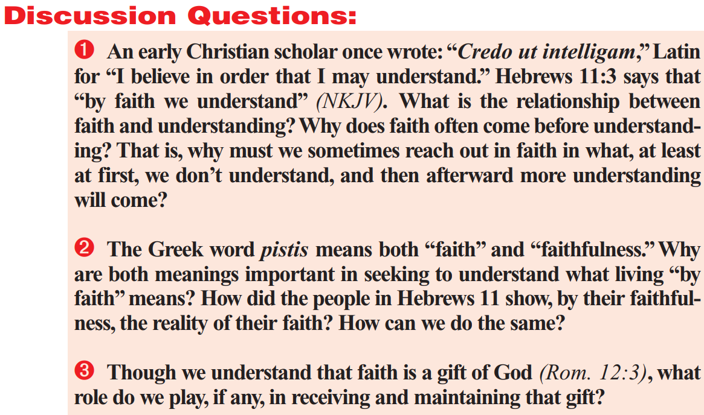

Slide 3
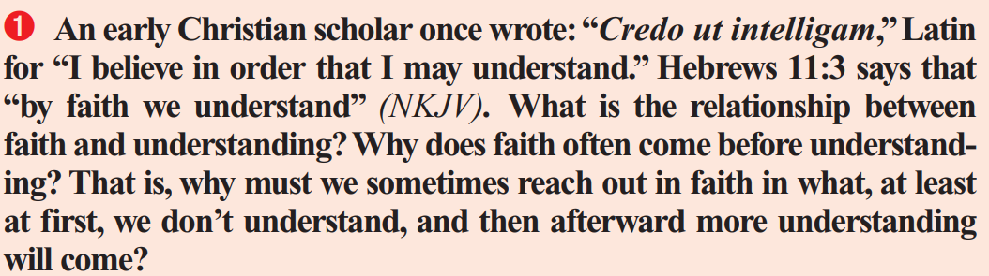
Hebrews 11:1-3
Now faith is the substance of things hoped for, the evidence of things not seen.
² For by it the elders obtained a good report.
³ Through faith we understand that the worlds were framed by the word of God, so that things which are seen were not made of things which do appear.

Slide 4
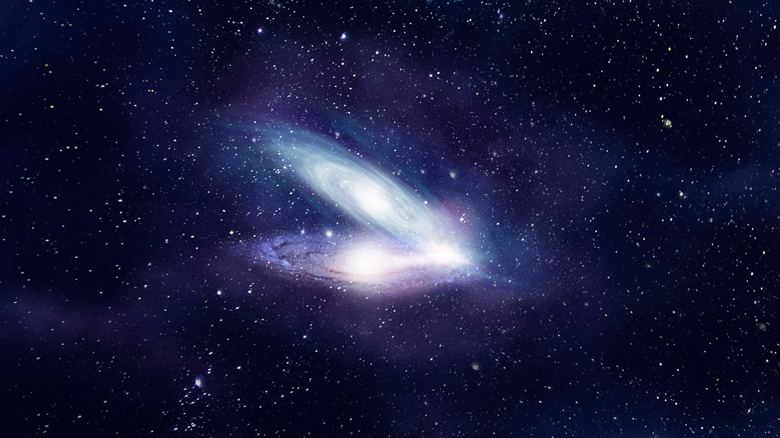
Understanding and Faith
Notice that Hebrews 11:3 doesn’t just state that “By faith we understand.” It says that through faith we are given to understand that God is the Creator of the universe. Note that faith is necessary for this since we weren’t there!
Hebrews 11:3:
³ Through faith we understand that the worlds were framed by the word of God, so that things which are seen were not made of things which do appear.

Slide 5

Understanding and Faith
Think back to when you were a child, before you understood very much about anything. I don’t know about you, but I wouldn’t have learned anything from someone I didn’t trust. And I wasn’t very trusting! You have to have a certain amount of trust (faith) if you’re going to listen long enough to understand!

Slide 6
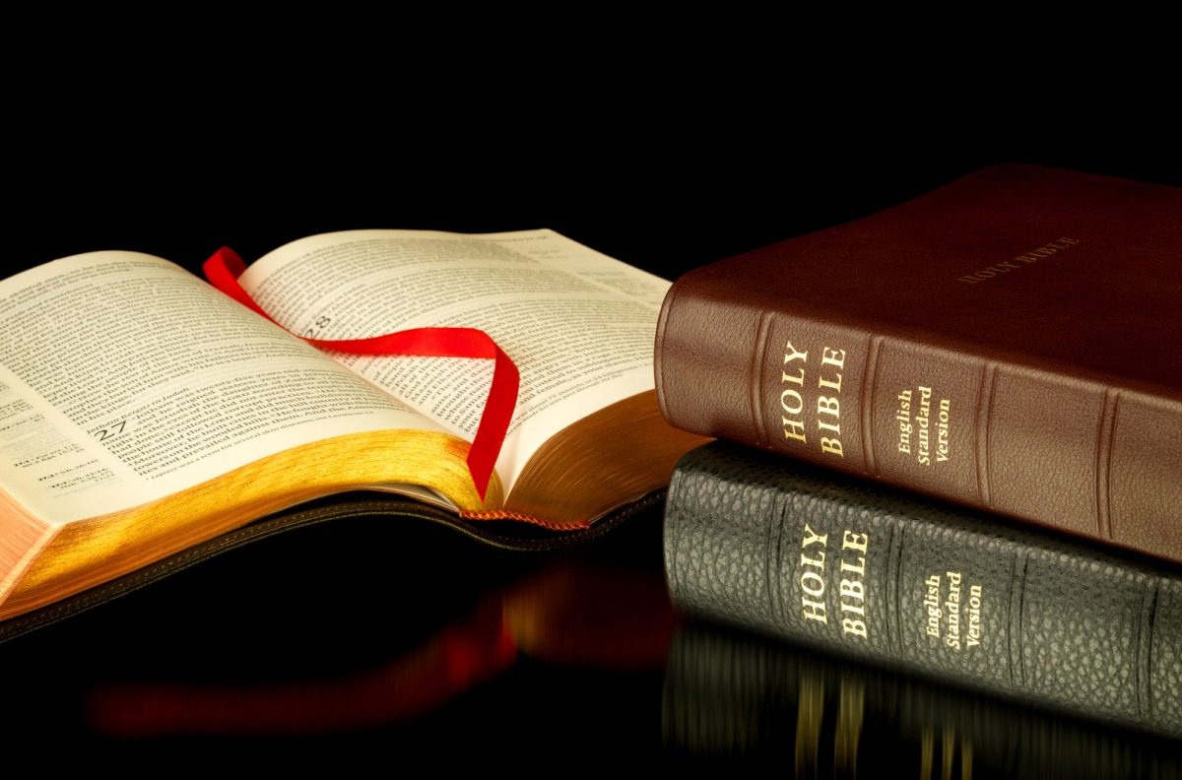
Understanding and Faith
We get a great deal of understanding—of ourselves, our world, our God, and our relationship with Him—through a careful study of His word. But that Word only has meaning for us through faith! Faith in the Bible is the starting place for understanding as well as wisdom!

Slide 7
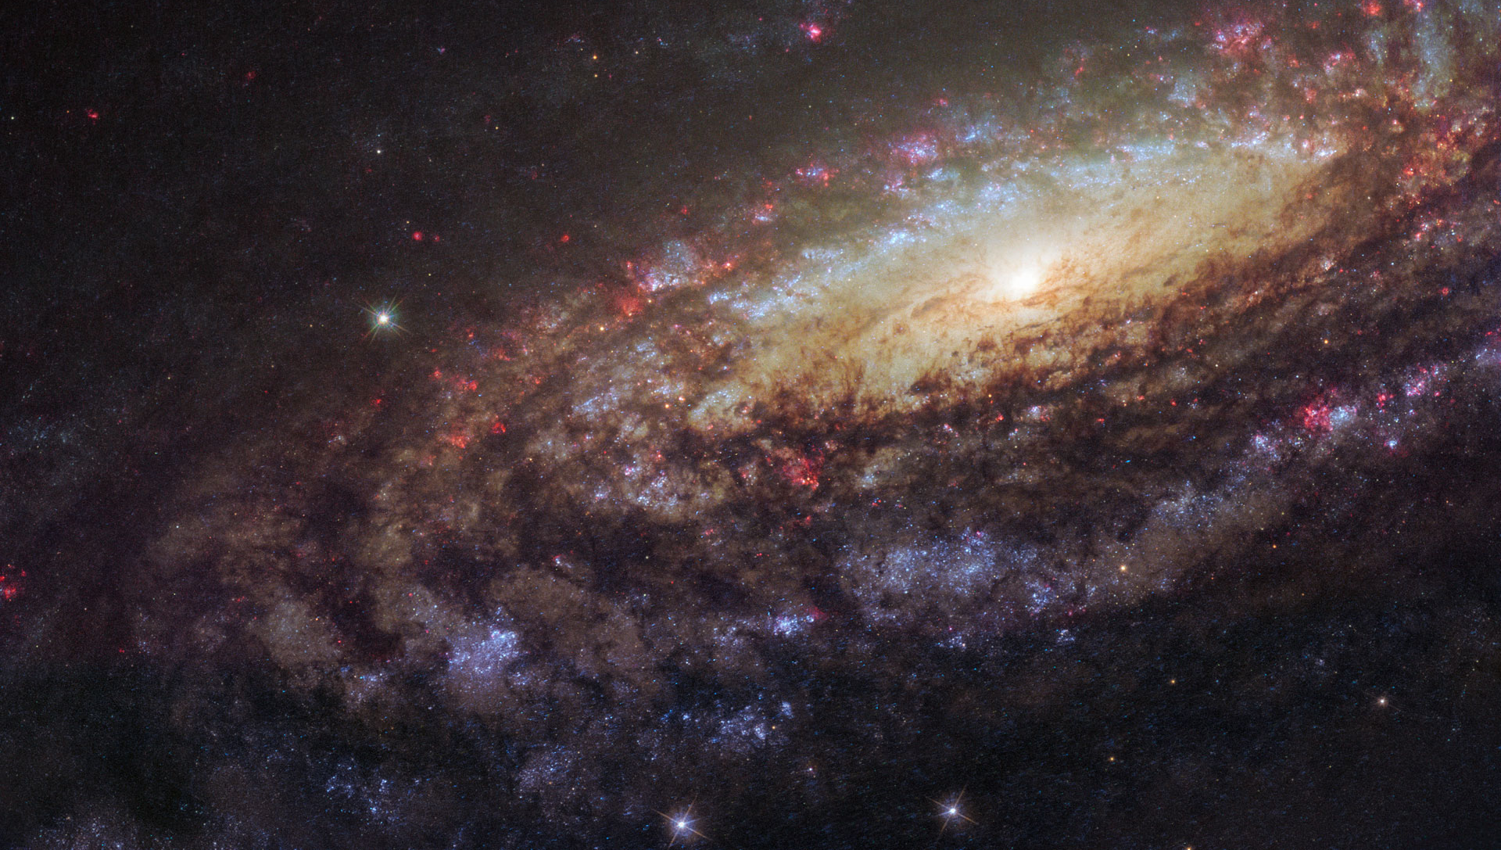
Understanding and Faith
To formulate mathematical proofs it is necessary to go back to the very foundation of mathematics. These are what we call the “axioms” of mathematics. They’re unprovable, generally accepted truths that form the very beginning of mathematical reasoning. The axioms of mathematics are generally considered to be a collection of nine axioms, known as the Zermelo-Fraenkel (ZF) Axioms. They are:

Slide 8
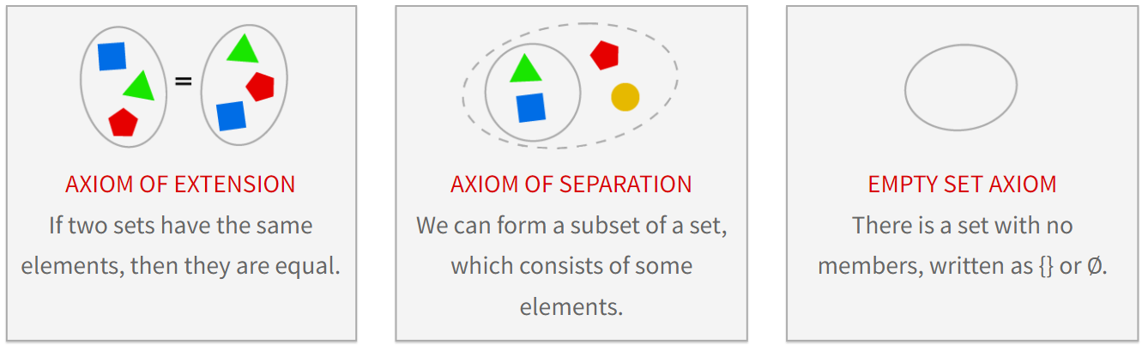
ZF Axioms 1-3

Slide 9
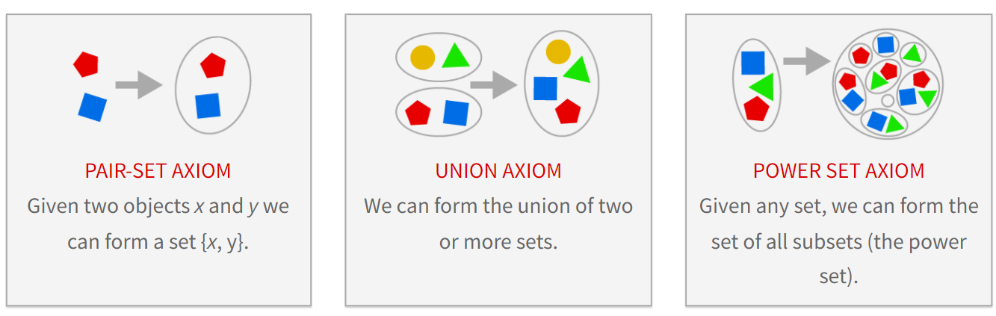
ZF Axioms 4-6

Slide 10
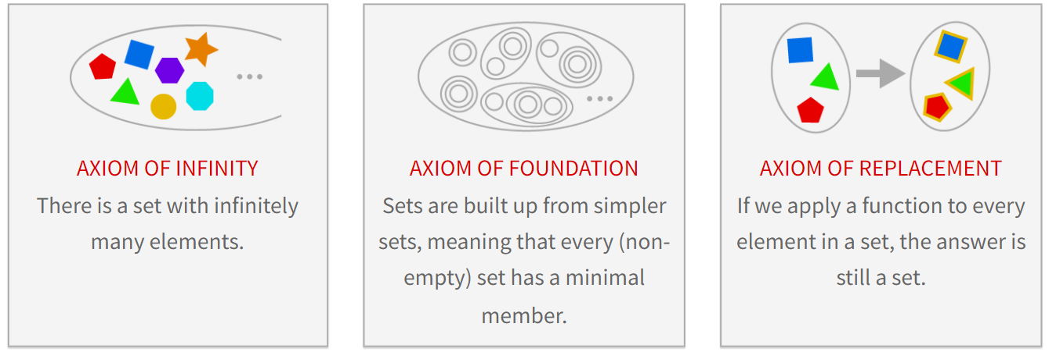
ZF Axioms 7-9

Slide 11
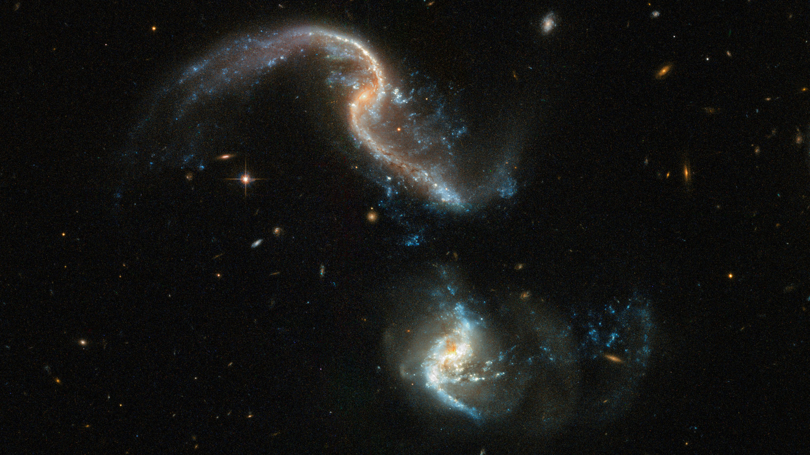
Understanding and Faith
Even in a field of rigid logic and proof like mathematics, understanding starts with a little bit of faith!

Slide 12
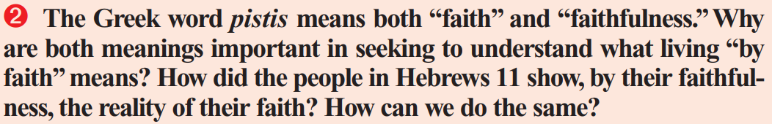
According to our best knowledge on the subject, Hebrews was probably written by Paul. Paul was a Roman citizen, born in Tarsus, but he was also a man with a great deal of Hebrew heritage.
Paul was a Pharisee, as was his father (Acts 23:6). He was born into the tribe of Benjamin. In his own words from Philippians 3:5, Paul was “Circumcised the eighth day, of the stock of Israel, of the tribe of Benjamin, an Hebrew of the Hebrews; as touching the law, a Pharisee.” The book of Hebrews was written in Greek, but it was written by a Hebrew to Hebrews, so it makes sense to consider the word "FAITH" in Hebrew.

Slide 13
Notice that “faith” is an ACTION WORD, not an abstract belief that something is the case!
So we see in Hebrews 11:5 that “By faith Enoch was translated that he should not see death; and was not found, because God had translated him: for before his translation he had this testimony, that he pleased God.”
It’s not that Enoch had faith (a belief) that God would translate him, but that he was translated as a result of his faith and his faithfulness—”he pleased God.”
Faith is not a belief but how we live BECAUSE OF a belief!

Slide 14
The fields were parched and brown from lack of rain, and the crops lay wilting from thirst. People were anxious and irritable as they searched the sky for any sign of relief. Days turned into arid weeks. No rain came. The ministers of the local churches called for an hour of prayer on the town square the following Saturday. They requested that everyone bring an object of faith for inspiration.
At high noon on the appointed Saturday the townspeople showed up in masses, filling the square with anxious faces and hopeful hearts. The ministers were touched to see the variety of objects clutched in prayerful hands --Bibles, crosses, and rosaries were only a few of their faith symbols.
When the hour ended, as if on magical command, a soft rain began to fall. Cheers swept the crowd as they held their treasured objects high in gratitude and praise. From the middle of the crowd, one faith symbol seemed to overshadow all the others; A small 9-year-old child had brought an umbrella.

Slide 15

What good is a belief if it never stirs you to action?
Is it even really a “belief”?

Slide 16
Romans 12:3
³ For I say, through the grace given unto me, to every man that is among you, not to think of himself more highly than he ought to think; but to think soberly, according as God hath dealt to every man the measure of faith.

Slide 17
John 1:12 - CONVERSION
¹² But as many as received him, to them gave he power to become the sons of God, even to them that believe on his name:

Slide 18
Romans 5:1, 2- JUSTIFICATION
Therefore being justified by faith, we have peace with God through our Lord Jesus Christ:
² By whom also we have access by faith into this grace wherein we stand, and rejoice in hope of the glory of God.

Slide 19
Acts 26:18 - SANCTIFICATION
¹⁸ To open their eyes, and to turn them from darkness to light, and from the power of Satan unto God, that they may receive forgiveness of sins, and inheritance among them which are sanctified by faith that is in me.

Slide 20
GLORIFICATION
Notice that for faith’s contribution to glorification we can just turn back to Hebrews 11:5!
“By faith Enoch was translated that he should not see death; and was not found, because God had translated him: for before his translation he had this testimony, that he pleased God.”

Slide 21
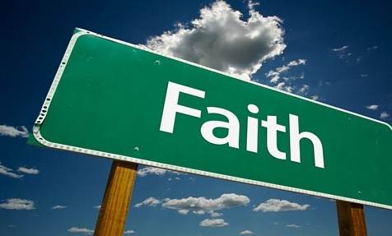
5 BIBLE CASE-STUDIES IN

Slide 22
Matthew 17:14-16
¹⁴ And when they were come to the multitude, there came to him a certain man, kneeling down to him, and saying,
¹⁵ Lord, have mercy on my son: for he is lunatick, and sore vexed: for ofttimes he falleth into the fire, and oft into the water.
¹⁶ And I brought him to thy disciples, and they could not cure him.

Slide 23
Matthew 17:17-19
¹⁷ Then Jesus answered and said, O faithless and perverse generation, how long shall I be with you? how long shall I suffer you? bring him hither to me.
¹⁸ And Jesus rebuked the devil; and he departed out of him: and the child was cured from that very hour.
¹⁹ Then came the disciples to Jesus apart, and said, Why could not we cast him out?

Slide 24
Matthew 17:20-21
²⁰ And Jesus said unto them, Because of your unbelief: for verily I say unto you, If ye have faith as a grain of mustard seed, ye shall say unto this mountain, Remove hence to yonder place; and it shall remove; and nothing shall be impossible unto you.
²¹ Howbeit this kind goeth not out but by prayer and fasting.

Slide 25
Romans 10:13-15
¹³ For whosoever shall call upon the name of the Lord shall be saved.
¹⁴ How then shall they call on him in whom they have not believed? and how shall they believe in him of whom they have not heard? and how shall they hear without a preacher?
¹⁵ And how shall they preach, except they be sent? as it is written, How beautiful are the feet of them that preach the gospel of peace, and bring glad tidings of good things!

Slide 26
Romans 10:16-17
¹⁶ But they have not all obeyed the gospel. For Esaias saith, Lord, who hath believed our report?
¹⁷ So then faith cometh by hearing, and hearing by the word of God.

Slide 27
Luke 17:5-7
⁵ And the apostles said unto the Lord, Increase our faith.
⁶ And the Lord said, If ye had faith as a grain of mustard seed, ye might say unto this sycamine tree, Be thou plucked up by the root, and be thou planted in the sea; and it should obey you.
⁷ But which of you, having a servant plowing or feeding cattle, will say unto him by and by, when he is come from the field, Go and sit down to meat?

Slide 28
Luke 17:8-10
⁸ And will not rather say unto him, Make ready wherewith I may sup, and gird thyself, and serve me, till I have eaten and drunken; and afterward thou shalt eat and drink?
⁹ Doth he thank that servant because he did the things that were commanded him? I trow not.
¹⁰ So likewise ye, when ye shall have done all those things which are commanded you, say, We are unprofitable servants: we have done that which was our duty to do.

Slide 29
Mark 9:23-24
²³ Jesus said unto him, If thou canst believe, all things are possible to him that believeth.
²⁴ And straightway the father of the child cried out, and said with tears, Lord, I believe; help thou mine unbelief.

Slide 30
James 2:14-17
¹⁴ What doth it profit, my brethren, though a man say he hath faith, and have not works? can faith save him?
¹⁵ If a brother or sister be naked, and destitute of daily food,
¹⁶ And one of you say unto them, Depart in peace, be ye warmed and filled; notwithstanding ye give them not those things which are needful to the body; what doth it profit?
¹⁷ Even so faith, if it hath not works, is dead, being alone.

Slide 31
James 2:18-20
¹⁸ Yea, a man may say, Thou hast faith, and I have works: shew me thy faith without thy works, and I will shew thee my faith by my works.
¹⁹ Thou believest that there is one God; thou doest well: the devils also believe, and tremble.
²⁰ But wilt thou know, O vain man, that faith without works is dead?

Slide 32
James 2:21-23
²¹ Was not Abraham our father justified by works, when he had offered Isaac his son upon the altar?
²² Seest thou how faith wrought with his works, and by works was faith made perfect?
²³ And the scripture was fulfilled which saith, Abraham believed God, and it was imputed unto him for righteousness: and he was called the Friend of God.

Slide 33
James 2:24-26
²⁴ Ye see then how that by works a man is justified, and not by faith only.
²⁵ Likewise also was not Rahab the harlot justified by works, when she had received the messengers, and had sent them out another way?
²⁶ For as the body without the spirit is dead, so faith without works is dead also.

