Slide 1
Judgement
Lesson 12

Slide 2
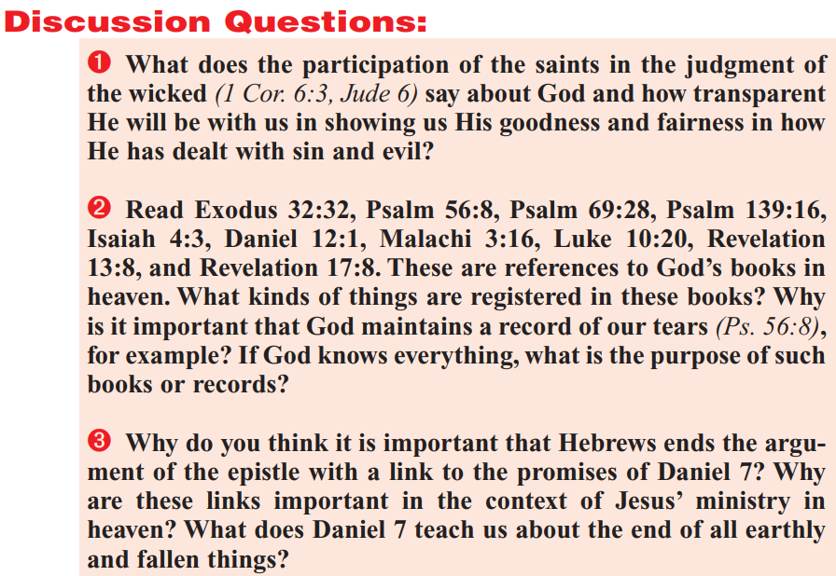

Slide 3
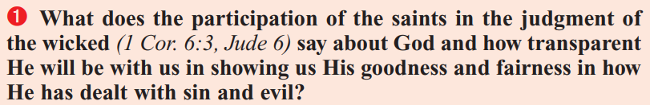
1 Corinthians 6:1-3
6 Dare any of you, having a matter against another, go to law before the unjust, and not before the saints?
² Do ye not know that the saints shall judge the world? and if the world shall be judged by you, are ye unworthy to judge the smallest matters?
³ Know ye not that we shall judge angels? how much more things that pertain to this life?

Slide 4
Jude 6
⁶ And the angels which kept not their first estate, but left their own habitation, he hath reserved in everlasting chains under darkness unto the judgment of the great day.

Slide 5
Revelation 20:4
⁴ And I saw thrones, and they sat upon them, and judgment was given unto them: and I saw the souls of them that were beheaded for the witness of Jesus, and for the word of God, and which had not worshipped the beast, neither his image, neither had received his mark upon their foreheads, or in their hands; and they lived and reigned with Christ a thousand years.

Slide 6
The great Controversy Pg. 660-661
During the thousand years between the first and the second resurrection the judgment of the wicked takes place. The apostle Paul points to this judgment as an event that follows the second advent. “Judge nothing before the time, until the Lord come, who both will bring to light the hidden things of darkness, and will make manifest the counsels of the hearts.” 1 Corinthians 4:5. Daniel declares that when the Ancient of Days came, “judgment was given to the saints of the Most High.” Daniel 7:22. At this time the righteous reign as kings and priests unto God. John in the Revelation says: “I saw thrones, and they sat upon them, and judgment was given unto them.” “They shall be priests of God and of Christ, and shall reign with Him a thousand years.” Revelation 20:4, 6.

Slide 7
The great Controversy Pg. 660-661
It is at this time that, as foretold by Paul, “the saints shall judge the world.” 1 Corinthians 6:2. In union with Christ they judge the wicked, comparing their acts with the statute book, the Bible, and deciding every case according to the deeds done in the body. Then the portion which the wicked must suffer is meted out, according to their works; and it is recorded against their names in the book of death. Satan also and evil angels are judged by Christ and His people. Says Paul: “Know ye not tha we shall judge angels?” Verse 3. And Jude declares that “the angels which kept not their first estate, but left their own habitation, He hath reserved in everlasting chains under darkness unto the judgment of the great day.” Jude 6.

Slide 8
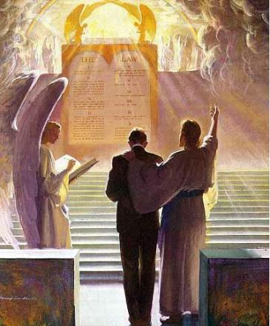
God is always good! But He is exceedingly gracious—much, much more than “fair”—in how He deals with sin and evil. The participation of the saints in the judgement of the wicked certainly shows the transparency of God’s government. But more than that, it’s designed to help us understand the necessity for God’s “strange act” in the final destruction of the wicked.

Slide 9
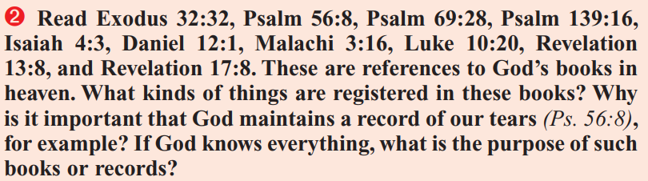
Exodus 32:31-34, 35
The books contain the names of God’s people, the righteous. This is the book of life!
³¹ And Moses returned unto the Lord, and said, Oh, this people have sinned a great sin, and have made them gods of gold.
³² Yet now, if thou wilt forgive their sin--; and if not, blot me, I pray thee, out of thy book which thou hast written.
³³ And the Lord said unto Moses, Whosoever hath sinned against me, him will I blot out of my book…
³⁵ And the Lord plagued the people, because they made the calf, which Aaron made.

Slide 10
Psalm 56:8-11
The books contain an accounting of the wrongs that the righteous have suffered—their “tears”. It’s an accurate history of wrongdoing!
⁸ Thou tellest my wanderings: put thou my tears into thy bottle: are they not in thy book?
⁹ When I cry unto thee, then shall mine enemies turn back: this I know; for God is for me.
¹⁰ In God will I praise his word: in the Lord will I praise his word.
¹¹ In God have I put my trust: I will not be afraid what man can do unto me.

Slide 11
Psalm 69:20-21, 26-28
The books contain names of the “living,” that is, those who belong to God. This is the book of life!
²⁰ Reproach hath broken my heart; and I am full of heaviness: and I looked for some to take pity, but there was none; and for comforters, but I found none.
²¹ They gave me also gall for my meat; and in my thirst they gave me vinegar to drink…
²⁶ For they persecute him whom thou hast smitten; and they talk to the grief of those whom thou hast wounded.
²⁷ Add iniquity unto their iniquity: and let them not come into thy righteousness.
²⁸ Let them be blotted out of the book of the living, and not be written with the righteous.

Slide 12
Psalm 139:14-16
All of the history of God’s marvelous creation is recorded in the books. They contain even continuously changing facts that we don’t know, like the number of hairs on our heads!
¹⁴ I will praise thee; for I am fearfully and wonderfully made: marvellous are thy works; and that my soul knoweth right well.
¹⁵ My substance was not hid from thee, when I was made in secret, and curiously wrought in the lowest parts of the earth.
¹⁶ Thine eyes did see my substance, yet being unperfect; and in thy book all my members were written, which in continuance were fashioned, when as yet there was none of them.

Slide 13
Isaiah 4:2-3
The book of life contains the names of the “living,” that is, the holy!
² In that day shall the branch of the Lord be beautiful and glorious, and the fruit of the earth shall be excellent and comely for them that are escaped of Israel.
³ And it shall come to pass, that he that is left in Zion, and he that remaineth in Jerusalem, shall be called holy, even every one that is written among the living in Jerusalem:

Slide 14
Daniel 12:1
The book of life is God’s great list of those who will be delivered!
And at that time shall Michael stand up, the great prince which standeth for the children of thy people: and there shall be a time of trouble, such as never was since there was a nation even to that same time: and at that time thy people shall be delivered, every one that shall be found written in the book.

Slide 15
Malachi 3:16-18
God’s history books include both actions and thoughts! We don’t need to wonder what people were thinking in various cases. God causes thoughts to be recorded as well as actions!
¹⁶ Then they that feared the Lord spake often one to another: and the Lord hearkened, and heard it, and a book of remembrance was written before him for them that feared the Lord, and that thought upon his name.
¹⁷ And they shall be mine, saith the Lord of hosts, in that day when I make up my jewels; and I will spare them, as a man spareth his own son that serveth him.
¹⁸ Then shall ye return, and discern between the righteous and the wicked, between him that serveth God and him that serveth him not.

Slide 16
Luke 10:19-20
¹⁹ Behold, I give unto you power to tread on serpents and scorpions, and over all the power of the enemy: and nothing shall by any means hurt you.
²⁰ Notwithstanding in this rejoice not, that the spirits are subject unto you; but rather rejoice, because your names are written in heaven.
God records the names of His people… and we need to be on that list!

Slide 17
Revelation 13:4, 7-8
The only thing that matters is having our names written in the Lamb’s book of life!
⁴ And they worshipped the dragon which gave power unto the beast: and they worshipped the beast, saying, Who is like unto the beast? who is able to make war with him? …
⁷ And it was given unto him to make war with the saints, and to overcome them: and power was given him over all kindreds, and tongues, and nations.
⁸ And all that dwell upon the earth shall worship him, whose names are not written in the book of life of the Lamb slain from the foundation of the world.

Slide 18
Revelation 17:8
⁸ The beast that thou sawest was, and is not; and shall ascend out of the bottomless pit, and go into perdition: and they that dwell on the earth shall wonder, whose names were not written in the book of life from the foundation of the world, when they behold the beast that was, and is not, and yet is.
The righteous are protected from the deceit of the beast, but those whose names aren’t recorded in the book of life will be fooled.

Slide 19
The great Controversy Pg. 480
The books of record in heaven, in which the names and the deeds of men are registered, are to determine the decisions of the judgment. Says the prophet Daniel: “The judgment was set, and the books were opened.” The revelator, describing the same scene, adds: “Another book was opened, which is the book of life: and the dead were judged out of those things which were written in the books, according to their works.” Revelation 20:12.

Slide 20
The great Controversy Pg. 480
The book of life contains the names of all who have ever entered the service of God. Jesus bade His disciples: “Rejoice, because your names are written in heaven.” Luke 10:20. Paul speaks of his faithful fellow workers, “whose names are in the book of life.” Philippians 4:3. Daniel, looking down to “a time of trouble, such as never was,” declares that God's people shall be delivered, “everyone that shall be found written in the book.” And the revelator says that those only shall enter the city of God whose names “are written in the Lamb's book of life.” Daniel 12:1; Revelation 21:27.

Slide 21
The great Controversy Pg. 481
“A book of remembrance” is written before God, in which are recorded the good deeds of “them that feared the Lord, and that thought upon His name.” Malachi 3:16. Their words of faith, their acts of love, are registered in heaven. Nehemiah refers to this when he says: “Remember me, O my God, ... and wipe not out my good deeds that I have done for the house of my God.” Nehemiah 13:14. In the book of God's remembrance every deed of righteousness is immortalized. There every temptation resisted, every evil overcome, every word of tender pity expressed, is faithfully chronicled. And every act of sacrifice, every suffering and sorrow endured for Christ's sake, is recorded. Says the psalmist: “Thou tellest my wanderings: put Thou my tears into Thy bottle: are they not in Thy book?” Psalm 56:8.

Slide 22
The great Controversy Pg. 481
There is a record also of the sins of men. “For God shall bring every work into judgment, with every secret thing, whether it be good, or whether it be evil.” “Every idle word that men shall speak, they shall give account thereof in the day of judgment.” Says the Saviour: “By thy words thou shalt be justified, and by thy words thou shalt be condemned.” Ecclesiastes 12:14; Matthew 12:36, 37. The secret purposes and motives appear in the unerring register; for God “will bring to light the hidden things of darkness, and will make manifest the counsels of the hearts.” 1 Corinthians 4:5. “Behold, it is written before Me, ... your iniquities, and the iniquities of your fathers together, saith the Lord.” Isaiah 65:6, 7.

Slide 23
The great Controversy Pg. 482
Every man's work passes in review before God and is registered for faithfulness or unfaithfulness. Opposite each name in the books of heaven is entered with terrible exactness every wrong word, every selfish act, every unfulfilled duty, and every secret sin, with every artful dissembling. Heaven-sent warnings or reproofs neglected, wasted moments, unimproved opportunities, the influence exerted for good or for evil, with its far-reaching results, all are chronicled by the recording angel.

Slide 24
The great Controversy Pg. 482
The law of God is the standard by which the characters and the lives of men will be tested in the judgment. Says the wise man: “Fear God, and keep His commandments: for this is the whole duty of man. For God shall bring every work into judgment.” Ecclesiastes 12:13, 14. The apostle James admonishes his brethren: “So speak ye, and so do, as they that shall be judged by the law of liberty.” James 2:12.

Slide 25
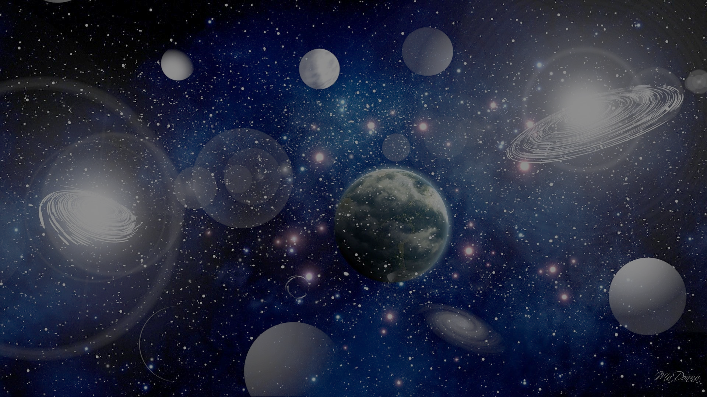
The entire universe has been examining the results and consequences of Satan’s rebellion against God’s government as it has played out on this planet. We humans are the only group in the entire cosmos that has NOT had the benefit of reviewing the comparison between God’s government and Satan’s government. The righteous—who have chosen to live under God's government—should of course have the same opportunity as the rest of the worlds to review this data. That’s why God has prepared these records!

Slide 26
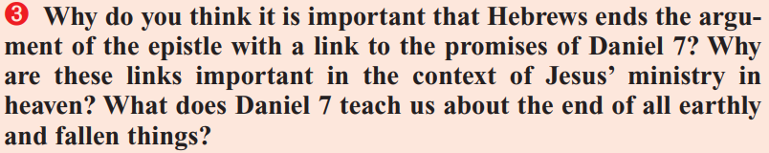
The Argument of the epistle
The quarterly states that Hebrews 12:18-29 is the “climax of the letter.” It goes on to conclude that, “The ending reaffirms the importance of Jesus’ achievements at the cross and directs believers to the consummation of Jesus’ victory at the Second Coming. Paul used imagery from Daniel 7 to remind the readers that Jesus has received a kingdom from God, the Judge (Dan. 7:9-14), and is going to share His kingdom with believers, “the saints of the Most High,” who will possess it forever and ever (Dan. 7:18).”
Let’s review this line of argument and the imagery of Daniel 7!

Slide 27
Hebrews 12:18-21
¹⁸ For ye are not come unto the mount that might be touched, and that burned with fire, nor unto blackness, and darkness, and tempest,
¹⁹ And the sound of a trumpet, and the voice of words; which voice they that heard intreated that the word should not be spoken to them any more:
²⁰ (For they could not endure that which was commanded, And if so much as a beast touch the mountain, it shall be stoned, or thrust through with a dart:
²¹ And so terrible was the sight, that Moses said, I exceedingly fear and quake:)

Slide 28
Hebrews 12:18-21
The incident to which the author of Hebrews refers is described in Exodus 19:9-25. The ancient Israelites approached Mount Sinai, where God would speak the Law to them. The sights and sounds of that event were never to be forgotten. God’s voice was so profound and overwhelming that the people afterward begged Moses to stand as intercessor for them. As they stood face to face with the Law-giver and Judge of all the earth they experienced something of the “terror of the Lord.” The giving of the law at Sinai was attended with a most impressive exhibition of the power and majesty of God. Never before or since has the world witnessed anything so awe-inspiring.

Slide 29
Hebrews 12:22-23
²² But ye are come unto mount Sion, and unto the city of the living God, the heavenly Jerusalem, and to an innumerable company of angels,
²³ To the general assembly and church of the firstborn, which are written in heaven, and to God the Judge of all, and to the spirits of just men made perfect,

Slide 30
Hebrews 12:22-23
God was the lawgiver at Mount Sinai with the ancient Israelites. At Mount Zion he appears as the “Judge of all” men, to judge them by the law He proclaimed from Sinai. It will be no less awe-inspiring (and potentially terrifying) to stand before God when He judges all men according to the standard of the law.

Slide 31
Hebrews 12:24-25
²⁴ And to Jesus the mediator of the new covenant, and to the blood of sprinkling, that speaketh better things than that of Abel.
²⁵ See that ye refuse not him that speaketh. For if they escaped not who refused him that spake on earth, much more shall not we escape, if we turn away from him that speaketh from heaven:

Slide 32
Hebrews 12:24-25
As you may recall, the blood of Abel cried forth for vengeance. The blood of Christ speaks eloquently of divine mercy and forgiveness. But Christ speaks now with the same divine power that He did on Mount Sinai! And refusing to listen to Him has always brought the same result—destruction. Israel refused to listen to the voice of God, and this refusal prefigured persistent disobedience. Christians are to beware of making the same mistake that ancient Israel made.

Slide 33
Hebrews 12:26-27
²⁶ Whose voice then shook the earth: but now he hath promised, saying, Yet once more I shake not the earth only, but also heaven.
²⁷ And this word, Yet once more, signifieth the removing of those things that are shaken, as of things that are made, that those things which cannot be shaken may remain.

Slide 34
Hebrews 12:26-27
This is an adapted quotation from Haggai 2:6-7. In Haggai, it applies to the Temple as restored after the Babylonian captivity and to the first coming of Christ as a baby. Here it applies to the second advent. The phrase “yet once more” implies that this second “shaking” is to be final. No further shaking will be required. Whatever can be shaken will be removed at the time of the second shaking. Sin and all its works will be shaken out! The present world and all that is in it will pass away. When God’s voice again shakes heaven and earth only that which is right and pure and true will remain.

Slide 35
Hebrews 12:28-29
²⁸ Wherefore we receiving a kingdom which cannot be moved, let us have grace, whereby we may serve God acceptably with reverence and godly fear:
²⁹ For our God is a consuming fire.

Slide 36
Hebrews 12:28-29
The writer here pictures the people of God as though they were already in possession of their eternal inheritance. The “kingdom which cannot be moved” is filled with all “just men made perfect” whose names are written in the Lamb’s Book of Life. The glorious future which God plans for us should inspire thankfulness. Nothing can be more acceptable to God than gratitude for the gracious provisions of the plan of salvation, for gratitude leads to loyal service. We should serve God in reverence, gratitude, and awe, as He is our Creator, Savior, and Friend!

Slide 37
Daniel 7:9-10
⁹ I beheld till the thrones were cast down, and the Ancient of days did sit, whose garment was white as snow, and the hair of his head like the pure wool: his throne was like the fiery flame, and his wheels as burning fire.
¹⁰ A fiery stream issued and came forth from before him: thousand thousands ministered unto him, and ten thousand times ten thousand stood before him: the judgment was set, and the books were opened.

Slide 38
Daniel 7:9-10
Daniel is here shown the great judgment scene in its investigative phase. Here the records of all who have at one time or another professed allegiance to Christ will be examined. The investigation is not conducted for the information of God or Christ, but for the information of the universe at large—that God may be vindicated in accepting some and rejecting others. Satan claims all men as his lawful subjects. Those for whom Jesus pleads in judgment, Satan accuses before God. But Jesus defends their penitence and faith.

Slide 39
Daniel 7:13-14
¹³ I saw in the night visions, and, behold, one like the Son of man came with the clouds of heaven, and came to the Ancient of days, and they brought him near before him.
¹⁴ And there was given him dominion, and glory, and a kingdom, that all people, nations, and languages, should serve him: his dominion is an everlasting dominion, which shall not pass away, and his kingdom that which shall not be destroyed.

Slide 40
Daniel 7:13-14
Here we see Christ coming to “the Ancient of days,” which represents the coming of Christ to the Most Holy Place for the cleansing of the sanctuary. So at the close of His priestly ministry in the sanctuary, while still in heaven, Christ receives the kingdom from His Father and then returns to earth for His saints. These are the same ideas spoken of in Hebrews 12, where the saints receive the kingdom from Christ after the “shaking” has removed all the impermanent elements.

