Slide 1
Brotherly Love
Lesson 13

Slide 2
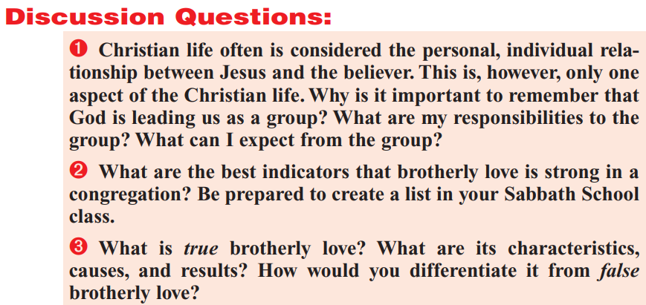

Slide 3
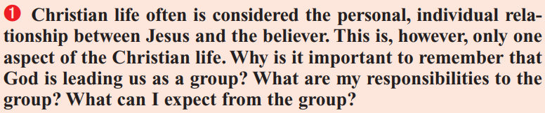
Hebrews 10:22-25
²² Let us draw near with a true heart in full assurance of faith, having our hearts sprinkled from an evil conscience, and our bodies washed with pure water.
²³ Let us hold fast the profession of our faith without wavering; (for he is faithful that promised;)
²⁴ And let us consider one another to provoke unto love and to good works:
²⁵ Not forsaking the assembling of ourselves together, as the manner of some is; but exhorting one another: and so much the more, as ye see the day approaching.

Slide 4
Genesis 7:1-5
7 And the Lord said unto Noah, Come thou and all thy house into the ark; for thee have I seen righteous before me in this generation.
² Of every clean beast thou shalt take to thee by sevens, the male and his female: and of beasts that are not clean by two, the male and his female.
³ Of fowls also of the air by sevens, the male and the female; to keep seed alive upon the face of all the earth.
⁴ For yet seven days, and I will cause it to rain upon the earth forty days and forty nights; and every living substance that I have made will I destroy from off the face of the earth.
⁵ And Noah did according unto all that the Lord commanded him.

Slide 5
Genesis 7:6-9
⁶ And Noah was six hundred years old when the flood of waters was upon the earth.
⁷ And Noah went in, and his sons, and his wife, and his sons' wives with him, into the ark, because of the waters of the flood.
⁸ Of clean beasts, and of beasts that are not clean, and of fowls, and of every thing that creepeth upon the earth,
⁹ There went in two and two unto Noah into the ark, the male and the female, as God had commanded Noah.

Slide 6
Genesis 7:10-13
¹⁰ And it came to pass after seven days, that the waters of the flood were upon the earth.
¹¹ In the six hundredth year of Noah's life, in the second month, the seventeenth day of the month, the same day were all the fountains of the great deep broken up, and the windows of heaven were opened.
¹² And the rain was upon the earth forty days and forty nights.
¹³ In the selfsame day entered Noah, and Shem, and Ham, and Japheth, the sons of Noah, and Noah's wife, and the three wives of his sons with them, into the ark;

Slide 7
Genesis 7:14-16
¹⁴ They, and every beast after his kind, and all the cattle after their kind, and every creeping thing that creepeth upon the earth after his kind, and every fowl after his kind, every bird of every sort.
¹⁵ And they went in unto Noah into the ark, two and two of all flesh, wherein is the breath of life.
¹⁶ And they that went in, went in male and female of all flesh, as God had commanded him: and the Lord shut him in.

Slide 8
Joshua 2:1-3
2 And Joshua the son of Nun sent out of Shittim two men to spy secretly, saying, Go view the land, even Jericho. And they went, and came into an harlot's house, named Rahab, and lodged there.
² And it was told the king of Jericho, saying, Behold, there came men in hither to night of the children of Israel to search out the country.
³ And the king of Jericho sent unto Rahab, saying, Bring forth the men that are come to thee, which are entered into thine house: for they be come to search out all the country.

Slide 9
Joshua 2:9-11
⁹ And she said unto the men, I know that the Lord hath given you the land, and that your terror is fallen upon us, and that all the inhabitants of the land faint because of you.
¹⁰ For we have heard how the Lord dried up the water of the Red sea for you, when ye came out of Egypt; and what ye did unto the two kings of the Amorites, that were on the other side Jordan, Sihon and Og, whom ye utterly destroyed.
¹¹ And as soon as we had heard these things, our hearts did melt, neither did there remain any more courage in any man, because of you: for the Lord your God, he is God in heaven above, and in earth beneath..

Slide 10
Joshua 2:12-14
¹² Now therefore, I pray you, swear unto me by the Lord, since I have shewed you kindness, that ye will also shew kindness unto my father's house, and give me a true token:
¹³ And that ye will save alive my father, and my mother, and my brethren, and my sisters, and all that they have, and deliver our lives from death.
¹⁴ And the men answered her, Our life for yours, if ye utter not this our business. And it shall be, when the Lord hath given us the land, that we will deal kindly and truly with thee.

Slide 11
Joshua 2:17-19
¹⁷ And the men said unto her, We will be blameless of this thine oath which thou hast made us swear.
¹⁸ Behold, when we come into the land, thou shalt bind this line of scarlet thread in the window which thou didst let us down by: and thou shalt bring thy father, and thy mother, and thy brethren, and all thy father's household, home unto thee.
¹⁹ And it shall be, that whosoever shall go out of the doors of thy house into the street, his blood shall be upon his head, and we will be guiltless: and whosoever shall be with thee in the house, his blood shall be on our head, if any hand be upon him.

Slide 12
Exodus 12:21-23
²¹ Then Moses called for all the elders of Israel, and said unto them, Draw out and take you a lamb according to your families, and kill the passover.
²² And ye shall take a bunch of hyssop, and dip it in the blood that is in the bason, and strike the lintel and the two side posts with the blood that is in the bason; and none of you shall go out at the door of his house until the morning.
²³ For the Lord will pass through to smite the Egyptians; and when he seeth the blood upon the lintel, and on the two side posts, the Lord will pass over the door, and will not suffer the destroyer to come in unto your houses to smite you.

Slide 13
There are a number of occasions in the Bible when God directed that people take shelter within a chosen structure. As we see in Hebrews 10 (and any number of other places within the New Testament), the structure in which God has chosen to shelter His people today is His church! That is, God is “leading us as a group” because we actually are a group—a church group! The church gives us refuge in a wacky world as well as providing various important kinds of discipline, help, instruction, and accountability. The last two questions here are sadly suggestive of self-interest, so it’s worth simply taking a look at a time when the church was as it ought to be!

Slide 14
Acts 4:31-32
³¹ And when they had prayed, the place was shaken where they were assembled together; and they were all filled with the Holy Ghost, and they spake the word of God with boldness.
³² And the multitude of them that believed were of one heart and of one soul: neither said any of them that ought of the things which he possessed was his own; but they had all things common.

Slide 15
Acts 4:33-34
³³ And with great power gave the apostles witness of the resurrection of the Lord Jesus: and great grace was upon them all.
³⁴ Neither was there any among them that lacked: for as many as were possessors of lands or houses sold them, and brought the prices of the things that were sold,

Slide 16
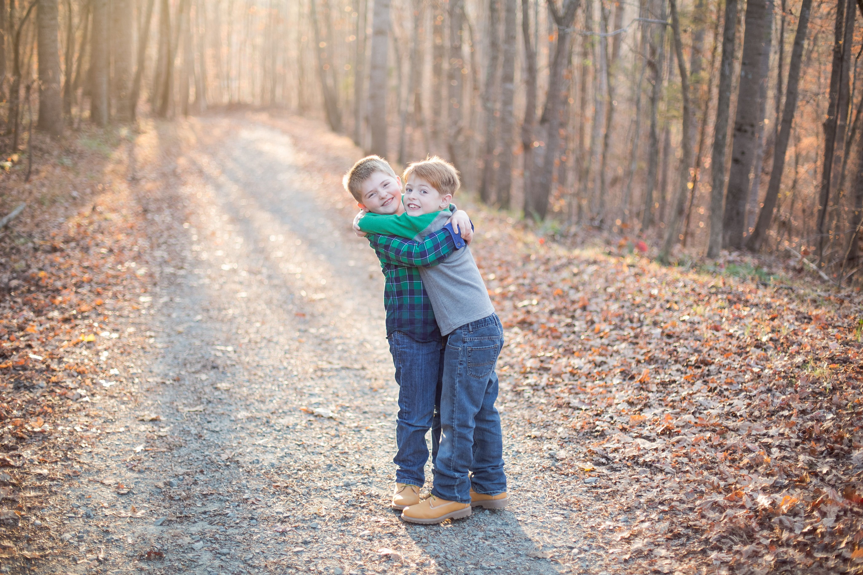
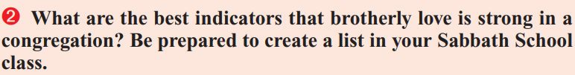

Slide 17
Hebrews 10:24-25
²⁴ And let us consider one another to provoke unto love and to good works:
²⁵ Not forsaking the assembling of ourselves together, as the manner of some is; but exhorting one another: and so much the more, as ye see the day approaching.
Provoking to love
Provoking to good works
Exhorting (urging, requiring more of) one another

Slide 18
Hebrews 13:1-3
13 Let brotherly love continue.
² Be not forgetful to entertain strangers: for thereby some have entertained angels unawares.
³ Remember them that are in bonds, as bound with them; and them which suffer adversity, as being yourselves also in the body.
Offering conspicuous hospitality
Offering support to those suffering for their faith
Offering support to those who are imprisoned for their faith

Slide 19
Hebrews 13:4-6
⁴ Marriage is honourable in all, and the bed undefiled: but whoremongers and adulterers God will judge.
⁵ Let your conversation be without covetousness; and be content with such things as ye have: for he hath said, I will never leave thee, nor forsake thee.
⁶ So that we may boldly say, The Lord is my helper, and I will not fear what man shall do unto me.
Practicing sexual morality
No covetousness—contentment with what we have
Boldness, lack of fear

Slide 20
Hebrews 13:7-8
⁷ Remember them which have the rule over you, who have spoken unto you the word of God: whose faith follow, considering the end of their conversation.
⁸ Jesus Christ the same yesterday, and to day, and for ever.
Conscientiously respecting our leaders, particularly those who speak the word of God and bear good fruits
Unchanging conviction, holding the line

Slide 21
Hebrews 13:9-10
⁹ Be not carried about with divers and strange doctrines. For it is a good thing that the heart be established with grace; not with meats, which have not profited them that have been occupied therein.
¹⁰ We have an altar, whereof they have no right to eat which serve the tabernacle.
Not easily influenced by new or strange teachings, so as not to be “carried about” by fads in religion or theology
Maintaining focus on true priorities

Slide 22
Hebrews 13:11-13
¹¹ For the bodies of those beasts, whose blood is brought into the sanctuary by the high priest for sin, are burned without the camp.
¹² Wherefore Jesus also, that he might sanctify the people with his own blood, suffered without the gate.
¹³ Let us go forth therefore unto him without the camp, bearing his reproach.
Willingness to suffer shame and abuse for our faith
Willingness to be peculiar and set apart, that is, outside the camp.

Slide 23
Hebrews 13:14-16
¹⁴ For here have we no continuing city, but we seek one to come.
¹⁵ By him therefore let us offer the sacrifice of praise to God continually, that is, the fruit of our lips giving thanks to his name.
¹⁶ But to do good and to communicate forget not: for with such sacrifices God is well pleased.
Accepting that we have no security aside from Christ
Constant praise and thanksgiving to God
Sacrificial ministering to the needs of others

Slide 24
Hebrews 13:17-19
¹⁷ Obey them that have the rule over you, and submit yourselves: for they watch for your souls, as they that must give account, that they may do it with joy, and not with grief: for that is unprofitable for you.
¹⁸ Pray for us: for we trust we have a good conscience, in all things willing to live honestly.
¹⁹ But I beseech you the rather to do this, that I may be restored to you the sooner.
Cooperation with leaders for their benefit as well as the benefit of the church
Constant prayer, especially for the leaders of the church

Slide 25
Hebrews 13:17-19
²⁰ Now the God of peace, that brought again from the dead our Lord Jesus, that great shepherd of the sheep, through the blood of the everlasting covenant,
²¹ Make you perfect in every good work to do his will, working in you that which is wellpleasing in his sight, through Jesus Christ; to whom be glory for ever and ever. Amen.
²² And I beseech you, brethren, suffer the word of exhortation: for I have written a letter unto you in few words.

Slide 26
Indicators that brotherly love is strong (1):
Provoking to love
Provoking to good works
Exhorting (urging, requiring more of) one another
Offering conspicuous hospitality
Offering support to those suffering for their faith
Offering support to those who are imprisoned for their faith
Practicing sexual morality
No covetousness—contentment with what we have
Boldness, lack of fear

Slide 27
Indicators that brotherly love is strong (2):
Conscientiously respecting our leaders, particularly those who speak the word of God and bear good fruits
Unchanging conviction, holding the line
Not easily influenced by new or strange teachings, so as not to be “carried about” by fads in religion or theology
Maintaining focus on true priorities
Willingness to suffer shame and abuse for our faith
Willingness to be peculiar and set apart, that is, outside the camp.

Slide 28
Indicators that brotherly love is strong (3):
Accepting that we have no security aside from Christ
Constant praise and thanksgiving to God
Sacrificial ministering to the needs of others
Cooperation with leaders for their benefit as well as the benefit of the church
Constant prayer, especially for the leaders of the church

Slide 29
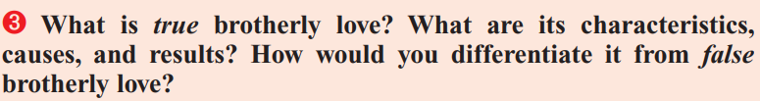
Luke 10:27 And he answering said, Thou shalt love the Lord thy God with all thy heart, and with all thy soul, and with all thy strength, and with all thy mind; and thy neighbour as thyself.
1 John 3:17-18 But whoso hath this world's good, and seeth his brother have need, and shutteth up his bowels of compassion from him, how dwelleth the love of God in him? My little children, let us not love in word, neither in tongue; but in deed and in truth.
John 15:12-13 This is my commandment, That ye love one another, as I have loved you. Greater love hath no man than this, that a man lay down his life for his friends.

Slide 30
John 15:8-11 Herein is my Father glorified, that ye bear much fruit; so shall ye be my disciples. As the Father hath loved me, so have I loved you: continue ye in my love. If ye keep my commandments, ye shall abide in my love; even as I have kept my Father's commandments, and abide in his love. These things have I spoken unto you, that my joy might remain in you, and that your joy might be full.
1John 4:7-9 Beloved, let us love one another: for love is of God; and every one that loveth is born of God, and knoweth God. He that loveth not knoweth not God; for God is love. In this was manifested the love of God toward us, because that God sent his only begotten Son into the world, that we might live through him.

Slide 31
1 Corinthians 13:4-8, 13
⁴ Charity suffereth long, and is kind; charity envieth not; charity vaunteth not itself, is not puffed up,
⁵ Doth not behave itself unseemly, seeketh not her own, is not easily provoked, thinketh no evil;
⁶ Rejoiceth not in iniquity, but rejoiceth in the truth;
⁷ Beareth all things, believeth all things, hopeth all things, endureth all things.
⁸ Charity never faileth: but whether there be prophecies, they shall fail; whether there be tongues, they shall cease; whether there be knowledge, it shall vanish away.
¹³ And now abideth faith, hope, charity, these three; but the greatest of these is charity.

