Slide 1
Part of God’s Family
Psalm 50, 106, 113, Galatians 3, Matthew 6
Lesson 1, 1st Quarter 2023

Slide 2
Memory Text: 1 John 3:1
3 Behold, what manner of love the Father hath bestowed upon us, that we should be called the sons of God: therefore the world knoweth us not, because it knew him not.

Slide 3
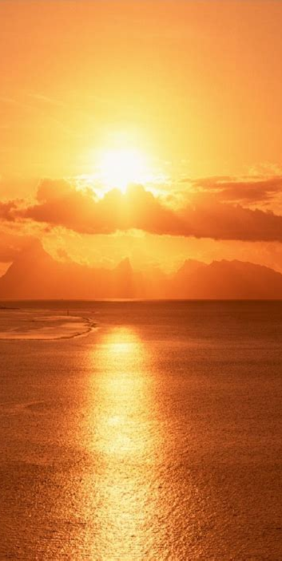
All Things are Made by Him
Psalm 50:1-23
50 The mighty God, even the Lord, hath spoken, and called the earth from the rising of the sun unto the going down thereof.
² Out of Zion, the perfection of beauty, God hath shined.
³ Our God shall come, and shall not keep silence: a fire shall devour before him, and it shall be very tempestuous round about him.

Slide 4
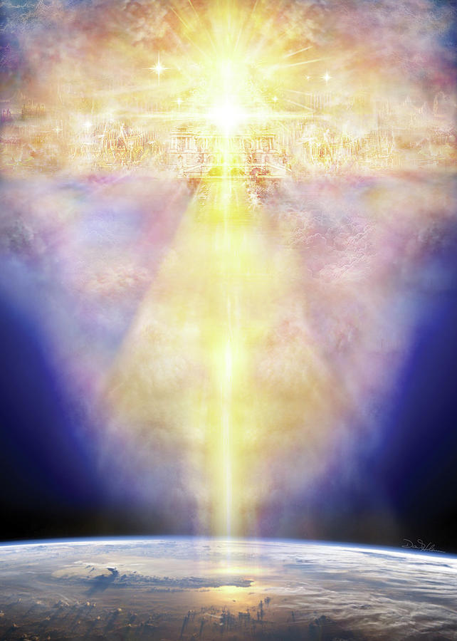
All Things are Made by Him
Psalm 50:4-23
⁴ He shall call to the heavens from above, and to the earth, that he may judge his people.
⁵ Gather my saints together unto me; those that have made a covenant with me by sacrifice.
⁶ And the heavens shall declare his righteousness: for God is judge himself. Selah.

Slide 5
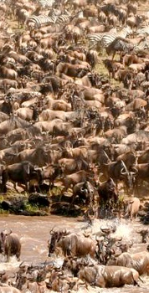
All Things are Made by Him
Psalm 50:7-23
⁷ Hear, O my people, and I will speak; O Israel, and I will testify against thee: I am God, even thy God.
⁸ I will not reprove thee for thy sacrifices or thy burnt offerings, to have been continually before me.
⁹ I will take no bullock out of thy house, nor he goats out of thy folds.
¹⁰ For every beast of the forest is mine, and the cattle upon a thousand hills.

Slide 6
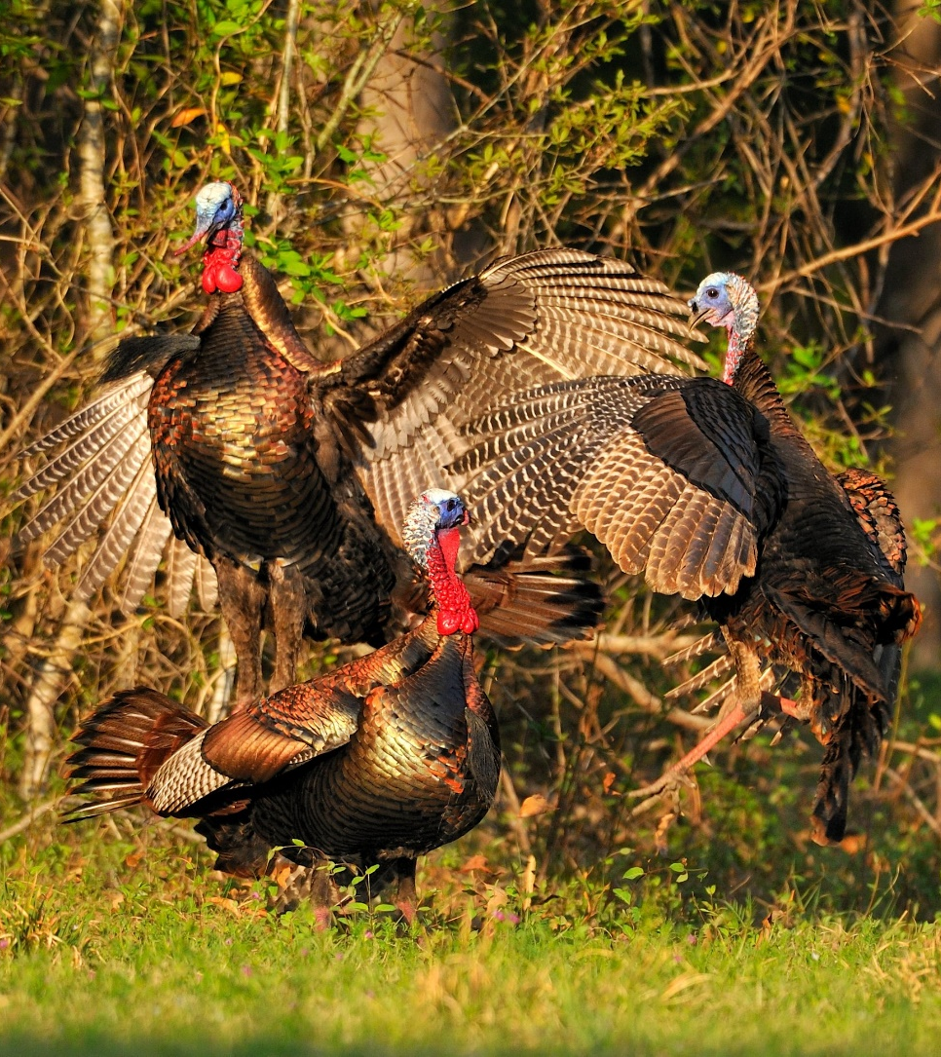
All Things are Made by Him
Psalm 50:11-23
¹¹ I know all the fowls of the mountains: and the wild beasts of the field are mine.
¹² If I were hungry, I would not tell thee: for the world is mine, and the fulness thereof.
¹³ Will I eat the flesh of bulls, or drink the blood of goats?

Slide 7
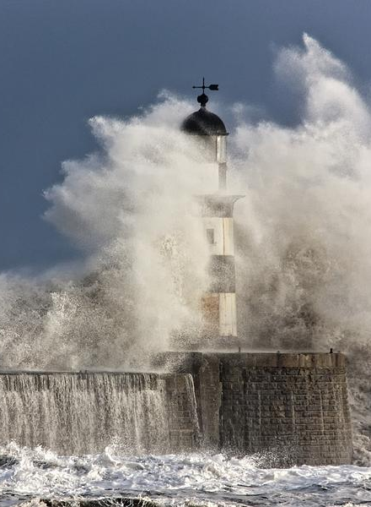
All Things are Made by Him
Psalm 50:14-23
¹⁴ Offer unto God thanksgiving; and pay thy vows unto the most High:
¹⁵ And call upon me in the day of trouble: I will deliver thee, and thou shalt glorify me.
¹⁶ But unto the wicked God saith, What hast thou to do to declare my statutes, or that thou shouldest take my covenant in thy mouth?

Slide 8
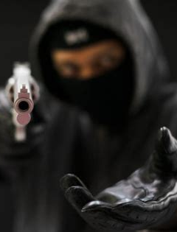
All Things are Made by Him
Psalm 50:17-23
¹⁷ Seeing thou hatest instruction, and casteth my words behind thee.
¹⁸ When thou sawest a thief, then thou consentedst with him, and hast been partaker with adulterers.
¹⁹ Thou givest thy mouth to evil, and thy tongue frameth deceit.

Slide 9
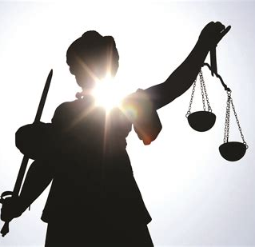
All Things are Made by Him
Psalm 50:20-23
²⁰ Thou sittest and speakest against thy brother; thou slanderest thine own mother's son.
²¹ These things hast thou done, and I kept silence; thou thoughtest that I was altogether such an one as thyself: but I will reprove thee, and set them in order before thine eyes.

Slide 10
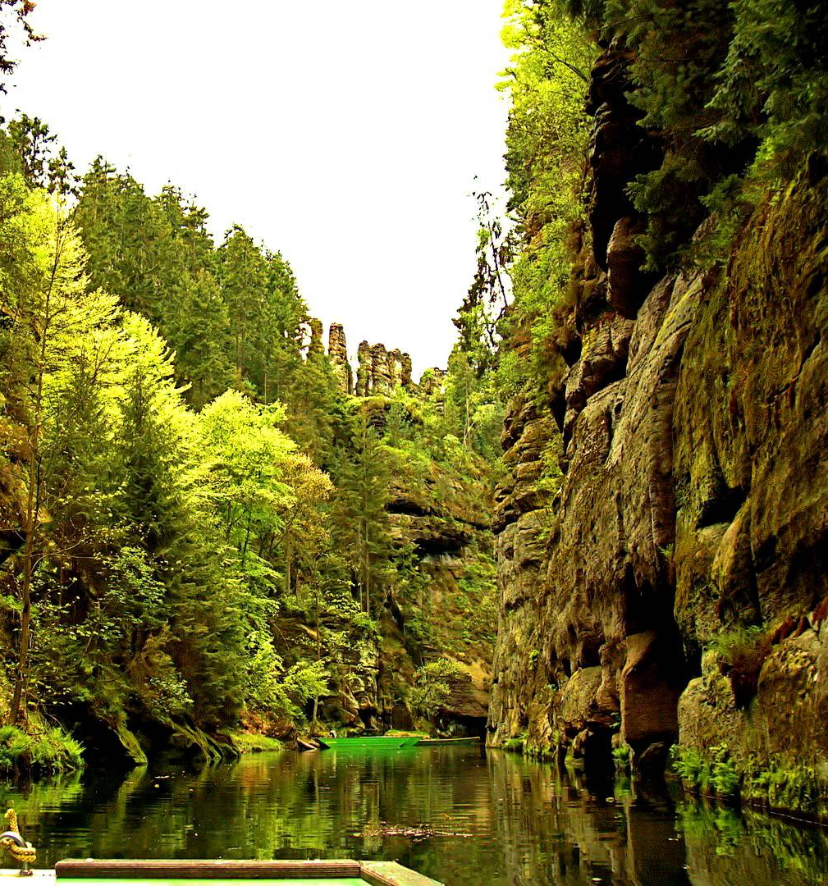
All Things are Made by Him
Psalm 50:22-23
²² Now consider this, ye that forget God, lest I tear you in pieces, and there be none to deliver.
²³ Whoso offereth praise glorifieth me: and to him that ordereth his conversation aright will I shew the salvation of God.

Slide 11
EGW: The Upward Look, pg. 327
God speaks to us in nature. It is His voice we hear as we gaze upon the beauty and richness of the natural world. We view His glory in the beauteous things His hand has made. We stand and behold His works without a veil between. God has given us these things that in beholding the works of His hands we may learn of Him.
God has given us these precious things as an expression of His love. The Lord is a lover of the beautiful, and to please and gratify us He has spread before us the beauties of nature, even as an earthly parent seeks to place beautiful things before the children that he loves.

Slide 12

EGW: The Upward Look, pg. 327
God speaks to us in nature. It is His voice we hear as we gaze upon the beauty and richness of the natural world. We view His glory in the beauteous things His hand has made. We stand and behold His works without a veil between. God has given us these things that in beholding the works of His hands we may learn of Him.
God has given us these precious things as an expression of His love. The Lord is a lover of the beautiful, and to please and gratify us He has spread before us the beauties of nature, even as an earthly parent seeks to place beautiful things before the children that he loves.

Slide 13
EGW: The Upward Look, pg. 327
The Lord is always pleased to see us happy. Sinful as it is with all its imperfections, the Lord has lavished upon this earth the useful and the beautiful. The beautiful, tinted flowers tell of His tenderness and love. They have a language of their own, reminding us of the Giver.
We may look up through nature to nature's God. In the beautiful, lofty trees, the shrubs, the flowers, God reveals His character. He is to be compared to the most beautiful lilies and roses and pinks.

Slide 14
The Covenant: Gratitude and Praise
Psalm 106:1-24, 43-48
106 Praise ye the Lord. O give thanks unto the Lord; for he is good: for his mercy endureth for ever.
² Who can utter the mighty acts of the Lord? who can shew forth all his praise?
³ Blessed are they that keep judgment, and he that doeth righteousness at all times.

Slide 15
The Covenant: Gratitude and Praise
Psalm 106:1-24, 43-48
⁴ Remember me, O Lord, with the favour that thou bearest unto thy people: O visit me with thy salvation;
⁵ That I may see the good of thy chosen, that I may rejoice in the gladness of thy nation, that I may glory with thine inheritance.
⁶ We have sinned with our fathers, we have committed iniquity, we have done wickedly.

Slide 16
The Covenant: Gratitude and Praise
Psalm 106:1-24, 43-48
⁷ Our fathers understood not thy wonders in Egypt; they remembered not the multitude of thy mercies; but provoked him at the sea, even at the Red sea.
⁸ Nevertheless he saved them for his name's sake, that he might make his mighty power to be known.
⁹ He rebuked the Red sea also, and it was dried up: so he led them through the depths, as through the wilderness.

Slide 17
The Covenant: Gratitude and Praise
Psalm 106:1-24, 43-48
¹⁰ And he saved them from the hand of him that hated them, and redeemed them from the hand of the enemy.
¹¹ And the waters covered their enemies: there was not one of them left.
¹² Then believed they his words; they sang his praise.
¹³ They soon forgat his works; they waited not for his counsel:

Slide 18
The Covenant: Gratitude and Praise
Psalm 106:1-24, 43-48
¹⁴ But lusted exceedingly in the wilderness, and tempted God in the desert.
¹⁵ And he gave them their request; but sent leanness into their soul.
¹⁶ They envied Moses also in the camp, and Aaron the saint of the Lord.
¹⁷ The earth opened and swallowed up Dathan and covered the company of Abiram.

Slide 19
The Covenant: Gratitude and Praise
Psalm 106:1-24, 43-48
¹⁸ And a fire was kindled in their company; the flame burned up the wicked.
¹⁹ They made a calf in Horeb, and worshipped the molten image.
²⁰ Thus they changed their glory into the similitude of an ox that eateth grass.
²¹ They forgat God their saviour, which had done great things in Egypt;

Slide 20
The Covenant: Gratitude and Praise
Psalm 106:1-24, 43-48
²² Wondrous works in the land of Ham, and terrible things by the Red sea.
²³ Therefore he said that he would destroy them, had not Moses his chosen stood before him in the breach, to turn away his wrath, lest he should destroy them.
²⁴ Yea, they despised the pleasant land, they believed not his word:

Slide 21
The Covenant: Gratitude and Praise
Psalm 106:1-24, 43-48
⁴³ Many times did he deliver them; but they provoked him with their counsel, and were brought low for their iniquity.
⁴⁴ Nevertheless he regarded their affliction, when he heard their cry:
⁴⁵ And he remembered for them his covenant, and repented according to the multitude of his mercies.

Slide 22
The Covenant: Gratitude and Praise
Psalm 106:1-24, 43-48
⁴⁶ He made them also to be pitied of all those that carried them captives.
⁴⁷ Save us, O Lord our God, and gather us from among the heathen, to give thanks unto thy holy name, and to triumph in thy praise.
⁴⁸ Blessed be the Lord God of Israel from everlasting to everlasting: and let all the people say, Amen. Praise ye the Lord.

Slide 23
The Covenant: Gratitude and Praise
Psalm 117
117 O praise the Lord, all ye nations: praise him, all ye people.
² For his merciful kindness is great toward us: and the truth of the Lord endureth for ever. Praise ye the Lord.

Slide 24
EGW: “Our High Calling,” pg. 45
Oh, we do not comprehend the value of the atonement! If we did, we would talk more about it. The gift of God in His beloved Son was the expression of an incomprehensible love. It was the utmost that God could do to preserve the honor of His law, and still save the transgressor.

Slide 25
The Covenant: Gratitude and Praise
Revelation 4:11
¹¹ Thou art worthy, O Lord, to receive glory and honour and power: for thou hast created all things, and for thy pleasure they are and were created.

Slide 26
The Covenant: Gratitude and Praise
Psalm 113
113 Praise ye the Lord. Praise, O ye servants of the Lord, praise the name of the Lord.
² Blessed be the name of the Lord from this time forth and for evermore.
³ From the rising of the sun unto the going down of the same the Lord's name is to be praised.
⁴ The Lord is high above all nations, and his glory above the heavens.

Slide 27
The Covenant: Gratitude and Praise
Psalm 113
⁵ Who is like unto the Lord our God, who dwelleth on high,
⁶ Who humbleth himself to behold the things that are in heaven, and in the earth!
⁷ He raiseth up the poor out of the dust, and lifteth the needy out of the dunghill;
⁸ That he may set him with princes, even with the princes of his people.

Slide 28
The Covenant: Gratitude and Praise
Psalm 113
⁹ He maketh the barren woman to keep house, and to be a joyful mother of children. Praise ye the Lord.

Slide 29
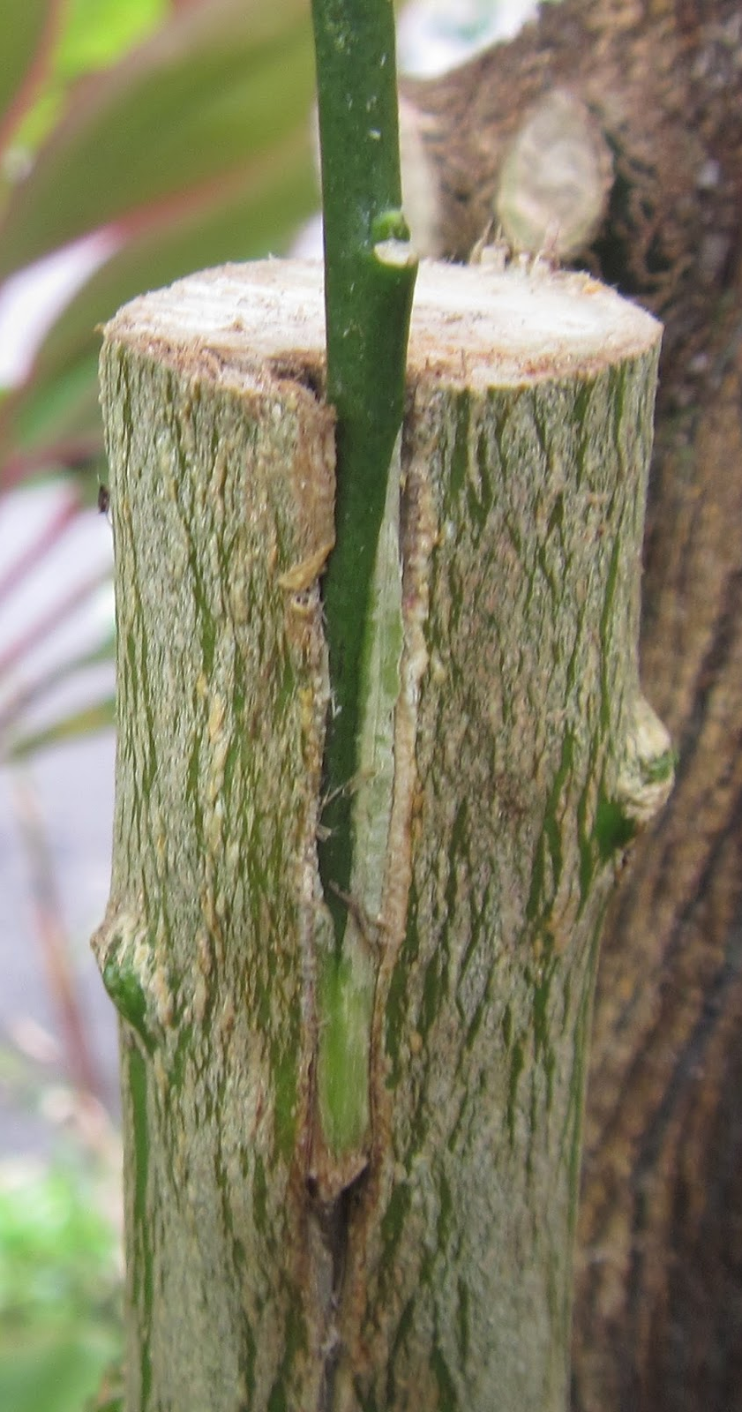
Grafted Into the Covenant
Galatians 3:6-9
⁶ Even as Abraham believed God, and it was accounted to him for righteousness.
⁷ Know ye therefore that they which are of faith, the same are the children of Abraham.
⁸ And the scripture, foreseeing that God would justify the heathen through faith, preached before the gospel unto Abraham, saying, In thee shall all nations be blessed.
⁹ So then they which be of faith are blessed with faithful Abraham.

Slide 30
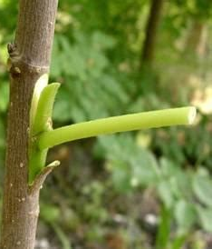
Grafted Into the Covenant
Galatians 3:14-17
¹⁴ That the blessing of Abraham might come on the Gentiles through Jesus Christ; that we might receive the promise of the Spirit through faith.
¹⁵ Brethren, I speak after the manner of men; Though it be but a man's covenant, yet if it be confirmed, no man disannulleth, or addeth thereto.

Slide 31
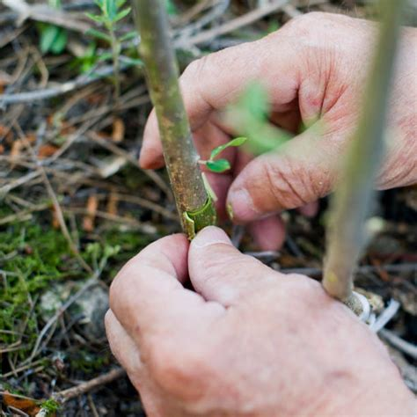
Grafted Into the Covenant
Galatians 3:16-17
¹⁶ Now to Abraham and his seed were the promises made. He saith not, And to seeds, as of many; but as of one, And to thy seed, which is Christ.
¹⁷ And this I say, that the covenant, that was confirmed before of God in Christ, the law, which was four hundred and thirty years after, cannot disannul, that it should make the promise of none effect.

Slide 32
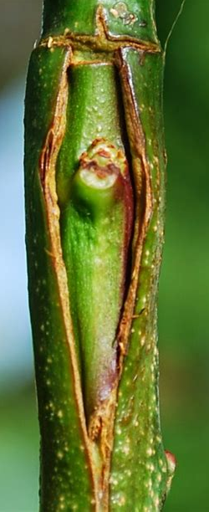
Grafted Into the Covenant
Galatians 3:26-29
²⁶ For ye are all the children of God by faith in Christ Jesus.
²⁷ For as many of you as have been baptized into Christ have put on Christ.

Slide 33
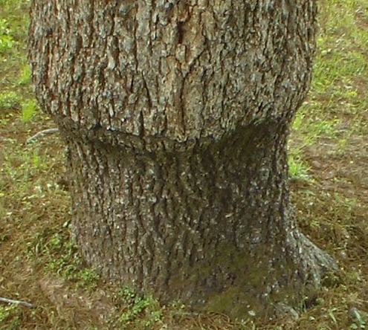
Grafted Into the Covenant
Galatians 3:28-29
²⁸ There is neither Jew nor Greek, there is neither bond nor free, there is neither male nor female: for ye are all one in Christ Jesus.
²⁹ And if ye be Christ's, then are ye Abraham's seed, and heirs according to the promise.

Slide 34
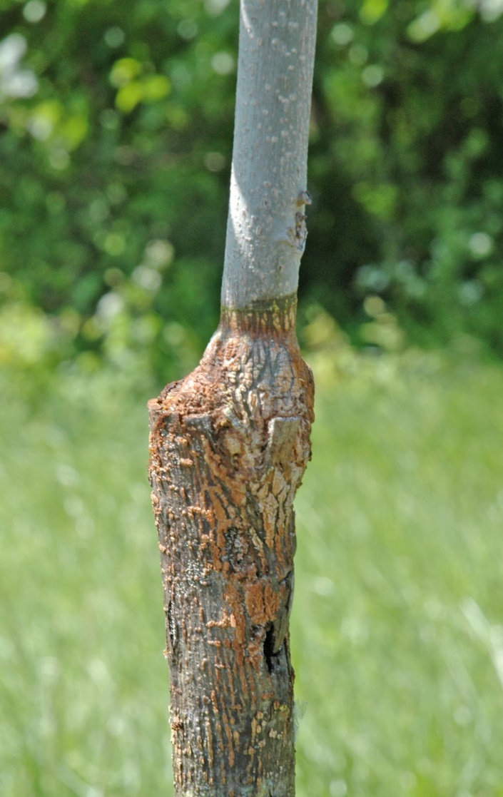
Grafted Into the Covenant
Romans 11:1-14
11 I say then, Hath God cast away his people? God forbid. For I also am an Israelite, of the seed of Abraham, of the tribe of Benjamin.
² God hath not cast away his people which he foreknew. Wot ye not what the scripture saith of Elias? how he maketh intercession to God against Israel saying,

Slide 35
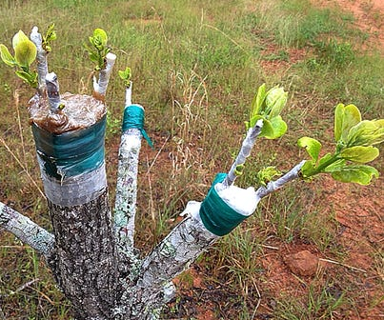
Grafted Into the Covenant
Romans 11:3-14
³ Lord, they have killed thy prophets, and digged down thine altars; and I am left alone, and they seek my life.
⁴ But what saith the answer of God unto him? I have reserved to myself seven thousand men, who have not bowed the knee to the image of Baal.
⁵ Even so then at this present time also there is a remnant according to the election of grace.

Slide 36
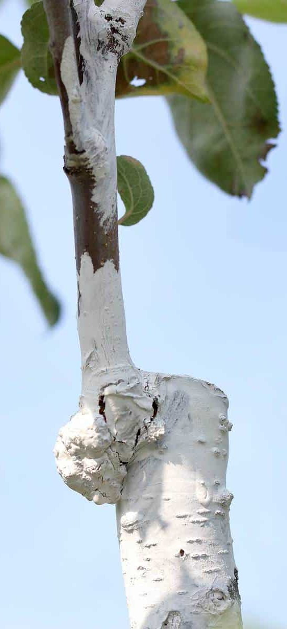
Grafted Into the Covenant
Romans 11:6-14
⁶ And if by grace, then is it no more of works: otherwise grace is no more grace. But if it be of works, then it is no more grace: otherwise work is no more work.
⁷ What then? Israel hath not obtained that which he seeketh for; but the election hath obtained it, and the rest were blinded.

Slide 37
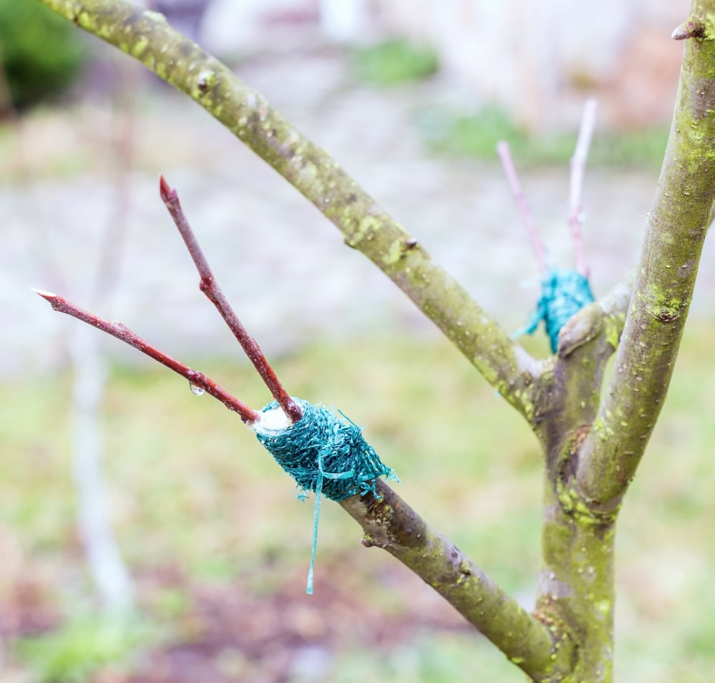
Grafted Into the Covenant
Romans 11:8-14
⁸ (According as it is written, God hath given them the spirit of slumber, eyes that they should not see, and ears that they should not hear;) unto this day.
⁹ And David saith, Let their table be made a snare, and a trap, and a stumblingblock, and a recompence unto them:
¹⁰ Let their eyes be darkened, that they may not see, and bow down their back alway.

Slide 38
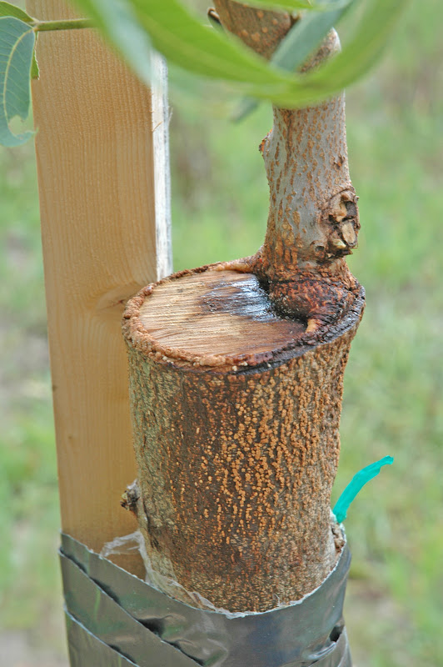
Grafted Into the Covenant
Romans 11:11-14
¹¹ I say then, Have they stumbled that they should fall? God forbid: but rather through their fall salvation is come unto the Gentiles, for to provoke them to jealousy.
¹² Now if the fall of them be the riches of the world, and the diminishing of them the riches of the Gentiles; how much more their fulness?

Slide 39
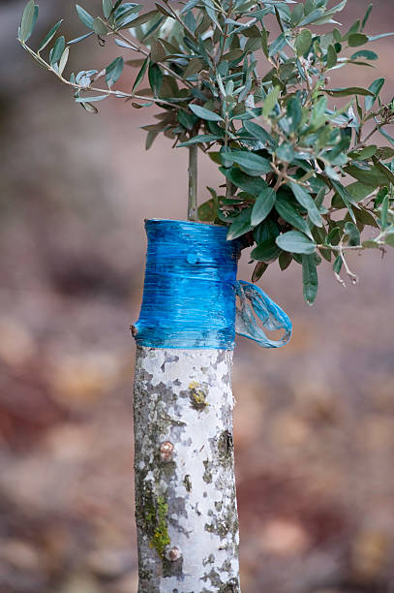
Grafted Into the Covenant
Romans 11:13-14
¹³ For I speak to you Gentiles, inasmuch as I am the apostle of the Gentiles, I magnify mine office:
¹⁴ If by any means I may provoke to emulation them which are my flesh, and might save some of them.

Slide 40
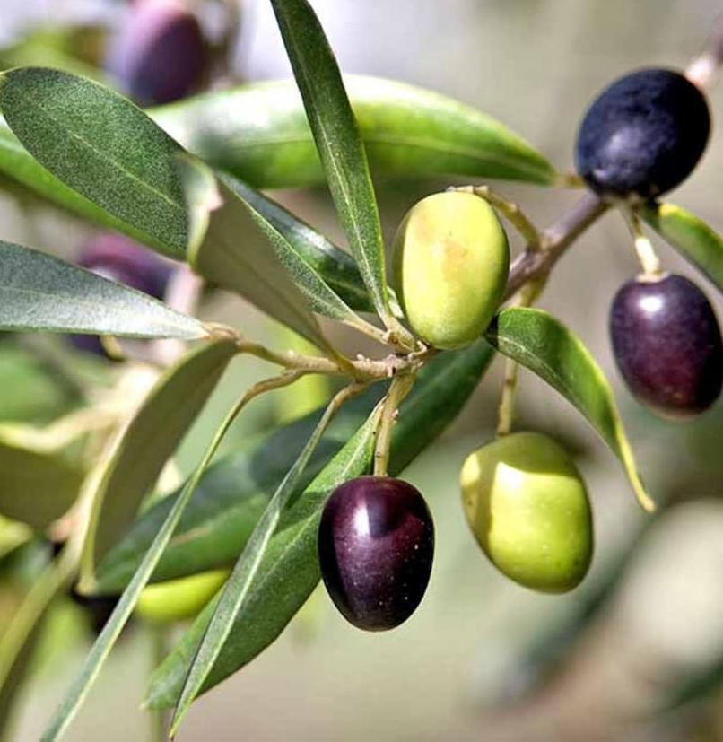
Grafted Into the Covenant
Romans 11:17-27
¹⁷ And if some of the branches be broken off, and thou, being a wild olive tree, wert grafted in among them, and with them partakest of the root and fatness of the olive tree;
¹⁸ Boast not against the branches. But if thou boast, thou bearest not the root, but the root thee.
¹⁹ Thou wilt say then, The branches were broken off, that I might be grafted in.

Slide 41
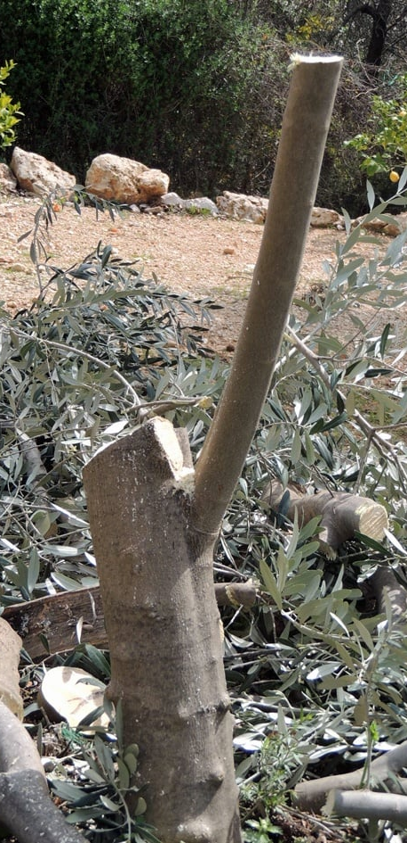
Grafted Into the Covenant
Romans 11:20-27
²⁰ Well; because of unbelief they were broken off, and thou standest by faith. Be not highminded, but fear:
²¹ For if God spared not the natural branches, take heed lest he also spare not thee.

Slide 42
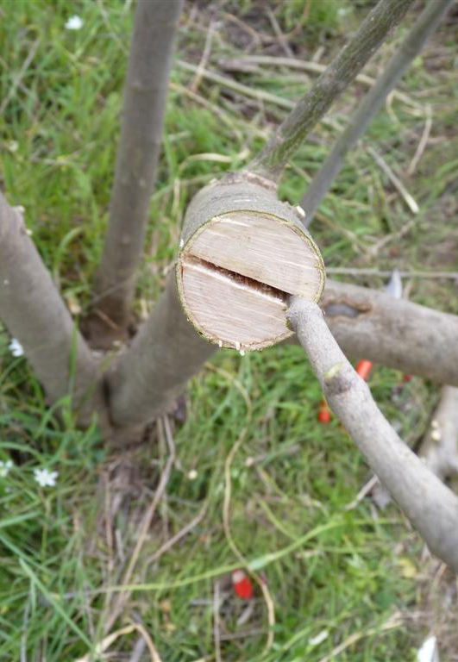
Grafted Into the Covenant
Romans 11:22-27
²² Behold therefore the goodness and severity of God: on them which fell, severity; but toward thee, goodness, if thou continue in his goodness: otherwise thou also shalt be cut off.
²³ And they also, if they abide not still in unbelief, shall be grafted in: for God is able to graft them in again.

Slide 43
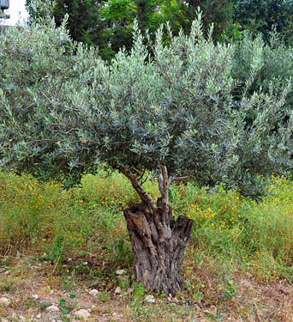
Grafted Into the Covenant
Romans 11:24-27
²⁴ For if thou wert cut out of the olive tree which is wild by nature, and wert grafted contrary to nature into a good olive tree: how much more shall these, which be the natural branches, be grafted into their own olive tree?
²⁵ For I would not, brethren, that ye should be ignorant of this mystery, lest ye should be wise in your own conceits; that blindness in part is happened to Israel, until the fulness of the Gentiles be come in.

Slide 44
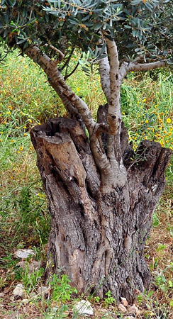
Grafted Into the Covenant
Romans 11:26-27
²⁶ And so all Israel shall be saved: as it is written, There shall come out of Sion the Deliverer, and shall turn away ungodliness from Jacob:
²⁷ For this is my covenant unto them, when I shall take away their sins.

Slide 45
EGW: Christ’s Object Lessons, pg. 317
Our privileges are far greater than were the privileges of God's ancient people. We have not only the great light committed to Israel, but we have the increased evidence of the great salvation brought to us through Christ. That which was type and symbol to the Jews is reality to us. They had the Old Testament history; we have that and the New Testament also. We have the assurance of a Saviour who has come, a Saviour who has been crucified, who has risen, and over the rent sepulcher of Joseph has proclaimed, “I am the resurrection and the life.”

Slide 46
EGW: Christ’s Object Lessons, pg. 317
In our knowledge of Christ and His love the kingdom of God is placed in the midst of us. Christ is revealed to us in sermons and chanted to us in songs. The spiritual banquet is set before us in rich abundance. The wedding garment, provided at infinite cost, is freely offered to every soul. By the messengers of God are presented to us the righteousness of Christ, justification by faith, the exceeding great and precious promises of God's word, free access to the Father by Christ, the comfort of the Spirit, the well-grounded assurance of eternal life in the kingdom of God. What could God do for us that He has not done in providing the great supper, the heavenly banquet?

Slide 47
Living in Gratitude
Matthew 6: 1, 5
6 Take heed that ye do not your alms before men, to be seen of them: otherwise ye have no reward of your Father which is in heaven.
…
⁵ And when thou prayest, thou shalt not be as the hypocrites are: for they love to pray standing in the synagogues and in the corners of the streets, that they may be seen of men. Verily I say unto you, They have their reward.

Slide 48
Living in Gratitude
Matthew 6: 6 - 8
⁶ But thou, when thou prayest, enter into thy closet, and when thou hast shut thy door, pray to thy Father which is in secret; and thy Father which seeth in secret shall reward thee openly.
⁷ But when ye pray, use not vain repetitions, as the heathen do: for they think that they shall be heard for their much speaking.
⁸ Be not ye therefore like unto them: for your Father knoweth what things ye have need of, before ye ask him.

Slide 49
Living in Gratitude
Matthew 6: 14-34
¹⁴ For if ye forgive men their trespasses, your heavenly Father will also forgive you:
¹⁵ But if ye forgive not men their trespasses, neither will your Father forgive your trespasses.
¹⁶ Moreover when ye fast, be not, as the hypocrites, of a sad countenance: for they disfigure their faces, that they may appear unto men to fast. Verily I say unto you, They have their reward.

Slide 50
Living in Gratitude
Matthew 6: 17-34
¹⁷ But thou, when thou fastest, anoint thine head, and wash thy face;
¹⁸ That thou appear not unto men to fast, but unto thy Father which is in secret: and thy Father, which seeth in secret, shall reward thee openly.
¹⁹ Lay not up for yourselves treasures upon earth, where moth and rust doth corrupt, and where thieves break through and steal:

Slide 51
Living in Gratitude
Matthew 6: 20-34
²⁰ But lay up for yourselves treasures in heaven, where neither moth nor rust doth corrupt, and where thieves do not break through nor steal:
²¹ For where your treasure is, there will your heart be also.
²² The light of the body is the eye: if therefore thine eye be single, thy whole body shall be full of light.

Slide 52
Living in Gratitude
Matthew 6: 23-34
²³ But if thine eye be evil, thy whole body shall be full of darkness. If therefore the light that is in thee be darkness, how great is that darkness!
²⁴ No man can serve two masters: for either he will hate the one, and love the other; or else he will hold to the one, and despise the other. Ye cannot serve God and mammon.

Slide 53
EGW: That I May Know Him, pg. 222
If the eye is single, if it is directed heavenward, the light of heaven will fill the soul, and earthly things will appear insignificant and uninviting. The purpose of the heart will be changed, and the admonition of Jesus will be heeded. You will lay up your treasure in heaven. Your thoughts will be fixed upon the great reward of eternity. All your plans will be made in reference to the future, immortal life. You will be drawn toward your treasure. You will not study your worldly interest, but in all your pursuits the silent inquiry will be, “Lord, what wilt thou have me to do?” (Acts 9:6). Bible religion will be woven into your daily life.

Slide 54
Living in Gratitude
Matthew 6: 25-34
²⁵ Therefore I say unto you, Take no thought for your life, what ye shall eat, or what ye shall drink; nor yet for your body, what ye shall put on. Is not the life more than meat, and the body than raiment?
²⁶ Behold the fowls of the air: for they sow not, neither do they reap, nor gather into barns; yet your heavenly Father feedeth them. Are ye not much better than they?

Slide 55
Living in Gratitude
Matthew 6: 27-34
²⁷ Which of you by taking thought can add one cubit unto his stature?
²⁸ And why take ye thought for raiment? Consider the lilies of the field, how they grow; they toil not, neither do they spin:
²⁹ And yet I say unto you, That even Solomon in all his glory was not arrayed like one of these.

Slide 56
Living in Gratitude
Matthew 6: 30-34
³⁰ Wherefore, if God so clothe the grass of the field, which to day is, and to morrow is cast into the oven, shall he not much more clothe you, O ye of little faith?
³¹ Therefore take no thought, saying, What shall we eat? or, What shall we drink? or, Wherewithal shall we be clothed?
³² (For after all these things do the Gentiles seek:) for your heavenly Father knoweth that ye have need of all these things.

Slide 57
Living in Gratitude
Matthew 6: 33-34
³³ But seek ye first the kingdom of God, and his righteousness; and all these things shall be added unto you.
³⁴ Take therefore no thought for the morrow: for the morrow shall take thought for the things of itself. Sufficient unto the day is the evil thereof.

Slide 58
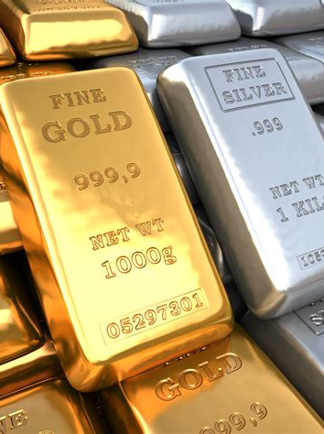
An OT Example
1 Chronicles 29:1-20
29 Furthermore David the king said unto all the congregation, Solomon my son, whom alone God hath chosen, is yet young and tender, and the work is great: for the palace is not for man, but for the Lord God.
² Now I have prepared with all my might for the house of my God the gold for things to be made of gold, and the silver for things of silver, and the brass for things of brass, the iron for things of iron, and wood for things of wood; onyx stones, and stones to be set, glistering stones, and of divers colours, and all manner of precious stones, and marble stones in abundance.

Slide 59
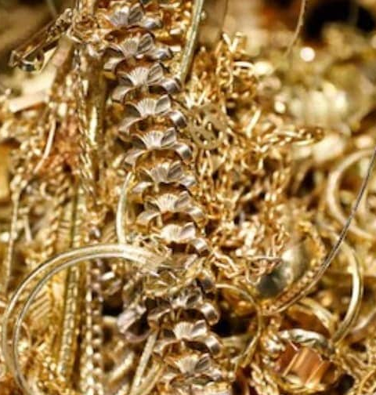
An OT Example
1 Chronicles 29:3-20
³ Moreover, because I have set my affection to the house of my God, I have of mine own proper good, of gold and silver, which I have given to the house of my God, over and above all that I have prepared for the holy house.
⁴ Even three thousand talents of gold, of the gold of Ophir, and seven thousand talents of refined silver, to overlay the walls of the houses withal:

Slide 60
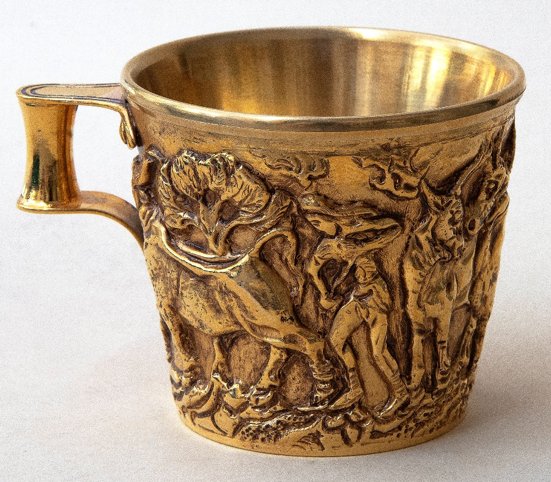
An OT Example
1 Chronicles 29:5-20
⁵ The gold for things of gold, and the silver for things of silver, and for all manner of work to be made by the hands of artificers. And who then is willing to consecrate his service this day unto the Lord?
⁶ Then the chief of the fathers and princes of the tribes of Israel and the captains of thousands and of hundreds, with the rulers of the king's work, offered willingly,

Slide 61
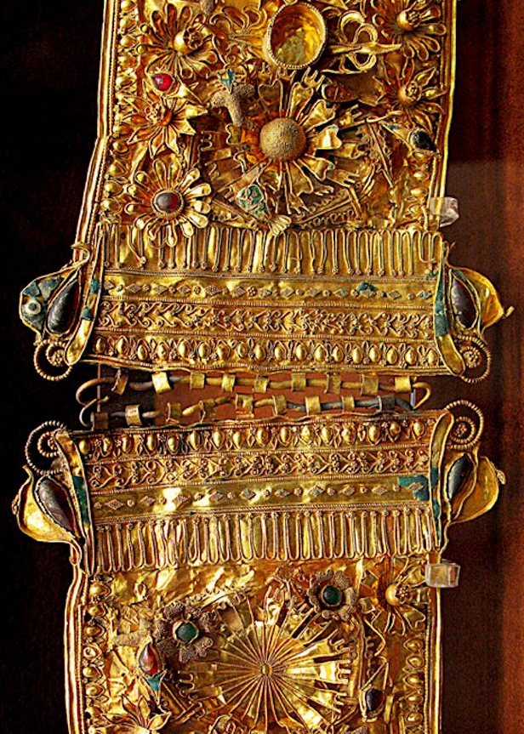
An OT Example
1 Chronicles 29:7-20
⁷ And gave for the service of the house of God of gold five thousand talents and ten thousand drams, and of silver ten thousand talents, and of brass eighteen thousand talents, and one hundred thousand talents of iron.
⁸ And they with whom precious stones were found gave them to the treasure of the house of the Lord, by the hand of Jehiel the Gershonite.

Slide 62
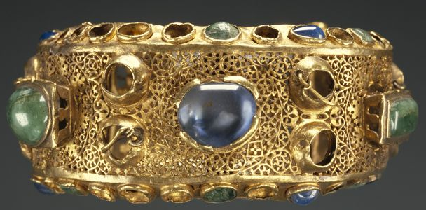
An OT Example
1 Chronicles 29:9-20
⁹ Then the people rejoiced, for that they offered willingly, because with perfect heart they offered willingly to the Lord: and David the king also rejoiced with great joy.
¹⁰ Wherefore David blessed the Lord before all the congregation: and David said, Blessed be thou, Lord God of Israel our father, for ever and ever.

Slide 63
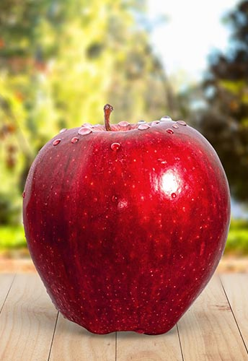
An OT Example
1 Chronicles 29:11-20
¹¹ Thine, O Lord is the greatness, and the power, and the glory, and the victory, and the majesty: for all that is in the heaven and in the earth is thine; thine is the kingdom, O Lord, and thou art exalted as head above all.
¹² Both riches and honour come of thee, and thou reignest over all; and in thine hand is power and might; and in thine hand it is to make great, and to give strength unto all.
¹³ Now therefore, our God, we thank thee, and praise thy glorious name.

Slide 64
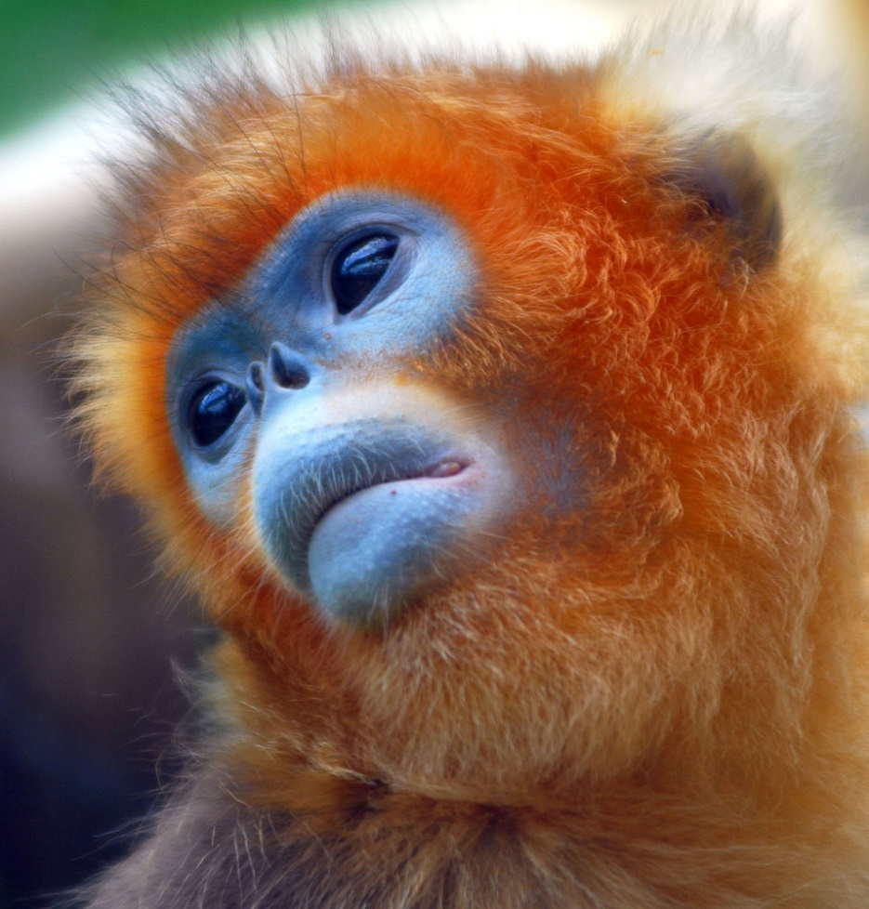
An OT Example
1 Chronicles 29:14-20
¹⁴ But who am I, and what is my people, that we should be able to offer so willingly after this sort? for all things come of thee, and of thine own have we given thee.
¹⁵ For we are strangers before thee, and sojourners, as were all our fathers: our days on the earth are as a shadow, and there is none abiding.

Slide 65
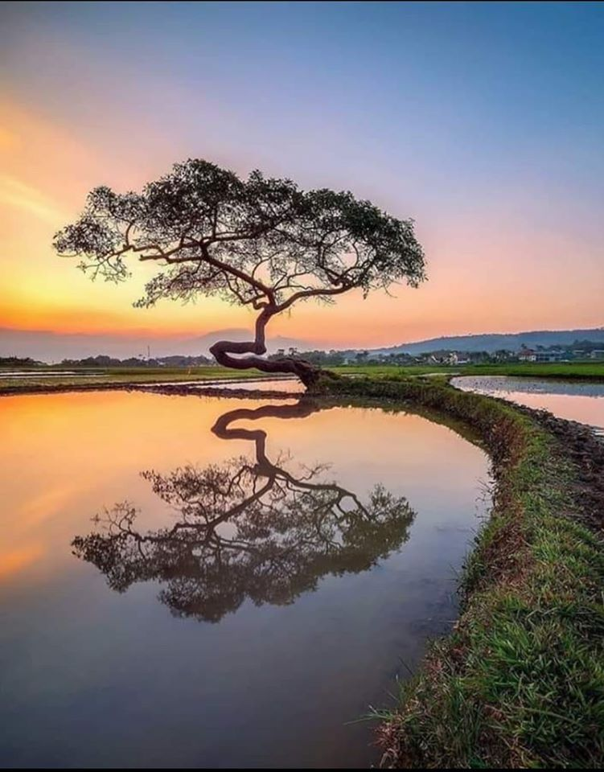
An OT Example
1 Chronicles 29:16-20
¹⁶ O Lord our God, all this store that we have prepared to build thee an house for thine holy name cometh of thine hand, and is all thine own.
¹⁷ I know also, my God, that thou triest the heart, and hast pleasure in uprightness. As for me, in the uprightness of mine heart I have willingly offered all these things: and now have I seen with joy thy people, which are present here, to offer willingly unto thee.

Slide 66

An OT Example
1 Chronicles 29:18-20
¹⁸ O Lord God of Abraham, Isaac, and of Israel, our fathers, keep this for ever in the imagination of the thoughts of the heart of thy people, and prepare their heart unto thee:

Slide 67

An OT Example
1 Chronicles 29:19-20
¹⁹ And give unto Solomon my son a perfect heart, to keep thy commandments, thy testimonies, and thy statutes, and to do all these things, and to build the palace, for the which I have made provision.
²⁰ And David said to all the congregation, Now bless the Lord your God. And all the congregation blessed the Lord God of their fathers, and bowed down their heads, and worshipped the Lord, and the king.

Slide 68
EGW: Patriarchs and Prophets, pg. 753
All that man receives of God's bounty still belongs to God. Whatever God has bestowed in the valuable and beautiful things of earth is placed in the hands of men to test them—to sound the depths of their love for Him and their appreciation of His favors. Whether it be the treasures of wealth or of intellect, they are to be laid, a willing offering, at the feet of Jesus; the giver saying, meanwhile, with David, “All things come of Thee, and of Thine own have we given Thee.”

Slide 69
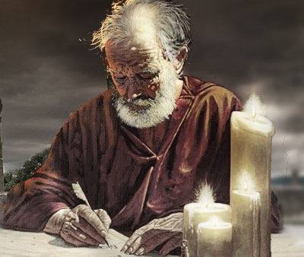
A NT Example
Philippians 4:4-20
⁴ Rejoice in the Lord always: and again I say, Rejoice.
⁵ Let your moderation be known unto all men. The Lord is at hand.
⁶ Be careful for nothing; but in every thing by prayer and supplication with thanksgiving let your requests be made known unto God.
⁷ And the peace of God, which passeth all understanding, shall keep your hearts and minds through Christ Jesus.

Slide 70
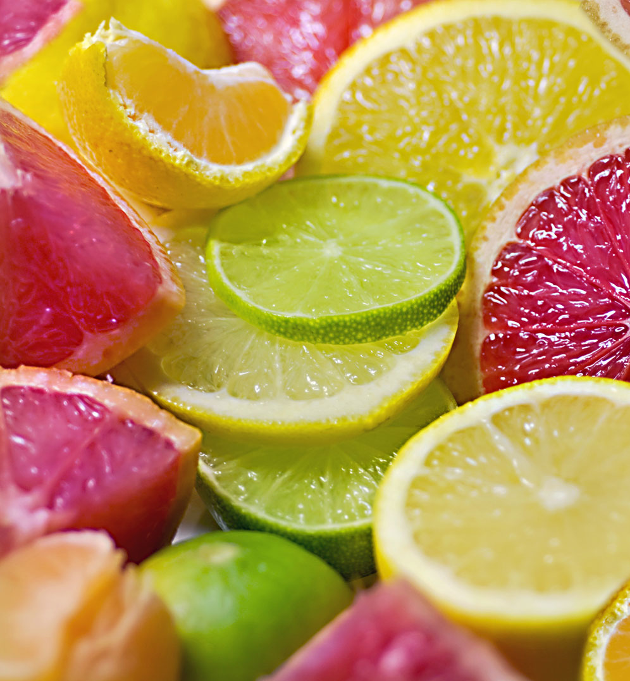
A NT Example
Philippians 4:8-20
⁸ Finally, brethren, whatsoever things are true, whatsoever things are honest, whatsoever things are just, whatsoever things are pure, whatsoever things are lovely, whatsoever things are of good report; if there be any virtue, and if there be any praise, think on these things.
⁹ Those things, which ye have both learned, and received, and heard, and seen in me, do: and the God of peace shall be with you.

Slide 71
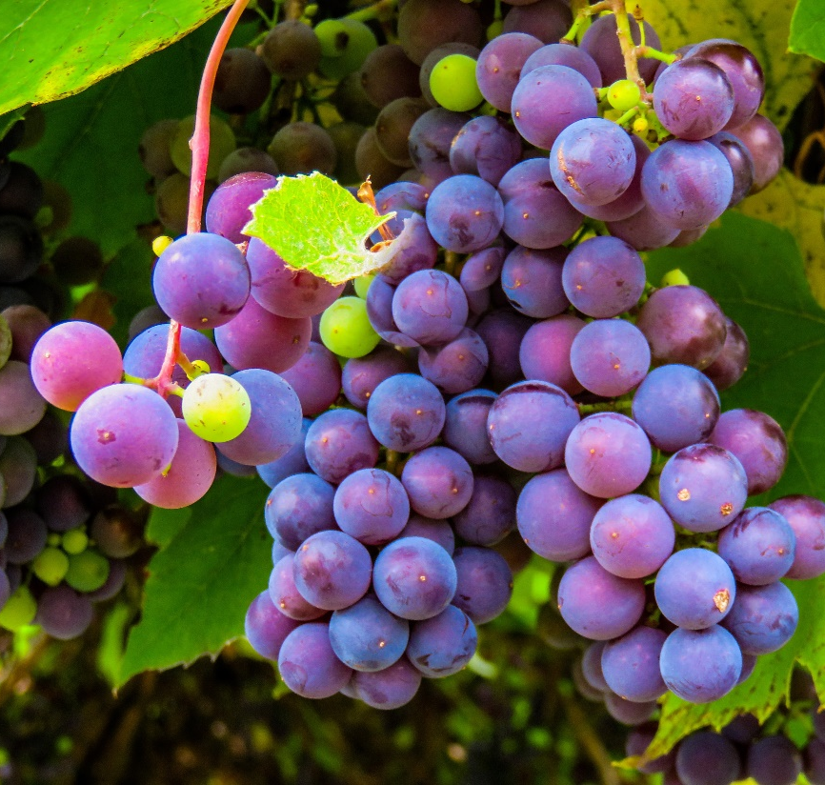
A NT Example
Philippians 4:10-20
¹⁰ But I rejoiced in the Lord greatly, that now at the last your care of me hath flourished again; wherein ye were also careful, but ye lacked opportunity.
¹¹ Not that I speak in respect of want: for I have learned, in whatsoever state I am, therewith to be content.
¹² I know both how to be abased, and I know how to abound: every where and in all things I am instructed both to be full and to be hungry, both to abound and to suffer need.

Slide 72
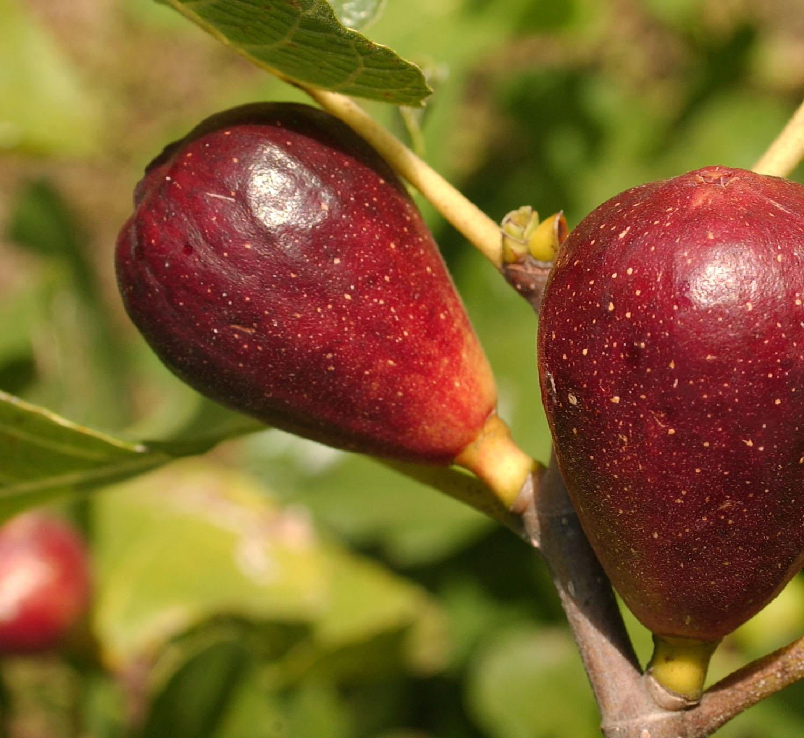
A NT Example
Philippians 4:13-20
¹³ I can do all things through Christ which strengtheneth me.
¹⁴ Notwithstanding ye have well done, that ye did communicate with my affliction.
¹⁵ Now ye Philippians know also, that in the beginning of the gospel, when I departed from Macedonia, no church communicated with me as concerning giving and receiving, but ye only.

Slide 73
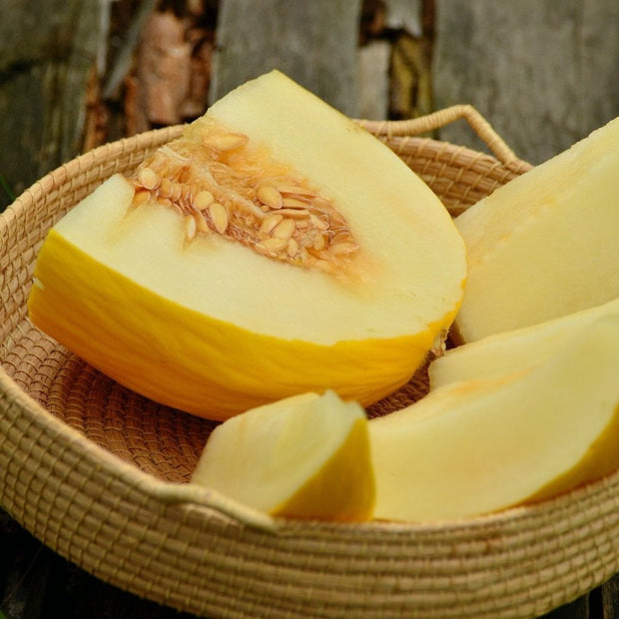
A NT Example
Philippians 4:16-20
¹⁶ For even in Thessalonica ye sent once and again unto my necessity.
¹⁷ Not because I desire a gift: but I desire fruit that may abound to your account.
¹⁸ But I have all, and abound: I am full, having received of Epaphroditus the things which were sent from you, an odour of a sweet smell, a sacrifice acceptable, wellpleasing to God.

Slide 74
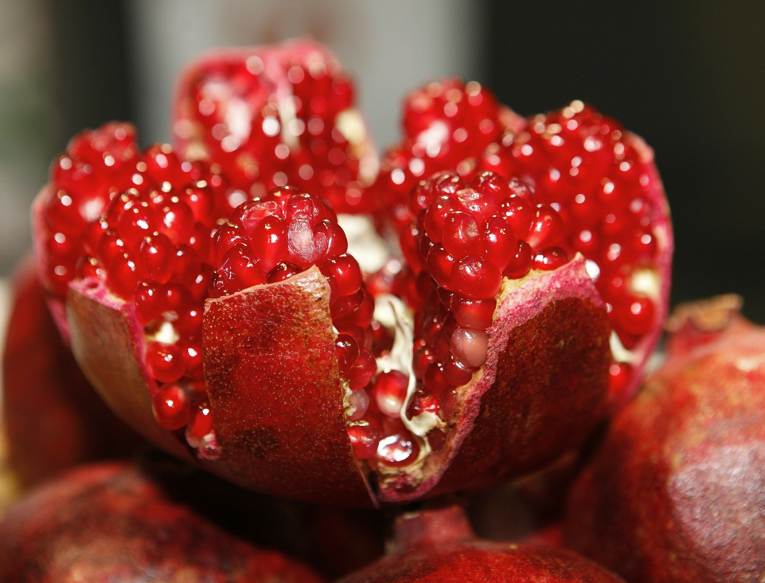
A NT Example
Philippians 4:19-20
¹⁹ But my God shall supply all your need according to his riches in glory by Christ Jesus.
²⁰ Now unto God and our Father be glory for ever and ever. Amen.

Slide 75
EGW: “The Fundamentals of Christian Education,” pg. 85
Your Heavenly Father has claims upon you; for without solicitation or merit on your part He gives you the bounties of His providence; and more than this, He has given you all heaven in one gift, that of His beloved Son. In return for this infinite gift, He claims of you willing obedience. As you are bought with a price, even the precious blood of the Son of God, He requires that you make a right use of the privileges you enjoy.

Slide 76
EGW: “The Fundamentals of Christian Education,” pg. 85
Your intellectual and moral faculties are God's gifts, talents intrusted to you for wise improvement, and you are not at liberty to let them lie dormant for want of proper cultivation, or be crippled and dwarfed by inaction. It is for you to determine whether or not the weighty responsibilities that rest upon you shall be faithfully met, whether or not your efforts shall be well directed and your best.

Slide 77
EGW: “The Fundamentals of Christian Education,” pg. 86
We are living in the perils of the last days. All heaven is interested in the characters you are forming. Every provision has been made for you, that you should be a partaker of the divine nature, having escaped the corruption that is in the world through lust. Man is not left alone to conquer the powers of evil by his own feeble efforts. Help is at hand, and will be given every soul who really desires it.

Slide 78
EGW: “The Fundamentals of Christian Education,” pg. 86
Angels of God, that ascend and descend the ladder that Jacob saw in vision, will help every soul who wills to climb even to the highest heaven. They are guarding the people of God, and watching how every step is taken. Those who climb the shining way will be rewarded; they will enter into the joy of their Lord.

