Slide 1
Owed to God
Deuteronomy 28, John 6, Acts 3 & 4
Lesson 2, 1st Quarter 2023

Slide 2
Memory Text: Deuteronomy 28:1-2
28 And it shall come to pass, if thou shalt hearken diligently unto the voice of the Lord thy God, to observe and to do all his commandments which I command thee this day, that the Lord thy God will set thee on high above all nations of the earth:
² And all these blessings shall come on thee, and overtake thee, if thou shalt hearken unto the voice of the Lord thy God.

Slide 3
The Old Covenant (Law): Deuteronomy 28:1-14
28 And it shall come to pass, if thou shalt hearken diligently unto the voice of the Lord thy God, to observe and to do all his commandments which I command thee this day, that the Lord thy God will set thee on high above all nations of the earth:
² And all these blessings shall come on thee, and overtake thee, if thou shalt hearken unto the voice of the Lord thy God.
³ Blessed shalt thou be in the city, and blessed shalt thou be in the field.

Slide 4
The Old Covenant (Law): Deuteronomy 28:4-14
⁴ Blessed shall be the fruit of thy body, and the fruit of thy ground, and the fruit of thy cattle, the increase of thy kine, and the flocks of thy sheep.
⁵ Blessed shall be thy basket and thy store.
⁶ Blessed shalt thou be when thou comest in, and blessed shalt thou be when thou goest out.
⁷ The Lord shall cause thine enemies that rise up against thee to be smitten before thy face: they shall come out against thee one way, and flee before thee seven ways.

Slide 5
The Old Covenant (Law): Deuteronomy 28:8-14
⁸ The Lord shall command the blessing upon thee in thy storehouses, and in all that thou settest thine hand unto; and he shall bless thee in the land which the Lord thy God giveth thee.
⁹ The Lord shall establish thee an holy people unto himself, as he hath sworn unto thee, if thou shalt keep the commandments of the Lord thy God, and walk in his ways.
¹⁰ And all people of the earth shall see that thou art called by the name of the Lord; and they shall be afraid of thee.

Slide 6
The Old Covenant (Law): Deuteronomy 28:11-14
¹¹ And the Lord shall make thee plenteous in goods, in the fruit of thy body, and in the fruit of thy cattle, and in the fruit of thy ground, in the land which the Lord sware unto thy fathers to give thee.
¹² The Lord shall open unto thee his good treasure, the heaven to give the rain unto thy land in his season, and to bless all the work of thine hand: and thou shalt lend unto many nations, and thou shalt not borrow.

Slide 7
The Old Covenant (Law): Deuteronomy 28:13-14
¹³ And the Lord shall make thee the head, and not the tail; and thou shalt be above only, and thou shalt not be beneath; if that thou hearken unto the commandments of the Lord thy God, which I command thee this day, to observe and to do them:
¹⁴ And thou shalt not go aside from any of the words which I command thee this day, to the right hand, or to the left, to go after other gods to serve them.

Slide 8
The New Covenant (Believe): John 6:29
²⁹ Jesus answered and said unto them, This is the work of God, that ye believe on him whom he hath sent.

Slide 9
The New Covenant (Believe): John 20:30-31
³⁰ And many other signs truly did Jesus in the presence of his disciples, which are not written in this book:
³¹ But these are written, that ye might believe that Jesus is the Christ, the Son of God; and that believing ye might have life through his name.

Slide 10
The New Covenant (Believe): Acts 16:30-32
³⁰ And brought them out, and said, Sirs, what must I do to be saved?
³¹ And they said, Believe on the Lord Jesus Christ, and thou shalt be saved, and thy house.
³² And they spake unto him the word of the Lord, and to all that were in his house.

Slide 11
The New Covenant (Believe): 1 John 5:11-13
¹¹ And this is the record, that God hath given to us eternal life, and this life is in his Son.
¹² He that hath the Son hath life; and he that hath not the Son of God hath not life.
¹³ These things have I written unto you that believe on the name of the Son of God; that ye may know that ye have eternal life, and that ye may believe on the name of the Son of God.

Slide 12
⁹ That if thou shalt confess with thy mouth the Lord Jesus, and shalt believe in thine heart that God hath raised him from the dead, thou shalt be saved.
¹⁰ For with the heart man believeth unto righteousness; and with the mouth confession is made unto salvation.
¹¹ For the scripture saith, Whosoever believeth on him shall not be ashamed.
Romans 10:9-11

Slide 13
Believe in What?: 1 John 5:11-13
¹¹ And this is the record, that God hath given to us eternal life, and this life is in his Son.
¹² He that hath the Son hath life; and he that hath not the Son of God hath not life.
¹³ These things have I written unto you that believe on the name of the Son of God; that ye may know that ye have eternal life, and that ye may believe on the name of the Son of God.

Slide 14
Believe in What?: Romans 10:9
⁹ That if thou shalt confess with thy mouth the Lord Jesus, and shalt believe in thine heart that God hath raised him from the dead, thou shalt be saved.

Slide 15
Believe in What?: James 2:19
¹⁹ Thou believest that there is one God; thou doest well: the devils also believe, and tremble.

Slide 16
An Example of (UN)Belief:
John 6:1-65

Slide 17
An Example of (UN)Belief: John 6:1-65
6 After these things Jesus went over the sea of Galilee, which is the sea of Tiberias.
² And a great multitude followed him, because they saw his miracles which he did on them that were diseased.
³ And Jesus went up into a mountain, and there he sat with his disciples.
⁴ And the passover, a feast of the Jews, was nigh.

Slide 18
An Example of (UN)Belief: John 6:5-65
⁵ When Jesus then lifted up his eyes, and saw a great company come unto him, he saith unto Philip, Whence shall we buy bread, that these may eat?
⁶ And this he said to prove him: for he himself knew what he would do.
⁷ Philip answered him, Two hundred pennyworth of bread is not sufficient for them, that every one of them may take a little.

Slide 19
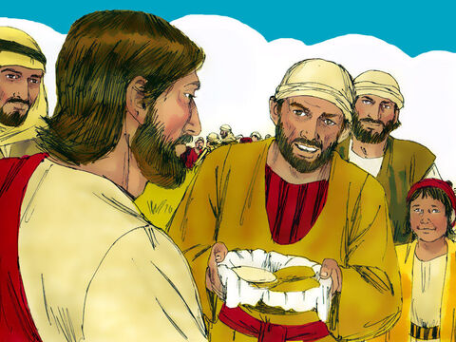
An Example of (UN)Belief: John 6:8-65
⁸ One of his disciples, Andrew, Simon Peter's brother, saith unto him,
⁹ There is a lad here, which hath five barley loaves, and two small fishes: but what are they among so many?

Slide 20
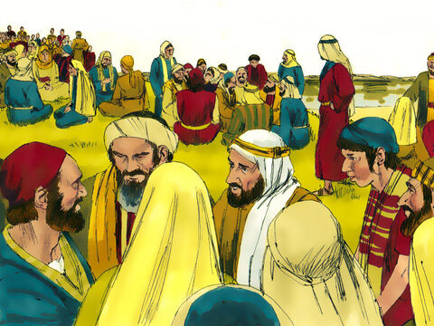
An Example of (UN)Belief: John 6:10-65
¹⁰ And Jesus said, Make the men sit down. Now there was much grass in the place. So the men sat down, in number about five thousand.

Slide 21
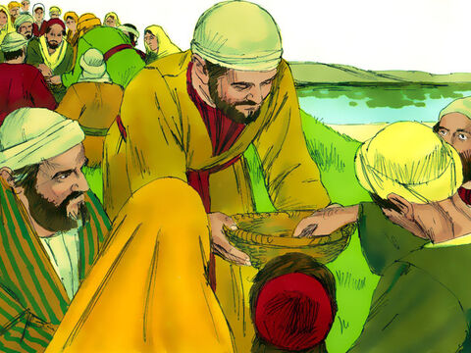
An Example of (UN)Belief: John 6:11-65
¹¹ And Jesus took the loaves; and when he had given thanks, he distributed to the disciples, and the disciples to them that were set down; and likewise of the fishes as much as they would.

Slide 22
An Example of (UN)Belief: John 6:12-65
¹² When they were filled, he said unto his disciples, Gather up the fragments that remain, that nothing be lost.
¹³ Therefore they gathered them together, and filled twelve baskets with the fragments of the five barley loaves, which remained over and above unto them that had eaten.
¹⁴ Then those men, when they had seen the miracle that Jesus did, said, This is of a truth that prophet that should come into the world.

Slide 23
An Example of (UN)Belief: John 6:15-65
¹⁵ When Jesus therefore perceived that they would come and take him by force, to make him a king, he departed again into a mountain himself alone.
¹⁶ And when even was now come, his disciples went down unto the sea,
¹⁷ And entered into a ship, and went over the sea toward Capernaum. And it was now dark, and Jesus was not come to them.
¹⁸ And the sea arose by reason of a great wind that blew.

Slide 24
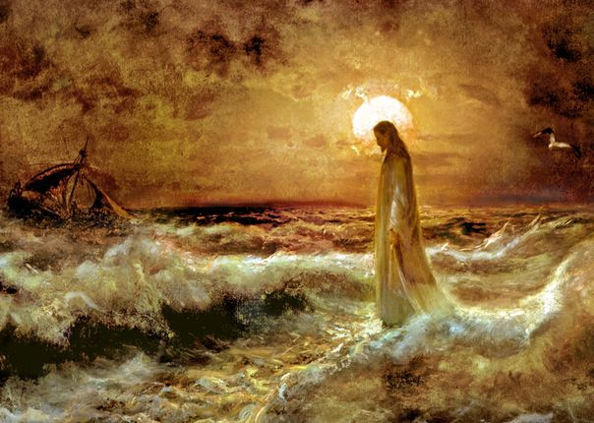
An Example of (UN)Belief: John 6:19-65
¹⁹ So when they had rowed about five and twenty or thirty furlongs, they see Jesus walking on the sea, and drawing nigh unto the ship: and they were afraid.
²⁰ But he saith unto them, It is I; be not afraid.

Slide 25
An Example of (UN)Belief: John 6:21-65
²¹ Then they willingly received him into the ship: and immediately the ship was at the land whither they went.
²² The day following, when the people which stood on the other side of the sea saw that there was none other boat there, save that one whereinto his disciples were entered, and that Jesus went not with his disciples into the boat, but that his disciples were gone away alone;

Slide 26
An Example of (UN)Belief: John 6:23-65
²³ (Howbeit there came other boats from Tiberias nigh unto the place where they did eat bread, after that the Lord had given thanks:)
²⁴ When the people therefore saw that Jesus was not there, neither his disciples, they also took shipping, and came to Capernaum, seeking for Jesus.
²⁵ And when they had found him on the other side of the sea, they said unto him, Rabbi, when camest thou hither?

Slide 27
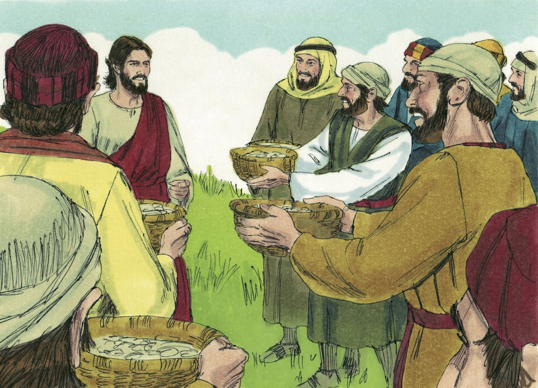
An Example of (UN)Belief: John 6:26-65
²⁶ Jesus answered them and said, Verily, verily, I say unto you, Ye seek me, not because ye saw the miracles, but because ye did eat of the loaves, and were filled.

Slide 28
An Example of (UN)Belief: John 6:27-65
²⁷ Labour not for the meat which perisheth, but for that meat which endureth unto everlasting life, which the Son of man shall give unto you: for him hath God the Father sealed.
²⁸ Then said they unto him, What shall we do, that we might work the works of God?
²⁹ Jesus answered and said unto them, This is the work of God, that ye believe on him whom he hath sent.

Slide 29
An Example of (UN)Belief: John 6:30-65
³⁰ They said therefore unto him, What sign shewest thou then, that we may see, and believe thee? what dost thou work?
³¹ Our fathers did eat manna in the desert; as it is written, He gave them bread from heaven to eat.
³² Then Jesus said unto them, Verily, verily, I say unto you, Moses gave you not that bread from heaven; but my Father giveth you the true bread from heaven.
³³ For the bread of God is he which cometh down from heaven, and giveth life unto the world.

Slide 30
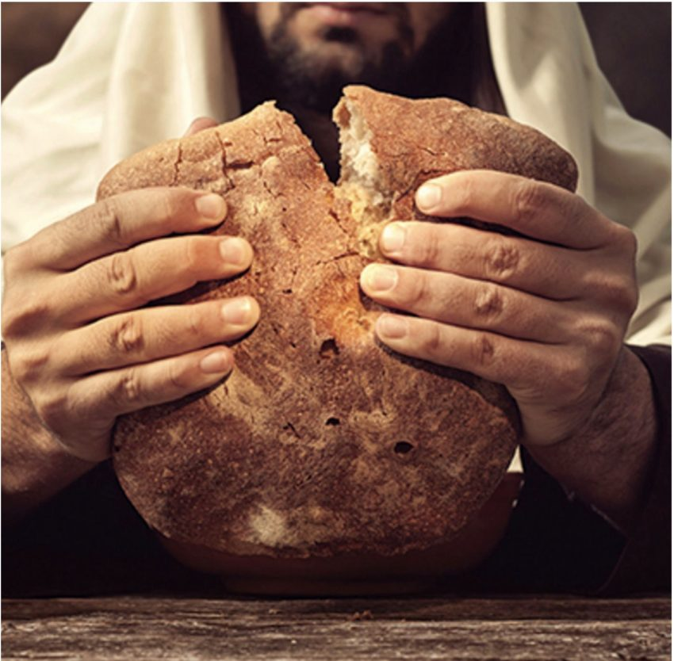
An Example of (UN)Belief: John 6:34-65
³⁴ Then said they unto him, Lord, evermore give us this bread.
³⁵ And Jesus said unto them, I am the bread of life: he that cometh to me shall never hunger; and he that believeth on me shall never thirst.

Slide 31
An Example of (UN)Belief: John 6:36-65
³⁶ But I said unto you, That ye also have seen me, and believe not.
³⁷ All that the Father giveth me shall come to me; and him that cometh to me I will in no wise cast out.
³⁸ For I came down from heaven, not to do mine own will, but the will of him that sent me.
³⁹ And this is the Father's will which hath sent me, that of all which he hath given me I should lose nothing, but should raise it up again at the last day.

Slide 32
An Example of (UN)Belief: John 6:40-65
⁴⁰ And this is the will of him that sent me, that every one which seeth the Son, and believeth on him, may have everlasting life: and I will raise him up at the last day.
⁴¹ The Jews then murmured at him, because he said, I am the bread which came down from heaven.
⁴² And they said, Is not this Jesus, the son of Joseph, whose father and mother we know? how is it then that he saith, I came down from heaven?

Slide 33
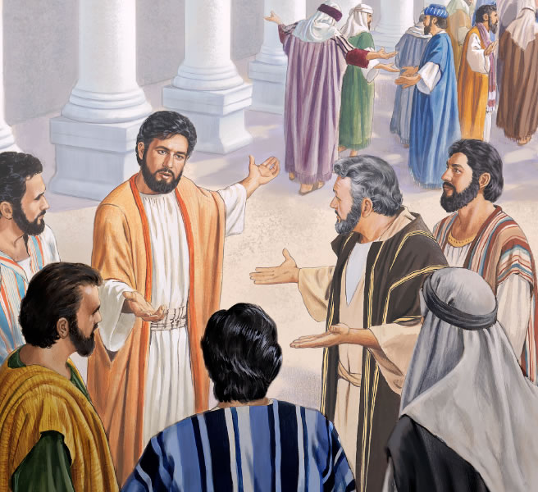
An Example of (UN)Belief: John 6:43-65
⁴³ Jesus therefore answered and said unto them, Murmur not among yourselves.
⁴⁴ No man can come to me, except the Father which hath sent me draw him: and I will raise him up at the last day.

Slide 34
An Example of (UN)Belief: John 6:45-65
⁴⁵ It is written in the prophets, And they shall be all taught of God. Every man therefore that hath heard, and hath learned of the Father, cometh unto me.
⁴⁶ Not that any man hath seen the Father, save he which is of God, he hath seen the Father.
⁴⁷ Verily, verily, I say unto you, He that believeth on me hath everlasting life.
⁴⁸ I am that bread of life.

Slide 35
An Example of (UN)Belief: John 6:49-65
⁴⁹ Your fathers did eat manna in the wilderness, and are dead.
⁵⁰ This is the bread which cometh down from heaven, that a man may eat thereof, and not die.
⁵¹ I am the living bread which came down from heaven: if any man eat of this bread, he shall live for ever: and the bread that I will give is my flesh, which I will give for the life of the world.

Slide 36
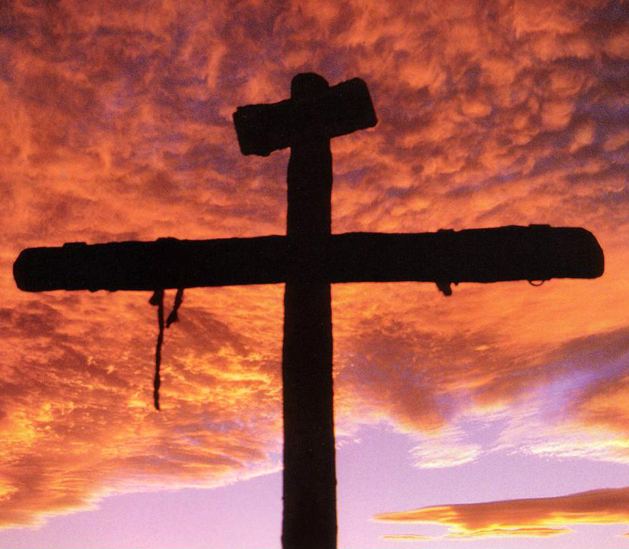
An Example of (UN)Belief: John 6:52-65
⁵² The Jews therefore strove among themselves, saying, How can this man give us his flesh to eat?
⁵³ Then Jesus said unto them, Verily, verily, I say unto you, Except ye eat the flesh of the Son of man, and drink his blood, ye have no life in you.

Slide 37
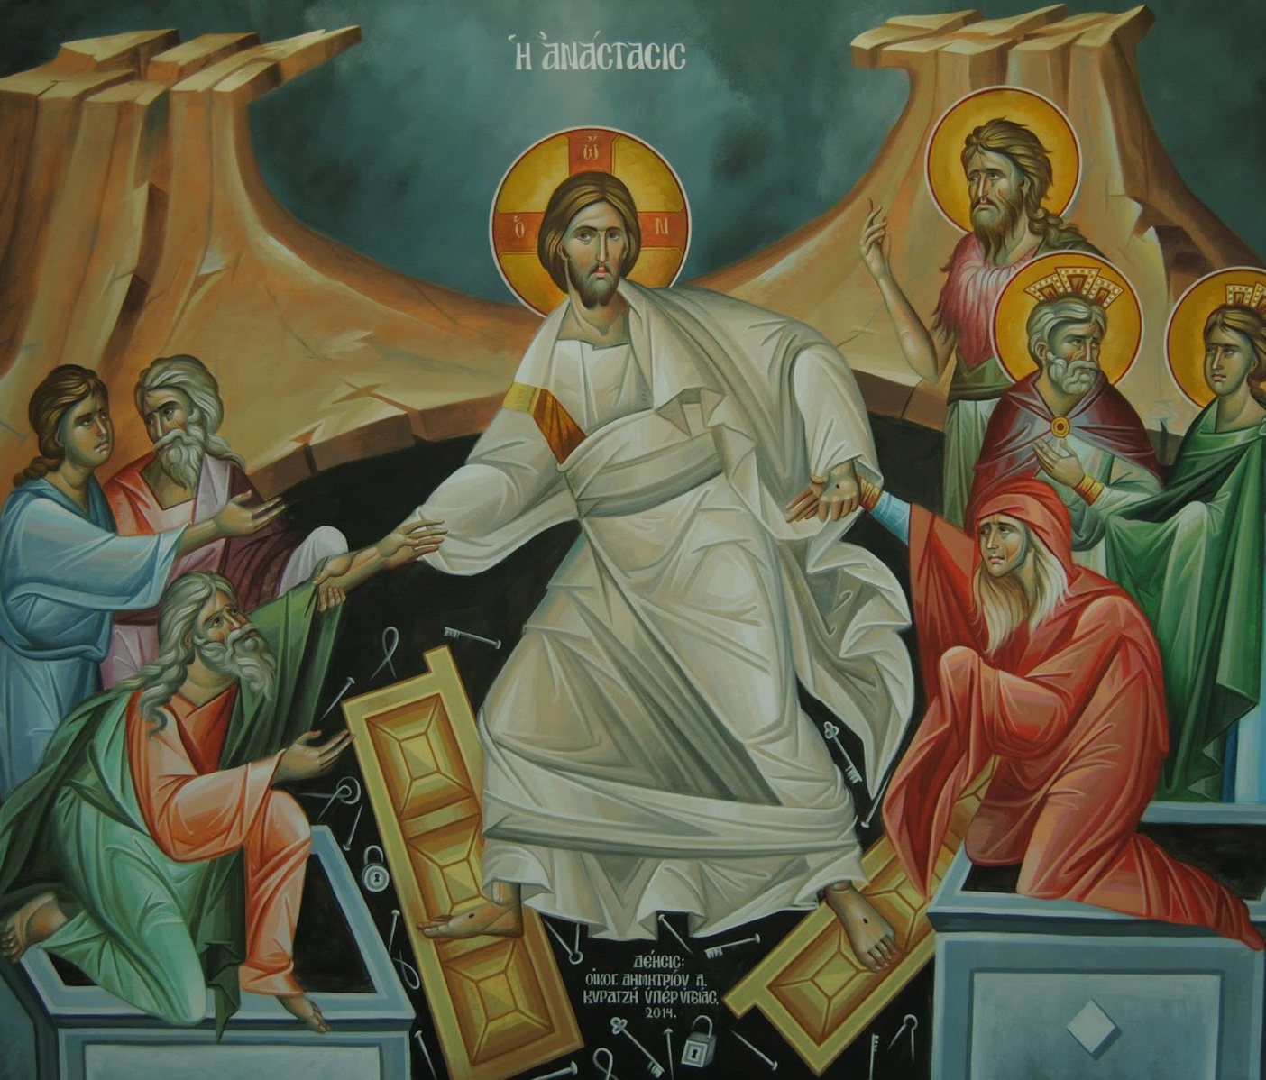
An Example of (UN)Belief: John 6:54-65
⁵⁴ Whoso eateth my flesh, and drinketh my blood, hath eternal life; and I will raise him up at the last day.
⁵⁵ For my flesh is meat indeed, and my blood is drink indeed.

Slide 38
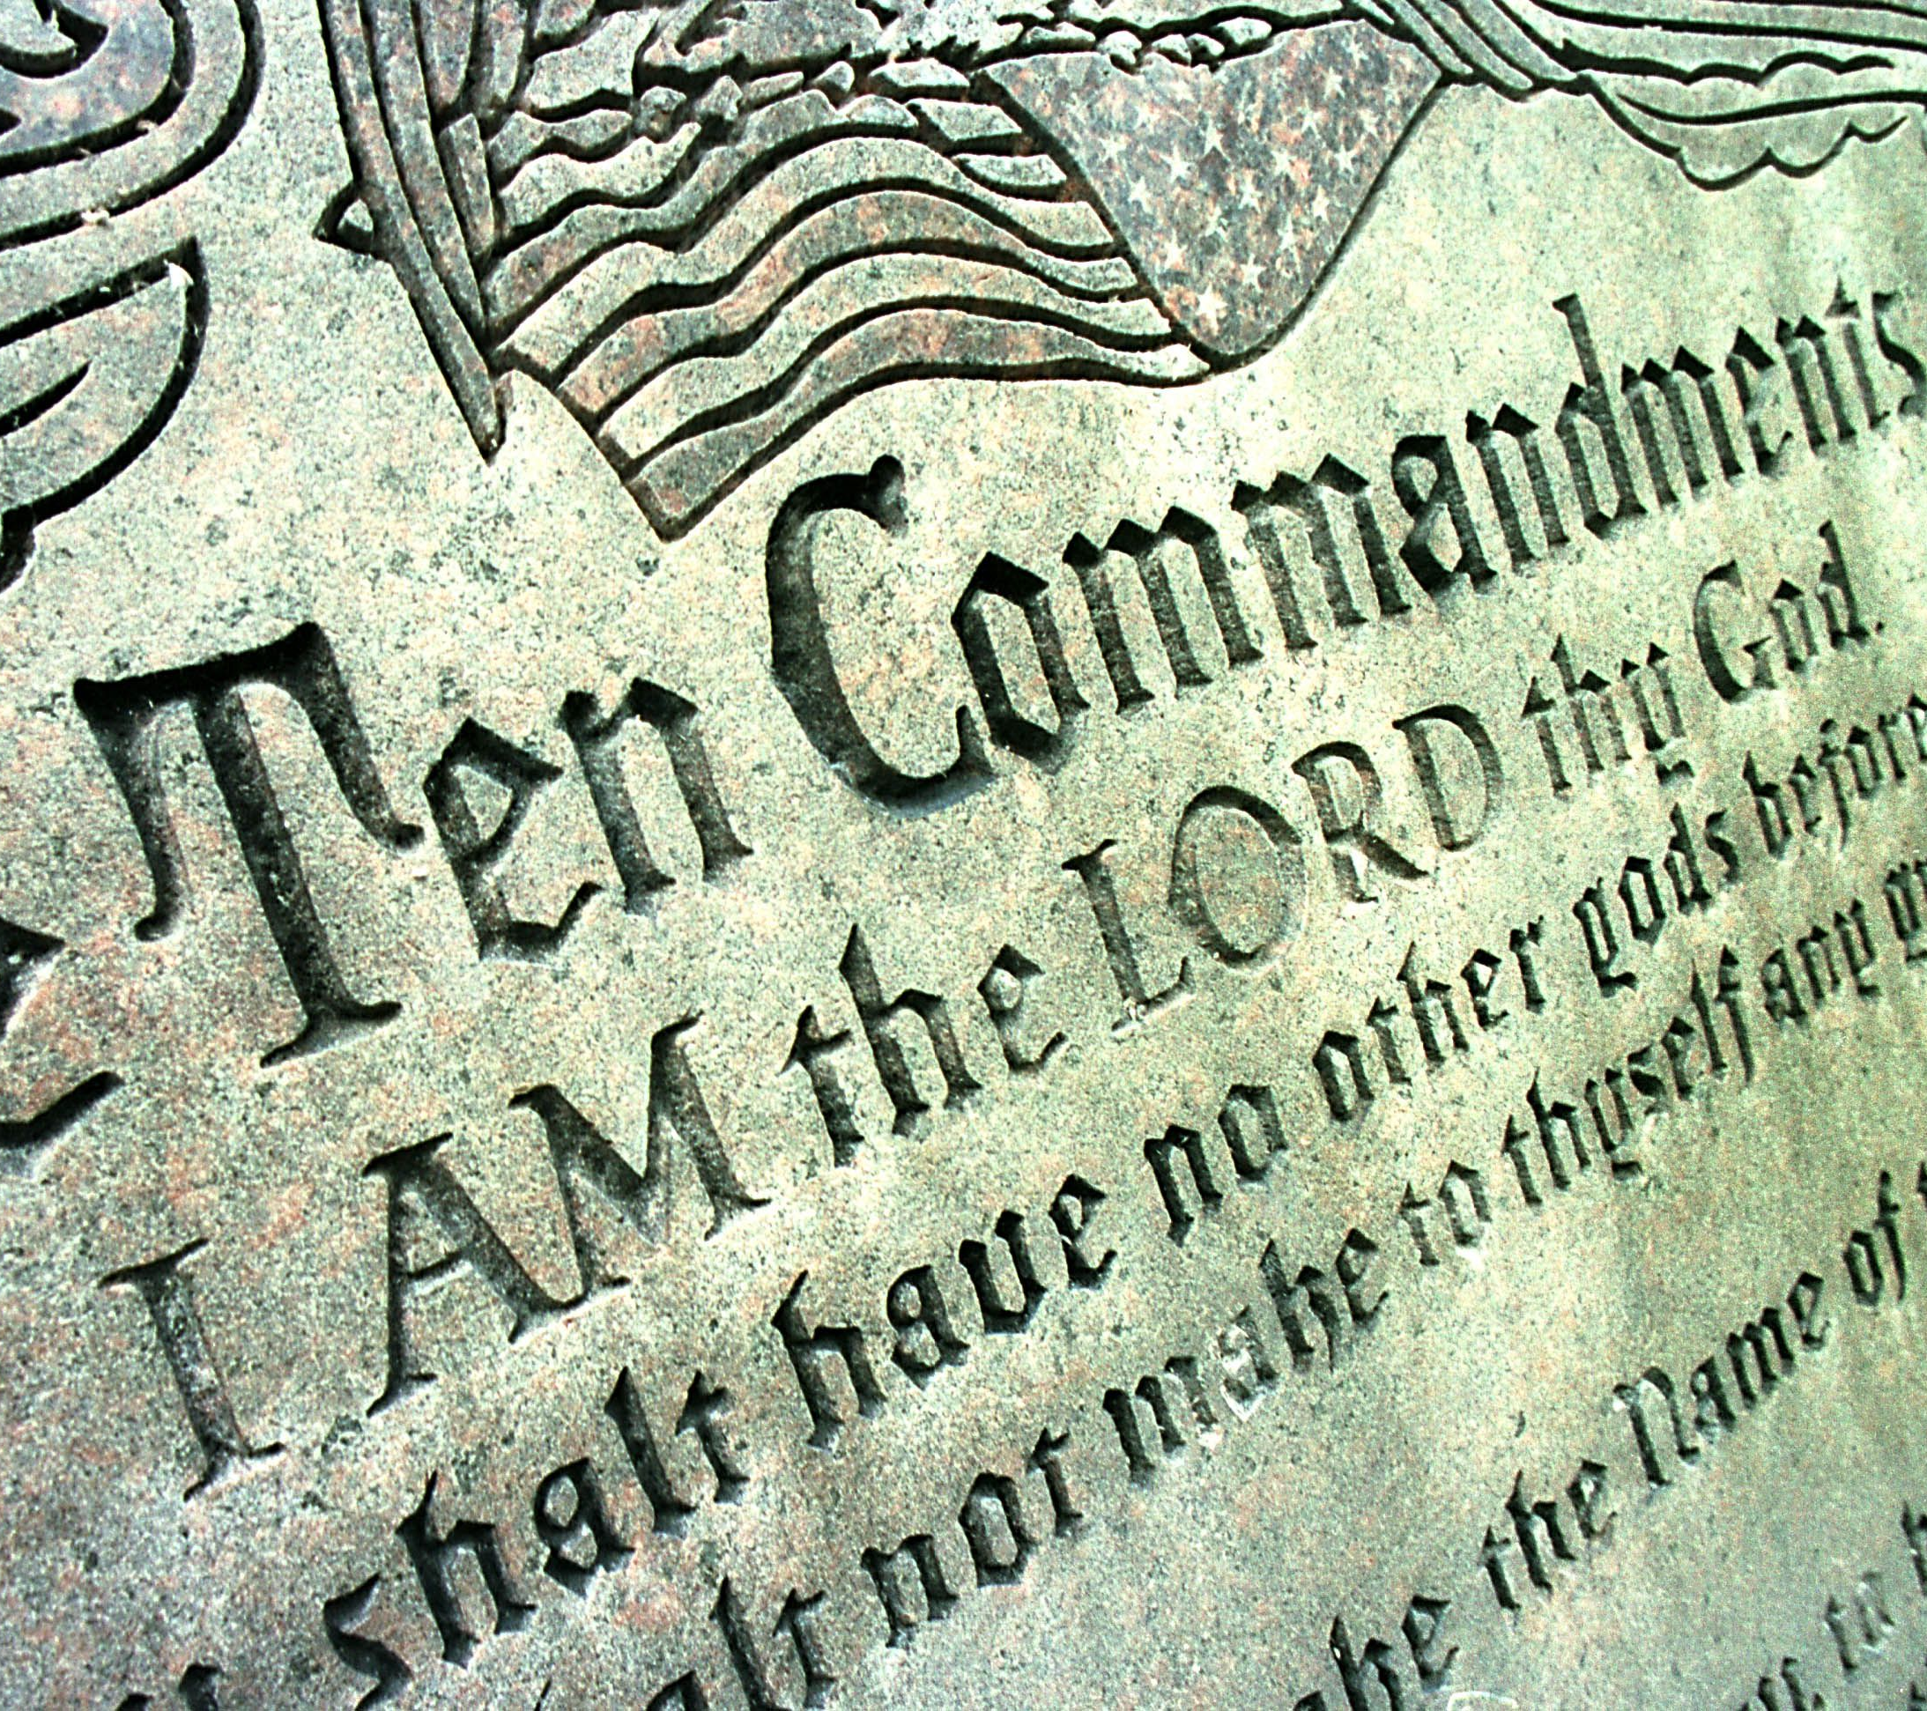
An Example of (UN)Belief: John 6:56-65
⁵⁶ He that eateth my flesh, and drinketh my blood, dwelleth in me, and I in him.
⁵⁷ As the living Father hath sent me, and I live by the Father: so he that eateth me, even he shall live by me.

Slide 39
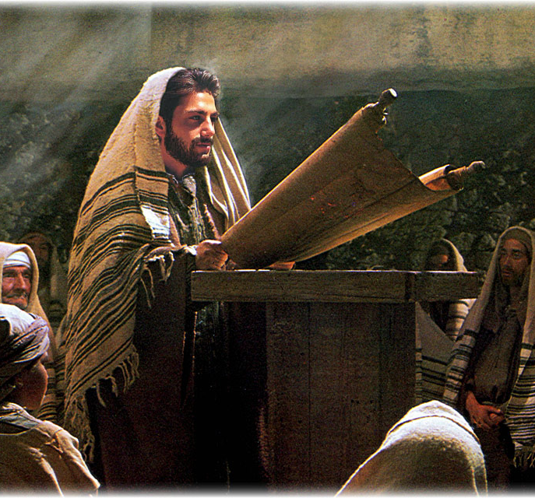
An Example of (UN)Belief: John 6:58-65
⁵⁸ This is that bread which came down from heaven: not as your fathers did eat manna, and are dead: he that eateth of this bread shall live for ever.

Slide 40
An Example of (UN)Belief: John 6:59-65
⁵⁹ These things said he in the synagogue, as he taught in Capernaum.
⁶⁰ Many therefore of his disciples, when they had heard this, said, This is an hard saying; who can hear it?
⁶¹ When Jesus knew in himself that his disciples murmured at it, he said unto them, Doth this offend you?
⁶² What and if ye shall see the Son of man ascend up where he was before?

Slide 41
An Example of (UN)Belief: John 6:63-65
⁶³ It is the spirit that quickeneth; the flesh profiteth nothing: the words that I speak unto you, they are spirit, and they are life.
⁶⁴ But there are some of you that believe not. For Jesus knew from the beginning who they were that believed not, and who should betray him.
⁶⁵ And he said, Therefore said I unto you, that no man can come unto me, except it were given unto him of my Father.

Slide 42
A Metaphor for Change:
Acts 3 &4

Slide 43
A Metaphor for Change: Acts 3:1-26
3 Now Peter and John went up together into the temple at the hour of prayer, being the ninth hour.
² And a certain man lame from his mother's womb was carried, whom they laid daily at the gate of the temple which is called Beautiful, to ask alms of them that entered into the temple;
³ Who seeing Peter and John about to go into the temple asked an alms.
⁴ And Peter, fastening his eyes upon him with John, said, Look on us.

Slide 44
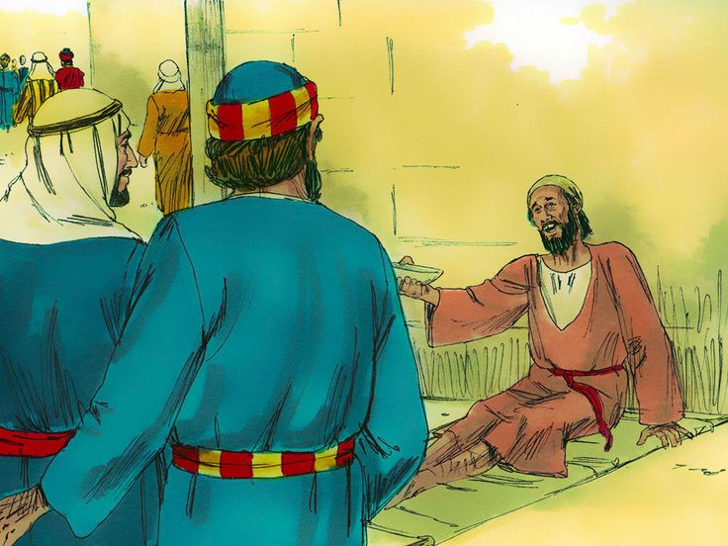
A Metaphor for Change: Acts 3:5-26
⁵ And he gave heed unto them, expecting to receive something of them.
⁶ Then Peter said, Silver and gold have I none; but such as I have give I thee: In the name of Jesus Christ of Nazareth rise up and walk.

Slide 45
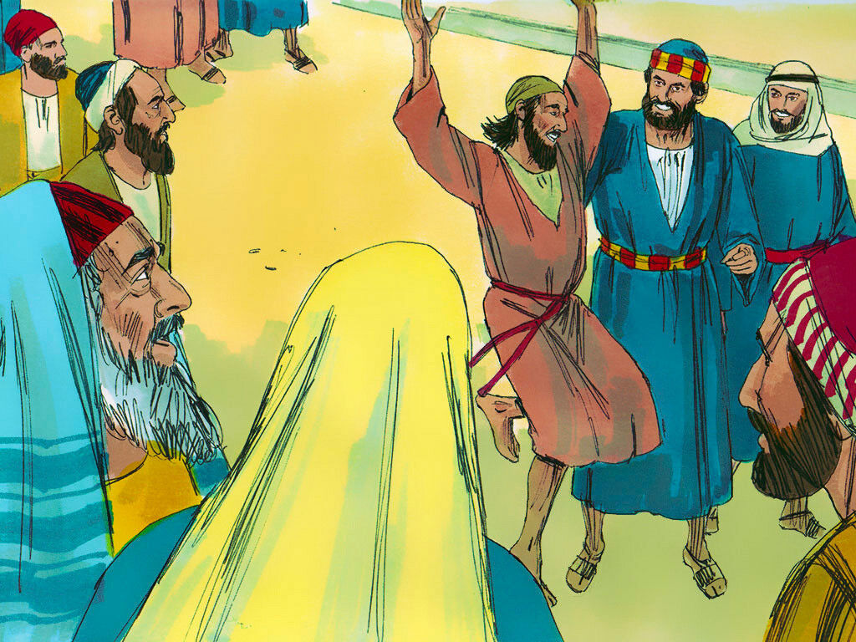
A Metaphor for Change: Acts 3:7-26
⁷ And he took him by the right hand, and lifted him up: and immediately his feet and ankle bones received strength.
⁸ And he leaping up stood, and walked, and entered with them into the temple, walking, and leaping, and praising God.

Slide 46
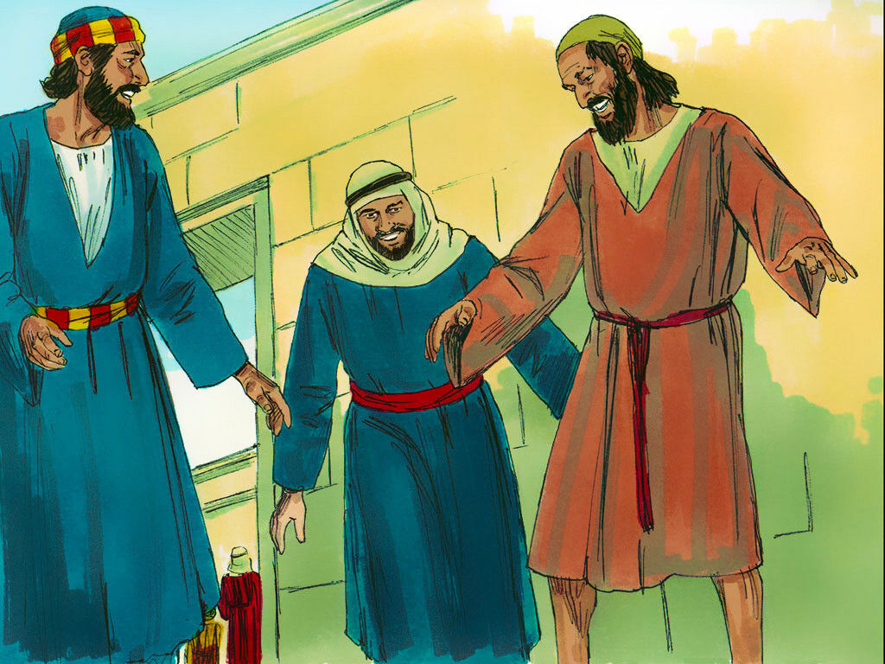
A Metaphor for Change: Acts 3:9-26
⁹ And all the people saw him walking and praising God:
¹⁰ And they knew that it was he which sat for alms at the Beautiful gate of the temple: and they were filled with wonder and amazement at that which had happened unto him.

Slide 47
A Metaphor for Change: Acts 3:11-26
¹¹ And as the lame man which was healed held Peter and John, all the people ran together unto them in the porch that is called Solomon's, greatly wondering.
¹² And when Peter saw it, he answered unto the people, Ye men of Israel, why marvel ye at this? or why look ye so earnestly on us, as though by our own power or holiness we had made this man to walk?

Slide 48
A Metaphor for Change: Acts 3:13-26
¹³ The God of Abraham, and of Isaac, and of Jacob, the God of our fathers, hath glorified his Son Jesus; whom ye delivered up, and denied him in the presence of Pilate, when he was determined to let him go.
¹⁴ But ye denied the Holy One and the Just, and desired a murderer to be granted unto you;
¹⁵ And killed the Prince of life, whom God hath raised from the dead; whereof we are witnesses.

Slide 49
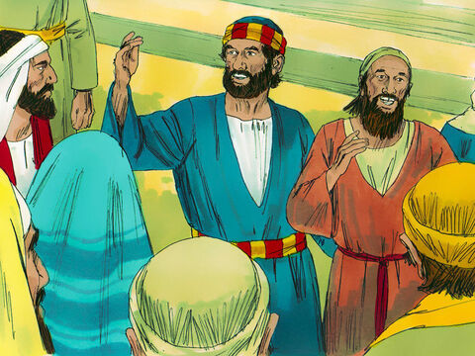
A Metaphor for Change: Acts 3:16-26
¹⁶ And his name through faith in his name hath made this man strong, whom ye see and know: yea, the faith which is by him hath given him this perfect soundness in the presence of you all.

Slide 50
A Metaphor for Change: Acts 3:17-26
¹⁷ And now, brethren, I wot that through ignorance ye did it, as did also your rulers.
¹⁸ But those things, which God before had shewed by the mouth of all his prophets, that Christ should suffer, he hath so fulfilled.

Slide 51
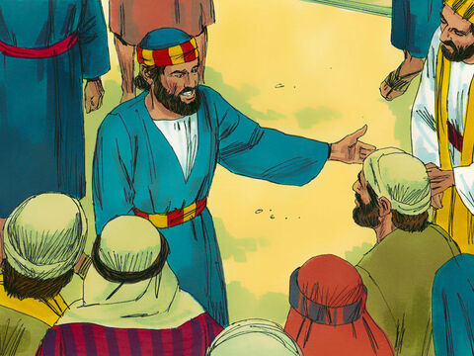
A Metaphor for Change: Acts 3:19-26
¹⁹ Repent ye therefore, and be converted, that your sins may be blotted out, when the times of refreshing shall come from the presence of the Lord.

Slide 52
A Metaphor for Change: Acts 3:20-26
²⁰ And he shall send Jesus Christ, which before was preached unto you:
²¹ Whom the heaven must receive until the times of restitution of all things, which God hath spoken by the mouth of all his holy prophets since the world began.
²² For Moses truly said unto the fathers, A prophet shall the Lord your God raise up unto you of your brethren, like unto me; him shall ye hear in all things whatsoever he shall say unto you.

Slide 53
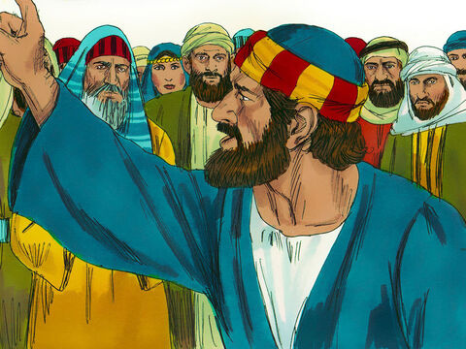
A Metaphor for Change: Acts 3:23-26
²³ And it shall come to pass, that every soul, which will not hear that prophet, shall be destroyed from among the people.
²⁴ Yea, and all the prophets from Samuel and those that follow after, as many as have spoken, have likewise foretold of these days.

Slide 54
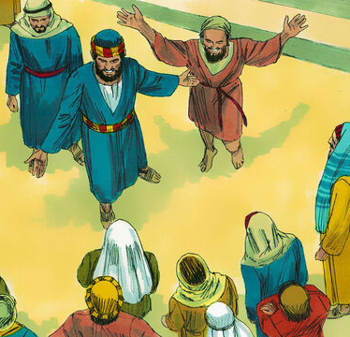
A Metaphor for Change: Acts 3:25-26
²⁵ Ye are the children of the prophets, and of the covenant which God made with our fathers, saying unto Abraham, And in thy seed shall all the kindreds of the earth be blessed.
²⁶ Unto you first God, having raised up his Son Jesus, sent him to bless you, in turning away every one of you from his iniquities.

Slide 55
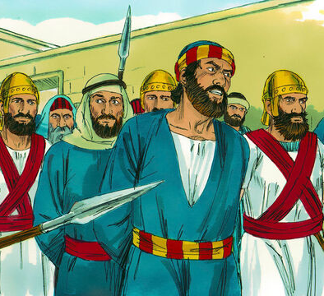
A Metaphor for Change: Acts 4:1-14
4 And as they spake unto the people, the priests, and the captain of the temple, and the Sadducees, came upon them,
² Being grieved that they taught the people, and preached through Jesus the resurrection from the dead.
³ And they laid hands on them, and put them in hold unto the next day: for it was now eventide.

Slide 56
A Metaphor for Change: Acts 4:4-14
⁴ Howbeit many of them which heard the word believed; and the number of the men was about five thousand.
⁵ And it came to pass on the morrow, that their rulers, and elders, and scribes,
⁶ And Annas the high priest, and Caiaphas, and John, and Alexander, and as many as were of the kindred of the high priest, were gathered together at Jerusalem.

Slide 57
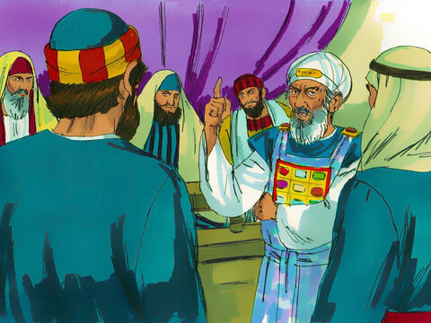
A Metaphor for Change: Acts 4:7-14
⁷ And when they had set them in the midst, they asked, By what power, or by what name, have ye done this?
⁸ Then Peter, filled with the Holy Ghost, said unto them, Ye rulers of the people, and elders of Israel,

Slide 58
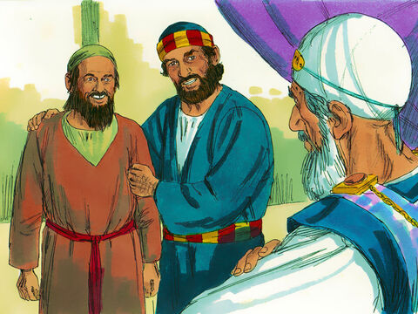
A Metaphor for Change: Acts 4:9-14
⁹ If we this day be examined of the good deed done to the impotent man, by what means he is made whole;
¹⁰ Be it known unto you all, and to all the people of Israel, that by the name of Jesus Christ of Nazareth, whom ye crucified, whom God raised from the dead, even by him doth this man stand here before you whole.

Slide 59
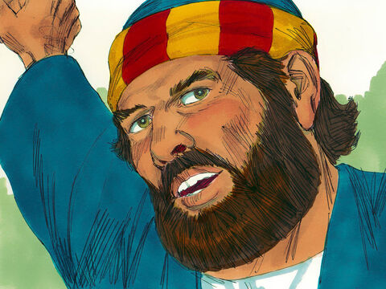
A Metaphor for Change: Acts 4:11-14
¹¹ This is the stone which was set at nought of you builders, which is become the head of the corner.
¹² Neither is there salvation in any other: for there is none other name under heaven given among men, whereby we must be saved.

Slide 60
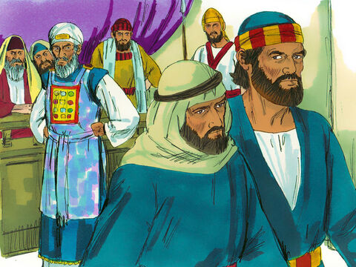
A Metaphor for Change: Acts 4:13-14
¹³ Now when they saw the boldness of Peter and John, and perceived that they were unlearned and ignorant men, they marvelled; and they took knowledge of them, that they had been with Jesus.
¹⁴ And beholding the man which was healed standing with them, they could say nothing against it.

Slide 61
Confidence and Prayer:
1 John 5:1-15;
3:22-24

Slide 62
Confidence and Prayer: 1 John 5:1-15
5 Whosoever believeth that Jesus is the Christ is born of God: and every one that loveth him that begat loveth him also that is begotten of him.
² By this we know that we love the children of God, when we love God, and keep his commandments.
³ For this is the love of God, that we keep his commandments: and his commandments are not grievous.

Slide 63
Confidence and Prayer: 1 John 5:4-15
⁴ For whatsoever is born of God overcometh 4he world: and this is the victory that overcometh the world, even our faith.
⁵ Who is he that overcometh the world, but he that believeth that Jesus is the Son of God?
⁶ This is he that came by water and blood, even Jesus Christ; not by water only, but by water and blood. And it is the Spirit that beareth witness, because the Spirit is truth.

Slide 64
Confidence and Prayer: 1 John 5:7-15
⁷ For there are three that bear record in heaven, the Father, the Word, and the Holy Ghost: and these three are one.
⁸ And there are three that bear witness in earth, the Spirit, and the water, and the blood: and these three agree in one.
⁹ If we receive the witness of men, the witness of God is greater: for this is the witness of God which he hath testified of his Son.

Slide 65
Confidence and Prayer: 1 John 5:10-15
¹⁰ He that believeth on the Son of God hath the witness in himself: he that believeth not God hath made him a liar; because he believeth not the record that God gave of his Son.
¹¹ And this is the record, that God hath given to us eternal life, and this life is in his Son.
¹² He that hath the Son hath life; and he that hath not the Son of God hath not life.

Slide 66
Confidence and Prayer: 1 John 5:13-15
¹³ These things have I written unto you that believe on the name of the Son of God; that ye may know that ye have eternal life, and that ye may believe on the name of the Son of God.
¹⁴ And this is the confidence that we have in him, that, if we ask any thing according to his will, he heareth us:
¹⁵ And if we know that he hear us, whatsoever we ask, we know that we have the petitions that we desired of him.

Slide 67
Confidence and Prayer: 1 John 3:22-24
²² And whatsoever we ask, we receive of him, because we keep his commandments, and do those things that are pleasing in his sight.
²³ And this is his commandment, That we should believe on the name of his Son Jesus Christ, and love one another, as he gave us commandment.
²⁴ And he that keepeth his commandments dwelleth in him, and he in him. And hereby we know that he abideth in us, by the Spirit which he hath given us.

Slide 68
Belief and Perfection:
Philippians 1:6; 3:11-16

Slide 69

Belief and Perfection: Philippians 1:6
⁶ Being confident of this very thing, that he which hath begun a good work in you will perform it until the day of Jesus Christ:

Slide 70
Belief and Perfection: Philippians 3:11-15
¹¹ If by any means I might attain unto the resurrection of the dead.
¹² Not as though I had already attained, either were already perfect: but I follow after, if that I may apprehend that for which also I am apprehended of Christ Jesus.
¹³ Brethren, I count not myself to have apprehended: but this one thing I do, forgetting those things which are behind, and reaching forth unto those things which are before,

Slide 71
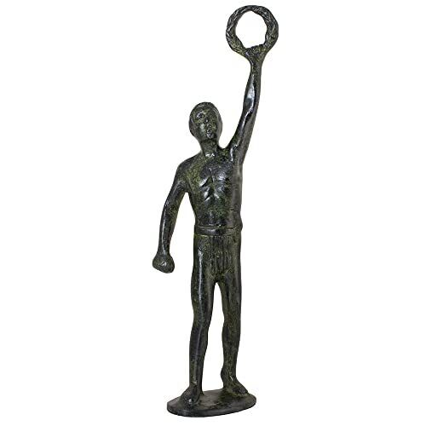
Belief and Perfection: Philippians 3:14-15
¹⁴ I press toward the mark for the prize of the high calling of God in Christ Jesus.
¹⁵ Let us therefore, as many as be perfect, be thus minded: and if in any thing ye be otherwise minded, God shall reveal even this unto you.

Slide 72
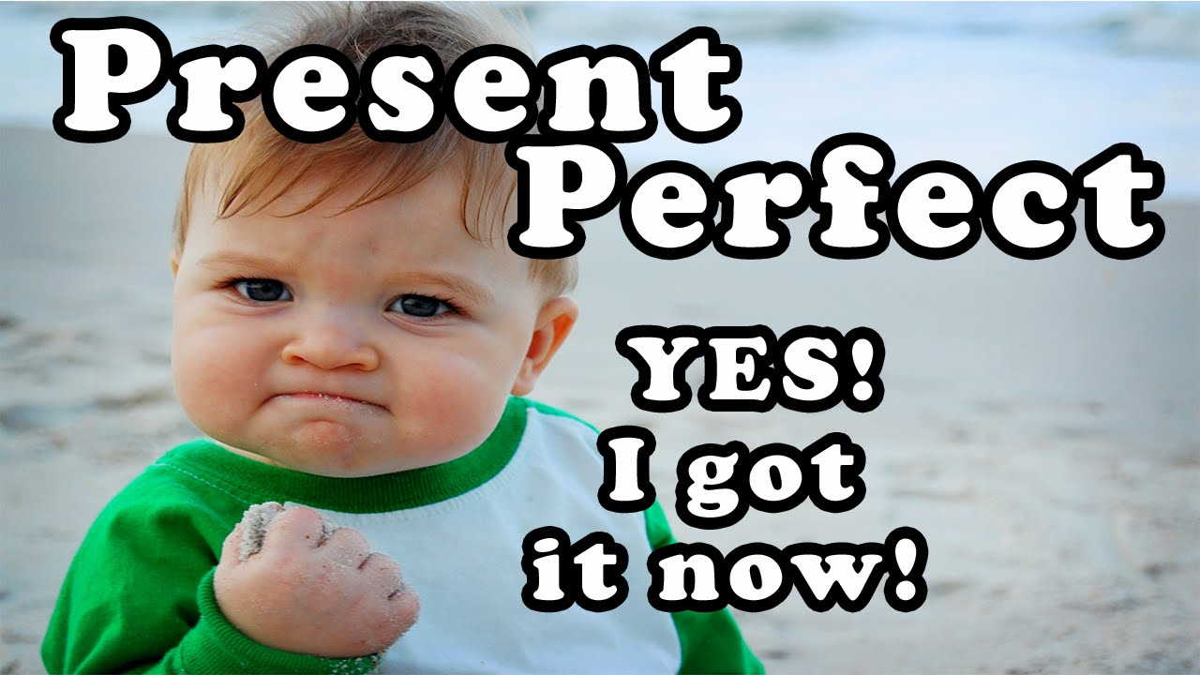
Belief and Perfection: Matthew 5:48
⁴⁸ Be ye therefore perfect, even as your Father which is in heaven is perfect.

Slide 73
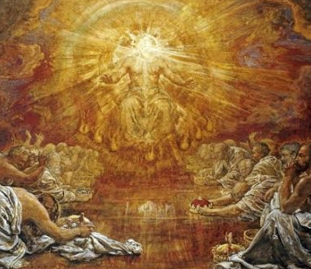
Belief and Perfection: Romans 12:1-2
12 I beseech you therefore, brethren, by the mercies of God, that ye present your bodies a living sacrifice, holy, acceptable unto God, which is your reasonable service.
² And be not conformed to this world: but be ye transformed by the renewing of your mind, that ye may prove what is that good, and acceptable, and perfect, will of God.

Slide 74
Happy Sabbath!!
Thank you! And…

