Slide 1

Laying Up Treasure in Heaven
Matthew 6, Mark 8, Hebrews 11
Lesson 6, 1st Quarter 2023

Slide 2

Memory Text:
Mark 8:36-37
³⁶ For what shall it profit a man, if he shall gain the whole world, and lose his own soul?
³⁷ Or what shall a man give in exchange for his soul?

Slide 3
Laying up Treasure: A Textual Analysis
Matthew 6:19-21
¹⁹ Lay not up for yourselves treasures upon earth, where moth and rust doth corrupt, and where thieves break through and steal:
²⁰ But lay up for yourselves treasures in heaven, where neither moth nor rust doth corrupt, and where thieves do not break through nor steal:
²¹ For where your treasure is, there will your heart be also.

Slide 4
Laying up Treasure: A Textual Analysis
From the SDA Quarterly, Sabbath February 4
Jesus gave us the world’s best investment strategy when He said: “Do not lay up for yourselves treasures on earth, where moth and rust destroy and where thieves break in and steal; but lay up for yourselves treasures in heaven, where neither moth nor rust destroys and where thieves do not break in and steal” (Matt. 6:19, 20, NKJV). Jesus concludes His investment strategy by saying,

Slide 5
Laying up Treasure: A Textual Analysis
From the SDA Quarterly, Sabbath February 4
“For where your treasure is, there your heart will be also” (Matt. 6:21, NKJV). In other words: show me what you spend your money on, and I will show you where your heart is, because wherever you put your money, your heart is sure to follow, if it’s not there already.

Slide 6
Laying up Treasure: A Textual Analysis
Matthew 6:19-21
¹⁹ Lay not up for yourselves treasures upon earth, where moth and rust doth corrupt, and where thieves break through and steal:
²⁰ But lay up for yourselves treasures in heaven, where neither moth nor rust doth corrupt, and where thieves do not break through nor steal:
²¹ For where your treasure is, there will your heart be also.

Slide 7
Laying up Treasure: A Textual Analysis
Matthew 6:19-21 (SDABC V5 p. 349)
¹⁹ Lay not up for yourselves treasures upon earth, where moth and rust doth corrupt, and where thieves break through and steal:
²⁰ But lay up for yourselves treasures in heaven, where neither moth nor rust doth corrupt, and where thieves do not break through nor steal:
²¹ For where your treasure is, there will your heart be also.
Literally, “do not have the habit of laying up” or “stop laying up.” The accumulation of worldly goods is generally motivated by a desire for security, and reflects fear and uncertainty for the future. Jesus points out to those who would be citizens of His kingdom that the possession of material wealth is a source of anxiety rather than a means of escape from it. The Christian will not be anxious concerning the material necessities of life because of his confidence that God knows his needs and will provide for them.

Slide 8
Laying up Treasure: A Textual Analysis
Matthew 6:19-21 (SDABC V5 p. 291, 349)
¹⁹ Lay not up for yourselves treasures upon earth, where moth and rust doth corrupt, and where thieves break through and steal:
²⁰ But lay up for yourselves treasures in heaven, where neither moth nor rust doth corrupt, and where thieves do not break through nor steal:
²¹ For where your treasure is, there will your heart be also.
Greek thēsaurous, meaning either “caskets,” “treasure chests,” used as receptacles for valuables, or “treasures.”
Christ here refers to wealth in the broad sense of all material possessions. The love of money was the ruling passion of thousands in the time of Christ, as it is of millions today.

Slide 9
Laying up Treasure: A Textual Analysis
Matthew 6:19-21 (SDABC V5 p. 350)
¹⁹ Lay not up for yourselves treasures upon earth, where moth and rust doth corrupt, and where thieves break through and steal:
²⁰ But lay up for yourselves treasures in heaven, where neither moth nor rust doth corrupt, and where thieves do not break through nor steal:
²¹ For where your treasure is, there will your heart be also.
There is no injunction here against laying up wealth provided it is laid up in the right place.
Christ would have the citizens of the kingdom of heaven make a sound investment of the time and strength their heavenly Father has seen fit to allot them in this life.

Slide 10
Laying up Treasure: A Textual Analysis
Matthew 6:19-21 (SDABC V5 p. 350)
Such treasure is permanent, unaffected by the enemies of earthly treasure and the ravages of time. Investments in heavenly treasure appreciate with time, whereas those in earthly treasure inevitably depreciate in value.
¹⁹ Lay not up for yourselves treasures upon earth, where moth and rust doth corrupt, and where thieves break through and steal:
²⁰ But lay up for yourselves treasures in heaven, where neither moth nor rust doth corrupt, and where thieves do not break through nor steal:
²¹ For where your treasure is, there will your heart be also.

Slide 11
Laying up Treasure: A Textual Analysis
Matthew 6:19-21 (SDABC V5 p. 350)
¹⁹ Lay not up for yourselves treasures upon earth, where moth and rust doth corrupt, and where thieves break through and steal:
²⁰ But lay up for yourselves treasures in heaven, where neither moth nor rust doth corrupt, and where thieves do not break through nor steal:
²¹ For where your treasure is, there will your heart be also.
Treasure is that on which a man sets his heart, regardless of intrinsic value. A child’s “treasures” may have little intrinsic worth, but they often mean as much to him as a king’s ransom. A man’s real interests lie where his “treasures” are.

Slide 12
Laying up Treasure: A Textual Analysis
Matthew 6:19-21
¹⁹ Lay not up for yourselves treasures upon earth, where moth and rust doth corrupt, and where thieves break through and steal:
²⁰ But lay up for yourselves treasures in heaven, where neither moth nor rust doth corrupt, and where thieves do not break through nor steal:
²¹ For where your treasure is, there will your heart be also.
It’s a matter of faith! The place where our “treasure” or real interests lie reveals the place where we have our faith. Do we trust in the security of earthly things or in the security of God’s promises?

Slide 13
Memory Text:
Mark 8:36-37
³⁶ For what shall it profit a man, if he shall gain the whole world, and lose his own soul?
³⁷ Or what shall a man give in exchange for his soul?

Slide 14
Memory Text: Context
Mark 8:31-38 Matthew 16:21-27
³¹ And he began to teach them, that the Son of man must suffer many things, and be rejected of the elders, and of the chief priests, and scribes, and be killed, and after three days rise again.
²¹ From that time forth began Jesus to shew unto his disciples, how that he must go unto Jerusalem, and suffer many things of the elders and chief priests and scribes, and be killed, and be raised again the third day.

Slide 15
Memory Text: Context
Mark 8:31-38 Matthew 16:21-27
³² And he spake that saying openly. And Peter took him, and began to rebuke him.
²² Then Peter took him, and began to rebuke him, saying, Be it far from thee, Lord: this shall not be unto thee.

Slide 16
Memory Text: Context
Mark 8:31-38 Matthew 16:21-27
³³ But when he had turned about and looked on his disciples, he rebuked Peter, saying, Get thee behind me, Satan: for thou savourest not the things that be of God, but the things that be of men.
²³ But he turned, and said unto Peter, Get thee behind me, Satan: thou art an offence unto me: for thou savourest not the things that be of God, but those that be of men.

Slide 17
Memory Text: Context
Mark 8:31-38 Matthew 16:21-27
³⁴ And when he had called the people unto him with his disciples also, he said unto them, Whosoever will come after me, let him deny himself, and take up his cross, and follow me.
²⁴ Then said Jesus unto his disciples, If any man will come after me, let him deny himself, and take up his cross, and follow me.

Slide 18
Memory Text: Context
Mark 8:31-38 Matthew 16:21-27
³⁵ For whosoever will save his life shall lose it; but whosoever shall lose his life for my sake and the gospel's, the same shall save it.
²⁵ For whosoever will save his life shall lose it: and whosoever will lose his life for my sake shall find it.

Slide 19
Memory Text: Context
Mark 8:31-38 Matthew 16:21-27
³⁶ For what shall it profit a man, if he shall gain the whole world, and lose his own soul?
³⁷ Or what shall a man give in exchange for his soul?
²⁶ For what is a man profited, if he shall gain the whole world, and lose his own soul? or what shall a man give in exchange for his soul?

Slide 20
Memory Text: Context
Mark 8:31-38 Matthew 16:21-27
³⁸ Whosoever therefore shall be ashamed of me and of my words in this adulterous and sinful generation; of him also shall the Son of man be ashamed, when he cometh in the glory of his Father with the holy angels.
²⁷ For the Son of man shall come in the glory of his Father with his angels; and then he shall reward every man according to his works.

Slide 21
Memory Text: Context
The Desire of Ages, pg. 415
Speechless with grief and amazement, the disciples listened. Christ had accepted Peter's acknowledgment of Him as the Son of God; and now His words pointing to His suffering and death seemed incomprehensible. Peter could not keep silent. He laid hold upon his Master, as if to draw Him back from His impending doom, exclaiming, “Be it far from Thee, Lord: this shall not be unto Thee.”

Slide 22
Memory Text: Context
The Desire of Ages, pg. 415
Peter loved his Lord; but Jesus did not commend him for thus manifesting the desire to shield Him from suffering. Peter's words were not such as would be a help and solace to Jesus in the great trial before Him. They were not in harmony with God's purpose of grace toward a lost world, nor with the lesson of self-sacrifice that Jesus had come to teach by His own example.

Slide 23
Memory Text: Context
The Desire of Ages, pg. 415
Peter did not desire to see the cross in the work of Christ. The impression which his words would make was directly opposed to that which Christ desired to make on the minds of His followers, and the Saviour was moved to utter one of the sternest rebukes that ever fell from His lips: “Get thee behind Me, Satan: thou art an offense unto Me: for thou savorest not the things that be of God, but those that be of men.”

Slide 24
Memory Text: Context
The Desire of Ages, pg. 416
It was to Peter a bitter lesson, and one which he learned but slowly, that the path of Christ on earth lay through agony and humiliation. The disciple shrank from fellowship with his Lord in suffering. But in the heat of the furnace fire he was to learn its blessing. Long afterward, when his active form was bowed with the burden of years and labors, he wrote,

Slide 25
Memory Text: Context
The Desire of Ages, pg. 416
“Beloved, think it not strange concerning the fiery trial which is to try you, as though some strange thing happened unto you: but rejoice, inasmuch as ye are partakers of Christ's sufferings; that, when His glory shall be revealed, ye may be glad also with exceeding joy.” 1 Peter 4:12, 13.
Jesus now explained to His disciples that His own life of self-abnegation was an example of what theirs should be.

Slide 26
Memory Text: Context
The Desire of Ages, pg. 416
Calling about Him, with the disciples, the people who had been lingering near, He said, “If any man will come after Me, let him deny himself, and take up his cross daily, and follow Me.” The cross was associated with the power of Rome. It was the instrument of the most cruel and humiliating form of death.

Slide 27
Memory Text: Context
The Desire of Ages, pg. 416
The lowest criminals were required to bear the cross to the place of execution; and often as it was about to be laid upon their shoulders, they resisted with desperate violence, until they were overpowered, and the instrument of torture was bound upon them. But Jesus bade His followers take up the cross and bear it after Him.

Slide 28
Memory Text: Context
The Desire of Ages, pg. 416
To the disciples His words, though dimly comprehended, pointed to their submission to the most bitter humiliation,—submission even unto death for the sake of Christ. No more complete self-surrender could the Saviour's words have pictured. But all this He had accepted for them. […]

Slide 29
Memory Text: Context
The Desire of Ages, pg. 417
Love for souls for whom Christ died means crucifixion of self. He who is a child of God should henceforth look upon himself as a link in the chain let down to save the world, one with Christ in His plan of mercy, going forth with Him to seek and save the lost. The Christian is ever to realize that he has consecrated himself to God, and that in character he is to reveal Christ to the world.

Slide 30
Memory Text: Context
The Desire of Ages, pg. 417
The self-sacrifice, the sympathy, the love, manifested in the life of Christ are to reappear in the life of the worker for God.
“Whosoever will save his life shall lose it; but whosoever shall lose his life for My sake and the gospel's, the same shall save it.” Selfishness is death. No organ of the body could live should it confine its service to itself.

Slide 31
Memory Text: Context
The Desire of Ages, pg. 417
The heart, failing to send its lifeblood to the hand and the head, would quickly lose its power. As our lifeblood, so is the love of Christ diffused through every part of His mystical body. We are members one of another, and the soul that refuses to impart will perish. And “what is a man profited,” said Jesus, “if he shall gain the whole world, and lose his own soul? or what shall a man give in exchange for his soul?”
Does it profit us to live indulgently for eighty or even a hundred years when we might have had life eternal in the perfectly recreated New Earth?

Slide 32
Memory Text: Context
Peter wanted to follow Jesus, but did not
relish the idea of being associated with a program destined to lead to suffering and death. Jesus, meanwhile, states clearly that following Him involves absolute denial of self. It still comes down to faith! Do we trust in God? Or do we require a more temporal bulwark for our future security?

Slide 33
A Solemn Warning
Hebrews 10:35-39
³⁵ Cast not away therefore your confidence, which hath great recompence of reward.
³⁶ For ye have need of patience, that, after ye have done the will of God, ye might receive the promise.
³⁷ For yet a little while, and he that shall come will come, and will not tarry.

Slide 34
A Solemn Warning
Hebrews 10:38-39
³⁸ Now the just shall live by faith: but if any man draw back, my soul shall have no pleasure in him.
³⁹ But we are not of them who draw back unto perdition; but of them that believe to the saving of the soul.

Slide 35
A Solemn Warning: Side Note
You probably know Hebrews 10:38 very well:
³⁸ Now the just shall live by faith: but if any man draw back, my soul shall have no pleasure in him.
But did you know that first part is quoted from Habakkuk 2:4?
⁴ Behold, his soul which is lifted up is not upright in him: but the just shall live by his faith.

Slide 36
A Solemn Warning: Side Note
Even from Old Testament times we’re instructed that the “just,” that is, the righteous or the saved, live by “faith,” that is, trust or confidence [in God].
Trust in God issues forth from the assurance that God will guide, protect, and bless those who do His will. Habakkuk here grandly affirms that he who lives by a simple faith and trust in the Lord will be saved, but the “soul which is lifted up” through its own willful pride and perverseness in sin will perish.
Notice how pride is posed as the opposite of faith!

Slide 37
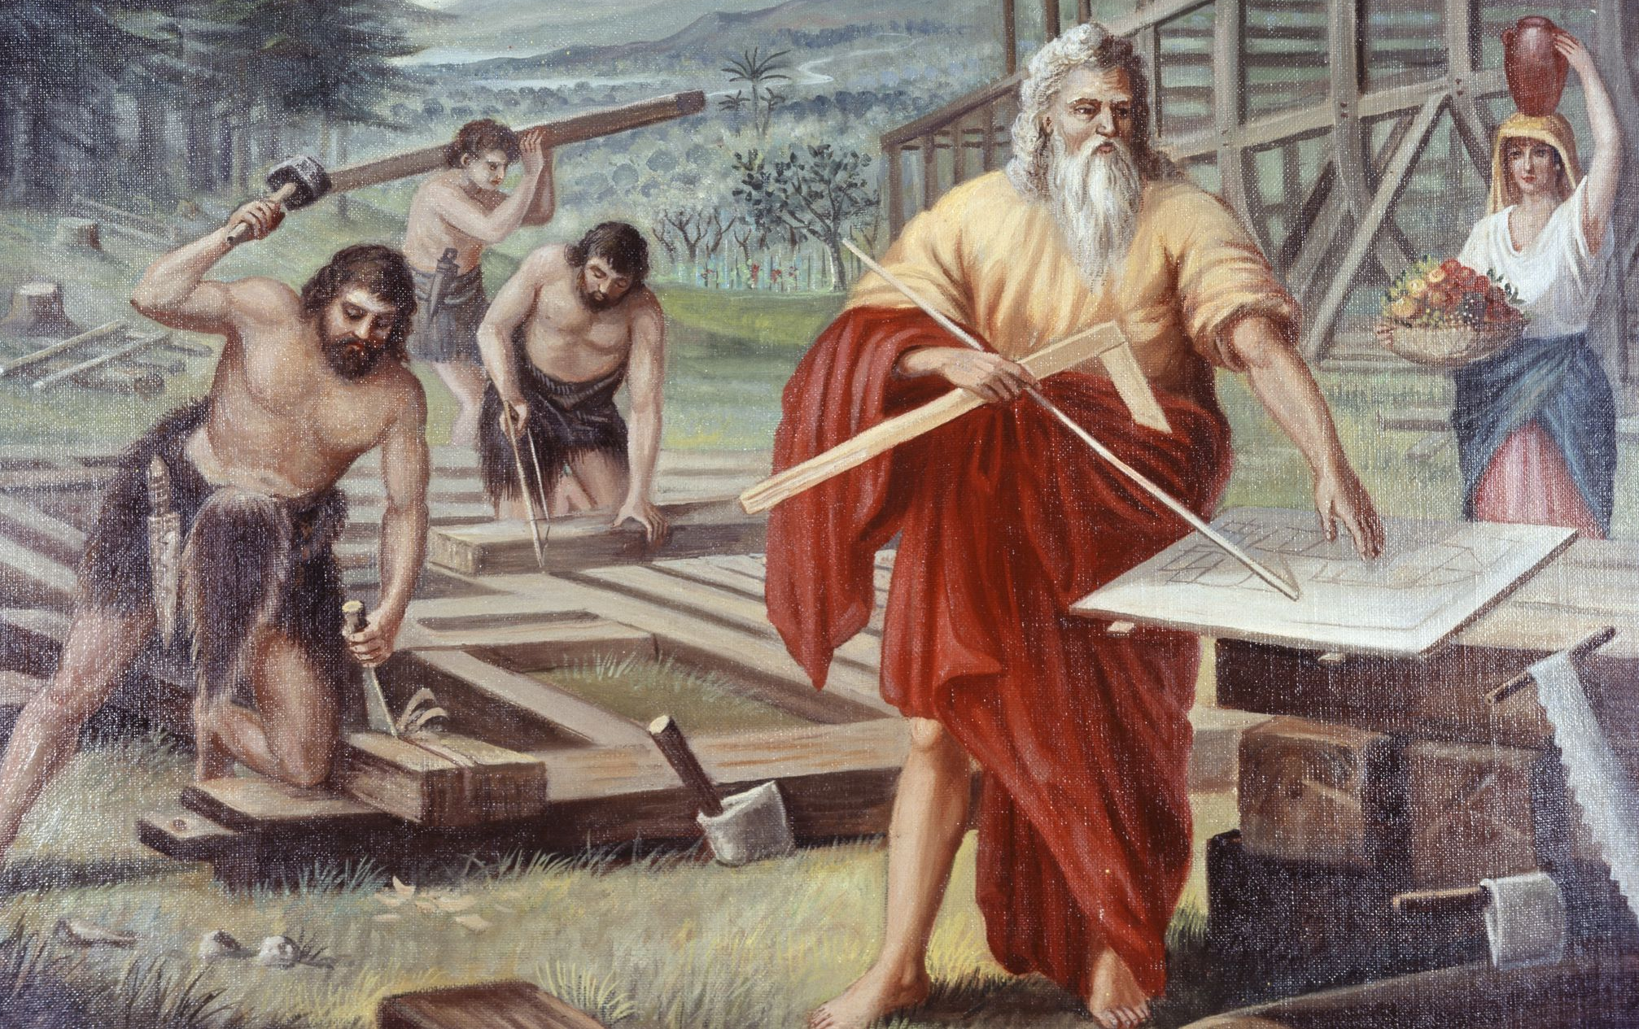
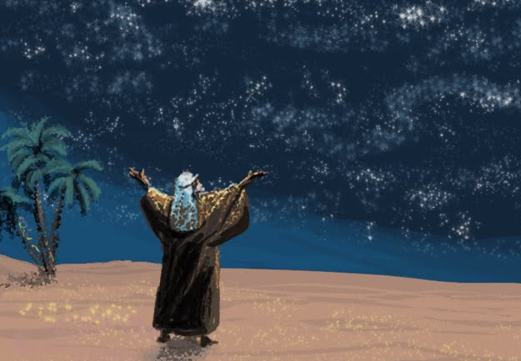
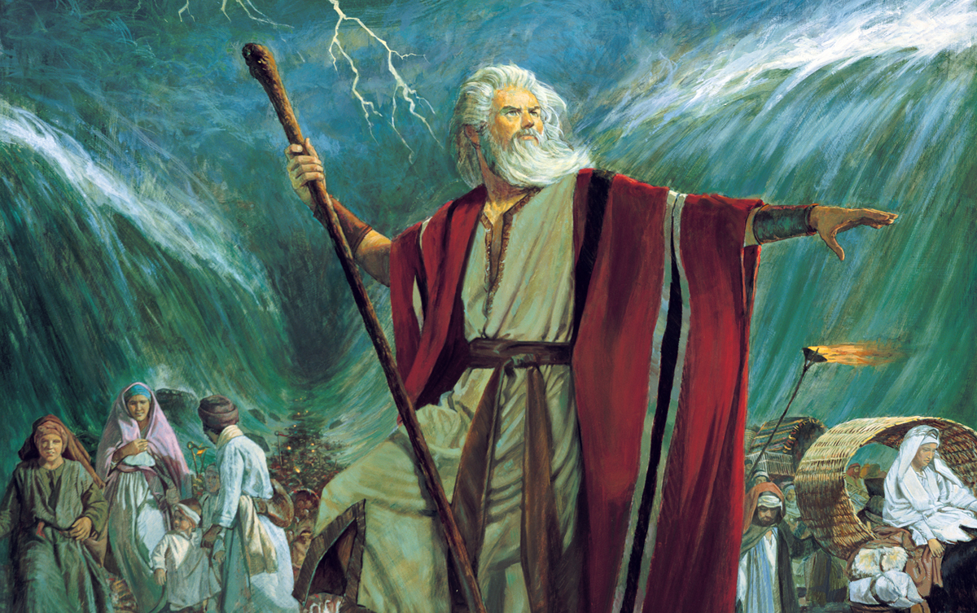
Examples in Faith:
Hebrews 11
Noah
Abraham
Moses

Slide 38
Examples in Faith:
Hebrews 11
Faith and faithfulness are the supreme need of those who await the coming of the Lord. There is danger that some will cast away their confidence because the Lord appears to delay His coming.

Slide 39
Examples in Faith:
Hebrews 11
All such “have need of patience” in order that they may “live by faith.” To a man, the worthies listed here “received not the promise” but only saw it “afar off.” Nevertheless, “these all…obtained a good report through faith.”

Slide 40
Examples in Faith:
Hebrews 11
If the worthies of ages past were so fully persuaded of the promises, “afar off” though they were from their fulfillment, should not we, who are to see them fulfilled, in “a little while” be patient and faithful also?

Slide 41
Examples in Faith:
Hebrews 11:1-3
11 Now faith is the substance of things hoped for, the evidence of things not seen.
² For by it the elders obtained a good report.
³ Through faith we understand that the worlds were framed by the word of God, so that things which are seen were not made of things which do appear.

Slide 42
Examples in Faith:
Hebrews 11
“Substance” is translated from the Greek hupostasis, “substantial nature,” “essence,” “actual being,” “reality.” Hupostasis is used in the ancient papyri of the legal documents by which a person proved his ownership of property. The documents were not the property, but they provided evidence of its existence and his right to it. Accordingly, hupostasis might here be rendered, “title-deed”–
“Faith is the title-deed of things hoped for…”

Slide 43
Examples in Faith:
Hebrews 11
“Evidence” is translated from the Greek elegchos, here meaning “proof,” “conviction.” Faith is not an abstract belief that evidence exists, but a settle assurance, based on a confidence that God will fulfill His promises. We may never have seen the generator that produces the electricity we use in our homes, but we rightly consider the presence of electricity sufficient evidence of the existence of the generator. Similarly, we believe that our physical, mental, and spiritual energy testify to the existence of a supernatural Source of life and power.

Slide 44
Examples in Faith:
Hebrews 11
By faith the elders “obtained a good report.” The faith of “the elders” led to faithful conduct, which in turn testified to the reality of their faith. It was their faith that won for them divine approval. If only flawless heroes of faith were listed here, the account would provide little encouragement for the common man. But these people were subject to “like passions as we are,” so there is every reason to believe that even the weakest of God’s children today can likewise obtain a “good report.”

Slide 45
Examples in Faith: Abel
Hebrews 11:4
⁴ By faith Abel offered unto God a more excellent sacrifice than Cain, by which he obtained witness that he was righteous, God testifying of his gifts: and by it he being dead yet speaketh.
By faith Abel grasped the promise of a Redeemer. There was power in Abel’s faith that led him to conform to the course of action God proscribed, and the powerful influence of his faith lives on today.
Abel treasured God’s directions!

Slide 46
Examples in Faith: Enoch
Hebrews 11:5-6
⁵ By faith Enoch was translated that he should not see death; and was not found, because God had translated him: for before his translation he had this testimony, that he pleased God.
⁶ But without faith it is impossible to please him: for he that cometh to God must believe that he is, and that he is a rewarder of them that diligently seek him.
Enoch treasured God’s company!

Slide 47
Examples in Faith: Noah
Hebrews 11:7
⁷ By faith Noah, being warned of God of things not seen as yet, moved with fear, prepared an ark to the saving of his house; by the which he condemned the world, and became heir of the righteousness which is by faith.
Noah treasured God’s Word.

Slide 48
Examples in Faith: Abraham
Hebrews 11:8-10
⁸ By faith Abraham, when he was called to go out into a place which he should after receive for an inheritance, obeyed; and he went out, not knowing whither he went.
⁹ By faith he sojourned in the land of promise, as in a strange country, dwelling in tabernacles with Isaac and Jacob, the heirs with him of the same promise:
¹⁰ For he looked for a city which hath foundations, whose builder and maker is God.
Abraham treasured God’s promises.

Slide 49
Examples in Faith: Sara
Hebrews 11:11-12
¹¹ Through faith also Sara herself received strength to conceive seed, and was delivered of a child when she was past age, because she judged him faithful who had promised.
¹² Therefore sprang there even of one, and him as good as dead, so many as the stars of the sky in multitude, and as the sand which is by the sea shore innumerable.
Sara treasured God’s promises too... Although it took her a while to trust!

Slide 50
Examples in Faith:
Hebrews 11:13-16
¹³ These all died in faith, not having received the promises, but having seen them afar off, and were persuaded of them, and embraced them, and confessed that they were strangers and pilgrims on the earth.
¹⁴ For they that say such things declare plainly that they seek a country.

Slide 51
Examples in Faith:
Hebrews 11:13-16
The elders here named are singled out as shining examples of the principle that faith is the decisive factor in godly living. They saw the promises afar off—by faith. They were persuaded of the reality of the promised inheritance. On the basis of these promises they renounced the present and lived exclusively for the future. They never entered into possession of the inheritance, either of the promised earthly Canaan or of the eternal kingdom.

Slide 52
Examples in Faith:
Hebrews 11:15-16
¹⁵ And truly, if they had been mindful of that country from whence they came out, they might have had opportunity to have returned.
¹⁶ But now they desire a better country, that is, an heavenly: wherefore God is not ashamed to be called their God: for he hath prepared for them a city.

Slide 53
Examples in Faith:
Hebrews 11:13-16
He is not “ashamed” to be known as their God because they reflect His character. Christ warned that in the last great day He will be “ashamed” of every man who has made the attempt to “save his life” by gaining what the world has to offer (Mark 8:34-38). On the other hand, the man who is willing to “lose”—forfeit—his life for Christ will actually be saving it.

Slide 54
Examples in Faith: Abraham
Hebrews 11:17-19
¹⁷ By faith Abraham, when he was tried, offered up Isaac: and he that had received the promises offered up his only begotten son,
¹⁸ Of whom it was said, That in Isaac shall thy seed be called:
¹⁹ Accounting that God was able to raise him up, even from the dead; from whence also he received him in a figure.
That is a LOT of faith in God’s promises! It must have appeared to Abraham that God was on the point of rendering His promises utterly impossible. But Abraham trusted Him anyway!

Slide 55
Examples in Faith: Isaac
Hebrews 11:20
²⁰ By faith Isaac blessed Jacob and Esau concerning things to come.
To Isaac, when he realized the deception that had been practiced upon him, the future of his family must have loomed dark indeed. His plans for Esau had been shattered. He was blind physically, but he lifted his eyes of faith and discerned the shape of things to come, the way by which the infinite purpose of God was to be accomplished.

Slide 56
Examples in Faith: Jacob
Hebrews 11:21
²¹ By faith Jacob, when he was a dying, blessed both the sons of Joseph; and worshipped, leaning upon the top of his staff.
Jacob sojourned, and eventually died, in a land of exile. Thus he revealed faith in the divine promises when he pronounced blessings on his sons.

Slide 57
Examples in Faith: Joseph
Hebrews 11:22
²² By faith Joseph, when he died, made mention of the departing of the children of Israel; and gave commandment concerning his bones.
Joseph had no direct evidence on which to base his expectation that the family would return to Canaan and occupy the land, but his request to be interred there when the family should return to dwell in Canaan was based in faith.

Slide 58
Examples in Faith: Moses
Hebrews 11:23-29
²³ By faith Moses, when he was born, was hid three months of his parents, because they saw he was a proper child; and they were not afraid of the king's commandment.
²⁴ By faith Moses, when he was come to years, refused to be called the son of Pharaoh's daughter;

Slide 59
Examples in Faith: Moses
Hebrews 11:25-29
²⁵ Choosing rather to suffer affliction with the people of God, than to enjoy the pleasures of sin for a season;
²⁶ Esteeming the reproach of Christ greater riches than the treasures in Egypt: for he had respect unto the recompence of the reward.
Moses understood the promise of the Messiah, and realized that more was involved in the liberation of the Hebrew people from Egypt than either they or the Egyptians realized at the time. Afar off his eye of faith saw the coming of the seed promised to Abraham through whom all nations would be blessed.

Slide 60
Examples in Faith: Moses
Hebrews 11:27-29
²⁷ By faith he forsook Egypt, not fearing the wrath of the king: for he endured, as seeing him who is invisible.
²⁸ Through faith he kept the passover, and the sprinkling of blood, lest he that destroyed the firstborn should touch them.
²⁹ By faith they passed through the Red sea as by dry land: which the Egyptians assaying to do were drowned.

Slide 61
Examples in Faith: Joshua
Hebrews 11:30
³⁰ By faith the walls of Jericho fell down, after they were compassed about seven days.
From a military point of view the procedure Joshua took to subdue Jericho was sheer folly, but the orders he issued were in accord with the instructions God had given him. As an experienced general, he might well have substituted what would have appeared to be a better plan. But Joshua was a man of great faith as well as of great military experience, and he was ready to place more confidence in God’s revealed will than in his own knowledge of war.

Slide 62
Examples in Faith: Rahab
Hebrews 11:31
³¹ By faith the harlot Rahab perished not with them that believed not, when she had received the spies with peace.
Rahab, unbelievably, trusted a foreign God more than all of the prowess and heathen deities of her own people. Her remarkable faith that “the Lord your God, he is God in heaven above and in earth beneath” shines across all the intervening centuries.

Slide 63
Examples in Faith:
Hebrews 11:32-40
³² And what shall I more say? for the time would fail me to tell of Gedeon, and of Barak, and of Samson, and of Jephthae; of David also, and Samuel, and of the prophets:
³³ Who through faith subdued kingdoms, wrought righteousness, obtained promises, stopped the mouths of lions.

Slide 64
Examples in Faith:
Hebrews 11:34-40
³⁴ Quenched the violence of fire, escaped the edge of the sword, out of weakness were made strong, waxed valiant in fight, turned to flight the armies of the aliens.
³⁵ Women received their dead raised to life again: and others were tortured, not accepting deliverance; that they might obtain a better resurrection:

Slide 65
Examples in Faith:
Hebrews 11:36-40
³⁶ And others had trial of cruel mockings and scourgings, yea, moreover of bonds and imprisonment:
³⁷ They were stoned, they were sawn asunder, were tempted, were slain with the sword: they wandered about in sheepskins and goatskins; being destitute, afflicted, tormented;

Slide 66
Examples in Faith:
Hebrews 11:38-40
³⁸ (Of whom the world was not worthy:) they wandered in deserts, and in mountains, and in dens and caves of the earth.
³⁹ And these all, having obtained a good report through faith, received not the promise:
⁴⁰ God having provided some better thing for us, that they without us should not be made perfect.

Slide 67
The Exhortation: Prioritize Properly!
Hebrews 12:1-2
12 Wherefore seeing we also are compassed about with so great a cloud of witnesses, let us lay aside every weight, and the sin which doth so easily beset us, and let us run with patience the race that is set before us,
² Looking unto Jesus the author and finisher of our faith; who for the joy that was set before him endured the cross, despising the shame, and is set down at the right hand of the throne of God.

Slide 68
The Exhortation: Prioritize Properly!
The Christian race is a lifelong experience. It calls for perseverance in the face of successive difficulties and disappointments, and patience to await the reward at the end of the course. We look to Jesus for grace and strength to overcome every difficulty and to endure unto the end.

Slide 69
The Exhortation: Prioritize Properly!
As Peter found when he essayed to walk on the wind-tossed waves of Galilee, it is dangerous to turn one’s eyes away from the Savior, even for a moment. To keep the eye of faith fixed upon Jesus is to maintain uninterrupted contact with Him who is the source of power, Him who can strengthen us to endure an to overcome.

Slide 70
The Exhortation: Prioritize Properly!
But keeping our focus—our eye of faith—so singularly upon our Savior means necessarily that we must turn our focus away from other things in life. In order to lay up treasures of faith in heaven, we must turn our attention from the glitter of earthly treasure.
Our focus, of necessity, must be exclusive. But what a view we have, surrounded by “so great a cloud of witnesses” with our vision fixed to our glorious Lord!

Slide 71
Thank you, and
Happy Sabbath!

