Slide 1
Unto the Least of These
Luke 4, Isaiah 61
Lesson 7, 1st Quarter 2023

Slide 2
Memory Text: Matthew 25:34
³⁴ Then shall the King say unto them on his right hand, Come, ye blessed of my Father, inherit the kingdom prepared for you from the foundation of the world:

Slide 3
SDA Quarterly Sunday, February 12, 2023
The Life and Ministry of Jesus
Early in Jesus’ public ministry, He traveled to Nazareth, in the region of Galilee. This was His hometown, and the local people already had heard of His work and miracles. As His custom was, Jesus attended Sabbath services in the synagogue. Though Jesus was not the officiating rabbi, the attendant handed Him the Isaiah scroll and asked Him to give the Scripture reading. Jesus read Isaiah 61:1, 2.

Slide 4
Isaiah 61:1-2
61 The Spirit of the Lord God is upon me; because the Lord hath anointed me to preach good tidings unto the meek; he hath sent me to bind up the brokenhearted, to proclaim liberty to the captives, and the opening of the prison to them that are bound;
² To proclaim the acceptable year of the Lord, and the day of vengeance of our God; to comfort all that mourn;

Slide 5
SDA Quarterly Sunday, February 12, 2023
The Life and Ministry of Jesus
Because the religious leaders apparently had overlooked the prophecies that spoke of a suffering Messiah and had misapplied those that pointed to the glory of His Second Coming (which should serve as a reminder to us of how important understanding prophecy really is), most of the people believed the false idea that the Messiah’s mission was to free Israel from its conquerors and oppressors, the Romans. To think that the Messiah’s mission statement came from Isaiah 61:1, 2 must have been a real shock.

Slide 6
SDA Quarterly Sunday, February 12, 2023
The Life and Ministry of Jesus
The poor usually were looked down upon by unscrupulous officials such as tax collectors, those in business, and even their own neighbors. It commonly was thought that poverty was the curse of God and that their unfortunate condition must have been their own fault. With this mindset, few people had any concern for the poor and their unhappy plight.

Slide 7
SDA Quarterly Sunday, February 12, 2023
The Life and Ministry of Jesus
Yet Jesus’ love for the poor was one of the greatest evidences of His Messiahship, as seen by how Jesus answered John the Baptist’s question about Him as the Messiah (see Matt. 11:1-6). “Like the Saviour’s disciples, John the Baptist did not understand the nature of Christ’s kingdom. He expected Jesus to take the throne of David; and as time passed, and the Saviour made no claim to kingly authority, John became perplexed and troubled.” — Ellen G. White, The Desire of Ages, p. 215.

Slide 8
Social Context: Desire of Ages pgs. 29-30
While the Jews desired the advent of the Messiah, they had no true conception of His mission. They did not seek redemption from sin, but deliverance from the Romans. They looked for the Messiah to come as a conqueror, to break the oppressor's power, and exalt Israel to universal dominion. Thus the way was prepared for them to reject the Saviour.

Slide 9
Social Context: Desire of Ages pgs. 29-30
At the time of the birth of Christ the nation was chafing under the rule of her foreign masters, and ra cked with internal strife. The Jews had been permitted to maintain the form of a separate government; but nothing could disguise the fact that they were under the Roman yoke, or reconcile them to the restriction of their power.

Slide 10
Social Context: Desire of Ages pgs. 29-30
The Romans claimed the right of appointing and removing the high priest, and the office was often secured by fraud, bribery, and even murder. Thus the priesthood became more and more corrupt. Yet the priests still possessed great power, and they employed it for selfish and mercenary ends. The people were subjected to their merciless demands, and were also heavily taxed by the Romans.

Slide 11
Social Context: Desire of Ages pgs. 29-30
This state of affairs caused widespread discontent. Popular outbreaks were frequent. Greed and violence, distrust and spiritual apathy, were eating out the very heart of the nation.
Hatred of the Romans, and national and spiritual pride, led the Jews still to adhere rigorously to their forms of worship.

Slide 12
Social Context: Desire of Ages pgs. 29-30
The priests tried to maintain a reputation for sanctity by scrupulous attention to the ceremonies of religion. The people, in their darkness and oppression, and the rulers, thirsting for power, longed for the coming of One who would vanquish their enemies and restore the kingdom to Israel. They had studied the prophecies, but without spiritual insight.

Slide 13
Social Context: Desire of Ages pgs. 29-30
Thus they overlooked those scriptures that point to the humiliation of Christ's first advent, and misapplied those that speak of the glory of His second coming. Pride obscured their vision. They interpreted prophecy in accordance with their selfish desires.

Slide 14
Temporal Context: Luke 4
Shortly after the temptations in the wilderness, Jesus returned to Galilee, the region in which He had grown up. There He began to teach the people. Word spread about His activities and “there went out a fame of Him through all the region round about.”

Slide 15
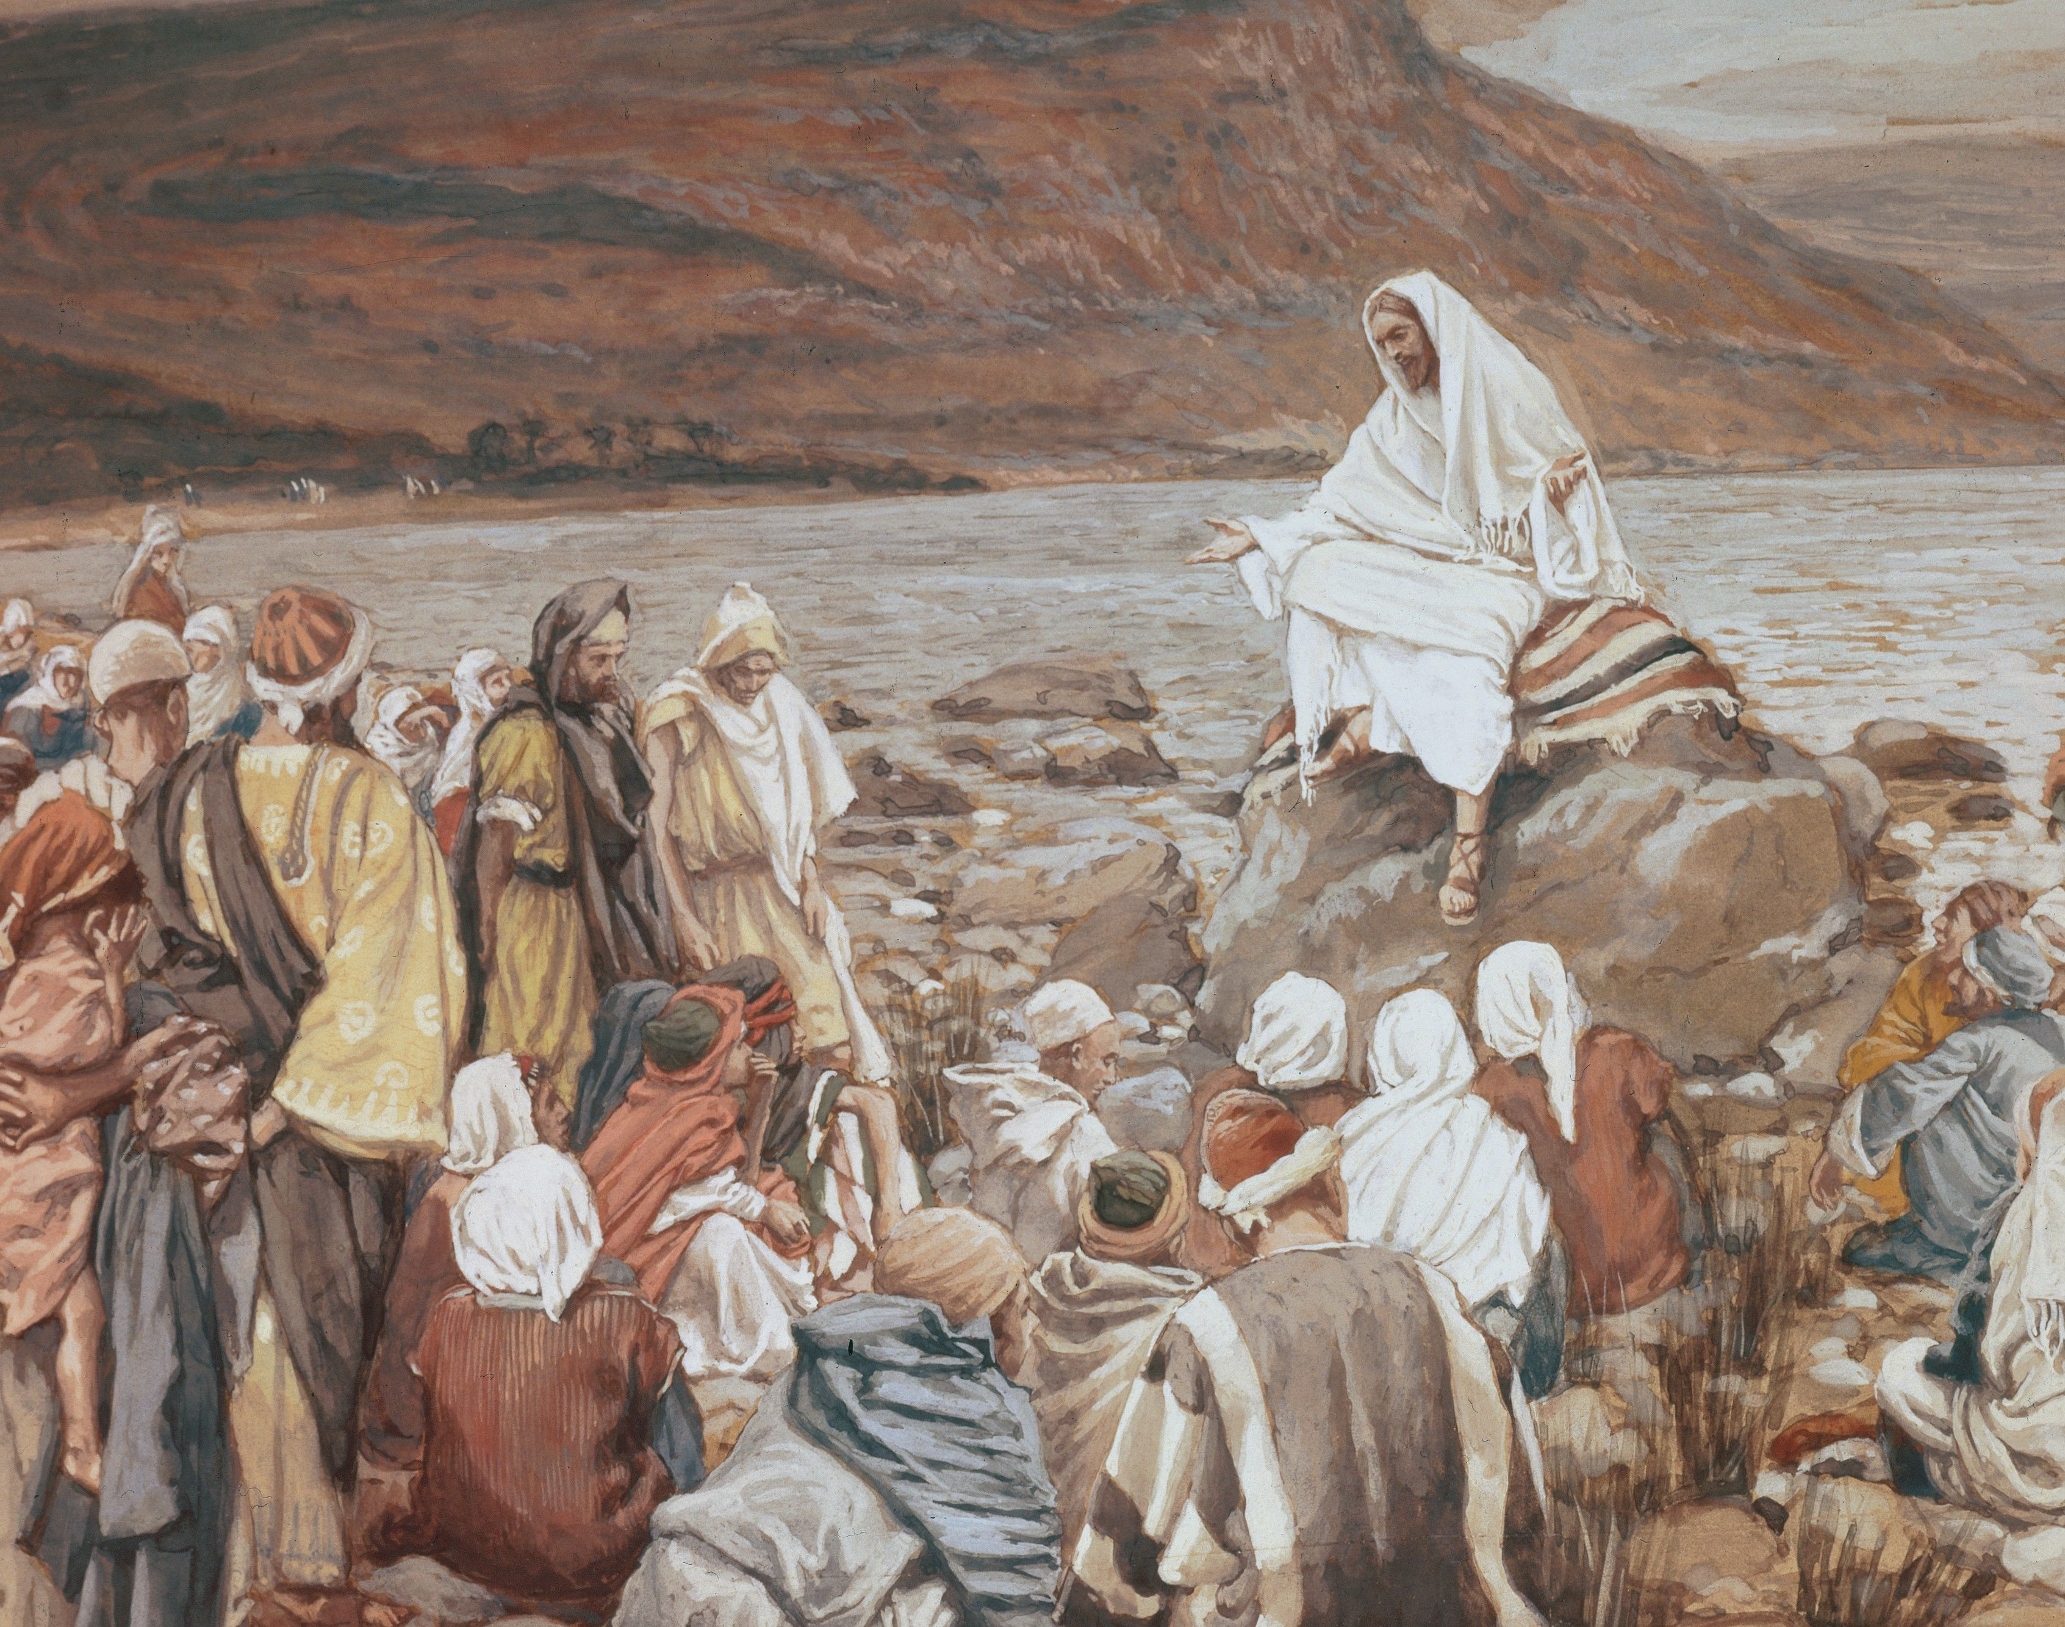
Luke 4:14-16
¹⁴ And Jesus returned in the power of the Spirit into Galilee: and there went out a fame of him through all the region round about.

Slide 16
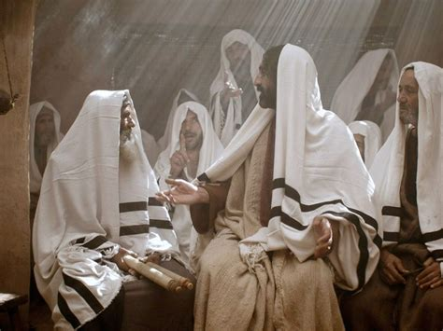
Luke 4:15-16
¹⁵ And he taught in their synagogues, being glorified of all.

Slide 17
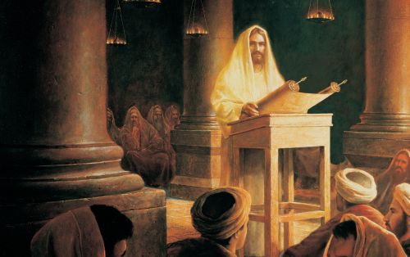
Luke 4:16
¹⁶ And he came to Nazareth, where he had been brought up: and, as his custom was, he went into the synagogue on the sabbath day, and stood up for to read.

Slide 18
Jesus in Church: Desire of Ages pg. 236
During His childhood and youth, Jesus had worshiped among His brethren in the synagogue at Nazareth. Since the opening of His ministry He had been absent from them, but they had not been ignorant of what had befallen Him. As He again appeared among them, their interest and expectation were excited to the highest pitch.

Slide 19
Jesus in Church: Desire of Ages pg. 236
Here were the familiar forms and faces of those whom He had known from infancy. Here were His mother, His brothers and sisters, and all eyes were turned upon Him as He entered the synagogue upon the Sabbath day, and took His place among the worshipers.

Slide 20
Jesus in Church: Desire of Ages pg. 236
When a rabbi was present at the synagogue, he was expected to deliver the sermon, and any Israelite might give the reading from the prophets. Upon this Sabbath Jesus was requested to take part in the service. He “stood up to read. And there was delivered unto Him a roll of the prophet Isaiah.” The scripture which He read was one that was understood as referring to the Messiah:

Slide 21
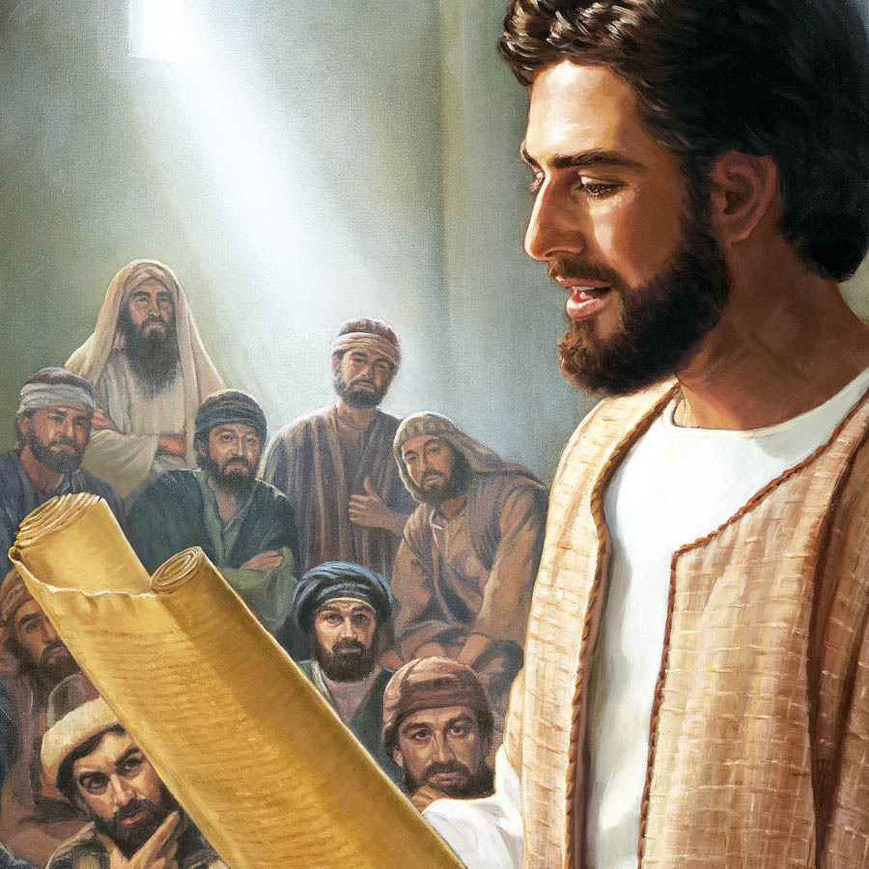
Jesus in Church: Luke 4:16
¹⁶ And he came to Nazareth, where he had been brought up: and, as his custom was, he went into the synagogue on the sabbath day, and stood up for to read.

Slide 22
Customs of the Day
SDABC V5 pg. 56-58
The synagogue was never a place of sacrifice like the Temple at Jerusalem, and thus was not considered a place of worship in the highest sense. During the week the synagogue also often served as a law court (see Mark 13:9), and generally as a school. The synagogue was essentially a place for scriptural instruction and for prayer.

Slide 23
Customs of the Day
SDABC V5 pg. 56-58
The priests were not directly connected with the administration of the synagogues, for there were no sacrifices, though they were often invited to participate in the services. The affairs of each synagogue and of the community attached to it were under the supervision of a board of elders, or rulers.

Slide 24
Customs of the Day
SDABC V5 pg. 56-58
The chief officer, the ruler of the synagogue, presided at the services or arranged for others to do so, and appointed suitable men from the congregation to pray, to read the Scriptures, and to exhort the congregation. There was no clergy as such.

Slide 25
Customs of the Day
SDABC V5 pg. 56-58
There was at least one lesser officer, a chazzan—equivalent to a deacon in the Christian church—who cared for the humbler duties, such as taking the rolls of the Law and the Prophets from the ark and replacing them, and inflicting corporal punishment decided upon by the elders.

Slide 26
Customs of the Day
SDABC V5 pg. 56-58
The main room of the synagogue was provided with a reading desk (podium), a seat for the expounder, and a chest, or ark, that contained the rolls of the Law and the Prophets. There were seats, or benches, at least for the wealthier members of the congregation, those in front near the reader’s desk being considered the “chief seats.”

Slide 27
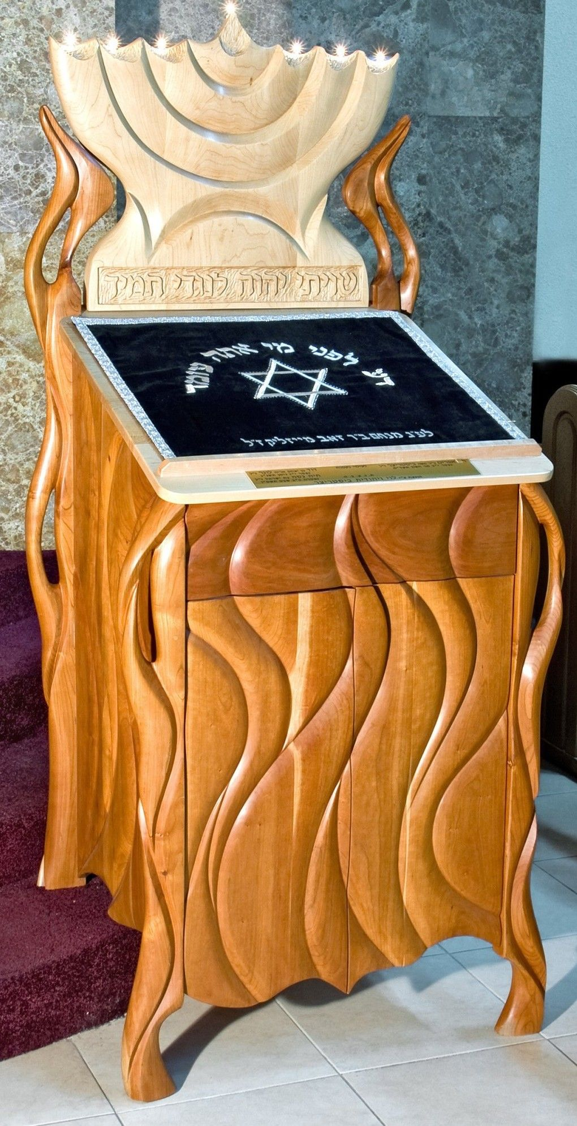
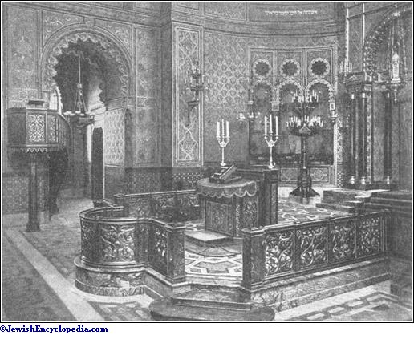
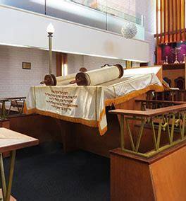
A Reading Desk

Slide 28
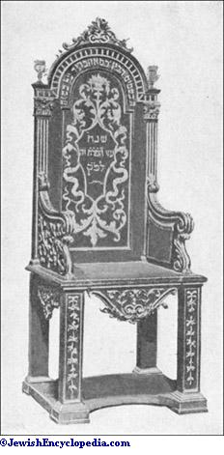
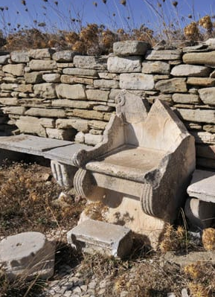
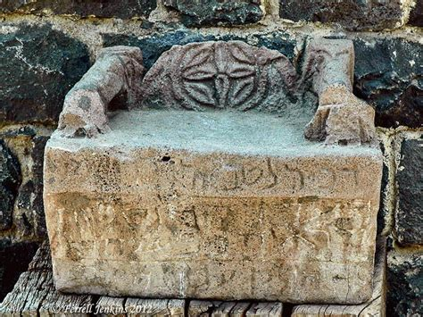
A Seat for the Expounder

Slide 29
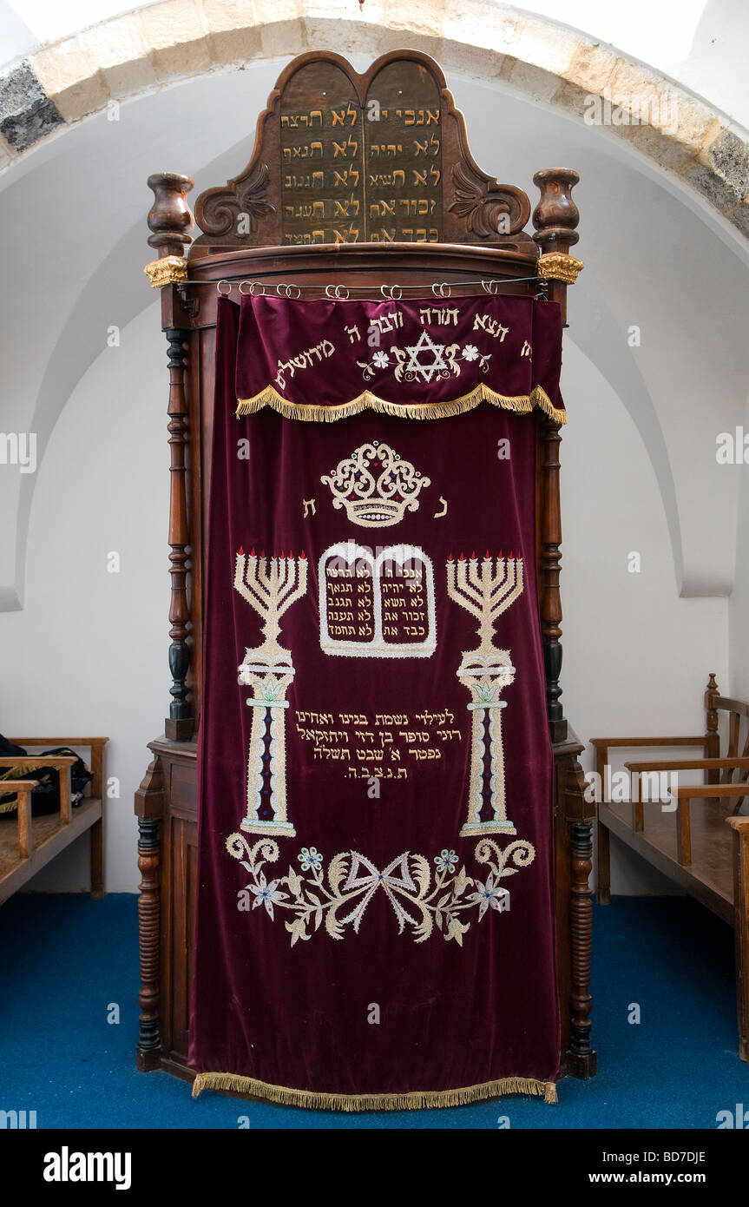
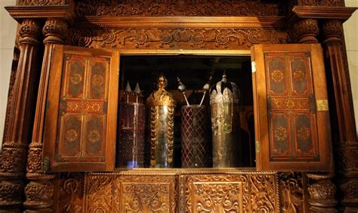
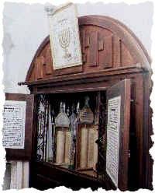
A Chest or Ark

Slide 30
Customs of the Day
SDABC V5 pg. 727
Reverence for the written Word required that the one reading it publicly remain standing. The Law and the Prophets were read thus, but not the Writings, which did not then enjoy equal status.

Slide 31
Customs of the Day
SDABC V1 pg. 37
The Hebrew Old Testament consisted of 24 books in 3 divisions:
The Law (torah) containing the five books of Moses, or the Pentateuch
The Prophets (nebi’im) containing Joshua, Judges, (1 & 2) Samuel, (1 & 2) Kings, Isaiah, Jeremiah, Ezekiel, and the twelve Minor Prophets as one book.
The Writings (kethubim) consisting of the remaining eleven books. Ezra/Nehemiah was considered one book, as was 1st and 2nd Samuel.

Slide 32
Customs of the Day
SDABC V5 pg. 56-58
Attendance [at the synagogue] was required on Sabbaths and feast days, and it was considered a meritorious act to take part in the service, which by modern standards was rather long. Authorities differ as to the details of the synagogue service in the 1st century… The following outline, however, is probably a close approximation to the order of service in the synagogue as Jesus and the apostles knew it.

Slide 33
The Synagogue Service (1)
SDABC V5 pg. 57-58
1: Recitation in unison of the shema’—a confession of faith chiefly from such passages as Deut. 6:4-9; 11:13-21; Num. 15:37-41—before and after which a member of the congregation stood before the ark of the Law to offer, on the Sabbath, a sevenfold prayer (18 parts on other days), each part of which was confirmed by the “Amen!” of the congregation. Between the 6th and 7th parts of this prayer, priests, if present, ascended the platform of the ark, lifted their hands, and pronounced in unison the Aaronic blessing from Lev. 9:22 and Num. 6:23-27.

Slide 34
The Synagogue Service (1)
The Recitation (shema’): Deuteronomy 6:4-9
⁴ Hear, O Israel: The Lord our God is one Lord:
⁵ And thou shalt love the Lord thy God with all thine heart, and with all thy soul, and with all thy might.
⁶ And these words, which I command thee this day, shall be in thine heart:

Slide 35
The Synagogue Service (1)
The Recitation (shema’): Deuteronomy 6:4-9
⁷ And thou shalt teach them diligently unto thy children, and shalt talk of them when thou sittest in thine house, and when thou walkest by the way, and when thou liest down, and when thou risest up.

Slide 36
The Synagogue Service (1)
The Recitation (shema’): Deuteronomy 6:4-9
⁸ And thou shalt bind them for a sign upon thine hand, and they shall be as frontlets between thine eyes.
⁹ And thou shalt write them upon the posts of thy house, and on thy gates.

Slide 37
The Synagogue Service (1)
The Aaronic Blessing: Numbers 6:24-27
²⁴ The Lord bless thee, and keep thee:
²⁵ The Lord make his face shine upon thee, and be gracious unto thee:
²⁶ The Lord lift up his countenance upon thee, and give thee peace.
²⁷ And they shall put my name upon the children of Israel, and I will bless them.

Slide 38
The Synagogue Service (2)
SDABC V5 pg. 57-58
2: The parashah, or reading of the appointed section of the Law. Reverence for the Law required that the scroll be unrolled behind a curtain, out of sight of the congregation. The Law—the five books of Moses—was read through in a three-year cycle, with a definite portion assigned for each Sabbath. Each of those portions was divided into seven parts of at least 3 verses each.

Slide 39
The Synagogue Service (2)
SDABC V5 pg. 57-58
(2) A different member of the congregation was called upon to read each of these subdivisions. Anyone who made the least mistake was immediately replaced by someone else. The reading of the Law was translated verse by verse from Hebrew into Aramaic, the language of the common people, by another person, to avoid the possibility that the translation should be mistaken for the actual text of the Scriptures.

Slide 40
The Synagogue Service (3)
SDABC V5 pg. 57-58
3: The haphtarah, or reading from the Prophets. Considered as less sacred than the Law, the scroll of the Prophets had one roller rather than two, like the Law, and might be unrolled in the sight of the congregation. There is no evidence that a cycle for the reading of the Prophets was followed during the time of Christ.

Slide 41
The Synagogue Service (3)
SDABC V5 pg. 57-58
(3) Therefore, the scroll was probably handed to the one appointed by the ruler of the synagogue to read, and he chose the passage to be read. It was this part of the service in which Jesus participated in the synagogue at Nazarath; using a reading from Isa. 61, He declared to the people His mission and its prophetic authorization.

Slide 42
The Synagogue Service (3)
SDABC V5 pg. 57-58
(3) The one who read from the Prophets was called the “dismisser” in view of the fact that this, together with his remarks and exhortation based on the passage read, constituted the closing part of the service.

Slide 43
The Synagogue Service (4)
SDABC V5 pg. 57-58
4: The derashah, or “investigation,” “study,” a sermon usually given by a member of the congregation. Like the readers from the Law, the one who read the haphtarah remained standing while he read. But for the sermon he sat down. It was customary in Palestine (but not in the Diaspora) to sit down to preach.

Slide 44
The Synagogue Service (4)
SDABC V5 pg. 57-58
(4) The sermon was usually based on the reading from the Prophets, but might also include that from the Law. In these discussions upon the prophetic messages, the speakers’ imagination often went far afield, through paraphrase, parable, or legend, in emphasizing what he understood the prophetic message to be. Visitors were often honored by being invited to deliver the discourse.

Slide 45
The Synagogue Service (5)
SDABC V5 pg. 57-58
5: The sermon was followed by the benediction. This was offered by a priest, if one was present; otherwise a prayer was offered. In some places the singing of songs was introduced into the service.

Slide 46
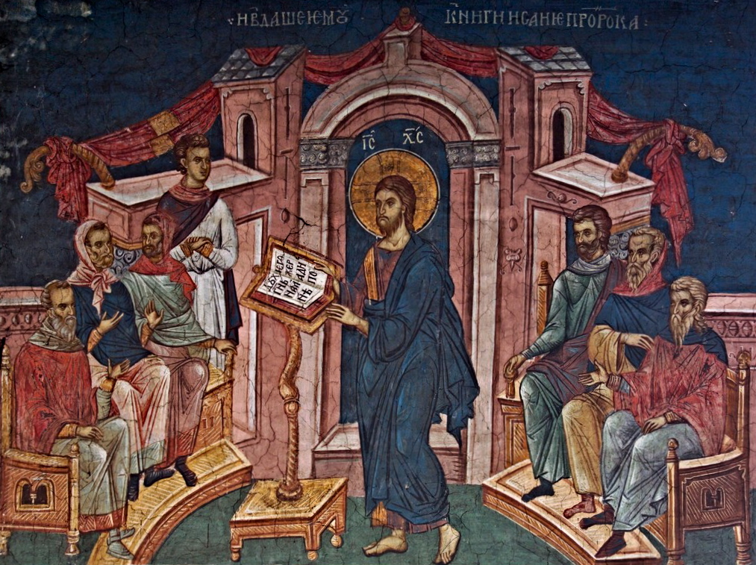
Luke 4:16-29
¹⁶ And he came to Nazareth, where he had been brought up: and, as his custom was, he went into the synagogue on the sabbath day, and stood up for to read.

Slide 47
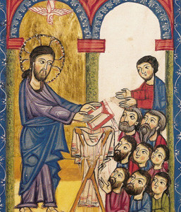
Luke 4:17-30
¹⁷ And there was delivered unto him the book of the prophet Esaias. And when he had opened the book, he found the place where it was written,

Slide 48
Luke 4 and Isaiah 61
Luke 4:18
Isaiah 61:1
The Spirit of the Lord is upon me, because he hath anointed me to preach the gospel to the poor; he hath sent me to heal the brokenhearted, to preach deliverance to the captives, and recovering of sight to the blind, to set at liberty them that are bruised,
The Spirit of the Lord God is upon me; because the Lord hath anointed me to preach good tidings unto the meek; he hath sent me to bind up the brokenhearted, to proclaim liberty to the captives, and the opening of the prison to them that are bound;

Slide 49
Luke 4 and Isaiah 61
Luke 4:19
Isaiah 61:2
¹⁹ To preach the acceptable year of the Lord.
² To proclaim the acceptable year of the Lord, and the day of vengeance of our God; to comfort all that mourn;

Slide 50
On Isaiah 61:1-3
SDABC V4 pg. 317
Ancient Jewish expositors recognized the Messianic import of this and many other passages in Isaiah. Verses 1-3 present a graphic picture of what the Messiah was to have accomplished for His people Israel as individuals and as a nation. Because of their rejection of Jesus as the Messiah, however, the nation as such forfeited the ministry and favor of Messiah.

Slide 51
On Isaiah 61:1-3
SDABC V4 pg. 317; V5 pg. 728
To preach good tidings to the meek/to preach the gospel to the poor…
Christ’s message was for the poor and meek in spirit. Perhaps Jesus was thinking also of the poor in spirit--those who sense their spiritual need. In fact, there is little use preaching the gospel to any but those who feel their need of something more than this world has to offer.

Slide 52
On Isaiah 61:1-3
SDABC V4 pg. 317; V5 pg. 728
To bind up the brokenhearted/to heal the brokenhearted…
Jesus came to assuage the suffering of those who are grieved and weary of their burden of sin. The “brokenhearted” here may be compared with those who “mourn” over sin, that is, those who are contrite of heart. Jesus came to mend broken hearts.

Slide 53
On Isaiah 61:1-3
SDABC V4 pg. 317; V5 pg. 728
To proclaim liberty to the captives/to preach deliverance to the captives…
Men who yield to sin become its captives and slaves. This does not refer to literal captives, but those who have been captives of Satan. Christ came to free men from the bondage of evil and to make them free in Him.

Slide 54
On Isaiah 61:1-3
SDABC V4 pg. 317; V5 pg. 728
the opening of the prison to them that are bound/ recovering of sight to the blind
The phrase “opening of the prison” in Isaiah 61:1 may be literally rendered “restoring the sight.” This miraculous restoration applies not only to the literally blind, but to the spiritually blind. Jesus came to restore humanity’s “sight” or understanding of God.

Slide 55
On Isaiah 61:1-3
SDABC V4 pg. 318; V5 pg. 728
the opening of the prison to them that are bound/ recovering of sight to the blind
The phrase “opening of the prison” in Isaiah 61:1 may be literally rendered “restoring the sight.” This miraculous restoration applies not only to the literally blind, but to the spiritually blind. Jesus came to restore humanity’s “sight” or understanding in many ways.

Slide 56
On Isaiah 61:1-3
SDABC V5 pg. 729
To set at liberty them that are bruised.
⁶ Is not this the fast that I have chosen? to loose the bands of wickedness, to undo the heavy burdens, and to let the oppressed go free, and that ye break every yoke?
This one doesn’t appear in Isaiah! A paraphrase of Isa. 58:6. In the reading of the Prophets, but not the Law, it was permissible to skip from one passage to another.
Jesus came to free men from the heavy burdens of sin, and from the oppressive rabbinical restrictions placed upon the Jews.

Slide 57
On Isaiah 61:1-3
SDABC V4 pg. 318; V5 pg. 729
To proclaim the acceptable year of the Lord/To preach the acceptable year of the Lord.
That is, the gospel age, when those who feel their spiritual need (the poor in spirit), those with contrite hearts (the brokenhearted), those who have been captives of sin and blinded to spiritual things, and those who have been wounded and crushed by the evil one, may expect a release from sin.

Slide 58
On Isaiah 61:1-3
SDABC V5 pg. 729
At the “acceptable year of the Lord” Jesus ended His reading. The next clause, which was to the patriotic Jew the climax of the entire passage— “the day of vengeance of our God” –He did not read. The Jews fondly believed that salvation was for them and retribution for the Gentiles. They delighted to dwell on the idea that the judgement was reserved for others, and may have been surprised when Jesus did not so much as mention this.

Slide 59
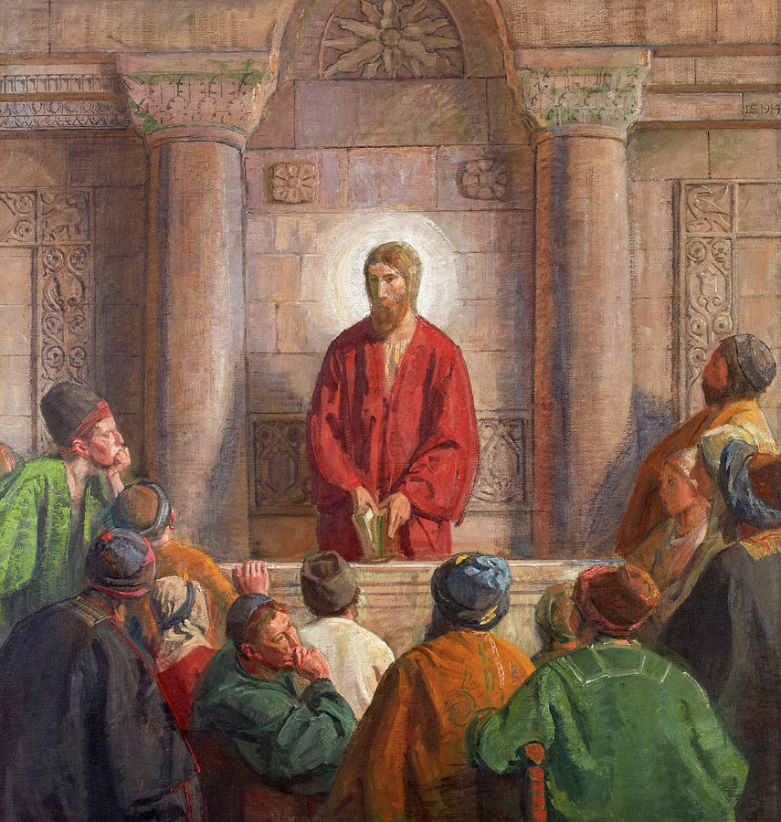
Luke 4:20-30
²⁰ And he closed the book, and he gave it again to the minister, and sat down. And the eyes of all them that were in the synagogue were fastened on him.

Slide 60
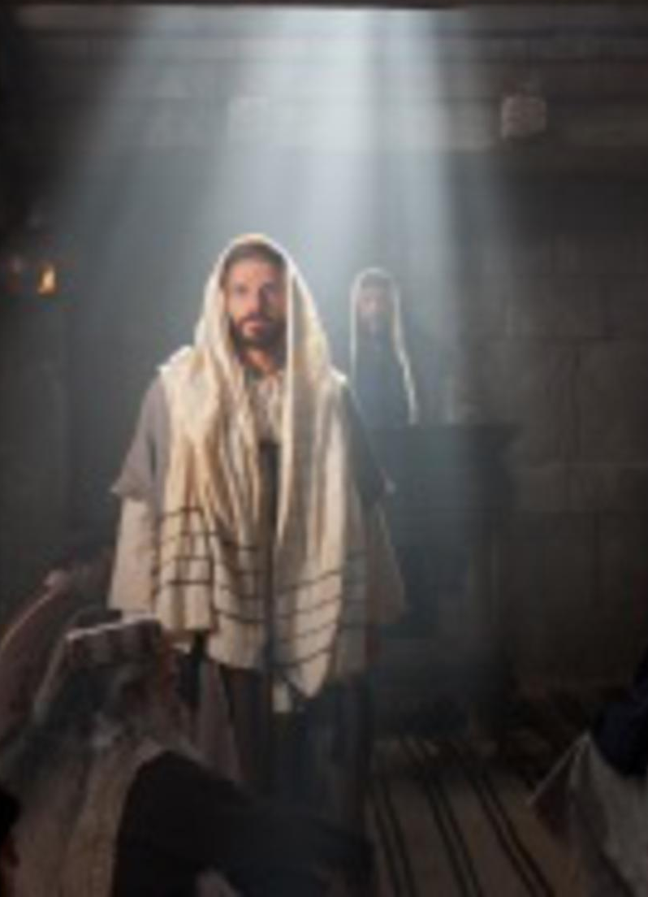
Luke 4:21-30
²¹ And he began to say unto them, This day is this scripture fulfilled in your ears.
²² And all bare him witness, and wondered at the gracious words which proceeded out of his mouth. And they said, Is not this Joseph's son?

Slide 61
Conflict in Church: Desire of Ages pgs. 237
But when Jesus announced, “This day is this scripture fulfilled in your ears,” they were suddenly recalled to think of themselves, and of the claims of Him who had been addressing them. They, Israelites, children of Abraham, had been represented as in bondage. They had been addressed as prisoners to be delivered from the power of evil; as in darkness, and needing the light of truth.

Slide 62
Conflict in Church: Desire of Ages pgs. 237
Their pride was offended, and their fears were roused. The words of Jesus indicated that His work for them was to be altogether different from what they desired. Their deeds might be investigated too closely. Notwithstanding their exactness in outward ceremonies, they shrank from inspection by those clear, searching eyes.

Slide 63
Conflict in Church: Desire of Ages pgs. 237
Who is this Jesus? they questioned. He who had claimed for Himself the glory of the Messiah was the son of a carpenter, and had worked at His trade with His father Joseph. They had seen Him toiling up and down the hills, they were acquainted with His brothers and sisters, and knew His life and labors. They had seen Him develop from childhood to youth, and from youth to manhood.

Slide 64
Conflict in Church: Desire of Ages pgs. 238
Although His life had been spotless, they would not believe that He was the Promised One.
What a contrast between His teaching in regard to the new kingdom and that which they had heard from their elder! Jesus had said nothing of delivering them from the Romans. They had heard of His miracles, and had hoped that His power would be exercised for their advantage, but they had seen no indication of such purpose.

Slide 65
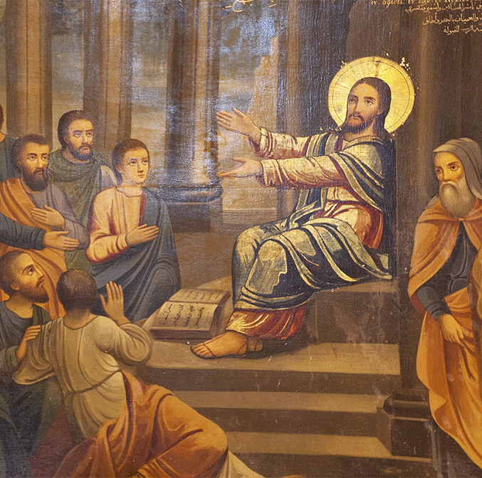
Luke 4:23-30
²³ And he said unto them, Ye will surely say unto me this proverb, Physician, heal thyself: whatsoever we have heard done in Capernaum, do also here in thy country.
²⁴ And he said, Verily I say unto you, No prophet is accepted in his own country.

Slide 66
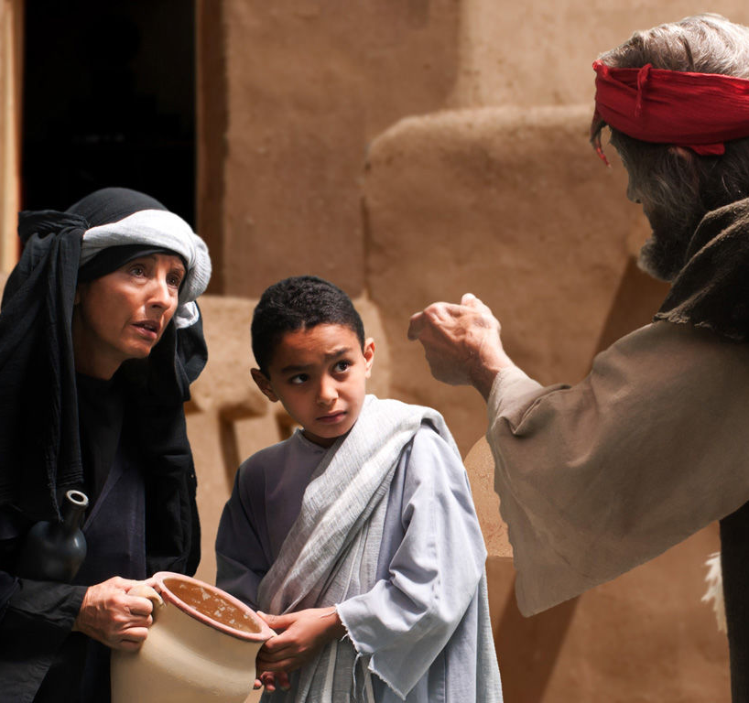
Luke 4:25-30
²⁵ But I tell you of a truth, many widows were in Israel in the days of Elias, when the heaven was shut up three years and six months, when great famine was throughout all the land;
²⁶ But unto none of them was Elias sent, save unto Sarepta, a city of Sidon, unto a woman that was a widow.

Slide 67
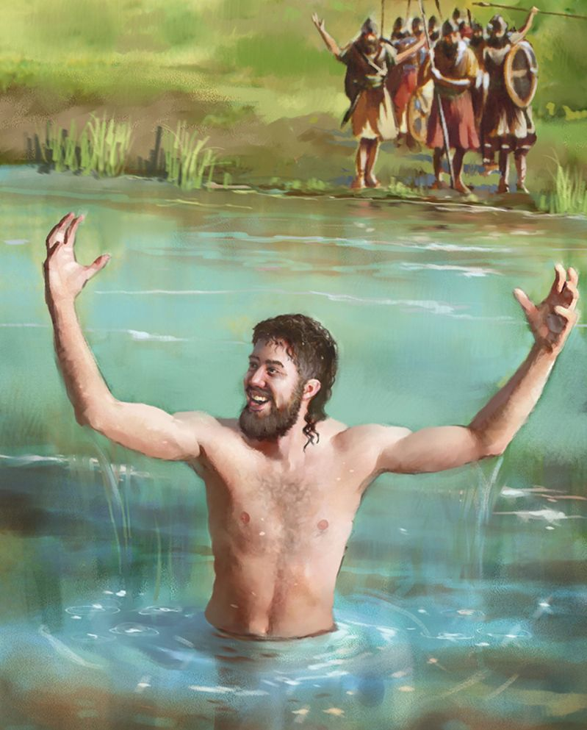
Luke 4:26-30
²⁷ And many lepers were in Israel in the time of Eliseus the prophet; and none of them was cleansed, saving Naaman the Syrian.

Slide 68
Jesus in Church: Desire of Ages pg. 239
The words of Jesus to His hearers in the synagogue struck at the root of their self-righteousness, pressing home upon them the bitter truth that they had departed from God and forfeited their claim to be His people. Every word cut like a knife as their real condition was set before them. They now scorned the faith with which Jesus had at first inspired them.

Slide 69
Jesus in Church: Desire of Ages pg. 239
They would not admit that He who had sprung from poverty and lowliness was other than a common man.
Their unbelief bred malice. Satan controlled them, and in wrath they cried out against the Saviour. They had turned from Him whose mission it was to heal and restore; now they manifested the attributes of the destroyer.

Slide 70
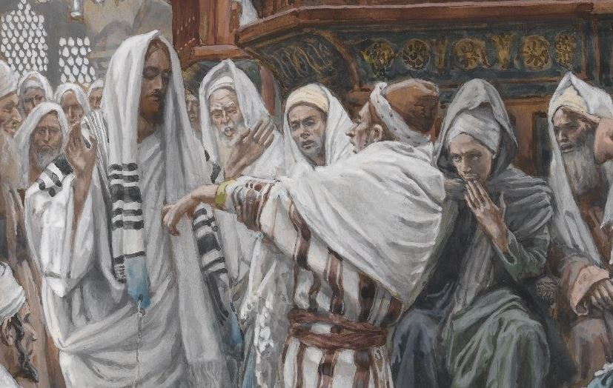
Luke 4:28-30
²⁸ And all they in the synagogue, when they heard these things, were filled with wrath,

Slide 71
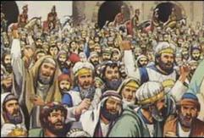
Luke 4:29-30
²⁹ And rose up, and thrust him out of the city, and led him unto the brow of the hill whereon their city was built, that they might cast him down headlong.
³⁰ But he passing through the midst of them went his way,

Slide 72
Conflict in Church: Desire of Ages pg. 240
When Jesus referred to the blessings given to the Gentiles, the fierce national pride of His hearers was aroused, and His words were drowned in a tumult of voices. These people had prided themselves on keeping the law; but now that their prejudices were offended, they were ready to commit murder. The assembly broke up, and laying hands upon Jesus, they thrust Him from the synagogue, and out of the city.

Slide 73
Conflict in Church: Desire of Ages pg. 240
All seemed eager for His destruction. They hurried Him to the brow of a precipice, intending to cast Him down headlong. Shouts and maledictions filled the air. Some were casting stones at Him, when suddenly He disappeared from among them. The heavenly messengers who had been by His side in the synagogue were with Him in the midst of that maddened throng. They shut Him in from His enemies, and conducted Him to a place of safety.

Slide 74
Conflict in Church: Desire of Ages pg. 240
So angels protected Lot, and led him out safely from the midst of Sodom. So they protected Elisha in the little mountain city. When the encircling hills were filled with the horses and chariots of the king of Syria, and the great host of his armed men, Elisha beheld the nearer hill slopes covered with the armies of God,—horses and chariots of fire round about the servant of the Lord.

Slide 75
Conflict in Church: Desire of Ages pg. 240
So, in all ages, angels have been near to Christ's faithful followers. The vast confederacy of evil is arrayed against all who would overcome; but Christ would have us look to the things which are not seen, to the armies of heaven encamped about all who love God, to deliver them.

Slide 76
Conflict in Church: Desire of Ages pg. 240
From what dangers, seen and unseen, we have been preserved through the interposition of the angels, we shall never know, until in the light of eternity we see the providences of God. Then we shall know that the whole family of heaven was interested in the family here below, and that messengers from the throne of God attended our steps from day to day.

Slide 77
Final Notes
In the synagogue of His youth, Jesus sought to persuade His old friends and neighbors of their need of repentance, of forgiveness, of a new life lived in harmony with God—in short, of their need of Him, the Messiah, who came to save them from their sins. Enraged by this appeal, which suggested their imperfect spiritual state, they sought to murder Him. But His time had not yet come.

Slide 78
Final Notes
If this passage represents the mission of Jesus, then it shows us a clear appeal for repentance and change. It’s time to acknowledge our failings, cast them aside, and live by His example. Of course, this will never make us popular. His own old friends and neighbors tried to murder the perfectly sinless Messiah.

Slide 79
Final Notes
“Truth was unpopular in Christ's day. It is unpopular in our day. It has been unpopular ever since Satan first gave man a disrelish for it by presenting fables that lead to self-exaltation. Do we not today meet theories and doctrines that have no foundation in the word of God? Men cling as tenaciously to them as did the Jews to their traditions.” DA 242

Slide 80
Final Notes
But we don’t need to fear doing the right thing—no matter how unpopular it might make us! Angels stepped in to prevent the furious mob from carrying out their object. God has arranged events for the good of His people in all ages. And His hand is not shortened today!

Slide 81
Thank you!
&
Happy Sabbath!!

