Slide 1
Giving Back
Lesson 10
1st Quarter 2023
Proverbs 27, Matthew 24 & 25, Revelation 13 & 14

Slide 2
Memory Text: Revelation 14:13
¹³ And I heard a voice from heaven saying unto me, Write, Blessed are the dead which die in the Lord from henceforth: Yea, saith the Spirit, that they may rest from their labours; and their works do follow them.

Slide 3
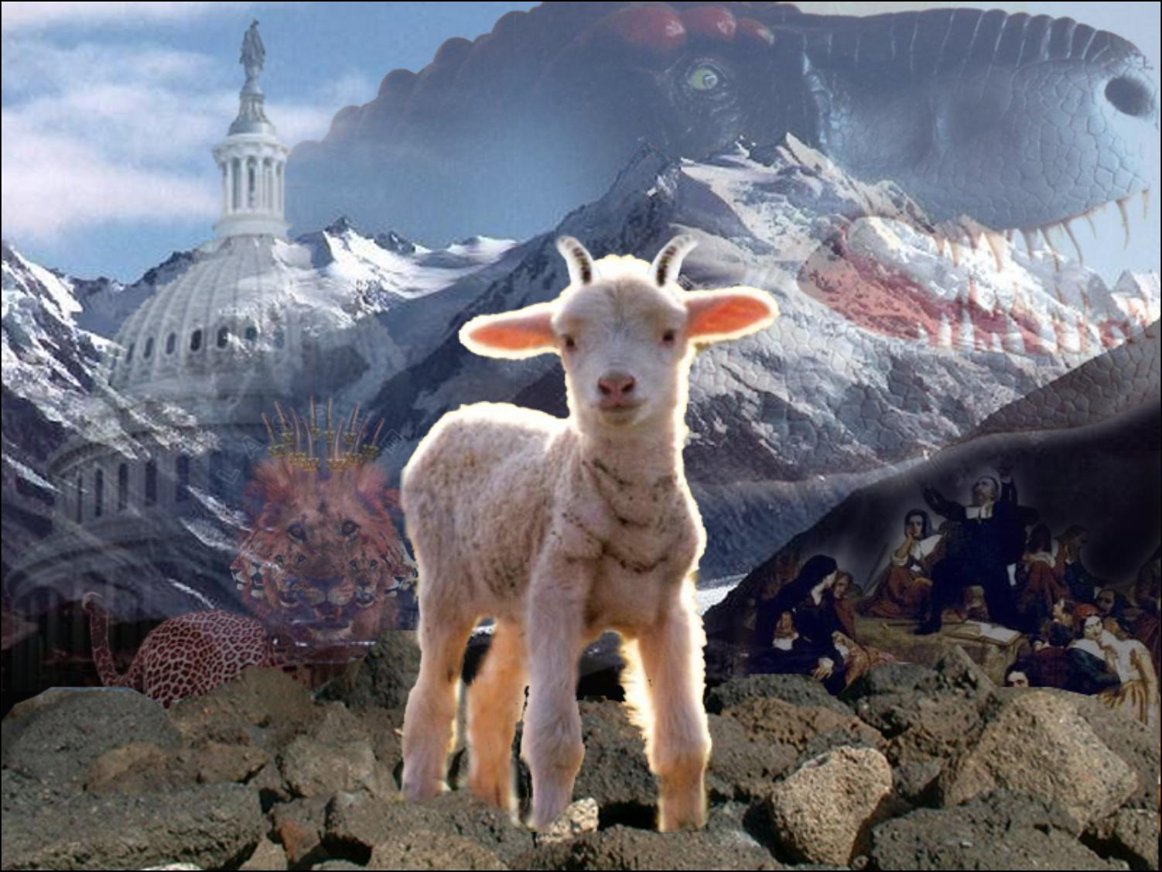
Memory Text Context: Revelation 13:11-18
¹¹ And I beheld another beast coming up out of the earth; and he had two horns like a lamb, and he spake as a dragon.
¹² And he exerciseth all the power of the first beast before him, and causeth the earth and them which dwell therein to worship the first beast, whose deadly wound was healed.

Slide 4
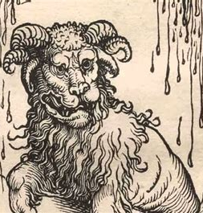
Memory Text Context: Revelation 13:13-18
¹³ And he doeth great wonders, so that he maketh fire come down from heaven on the earth in the sight of men,
¹⁴ And deceiveth them that dwell on the earth by the means of those miracles which he had power to do in the sight of the beast; saying to them that dwell on the earth, that they should make an image to the beast, which had the wound by a sword, and did live.

Slide 5

Memory Text Context: Revelation 13:15-18
¹⁵ And he had power to give life unto the image of the beast, that the image of the beast should both speak, and cause that as many as would not worship the image of the beast should be killed.

Slide 6
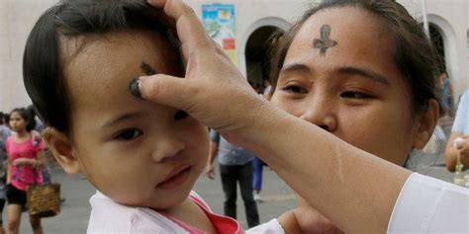
Memory Text Context: Revelation 13:16-18
¹⁶ And he causeth all, both small and great, rich and poor, free and bond, to receive a mark in their right hand, or in their foreheads:
¹⁷ And that no man might buy or sell, save he that had the mark, or the name of the beast, or the number of his name.

Slide 7
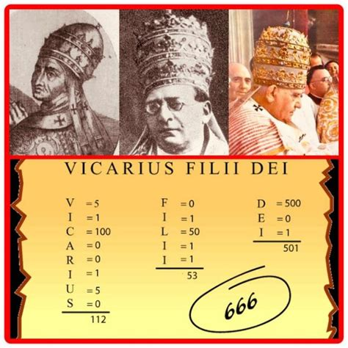
Memory Text Context: Revelation 14:18
¹⁸ Here is wisdom. Let him that hath understanding count the number of the beast: for it is the number of a man; and his number is Six hundred threescore and six.

Slide 8
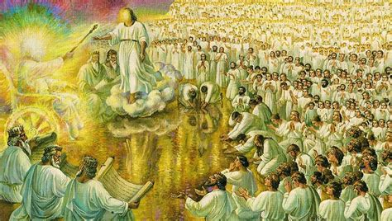
Memory Text Context: Revelation 14:1-13
14 And I looked, and, lo, a Lamb stood on the mount Sion, and with him an hundred forty and four thousand, having his Father's name written in their foreheads.
² And I heard a voice from heaven, as the voice of many waters, and as the voice of a great thunder: and I heard the voice of harpers harping with their harps:

Slide 9
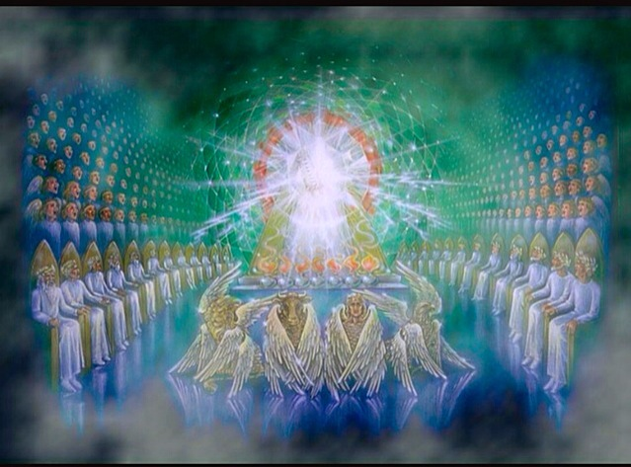
Memory Text Context: Revelation 14:3-13
³ And they sung as it were a new song before the throne, and before the four beasts, and the elders: and no man could learn that song but the hundred and forty and four thousand, which were redeemed from the earth.

Slide 10
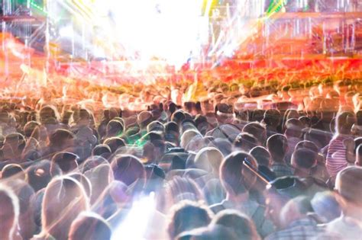
Memory Text Context: Revelation 14:4-13
⁴ These are they which were not defiled with women; for they are virgins. These are they which follow the Lamb whithersoever he goeth. These were redeemed from among men, being the firstfruits unto God and to the Lamb.
⁵ And in their mouth was found no guile: for they are without fault before the throne of God.

Slide 11
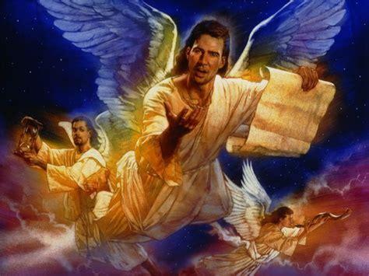
Memory Text Context: Revelation 14:6-13
⁶ And I saw another angel fly in the midst of heaven, having the everlasting gospel to preach unto them that dwell on the earth, and to every nation, and kindred, and tongue, and people,
⁷ Saying with a loud voice, Fear God, and give glory to him; for the hour of his judgment is come: and worship him that made heaven, and earth, and the sea, and the fountains of waters.

Slide 12
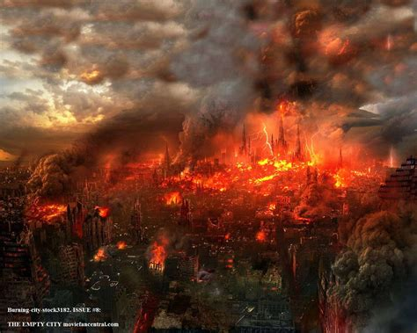
Memory Text Context: Revelation 14:8-13
⁸ And there followed another angel, saying, Babylon is fallen, is fallen, that great city, because she made all nations drink of the wine of the wrath of her fornication.

Slide 13
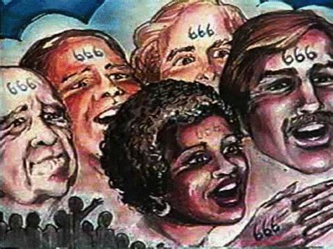
Memory Text Context: Revelation 14:9-13
⁹ And the third angel followed them, saying with a loud voice, If any man worship the beast and his image, and receive his mark in his forehead, or in his hand,
¹⁰ The same shall drink of the wine of the wrath of God, which is poured out without mixture into the cup of his indignation; and he shall be tormented with fire and brimstone in the presence of the holy angels, and in the presence of the Lamb:

Slide 14
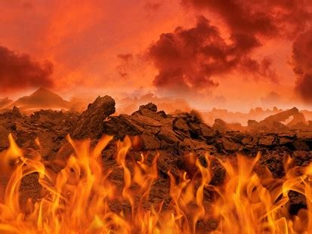
Memory Text Context: Revelation 14:11-13
¹¹ And the smoke of their torment ascendeth up for ever and ever: and they have no rest day nor night, who worship the beast and his image, and whosoever receiveth the mark of his name.

Slide 15
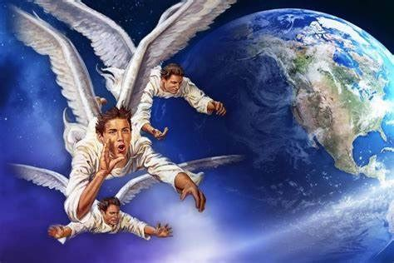
Memory Text Context: Revelation 14:12-13
¹² Here is the patience of the saints: here are they that keep the commandments of God, and the faith of Jesus.
¹³ And I heard a voice from heaven saying unto me, Write, Blessed are the dead which die in the Lord from henceforth: Yea, saith the Spirit, that they may rest from their labours; and their works do follow them.

Slide 16
Memory Text Context: SDABC V.7 p.833
“Blessed are the dead which die in the Lord from henceforth…”
This doubtless refers to the period of the three angels’ messages, which embraces the period of persecution by the beast and its image, when the boycott is imposed and the death penalty passed (see ch. 13:12-17). Those who go to their graves in this period rest, as it were, a little moment until the indignation be overpast.

Slide 17
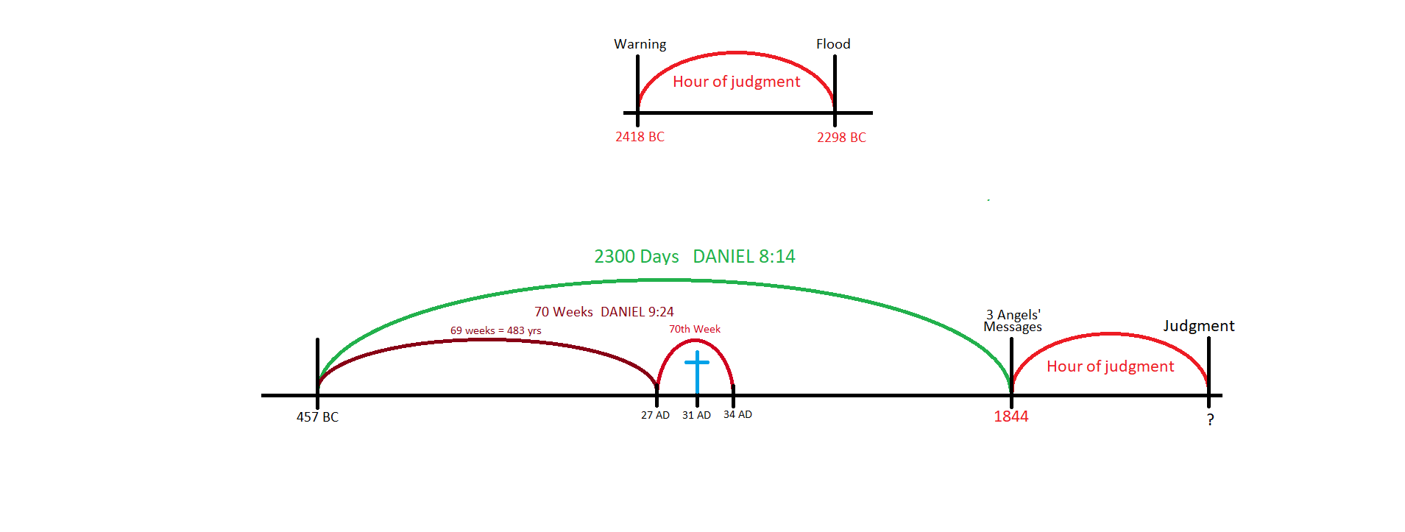

Slide 19
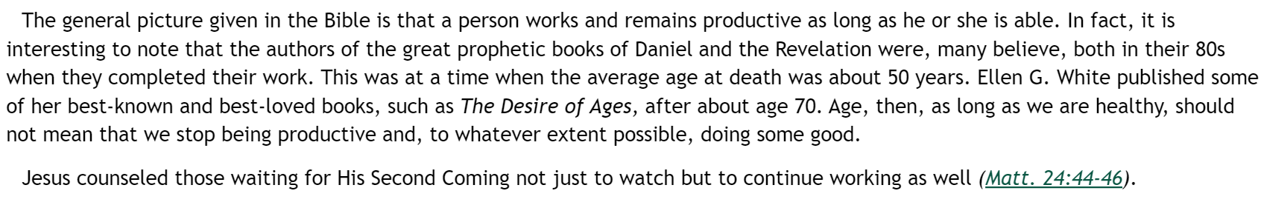
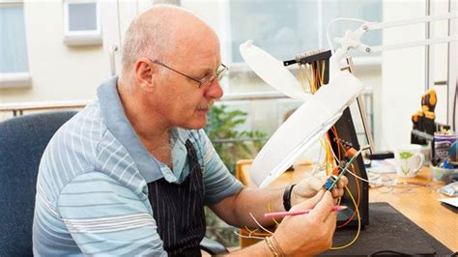
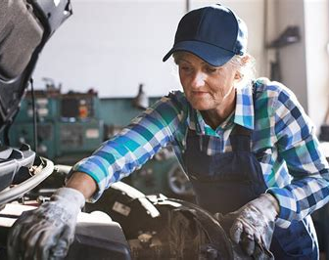
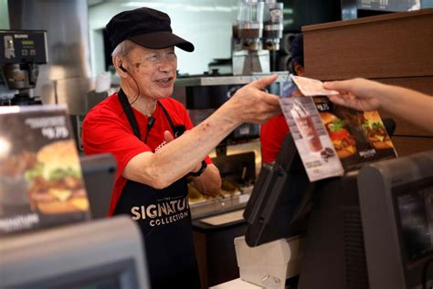
SDA Quarterly, Sunday March 5

Slide 20
The End of Time Context: SDABC V.5 p.495
It was late on Tuesday afternoon. Jesus had spent the day teaching in the Temple courts, and had been assailed repeatedly by group after group of Jewish leaders. Finally, in His last public discourse (ch. 23), He delineated in unmistakable terms the hypocritical character of these “blind guides” (v. 16) and then departed from the Temple courts forever.

Slide 21
The End of Time Context: SDABC V.5 p.495
Leaving the Temple, Jesus and at least four of His disciples made a steep descent to the Kidron Valley, and ascended the slope of the Mount of Olives, which rises some 400 ft above the Kidron Valley. Being about 300 ft higher than the Temple, the mountain provides a view of the Temple and the city.

Slide 22
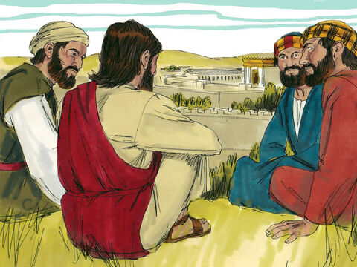
The End of Time: Matthew 24:1-31
24 And Jesus went out, and departed from the temple: and his disciples came to him for to shew him the buildings of the temple.
² And Jesus said unto them, See ye not all these things? verily I say unto you, There shall not be left here one stone upon another, that shall not be thrown down.

Slide 23
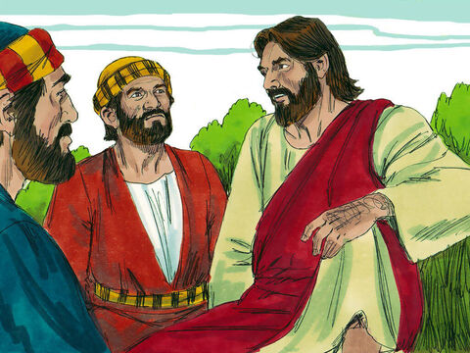
The End of Time: Matthew 24:3-31
³ And as he sat upon the mount of Olives, the disciples came unto him privately, saying, Tell us, when shall these things be? and what shall be the sign of thy coming, and of the end of the world?
⁴ And Jesus answered and said unto them, Take heed that no man deceive you.

Slide 24
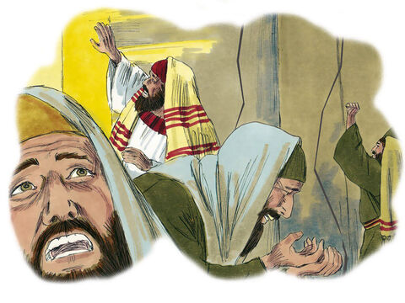
The End of Time: Matthew 24:5-31
⁵ For many shall come in my name, saying, I am Christ; and shall deceive many.
⁶ And ye shall hear of wars and rumours of wars: see that ye be not troubled: for all these things must come to pass, but the end is not yet.

Slide 25
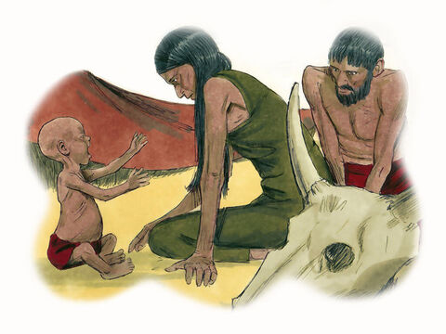
The End of Time: Matthew 24:7-31
⁷ For nation shall rise against nation, and kingdom against kingdom: and there shall be famines, and pestilences, and earthquakes, in divers places.
⁸ All these are the beginning of sorrows.

Slide 26
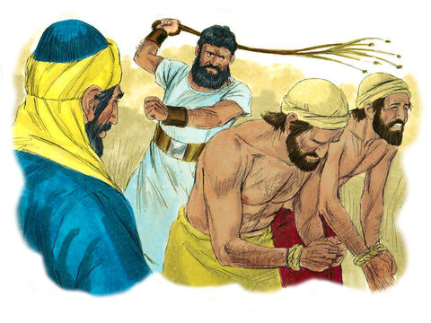
The End of Time: Matthew 24:9-31
⁹ Then shall they deliver you up to be afflicted, and shall kill you: and ye shall be hated of all nations for my name's sake.
¹⁰ And then shall many be offended, and shall betray one another, and shall hate one another.

Slide 27
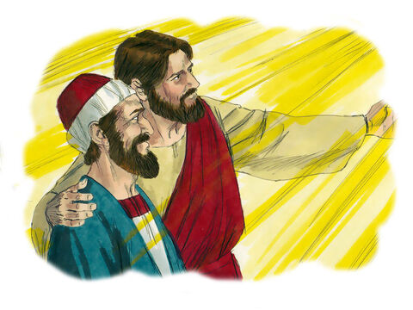
The End of Time: Matthew 24:11-51
¹¹ And many false prophets shall rise, and shall deceive many.
¹² And because iniquity shall abound, the love of many shall wax cold.
¹³ But he that shall endure unto the end, the same shall be saved.

Slide 28
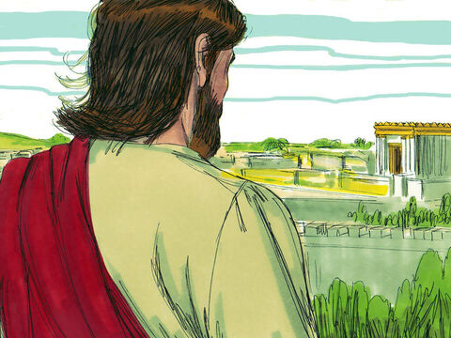
The End of Time: Matthew 24:14-31
¹⁴ And this gospel of the kingdom shall be preached in all the world for a witness unto all nations; and then shall the end come.
¹⁵ When ye therefore shall see the abomination of desolation, spoken of by Daniel the prophet, stand in the holy place, (whoso readeth, let him understand:)

Slide 29

Abominable: Daniel 9:27
²⁷ And he shall confirm the covenant with many for one week: and in the midst of the week he shall cause the sacrifice and the oblation to cease, and for the overspreading of abominations he shall make it desolate, even until the consummation, and that determined shall be poured upon the desolate.

Slide 31
Abominable: Daniel 11:30-32
³⁰ For the ships of Chittim shall come against him: therefore he shall be grieved, and return, and have indignation against the holy covenant: so shall he do; he shall even return, and have intelligence with them that forsake the holy covenant.
³¹ And arms shall stand on his part, and they shall pollute the sanctuary of strength, and shall take away the daily sacrifice, and they shall place the abomination that maketh desolate.
³² And such as do wickedly against the covenant shall he corrupt by flatteries: but the people that do know their God shall be strong, and do exploits.

Slide 32
Abominable: Daniel 12:9-11
⁹ And he said, Go thy way, Daniel: for the words are closed up and sealed till the time of the end.
¹⁰ Many shall be purified, and made white, and tried; but the wicked shall do wickedly: and none of the wicked shall understand; but the wise shall understand.
¹¹ And from the time that the daily sacrifice shall be taken away, and the abomination that maketh desolate set up, there shall be a thousand two hundred and ninety days.

Slide 33
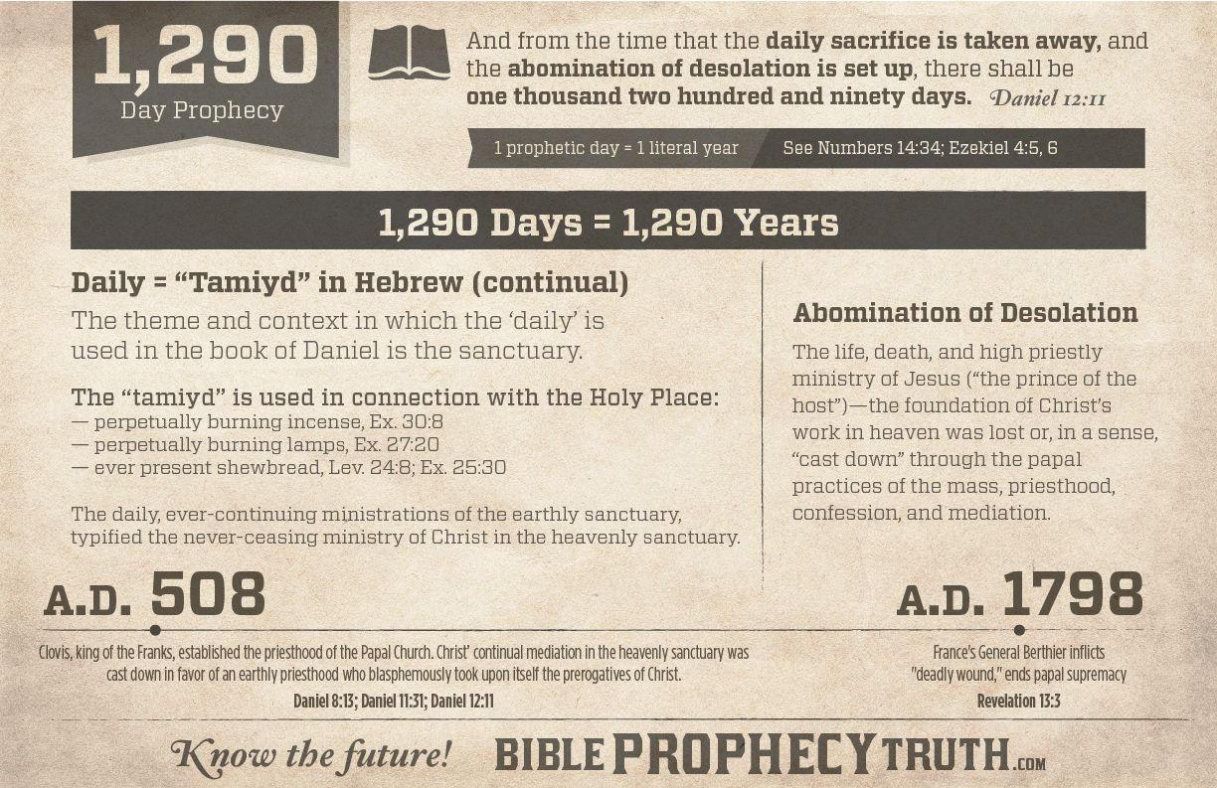

Slide 34
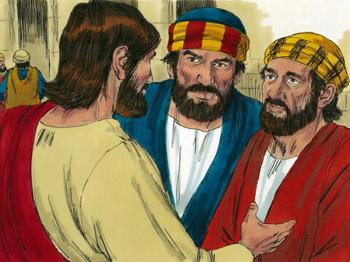
The End of Time: Matthew 24:15-31
¹⁵ When ye therefore shall see the abomination of desolation, spoken of by Daniel the prophet, stand in the holy place, (whoso readeth, let him understand:)

Slide 35
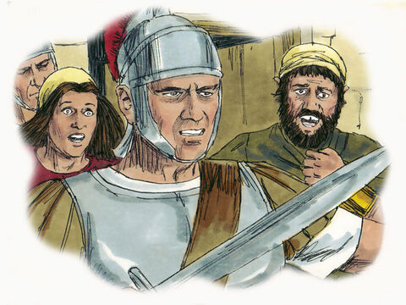
The End of Time: Matthew 24:16-31
¹⁶ Then let them which be in Judaea flee into the mountains:
¹⁷ Let him which is on the housetop not come down to take any thing out of his house:
¹⁸ Neither let him which is in the field return back to take his clothes.

Slide 36
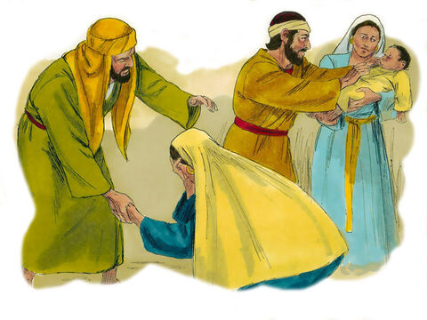
The End of Time: Matthew 24:19-31
¹⁹ And woe unto them that are with child, and to them that give suck in those days!
²⁰ But pray ye that your flight be not in the winter, neither on the sabbath day:

Slide 37
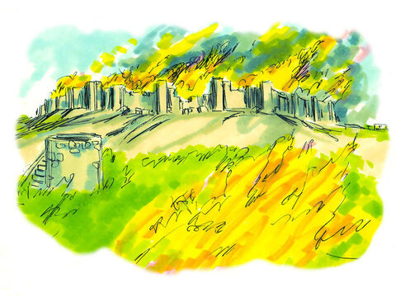
The End of Time: Matthew 24:21-31
²¹ For then shall be great tribulation, such as was not since the beginning of the world to this time, no, nor ever shall be.
²² And except those days should be shortened, there should no flesh be saved: but for the elect's sake those days shall be shortened.

Slide 38
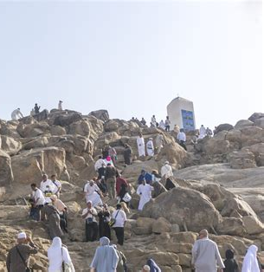
The End of Time: Matthew 24:23-31
²³ Then if any man shall say unto you, Lo, here is Christ, or there; believe it not.
²⁴ For there shall arise false Christs, and false prophets, and shall shew great signs and wonders; insomuch that, if it were possible, they shall deceive the very elect.
²⁵ Behold, I have told you before.

Slide 39
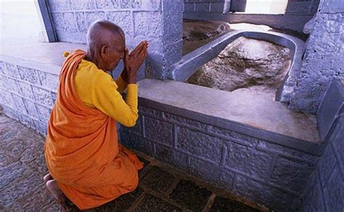
The End of Time: Matthew 24:26-31
²⁶ Wherefore if they shall say unto you, Behold, he is in the desert; go not forth: behold, he is in the secret chambers; believe it not.
²⁷ For as the lightning cometh out of the east, and shineth even unto the west; so shall also the coming of the Son of man be.

Slide 40
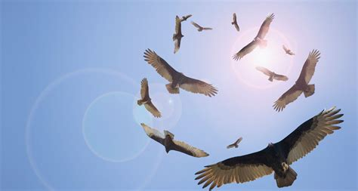
The End of Time: Matthew 24:28-31
²⁸ For wheresoever the carcase is, there will the eagles be gathered together.

Slide 41

The End of Time: Matthew 24:29-31
²⁹ Immediately after the tribulation of those days shall the sun be darkened, and the moon shall not give her light, and the stars shall fall from heaven, and the powers of the heavens shall be shaken:

Slide 42
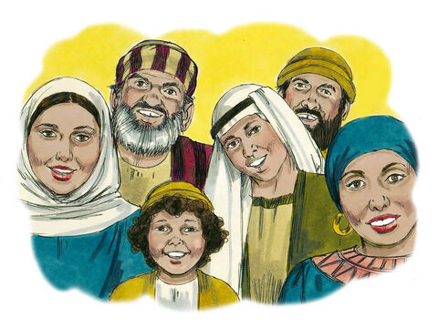
The End of Time: Matthew 24:30-31
³⁰ And then shall appear the sign of the Son of man in heaven: and then shall all the tribes of the earth mourn, and they shall see the Son of man coming in the clouds of heaven with power and great glory.

Slide 43
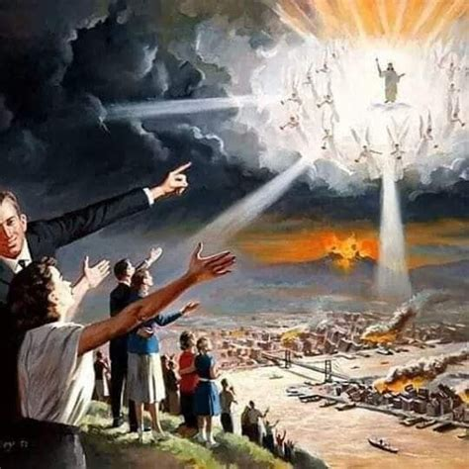
The End of Time: Matthew 24:31-31
³¹ And he shall send his angels with a great sound of a trumpet, and they shall gather together his elect from the four winds, from one end of heaven to the other.

Slide 44
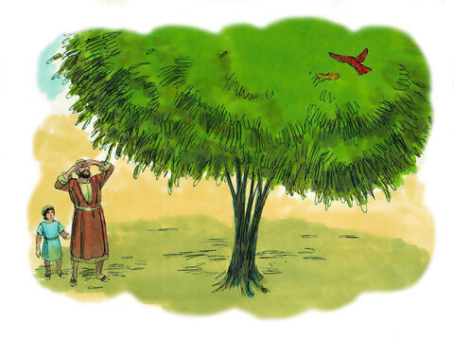
A Pointed Parable: Matthew 24:32-34
³² Now learn a parable of the fig tree; When his branch is yet tender, and putteth forth leaves, ye know that summer is nigh:
³³ So likewise ye, when ye shall see all these things, know that it is near, even at the doors.
³⁴ Verily I say unto you, This generation shall not pass, till all these things be fulfilled.

Slide 45
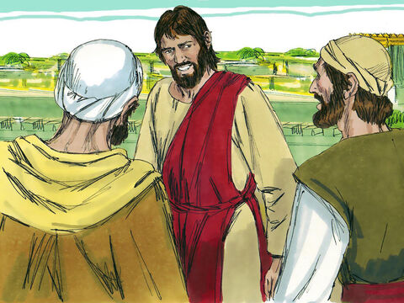
Action Plans: Matthew 24:35-51
³⁵ Heaven and earth shall pass away, but my words shall not pass away.
³⁶ But of that day and hour knoweth no man, no, not the angels of heaven, but my Father only.

Slide 46
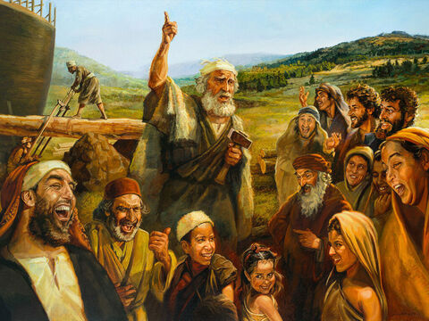
Action Plans: Matthew 24:37-51
³⁷ But as the days of Noah were, so shall also the coming of the Son of man be.
³⁸ For as in the days that were before the flood they were eating and drinking, marrying and giving in marriage, until the day that Noe entered into the ark,

Slide 47
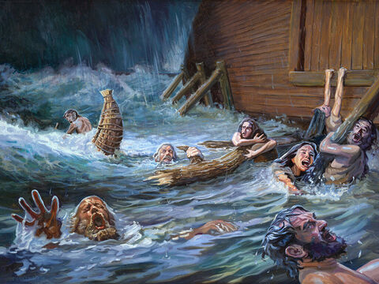
Action Plans: Matthew 24:39-51
³⁹ And knew not until the flood came, and took them all away; so shall also the coming of the Son of man be.

Slide 48
Action Plans: Matthew 24:40-51
⁴⁰ Then shall two be in the field; the one shall be taken, and the other left.
⁴¹ Two women shall be grinding at the mill; the one shall be taken, and the other left.
⁴² Watch therefore: for ye know not what hour your Lord doth come.

Slide 49
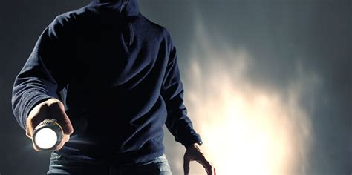
Action Plans: Matthew 24:43-51
⁴³ But know this, that if the goodman of the house had known in what watch the thief would come, he would have watched, and would not have suffered his house to be broken up.
⁴⁴ Therefore be ye also ready: for in such an hour as ye think not the Son of man cometh.

Slide 50
Action Plans: Matthew 24:45-51
⁴⁵ Who then is a faithful and wise servant, whom his lord hath made ruler over his household, to give them meat in due season?
⁴⁶ Blessed is that servant, whom his lord when he cometh shall find so doing.
⁴⁷ Verily I say unto you, That he shall make him ruler over all his goods.

Slide 51
Action Plans: Matthew 24:48-51
⁴⁸ But and if that evil servant shall say in his heart, My lord delayeth his coming;
⁴⁹ And shall begin to smite his fellowservants, and to eat and drink with the drunken;
⁵⁰ The lord of that servant shall come in a day when he looketh not for him, and in an hour that he is not aware of,
⁵¹ And shall cut him asunder, and appoint him his portion with the hypocrites: there shall be weeping and gnashing of teeth.

Slide 52
Action Plans: The Desire of Ages, p.634
Because we know not the exact time of His coming, we are commanded to watch. “Blessed are those servants, whom the Lord when He cometh shall find watching.” Luke 12:37. Those who watch for the Lord's coming are not waiting in idle expectancy. The expectation of Christ's coming is to make men fear the Lord, and fear His judgments upon transgression. It is to awaken them to the great sin of rejecting His offers of mercy. Those who are watching for the Lord are purifying their souls by obedience to the truth.

Slide 53
Action Plans: The Desire of Ages, p.634
With vigilant watching they combine earnest working. Because they know that the Lord is at the door, their zeal is quickened to co-operate with the divine intelligences in working for the salvation of souls. These are the faithful and wise servants who give to the Lord's household “their portion of meat in due season.” Luke 12:42. They are declaring the truth that is now specially applicable. As Enoch, Noah, Abraham, and Moses each declared the truth for his time, so will Christ's servants now give the special warning for their generation.

Slide 54
Action Plans: The Desire of Ages, p.635
The advent of Christ will surprise the false teachers. They are saying, “Peace and safety.” Like the priests and teachers before the fall of Jerusalem, they look for the church to enjoy earthly prosperity and glory. The signs of the times they interpret as foreshadowing this. But what saith the word of Inspiration? “Sudden destruction cometh upon them.” 1 Thessalonians 5:3. Upon all who dwell on the face of the whole earth, upon all who make this world their home, the day of God will come as a snare. It comes to them as a prowling thief.

Slide 55
Action Plans: The Desire of Ages, p.636
The crisis is stealing gradually upon us. The sun shines in the heavens, passing over its usual round, and the heavens still declare the glory of God. Men are still eating and drinking, planting and building, marrying, and giving in marriage. Merchants are still buying and selling. Men are jostling one against another, contending for the highest place. Pleasure lovers are still crowding to theaters, horse races, gambling hells.

Slide 56
Action Plans: The Desire of Ages, p.636
The highest excitement prevails, yet probation's hour is fast closing, and every case is about to be eternally decided. Satan sees that his time is short. He has set all his agencies at work that men may be deceived, deluded, occupied and entranced, until the day of probation shall be ended, and the door of mercy be forever shut.

Slide 57
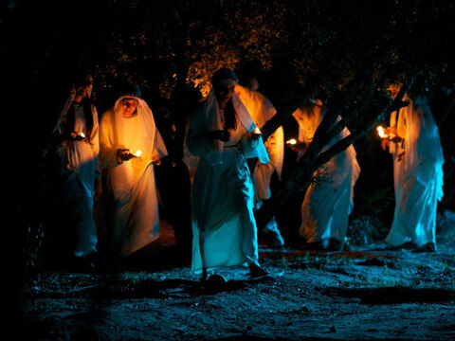
Being Ready: Matthew 25:1-13
25 Then shall the kingdom of heaven be likened unto ten virgins, which took their lamps, and went forth to meet the bridegroom.
² And five of them were wise, and five were foolish.

Slide 58
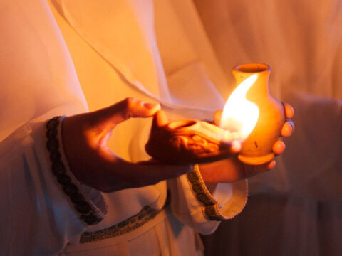
Being Ready: Matthew 25:3-13
³ They that were foolish took their lamps, and took no oil with them:
⁴ But the wise took oil in their vessels with their lamps.

Slide 59
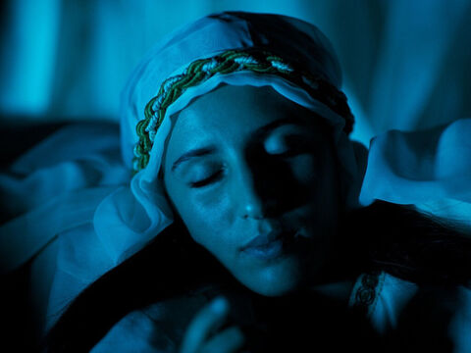
Being Ready: Matthew 25:5-13
⁵ While the bridegroom tarried, they all slumbered and slept.
⁶ And at midnight there was a cry made, Behold, the bridegroom cometh; go ye out to meet him.

Slide 60
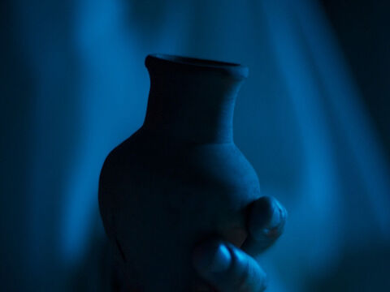
Being Ready: Matthew 25:7-13
⁷ Then all those virgins arose, and trimmed their lamps.
⁸ And the foolish said unto the wise, Give us of your oil; for our lamps are gone out.

Slide 61
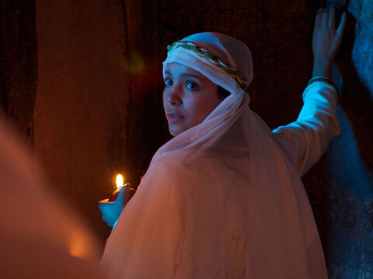
Being Ready: Matthew 25:9-13
⁹ But the wise answered, saying, Not so; lest there be not enough for us and you: but go ye rather to them that sell, and buy for yourselves.

Slide 62
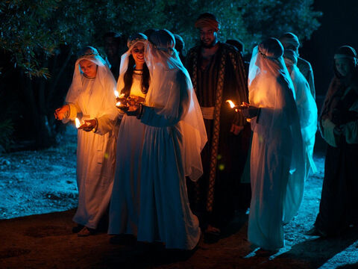
Being Ready: Matthew 25:10-13
¹⁰ And while they went to buy, the bridegroom came; and they that were ready went in with him to the marriage: and the door was shut.

Slide 63
Being Ready: Matthew 25:11-13
¹¹ Afterward came also the other virgins, saying, Lord, Lord, open to us.
¹² But he answered and said, Verily I say unto you, I know you not.
¹³ Watch therefore, for ye know neither the day nor the hour wherein the Son of man cometh.

Slide 64
Being Ready: Christ’s Object Lessons p. 406
The two classes of watchers represent the two classes who profess to be waiting for their Lord. They are called virgins because they profess a pure faith. By the lamps is represented the word of God. The psalmist says, “Thy word is a lamp unto my feet, and a light unto my path.” Psalm 119:105. The oil is a symbol of the Holy Spirit.

Slide 65
Being Ready: Christ’s Object Lessons p. 408
In the parable, all the ten virgins went out to meet the bridegroom. All had lamps and vessels for oil. For a time there was seen no difference between them. So with the church that lives just before Christ's second coming. All have a knowledge of the Scriptures. All have heard the message of Christ's near approach, and confidently expect His appearing. But as in the parable, so it is now.

Slide 66
Being Ready: Christ’s Object Lessons p. 408
A time of waiting intervenes, faith is tried; and when the cry is heard, “Behold, the Bridegroom cometh; go ye out to meet Him,” many are unready. They have no oil in their vessels with their lamps. They are destitute of the Holy Spirit.

Slide 67
Being Ready: Christ’s Object Lessons p. 411
The class represented by the foolish virgins are not hypocrites. They have a regard for the truth, they have advocated the truth, they are attracted to those who believe the truth; but they have not yielded themselves to the Holy Spirit's working. They have not fallen upon the Rock, Christ Jesus, and permitted their old nature to be broken up.

Slide 68
Being Ready: Christ’s Object Lessons p. 411
The Spirit works upon man's heart, according to his desire and consent implanting in him a new nature; but the class represented by the foolish virgins have been content with a superficial work. They do not know God. They have not studied His character; they have not held communion with Him; therefore they do not know how to trust, how to look and live. Their service to God degenerates into a form.

Slide 69
Being Ready: Christ’s Object Lessons p. 412
It is in a crisis that character is revealed. When the earnest voice proclaimed at midnight, “Behold, the bridegroom cometh; go ye out to meet him,” and the sleeping virgins were roused from their slumbers, it was seen who had made preparation for the event. Both parties were taken unawares; but one was prepared for the emergency, and the other was found without preparation.

Slide 70
Being Ready: Christ’s Object Lessons p. 412
So now, a sudden and unlooked-for calamity, something that brings the soul face to face with death, will show whether there is any real faith in the promises of God. It will show whether the soul is sustained by grace. The great final test comes at the close of human probation, when it will be too late for the soul's need to be supplied.

Slide 71
Being Ready: Christ’s Object Lessons p. 412
The ten virgins are watching in the evening of this earth's history. All claim to be Christians. All have a call, a name, a lamp, and all profess to be doing God's service. All apparently wait for Christ's appearing. But five are unready. Five will be found surprised, dismayed, outside the banquet hall.

Slide 72
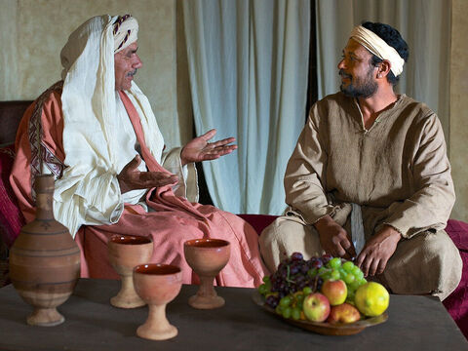
Use It or Lose It: Matthew 25:14-30
¹⁴ For the kingdom of heaven is as a man travelling into a far country, who called his own servants, and delivered unto them his goods.

Slide 73
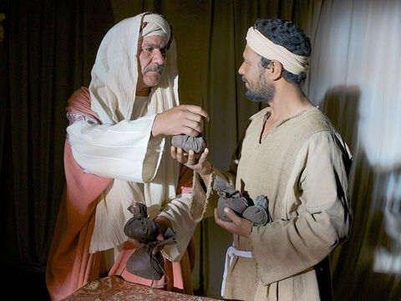
Use It or Lose It: Matthew 25:15-30
¹⁵ And unto one he gave five talents, to another two, and to another one; to every man according to his several ability; and straightway took his journey.

Slide 74
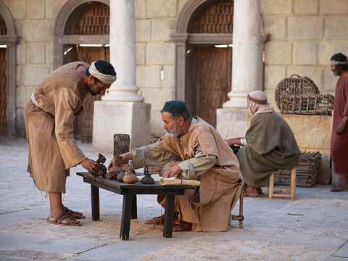
Use It or Lose It: Matthew 25:16-30
¹⁶ Then he that had received the five talents went and traded with the same, and made them other five talents.
¹⁷ And likewise he that had received two, he also gained other two.

Slide 75
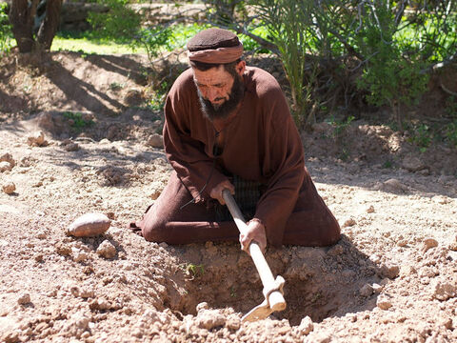
Use It or Lose It: Matthew 25:18-30
¹⁸ But he that had received one went and digged in the earth, and hid his lord's money.

Slide 76
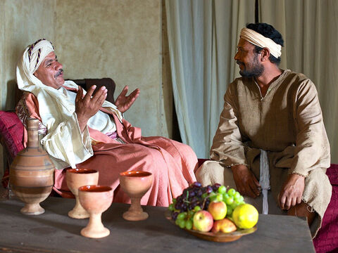
Use It or Lose It: Matthew 25:19-30
¹⁹ After a long time the lord of those servants cometh, and reckoneth with them.

Slide 77

Use It or Lose It: Matthew 25:20-30
²⁰ And so he that had received five talents came and brought other five talents, saying, Lord, thou deliveredst unto me five talents: behold, I have gained beside them five talents more.

Slide 78

Use It or Lose It: Matthew 25:21-30
²¹ His lord said unto him, Well done, thou good and faithful servant: thou hast been faithful over a few things, I will make thee ruler over many things: enter thou into the joy of thy lord.

Slide 79
Use It or Lose It: Matthew 25:22-30
²² He also that had received two talents came and said, Lord, thou deliveredst unto me two talents: behold, I have gained two other talents beside them.
²³ His lord said unto him, Well done, good and faithful servant; thou hast been faithful over a few things, I will make thee ruler over many things: enter thou into the joy of thy lord.

Slide 80

Use It or Lose It: Matthew 25:24-30
²⁴ Then he which had received the one talent came and said, Lord, I knew thee that thou art an hard man, reaping where thou hast not sown, and gathering where thou hast not strawed:

Slide 81
Use It or Lose It: Matthew 25:25-30
²⁵ And I was afraid, and went and hid thy talent in the earth: lo, there thou hast that is thine.
²⁶ His lord answered and said unto him, Thou wicked and slothful servant, thou knewest that I reap where I sowed not, and gather where I have not strawed:
²⁷ Thou oughtest therefore to have put my money to the exchangers, and then at my coming I should have received mine own with usury.

Slide 82

Use It or Lose It: Matthew 25:28-30
²⁸ Take therefore the talent from him, and give it unto him which hath ten talents.
²⁹ For unto every one that hath shall be given, and he shall have abundance: but from him that hath not shall be taken away even that which he hath.

Slide 83

Plan & Practice: Matthew 25:31-46
³¹ When the Son of man shall come in his glory, and all the holy angels with him, then shall he sit upon the throne of his glory:

Slide 84

Plan & Practice: Matthew 25:32-46
³² And before him shall be gathered all nations: and he shall separate them one from another, as a shepherd divideth his sheep from the goats:
³³ And he shall set the sheep on his right hand, but the goats on the left.

Slide 85

Plan & Practice: Matthew 25:34-46
³⁴ Then shall the King say unto them on his right hand, Come, ye blessed of my Father, inherit the kingdom prepared for you from the foundation of the world:

Slide 86

Plan & Practice: Matthew 25:35-46
³⁵ For I was an hungred, and ye gave me meat: I was thirsty, and ye gave me drink: I was a stranger, and ye took me in:
³⁶ Naked, and ye clothed me: I was sick, and ye visited me: I was in prison, and ye came unto me.

Slide 87

Plan & Practice: Matthew 25:37-46
³⁷ Then shall the righteous answer him, saying, Lord, when saw we thee an hungred, and fed thee? or thirsty, and gave thee drink?
³⁸ When saw we thee a stranger, and took thee in? or naked, and clothed thee?
³⁹ Or when saw we thee sick, or in prison, and came unto thee?

Slide 88

Plan & Practice: Matthew 25:40-46
⁴⁰ And the King shall answer and say unto them, Verily I say unto you, Inasmuch as ye have done it unto one of the least of these my brethren, ye have done it unto me.

Slide 89

Plan & Practice: Matthew 25:41-46
⁴¹ Then shall he say also unto them on the left hand, Depart from me, ye cursed, into everlasting fire, prepared for the devil and his angels:
⁴² For I was an hungred, and ye gave me no meat: I was thirsty, and ye gave me no drink:

Slide 90

Plan & Practice: Matthew 25:44-46
⁴³ I was a stranger, and ye took me not in: naked, and ye clothed me not: sick, and in prison, and ye visited me not.

Slide 91
Plan & Practice: Matthew 25:41-46
⁴⁴ Then shall they also answer him, saying, Lord, when saw we thee an hungred, or athirst, or a stranger, or naked, or sick, or in prison, and did not minister unto thee?
⁴⁵ Then shall he answer them, saying, Verily I say unto you, Inasmuch as ye did it not to one of the least of these, ye did it not to me.

Slide 92

Plan & Practice: Matthew 25:46
⁴⁶ And these shall go away into everlasting punishment: but the righteous into life eternal.

Slide 93
Action Plans: SDABC V.5 p.512
What consolation that Christ identifies Himself with His chosen ones to the extent that whatever concerns them concerns Him personally. We can feel no pain or disappointment, we can experience no need, but that Christ sympathizes with us. In making the needs of others our responsibility we reflect this same aspect of the divine character.

Slide 94
Action Plans: SDABC V.5 p.512
When we reflect the character of Jesus perfectly we will feel as He does toward those in need, and through us He will be able to solace and succor others. The best evidence of love for God is love that leads us to ear “one another’s burdens and so fulfill the law of Christ.” The best evidence that a person has become a son of God is that he does the works of God.

Slide 95
Action Plans: Selected Messages V.1 p.121
A revival of true godliness among us is the greatest and most urgent of all our needs. To seek this should be our first work. There must be earnest effort to obtain the blessing of the Lord, not because God is not willing to bestow His blessing upon us, but because we are unprepared to receive it.

Slide 96
Action Plans: Selected Messages V.1 p.121
Our heavenly Father is more willing to give His Holy Spirit to them that ask Him, than are earthly parents to give good gifts to their children. But it is our work, by confession, humiliation, repentance, and earnest prayer, to fulfill the conditions upon which God has promised to grant us His blessing.

Slide 97
Action Plans: Selected Messages V.1 p.121
A revival need be expected only in answer to prayer. While the people are so destitute of God's Holy Spirit, they cannot appreciate the preaching of the Word; but when the Spirit's power touches their hearts, then the discourses given will not be without effect.

Slide 98
Action Plans: Selected Messages V.1 p.121
Guided by the teachings of God's Word, with the manifestation of His Spirit, in the exercise of sound discretion, those who attend our meetings will gain a precious experience, and returning home, will be prepared to exert a healthful influence.

Slide 99
Action Plans: Selected Messages V.1 p.124
From every member of the church a steady light may shine forth before the world, so that they shall not be led to inquire, What do these people more than others? There can be and must be a withdrawal from conformity to the world, a shunning of all appearance of evil, so that no occasion shall be given for gainsayers. We cannot escape reproach; it will come; but we should be very careful that we are not reproached for our own sins or follies, but for Christ's sake.

Slide 100
Action Plans: Selected Messages V.1 p.126
The work is before us; will we engage in it? We must work fast, we must go steadily forward. We must be preparing for the great day of the Lord. We have no time to lose, no time to be engaged in selfish purposes. The world is to be warned. What are we doing as individuals to bring the light before others? God has left to every man his work; every one has a part to act, and we cannot neglect this work except at the peril of our souls.

Slide 101
Plan & Practice: Proverbs 27:20-27
²⁰ Hell and destruction are never full; so the eyes of man are never satisfied.
²¹ As the fining pot for silver, and the furnace for gold; so is a man to his praise.
²² Though thou shouldest bray a fool in a mortar among wheat with a pestle, yet will not his foolishness depart from him.

Slide 102
Plan & Practice: Proverbs 27:23-27
²³ Be thou diligent to know the state of thy flocks, and look well to thy herds.
²⁴ For riches are not for ever: and doth the crown endure to every generation?
²⁵ The hay appeareth, and the tender grass sheweth itself, and herbs of the mountains are gathered.

Slide 103
Plan & Practice: Proverbs 27:26-27
²⁶ The lambs are for thy clothing, and the goats are the price of the field.
²⁷ And thou shalt have goats' milk enough for thy food, for the food of thy household, and for the maintenance for thy maidens.

Slide 104
THANK YOU!
… and Happy Sabbath!

