Slide 1
Managing in Tough Times
2 Chronicles 17-20,
1 Chronicles 21, 2 Kings 6
Lesson 11, 1st Quarter 2023

Slide 2
Memory Text: Psalm 50:14-15
¹⁴ Offer unto God thanksgiving; and pay thy vows unto the most High:
¹⁵ And call upon me in the day of trouble: I will deliver thee, and thou shalt glorify me.

Slide 3
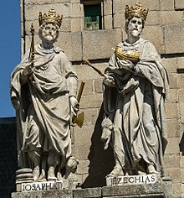
Jehoshaphat: An Example of Faith and Struggle
Jehoshaphat ( "Yahweh has judged"), according to 1 Kings 22:41, was the son of Asa, and the fourth king of the Kingdom of Judah, in succession to his father. The Jerusalem Bible states that "the Chronicler sees Asa as a type of the peaceful, Jehoshaphat of the strong king."
Statues of Kings Jehoshaphat and Hezekiah at El Escorial, Spain

Slide 4
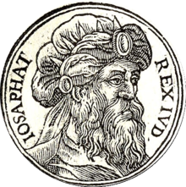
Jehoshaphat: 2 Chronicles 17:1-19
17 And Jehoshaphat his son reigned in his stead, and strengthened himself against Israel.
² And he placed forces in all the fenced cities of Judah, and set garrisons in the land of Judah, and in the cities of Ephraim, which Asa his father had taken.

Slide 5
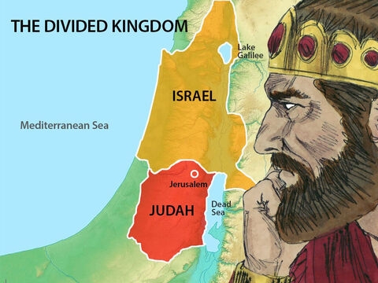
Jehoshaphat: 2 Chronicles 17:3-19
³ And the Lord was with Jehoshaphat, because he walked in the first ways of his father David, and sought not unto Baalim;
⁴ But sought to the Lord God of his father, and walked in his commandments, and not after the doings of Israel.

Slide 6
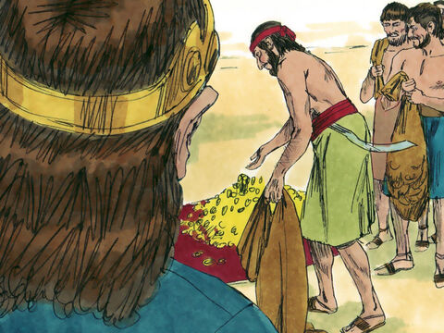
Jehoshaphat: 2 Chronicles 17:5-19
⁵ Therefore the Lord stablished the kingdom in his hand; and all Judah brought to Jehoshaphat presents; and he had riches and honour in abundance.

Slide 7
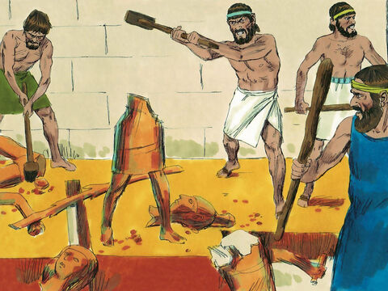
Jehoshaphat: 2 Chronicles 17:6-19
⁶ And his heart was lifted up in the ways of the Lord: moreover he took away the high places and groves out of Judah.

Slide 8
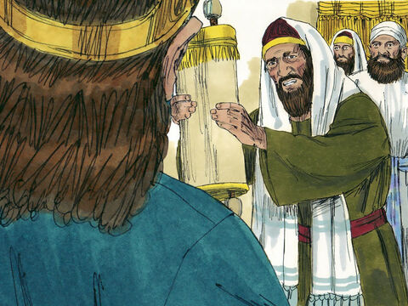
Jehoshaphat: 2 Chronicles 17:7-19
⁷ Also in the third year of his reign he sent to his princes, even to Benhail, and to Obadiah, and to Zechariah, and to Nethaneel, and to Michaiah, to teach in the cities of Judah.

Slide 9
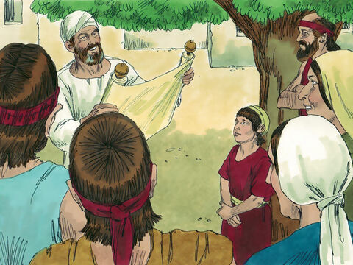
Jehoshaphat: 2 Chronicles 17:8-19
⁸ And with them he sent Levites, even Shemaiah, and Nethaniah, and Zebadiah, and Asahel, and Shemiramoth, and Jehonathan, and Adonijah, and Tobijah, and Tobadonijah, Levites; and with them Elishama and Jehoram, priests.

Slide 10
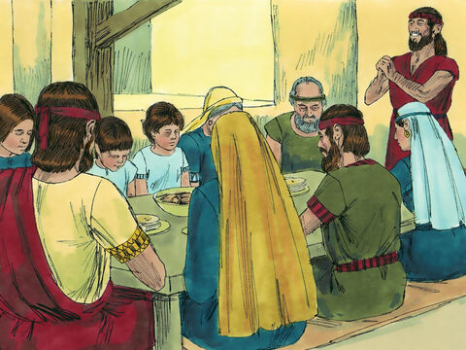
Jehoshaphat: 2 Chronicles 17:9-19
⁹ And they taught in Judah, and had the book of the law of the Lord with them, and went about throughout all the cities of Judah, and taught the people.
¹⁰ And the fear of the Lord fell upon all the kingdoms of the lands that were round about Judah, so that they made no war against Jehoshaphat.

Slide 11
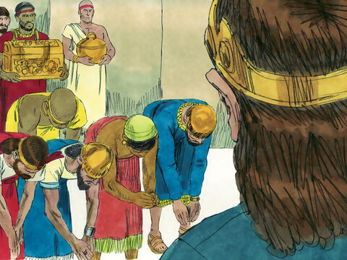
Jehoshaphat: 2 Chronicles 17:11-19
¹¹ Also some of the Philistines brought Jehoshaphat presents, and tribute silver; and the Arabians brought him flocks, seven thousand and seven hundred rams, and seven thousand and seven hundred he goats.
¹² And Jehoshaphat waxed great exceedingly; and he built in Judah castles, and cities of store.

Slide 12
Jehoshaphat: 2 Chronicles 17:13-19
¹³ And he had much business in the cities of Judah: and the men of war, mighty men of valour, were in Jerusalem.
¹⁴ And these are the numbers of them according to the house of their fathers: Of Judah, the captains of thousands; Adnah the chief, and with him mighty men of valour three hundred thousand.
¹⁵ And next to him was Jehohanan the captain, and with him two hundred and fourscore thousand.

Slide 13
Jehoshaphat: 2 Chronicles 17:16-19
¹⁶ And next him was Amasiah the son of Zichri, who willingly offered himself unto the Lord; and with him two hundred thousand mighty men of valour.
¹⁷ And of Benjamin; Eliada a mighty man of valour, and with him armed men with bow and shield two hundred thousand.
¹⁸ And next him was Jehozabad, and with him an hundred and fourscore thousand ready prepared for the war.

Slide 14
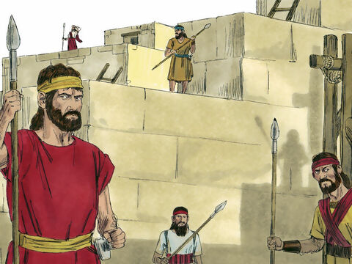
Jehoshaphat: 2 Chronicles 17:19
¹⁹ These waited on the king, beside those whom the king put in the fenced cities throughout all Judah.

Slide 15
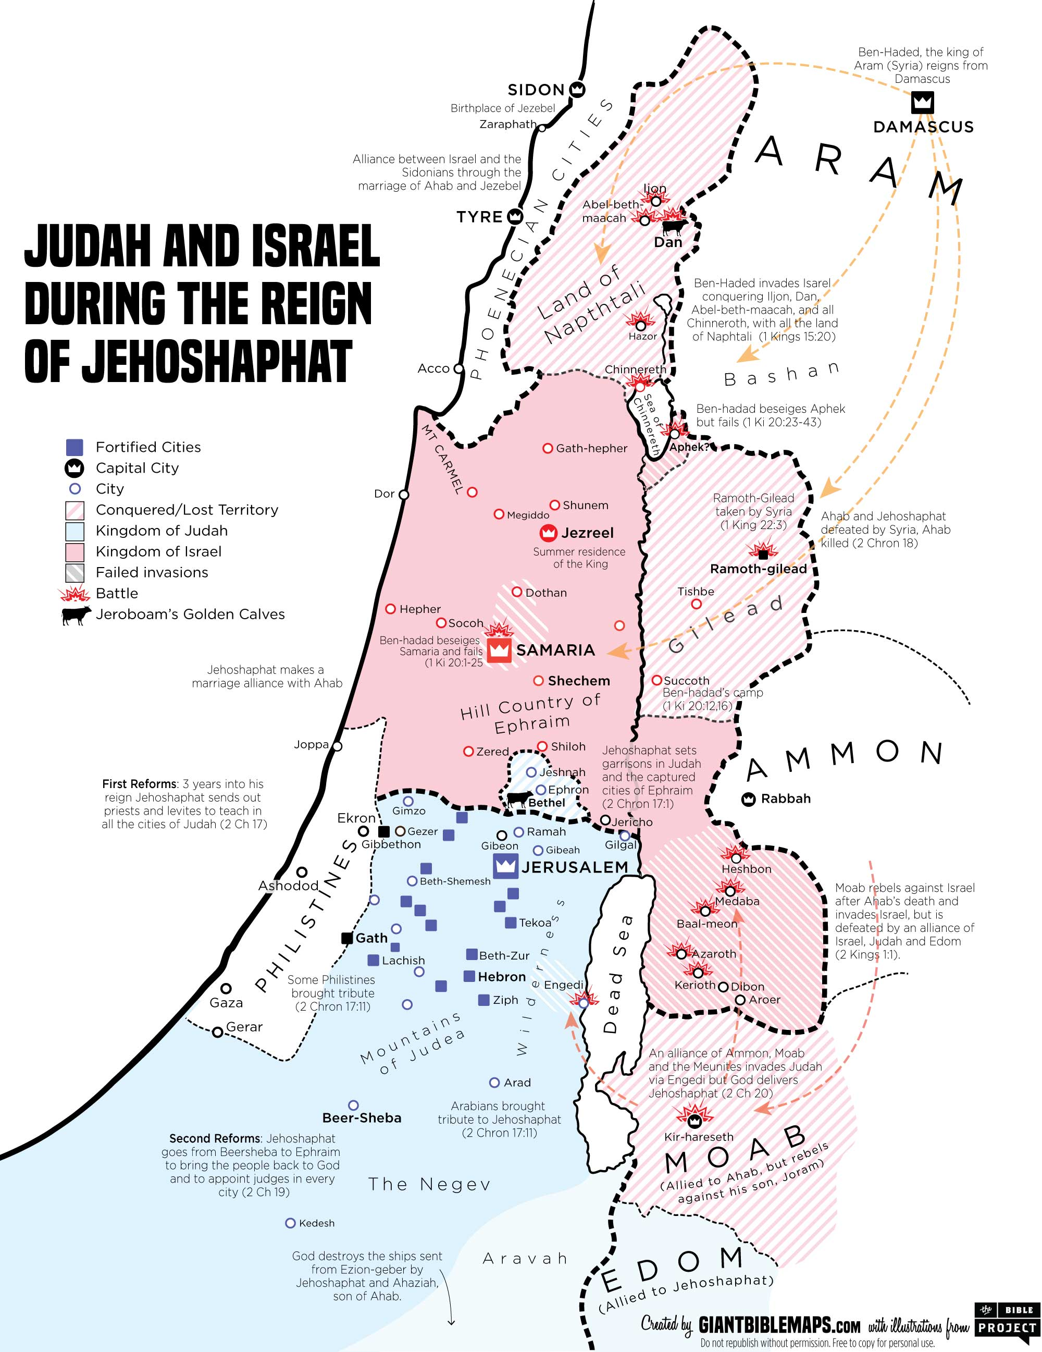

Slide 16
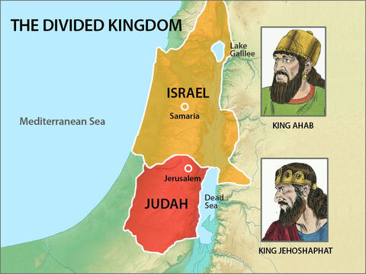
Jehoshaphat: 2 Chronicles 18:1-34
18 Now Jehoshaphat had riches and honour in abundance, and joined affinity with Ahab.
² And after certain years he went down to Ahab to Samaria. And Ahab killed sheep and oxen for him in abundance, and for the people that he had with him, and persuaded him to go up with him to Ramothgilead.

Slide 17
Some Context:
During the time that Jehoshaphat reigned the worship of Baal secured a strong hold on the northern kingdom (Israel). Jehoshaphat was a contemporary of Ahab and Jezebel, and lived during the time that Elijah raised his voice in a loud protest against the terrible apostasy then sweeping the northern kingdom.
The word translated “joined affinity” mans to form a marriage alliance. The alliance between the kings was sealed by the marriage of Athaliah, the daughter of Ahab and Jezebel, to Jehoram, the son of Jehoshaphat.

Slide 18
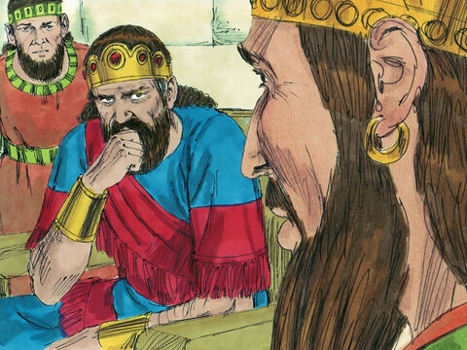
Jehoshaphat: 2 Chronicles 18:3-34
³ And Ahab king of Israel said unto Jehoshaphat king of Judah, Wilt thou go with me to Ramothgilead? And he answered him, I am as thou art, and my people as thy people; and we will be with thee in the war.
⁴ And Jehoshaphat said unto the king of Israel, Enquire, I pray thee, at the word of the Lord to day.

Slide 19
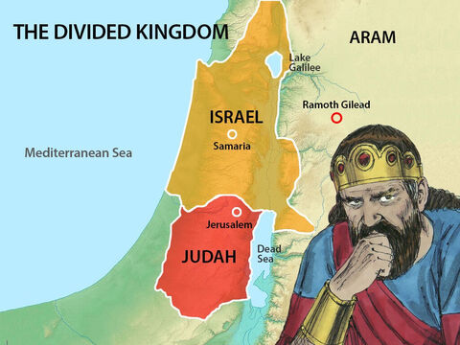
Jehoshaphat: 2 Chronicles 18:5-34
⁵ Therefore the king of Israel gathered together of prophets four hundred men, and said unto them, Shall we go to Ramothgilead to battle, or shall I forbear? And they said, Go up; for God will deliver it into the king's hand.
⁶ But Jehoshaphat said, Is there not here a prophet of the Lord besides, that we might enquire of him?

Slide 20
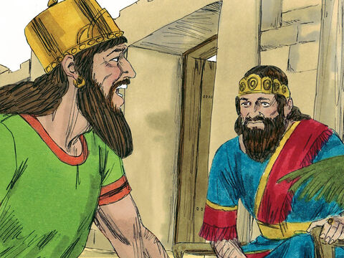
Jehoshaphat: 2 Chronicles 18:7-34
⁷ And the king of Israel said unto Jehoshaphat, There is yet one man, by whom we may enquire of the Lord: but I hate him; for he never prophesied good unto me, but always evil: the same is Micaiah the son of Imla. And Jehoshaphat said, Let not the king say so.

Slide 21
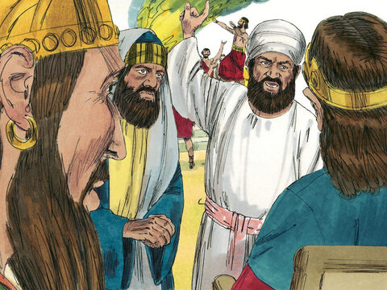
Jehoshaphat: 2 Chronicles 18:8-34
⁸ And the king of Israel called for one of his officers, and said, Fetch quickly Micaiah the son of Imla.
⁹ And the king of Israel and Jehoshaphat king of Judah sat either of them on his throne, clothed in their robes, and they sat in a void place at the entering in of the gate of Samaria; and all the prophets prophesied before them.

Slide 22
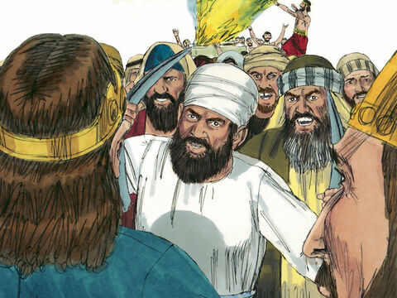
Jehoshaphat: 2 Chronicles 18:7-34
¹⁰ And Zedekiah the son of Chenaanah had made him horns of iron, and said, Thus saith the Lord, With these thou shalt push Syria until they be consumed.
¹¹ And all the prophets prophesied so, saying, Go up to Ramothgilead, and prosper: for the Lord shall deliver it into the hand of the king.

Slide 23
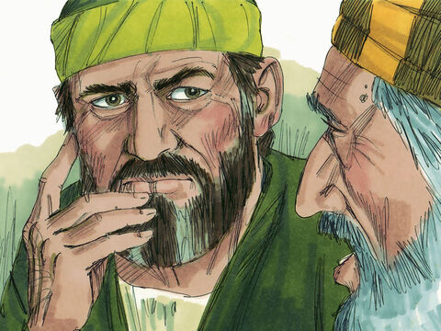
Jehoshaphat: 2 Chronicles 18:12-34
¹² And the messenger that went to call Micaiah spake to him, saying, Behold, the words of the prophets declare good to the king with one assent; let thy word therefore, I pray thee, be like one of their's, and speak thou good.

Slide 24
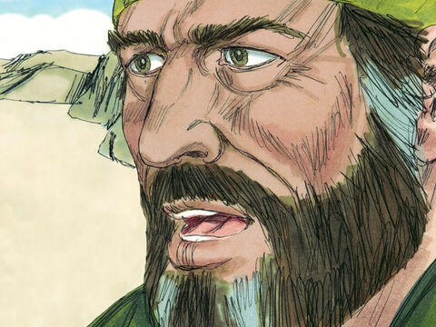
Jehoshaphat: 2 Chronicles 18:13-34
¹³ And Micaiah said, As the Lord liveth, even what my God saith, that will I speak.

Slide 25
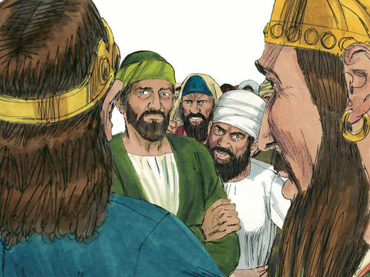
Jehoshaphat: 2 Chronicles 18:14-34
¹⁴ And when he was come to the king, the king said unto him, Micaiah, shall we go to Ramothgilead to battle, or shall I forbear? And he said, Go ye up, and prosper, and they shall be delivered into your hand.
Micaiah seems here to be speaking in dramatic irony, simply repeating the false message of the false prophets. Evidently, his tone made that clear, as is shown by Ahab’s response.

Slide 26
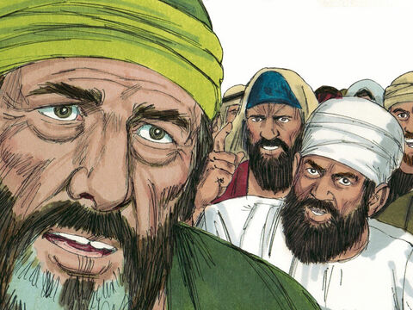
Jehoshaphat: 2 Chronicles 18:15-34
¹⁵ And the king said to him, How many times shall I adjure thee that thou say nothing but the truth to me in the name of the Lord?
¹⁶ Then he said, I did see all Israel scattered upon the mountains, as sheep that have no shepherd: and the Lord said, These have no master; let them return therefore every man to his house in peace.

Slide 27
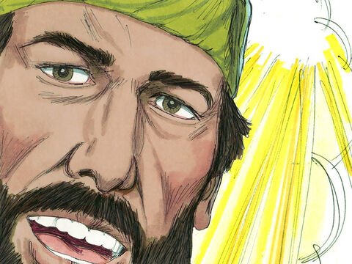
Jehoshaphat: 2 Chronicles 18:17-34
¹⁷ And the king of Israel said to Jehoshaphat, Did I not tell thee that he would not prophesy good unto me, but evil?
¹⁸ Again he said, Therefore hear the word of the Lord; I saw the Lord sitting upon his throne, and all the host of heaven standing on his right hand and on his left.

Slide 28
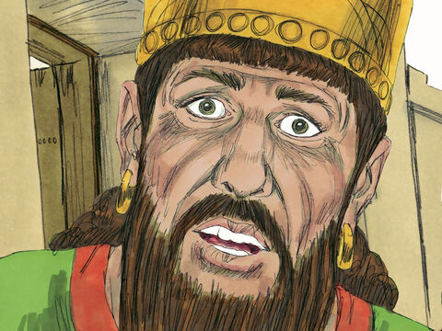
Jehoshaphat: 2 Chronicles 18:19-34
¹⁹ And the Lord said, Who shall entice Ahab king of Israel, that he may go up and fall at Ramothgilead? And one spake saying after this manner, and another saying after that manner.
²⁰ Then there came out a spirit, and stood before the Lord, and said, I will entice him. And the Lord said unto him, Wherewith?

Slide 29
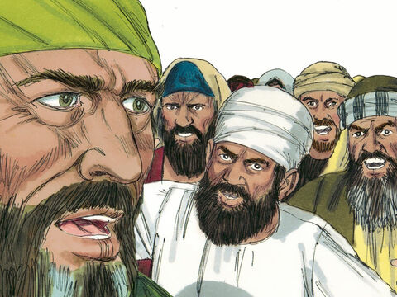
Jehoshaphat: 2 Chronicles 18:21-34
²¹ And he said, I will go out, and be a lying spirit in the mouth of all his prophets. And the Lord said, Thou shalt entice him, and thou shalt also prevail: go out, and do even so.
²² Now therefore, behold, the Lord hath put a lying spirit in the mouth of these thy prophets, and the Lord hath spoken evil against thee.

Slide 30
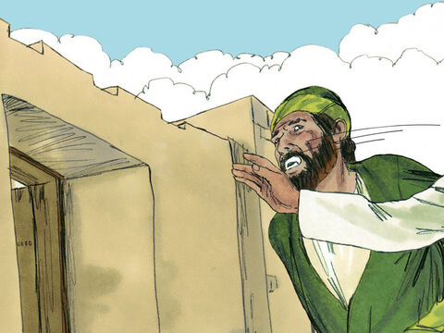
Jehoshaphat: 2 Chronicles 18:23-34
²³ Then Zedekiah the son of Chenaanah came near, and smote Micaiah upon the cheek, and said, Which way went the Spirit of the Lord from me to speak unto thee?

Slide 31
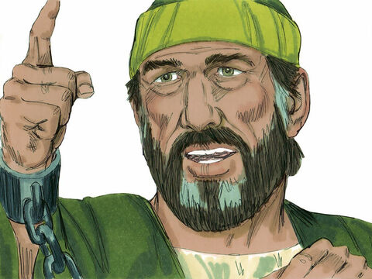
Jehoshaphat: 2 Chronicles 18:24-34
²⁴ And Micaiah said, Behold, thou shalt see on that day when thou shalt go into an inner chamber to hide thyself.

Slide 32
Jehoshaphat: 2 Chronicles 18:25-34
²⁵ Then the king of Israel said, Take ye Micaiah, and carry him back to Amon the governor of the city, and to Joash the king's son;
²⁶ And say, Thus saith the king, Put this fellow in the prison, and feed him with bread of affliction and with water of affliction, until I return in peace.
²⁷ And Micaiah said, If thou certainly return in peace, then hath not the Lord spoken by me. And he said, Hearken, all ye people.

Slide 33
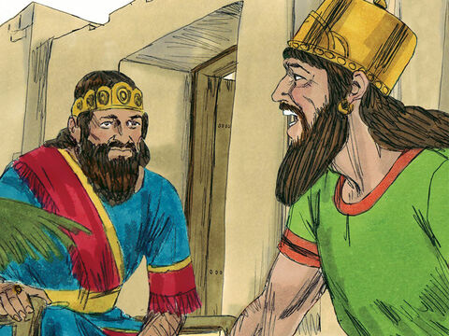
Jehoshaphat: 2 Chronicles 18:28-34
²⁸ So the king of Israel and Jehoshaphat the king of Judah went up to Ramothgilead.
²⁹ And the king of Israel said unto Jehoshaphat, I will disguise myself, and I will go to the battle; but put thou on thy robes. So the king of Israel disguised himself; and they went to the battle.

Slide 34
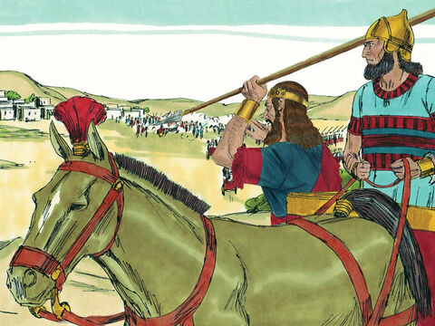
Jehoshaphat: 2 Chronicles 18:30-34
³⁰ Now the king of Syria had commanded the captains of the chariots that were with him, saying, Fight ye not with small or great, save only with the king of Israel.
³¹ And it came to pass, when the captains of the chariots saw Jehoshaphat, that they said, It is the king of Israel. Therefore they compassed about him to fight: but Jehoshaphat cried out, and the Lord helped him; and God moved them to depart from him.

Slide 35
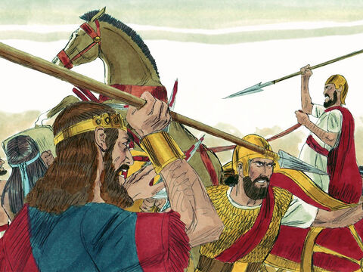
Jehoshaphat: 2 Chronicles 18:32-34
³² For it came to pass, that, when the captains of the chariots perceived that it was not the king of Israel, they turned back again from pursuing him.

Slide 36
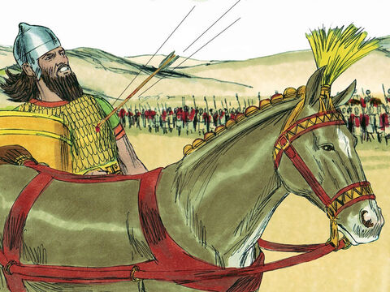
Jehoshaphat: 2 Chronicles 18:33-34
³³ And a certain man drew a bow at a venture, and smote the king of Israel between the joints of the harness: therefore he said to his chariot man, Turn thine hand, that thou mayest carry me out of the host; for I am wounded.
³⁴ And the battle increased that day: howbeit the king of Israel stayed himself up in his chariot against the Syrians until the even: and about the time of the sun going down he died.

Slide 37
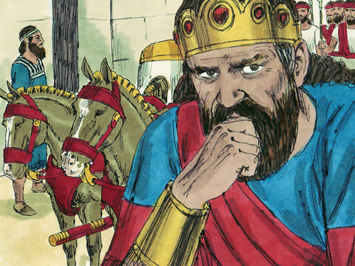
Jehoshaphat: 2 Chronicles 19:1-3
19 And Jehoshaphat the king of Judah returned to his house in peace to Jerusalem.

Slide 38
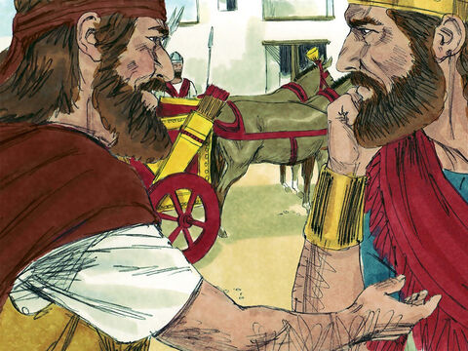
Jehoshaphat: 2 Chronicles 19:2-3
² And Jehu the son of Hanani the seer went out to meet him, and said to king Jehoshaphat, Shouldest thou help the ungodly, and love them that hate the Lord? therefore is wrath upon thee from before the Lord.
³ Nevertheless there are good things found in thee, in that thou hast taken away the groves out of the land, and hast prepared thine heart to seek God.

Slide 39
Some Context:
Hanani was the name of the prophet who had rebuked Jehoshaphat’s father for relying on the king of Syria rather than on the Lord, and who had been thrown into prison for his rebuke (2 Ch. 16:7-10).
Jehu was also the historian of Jehoshaphat’s reign (2 Ch. 20:34).
The record implies that the Syrians had successfully repulsed the attack, but had made no attempt to follow up their success. Jehoshaphat returned to Jerusalem sound and unhurt, a sadder but wiser man.

Slide 40
SDABC V.3 pg. 260
From a human standpoint, the conduct of Jehoshaphat in joining with Ahab in an attack on Syria might have appeared wise. Syria was growing in power, a menace to both Judah and Israel. The Hebrews had a right to recover the cities across the Jordan that Syria had taken from them. Probably Jehoshaphat had carefully appraised the situation and may have felt that his undertaking against Syria was sound. But the venture did not have divine sanction and in carrying it out Jehoshaphat was associated with a man whom the Lord could not bless.

Slide 41
SDABC V.3 pg. 260
Ahab was a base idolater, while Jehoshaphat had been endeavoring to wipe out idolatry. There was little in common between the two, and Jehoshaphat had no right to join himself to so base a man. He would have been much better off and would have been surer of success if he had gone against Syria alone. With God’s help and blessing he could have succeeded, even without the assistance of the forces of Ahab. Human help can prove to be more of a curse than a blessing, if it does not have the benediction of Heaven.

Slide 42
Jehoshaphat: 2 Chronicles 19:1-3
Prophets and Kings, pg. 197-198
From this disastrous battle Jehoshaphat returned to Jerusalem. As he approached the city, the prophet Jehu met him with the reproof: “Shouldest thou help the ungodly, and love them that hate the Lord? therefore is wrath upon thee from before the Lord. Nevertheless there are good things found in thee, in that thou hast taken away the groves out of the land, and hast prepared thine heart to seek God.” 2 Chronicles 19:2, 3.

Slide 43
Jehoshaphat: 2 Chronicles 19:1-3
Prophets and Kings, pg. 197-198
The later years of Jehoshaphat's reign were largely spent in strengthening the national and spiritual defenses of Judah. He “went out again through the people from Beersheba to Mount Ephraim, and brought them back unto the Lord God of their fathers.” Verse 4.

Slide 44
Jehoshaphat: 2 Chronicles 19:1-3
Prophets and Kings, pg. 197-198
One of the important steps taken by the king was the establishment and maintenance of efficient courts of justice. He “set judges in the land throughout all the fenced cities of Judah, city by city;” and in the charge given them he urged: “Take heed what ye do: for ye judge not for man, but for the Lord, who is with you in the judgment. Wherefore now let the fear of the Lord be upon you; take heed and do it: for there is no iniquity with the Lord our God, nor respect of persons, nor taking of gifts.” Verses 5-7.

Slide 45
Jehoshaphat: 2 Chronicles 19:1-3
Prophets and Kings, pg. 197-198
The judicial system was perfected by the founding of a court of appeal at Jerusalem, where Jehoshaphat “set of the Levites, and of the priests, and of the chief of the fathers of Israel, for the judgment of the Lord, and for controversies.” Verse 8.

Slide 46
Jehoshaphat: 2 Chronicles 19:1-3
Prophets and Kings, pg. 197-198
The king exhorted these judges to be faithful. “Thus shall ye do in the fear of the Lord, faithfully, and with a perfect heart,” he charged them. “And what cause soever shall come to you of your brethren that dwell in their cities, between blood and blood, between law and commandment, statutes and judgments, ye shall even warn them that they trespass not against the Lord, and so wrath come upon you, and upon your brethren: this do, and ye shall not trespass.

Slide 47
Jehoshaphat: 2 Chronicles 19:1-3
Prophets and Kings, pg. 197-198
“And, behold, Amariah the chief priest is over you in all matters of the Lord; and Zebadiah the son of Ishmael, the ruler of the house of Judah, for all the king's matters: also the Levites shall be officers before you. PK 197.4
“Deal courageously, and the Lord shall be with the good.” Verses 9-11.

Slide 48
Jehoshaphat: 2 Chronicles 19:1-3
Prophets and Kings, pg. 197-198
In his careful safeguarding of the rights and liberties of his subjects, Jehoshaphat emphasized the consideration that every member of the human family receives from the God of justice, who rules over all. “God standeth in the congregation of the mighty; He judgeth among the gods.” And those who are appointed to act as judges under Him, are to “defend the poor and fatherless;” they are to “do justice to the afflicted and needy,” and “rid them out of the hand of the wicked.” Psalm 82:1, 3, 4.

Slide 49
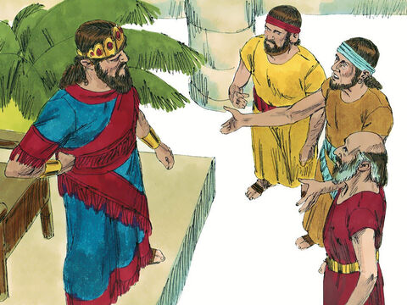
Jehoshaphat: 2 Chronicles 20:1-30
20 It came to pass after this also, that the children of Moab, and the children of Ammon, and with them other beside the Ammonites, came against Jehoshaphat to battle.
² Then there came some that told Jehoshaphat, saying, There cometh a great multitude against thee from beyond the sea on this side Syria; and, behold, they be in Hazazontamar, which is Engedi.

Slide 50
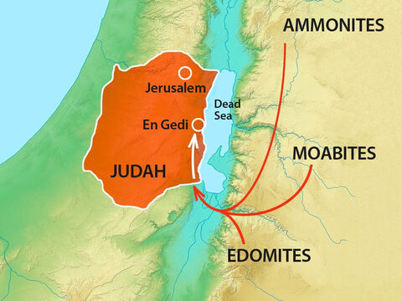
Jehoshaphat: 2 Chronicles 20:1-30

Slide 51
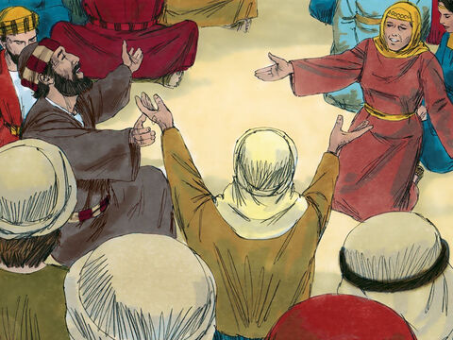
Jehoshaphat: 2 Chronicles 20:3-30
³ And Jehoshaphat feared, and set himself to seek the Lord, and proclaimed a fast throughout all Judah.
⁴ And Judah gathered themselves together, to ask help of the Lord: even out of all the cities of Judah they came to seek the Lord.

Slide 52
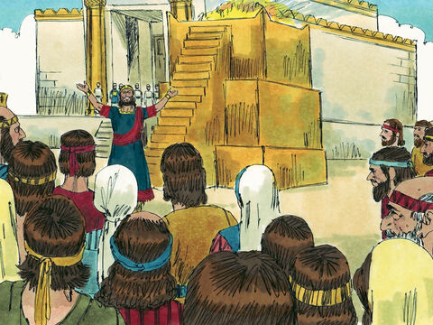
Jehoshaphat: 2 Chronicles 20:5-30
⁵ And Jehoshaphat stood in the congregation of Judah and Jerusalem, in the house of the Lord, before the new court,
⁶ And said, O Lord God of our fathers, art not thou God in heaven? and rulest not thou over all the kingdoms of the heathen? and in thine hand is there not power and might, so that none is able to withstand thee?

Slide 53
Jehoshaphat: 2 Chronicles 20:7-30
⁷ Art not thou our God, who didst drive out the inhabitants of this land before thy people Israel, and gavest it to the seed of Abraham thy friend for ever?
⁸ And they dwelt therein, and have built thee a sanctuary therein for thy name, saying,
⁹ If, when evil cometh upon us, as the sword, judgment, or pestilence, or famine, we stand before this house, and in thy presence, (for thy name is in this house,) and cry unto thee in our affliction, then thou wilt hear and help.

Slide 54
Jehoshaphat: 2 Chronicles 20:10-30
¹⁰ And now, behold, the children of Ammon and Moab and mount Seir, whom thou wouldest not let Israel invade, when they came out of the land of Egypt, but they turned from them, and destroyed them not;
¹¹ Behold, I say, how they reward us, to come to cast us out of thy possession, which thou hast given us to inherit.
¹² O our God, wilt thou not judge them? for we have no might against this great company that cometh against us; neither know we what to do: but our eyes are upon thee.

Slide 55
Jehoshaphat: 2 Chronicles 20:13-30
¹³ And all Judah stood before the Lord, with their little ones, their wives, and their children.
¹⁴ Then upon Jahaziel the son of Zechariah, the son of Benaiah, the son of Jeiel, the son of Mattaniah, a Levite of the sons of Asaph, came the Spirit of the Lord in the midst of the congregation;
¹⁵ And he said, Hearken ye, all Judah, and ye inhabitants of Jerusalem, and thou king Jehoshaphat, Thus saith the Lord unto you, Be not afraid nor dismayed by reason of this great multitude; for the battle is not yours, but God's.

Slide 56
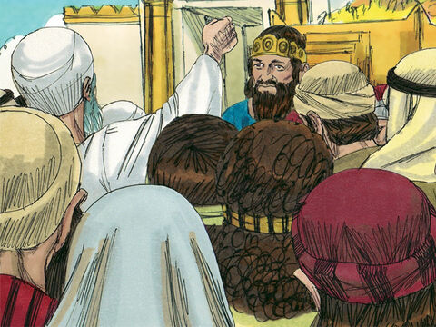
Jehoshaphat: 2 Chronicles 20:16-30
¹⁶ To morrow go ye down against them: behold, they come up by the cliff of Ziz; and ye shall find them at the end of the brook, before the wilderness of Jeruel.

Slide 57
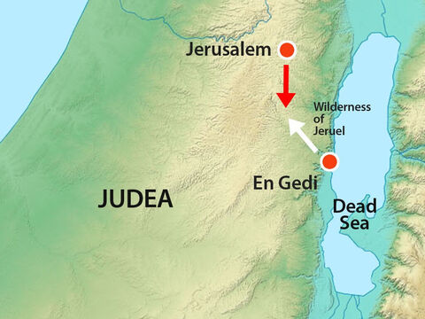
Jehoshaphat: 2 Chronicles 20:16-30

Slide 58
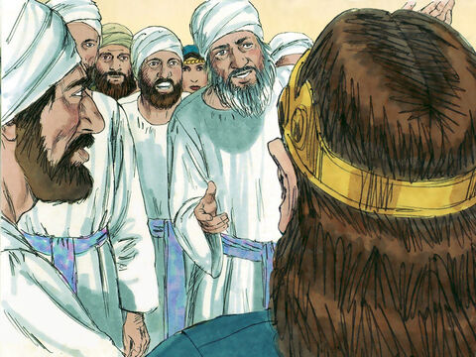
Jehoshaphat: 2 Chronicles 20:17-30
¹⁷ Ye shall not need to fight in this battle: set yourselves, stand ye still, and see the salvation of the Lord with you, O Judah and Jerusalem: fear not, nor be dismayed; to morrow go out against them: for the Lord will be with you.

Slide 59
Jehoshaphat: 2 Chronicles 20:18-30
¹⁸ And Jehoshaphat bowed his head with his face to the ground: and all Judah and the inhabitants of Jerusalem fell before the Lord, worshipping the Lord.
¹⁹ And the Levites, of the children of the Kohathites, and of the children of the Korhites, stood up to praise the Lord God of Israel with a loud voice on high.
²⁰ And they rose early in the morning, and went forth into the wilderness of Tekoa: and as they went forth, Jehoshaphat stood and said, Hear me, O Judah, and ye inhabitants of Jerusalem; Believe in the Lord your God, so shall ye be established; believe his prophets, so shall ye prosper.

Slide 60
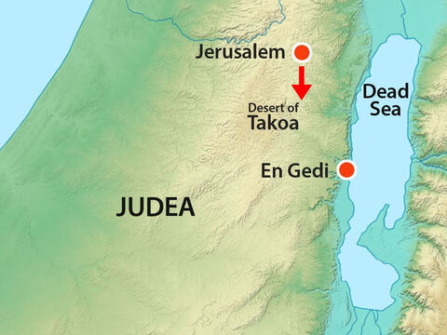
Jehoshaphat: 2 Chronicles 20:18-30

Slide 61
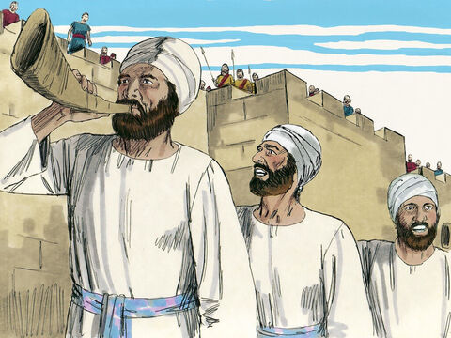
Jehoshaphat: 2 Chronicles 20:21-30
²¹ And when he had consulted with the people, he appointed singers unto the Lord, and that should praise the beauty of holiness, as they went out before the army, and to say, Praise the Lord; for his mercy endureth for ever.

Slide 62
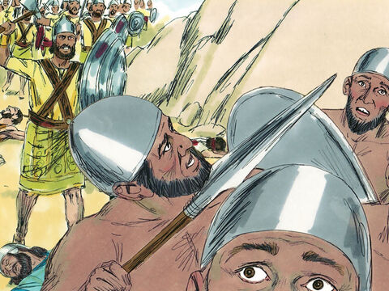
Jehoshaphat: 2 Chronicles 20:22-30
²² And when they began to sing and to praise, the Lord set ambushments against the children of Ammon, Moab, and mount Seir, which were come against Judah; and they were smitten.
²³ For the children of Ammon and Moab stood up against the inhabitants of mount Seir, utterly to slay and destroy them: and when they had made an end of the inhabitants of Seir, every one helped to destroy another.

Slide 63
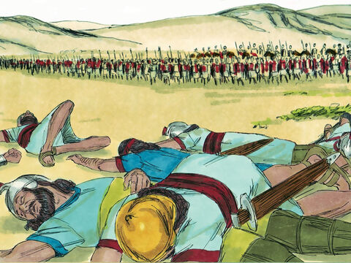
Jehoshaphat: 2 Chronicles 20:24-30
²⁴ And when Judah came toward the watch tower in the wilderness, they looked unto the multitude, and, behold, they were dead bodies fallen to the earth, and none escaped.

Slide 64
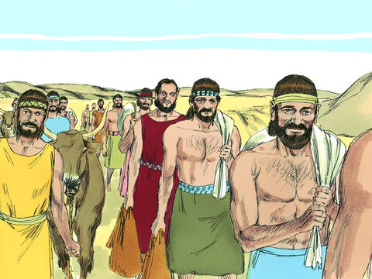
Jehoshaphat: 2 Chronicles 20:25-30
²⁵ And when Jehoshaphat and his people came to take away the spoil of them, they found among them in abundance both riches with the dead bodies, and precious jewels, which they stripped off for themselves, more than they could carry away: and they were three days in gathering of the spoil, it was so much.

Slide 65
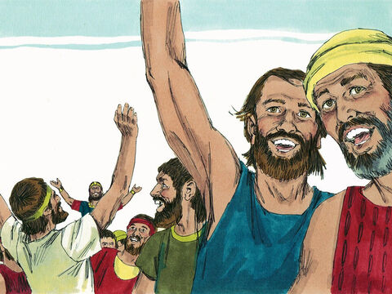
Jehoshaphat: 2 Chronicles 20:26-30
²⁶ And on the fourth day they assembled themselves in the valley of Berachah; for there they blessed the Lord: therefore the name of the same place was called, The valley of Berachah, unto this day.
²⁷ Then they returned, every man of Judah and Jerusalem, and Jehoshaphat in the forefront of them, to go again to Jerusalem with joy; for the Lord had made them to rejoice over their enemies.

Slide 66
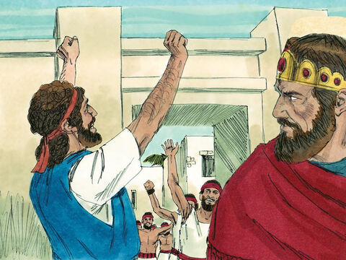
Jehoshaphat: 2 Chronicles 20:28-30
²⁸ And they came to Jerusalem with psalteries and harps and trumpets unto the house of the Lord.
²⁹ And the fear of God was on all the kingdoms of those countries, when they had heard that the Lord fought against the enemies of Israel.
³⁰ So the realm of Jehoshaphat was quiet: for his God gave him rest round about.

Slide 67
A Poor Example: 1 Chronicles 21:1-18
21 And Satan stood up against Israel, and provoked David to number Israel.
² And David said to Joab and to the rulers of the people, Go, number Israel from Beersheba even to Dan; and bring the number of them to me, that I may know it.
³ And Joab answered, The Lord make his people an hundred times so many more as they be: but, my lord the king, are they not all my lord's servants? why then doth my lord require this thing? why will he be a cause of trespass to Israel?

Slide 68
SDABC V.3 pg. 184
The census to be taken of Israel was for military purposes, a form of registration for military service. The number sought was not the whole population, but the fighting strength of the nation. By increasing his military might David thought to increase still further the power and prestige of Israel. By doing this, however, he was causing the nations round about to think that Israel’s strength lay in its powerful army and not in God.

Slide 69
A Poor Example: 1 Chronicles 21:4-18
⁴ Nevertheless the king's word prevailed against Joab. Wherefore Joab departed, and went throughout all Israel, and came to Jerusalem.
⁵ And Joab gave the sum of the number of the people unto David. And all they of Israel were a thousand thousand and an hundred thousand men that drew sword: and Judah was four hundred threescore and ten thousand men that drew sword.
⁶ But Levi and Benjamin counted he not among them: for the king's word was abominable to Joab.

Slide 70
A Poor Example: 1 Chronicles 21:7-18
⁷ And God was displeased with this thing; therefore he smote Israel.
⁸ And David said unto God, I have sinned greatly, because I have done this thing: but now, I beseech thee, do away the iniquity of thy servant; for I have done very foolishly.
⁹ And the Lord spake unto Gad, David's seer, saying,
¹⁰ Go and tell David, saying, Thus saith the Lord, I offer thee three things: choose thee one of them, that I may do it unto thee.

Slide 71
A Poor Example: 1 Chronicles 21:11-18
¹¹ So Gad came to David, and said unto him, Thus saith the Lord, Choose thee
¹² Either three years' famine; or three months to be destroyed before thy foes, while that the sword of thine enemies overtaketh thee; or else three days the sword of the Lord, even the pestilence, in the land, and the angel of the Lord destroying throughout all the coasts of Israel. Now therefore advise thyself what word I shall bring again to him that sent me.
¹³ And David said unto Gad, I am in a great strait: let me fall now into the hand of the Lord; for very great are his mercies: but let me not fall into the hand of man.

Slide 72
A Poor Example: 1 Chronicles 21:14-18
¹⁴ So the Lord sent pestilence upon Israel: and there fell of Israel seventy thousand men.
¹⁵ And God sent an angel unto Jerusalem to destroy it: and as he was destroying, the Lord beheld, and he repented him of the evil, and said to the angel that destroyed, It is enough, stay now thine hand. And the angel of the Lord stood by the threshingfloor of Ornan the Jebusite.
¹⁶ And David lifted up his eyes, and saw the angel of the Lord stand between the earth and the heaven, having a drawn sword in his hand stretched out over Jerusalem. Then David and the elders of Israel, who were clothed in sackcloth, fell upon their faces.

Slide 73
A Poor Example: 1 Chronicles 21:17-18
¹⁷ And David said unto God, Is it not I that commanded the people to be numbered? even I it is that have sinned and done evil indeed; but as for these sheep, what have they done? let thine hand, I pray thee, O Lord my God, be on me, and on my father's house; but not on thy people, that they should be plagued.
¹⁸ Then the angel of the Lord commanded Gad to say to David, that David should go up, and set up an altar unto the Lord in the threshingfloor of Ornan the Jebusite.

Slide 74
A Personal Example: 2 Kings 6:1-7
6 And the sons of the prophets said unto Elisha, Behold now, the place where we dwell with thee is too strait for us.
² Let us go, we pray thee, unto Jordan, and take thence every man a beam, and let us make us a place there, where we may dwell. And he answered, Go ye.
³ And one said, Be content, I pray thee, and go with thy servants. And he answered, I will go.
⁴ So he went with them. And when they came to Jordan, they cut down wood.

Slide 75
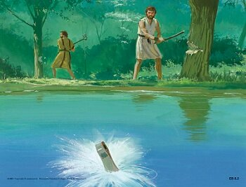
A Personal Example: 2 Kings 6:5-7
⁵ But as one was felling a beam, the axe head fell into the water: and he cried, and said, Alas, master! for it was borrowed.

Slide 76
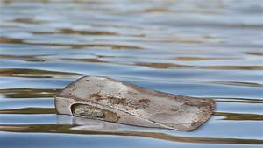
A Personal Example: 2 Kings 6:6-7
⁶ And the man of God said, Where fell it? And he shewed him the place. And he cut down a stick, and cast it in thither; and the iron did swim.
⁷ Therefore said he, Take it up to thee. And he put out his hand, and took it.

Slide 77
SDABC V.2 pg. 883
Man, in the narrowness of his vision, is likely to reas0on that it is only in great things that divine intervention should be looked for. But there is not a grief or a heartache on the part of any of God’s children on earth but the Father’s great heart of sympathy goes out to the one in need. God’s heart still responds to the needs of the children of men, and Heaven still acts in their behalf. Not a day passes but the Lord intervenes in the interests of those who call upon Him, supplying their needs. The day of miracles is not yet over. There may not be an Elisha present, but in His own way God works in behalf of His children who have faith in Him.

Slide 78
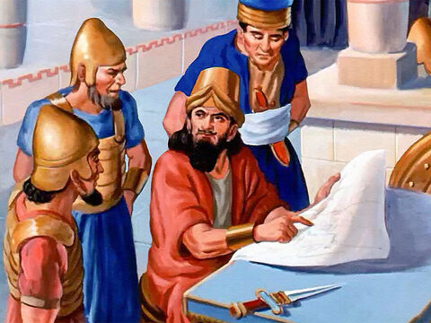
Managing in Tough Times: 2 Kings 6:8-23
⁸ Then the king of Syria warred against Israel, and took counsel with his servants, saying, In such and such a place shall be my camp.
⁹ And the man of God sent unto the king of Israel, saying, Beware that thou pass not such a place; for thither the Syrians are come down.

Slide 79
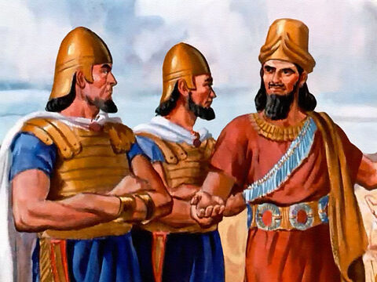

Managing in Tough Times: 2 Kings 6:10-23
¹⁰ And the king of Israel sent to the place which the man of God told him and warned him of, and saved himself there, not once nor twice.

Slide 80

Managing in Tough Times: 2 Kings 6:11-23
¹¹ Therefore the heart of the king of Syria was sore troubled for this thing; and he called his servants, and said unto them, Will ye not shew me which of us is for the king of Israel?

Slide 81

Managing in Tough Times: 2 Kings 6:12-23
¹² And one of his servants said, None, my lord, O king: but Elisha, the prophet that is in Israel, telleth the king of Israel the words that thou speakest in thy bedchamber.

Slide 82

Managing in Tough Times: 2 Kings 6:13-23
¹³ And he said, Go and spy where he is, that I may send and fetch him. And it was told him, saying, Behold, he is in Dothan.

Slide 83

Managing in Tough Times: 2 Kings 6:14-23
¹⁴ Therefore sent he thither horses, and chariots, and a great host: and they came by night, and compassed the city about.

Slide 84

Managing in Tough Times: 2 Kings 6:15-23
¹⁵ And when the servant of the man of God was risen early, and gone forth, behold, an host compassed the city both with horses and chariots. And his servant said unto him, Alas, my master! how shall we do?

Slide 85

Managing in Tough Times: 2 Kings 6:16-23
¹⁶ And he answered, Fear not: for they that be with us are more than they that be with them.

Slide 86

Managing in Tough Times: 2 Kings 6:17-23
¹⁷ And Elisha prayed, and said, Lord, I pray thee, open his eyes, that he may see. And the Lord opened the eyes of the young man; and he saw: and, behold, the mountain was full of horses and chariots of fire round about Elisha.

Slide 87

Managing in Tough Times: 2 Kings 6:18-23
¹⁸ And when they came down to him, Elisha prayed unto the Lord, and said, Smite this people, I pray thee, with blindness. And he smote them with blindness according to the word of Elisha.
¹⁹ And Elisha said unto them, This is not the way, neither is this the city: follow me, and I will bring you to the man whom ye seek. But he led them to Samaria.

Slide 88

Managing in Tough Times: 2 Kings 6:20-23
²⁰ And it came to pass, when they were come into Samaria, that Elisha said, Lord, open the eyes of these men, that they may see. And the Lord opened their eyes, and they saw; and, behold, they were in the midst of Samaria.

Slide 89

Managing in Tough Times: 2 Kings 6:21-23
²¹ And the king of Israel said unto Elisha, when he saw them, My father, shall I smite them? shall I smite them?
²² And he answered, Thou shalt not smite them: wouldest thou smite those whom thou hast taken captive with thy sword and with thy bow? set bread and water before them, that they may eat and drink, and go to their master.

Slide 90

Managing in Tough Times: 2 Kings 6:23
²³ And he prepared great provision for them: and when they had eaten and drunk, he sent them away, and they went to their master. So the bands of Syria came no more into the land of Israel.

Slide 91
Managing in Tough Times

Slide 92
Thank you!
And Happy Sabbath!!

