Slide 1
Rewards of Faithfulness
Isaiah 58, 59, 60 & 62, Romans 7-8, Revelation 21
Lesson 12, 1st Quarter 2023

Slide 2
Memory Text: Matthew 25:21
²¹ His lord said unto him, Well done, thou good and faithful servant: thou hast been faithful over a few things, I will make thee ruler over many things: enter thou into the joy of thy lord.

Slide 3
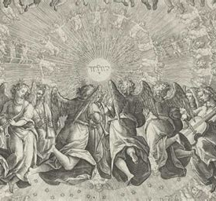
Isaiah 57:15-21
¹⁵ For thus saith the high and lofty One that inhabiteth eternity, whose name is Holy; I dwell in the high and holy place, with him also that is of a contrite and humble spirit, to revive the spirit of the humble, and to revive the heart of the contrite ones.

Slide 4
SDABC V4 p. 303
Contrition and humility—the spirit of sincere repentance for sin, coupled with a sense of one’s inability, of oneself, to earn salvation—are the two essential qualifications for acceptance with God. Contrition prepares the way for justification, as humility does for sanctification. God can do little for the man who does not feel a keen sense of his own need and who does not reach out for power from above.

Slide 5
Contrition and Humility
⁸ He hath shewed thee, O man, what is good; and what doth the Lord require of thee, but to do justly, and to love mercy, and to walk humbly with thy God?
-Micah 6:8
²⁹ Take my yoke upon you, and learn of me; for I am meek and lowly in heart: and ye shall find rest unto your souls.
-Matthew 11:29

Slide 6
Truth & Consequences: Isaiah 57:15-21
¹⁵ For thus saith the high and lofty One that inhabiteth eternity, whose name is Holy; I dwell in the high and holy place, with him also that is of a contrite and humble spirit, to revive the spirit of the humble, and to revive the heart of the contrite ones.

Slide 7
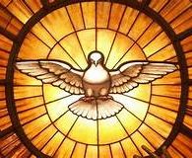
Truth & Consequences: Isaiah 57:16-21
¹⁶ For I will not contend for ever, neither will I be always wroth: for the spirit should fail before me, and the souls which I have made.

Slide 8
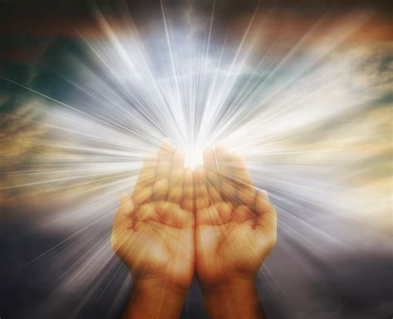
Truth & Consequences: Isaiah 57:17-21
¹⁷ For the iniquity of his covetousness was I wroth, and smote him: I hid me, and was wroth, and he went on frowardly in the way of his heart.
¹⁸ I have seen his ways, and will heal him: I will lead him also, and restore comforts unto him and to his mourners.

Slide 9
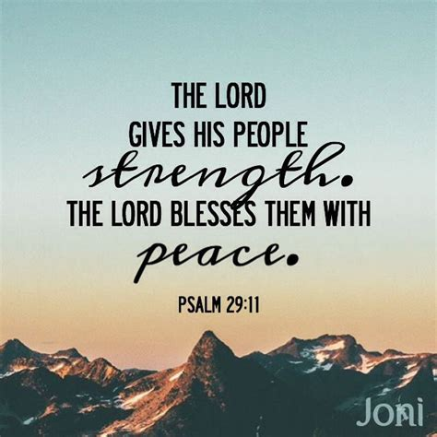
Truth & Consequences: Isaiah 57:19-21
¹⁹ I create the fruit of the lips; Peace, peace to him that is far off, and to him that is near, saith the Lord; and I will heal him.
²⁰ But the wicked are like the troubled sea, when it cannot rest, whose waters cast up mire and dirt.

Slide 10





Truth & Consequences:
Isaiah 57:21
²¹ There is no peace, saith my God, to the wicked.

Slide 11
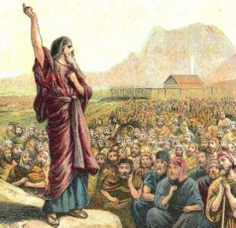
Truth & Hypocrisy: Isaiah 58:1-14
58 Cry aloud, spare not, lift up thy voice like a trumpet, and shew my people their transgression, and the house of Jacob their sins.

Slide 12
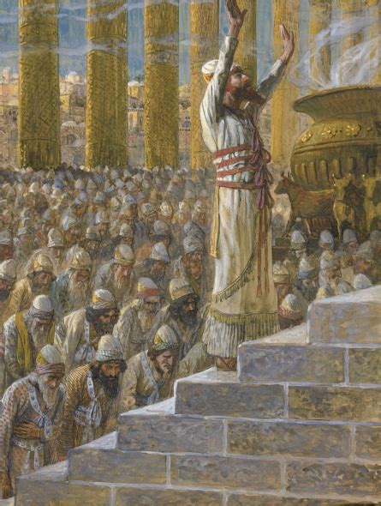
Truth & Hypocrisy: Isaiah 58:2-14
² Yet they seek me daily, and delight to know my ways, as a nation that did righteousness, and forsook not the ordinance of their God: they ask of me the ordinances of justice; they take delight in approaching to God.

Slide 13
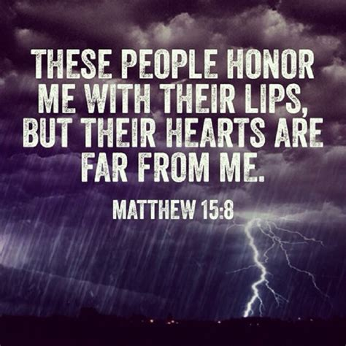
Truth & Hypocrisy: Isaiah 58:3-14
³ Wherefore have we fasted, say they, and thou seest not? wherefore have we afflicted our soul, and thou takest no knowledge? Behold, in the day of your fast ye find pleasure, and exact all your labours.

Slide 14
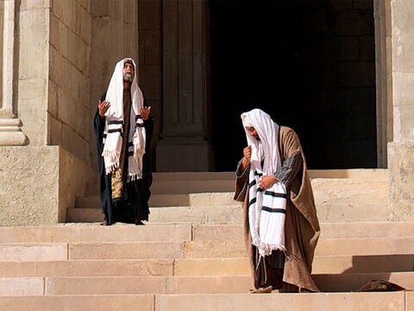
Truth & Hypocrisy: Isaiah 58:4-14
⁴ Behold, ye fast for strife and debate, and to smite with the fist of wickedness: ye shall not fast as ye do this day, to make your voice to be heard on high.

Slide 15
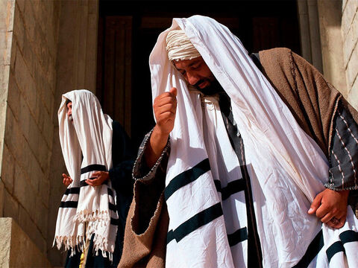
Truth & Hypocrisy: Isaiah 58:5-14
⁵ Is it such a fast that I have chosen? a day for a man to afflict his soul? is it to bow down his head as a bulrush, and to spread sackcloth and ashes under him? wilt thou call this a fast, and an acceptable day to the Lord?

Slide 16
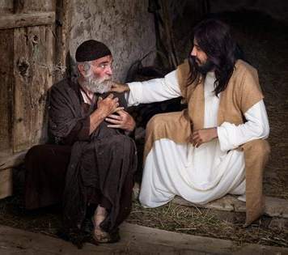
Truth & Hypocrisy: Isaiah 58:6-14
⁶ Is not this the fast that I have chosen? to loose the bands of wickedness, to undo the heavy burdens, and to let the oppressed go free, and that ye break every yoke?

Slide 17
SDABC V4 p. 306
True fasting was designed to purify the motives and reform the life. But with the Jews the practices of religion had become a cloak for oppression of the weak, robbery of widows and orphans, and all forms of bribery, deceit, and injustice. The true purpose of religion is to release men from their burdens of sin, to eliminate intolerance and oppression, and to promote justice, liberty, and peace. God intended His people to be free, but the leaders of Israel were making slaves and paupers of them.

Slide 18
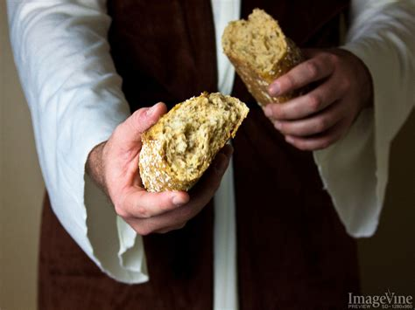
Truth & Hypocrisy: Isaiah 58:7-14
⁷ Is it not to deal thy bread to the hungry, and that thou bring the poor that are cast out to thy house? when thou seest the naked, that thou cover him; and that thou hide not thyself from thine own flesh?

Slide 19
SDABC V4 p. 306
True religion is practical. To be sure, it includes the rites and ceremonies of the church, but it is in the life lived before one’s fellows that the presence or absence of true religion is manifest. It is not so much a matter of abstaining from food as it is of sharing food with the hungry. Practical godliness is the only kind of religion recognized at the judgement bar of God.

Slide 20
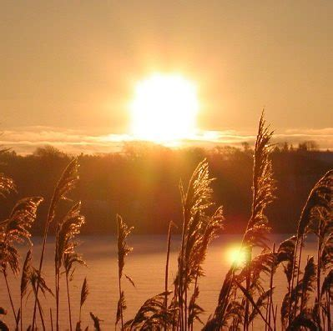
Truth & Hypocrisy: Isaiah 58:8-14
⁸ Then shall thy light break forth as the morning, and thine health shall spring forth speedily: and thy righteousness shall go before thee; the glory of the Lord shall be thy reward.

Slide 21
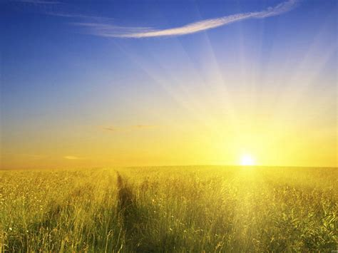
Truth & Hypocrisy: Isaiah 58:9-14
⁹ Then shalt thou call, and the Lord shall answer; thou shalt cry, and he shall say, Here I am. If thou take away from the midst of thee the yoke, the putting forth of the finger, and speaking vanity;

Slide 22
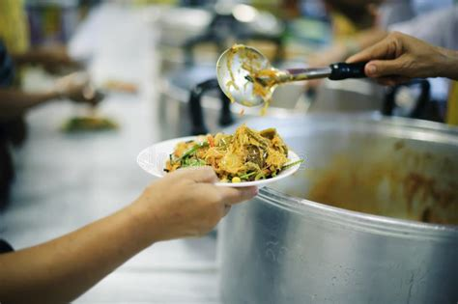
Truth & Hypocrisy: Isaiah 58:10-14
¹⁰ And if thou draw out thy soul to the hungry, and satisfy the afflicted soul; then shall thy light rise in obscurity, and thy darkness be as the noon day:

Slide 23
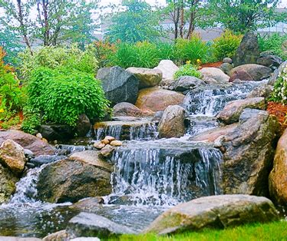
Restoration: Isaiah 58:11-14
¹¹ And the Lord shall guide thee continually, and satisfy thy soul in drought, and make fat thy bones: and thou shalt be like a watered garden, and like a spring of water, whose waters fail not.

Slide 24
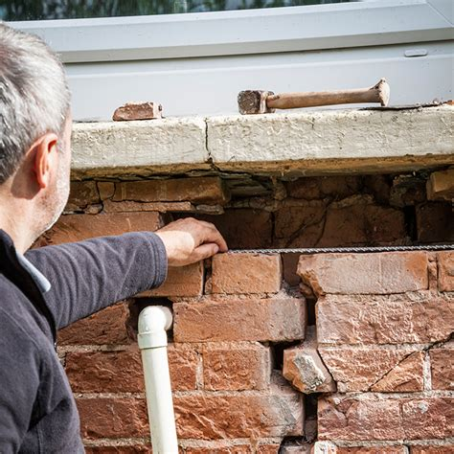
Restoration: Isaiah 58:12-14
¹² And they that shall be of thee shall build the old waste places: thou shalt raise up the foundations of many generations; and thou shalt be called, The repairer of the breach, The restorer of paths to dwell in.

Slide 25
SDABC V4 p. 307
When, eventually, the Jews should return from captivity they would find Jerusalem in ruins. But the nation’s moral edifice also lay in ruins, and this must be rebuilt. Here is pictured a great work of revival, reformation, and restoration. A breach had been made in the wall, as it were, because of the failure to practice true religion. Nevertheless, the foundations remained, and upon them a new structure was to be reared. The manner of rebuilding the “old waste places” has been set forth in v. 6-10; it consists of a revival of practical religion.

Slide 26
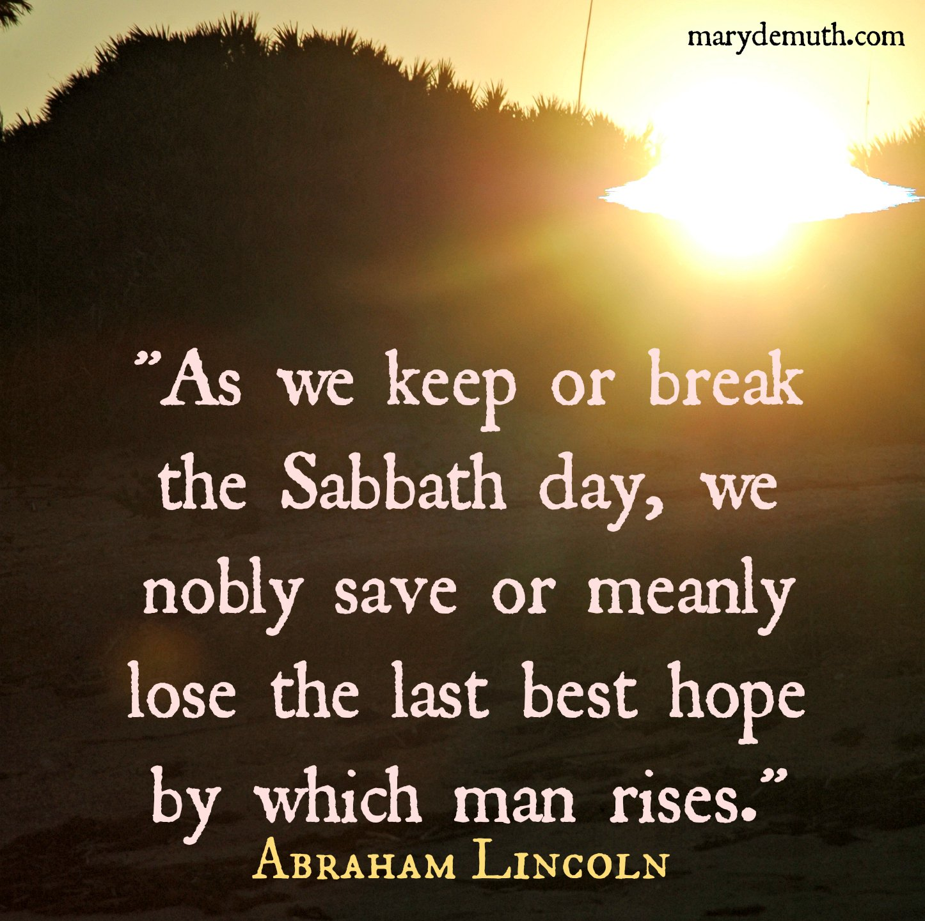
Restoration: Isaiah 58:13-14
¹³ If thou turn away thy foot from the sabbath, from doing thy pleasure on my holy day; and call the sabbath a delight, the holy of the Lord, honourable; and shalt honour him, not doing thine own ways, nor finding thine own pleasure, nor speaking thine own words:

Slide 27
SDABC V4 p. 307
The work of restoration is to begin with a revival of true Sabbath observance, the essence of which is communion with God and remembrance of His creative power, on the day He made holy. The fate of Israel as a nation was determined by its attitude toward God’s holy day. The Sabbath was never intended to be an end in itself, but rather a means by which man might become acquainted with the character and purposes of his Creator.

Slide 28
Restoration: Jeremiah 17:19-27
¹⁹ Thus said the Lord unto me; Go and stand in the gate of the children of the people, whereby the kings of Judah come in, and by the which they go out, and in all the gates of Jerusalem;
²⁰ And say unto them, Hear ye the word of the Lord, ye kings of Judah, and all Judah, and all the inhabitants of Jerusalem, that enter in by these gates:

Slide 29
Restoration: Jeremiah 17:21-27
²¹ Thus saith the Lord; Take heed to yourselves, and bear no burden on the sabbath day, nor bring it in by the gates of Jerusalem;
²² Neither carry forth a burden out of your houses on the sabbath day, neither do ye any work, but hallow ye the sabbath day, as I commanded your fathers.
²³ But they obeyed not, neither inclined their ear, but made their neck stiff, that they might not hear, nor receive instruction.

Slide 30
Restoration: Jeremiah 17:24-27
²⁴ And it shall come to pass, if ye diligently hearken unto me, saith the Lord, to bring in no burden through the gates of this city on the sabbath day, but hallow the sabbath day, to do no work therein;
²⁵ Then shall there enter into the gates of this city kings and princes sitting upon the throne of David, riding in chariots and on horses, they, and their princes, the men of Judah, and the inhabitants of Jerusalem: and this city shall remain for ever.

Slide 31
Restoration: Jeremiah 17:26-27
²⁶ And they shall come from the cities of Judah, and from the places about Jerusalem, and from the land of Benjamin, and from the plain, and from the mountains, and from the south, bringing burnt offerings, and sacrifices, and meat offerings, and incense, and bringing sacrifices of praise, unto the house of the Lord.
²⁷ But if ye will not hearken unto me to hallow the sabbath day, and not to bear a burden, even entering in at the gates of Jerusalem on the sabbath day; then will I kindle a fire in the gates thereof, and it shall devour the palaces of Jerusalem, and it shall not be quenched.

Slide 32
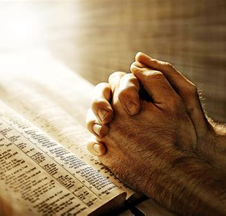
Restoration: Isaiah 58:13-14
¹³ If thou turn away thy foot from the sabbath, from doing thy pleasure on my holy day; and call the sabbath a delight, the holy of the Lord, honourable; and shalt honour him, not doing thine own ways, nor finding thine own pleasure, nor speaking thine own words:

Slide 33
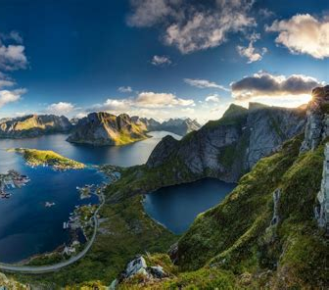
Restoration: Isaiah 58:14
¹⁴ Then shalt thou delight thyself in the Lord; and I will cause thee to ride upon the high places of the earth, and feed thee with the heritage of Jacob thy father: for the mouth of the Lord hath spoken it.

Slide 34
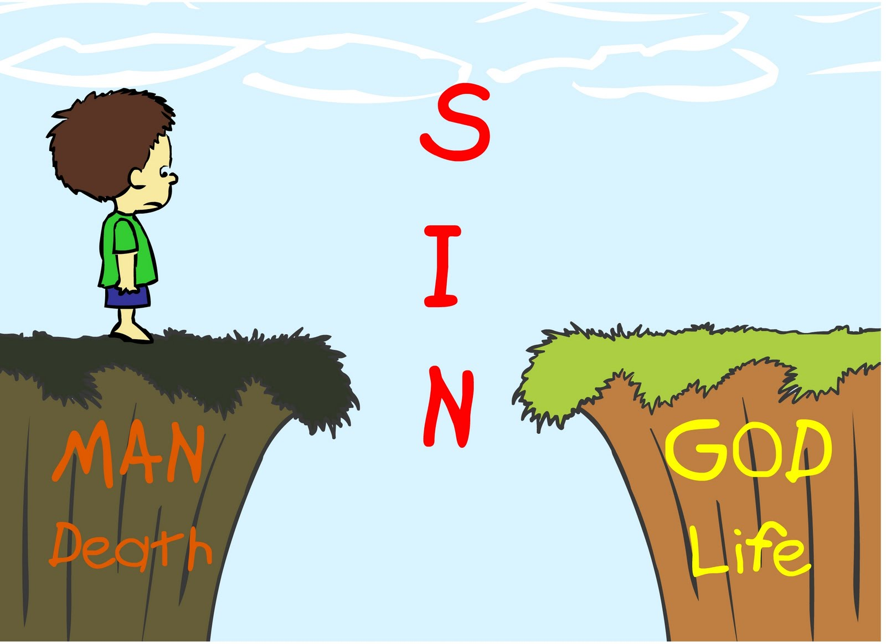
Current Affairs: Isaiah 59:1-21
59 Behold, the Lord's hand is not shortened, that it cannot save; neither his ear heavy, that it cannot hear:
² But your iniquities have separated between you and your God, and your sins have hid his face from you, that he will not hear.

Slide 35
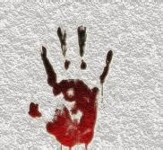
Current Affairs: Isaiah 59:3-21
³ For your hands are defiled with blood, and your fingers with iniquity; your lips have spoken lies, your tongue hath muttered perverseness.

Slide 36

Current Affairs: Isaiah 59:4-21
⁴ None calleth for justice, nor any pleadeth for truth: they trust in vanity, and speak lies; they conceive mischief, and bring forth iniquity.

Slide 37
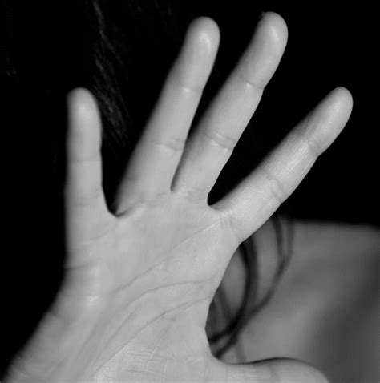
Current Affairs: Isaiah 59:5-21
⁵ They hatch cockatrice' eggs, and weave the spider's web: he that eateth of their eggs dieth, and that which is crushed breaketh out into a viper.
⁶ Their webs shall not become garments, neither shall they cover themselves with their works: their works are works of iniquity, and the act of violence is in their hands.

Slide 38
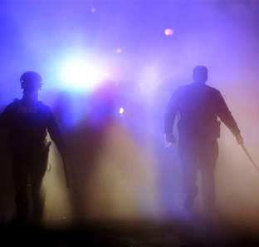
Current Affairs: Isaiah 59:7-21
⁷ Their feet run to evil, and they make haste to shed innocent blood: their thoughts are thoughts of iniquity; wasting and destruction are in their paths.
⁸ The way of peace they know not; and there is no judgment in their goings: they have made them crooked paths: whosoever goeth therein shall not know peace.

Slide 39
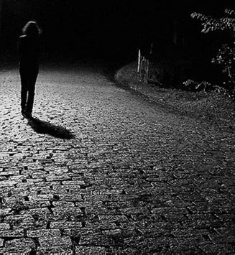
Current Affairs: Isaiah 59:9-21
⁹ Therefore is judgment far from us, neither doth justice overtake us: we wait for light, but behold obscurity; for brightness, but we walk in darkness.
¹⁰ We grope for the wall like the blind, and we grope as if we had no eyes: we stumble at noon day as in the night; we are in desolate places as dead men.

Slide 40
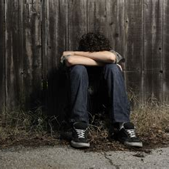
Current Affairs: Isaiah 59:11-21
¹¹ We roar all like bears, and mourn sore like doves: we look for judgment, but there is none; for salvation, but it is far off from us.
¹² For our transgressions are multiplied before thee, and our sins testify against us: for our transgressions are with us; and as for our iniquities, we know them;

Slide 41
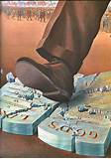
Current Affairs: Isaiah 59:13-21
¹³ In transgressing and lying against the Lord, and departing away from our God, speaking oppression and revolt, conceiving and uttering from the heart words of falsehood.
¹⁴ And judgment is turned away backward, and justice standeth afar off: for truth is fallen in the street, and equity cannot enter.

Slide 42
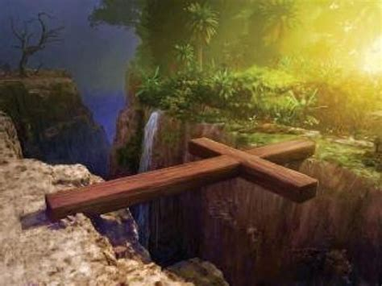
Future History: Isaiah 59:15-21
¹⁵ Yea, truth faileth; and he that departeth from evil maketh himself a prey: and the Lord saw it, and it displeased him that there was no judgment.

Slide 43
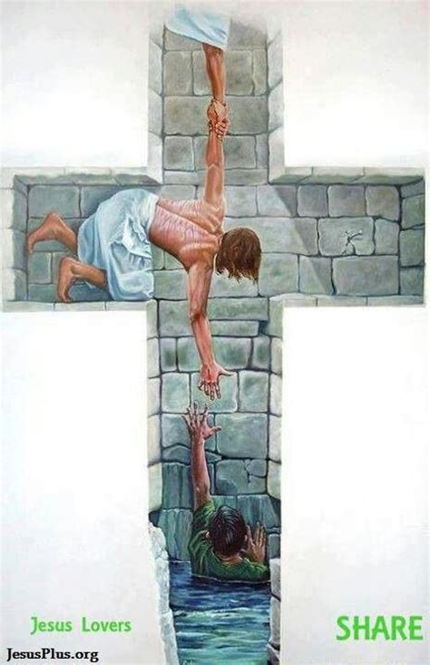
Future History: Isaiah 59:16-21
¹⁶ And he saw that there was no man, and wondered that there was no intercessor: therefore his arm brought salvation unto him; and his righteousness, it sustained him.

Slide 44
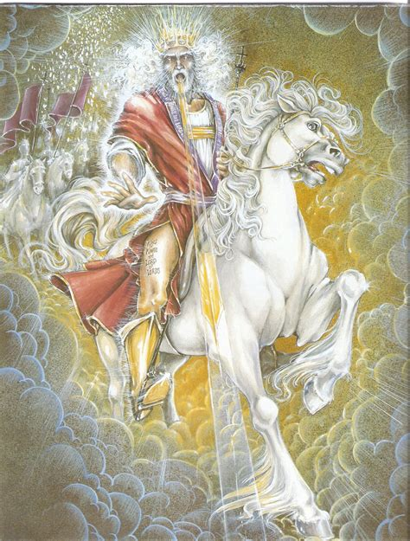
Future History: Isaiah 59:17-21
¹⁷ For he put on righteousness as a breastplate, and an helmet of salvation upon his head; and he put on the garments of vengeance for clothing, and was clad with zeal as a cloak.

Slide 45
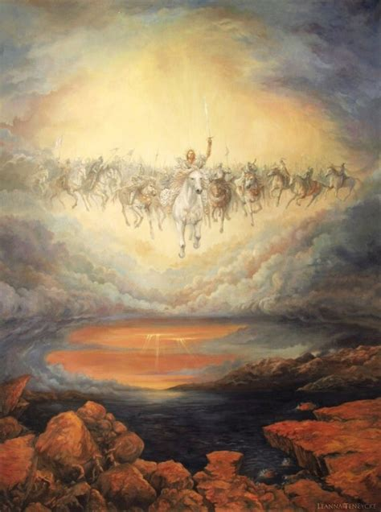
Future History: Isaiah 59:18-21
¹⁸ According to their deeds, accordingly he will repay, fury to his adversaries, recompence to his enemies; to the islands he will repay recompence.

Slide 46
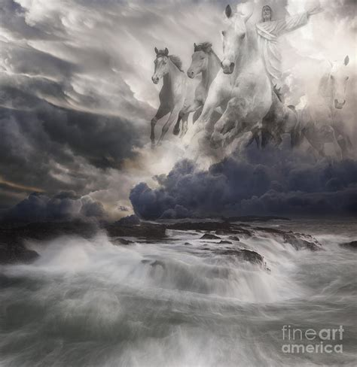
Future History: Isaiah 59:19-21
¹⁹ So shall they fear the name of the Lord from the west, and his glory from the rising of the sun. When the enemy shall come in like a flood, the Spirit of the Lord shall lift up a standard against him.
²⁰ And the Redeemer shall come to Zion, and unto them that turn from transgression in Jacob, saith the Lord.

Slide 47
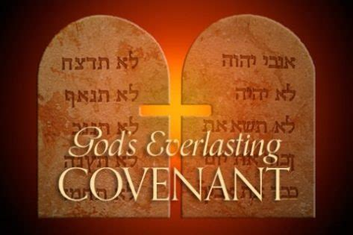
Future History: Isaiah 59:21
²¹ As for me, this is my covenant with them, saith the Lord; My spirit that is upon thee, and my words which I have put in thy mouth, shall not depart out of thy mouth, nor out of the mouth of thy seed, nor out of the mouth of thy seed's seed, saith the Lord, from henceforth and for ever.

Slide 48
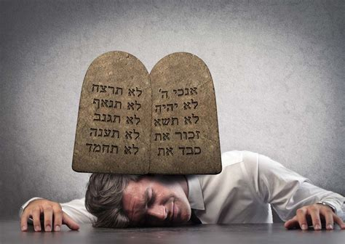
The Covenant: Romans 7:1-25
7 Know ye not, brethren, (for I speak to them that know the law,) how that the law hath dominion over a man as long as he liveth?
² For the woman which hath an husband is bound by the law to her husband so long as he liveth; but if the husband be dead, she is loosed from the law of her husband.

Slide 49
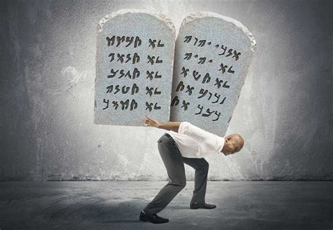
The Covenant: Romans 7:3-25
³ So then if, while her husband liveth, she be married to another man, she shall be called an adulteress: but if her husband be dead, she is free from that law; so that she is no adulteress, though she be married to another man.

Slide 50
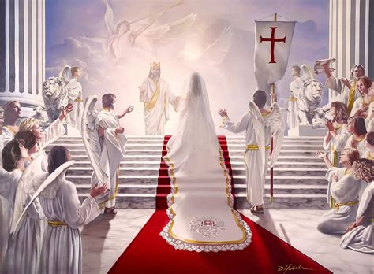
The Covenant: Romans 7:4-25
⁴ Wherefore, my brethren, ye also are become dead to the law by the body of Christ; that ye should be married to another, even to him who is raised from the dead, that we should bring forth fruit unto God.

Slide 51
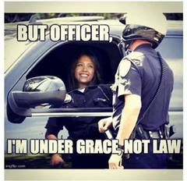
The Covenant: Romans 7:5-25
⁵ For when we were in the flesh, the motions of sins, which were by the law, did work in our members to bring forth fruit unto death.
⁶ But now we are delivered from the law, that being dead wherein we were held; that we should serve in newness of spirit, and not in the oldness of the letter.

Slide 52
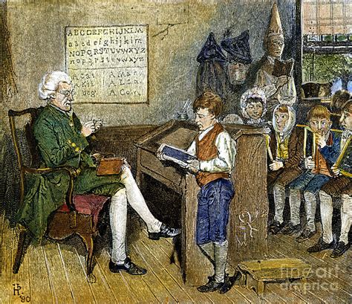
The Covenant: Romans 7:7-25
⁷ What shall we say then? Is the law sin? God forbid. Nay, I had not known sin, but by the law: for I had not known lust, except the law had said, Thou shalt not covet.

Slide 53
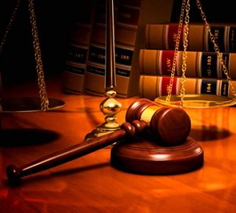
The Covenant: Romans 7:8-25
⁸ But sin, taking occasion by the commandment, wrought in me all manner of concupiscence. For without the law sin was dead.
Strong desire; Improper or illicit desire; sensual appetite; especially lustful desire or appetite.

Slide 54
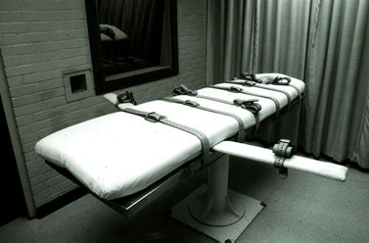
The Covenant: Romans 7:9-25
⁹ For I was alive without the law once: but when the commandment came, sin revived, and I died.
¹⁰ And the commandment, which was ordained to life, I found to be unto death.

Slide 55
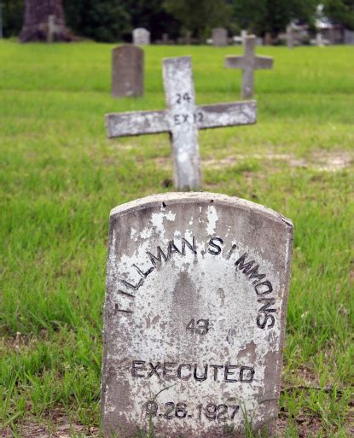
The Covenant: Romans 7:11-25
¹¹ For sin, taking occasion by the commandment, deceived me, and by it slew me.
¹² Wherefore the law is holy, and the commandment holy, and just, and good.

Slide 56
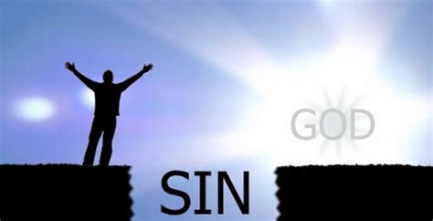
The Covenant: Romans 7:13-25
¹³ Was then that which is good made death unto me? God forbid. But sin, that it might appear sin, working death in me by that which is good; that sin by the commandment might become exceeding sinful.

Slide 57
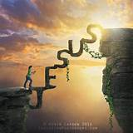
The Covenant: Romans 7:14-25
¹⁴ For we know that the law is spiritual: but I am carnal, sold under sin.
¹⁵ For that which I do I allow not: for what I would, that do I not; but what I hate, that do I.
¹⁶ If then I do that which I would not, I consent unto the law that it is good.

Slide 58
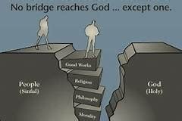
The Covenant: Romans 7:17-25
¹⁷ Now then it is no more I that do it, but sin that dwelleth in me.
¹⁸ For I know that in me (that is, in my flesh,) dwelleth no good thing: for to will is present with me; but how to perform that which is good I find not.

Slide 59
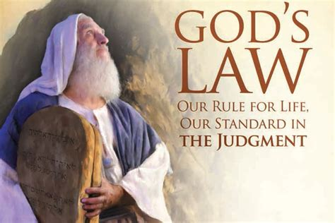
The Covenant: Romans 7:19-25
¹⁹ For the good that I would I do not: but the evil which I would not, that I do.
²⁰ Now if I do that I would not, it is no more I that do it, but sin that dwelleth in me.
²¹ I find then a law, that, when I would do good, evil is present with me.

Slide 60
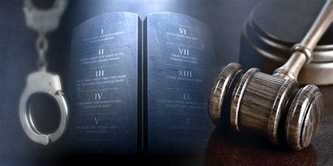
The Covenant: Romans 7:22-25
²² For I delight in the law of God after the inward man:
²³ But I see another law in my members, warring against the law of my mind, and bringing me into captivity to the law of sin which is in my members.

Slide 61
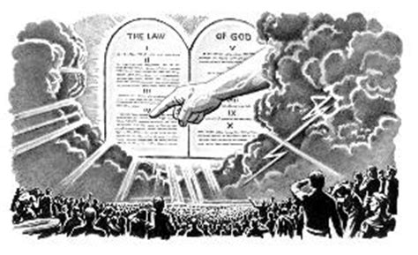
The Covenant: Romans 7:24-25
²⁴ O wretched man that I am! who shall deliver me from the body of this death?
²⁵ I thank God through Jesus Christ our Lord. So then with the mind I myself serve the law of God; but with the flesh the law of sin.

Slide 62
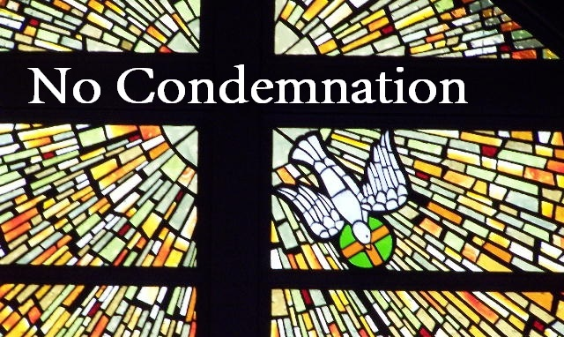
The Covenant: Romans 8:1-18
8 There is therefore now no condemnation to them which are in Christ Jesus, who walk not after the flesh, but after the Spirit.
² For the law of the Spirit of life in Christ Jesus hath made me free from the law of sin and death.

Slide 63
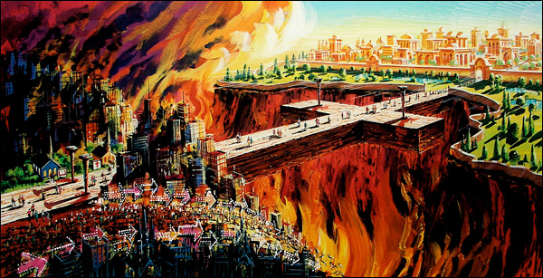
The Covenant: Romans 8:3-18
³ For what the law could not do, in that it was weak through the flesh, God sending his own Son in the likeness of sinful flesh, and for sin, condemned sin in the flesh:

Slide 64
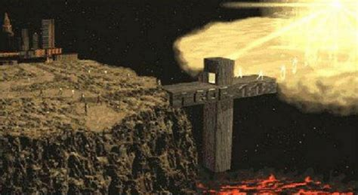
The Covenant: Romans 8:4-18
⁴ That the righteousness of the law might be fulfilled in us, who walk not after the flesh, but after the Spirit.
⁵ For they that are after the flesh do mind the things of the flesh; but they that are after the Spirit the things of the Spirit.

Slide 65
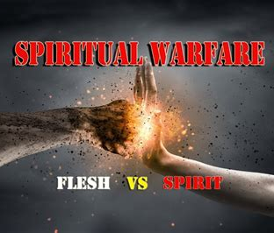
The Covenant: Romans 8:6-18
⁶ For to be carnally minded is death; but to be spiritually minded is life and peace.
⁷ Because the carnal mind is enmity against God: for it is not subject to the law of God, neither indeed can be.
⁸ So then they that are in the flesh cannot please God.

Slide 66

The Covenant: Romans 8:9-18
⁹ But ye are not in the flesh, but in the Spirit, if so be that the Spirit of God dwell in you. Now if any man have not the Spirit of Christ, he is none of his.
¹⁰ And if Christ be in you, the body is dead because of sin; but the Spirit is life because of righteousness.

Slide 67

The Covenant: Romans 8:11-18
¹¹ But if the Spirit of him that raised up Jesus from the dead dwell in you, he that raised up Christ from the dead shall also quicken your mortal bodies by his Spirit that dwelleth in you.
¹² Therefore, brethren, we are debtors, not to the flesh, to live after the flesh.

Slide 68

The Covenant: Romans 8:13-18
¹³ For if ye live after the flesh, ye shall die: but if ye through the Spirit do mortify the deeds of the body, ye shall live.
¹⁴ For as many as are led by the Spirit of God, they are the sons of God.
¹⁵ For ye have not received the spirit of bondage again to fear; but ye have received the Spirit of adoption, whereby we cry, Abba, Father.

Slide 69

The Covenant: Romans 8:16-18
¹⁶ The Spirit itself beareth witness with our spirit, that we are the children of God:
¹⁷ And if children, then heirs; heirs of God, and joint-heirs with Christ; if so be that we suffer with him, that we may be also glorified together.

Slide 70

The Covenant: Romans 8:18
¹⁸ For I reckon that the sufferings of this present time are not worthy to be compared with the glory which shall be revealed in us.

Slide 71

Future History of the Past: Isaiah 60:1-22
60 Arise, shine; for thy light is come, and the glory of the Lord is risen upon thee.
² For, behold, the darkness shall cover the earth, and gross darkness the people: but the Lord shall arise upon thee, and his glory shall be seen upon thee.

Slide 72

Future History of the Past: Isaiah 60:3-22
³ And the Gentiles shall come to thy light, and kings to the brightness of thy rising.
⁴ Lift up thine eyes round about, and see: all they gather themselves together, they come to thee: thy sons shall come from far, and thy daughters shall be nursed at thy side.

Slide 73

Future History of the Past: Isaiah 60:5-22
⁵ Then thou shalt see, and flow together, and thine heart shall fear, and be enlarged; because the abundance of the sea shall be converted unto thee, the forces of the Gentiles shall come unto thee.

Slide 74

Future History of the Past: Isaiah 60:6-22
⁶ The multitude of camels shall cover thee, the dromedaries of Midian and Ephah; all they from Sheba shall come: they shall bring gold and incense; and they shall shew forth the praises of the Lord.

Slide 75

Future History of the Past: Isaiah 60:7-22
⁷ All the flocks of Kedar shall be gathered together unto thee, the rams of Nebaioth shall minister unto thee: they shall come up with acceptance on mine altar, and I will glorify the house of my glory.
⁸ Who are these that fly as a cloud, and as the doves to their windows?

Slide 76

Future History of the Past: Isaiah 60:9-22
⁹ Surely the isles shall wait for me, and the ships of Tarshish first, to bring thy sons from far, their silver and their gold with them, unto the name of the Lord thy God, and to the Holy One of Israel, because he hath glorified thee.

Slide 77

Future History of the Past: Isaiah 60:10-22
¹⁰ And the sons of strangers shall build up thy walls, and their kings shall minister unto thee: for in my wrath I smote thee, but in my favour have I had mercy on thee.
¹¹ Therefore thy gates shall be open continually; they shall not be shut day nor night; that men may bring unto thee the forces of the Gentiles, and that their kings may be brought.

Slide 78

Future History of the Past: Isaiah 60:12-22
¹² For the nation and kingdom that will not serve thee shall perish; yea, those nations shall be utterly wasted.
¹³ The glory of Lebanon shall come unto thee, the fir tree, the pine tree, and the box together, to beautify the place of my sanctuary; and I will make the place of my feet glorious.

Slide 79

Future History of the Past: Isaiah 60:14-22
¹⁴ The sons also of them that afflicted thee shall come bending unto thee; and all they that despised thee shall bow themselves down at the soles of thy feet; and they shall call thee; The city of the Lord, The Zion of the Holy One of Israel.

Slide 80

Future History of the Past: Isaiah 60:15-22
¹⁵ Whereas thou has been forsaken and hated, so that no man went through thee, I will make thee an eternal excellency, a joy of many generations.

Slide 81

Future History of the Past: Isaiah 60:16-22
¹⁶ Thou shalt also suck the milk of the Gentiles, and shalt suck the breast of kings: and thou shalt know that I the Lord am thy Saviour and thy Redeemer, the mighty One of Jacob.

Slide 82

Future History of the Past: Isaiah 60:17-22
¹⁷ For brass I will bring gold, and for iron I will bring silver, and for wood brass, and for stones iron: I will also make thy officers peace, and thine exactors righteousness.

Slide 83

Future History of the Past: Isaiah 60:18-22
¹⁸ Violence shall no more be heard in thy land, wasting nor destruction within thy borders; but thou shalt call thy walls Salvation, and thy gates Praise.

Slide 84

Future History of the Past: Isaiah 60:19-22
¹⁹ The sun shall be no more thy light by day; neither for brightness shall the moon give light unto thee: but the Lord shall be unto thee an everlasting light, and thy God thy glory.

Slide 85

Future History of the Past: Isaiah 60:20-22
²⁰ Thy sun shall no more go down; neither shall thy moon withdraw itself: for the Lord shall be thine everlasting light, and the days of thy mourning shall be ended.

Slide 86

Future History of the Past: Isaiah 60:21-22
²¹ Thy people also shall be all righteous: they shall inherit the land for ever, the branch of my planting, the work of my hands, that I may be glorified.
²² A little one shall become a thousand, and a small one a strong nation: I the Lord will hasten it in his time.

Slide 87

Future History of the Future: Revelation 21:9-27
⁹ And there came unto me one of the seven angels which had the seven vials full of the seven last plagues, and talked with me, saying, Come hither, I will shew thee the bride, the Lamb's wife.

Slide 88

Future History of the Future: Revelation 21:10-27
¹⁰ And he carried me away in the spirit to a great and high mountain, and shewed me that great city, the holy Jerusalem, descending out of heaven from God,
¹¹ Having the glory of God: and her light was like unto a stone most precious, even like a jasper stone, clear as crystal;

Slide 89

Future History of the Future: Revelation 21:12-27
¹² And had a wall great and high, and had twelve gates, and at the gates twelve angels, and names written thereon, which are the names of the twelve tribes of the children of Israel:
¹³ On the east three gates; on the north three gates; on the south three gates; and on the west three gates.

Slide 90

Future History of the Future: Revelation 21:14-27
¹⁴ And the wall of the city had twelve foundations, and in them the names of the twelve apostles of the Lamb.
¹⁵ And he that talked with me had a golden reed to measure the city, and the gates thereof, and the wall thereof.

Slide 91

Future History of the Future: Revelation 21:16-27
¹⁶ And the city lieth foursquare, and the length is as large as the breadth: and he measured the city with the reed, twelve thousand furlongs. The length and the breadth and the height of it are equal.
¹⁷ And he measured the wall thereof, an hundred and forty and four cubits, according to the measure of a man, that is, of the angel.

Slide 92

Future History of the Future: Revelation 21:18-27
¹⁸ And the building of the wall of it was of jasper: and the city was pure gold, like unto clear glass.
¹⁹ And the foundations of the wall of the city were garnished with all manner of precious stones. The first foundation was jasper; the second, sapphire; the third, a chalcedony; the fourth, an emerald;

Slide 93

Future History of the Future: Revelation 21:20-27
²⁰ The fifth, sardonyx; the sixth, sardius; the seventh, chrysolyte; the eighth, beryl; the ninth, a topaz; the tenth, a chrysoprasus; the eleventh, a jacinth; the twelfth, an amethyst.
²¹ And the twelve gates were twelve pearls: every several gate was of one pearl: and the street of the city was pure gold, as it were transparent glass.

Slide 94

Future History of the Future: Revelation 21:22-27
²² And I saw no temple therein: for the Lord God Almighty and the Lamb are the temple of it.
²³ And the city had no need of the sun, neither of the moon, to shine in it: for the glory of God did lighten it, and the Lamb is the light thereof.

Slide 95

Future History of the Future: Revelation 21:24-27
²⁴ And the nations of them which are saved shall walk in the light of it: and the kings of the earth do bring their glory and honour into it.
²⁵ And the gates of it shall not be shut at all by day: for there shall be no night there.

Slide 96

Future History of the Future: Revelation 21:26-27
²⁶ And they shall bring the glory and honour of the nations into it.
²⁷ And there shall in no wise enter into it any thing that defileth, neither whatsoever worketh abomination, or maketh a lie: but they which are written in the Lamb's book of life.

Slide 97

The Future: Isaiah 62:1-12
62 For Zion's sake will I not hold my peace, and for Jerusalem's sake I will not rest, until the righteousness thereof go forth as brightness, and the salvation thereof as a lamp that burneth.
² And the Gentiles shall see thy righteousness, and all kings thy glory: and thou shalt be called by a new name, which the mouth of the Lord shall name.

Slide 98
The Future: Isaiah 62:3-12
³ Thou shalt also be a crown of glory in the hand of the Lord, and a royal diadem in the hand of thy God.
⁴ Thou shalt no more be termed Forsaken; neither shall thy land any more be termed Desolate: but thou shalt be called Hephzibah, and thy land Beulah: for the Lord delighteth in thee, and thy land shall be married.
Hephzibah: Literally, “My delight is in her.”
Beulah: Literally, “possessed” or “married.”

Slide 99

The Future: Isaiah 62:5-12
⁵ For as a young man marrieth a virgin, so shall thy sons marry thee: and as the bridegroom rejoiceth over the bride, so shall thy God rejoice over thee.

Slide 100

The Future: Isaiah 62:6-12
⁶ I have set watchmen upon thy walls, O Jerusalem, which shall never hold their peace day nor night: ye that make mention of the Lord, keep not silence,
⁷ And give him no rest, till he establish, and till he make Jerusalem a praise in the earth.

Slide 101

The Future: Isaiah 62:8-12
⁸ The Lord hath sworn by his right hand, and by the arm of his strength, Surely I will no more give thy corn to be meat for thine enemies; and the sons of the stranger shall not drink thy wine, for the which thou hast laboured:

Slide 102

The Future: Isaiah 62:9-12
⁹ But they that have gathered it shall eat it, and praise the Lord; and they that have brought it together shall drink it in the courts of my holiness.

Slide 103

The Future: Isaiah 62:10-12
¹⁰ Go through, go through the gates; prepare ye the way of the people; cast up, cast up the highway; gather out the stones; lift up a standard for the people.

Slide 104
SDABC V4 p. 321
The “standard” spoken of here may also be translated “flag” or “ensign.” A flag stands for authority and challenges men to be loyal to that authority. God’s law is a spiritual ensign. Similarly, the Scriptures as a whole bear the stamp of Heaven and call for loyal obedience. It is the solemn duty of God’s spiritual watchmen to lift high the standard of truth that God has entrusted to them.

Slide 105

The Future: Isaiah 62:11-12
¹¹ Behold, the Lord hath proclaimed unto the end of the world, Say ye to the daughter of Zion, Behold, thy salvation cometh; behold, his reward is with him, and his work before him.
¹² And they shall call them, The holy people, The redeemed of the Lord: and thou shalt be called, Sought out, A city not forsaken.

Slide 106
Thank you!
And Happy Sabbath!

