Slide 1

UPON WHOM THE ENDS HAVE COME
2nd Quarter, 2025
Lesson 10

Slide 2
Memory Verse: 1 Corinthians 10:11-12
¹¹ Now all these things happened unto them for examples: and they are written for our admonition, upon whom the ends of the world are come.
¹² Wherefore let him that thinketh he standeth take heed lest he fall.

Slide 3
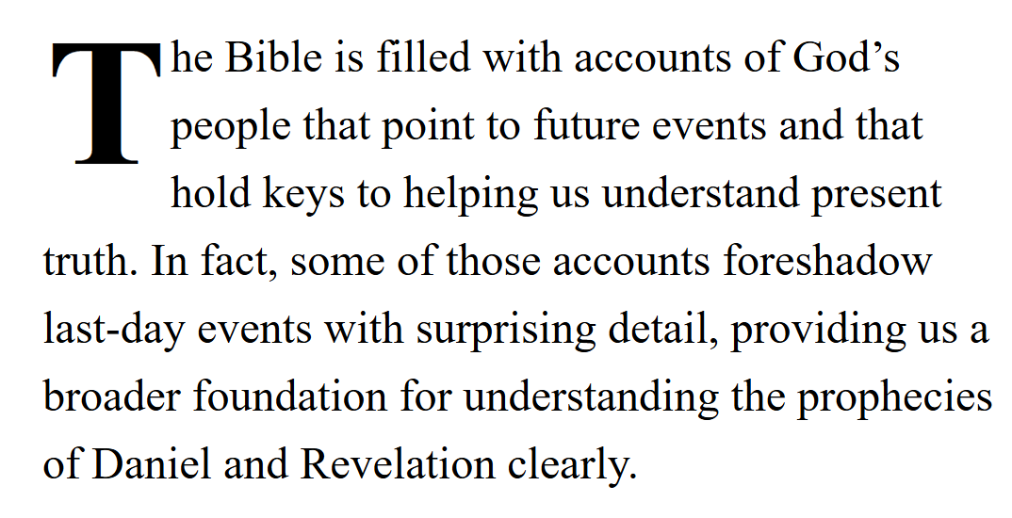
SDA Quarterly, May 31 2025,
Sabbath Afternoon

Slide 4
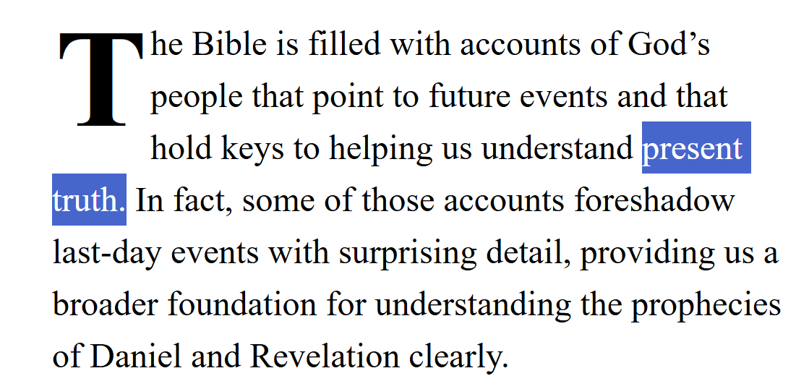
SDA Quarterly, May 31 2025,
Sabbath Afternoon

Slide 5
What is “Present Truth”?
a. It’s truth that we are particularly focused on.
b. It’s truth that is particularly applicable to modern times.
c. It has something to do with last-day events.
d. It’s truth that is present or active within us.
e. It’s the same as eternal truth.
f. It has to do with the Sabbath and the Second Coming of Jesus.

Slide 6
Present Truth: 2 Peter 1:12-13
¹² Wherefore I will not be negligent to put you always in remembrance of these things, though ye know them, and be established in the present truth.
¹³ Yea, I think it meet, as long as I am in this tabernacle, to stir you up by putting you in remembrance;

Slide 7
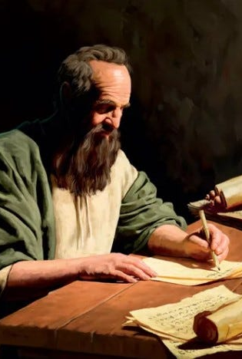
Present Truth: 2 Peter 1:1-12
1 Simon Peter, a servant and an apostle of Jesus Christ, to them that have obtained like precious faith with us through the righteousness of God and our Saviour Jesus Christ:
² Grace and peace be multiplied unto you through the knowledge of God, and of Jesus our Lord,

Slide 8
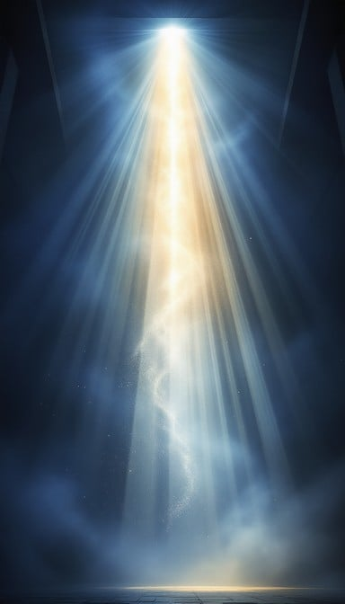
Present Truth: 2 Peter 1:3-12
3 According as his divine power hath given unto us all things that pertain unto life and godliness, through the knowledge of him that hath called us to glory and virtue:

Slide 9
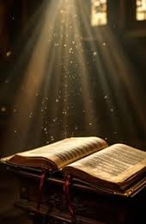
Present Truth: 2 Peter 1:4-12
4 Whereby are given unto us exceeding great and precious promises: that by these ye might be partakers of the divine nature, having escaped the corruption that is in the world through lust.

Slide 10
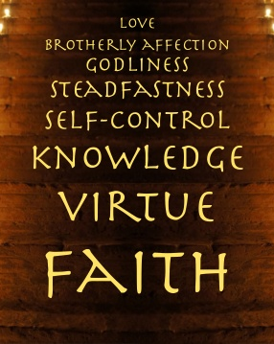
Present Truth: 2 Peter 1:5-12
⁵ And beside this, giving all diligence, add to your faith virtue; and to virtue knowledge;
⁶ And to knowledge temperance; and to temperance patience; and to patience godliness;

Slide 11

Present Truth: 2 Peter 1:7-12
⁷ And to godliness brotherly kindness; and to brotherly kindness charity.
⁸ For if these things be in you, and abound, they make you that ye shall neither be barren nor unfruitful in the knowledge of our Lord Jesus Christ.

Slide 12
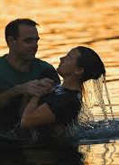
Present Truth: 2 Peter 1:9-12
⁹ But he that lacketh these things is blind, and cannot see afar off, and hath forgotten that he was purged from his old sins.
¹⁰ Wherefore the rather, brethren, give diligence to make your calling and election sure: for if ye do these things, ye shall never fall:

Slide 13
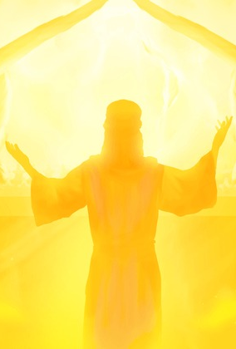
Present Truth: 2 Peter 1:11-12
¹¹ For so an entrance shall be ministered unto you abundantly into the everlasting kingdom of our Lord and Saviour Jesus Christ.
¹² Wherefore I will not be negligent to put you always in remembrance of these things, though ye know them, and be established in the present truth.

Slide 14
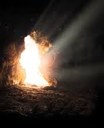
TRUTH: 2 peter 1:19-21
¹⁹ We have also a more sure word of prophecy; whereunto ye do well that ye take heed, as unto a light that shineth in a dark place, until the day dawn, and the day star arise in your hearts:

Slide 15
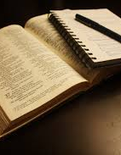
TRUTH: 2 peter 1:20-21
²⁰ Knowing this first, that no prophecy of the scripture is of any private interpretation.
²¹ For the prophecy came not in old time by the will of man: but holy men of God spake as they were moved by the Holy Ghost.

Slide 16
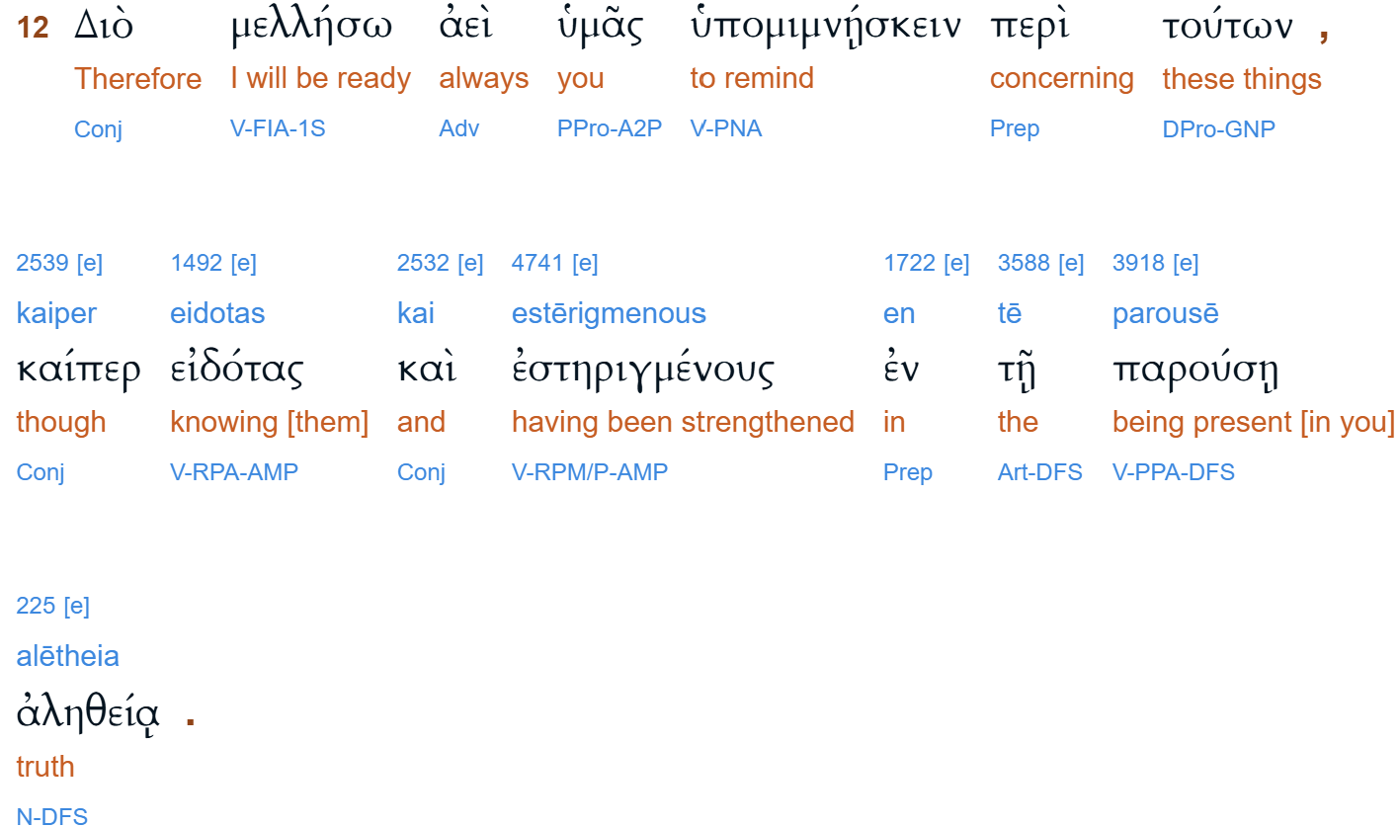
Present Truth: 2 Peter 2:12

Slide 17
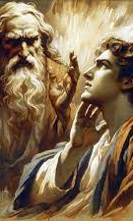
Present Truth: Direct Messages
Jonah 3:1-2
And the word of the Lord came unto Jonah the second time, saying, ² Arise, go unto Nineveh, that great city, and preach unto it the preaching that I bid thee.
2 Chronicles 24:19
Yet he [God] sent prophets to them [the people], to bring them again unto the LORD; and they testified against them: but they would not give ear.

Slide 18
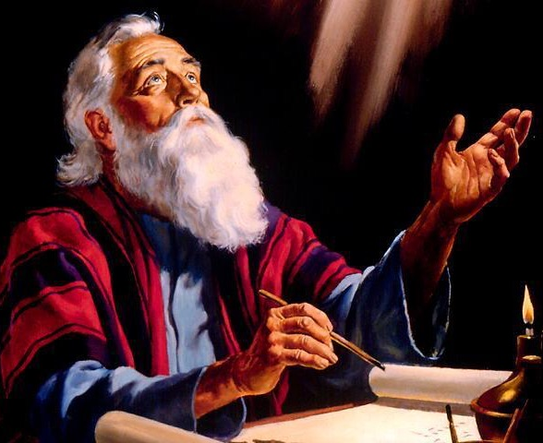
Present Truth: Messages for a time
Daniel 12:4
⁴ But thou, O Daniel, shut up the words, and seal the book, even to the time of the end: many shall run to and fro, and knowledge shall be increased.

Slide 19
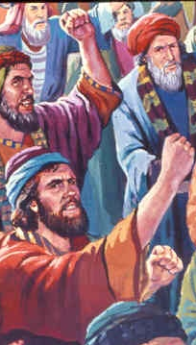
Present Truth: Messages for a time
Numbers 13, 14
² Send thou men, that they may search the land of Canaan, which I give unto the children of Israel…
² And all the children of Israel murmured against Moses and against Aaron…³ And wherefore hath the Lord brought us unto this land, to fall by the sword, that our wives and our children should be a prey?

Slide 20
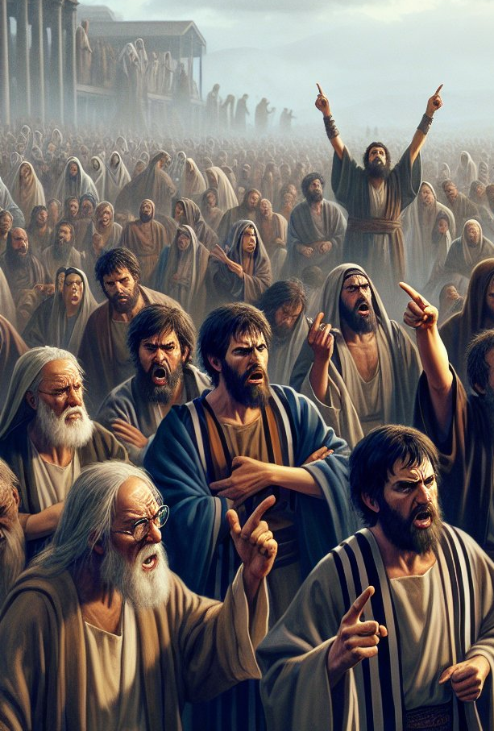
Present Truth: Messages for a time
Numbers 13, 14
[God said] Tomorrow turn you, and get you into the wilderness by the way of the Red sea.
⁴⁰ And they rose up early in the morning… saying, Lo, we be here, and will go up unto the place which the Lord hath promised: for we have sinned. ⁴¹ And Moses said, Wherefore now do ye transgress the commandment of the Lord?

Slide 21

Present Truth: Messages For a Time
Revelation 2, 3
Unto the angel of the church of Ephesus write…
Unto the angel of the church in Smyrna write…
Unto the angel of the church in Pergamos write…
Unto the angel of the church in Thyatira write…
Unto the angel of the church in Sardis write…
Unto the angel of the church in Philadelphia write…
Unto the angel of the church of the Laodiceans write…

Slide 22
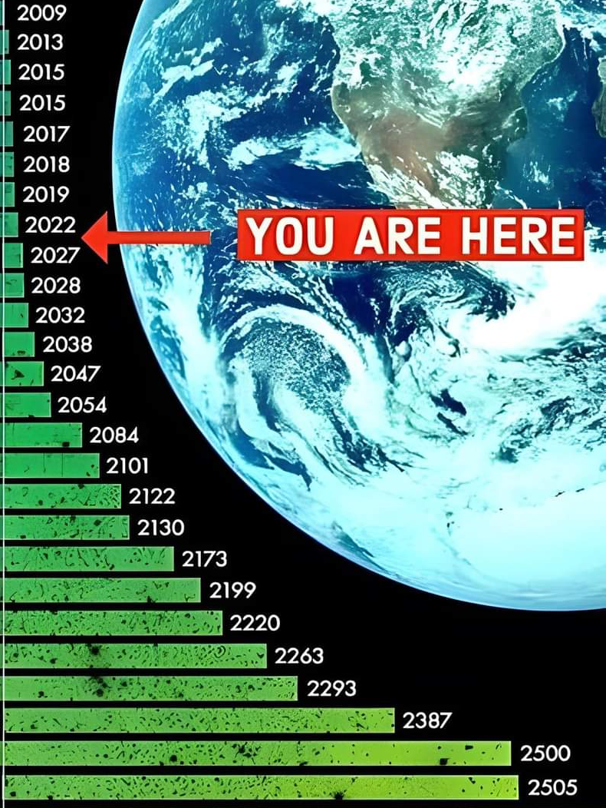
Egw, Testimonies V2 p. 693
“Special truths have been adapted to the conditions of the generations as they have existed. The present truth, which is a test to the people of this generation, was not a test to the people of generations far back. If the light which now shines upon us in regard to the Sabbath of the fourth commandment had been given to the generations in the past, God would have held them accountable for that light.”

Slide 23
What is “Present Truth”?
a. It’s truth that we are particularly focused on.
b. It’s truth that is particularly applicable to modern times.
c. It has something to do with last-day events.
d. It’s truth that is present or active within us.
e. It’s the same as eternal truth.
f. It has to do with the Sabbath and the Second Coming of Jesus.

Slide 24
SDA Quarterly, May 31 2025,
Sabbath Afternoon

Slide 25
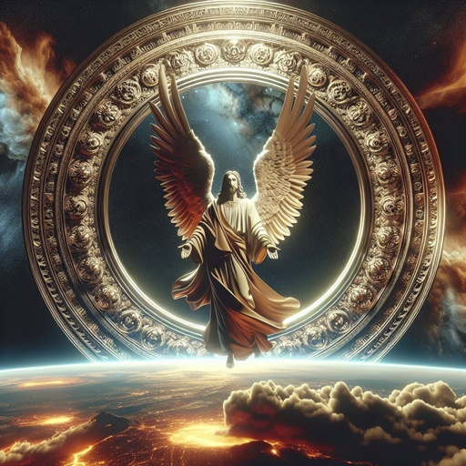
The Days of Noah: Matthew 24:36
But of that day and hour knoweth no man, no, not the angels of heaven, but my Father only.

Slide 26
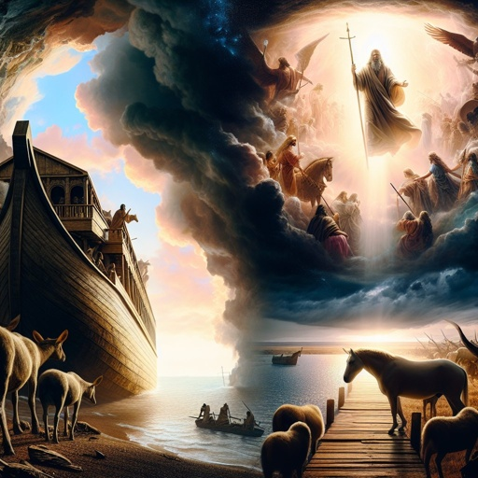
The Days of Noah: Matthew 24:37
But as the days of Noe were, so shall also the coming of the Son of man be.

Slide 27
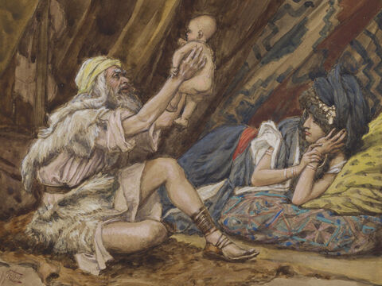
Finding Grace: Genesis 6:1
And it came to pass, when men began to multiply on the face of the earth, and daughters were born unto them,

Slide 28
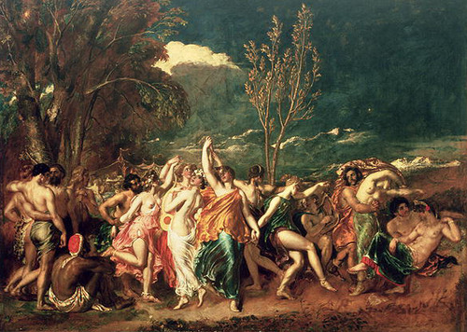
Finding Grace: Genesis 6:2
That the sons of God saw the daughters of men that they were fair; and they took them wives of all which they chose.

Slide 29

Finding Grace: Genesis 6:3
And the Lord said, My spirit shall not always strive with man, for that he also is flesh: yet his days shall be an hundred and twenty years.

Slide 30
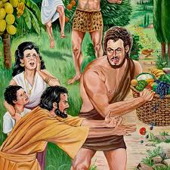
Finding Grace: Genesis 6:4
There were giants in the earth in those days; and also after that, when the sons of God came in unto the daughters of men, and they bare children to them, the same became mighty men which were of old, men of renown.

Slide 31
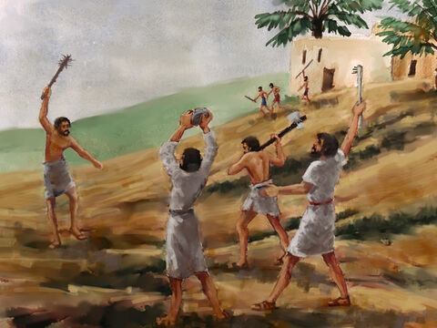
Finding Grace: Genesis 6:5
And God saw that the wickedness of man was great in the earth, and that every imagination of the thoughts of his heart was only evil continually.

Slide 32
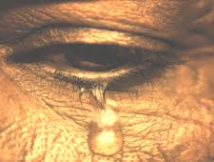
Finding Grace: Genesis 6:6
And it repented the Lord that he had made man on the earth, and it grieved him at his heart.

Slide 33
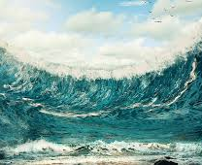
Finding Grace: Genesis 6:7
And the Lord said, I will destroy man whom I have created from the face of the earth; both man, and beast, and the creeping thing, and the fowls of the air; for it repenteth me that I have made them.

Slide 34
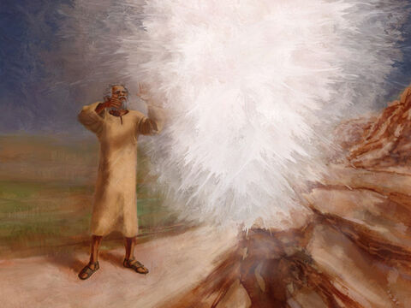
Finding Grace: Genesis 6:8
But Noah found grace in the eyes of the Lord.

Slide 35
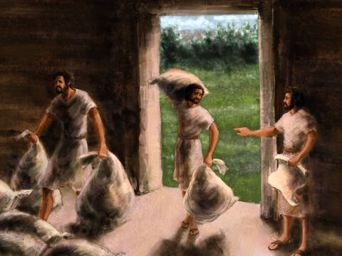
Finding Grace: Genesis 6:9
These are the generations of Noah: Noah was a just man and perfect in his generations, and Noah walked with God.

Slide 36
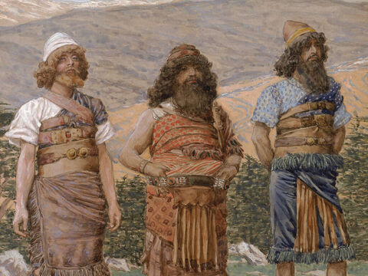
Finding Grace: Genesis 6:10
And Noah begat three sons, Shem, Ham, and Japheth.

Slide 37
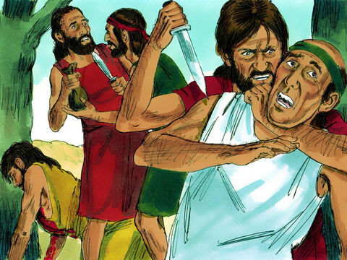
Finding Grace: Genesis 6:11
The earth also was corrupt before God, and the earth was filled with violence.

Slide 38
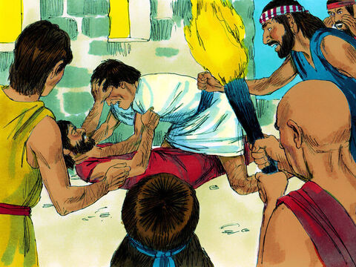
Finding Grace: Genesis 6:12
And God looked upon the earth, and, behold, it was corrupt; for all flesh had corrupted his way upon the earth.

Slide 39
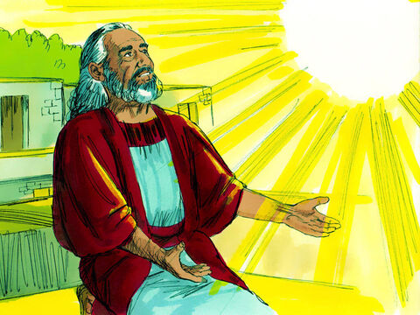
Finding Grace: Genesis 6:13
And God said unto Noah, The end of all flesh is come before me; for the earth is filled with violence through them; and, behold, I will destroy them with the earth.

Slide 40
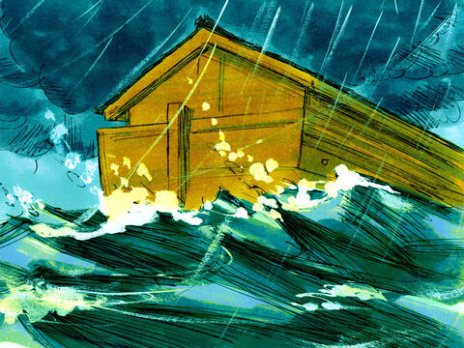
Finding Grace: 2 Peter 3:5
For this they willingly are ignorant of, that by the word of God the heavens were of old, and the earth standing out of the water and in the water:

Slide 41
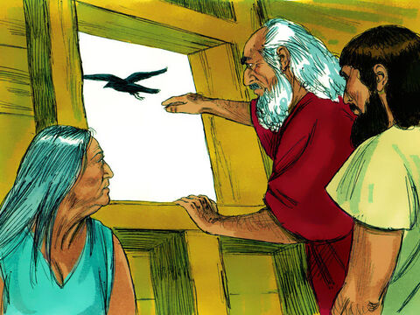
Finding Grace: Hebrews 11:7
By faith Noah, being warned of God of things not seen as yet, moved with fear, prepared an ark to the saving of his house; by the which he condemned the world, and became heir of the righteousness which is by faith.

Slide 42
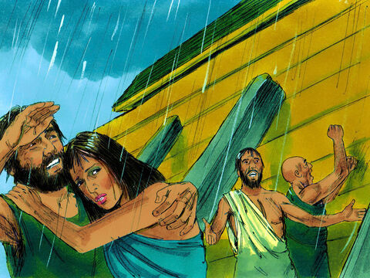
The Days of Noah: Matthew 24:38
For as in the days that were before the flood they were eating and drinking, marrying and giving in marriage, until the day that Noe entered into the ark,

Slide 43
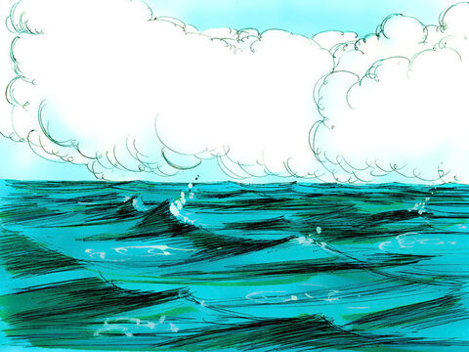
The Days of Noah: Matthew 24:39
And knew not until the flood came, and took them all away; so shall also the coming of the Son of man be.

Slide 44
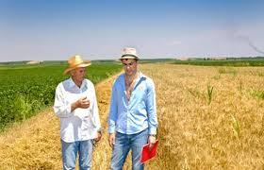
The Days of Noah: Matthew 24:40
Then shall two be in the field; the one shall be taken, and the other left.

Slide 45
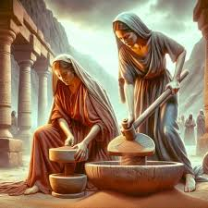
The Days of Noah: Matthew 24:41
Two women shall be grinding at the mill; the one shall be taken, and the other left.

Slide 46
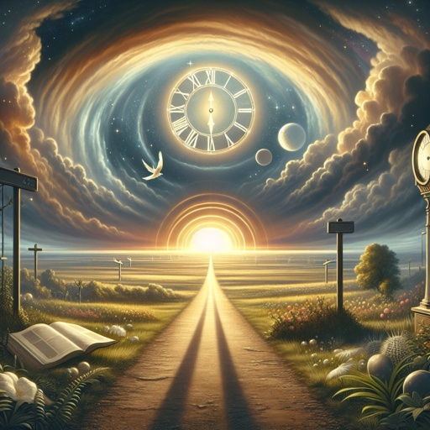
The Days of Noah: Matthew 24:42
Watch therefore: for ye know not what hour your Lord doth come.

Slide 47

The Days of Noah: Matthew 24:43
But know this, that if the goodman of the house had known in what watch the thief would come, he would have watched, and would not have suffered his house to be broken up.

Slide 48
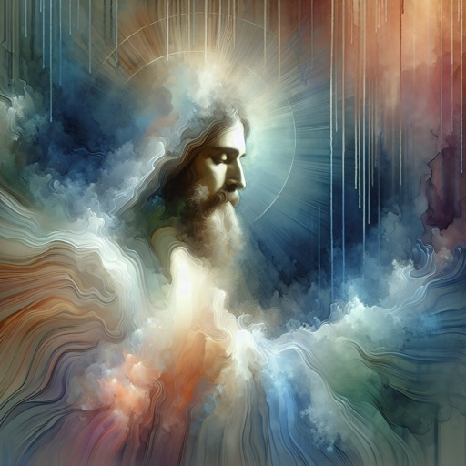
The Days of Noah: Matthew 24:44
Therefore be ye also ready: for in such an hour as ye think not the Son of man cometh.

Slide 49
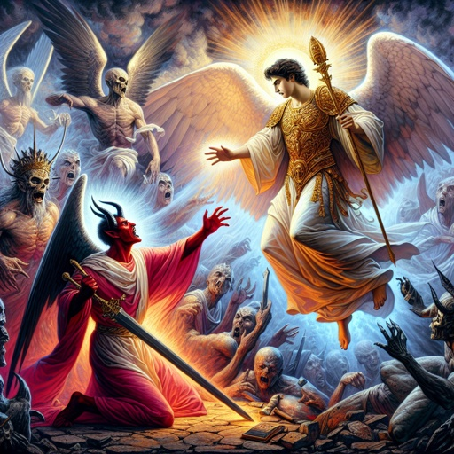
Coming Destruction: 2 Peter 2:4
For if God spared not the angels that sinned, but cast them down to hell, and delivered them into chains of darkness, to be reserved unto judgment;

Slide 50
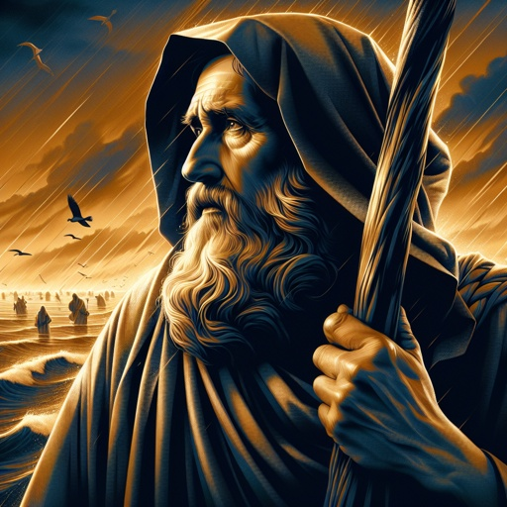
Coming Destruction: 2 Peter 2:5
And spared not the old world, but saved Noah the eighth person, a preacher of righteousness, bringing in the flood upon the world of the ungodly;

Slide 51
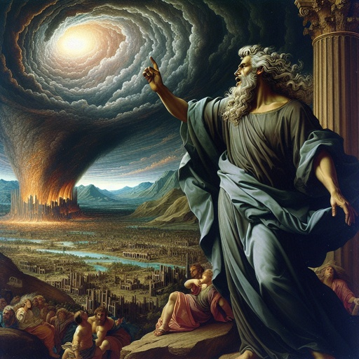
Coming Destruction: 2 Peter 2:6
And turning the cities of Sodom and Gomorrha into ashes condemned them with an overthrow, making them an ensample unto those that after should live ungodly;

Slide 52
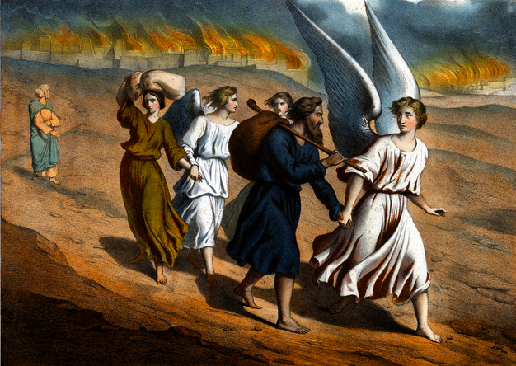
Coming Destruction: 2 Peter 2:7
And delivered just Lot, vexed with the filthy conversation of the wicked:

Slide 53
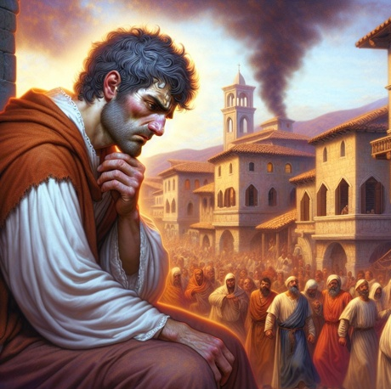
Coming Destruction: 2 Peter 2:8
(For that righteous man dwelling among them, in seeing and hearing, vexed his righteous soul from day to day with their unlawful deeds;)

Slide 54
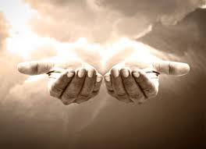
Coming Destruction: 2 Peter 2:9
The Lord knoweth how to deliver the godly out of temptations, and to reserve the unjust unto the day of judgment to be punished:

Slide 55

Coming Destruction: 2 Peter 2:10
But chiefly them that walk after the flesh in the lust of uncleanness, and despise government. Presumptuous are they, selfwilled, they are not afraid to speak evil of dignities.

Slide 56
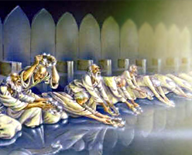
Coming Destruction: 2 Peter 2:11
Whereas angels, which are greater in power and might, bring not railing accusation against them before the Lord.

Slide 57
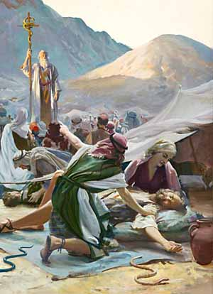
Coming Destruction: Jude 1:5
I will therefore put you in remembrance, though ye once knew this, how that the Lord, having saved the people out of the land of Egypt, afterward destroyed them that believed not.

Slide 58
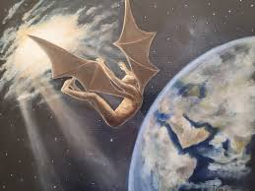
Coming Destruction: Jude 1:6
And the angels which kept not their first estate, but left their own habitation, he hath reserved in everlasting chains under darkness unto the judgment of the great day.

Slide 59
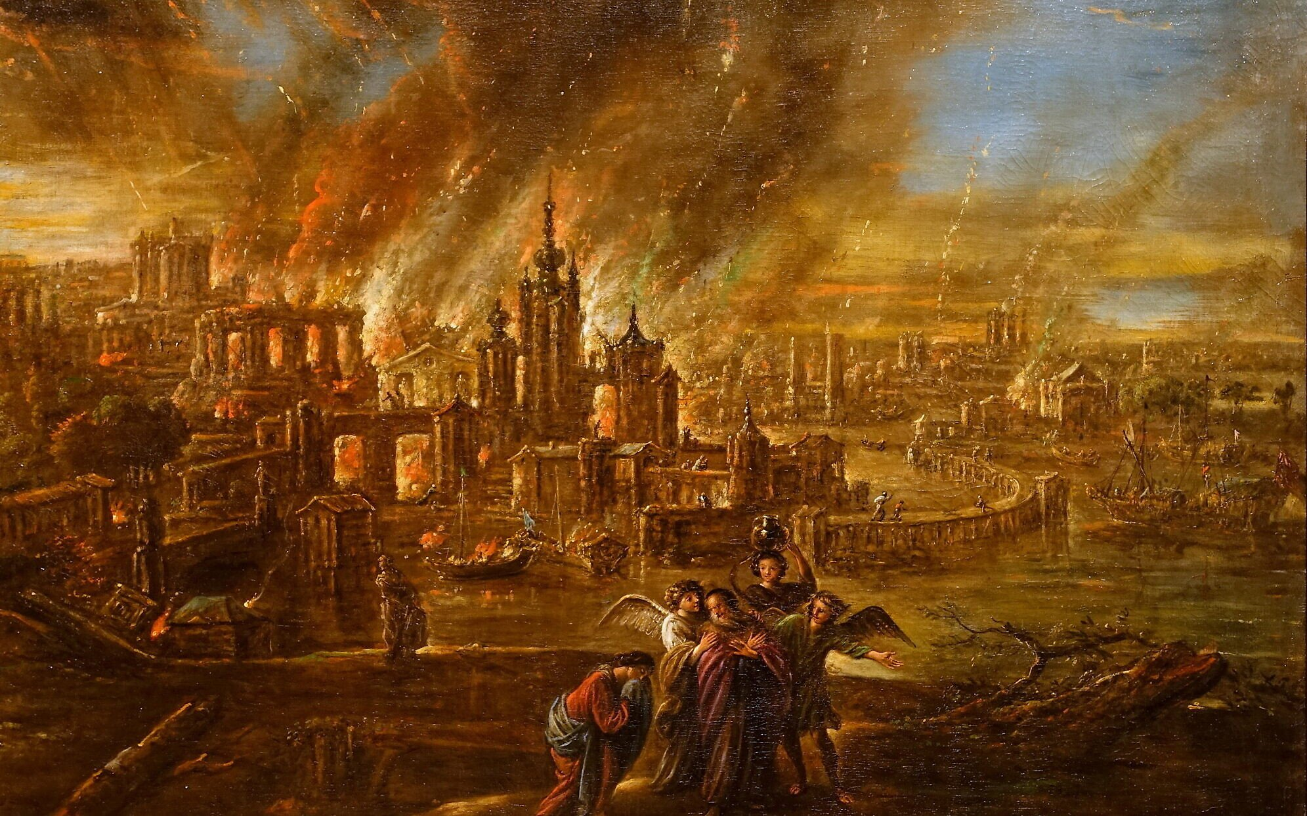
Coming Destruction: Jude 1:7
Even as Sodom and Gomorrha, and the cities about them in like manner, giving themselves over to fornication, and going after strange flesh, are set forth for an example, suffering the vengeance of eternal fire.

Slide 60
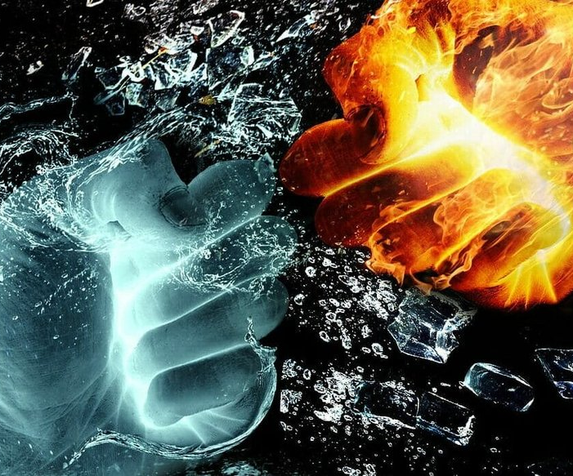
Coming Destruction: Jude 1:8
Likewise also these filthy dreamers defile the flesh, despise dominion, and speak evil of dignities.

Slide 61
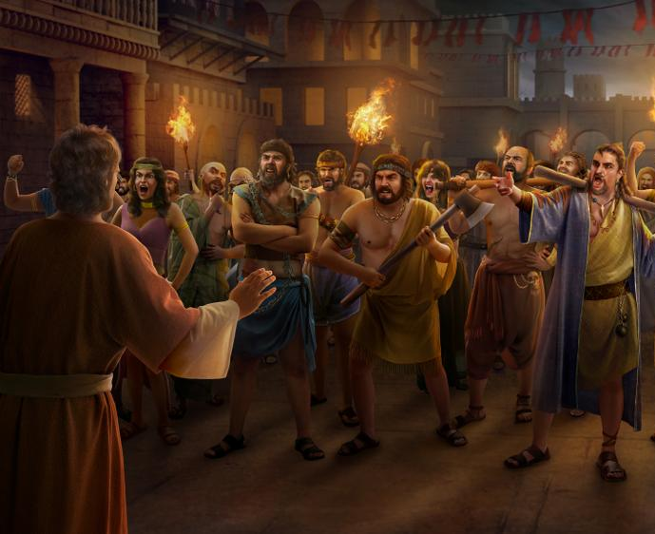
Coming Destruction: Ezekiel 16:46
And thine elder sister is Samaria, she and her daughters that dwell at thy left hand: and thy younger sister, that dwelleth at thy right hand, is Sodom and her daughters.

Slide 62

Judgment: Amos 3:7
Surely the Lord God will do nothing, but he revealeth his secret unto his servants the prophets.

Slide 63

Judgment: Genesis 18:17
And the Lord said, Shall I hide from Abraham that thing which I do;

Slide 64

Judgment: Genesis 18:18
Seeing that Abraham shall surely become a great and mighty nation, and all the nations of the earth shall be blessed in him?

Slide 65

Judgment: Genesis 18:19
For I know him, that he will command his children and his household after him, and they shall keep the way of the Lord, to do justice and judgment; that the Lord may bring upon Abraham that which he hath spoken of him.

Slide 66

Judgment: Genesis 18:20
And the Lord said, Because the cry of Sodom and Gomorrah is great, and because their sin is very grievous;

Slide 67

Judgment: Genesis 18:21
I will go down now, and see whether they have done altogether according to the cry of it, which is come unto me; and if not, I will know.

Slide 68

Judgment: Genesis 18:22
And the men turned their faces from thence, and went toward Sodom: but Abraham stood yet before the Lord.

Slide 69

Judgment: Genesis 18:23
And Abraham drew near, and said, Wilt thou also destroy the righteous with the wicked?

Slide 70

Judgment: Genesis 18:24
Peradventure there be fifty righteous within the city: wilt thou also destroy and not spare the place for the fifty righteous that are therein?

Slide 71

Judgment: Genesis 18:25
That be far from thee to do after this manner, to slay the righteous with the wicked: and that the righteous should be as the wicked, that be far from thee: Shall not the Judge of all the earth do right?

Slide 72

Judgment: Genesis 18:26
And the Lord said, If I find in Sodom fifty righteous within the city, then I will spare all the place for their sakes.

Slide 73

Judgment: Genesis 18:27
And Abraham answered and said, Behold now, I have taken upon me to speak unto the Lord, which am but dust and ashes:

Slide 74
Judgment: Genesis 18:28
Peradventure there shall lack five of the fifty righteous: wilt thou destroy all the city for lack of five? And he said, If I find there forty and five, I will not destroy it.

Slide 75

Judgment: Genesis 18:29
And he spake unto him yet again, and said, Peradventure there shall be forty found there. And he said, I will not do it for forty's sake.

Slide 76
Judgment: Genesis 18:30
And he said unto him, Oh let not the Lord be angry, and I will speak: Peradventure there shall thirty be found there. And he said, I will not do it, if I find thirty there.

Slide 77

Judgment: Genesis 18:31
And he said, Behold now, I have taken upon me to speak unto the Lord: Peradventure there shall be twenty found there. And he said, I will not destroy it for twenty's sake.

Slide 78

Judgment: Genesis 18:32
And he said, Oh let not the Lord be angry, and I will speak yet but this once: Peradventure ten shall be found there. And he said, I will not destroy it for ten's sake.

Slide 79

Judgment: Genesis 18:33
And the Lord went his way, as soon as he had left communing with Abraham: and Abraham returned unto his place.

Slide 80

Final Judgment: Ecclesiastes 12:14
For God shall bring every work into judgment, with every secret thing, whether it be good, or whether it be evil.

Slide 81

Final Judgment: Daniel 7:9
I beheld till the thrones were cast down, and the Ancient of days did sit, whose garment was white as snow, and the hair of his head like the pure wool: his throne was like the fiery flame, and his wheels as burning fire.

Slide 82

Final Judgment: Daniel 7:10
A fiery stream issued and came forth from before him: thousand thousands ministered unto him, and ten thousand times ten thousand stood before him: the judgment was set, and the books were opened.

Slide 83

Final Judgment: Daniel 7:13
I saw in the night visions, and, behold, one like the Son of man came with the clouds of heaven, and came to the Ancient of days, and they brought him near before him.

Slide 84

Final Judgment: Daniel 7:14
And there was given him dominion, and glory, and a kingdom, that all people, nations, and languages, should serve him: his dominion is an everlasting dominion, which shall not pass away, and his kingdom that which shall not be destroyed.

Slide 85

Final Judgment: Daniel 7:22
Until the Ancient of days came, and judgment was given to the saints of the most High; and the time came that the saints possessed the kingdom.

Slide 86

Final Judgment: Daniel 7:26
But the judgment shall sit, and they shall take away his [the little horn’s] dominion, to consume and to destroy it unto the end.

Slide 87

Final Judgment: Daniel 7:27
And the kingdom and dominion, and the greatness of the kingdom under the whole heaven, shall be given to the people of the saints of the most High, whose kingdom is an everlasting kingdom, and all dominions shall serve and obey him.

Slide 88
Thank you and
Happy Sabbath!!

