Slide 1

Ruth and Esther
2nd Quarter, 2025
Lesson 11

Slide 2
Memory Verse: Esther 5:2
And it was so, when the king saw Esther the queen standing in the court, that she obtained favour in his sight: and the king held out to Esther the golden sceptre that was in his hand. So Esther drew near, and touched the top of the sceptre.

Slide 3
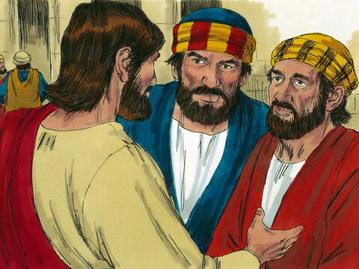
Jesus Explains End Times: Matthew 24:4-5
4 And Jesus answered and said unto them, Take heed that no man deceive you.
5 For many shall come in my name, saying, I am Christ; and shall deceive many.

Slide 4
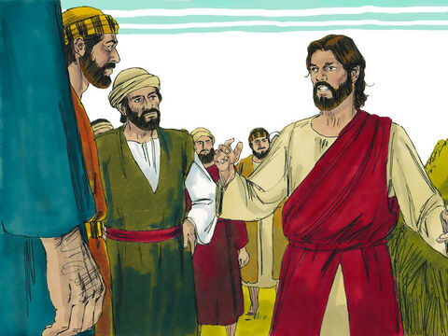
Jesus Explains End Times: Matthew 24:36
But of that day and hour knoweth no man, no, not the angels of heaven, but my Father only.

Slide 5
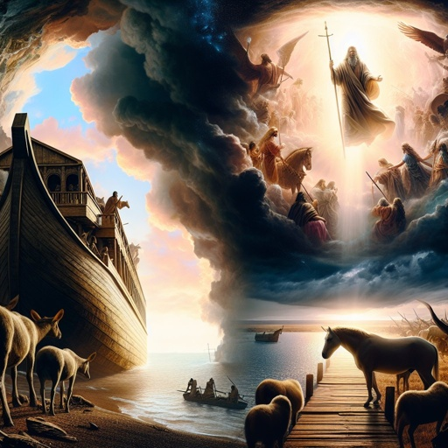
Jesus Explains End Times: Matthew 24:37
But as the days of Noe were, so shall also the coming of the Son of man be.

Slide 6
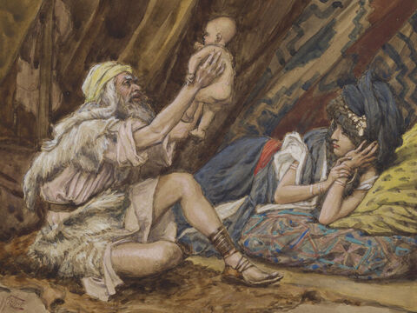
The Days of Noah: Genesis 6:1
And it came to pass, when men began to multiply on the face of the earth, and daughters were born unto them,

Slide 7
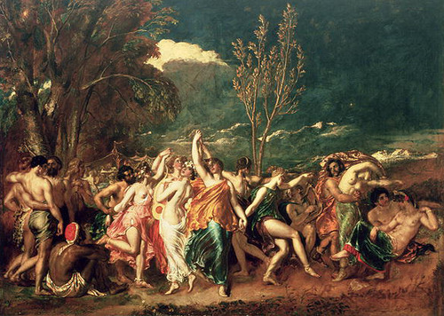
The Days of Noah : Genesis 6:2
That the sons of God saw the daughters of men that they were fair; and they took them wives of all which they chose.

Slide 8
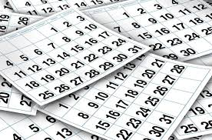
The Days of Noah: Genesis 6:3
And the Lord said, My spirit shall not always strive with man, for that he also is flesh: yet his days shall be an hundred and twenty years.

Slide 9
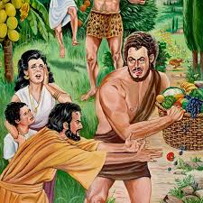
The Days of Noah: Genesis 6:4
There were giants in the earth in those days; and also after that, when the sons of God came in unto the daughters of men, and they bare children to them, the same became mighty men which were of old, men of renown.

Slide 10
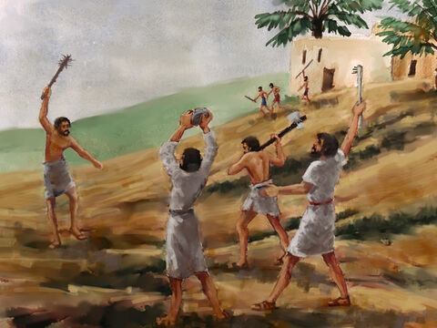
The Days of Noah: Genesis 6:5
And God saw that the wickedness of man was great in the earth, and that every imagination of the thoughts of his heart was only evil continually.

Slide 11
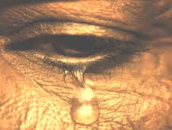
The Days of Noah: Genesis 6:6
And it repented the Lord that he had made man on the earth, and it grieved him at his heart.

Slide 12
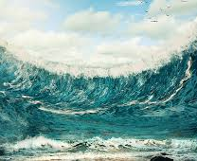
The Days of Noah: Genesis 6:7
And the Lord said, I will destroy man whom I have created from the face of the earth; both man, and beast, and the creeping thing, and the fowls of the air; for it repenteth me that I have made them.

Slide 13
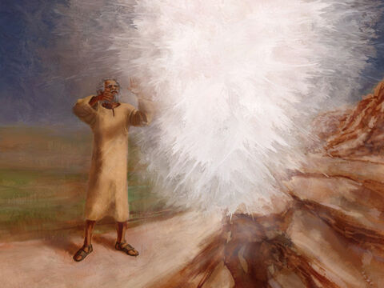
The Days of Noah: Genesis 6:8
But Noah found grace in the eyes of the Lord.

Slide 14
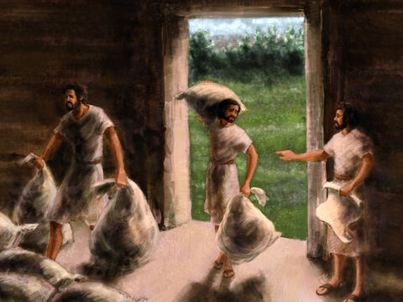
The Days of Noah: Genesis 6:9
These are the generations of Noah: Noah was a just man and perfect in his generations, and Noah walked with God.

Slide 15
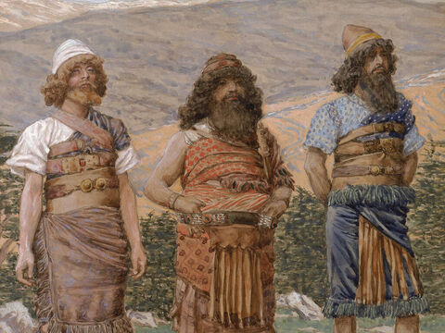
The Days of Noah: Genesis 6:10
And Noah begat three sons, Shem, Ham, and Japheth.

Slide 16
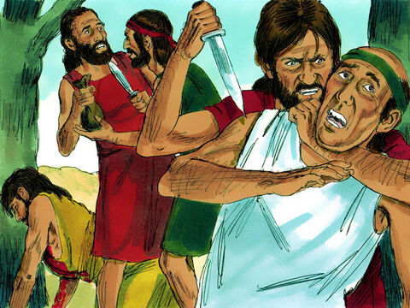
The Days of Noah: Genesis 6:11
The earth also was corrupt before God, and the earth was filled with violence.

Slide 17
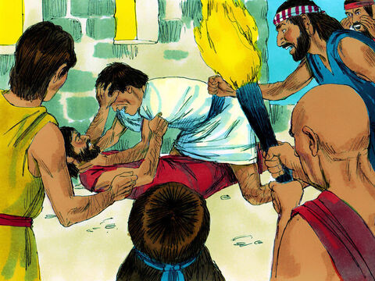
The Days of Noah: Genesis 6:12
And God looked upon the earth, and, behold, it was corrupt; for all flesh had corrupted his way upon the earth.

Slide 18
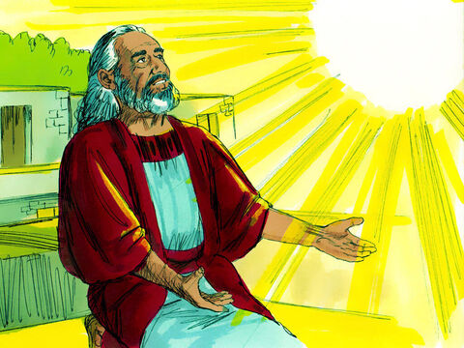
The Days of Noah: Genesis 6:13
And God said unto Noah, The end of all flesh is come before me; for the earth is filled with violence through them; and, behold, I will destroy them with the earth.

Slide 19
The Days of Noah: The Signs of the End
What do you notice?

Slide 20
The Days of Noah: The Signs of the End
The world was unendingly, desperately wicked-particularly regarding sexual immorality.
That the sons of God saw the daughters of men that they were fair; and they took them wives of all which they chose.
Genesis 6:2

Slide 21
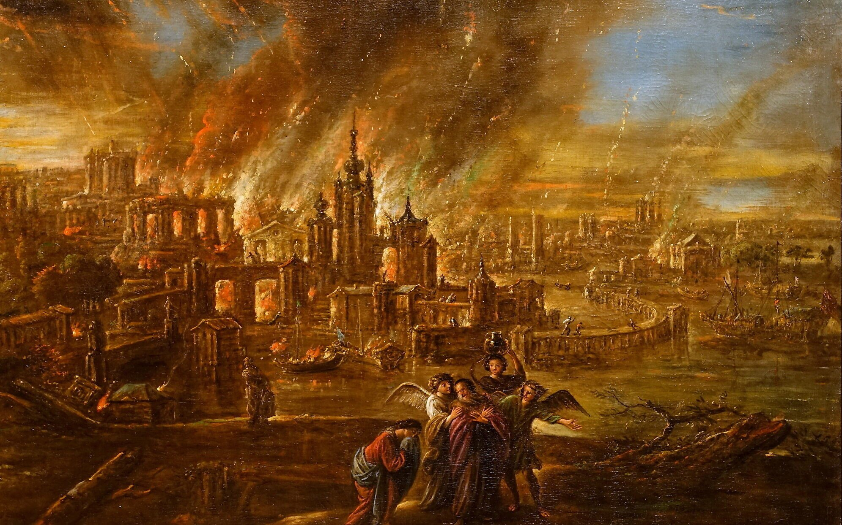
Coming Destruction: Jude 1:7
Even as Sodom and Gomorrha, and the cities about them in like manner, giving themselves over to fornication, and going after strange flesh, are set forth for an example, suffering the vengeance of eternal fire.

Slide 22
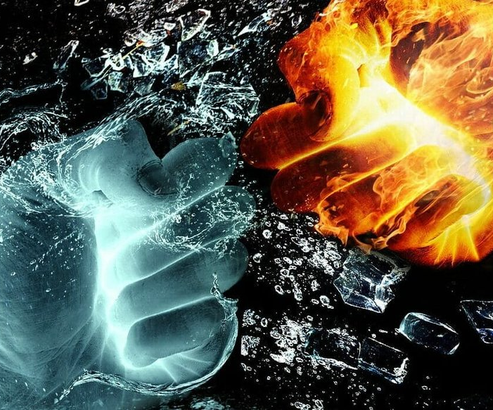
Coming Destruction: Jude 1:8
Likewise also these filthy dreamers defile the flesh, despise dominion, and speak evil of dignities.

Slide 23
The Days of Noah: The Signs of the End
God is JUST… And justice has a time limit.
The righteous live.
The wicked don’t.
And the Lord said, My spirit shall not always strive with man, for that he also is flesh: yet his days shall be an hundred and twenty years.
Genesis 6:3

Slide 24
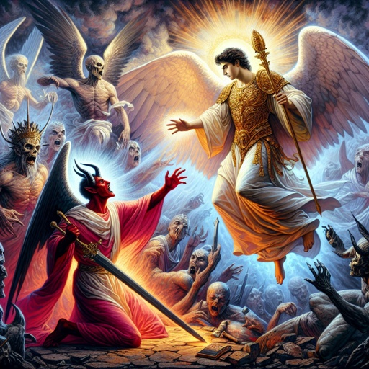
Coming Destruction: 2 Peter 2:4
For if God spared not the angels that sinned, but cast them down to hell, and delivered them into chains of darkness, to be reserved unto judgment;

Slide 25
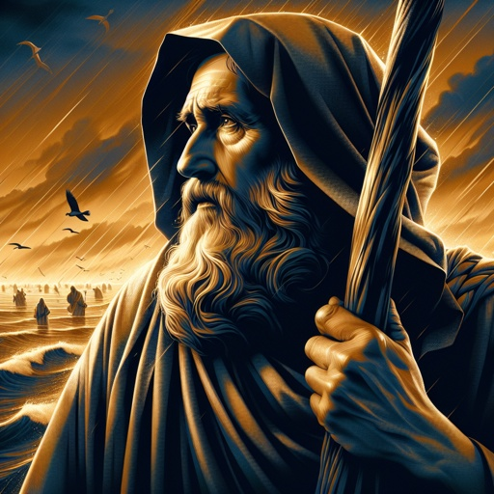
Coming Destruction: 2 Peter 2:5
And spared not the old world, but saved Noah the eighth person, a preacher of righteousness, bringing in the flood upon the world of the ungodly;

Slide 26
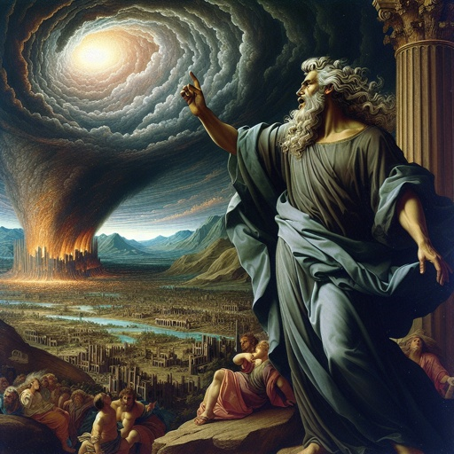
Coming Destruction: 2 Peter 2:6
And turning the cities of Sodom and Gomorrha into ashes condemned them with an overthrow, making them an ensample unto those that after should live ungodly;

Slide 27
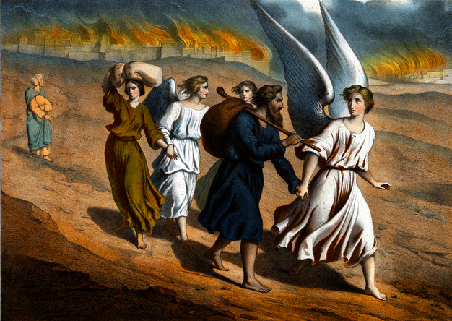
Coming Destruction: 2 Peter 2:7
And delivered just Lot, vexed with the filthy conversation of the wicked:

Slide 28
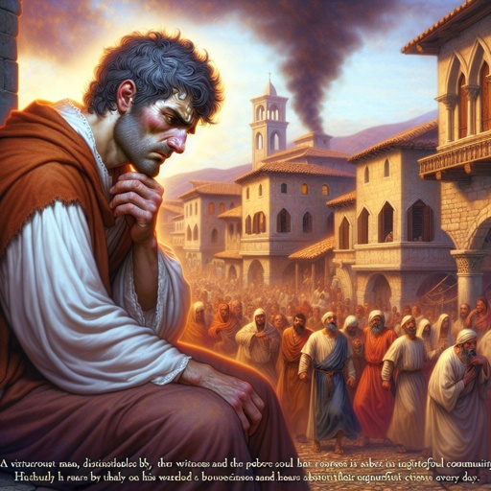
Coming Destruction: 2 Peter 2:8
(For that righteous man dwelling among them, in seeing and hearing, vexed his righteous soul from day to day with their unlawful deeds;)

Slide 29
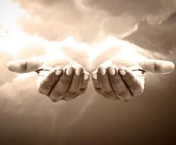
Coming Destruction: 2 Peter 2:9
The Lord knoweth how to deliver the godly out of temptations, and to reserve the unjust unto the day of judgment to be punished:

Slide 30

Coming Destruction: 2 Peter 2:10
But chiefly them that walk after the flesh in the lust of uncleanness, and despise government. Presumptuous are they, selfwilled, they are not afraid to speak evil of dignities.

Slide 31
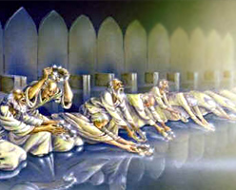
Coming Destruction: 2 Peter 2:11
Whereas angels, which are greater in power and might, bring not railing accusation against them before the Lord.

Slide 32
The Days of Noah: The Signs of the End
The disregard of God’s will was absolute.
And God saw that the wickedness of man was great in the earth, and that every imagination of the thoughts of his heart was only evil continually.
Genesis 6:5

Slide 33
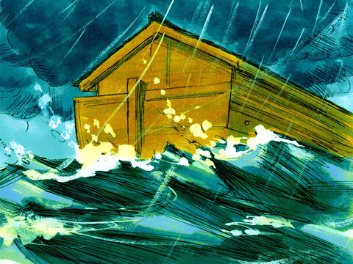
The Days of Noah: 2 Peter 3:5
For this they willingly are ignorant of, that by the word of God the heavens were of old, and the earth standing out of the water and in the water:

Slide 34
The Days of Noah: The Signs of the End
God saved a small minority.
But Noah found grace in the eyes of the Lord.
Genesis 6:8

Slide 35
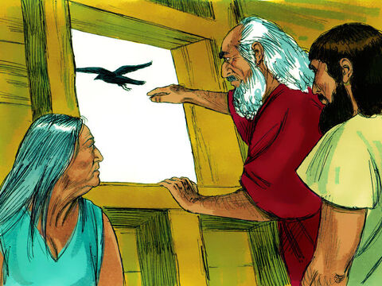
The Days of Noah: Hebrews 11:7
By faith Noah, being warned of God of things not seen as yet, moved with fear, prepared an ark to the saving of his house; by the which he condemned the world, and became heir of the righteousness which is by faith.

Slide 36
The Days of Noah: The Signs of the End
The wicked did NOT foresee the coming judgment.
The earth also was corrupt before God, and the earth was filled with violence.
And God looked upon the earth, and, behold, it was corrupt; for all flesh had corrupted his way upon the earth.
Genesis 6:11-12

Slide 37
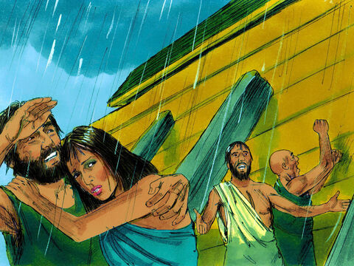
The Days of Noah: Matthew 24:38
For as in the days that were before the flood they were eating and drinking, marrying and giving in marriage, until the day that Noe entered into the ark,

Slide 38
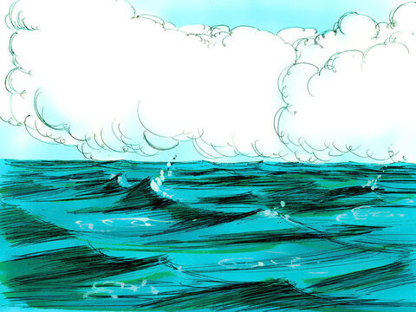
The Days of Noah: Matthew 24:39
And knew not until the flood came, and took them all away; so shall also the coming of the Son of man be.

Slide 39
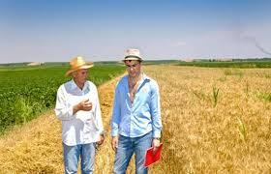
The Days of Noah: Matthew 24:40
Then shall two be in the field; the one shall be taken, and the other left.

Slide 40
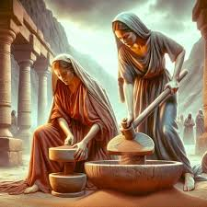
The Days of Noah: Matthew 24:41
Two women shall be grinding at the mill; the one shall be taken, and the other left.

Slide 41
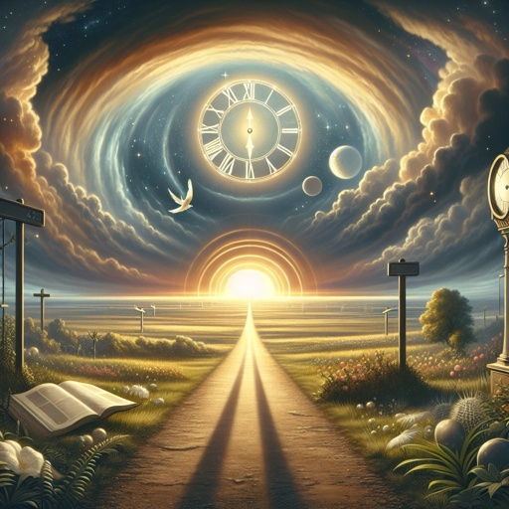
The Days of Noah: Matthew 24:42
Watch therefore: for ye know not what hour your Lord doth come.

Slide 42
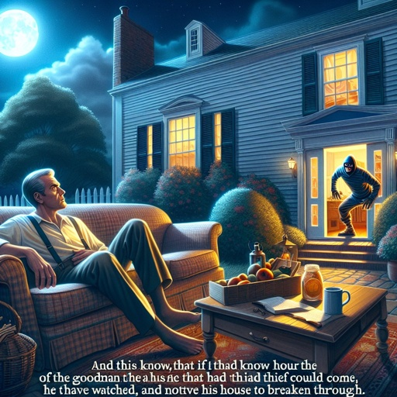
The Days of Noah: Matthew 24:43
But know this, that if the goodman of the house had known in what watch the thief would come, he would have watched, and would not have suffered his house to be broken up.

Slide 43
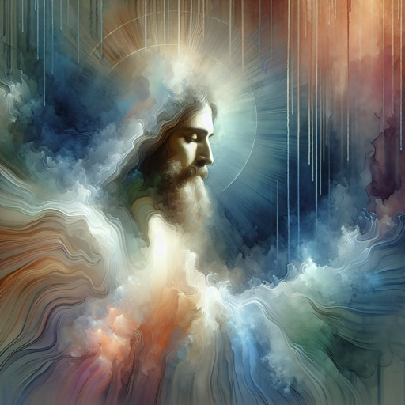
The Days of Noah: Matthew 24:44
Therefore be ye also ready: for in such an hour as ye think not the Son of man cometh.

Slide 44
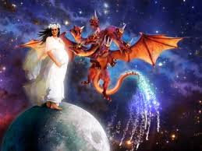
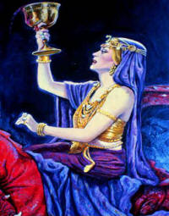
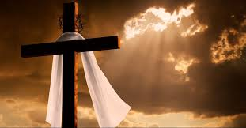
Further Types and Antitypes

Slide 45
A woman is a Biblical symbol for…
a church.

Slide 46
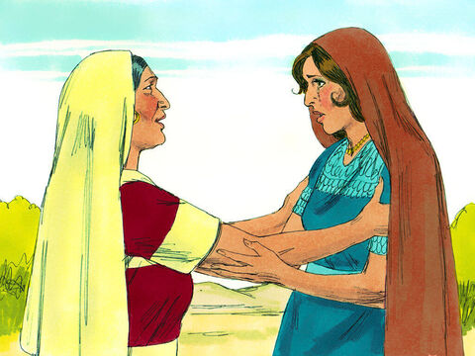
A Virtuous Woman: Ruth 1:16
And Ruth said, Intreat me not to leave thee, or to return from following after thee: for whither thou goest, I will go; and where thou lodgest, I will lodge: thy people shall be my people, and thy God my God:

Slide 47
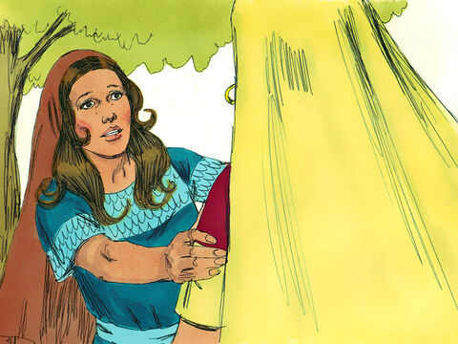
A Virtuous Woman: Ruth 1:17
Where thou diest, will I die, and there will I be buried: the LORD do so to me, and more also, if ought but death part thee and me.

Slide 48
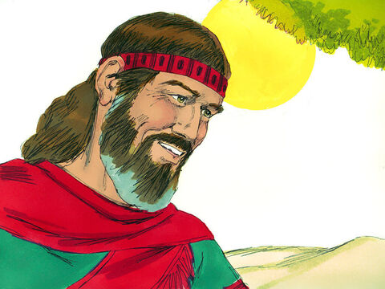
A Virtuous Woman: Ruth 2:1
And Naomi had a kinsman of her husband's, a mighty man of wealth, of the family of Elimelech; and his name was Boaz.

Slide 49
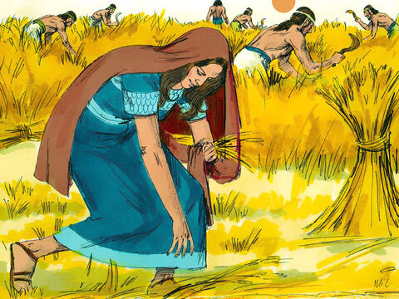
A Virtuous Woman: Ruth 2:2
And Ruth the Moabitess said unto Naomi, Let me now go to the field, and glean ears of corn after him in whose sight I shall find grace. And she said unto her, Go, my daughter.

Slide 50
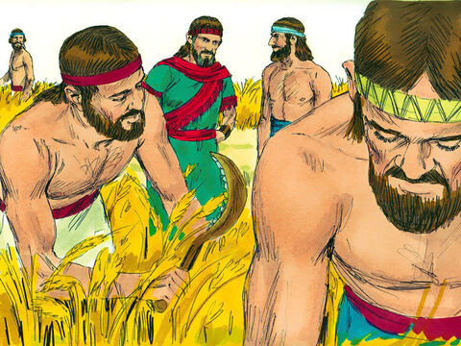
A Virtuous Woman: Ruth 2:3
And she went, and came, and gleaned in the field after the reapers: and her hap was to light on a part of the field belonging unto Boaz, who was of the kindred of Elimelech.

Slide 51
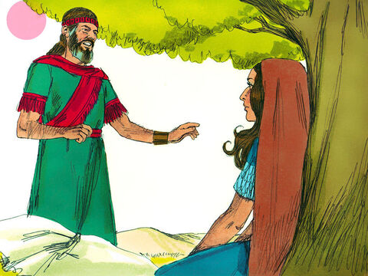
A Virtuous Woman: Ruth 2:8
Then said Boaz unto Ruth, Hearest thou not, my daughter? Go not to glean in another field, neither go from hence, but abide here fast by my maidens:

Slide 52
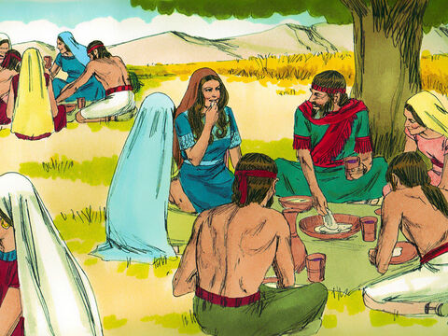
A Virtuous Woman: Ruth 2:9
Let thine eyes be on the field that they do reap, and go thou after them: have I not charged the young men that they shall not touch thee? and when thou art athirst, go unto the vessels, and drink of that which the young men have drawn.

Slide 53
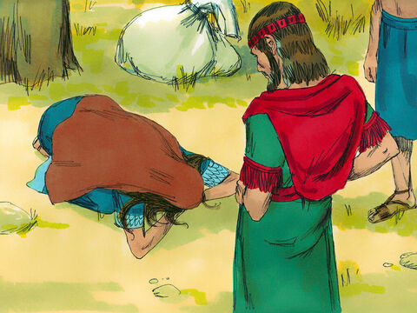
A Virtuous Woman: Ruth 2:10
Then she fell on her face, and bowed herself to the ground, and said unto him, Why have I found grace in thine eyes, that thou shouldest take knowledge of me, seeing I am a stranger?

Slide 54
A Virtuous Woman: Ruth 2:11
And Boaz answered and said unto her, It hath fully been shewed me, all that thou hast done unto thy mother in law since the death of thine husband: and how thou hast left thy father and thy mother, and the land of thy nativity, and art come unto a people which thou knewest not heretofore.

Slide 55
A Virtuous Woman: Ruth 2:12
The LORD recompense thy work, and a full reward be given thee of the LORD God of Israel, under whose wings thou art come to trust.

Slide 56
A Virtuous Woman: Ruth 2:13
Then she said, Let me find favour in thy sight, my lord; for that thou hast comforted me, and for that thou hast spoken friendly unto thine handmaid, though I be not like unto one of thine handmaidens.

Slide 57
A Virtuous Woman: Ruth 2:14
And Boaz said unto her, At mealtime come thou hither, and eat of the bread, and dip thy morsel in the vinegar. And she sat beside the reapers: and he reached her parched corn, and she did eat, and was sufficed, and left.

Slide 58
A Virtuous Woman: Ruth 2:15
And when she was risen up to glean, Boaz commanded his young men, saying, Let her glean even among the sheaves, and reproach her not:

Slide 59
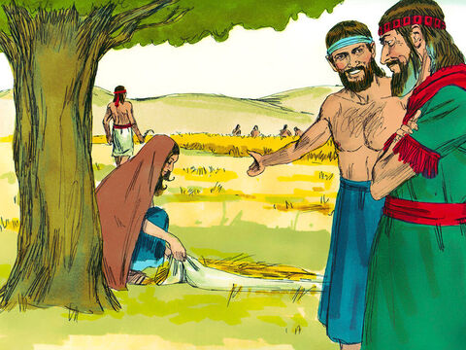
A Virtuous Woman: Ruth 2:16
And let fall also some of the handfuls of purpose for her, and leave them, that she may glean them, and rebuke her not.

Slide 60
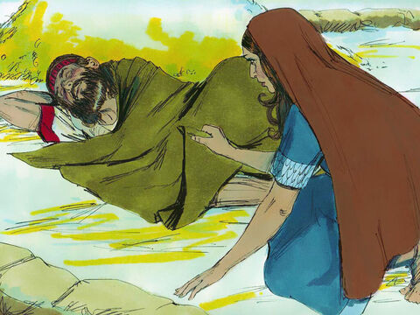
A Virtuous Woman: Ruth 3:7
And when Boaz had eaten and drunk, and his heart was merry, he went to lie down at the end of the heap of corn: and she came softly, and uncovered his feet, and laid her down.

Slide 61
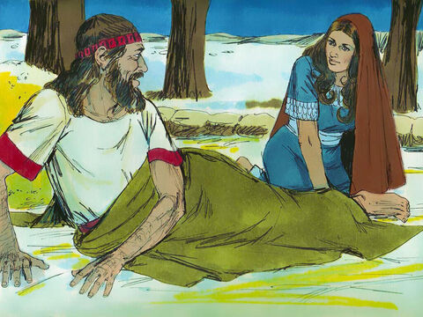
A Virtuous Woman: Ruth 3:8
And it came to pass at midnight, that the man was afraid, and turned himself: and, behold, a woman lay at his feet.

Slide 62
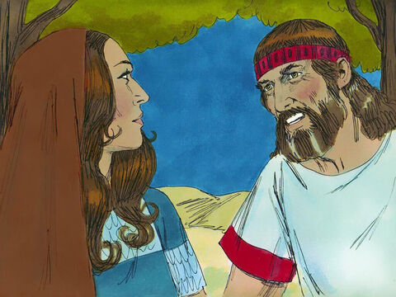
A Virtuous Woman: Ruth 3:9
And he said, Who art thou? And she answered, I am Ruth thine handmaid: spread therefore thy skirt over thine handmaid; for thou art a near kinsman.

Slide 63
A Virtuous Woman: Ruth 3:10
And he said, Blessed be thou of the LORD, my daughter: for thou hast shewed more kindness in the latter end than at the beginning, inasmuch as thou followedst not young men, whether poor or rich.

Slide 64
A Virtuous Woman: Ruth 3:11
And now, my daughter, fear not; I will do to thee all that thou requirest: for all the city of my people doth know that thou art a virtuous woman.

Slide 65
A Virtuous Woman: Ruth 3:12
And now it is true that I am thy near kinsman: howbeit there is a kinsman nearer than I.

Slide 66
A Virtuous Woman: Ruth 3:13
Tarry this night, and it shall be in the morning, that if he will perform unto thee the part of a kinsman, well; let him do the kinsman's part: but if he will not do the part of a kinsman to thee, then will I do the part of a kinsman to thee, as the LORD liveth: lie down until the morning.

Slide 67
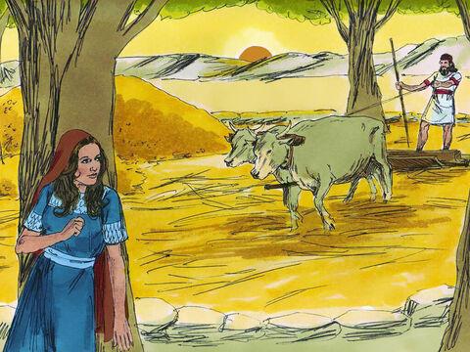
A Virtuous Woman: Ruth 3:14
And she lay at his feet until the morning: and she rose up before one could know another. And he said, Let it not be known that a woman came into the floor.

Slide 68
The Story of Boaz & Ruth: Christ & His Church
What do you notice?

Slide 69
The Story of Boaz & Ruth: Christ & His Church
Boaz (a type or example of Christ)
showers Ruth (a type or example of the true church) with undeserved favor.
Then she fell on her face, and bowed herself to the ground, and said unto him, Why have I found grace in thine eyes, that thou shouldest take knowledge of me, seeing I am a stranger?
Ruth 2:10

Slide 70
The Story of Boaz & Ruth: Christ & His Church
And Boaz said unto the elders, and unto all the people, Ye are witnesses this day… Moreover Ruth the Moabitess, the wife of Mahlon, have I purchased to be my wife, to raise up the name of the dead upon his inheritance, that the name of the dead be not cut off from among his brethren, and from the gate of his place: ye are witnesses this day.
Ruth 4:9-10
Boaz redeems or reclaims (at his own expense) Ruth’s inheritance and establishes her security.

Slide 71

A Woman of Faith: Esther 3:13
And the letters were sent by posts into all the king's provinces, to destroy, to kill, and to cause to perish, all Jews, both young and old, little children and women, in one day, even upon the thirteenth day of the twelfth month, which is the month Adar, and to take the spoil of them for a prey.

Slide 72

A Woman of Faith: Esther 4:3
And in every province, whithersoever the king's commandment and his decree came, there was great mourning among the Jews, and fasting, and weeping, and wailing; and many lay in sackcloth and ashes.

Slide 73

A Woman of Faith: Esther 4:4
So Esther's maids and her chamberlains came and told it her. Then was the queen exceedingly grieved; and she sent raiment to clothe Mordecai, and to take away his sackcloth from him: but he received it not.

Slide 74

A Woman of Faith: Esther 4:7
And Mordecai told him of all that had happened unto him, and of the sum of the money that Haman had promised to pay to the king's treasuries for the Jews, to destroy them.

Slide 75

A Woman of Faith: Esther 4:8
Also he gave him the copy of the writing of the decree that was given at Shushan to destroy them, to shew it unto Esther, and to declare it unto her, and to charge her that she should go in unto the king, to make supplication unto him, and to make request before him for her people.

Slide 76

A Woman of Faith: Esther 4:15
Then Esther bade them return Mordecai this answer,

Slide 77

A Woman of Faith: Esther 4:16
Go, gather together all the Jews that are present in Shushan, and fast ye for me, and neither eat nor drink three days, night or day: I also and my maidens will fast likewise; and so will I go in unto the king, which is not according to the law: and if I perish, I perish.

Slide 78

A Woman of Faith: Esther 5:1
Now it came to pass on the third day, that Esther put on her royal apparel, and stood in the inner court of the king's house, over against the king's house: and the king sat upon his royal throne in the royal house, over against the gate of the house.

Slide 79

A Woman of Faith: Esther 5:2
And it was so, when the king saw Esther the queen standing in the court, that she obtained favour in his sight: and the king held out to Esther the golden sceptre that was in his hand. So Esther drew near, and touched the top of the sceptre.

Slide 80
A Woman of Faith: Esther 5:3
Then said the king unto her, What wilt thou, queen Esther? and what is thy request? it shall be even given thee to the half of the kingdom.

Slide 81

A Woman of Faith: Esther 7:1
So the king and Haman came to banquet with Esther the queen.

Slide 82
A Woman of Faith: Esther 7:2
And the king said again unto Esther on the second day at the banquet of wine, What is thy petition, queen Esther? and it shall be granted thee: and what is thy request? and it shall be performed, even to the half of the kingdom.

Slide 83

A Woman of Faith: Esther 7:3
Then Esther the queen answered and said, If I have found favour in thy sight, O king, and if it please the king, let my life be given me at my petition, and my people at my request:

Slide 84

A Woman of Faith: Esther 7:4
For we are sold, I and my people, to be destroyed, to be slain, and to perish. But if we had been sold for bondmen and bondwomen, I had held my tongue, although the enemy could not countervail the king's damage.

Slide 85
A Woman of Faith: Esther 7:5
Then the king Ahasuerus answered and said unto Esther the queen, Who is he, and where is he, that durst presume in his heart to do so?

Slide 86

A Woman of Faith: Esther 7:6
And Esther said, The adversary and enemy is this wicked Haman. Then Haman was afraid before the king and the queen.

Slide 87

A Woman of Faith: Esther 8:3
And Esther spake yet again before the king, and fell down at his feet, and besought him with tears to put away the mischief of Haman the Agagite, and his device that he had devised against the Jews.

Slide 88
A Woman of Faith: Esther 8:4
Then the king held out the golden sceptre toward Esther. So Esther arose, and stood before the king,

Slide 89
A Woman of Faith: Esther 8:5
And said, If it please the king, and if I have found favour in his sight, and the thing seem right before the king, and I be pleasing in his eyes, let it be written to reverse the letters devised by Haman the son of Hammedatha the Agagite, which he wrote to destroy the Jews which are in all the king's provinces:

Slide 90

A Woman of Faith: Esther 8:6
For how can I endure to see the evil that shall come unto my people? or how can I endure to see the destruction of my kindred?

Slide 91

A Woman of Faith: Esther 8:14
So the posts that rode upon mules and camels went out, being hastened and pressed on by the king's commandment. And the decree was given at Shushan the palace.

Slide 92

A Woman of Faith: Esther 8:15
And Mordecai went out from the presence of the king in royal apparel of blue and white, and with a great crown of gold, and with a garment of fine linen and purple: and the city of Shushan rejoiced and was glad.

Slide 93

A Woman of Faith: Esther 8:16
The Jews had light, and gladness, and joy, and honour.

Slide 94

A Woman of Faith: Esther 8:17
And in every province, and in every city, whithersoever the king's commandment and his decree came, the Jews had joy and gladness, a feast and a good day. And many of the people of the land became Jews; for the fear of the Jews fell upon them.

Slide 95
Esther Goes to the King: The Church Goes to God
What do you notice?

Slide 96
Esther Goes to the King: The Church Goes to God
Esther and her people are condemned to death by law.
Also he gave him the copy of the writing of the decree that was given at Shushan to destroy them, to shew it unto Esther, and to declare it unto her, and to charge her that she should go in unto the king, to make supplication unto him, and to make request before him for her people.
Esther 4:8

Slide 97
Esther Goes to the King: The Church Goes to God
The King is moved by pity to save them from this fate.
And the king arising from the banquet of wine in his wrath went into the palace garden: and Haman stood up to make request for his life to Esther the queen; for he saw that there was evil determined against him by the king.
Esther 4:8

Slide 98
Esther Goes to the King: The Church Goes to God
Esther and her people are utterly saved and secure.
The Jews had light, and gladness, and joy, and honour.
Esther 8:16

Slide 99
Thank you and
Happy Sabbath!!

