Slide 1
Precursors
2nd Quarter 2025, Lesson 12

Slide 2
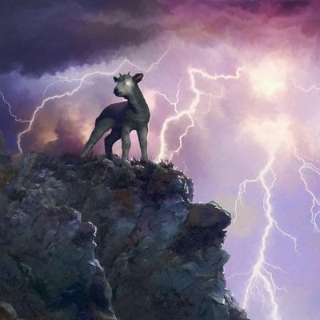
The End of the Story:
Revelation 13:11
And I beheld another beast coming up out of the earth; and he had two horns like a lamb, and he spake as a dragon.

Slide 3
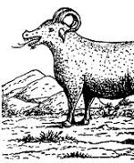
The End of the Story:
Revelation 13:12
And he exerciseth all the power of the first beast before him, and causeth the earth and them which dwell therein to worship the first beast, whose deadly wound was healed.

Slide 4
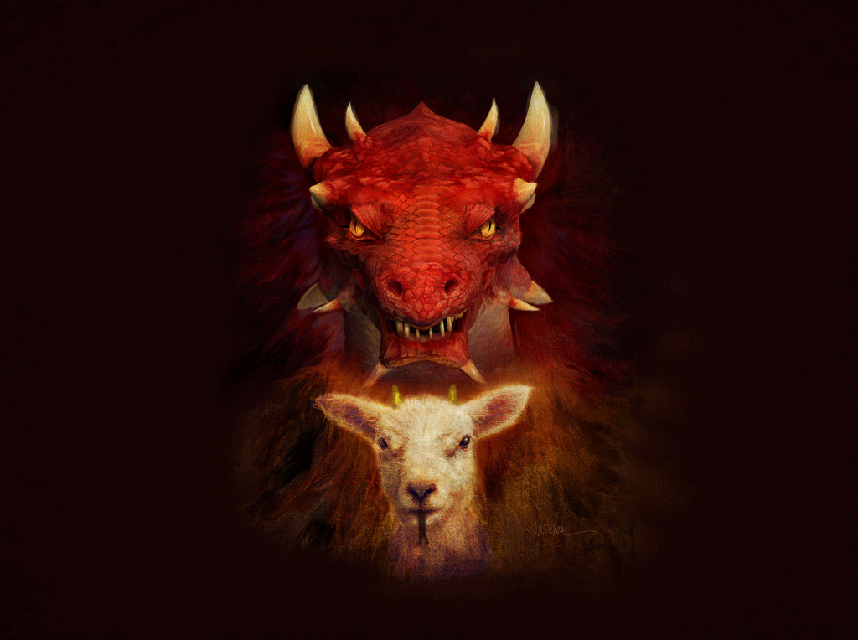
The End of the Story:
Revelation 13:13
And he doeth great wonders, so that he maketh fire come down from heaven on the earth in the sight of men,

Slide 5
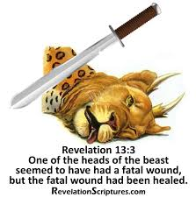
The End of the Story:
Revelation 13:14
And deceiveth them that dwell on the earth by the means of those miracles which he had power to do in the sight of the beast; saying to them that dwell on the earth, that they should make an image to the beast, which had the wound by a sword, and did live.

Slide 6
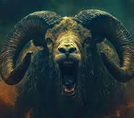
The End of the Story:
Revelation 13:15
And he had power to give life unto the image of the beast, that the image of the beast should both speak, and cause that as many as would not worship the image of the beast should be killed.

Slide 7

The End of the Story:
Revelation 13:16
And he causeth all, both small and great, rich and poor, free and bond, to receive a mark in their right hand, or in their foreheads:

Slide 8
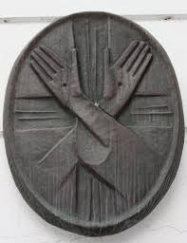
The End of the Story:
Revelation 13:17
And that no man might buy or sell, save he that had the mark, or the name of the beast, or the number of his name.

Slide 9
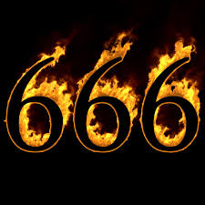
The End of the Story:
Revelation 13:18
Here is wisdom. Let him that hath understanding count the number of the beast: for it is the number of a man; and his number is Six hundred threescore and six.

Slide 10
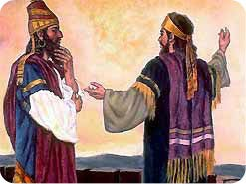
Certainty: Daniel 2:27
Daniel answered in the presence of the king, and said, The secret which the king hath demanded cannot the wise men, the astrologers, the magicians, the soothsayers, shew unto the king;

Slide 11
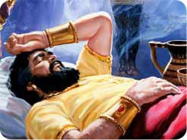
Certainty: Daniel 2:28
But there is a God in heaven that revealeth secrets, and maketh known to the king Nebuchadnezzar what shall be in the latter days. Thy dream, and the visions of thy head upon thy bed, are these;

Slide 12
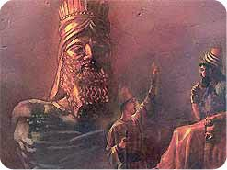
Certainty: Daniel 2:29
As for thee, O king, thy thoughts came into thy mind upon thy bed, what should come to pass hereafter: and he that revealeth secrets maketh known to thee what shall come to pass.

Slide 13
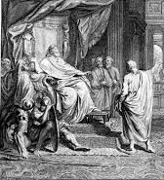
Certainty: Daniel 2:30
But as for me, this secret is not revealed to me for any wisdom that I have more than any living, but for their sakes that shall make known the interpretation to the king, and that thou mightest know the thoughts of thy heart.

Slide 14
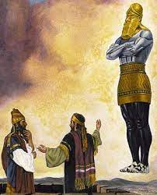
Certainty: Daniel 2:31
Thou, O king, sawest, and behold a great image. This great image, whose brightness was excellent, stood before thee; and the form thereof was terrible.

Slide 15
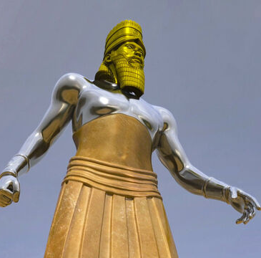
Certainty: Daniel 2:32
This image's head was of fine gold, his breast and his arms of silver, his belly and his thighs of brass,

Slide 16
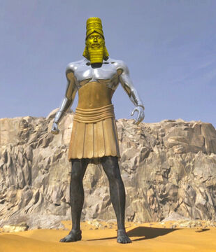
Certainty: Daniel 2:33
His legs of iron, his feet part of iron and part of clay.

Slide 17
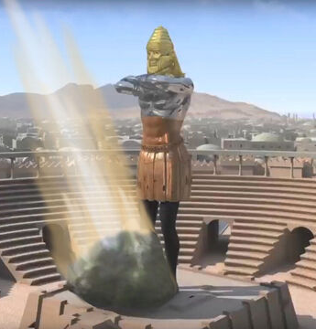
Certainty: Daniel 2:34
Thou sawest till that a stone was cut out without hands, which smote the image upon his feet that were of iron and clay, and brake them to pieces.

Slide 18
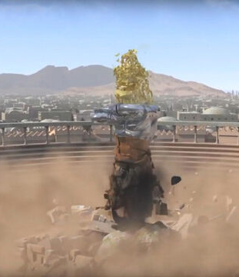
Certainty: Daniel 2:35
Then was the iron, the clay, the brass, the silver, and the gold, broken to pieces together, and became like the chaff of the summer threshingfloors; and the wind carried them away, that no place was found for them: and the stone that smote the image became a great mountain, and filled the whole earth.

Slide 19
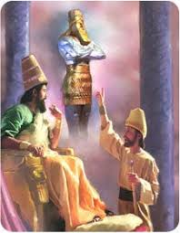
Certainty: Daniel 2:36
This is the dream; and we will tell the interpretation thereof before the king.

Slide 20
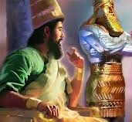
Certainty: Daniel 2:37
Thou, O king, art a king of kings: for the God of heaven hath given thee a kingdom, power, and strength, and glory.

Slide 21
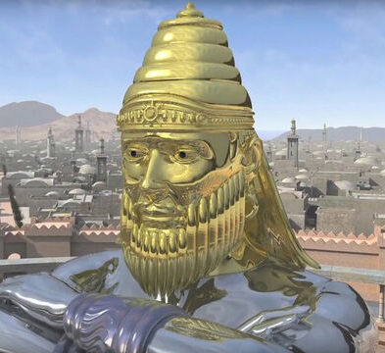
Certainty: Daniel 2:38
And wheresoever the children of men dwell, the beasts of the field and the fowls of the heaven hath he given into thine hand, and hath made thee ruler over them all. Thou art this head of gold.

Slide 22
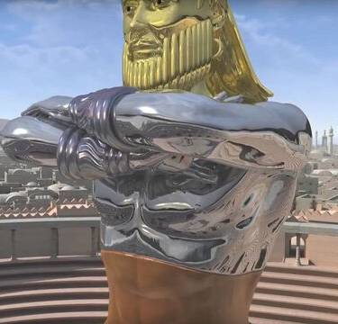
Certainty: Daniel 2:39
And after thee shall arise another kingdom inferior to thee, and another third kingdom of brass, which shall bear rule over all the earth.

Slide 23
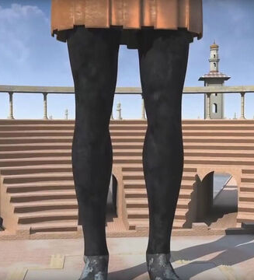
Certainty: Daniel 2:40
And the fourth kingdom shall be strong as iron: forasmuch as iron breaketh in pieces and subdueth all things: and as iron that breaketh all these, shall it break in pieces and bruise.

Slide 24
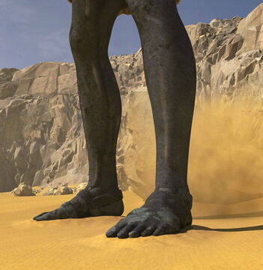
Certainty: Daniel 2:41
And whereas thou sawest the feet and toes, part of potters' clay, and part of iron, the kingdom shall be divided; but there shall be in it of the strength of the iron, forasmuch as thou sawest the iron mixed with miry clay.

Slide 25
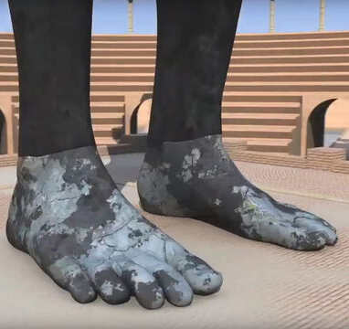
Certainty: Daniel 2:42
And as the toes of the feet were part of iron, and part of clay, so the kingdom shall be partly strong, and partly broken.

Slide 26
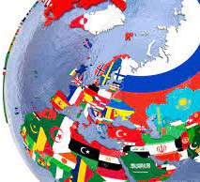
Certainty: Daniel 2:43
And whereas thou sawest iron mixed with miry clay, they shall mingle themselves with the seed of men: but they shall not cleave one to another, even as iron is not mixed with clay.

Slide 27
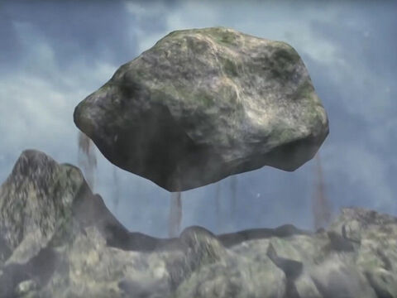
Certainty: Daniel 2:44
And in the days of these kings shall the God of heaven set up a kingdom, which shall never be destroyed: and the kingdom shall not be left to other people, but it shall break in pieces and consume all these kingdoms, and it shall stand for ever.

Slide 28
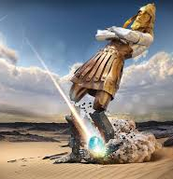
Certainty: Daniel 2:45
Forasmuch as thou sawest that the stone was cut out of the mountain without hands, and that it brake in pieces the iron, the brass, the clay, the silver, and the gold; the great God hath made known to the king what shall come to pass hereafter: and the dream is certain, and the interpretation thereof sure.

Slide 29
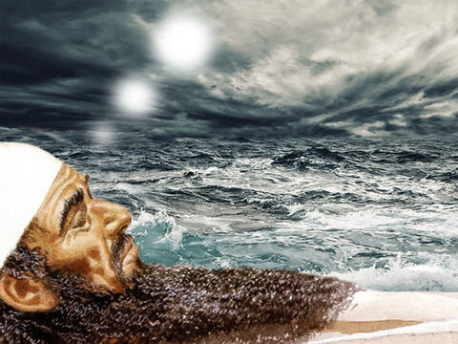
World History: Daniel 7:2
Daniel spake and said, I saw in my vision by night, and, behold, the four winds of the heaven strove upon the great sea.
Revelation 17:15 The waters which thou sawest…are peoples, and multitudes, and nations, and tongues.

Slide 30
World History: Daniel 7:3
And four great beasts came up from the sea, diverse one from another.

Slide 31
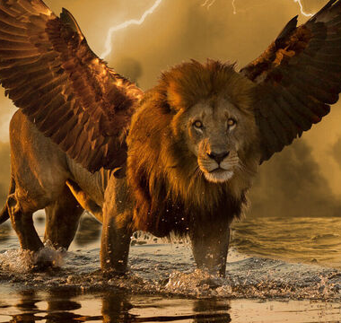
World History: Daniel 7:4
The first was like a lion, and had eagle's wings: I beheld till the wings thereof were plucked, and it was lifted up from the earth, and made stand upon the feet as a man, and a man's heart was given to it.

Slide 32
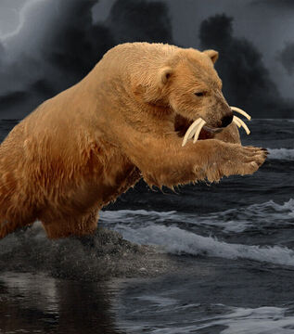
World History: Daniel 7:5
And behold another beast, a second, like to a bear, and it raised up itself on one side, and it had three ribs in the mouth of it between the teeth of it: and they said thus unto it, Arise, devour much flesh.

Slide 33
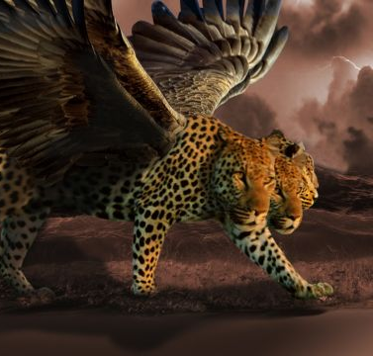
World History: Daniel 7:6
After this I beheld, and lo another, like a leopard, which had upon the back of it four wings of a fowl; the beast had also four heads; and dominion was given to it.

Slide 34
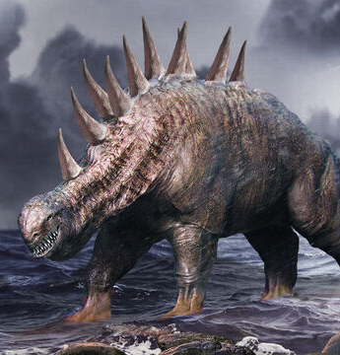
World History: Daniel 7:7
After this I saw in the night visions, and behold a fourth beast, dreadful and terrible, and strong exceedingly; and it had great iron teeth: it devoured and brake in pieces, and stamped the residue with the feet of it: and it was diverse from all the beasts that were before it; and it had ten horns.

Slide 35
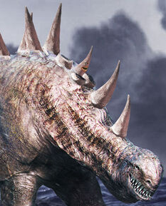
World History: Daniel 7:8
I considered the horns, and, behold, there came up among them another little horn, before whom there were three of the first horns plucked up by the roots: and, behold, in this horn were eyes like the eyes of man, and a mouth speaking great things.

Slide 36
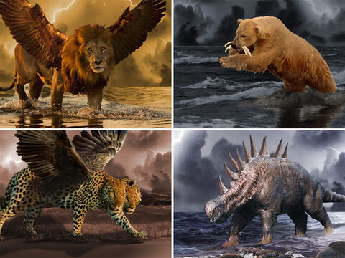
World History: Daniel 7:17
These great beasts, which are four, are four kings, which shall arise out of the earth.

Slide 37
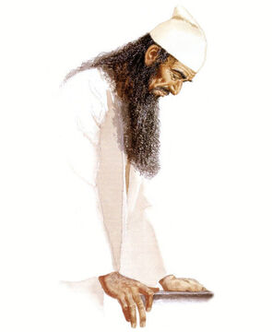
World History: Daniel 7:19
Then I would know the truth of the fourth beast, which was diverse from all the others, exceeding dreadful, whose teeth were of iron, and his nails of brass; which devoured, brake in pieces, and stamped the residue with his feet;

Slide 38
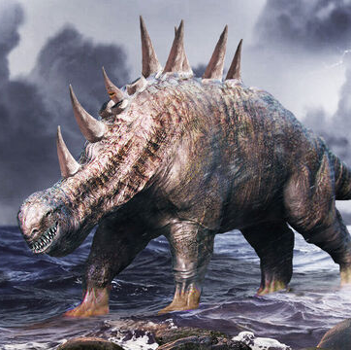
World History: Daniel 7:20
And of the ten horns that were in his head, and of the other which came up, and before whom three fell; even of that horn that had eyes, and a mouth that spake very great things, whose look was more stout than his fellows.

Slide 39
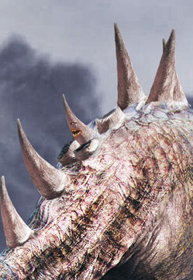
World History: Daniel 7:21
I beheld, and the same horn made war with the saints, and prevailed against them;

Slide 40
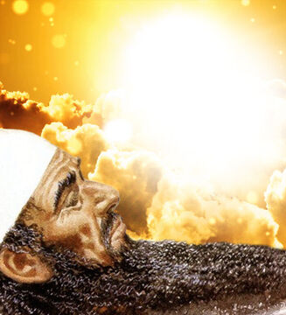
World History: Daniel 7:22
Until the Ancient of days came, and judgment was given to the saints of the most High; and the time came that the saints possessed the kingdom.

Slide 41
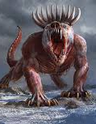
World History: Daniel 7:23
Thus he said, The fourth beast shall be the fourth kingdom upon earth, which shall be diverse from all kingdoms, and shall devour the whole earth, and shall tread it down, and break it in pieces.

Slide 42
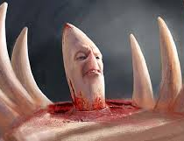
World History: Daniel 7:24
And the ten horns out of this kingdom are ten kings that shall arise: and another shall rise after them; and he shall be diverse from the first, and he shall subdue three kings.

Slide 43
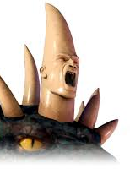
World History: Daniel 7:25
And he shall speak great words against the most High, and shall wear out the saints of the most High, and think to change times and laws: and they shall be given into his hand until a time and times and the dividing of time.

Slide 44
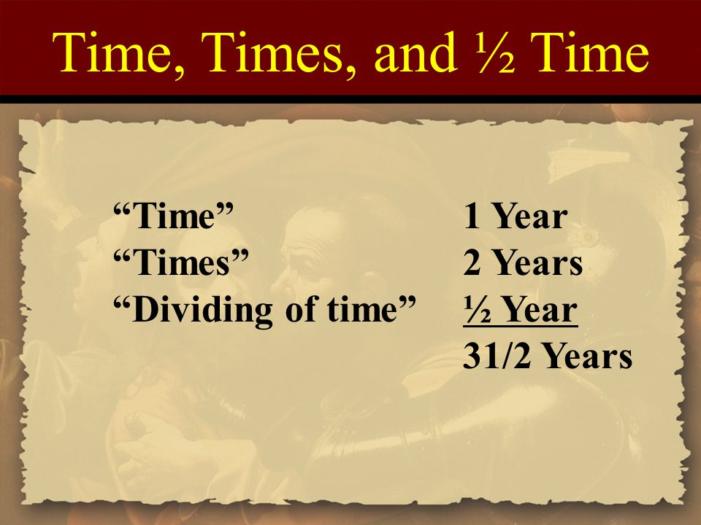
3.5 years x 360-day Hebrew year = 1260 days
1260 prophetic years
Year-for-a-Day Principle (Numbers 14:34, Ezekiel 4:5-6)

Slide 45
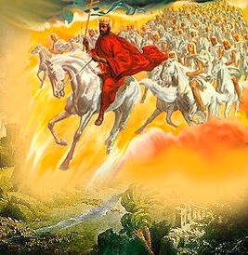
World History: Daniel 7:26
But the judgment shall sit, and they shall take away his dominion, to consume and to destroy it unto the end.

Slide 46
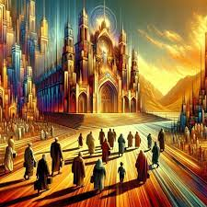
World History: Daniel 7:27
And the kingdom and dominion, and the greatness of the kingdom under the whole heaven, shall be given to the people of the saints of the most High, whose kingdom is an everlasting kingdom, and all dominions shall serve and obey him.

Slide 47
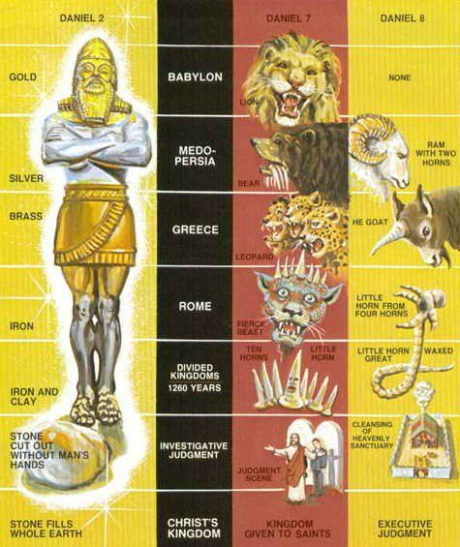
Daniel 2 and Daniel 7 give us the SAME outline of world history with increasing detail. As it turns out, Daniel 8 gives us yet another outline with still more details. But the overview is absolutely the same.

Slide 48
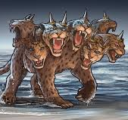
The First Beast: Revelation 13:1
And I stood upon the sand of the sea, and saw a beast rise up out of the sea, having seven heads and ten horns, and upon his horns ten crowns, and upon his heads the name of blasphemy.

Slide 49
The First Beast: Revelation 13:1
10 Horns? Recall the fourth beast, dreadful and terrible… great iron teeth: it devoured and brake in pieces… it was diverse from all the beasts that were before it; and it had ten horns. (Dan. 7:7)
(ROME)
And I stood upon the sand of the sea, and saw a beast rise up out of the sea, having seven heads and ten horns, and upon his horns ten crowns, and upon his heads the name of blasphemy.

Slide 50
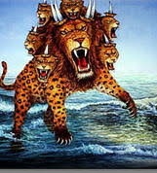
The First Beast: Revelation 13:2
And the beast which I saw was like unto a leopard, and his feet were as the feet of a bear, and his mouth as the mouth of a lion: and the dragon gave him his power, and his seat, and great authority.

Slide 51
The First Beast: Revelation 13:2
And the beast which I saw was like unto a leopard, and his feet were as the feet of a bear, and his mouth as the mouth of a lion: and the dragon gave him his power, and his seat, and great authority.
Greece (Leopard, Dan. 7)
Medo-Persia (Bear, Dan. 7)
Babylon (Lion, Dan. 7)
That old serpent called the devil and Satan.

Slide 52
The First Beast: Revelation 13:3
And I saw one of his heads as it were wounded to death; and his deadly wound was healed: and all the world wondered after the beast.

Slide 53
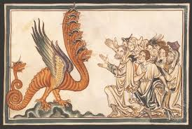
The First Beast: Revelation 13:4
And they worshipped the dragon which gave power unto the beast: and they worshipped the beast, saying, Who is like unto the beast? who is able to make war with him?

Slide 54
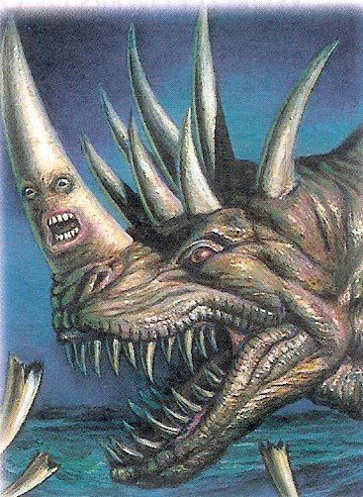
The First Beast: Revelation 13:5
And there was given unto him a mouth speaking great things and blasphemies; and power was given unto him to continue forty and two months.

Slide 55
Forty and Two Months
Forty- Two months 42
30-day Hebrew month x 30
1260 days
1260 prophetic years
Year-for-a-Day Principle (Numbers 14:34, Ezekiel 4:5-6)

Slide 56

The First Beast: Revelation 13:6
And he opened his mouth in blasphemy against God, to blaspheme his name, and his tabernacle, and them that dwell in heaven.

Slide 57
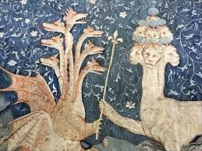
The First Beast: Revelation 13:7
And it was given unto him to make war with the saints, and to overcome them: and power was given him over all kindreds, and tongues, and nations.

Slide 58
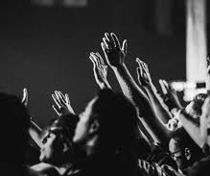
The First Beast: Revelation 13:8
And all that dwell upon the earth shall worship him, whose names are not written in the book of life of the Lamb slain from the foundation of the world.

Slide 59




Slide 60

The Second Beast: Revelation 13:11
And I beheld another beast coming up out of the earth; and he had two horns like a lamb, and he spake as a dragon.

Slide 61

The Second Beast: Revelation 13:12
And he exerciseth all the power of the first beast before him, and causeth the earth and them which dwell therein to worship the first beast, whose deadly wound was healed.

Slide 62

The Second Beast: Revelation 13:13
And he doeth great wonders, so that he maketh fire come down from heaven on the earth in the sight of men,

Slide 63

The Second Beast: Revelation 13:14
And deceiveth them that dwell on the earth by the means of those miracles which he had power to do in the sight of the beast; saying to them that dwell on the earth, that they should make an image to the beast, which had the wound by a sword, and did live.

Slide 64

The Second Beast: Revelation 13:15
And he had power to give life unto the image of the beast, that the image of the beast should both speak, and cause that as many as would not worship the image of the beast should be killed.

Slide 65
The Second Beast: Revelation 13:15
And he had power to give life unto the image of the beast, that the image of the beast should both speak, and cause that as many as would not worship the image of the beast should be killed.

Slide 66

The Second Beast: Revelation 13:16
And he causeth all, both small and great, rich and poor, free and bond, to receive a mark in their right hand, or in their foreheads:

Slide 67
Deuteronomy 6:4-6, 8
⁴ Hear, O Israel: The Lord our God is one Lord:
⁵ And thou shalt love the Lord thy God with all thine heart, and with all thy soul, and with all thy might.
⁶ And these words, which I command thee this day, shall be in thine heart…
⁸ And thou shalt bind them for a sign upon thine hand, and they shall be as frontlets between thine eyes.

Slide 68

The Second Beast: Revelation 13:17
And that no man might buy or sell, save he that had the mark, or the name of the beast, or the number of his name.

Slide 69

The Second Beast: Revelation 13:18
Here is wisdom. Let him that hath understanding count the number of the beast: for it is the number of a man; and his number is Six hundred threescore and six.

Slide 70

The (REAL) End of the Story: Daniel 3:1
Nebuchadnezzar the king made an image of gold, whose height was threescore cubits, and the breadth thereof six cubits: he set it up in the plain of Dura, in the province of Babylon.

Slide 71

The (REAL) End of the Story: Daniel 3:2
Then Nebuchadnezzar the king sent to gather together the princes, the governors, and the captains, the judges, the treasurers, the counsellors, the sheriffs, and all the rulers of the provinces, to come to the dedication of the image which Nebuchadnezzar the king had set up.

Slide 72

The (REAL) End of the Story: Daniel 3:3
Then the princes, the governors, and captains, the judges, the treasurers, the counsellors, the sheriffs, and all the rulers of the provinces, were gathered together unto the dedication of the image that Nebuchadnezzar the king had set up; and they stood before the image that Nebuchadnezzar had set up.

Slide 73

The (REAL) End of the Story: Daniel 3:4
Then an herald cried aloud, To you it is commanded, O people, nations, and languages,

Slide 74

The (REAL) End of the Story: Daniel 3:5
That at what time ye hear the sound of the cornet, flute, harp, sackbut, psaltery, dulcimer, and all kinds of musick, ye fall down and worship the golden image that Nebuchadnezzar the king hath set up:

Slide 75

The (REAL) End of the Story: Daniel 3:6
And whoso falleth not down and worshippeth shall the same hour be cast into the midst of a burning fiery furnace.

Slide 76

The (REAL) End of the Story: Daniel 3:7
Therefore at that time, when all the people heard the sound of the cornet, flute, harp, sackbut, psaltery, and all kinds of musick, all the people, the nations, and the languages, fell down and worshipped the golden image that Nebuchadnezzar the king had set up.

Slide 77

The (REAL) End of the Story: Daniel 3:8
Wherefore at that time certain Chaldeans came near, and accused the Jews.

Slide 78

The (REAL) End of the Story: Daniel 3:9
They spake and said to the king Nebuchadnezzar, O king, live for ever.

Slide 79

The (REAL) End of the Story: Daniel 3:10
Thou, O king, hast made a decree, that every man that shall hear the sound of the cornet, flute, harp, sackbut, psaltery, and dulcimer, and all kinds of musick, shall fall down and worship the golden image:

Slide 80

The (REAL) End of the Story: Daniel 3:11
And whoso falleth not down and worshippeth, that he should be cast into the midst of a burning fiery furnace.

Slide 81

The (REAL) End of the Story: Daniel 3:12
There are certain Jews whom thou hast set over the affairs of the province of Babylon, Shadrach, Meshach, and Abednego; these men, O king, have not regarded thee: they serve not thy gods, nor worship the golden image which thou hast set up.

Slide 82

The (REAL) End of the Story: Daniel 3:13
Then Nebuchadnezzar in his rage and fury commanded to bring Shadrach, Meshach, and Abednego. Then they brought these men before the king.

Slide 83

The (REAL) End of the Story: Daniel 3:14
Nebuchadnezzar spake and said unto them, Is it true, O Shadrach, Meshach, and Abednego, do not ye serve my gods, nor worship the golden image which I have set up?

Slide 84

The (REAL) End of the Story: Daniel 3:16
Shadrach, Meshach, and Abednego, answered and said to the king, O Nebuchadnezzar, we are not careful to answer thee in this matter.

Slide 85

The (REAL) End of the Story: Daniel 3:17
If it be so, our God whom we serve is able to deliver us from the burning fiery furnace, and he will deliver us out of thine hand, O king.

Slide 86

The (REAL) End of the Story: Daniel 3:18
But if not, be it known unto thee, O king, that we will not serve thy gods, nor worship the golden image which thou hast set up.

Slide 87

The (REAL) End of the Story: Daniel 3:19
Then was Nebuchadnezzar full of fury, and the form of his visage was changed against Shadrach, Meshach, and Abednego: therefore he spake, and commanded that they should heat the furnace one seven times more than it was wont to be heated.

Slide 88

The (REAL) End of the Story: Daniel 3:20
And he commanded the most mighty men that were in his army to bind Shadrach, Meshach, and Abednego, and to cast them into the burning fiery furnace.

Slide 89

The (REAL) End of the Story: Daniel 3:21
Then these men were bound in their coats, their hosen, and their hats, and their other garments, and were cast into the midst of the burning fiery furnace.

Slide 90

The (REAL) End of the Story: Daniel 3:22
Therefore because the king's commandment was urgent, and the furnace exceeding hot, the flame of the fire slew those men that took up Shadrach, Meshach, and Abednego.

Slide 91

The (REAL) End of the Story: Daniel 3:23
And these three men, Shadrach, Meshach, and Abednego, fell down bound into the midst of the burning fiery furnace.

Slide 92

The (REAL) End of the Story: Daniel 3:24
Then Nebuchadnezzar the king was astonied, and rose up in haste, and spake, and said unto his counsellors, Did not we cast three men bound into the midst of the fire? They answered and said unto the king, True, O king.

Slide 93

The (REAL) End of the Story: Daniel 3:25
He answered and said, Lo, I see four men loose, walking in the midst of the fire, and they have no hurt; and the form of the fourth is like the Son of God.

Slide 94

The (REAL) End of the Story: Daniel 3:26
Then Nebuchadnezzar came near to the mouth of the burning fiery furnace, and spake, and said, Shadrach, Meshach, and Abednego, ye servants of the most high God, come forth, and come hither. Then Shadrach, Meshach, and Abednego, came forth of the midst of the fire.

Slide 95
THANK YOU and
Happy Sabbath!!

