Slide 1
Images of the End
2nd Quarter 2025, Lesson 13

Slide 2

Type and Antitype - Romans 5:14
Nevertheless death reigned from Adam to Moses, even over them that had not sinned after the similitude of Adam's transgression, who is the figure of him that was to come.

Slide 3
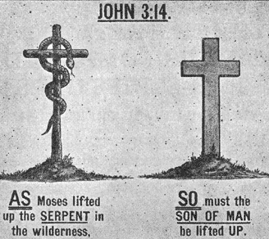
Type and Antitype - John 6:32-33
Then Jesus said unto them, Verily, verily, I say unto you, Moses gave you not that bread from heaven; but my Father giveth you the true bread from heaven.
For the bread of God is he which cometh down from heaven, and giveth life unto the world.

Slide 4
God revealed His plan of salvation through types and symbols. The sacrificial system was designed to illustrate the way in which Christ would save humanity. The lambs that were slain pointed to the Lamb of God, who would take away the sin of the world.
The Desire of Ages p. 28

Slide 5
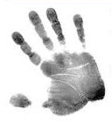
Type and Antitype –
1 Corinthians 10:11
Now all these things happened unto them for ensamples: and they are written for our admonition, upon whom the ends of the world are come.

Slide 6
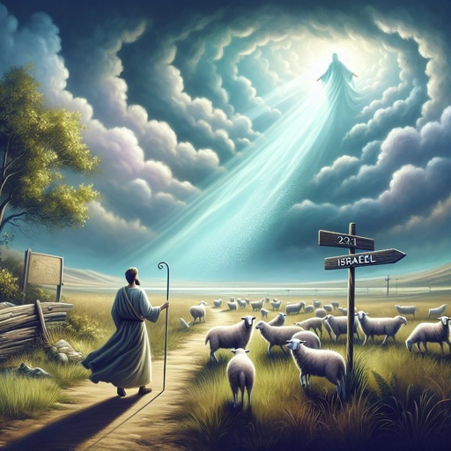
Type and Antitype - Amos 3:7
Surely the Lord GOD will do nothing, but he revealeth his secret unto his servants the prophets.

Slide 7
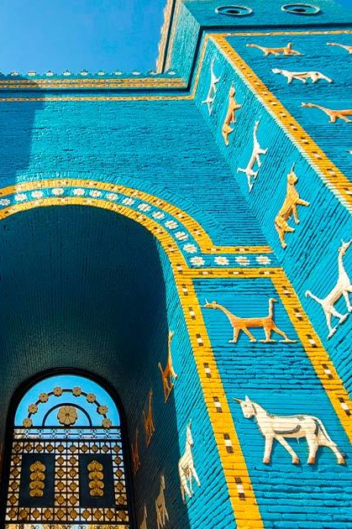
Babylon
The ancient city of Babylon was a great empire in history, known for its wealth, power, and influence, but also for its idolatry and oppression. Historically, Babylon was the conqueror of Judah, and it served as a symbol of rebellion against God.

Slide 8
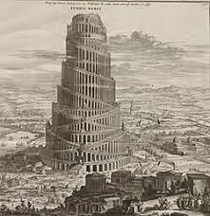
Babylon’s History – Genesis 11:4
And they said, Go to, let us build us a city and a tower, whose top may reach unto heaven; and let us make us a name, lest we be scattered abroad upon the face of the whole earth.

Slide 9
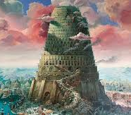
Babylon’s History – Genesis 11:5
And the Lord came down to see the city and the tower, which the children of men builded.

Slide 10
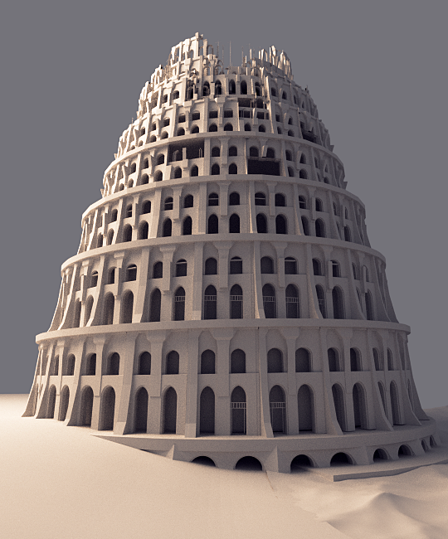
Babylon’s History – Genesis 11:6
And the Lord said, Behold, the people is one, and they have all one language; and this they begin to do: and now nothing will be restrained from them, which they have imagined to do.

Slide 11
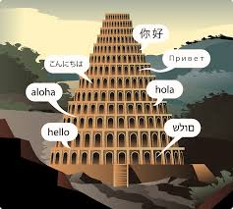
Babylon’s History – Genesis 11:7
Go to, let us go down, and there confound their language, that they may not understand one another's speech.

Slide 12
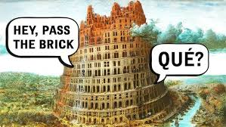
Babylon’s History – Genesis 11:8
So the LORD scattered them abroad from thence upon the face of all the earth: and they left off to build the city.

Slide 13
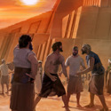
Babylon’s History – Genesis 11:9
Therefore is the name of it called Babel; because the Lord did there confound the language of all the earth: and from thence did the Lord scatter them abroad upon the face of all the earth.

Slide 14
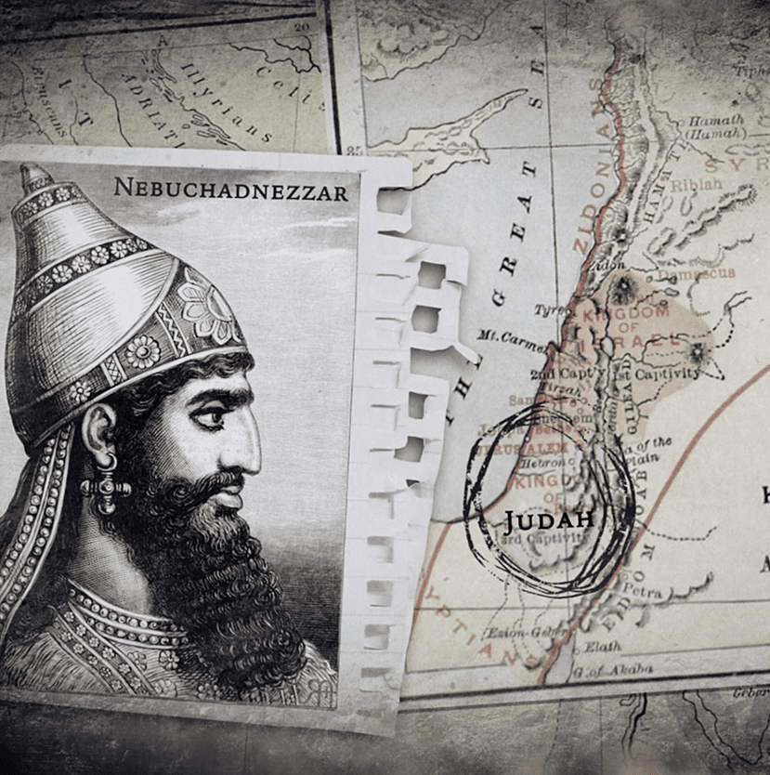
Babylon’s History - Daniel 1:1
In the third year of the reign of Jehoiakim king of Judah came Nebuchad-nezzar king of Babylon unto Jerusalem, and besieged it.

Slide 15
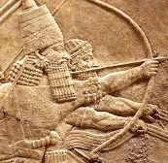
Babylon’s History - Daniel 1:2
And the Lord gave Jehoiakim king of Judah into his hand, with part of the vessels of the house of God: which he carried into the land of Shinar to the house of his god; and he brought the vessels into the treasure house of his god.

Slide 16
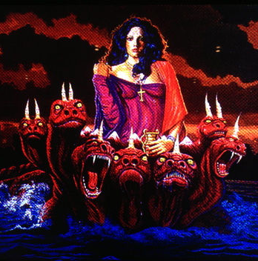
Babylon’s Apostasy - Revelation 17:1
And there came one of the seven angels which had the seven vials, and talked with me, saying unto me, Come hither; I will shew unto thee the judgment of the great whore that sitteth upon many waters:

Slide 17
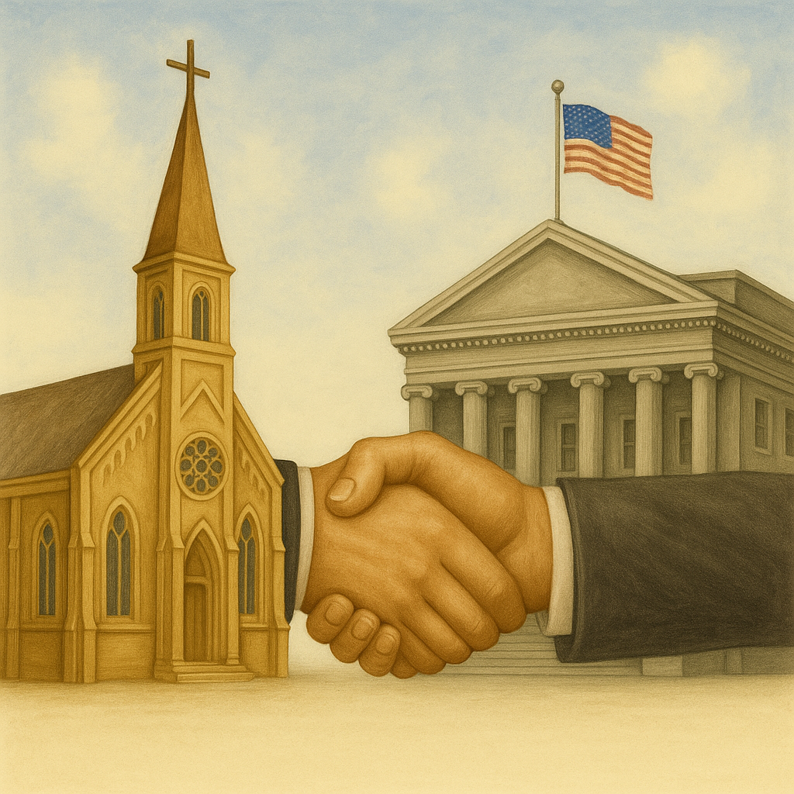
Babylon’s Apostasy - Revelation 17:2
With whom the kings of the earth have committed fornication, and the inhabitants of the earth have been made drunk with the wine of her fornication.

Slide 18
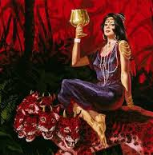
Babylon’s Apostasy - Revelation 17:3
So he carried me away in the spirit into the wilderness: and I saw a woman sit upon a scarlet coloured beast, full of names of blasphemy, having seven heads and ten horns.

Slide 19
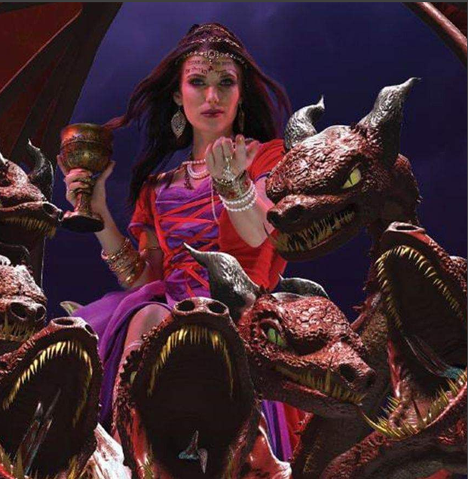
Babylon’s Apostasy - Revelation 17:4
And the woman was arrayed in purple and scarlet colour, and decked with gold and precious stones and pearls, having a golden cup in her hand full of abominations and filthiness of her fornication:

Slide 20
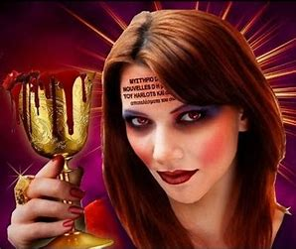
Babylon’s Apostasy - Revelation 17:5
And upon her forehead was a name written, MYSTERY, BABYLON THE GREAT, THE MOTHER OF HARLOTS AND ABOMINATIONS OF THE EARTH.

Slide 21
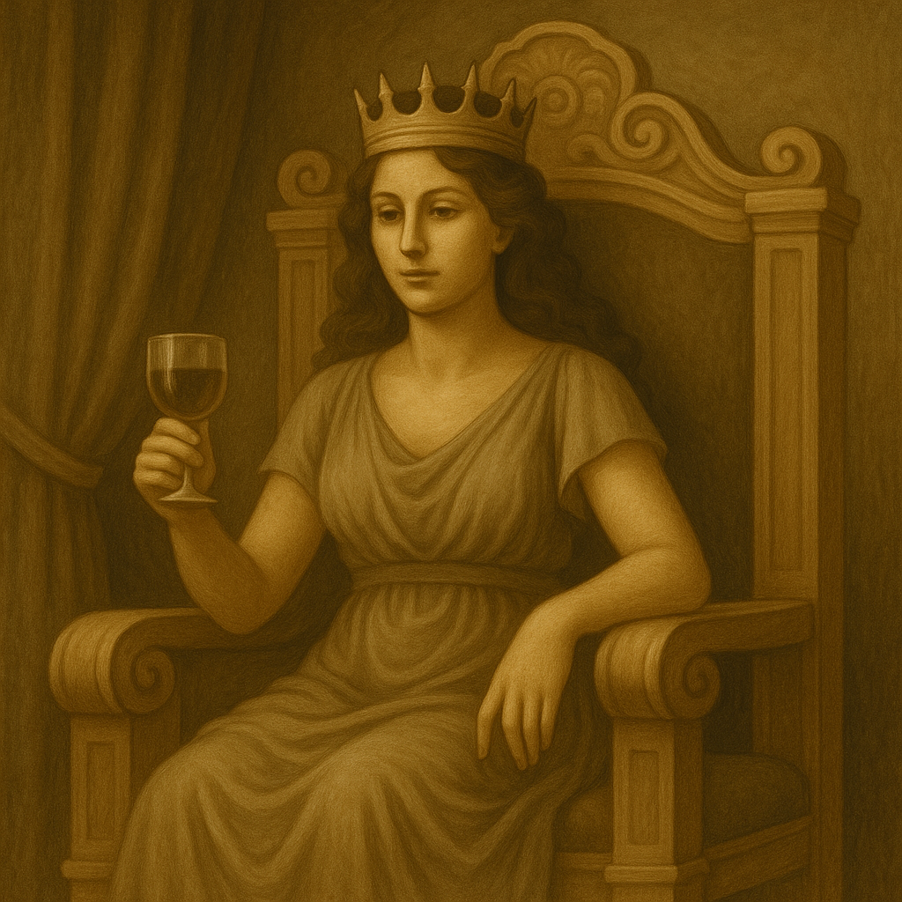
Babylon’s Apostasy - Isaiah 47:8
Therefore hear now this, thou that art given to pleasures, that dwellest carelessly, that sayest in thine heart, I am, and none else beside me; I shall not sit as a widow, neither shall I know the loss of children:

Slide 22
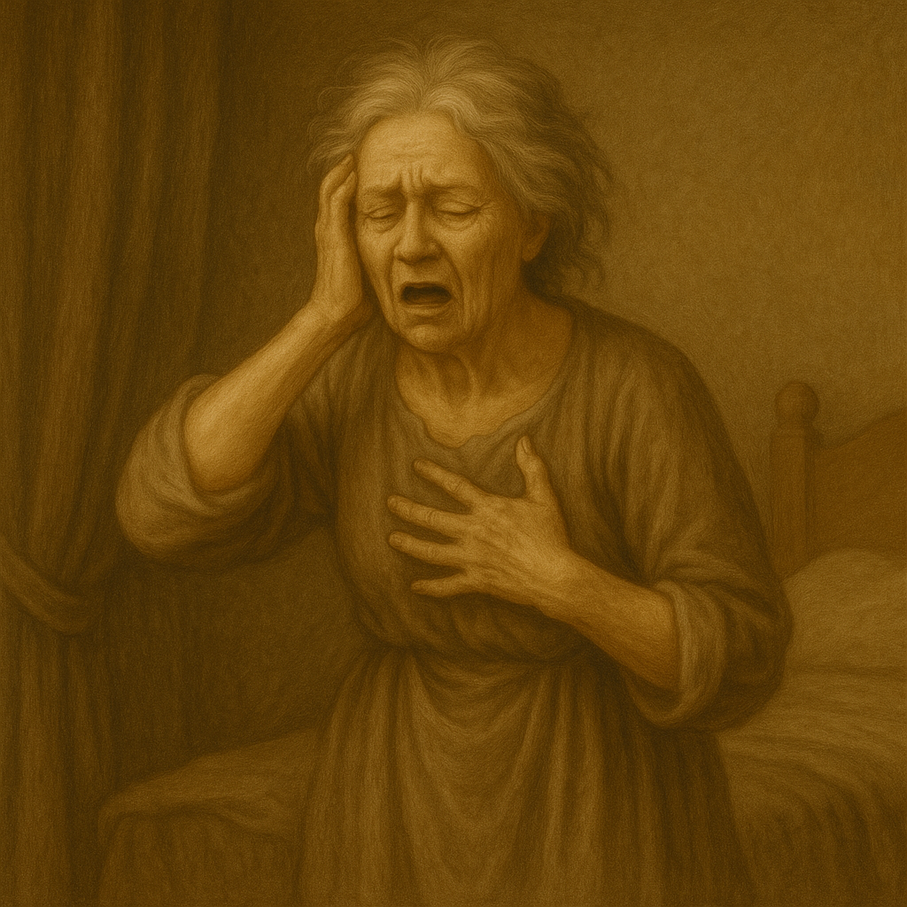
Babylon’s Apostasy - Isaiah 47:9
But these two things shall come to thee in a moment in one day, the loss of children, and widowhood: they shall come upon thee in their perfection for the multitude of thy sorceries, and for the great abundance of thine enchantments.

Slide 23
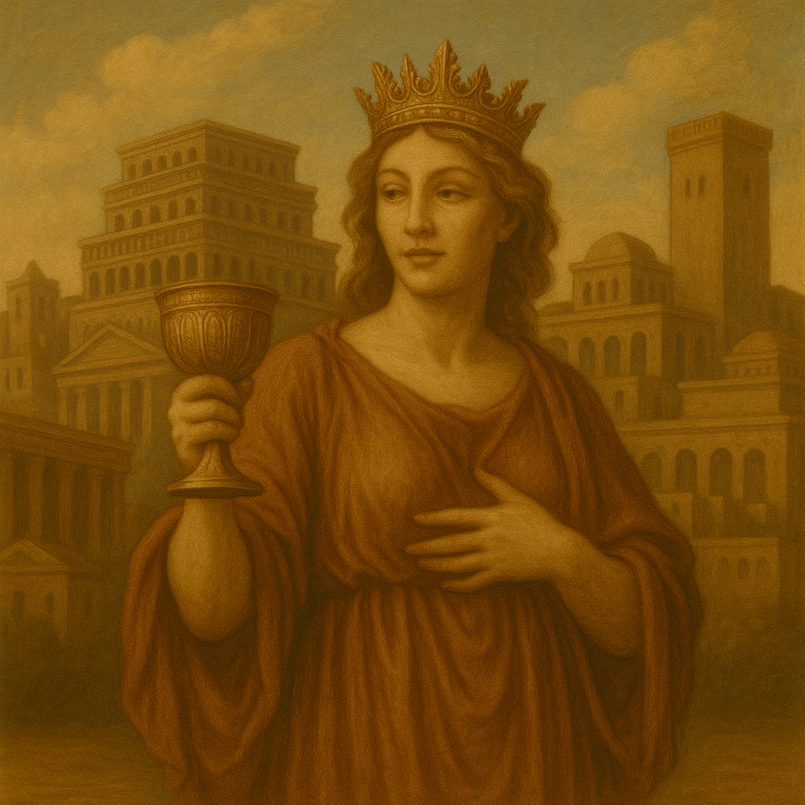
Babylon Fallen - Revelation 14:8
And there followed another angel, saying, Babylon is fallen, is fallen, that great city, because she made all nations drink of the wine of the wrath of her fornication.

Slide 24
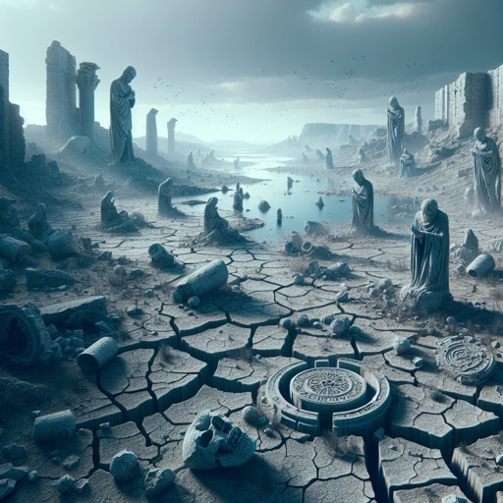
Babylon Fallen - Jeremiah 50:38
A drought is upon her waters; and they shall be dried up: for it is the land of graven images, and they are mad upon their idols.

Slide 25
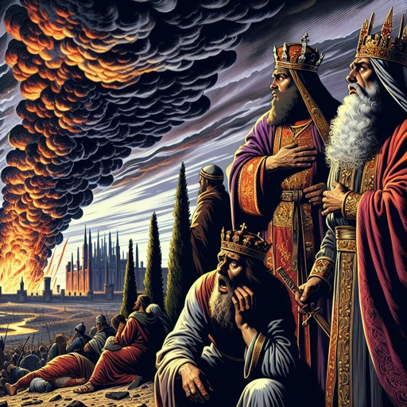
Babylon’s Influence - Revelation 18:9
And the kings of the earth, who have committed fornication and lived deliciously with her, shall bewail her, and lament for her, when they shall see the smoke of her burning,

Slide 26
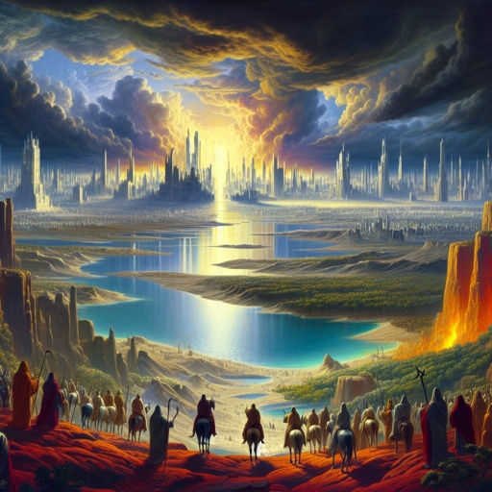
Babylon’s Influence: Revelation 18:10
Standing afar off for the fear of her torment, saying, Alas, alas, that great city Babylon, that mighty city! for in one hour is thy judgment come.

Slide 27
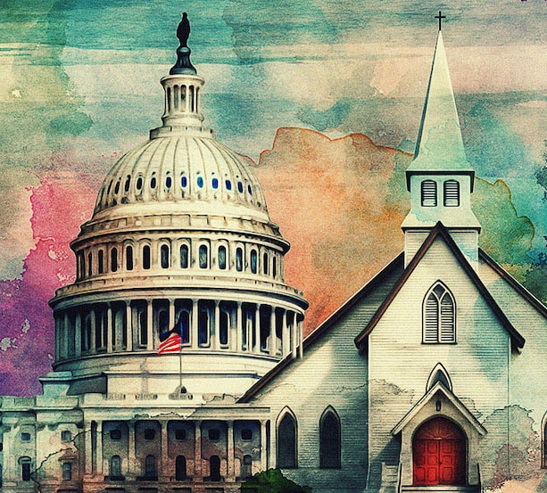
Babylon’s Influence: Revelation 17:18
And the woman which thou sawest is that great city, which reigneth over the kings of the earth.

Slide 28
Babylon is a symbol of apostasy. The name Babylon, which signifies confusion, was given to the ancient city because of its false worship and rebellion against God. In the last days, Babylon represents all who oppose the truth and follow after false systems of worship.
The Great Controversy p. 381

Slide 29
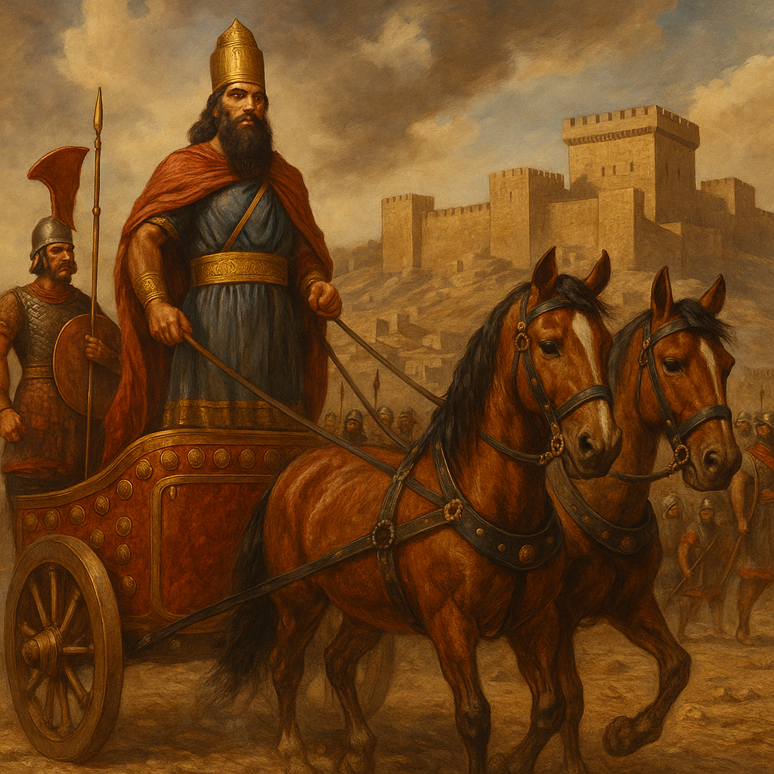
Nebuchadnezzar- Daniel 4:28
All this came upon the king Nebuchad-nezzar.

Slide 30
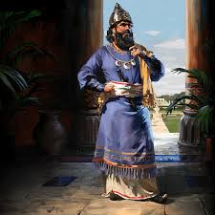
Nebuchadnezzar- Daniel 4:29
At the end of twelve months he walked in the palace of the kingdom of Babylon.

Slide 31
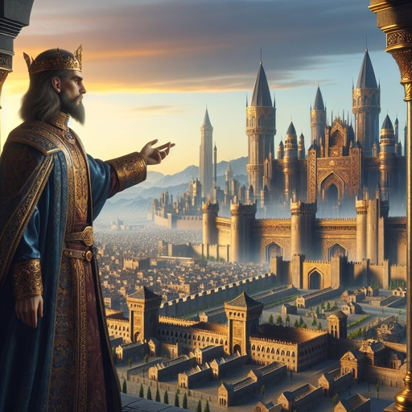
Nebuchadnezzar- Daniel 4:30
The king spake, and said, Is not this great Babylon, that I have built for the house of the kingdom by the might of my power, and for the honour of my majesty?

Slide 32
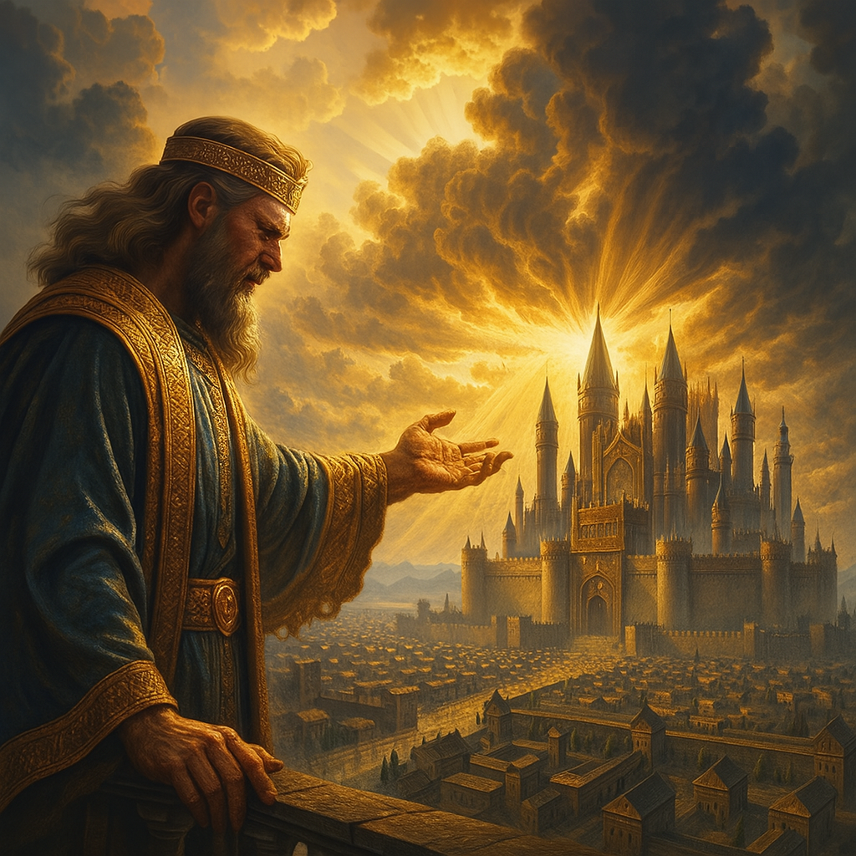
Nebuchadnezzar - Daniel 4:31
While the word was in the king's mouth, there fell a voice from heaven, saying, O king Nebuchadnezzar, to thee it is spoken; The kingdom is departed from thee.

Slide 33
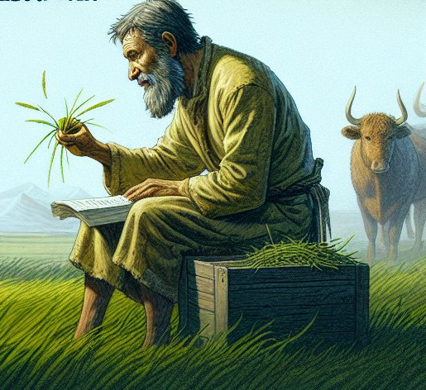
Nebuchadnezzar- Daniel 4:32
And they shall drive thee from men, and thy dwelling shall be with the beasts of the field: they shall make thee to eat grass as oxen, and seven times shall pass over thee, until thou know that the most High ruleth in the kingdom of men, and giveth it to whomsoever he will.

Slide 34
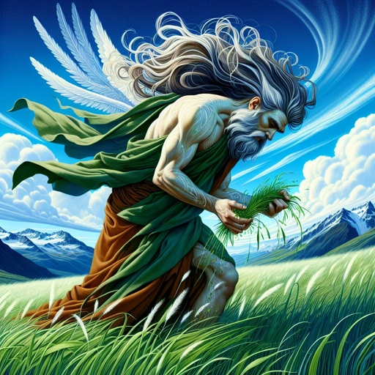
Nebuchadnezzar- Daniel 4:33
The same hour was the thing fulfilled upon Nebuchadnezzar: and he was driven from men, and did eat grass as oxen, and his body was wet with the dew of heaven, till his hairs were grown like eagles' feathers, and his nails like birds' claws.

Slide 35
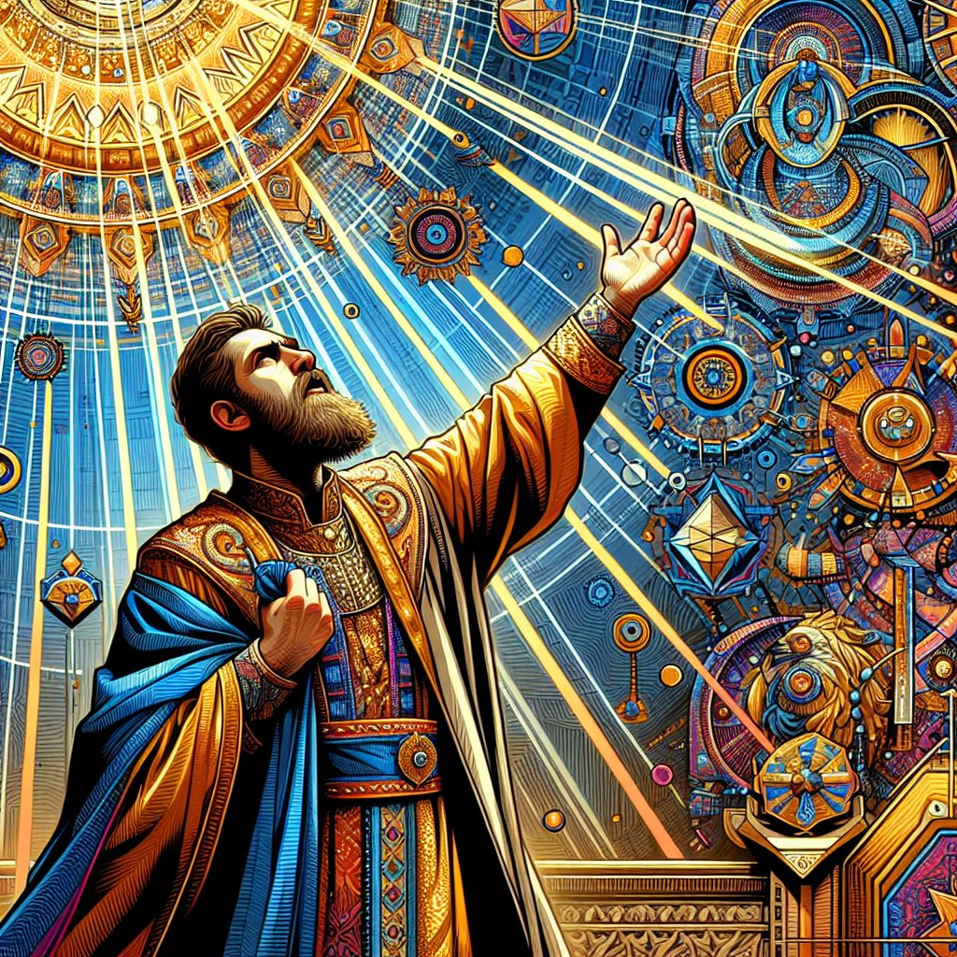
Nebuchadnezzar- Daniel 4:34
And at the end of the days I Nebuchadnezzar lifted up mine eyes unto heaven, and mine understanding returned unto me, and I blessed the most High, and I praised and honoured him that liveth for ever, whose dominion is an everlasting dominion, and his kingdom is from generation to generation:

Slide 36
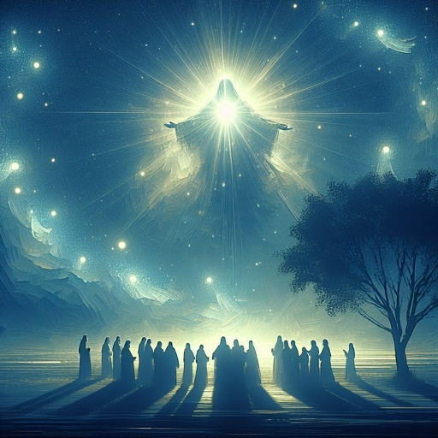
Nebuchadnezzar- Daniel 4:35
And all the inhabitants of the earth are reputed as nothing: and he doeth according to his will in the army of heaven, and among the inhabitants of the earth: and none can stay his hand, or say unto him, What doest thou?

Slide 37
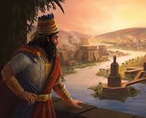
Nebuchadnezzar- Daniel 4:36
At the same time my reason returned unto me; and for the glory of my kingdom, mine honour and brightness returned unto me; and my counsellors and my lords sought unto me; and I was established in my kingdom, and excellent majesty was added unto me.

Slide 38
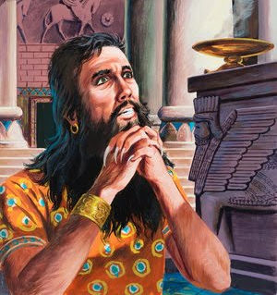
Nebuchadnezzar- Daniel 4:37
Now I Nebuchadnezzar praise and extol and honour the King of heaven, all whose works are truth, and his ways judgment: and those that walk in pride he is able to abase.

Slide 39
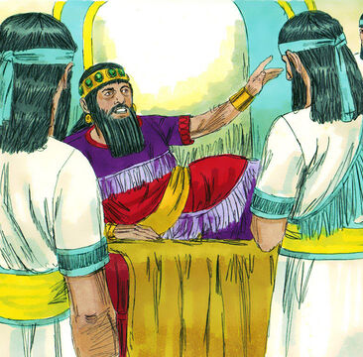
The Feast - Daniel 5:1
Belshazzar the king made a great feast to a thousand of his lords, and drank wine before the thousand.

Slide 40
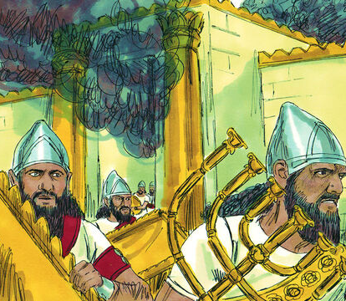
The Feast - Daniel 5:2
Belshazzar, whiles he tasted the wine, commanded to bring the golden and silver vessels which his father Nebuchadnezzar had taken out of the temple which was in Jerusalem; that the king, and his princes, his wives, and his concubines, might drink therein.

Slide 41
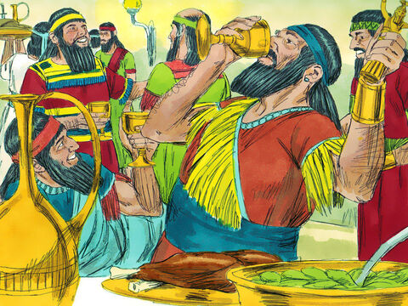
The Feast - Daniel 5:3
Then they brought the golden vessels that were taken out of the temple of the house of God which was at Jerusalem; and the king, and his princes, his wives, and his concubines, drank in them.

Slide 42
The Feast - Daniel 5:4
They drank wine, and praised the gods of gold, and of silver, of brass, of iron, of wood, and of stone.

Slide 43
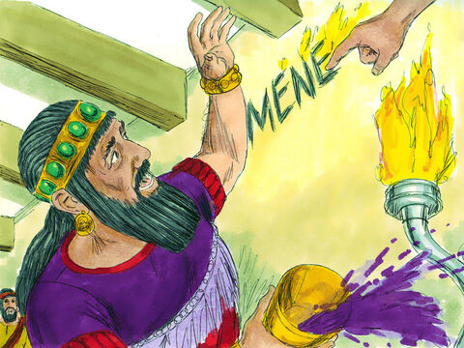
The Feast - Daniel 5:5
In the same hour came forth fingers of a man's hand, and wrote over against the candlestick upon the plaister of the wall of the king's palace: and the king saw the part of the hand that wrote.

Slide 44
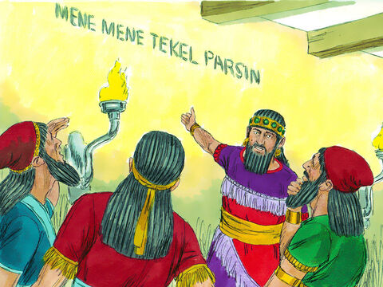
The Feast - Daniel 5:6
Then the king's countenance was changed, and his thoughts troubled him, so that the joints of his loins were loosed, and his knees smote one against another.

Slide 45
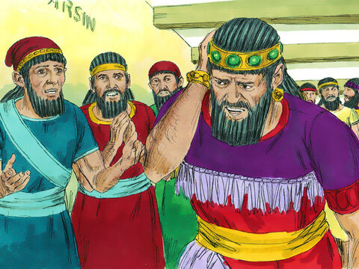
The Feast - Daniel 5:7
The king cried aloud to bring in the astrologers, the Chaldeans, and the soothsayers. And the king spake, and said to the wise men of Babylon, Whosoever shall read this writing, and shew me the interpretation thereof, shall be clothed with scarlet, and have a chain of gold about his neck, and shall be the third ruler in the kingdom.

Slide 46
The Feast - Daniel 5:8
Then came in all the king's wise men: but they could not read the writing, nor make known to the king the interpretation thereof.

Slide 47
The Feast - Daniel 5:9
Then was king Belshazzar greatly troubled, and his countenance was changed in him, and his lords were astonied.

Slide 48
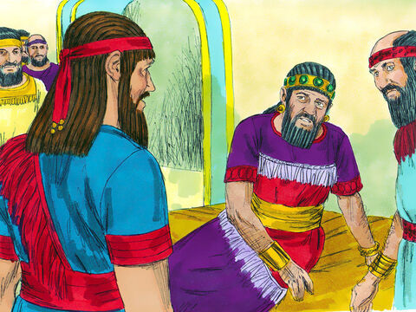
Babylon Falls –
Daniel 5:13
¹³ Then was Daniel brought in before the king. And the king spake and said unto Daniel, Art thou that Daniel, which art of the children of the captivity of Judah, whom the king my father brought out of Jewry?

Slide 49
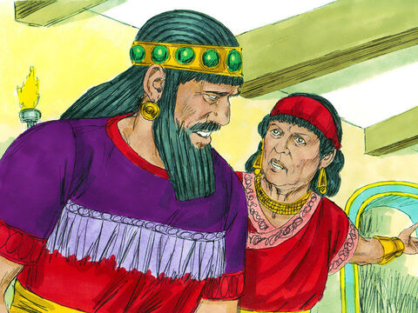
Babylon Falls –
Daniel 5:16
And I have heard of thee, that thou canst make interpretations, and dissolve doubts: now if thou canst read the writing, and make known to me the interpretation thereof, thou shalt be clothed with scarlet, and have a chain of gold about thy neck, and shalt be the third ruler in the kingdom.

Slide 50
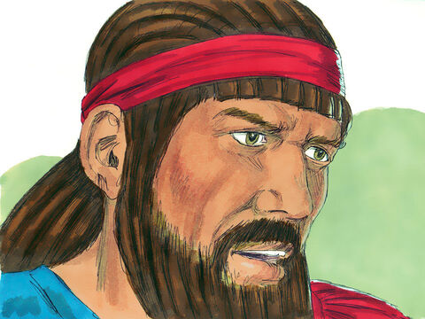
Babylon Falls –
Daniel 5:17
Then Daniel answered and said before the king, Let thy gifts be to thyself, and give thy rewards to another; yet I will read the writing unto the king, and make known to him the interpretation.

Slide 51
Babylon Falls –
Daniel 5:18
O thou king, the most high God gave Nebuchadnezzar thy father a kingdom, and majesty, and glory, and honour:

Slide 52
Babylon Falls –
Daniel 5:20
But when his heart was lifted up, and his mind hardened in pride, he was deposed from his kingly throne, and they took his glory from him:

Slide 53
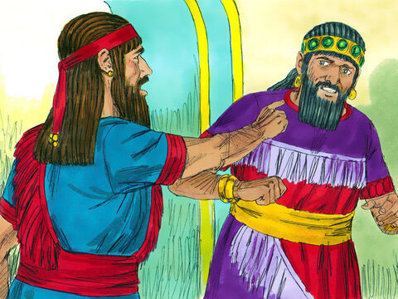
Babylon Falls –
Daniel 5:22
And thou his son, O Belshazzar, hast not humbled thine heart, though thou knewest all this;

Slide 54
Babylon Falls –
Daniel 5:23
But hast lifted up thyself against the Lord of heaven; and they have brought the vessels of his house before thee, and thou, and thy lords, thy wives, and thy concubines, have drunk wine in them; and thou hast praised the gods of silver, and gold, of brass, iron, wood, and stone, which see not, nor hear, nor know: and the God in whose hand thy breath is, and whose are all thy ways, hast thou not glorified:

Slide 55
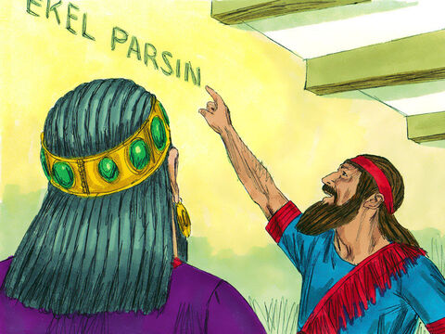
Babylon Falls –
Daniel 5:24
Then was the part of the hand sent from him; and this writing was written.

Slide 56
Babylon Falls –
Daniel 5:25
And this is the writing that was written, MENE, MENE, TEKEL, UPHARSIN.

Slide 57
Babylon Falls –
Daniel 5:26
This is the interpretation of the thing: MENE; God hath numbered thy kingdom, and finished it.

Slide 58
Babylon Falls –
Daniel 5:27
TEKEL; Thou art weighed in the balances, and art found wanting.

Slide 59
Babylon Falls –
Daniel 5:28
PERES; Thy kingdom is divided, and given to the Medes and Persians.

Slide 60
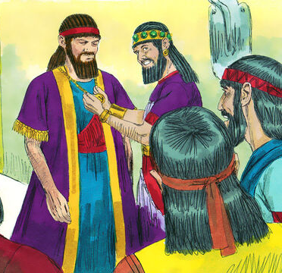
Babylon Falls –
Daniel 5:29
Then commanded Belshazzar, and they clothed Daniel with scarlet, and put a chain of gold about his neck, and made a proclamation concerning him, that he should be the third ruler in the kingdom.

Slide 61
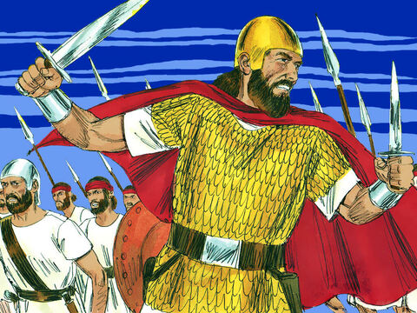
Babylon Falls –
Daniel 5:30
In that night was Belshazzar the king of the Chaldeans slain.

Slide 62
Babylon Falls –
Daniel 5:31
And Darius the Median took the kingdom, being about threescore and two years old.

Slide 63
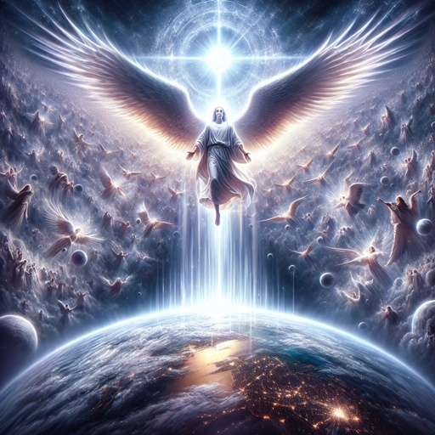
Babylon Rises - Revelation 18:1
And after these things I saw another angel come down from heaven, having great power; and the earth was lightened with his glory.

Slide 64
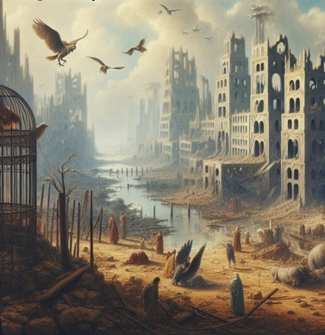
Babylon Rises - Revelation 18:2
And he cried mightily with a strong voice, saying, Babylon the great is fallen, is fallen, and is become the habitation of devils, and the hold of every foul spirit, and a cage of every unclean and hateful bird.

Slide 65
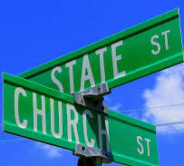
Babylon Rises - Revelation 18:3
For all nations have drunk of the wine of the wrath of her fornication, and the kings of the earth have committed fornication with her, and the merchants of the earth are waxed rich through the abundance of her delicacies.

Slide 66

Babylon Rises - Revelation 18:4
And I heard another voice from heaven, saying, Come out of her, my people, that ye be not partakers of her sins, and that ye receive not of her plagues.

Slide 67

Babylon Rises - Revelation 18:5
For her sins have reached unto heaven, and God hath remembered her iniquities.

Slide 68
The time will come when the call 'Come out of her, my people' will be heard with power, urging God's people to leave the apostate churches that have become Babylon, and to join themselves to the true and faithful believers.
The Great Controversy p. 389

Slide 69

The Warning-
Matthew 24:24
For there shall arise false Christs, and false prophets, and shall shew great signs and wonders; insomuch that, if it were possible, they shall deceive the very elect.

Slide 70

The Plan –
Acts 17:11
These were more noble than those in Thessalonica, in that they received the word with all readiness of mind, and searched the scriptures daily, whether those things were so.

Slide 71

The Plan –
1 Thessalonians 5:21
Prove all things; hold fast that which is good.

Slide 72

The Plan –
Daniel 1:8
But Daniel purposed in his heart that he would not defile himself with the portion of the king's meat, nor with the wine which he drank: therefore he requested of the prince of the eunuchs that he might not defile himself.

Slide 73

The Final Victory - Isaiah 13:19
And Babylon, the glory of kingdoms, the beauty of the Chaldees' excellency, shall be as when God overthrew Sodom and Gomorrah.

Slide 74

The Final Victory - Isaiah 13:20
It shall never be inhabited, neither shall it be dwelt in from generation to generation: neither shall the Arabian pitch tent there; neither shall the shepherds make their fold there.

Slide 75

The Final Victory - Isaiah 13:21
But wild beasts of the desert shall lie there; and their houses shall be full of doleful creatures; and owls shall dwell there, and satyrs shall dance there.

Slide 76

The Final Victory - Isaiah 13:22
And the wild beasts of the islands shall cry in their desolate houses, and dragons in their pleasant palaces: and her time is near to come, and her days shall not be prolonged.

Slide 77

Assurance –
Daniel 6:22
My God hath sent his angel, and hath shut the lions' mouths, that they have not hurt me: forasmuch as before him innocency was found in me; and also before thee, O king, have I done no hurt.

Slide 78

Assurance - Psalm 91:7
A thousand shall fall at thy side, and ten thousand at thy right hand; but it shall not come nigh thee.

Slide 79

Assurance - Psalm 91:8
Only with thine eyes shalt thou behold and see the reward of the wicked.

Slide 80

Assurance - Psalm 91:9
Because thou hast made the LORD, which is my refuge, even the most High, thy habitation;

Slide 81

Assurance –
Psalm 91:10
There shall no evil befall thee, neither shall any plague come nigh thy dwelling.

Slide 82
Thank you and
HAPPY SABBATH!!

